Slide 2
Contactless ordering for restaurants

Slide 3



Contactless ordering for restaurants
Zeeshan Khawaja
Anna Kristín Jeppesen
Alejandro Vazquez
Product Owner
Principal Product Owner
Senior Consultant

Slide 4
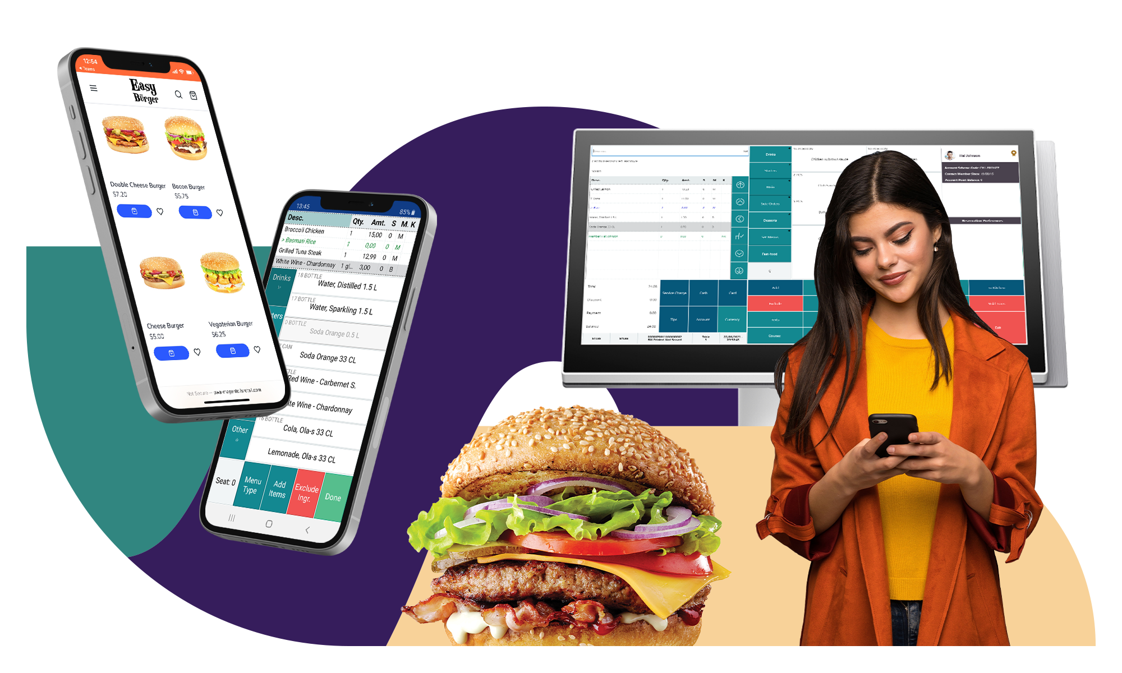

Slide 5






eCommerce
POS
Point of Sale
Master Data
eCom Profile
Customer Loyalty
Takeaway
QR Code Ordering
Transaction Repository
KDS
Home Delivery
Activity
+
+

Slide 6

Traditional UI
Progressive Web App (PWA)
eCommerce API
Commerce Service for LS Central

Slide 7
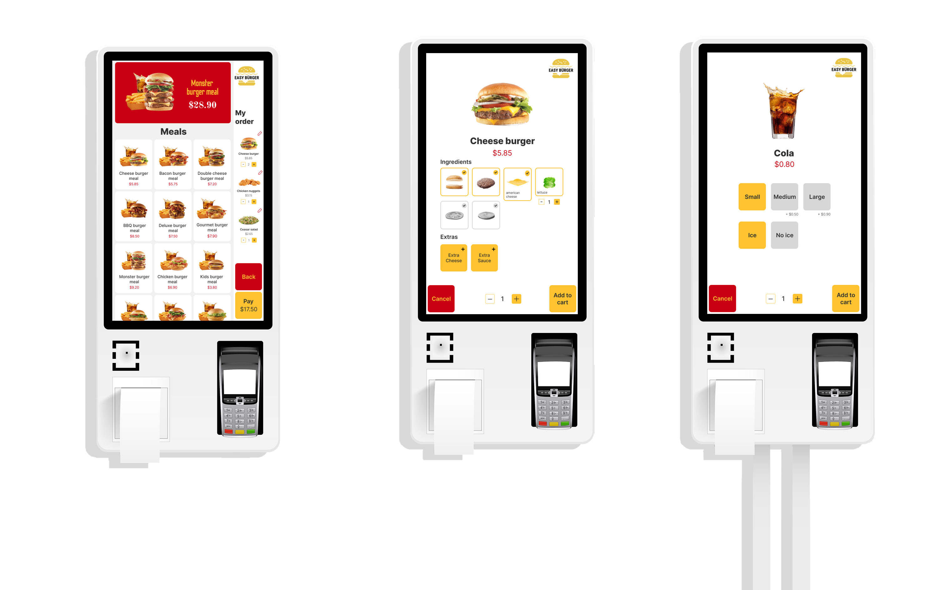

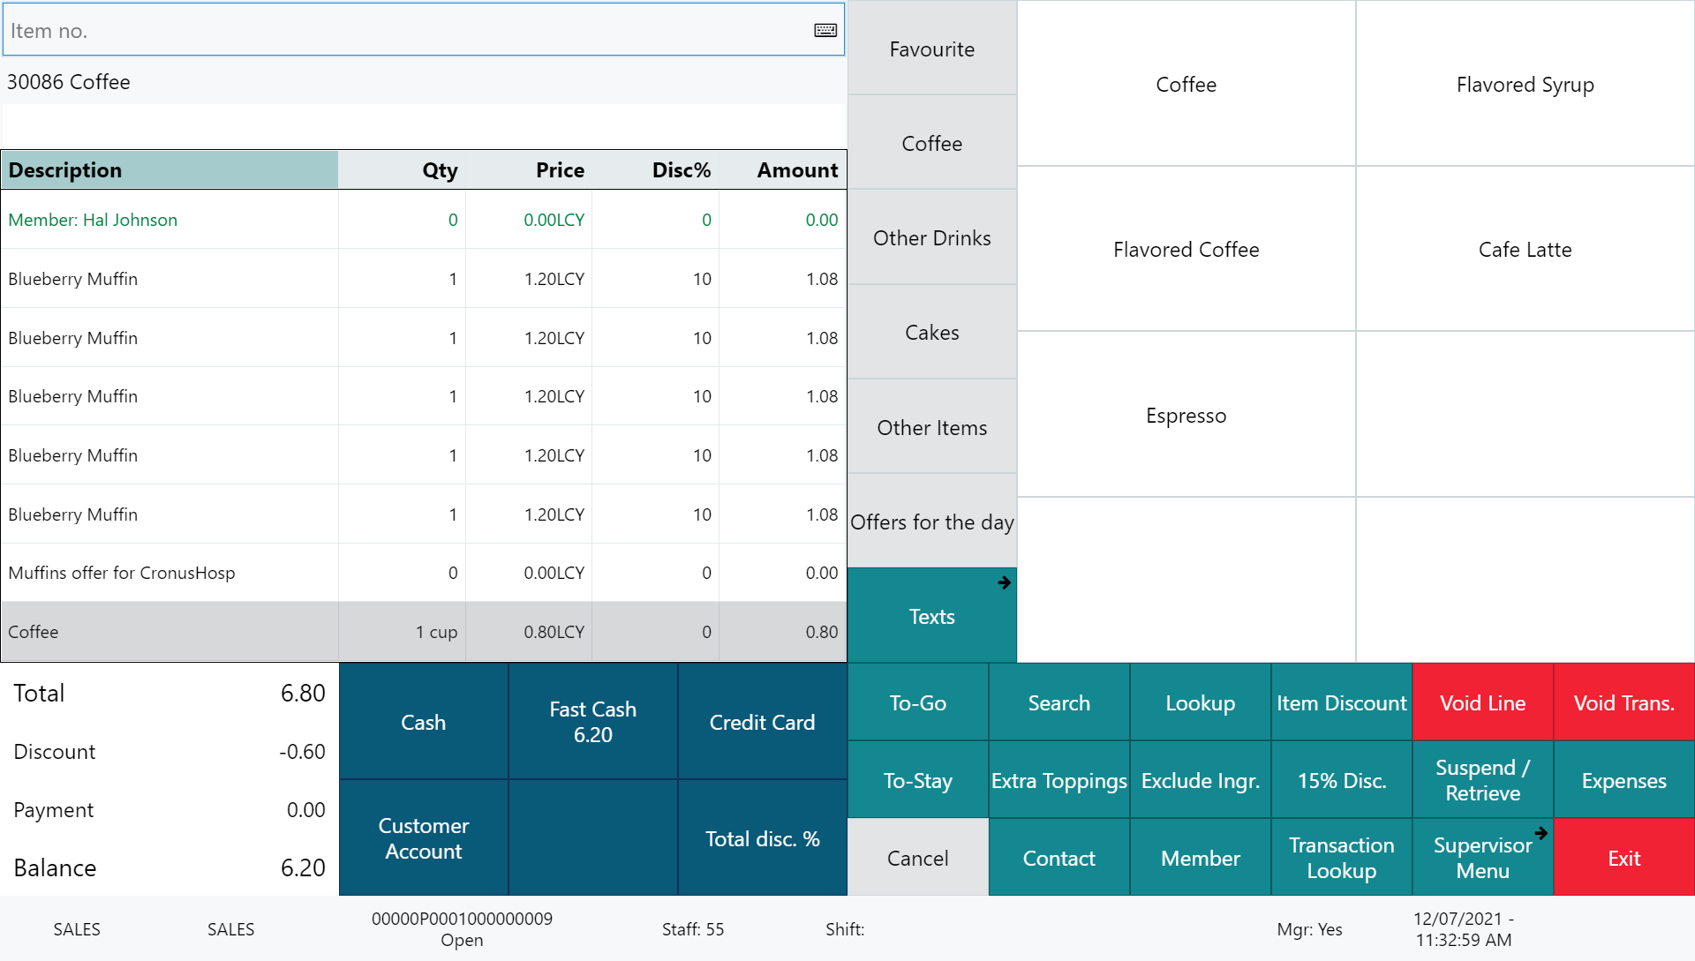






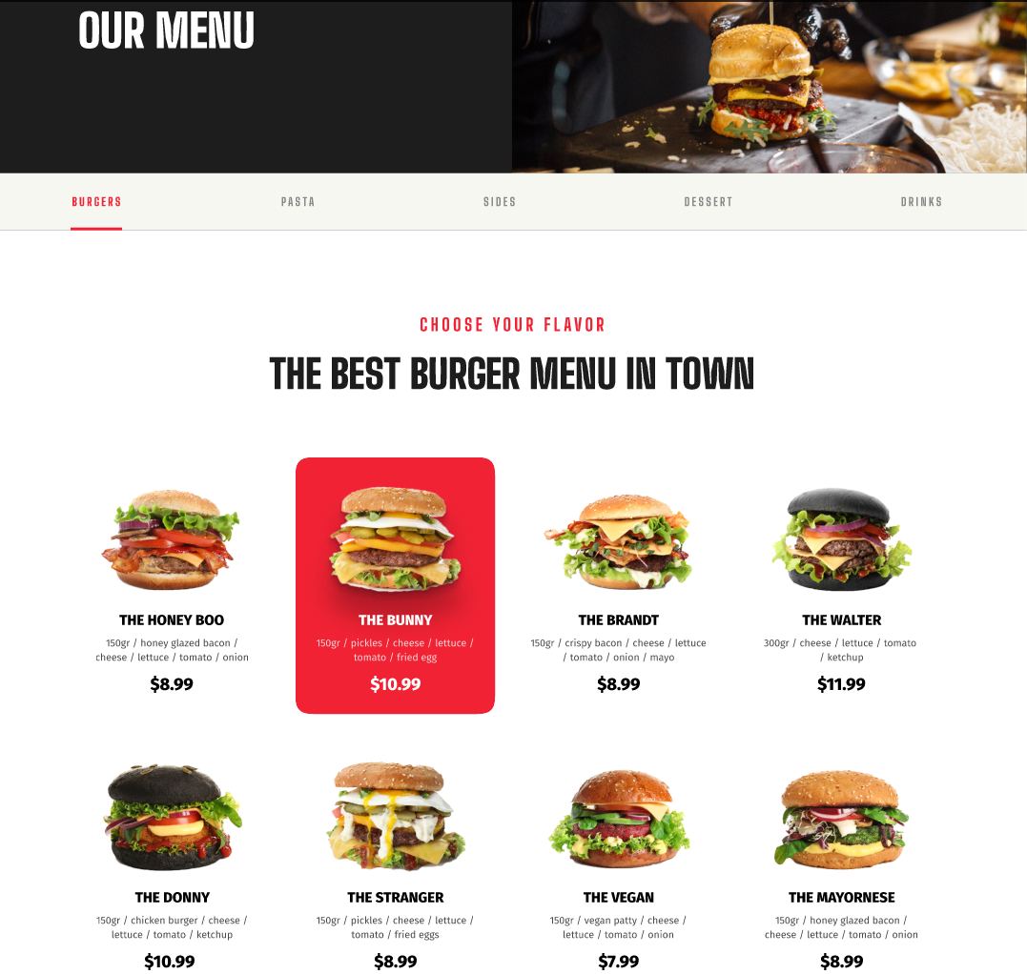
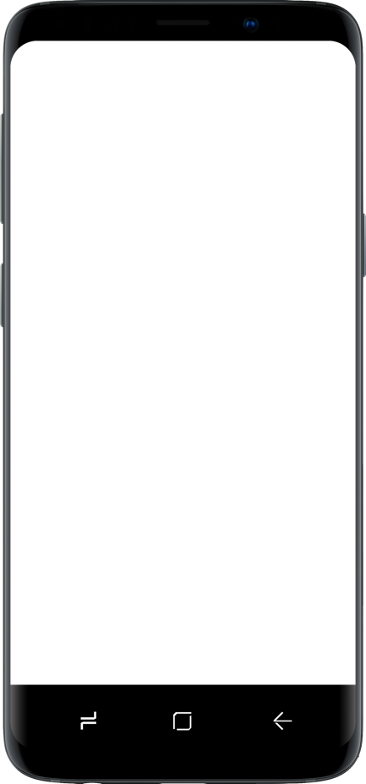
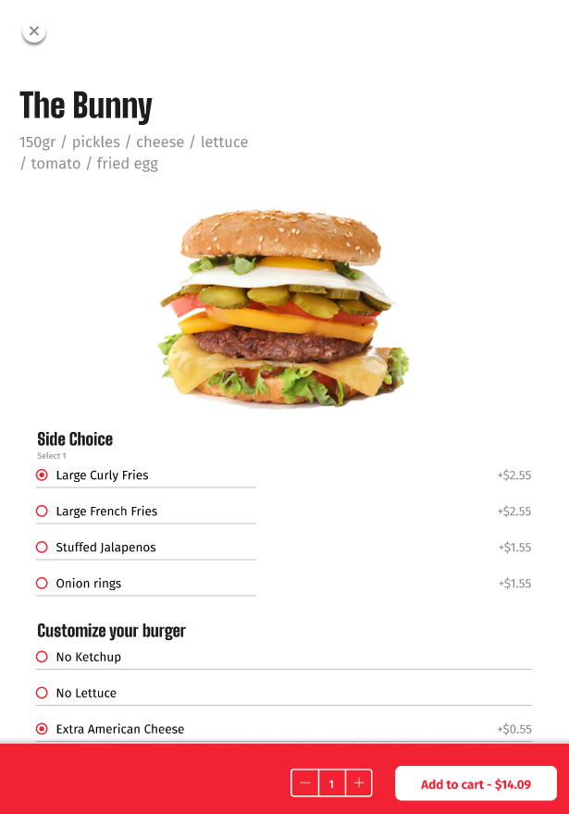
Restaurant
KDS preparation stations
Self Service Kiosks
POS 1
POS 2
LS KDS
Grill
KDS
Cold
Expeditor
station
Kitchen Service
Dessert
Bar
Online ordering

Slide 8
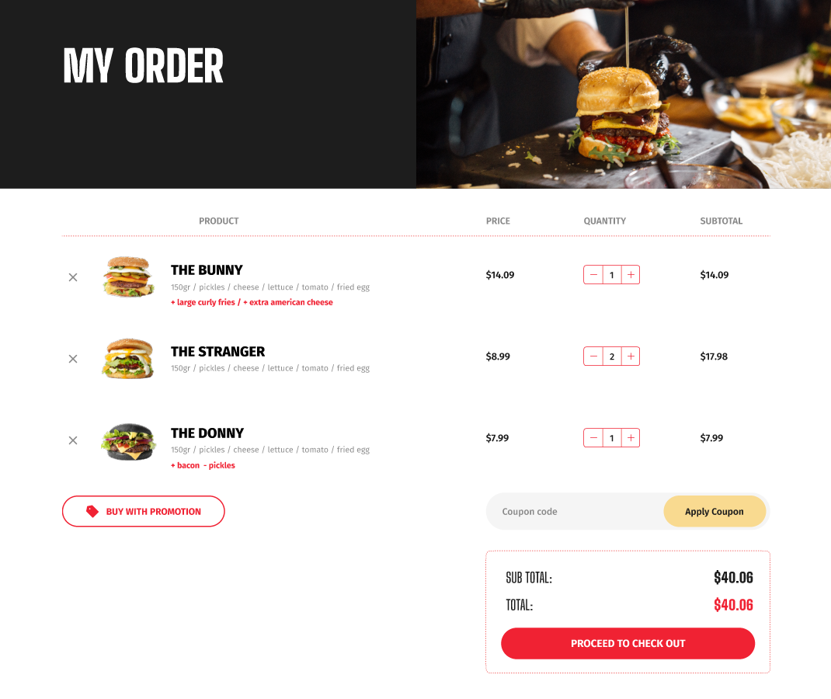
/

Slide 9
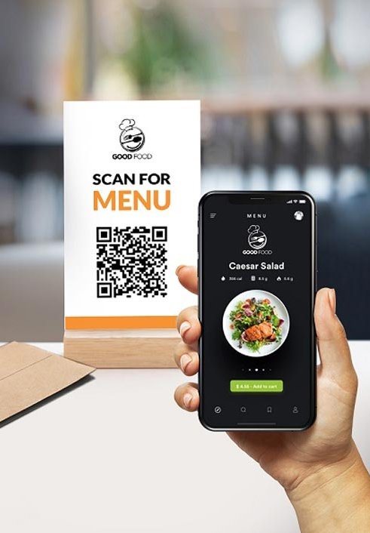
Features
Home delivery, takeaway, dine-in, & QR code ordering
Ordering calender and Timeslots
Preorder meal
Menu setup in LS Central
  Items (images, longer descriptions)
  Deals with price change support
  Modifiers
  Ingredients and allergens
Basket calculation via LS Central
Member management
Order updates through Webhooks
Orders instantly posted to LS Central and routed to the KDS
Many more...

Slide 10
Where are you?
At home ordering:
  Takeaway
  Delivery
Or somewhere where your placement is identified by a QR Code
  Table in the restaurant
  Hotel room
  Cabin on a ferry
  Sunbathing at the pool side
  Seat at an arena

Slide 11
Restaurant workflow
Order to
LS Central
Hospitality type
Payment information
Sent to KDS
Routing
Order
delivery
Depending on order information
Order information

Slide 12
Demo

Slide 13
LS Retail Consulting
Empowering partners and customers
Alejandro Vázquez
Senior Consulting

Slide 14


Workshops
Training
Implement
Magento
V. M.
Customization
Support

Slide 15
Questions?

