Slide 2
Sergio Castelluccio
Consulting Manager
Be in control of your SaaS tenant
An essential guide for Partners and Customers

Slide 3

Who is responsible to manage the SaaS tenant?
Parties involved:
Microsoft
Partner
Customer
ISVs (?)

Slide 4
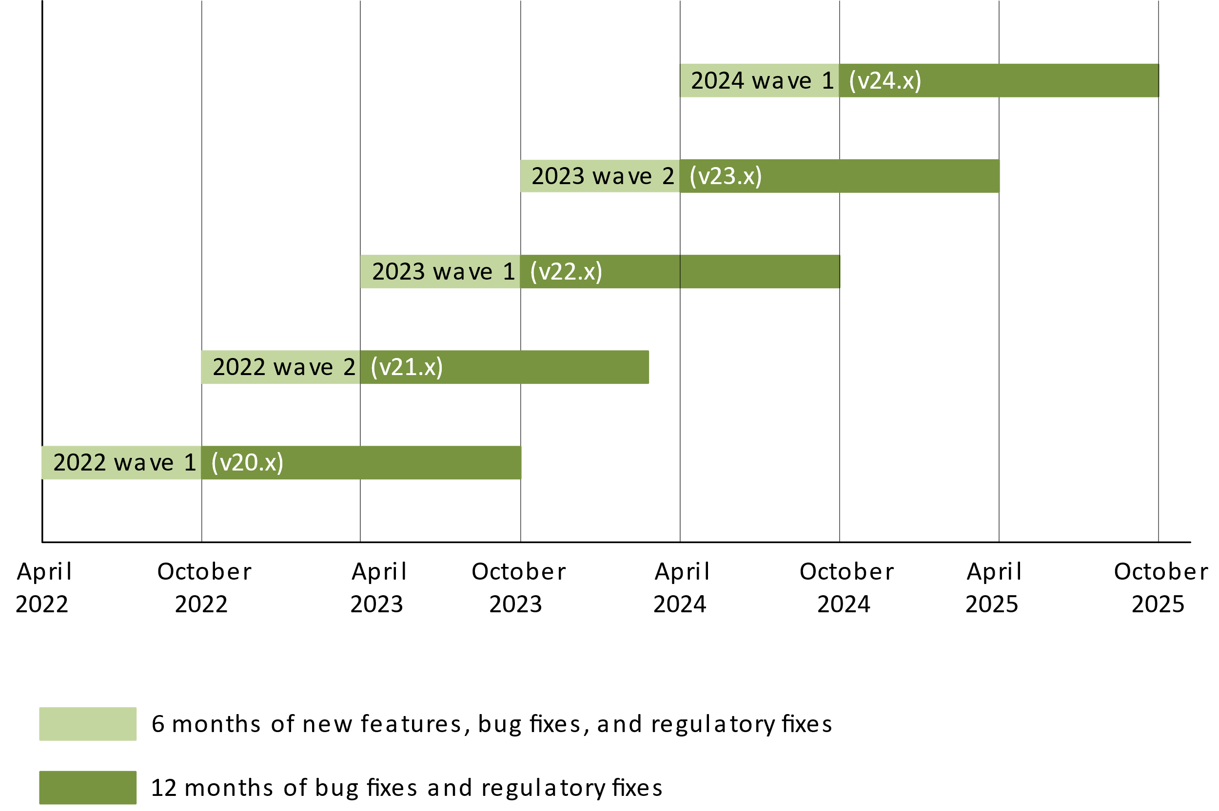
BC Lifecycle & Supported Versions
The following image illustrates the update schedule for Dynamics 365 Business Central.
Source: https://learn.microsoft.com/en-us/dynamics365/business-central/dev-itpro/terms/lifecycle-policy-on-premises

Slide 5
Version numbers in Business Central
major is the major version of Business Central
  25 is the Business Central 2024 release wave 2 update in October 2024 and forward
  24 is the Business Central 2024 release wave 1 update in April 2024 and forward
  23 is the Business Central 2023 release wave 2 update in October 2023 and forward
  22 is the Business Central 2023 release wave 1 update in April 2023 and forward
  21 is the Business Central 2022 release wave 2 update in October 2022 and forward
  20 is the Business Central 2022 release wave 1 update in April 2022 and forward
  19 is the Business Central 2021 release wave 2 update in October 2021 and forward
  18 is the Business Central 2021 release wave 1 update in April 2021 and forward
  17 is the Business Central 2020 release wave 2 update in October 2020 and forward
  16 is the Business Central 2020 release wave 1 update in April 2020 and forward
  15 is the Business Central 2019 release wave 2 update in October 2019 and forward
  14 is the Business Central April 2019 release
  13 is the Business Central October 2018 release
  12 is the April 2018 launch of Business Central
minor is the monthly update number, such as 0, 1, 2, 3, 4, 5.
build is the five digit build number, such as 23456.
revision is set to 0 for the original release and can remain at 0. However, if the tenant is patched with a hotfix, then that build number can be applied.
In other words, if you see a version number such as 20.1.23456.26323, then it means major version 20, update number 1, build number 23456, and hotfix number 26323.
Source: https://learn.microsoft.com/en-us/dynamics365/business-central/dev-itpro/administration/version-numbers

Slide 6
Timelines for Major updates
The following figure illustrates the key milestones and dates for rolling out a major update. The dates are loosely based on 2021 release wave 1 and 2021 release wave 2. The same timeline applies to all other major updates, though dates will differ.
Upadate is available
Upadate
start
Last day to schedule update
Preview
Upgrade window
Outside upgrade window
Release wave 1
April 1
April 8
June 1
Release wave 2
October 1
October 8
December 1
60 days
Source: https://learn.microsoft.com/en-us/dynamics365/business-central/dev-itpro/administration/update-rollout-timeline

Slide 7
Timelines for Minor updates
The monthly minor updates contain both application and platform changes that are critical improvements to the service, including regulatory updates.
A minor update will rollout across Azure regions over several days and weeks.
Here an example:
Upadate is available
Upadate
start
Last day to schedule update
Automatic roll-out period
May7
May 14
May 28
20 days
Source: https://learn.microsoft.com/en-us/dynamics365/business-central/dev-itpro/administration/update-rollout-timeline

Slide 8
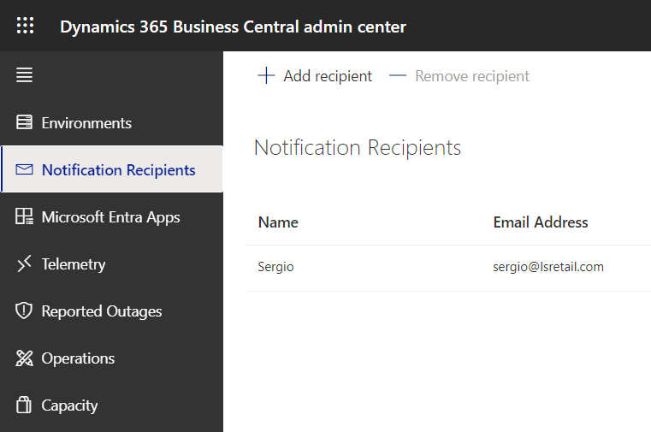
Setup: Receive Notifications from Microsoft
You will receive an email also if your Extension cannot be installed in the newer version
Add more recipients or use a Distribution List

Slide 9
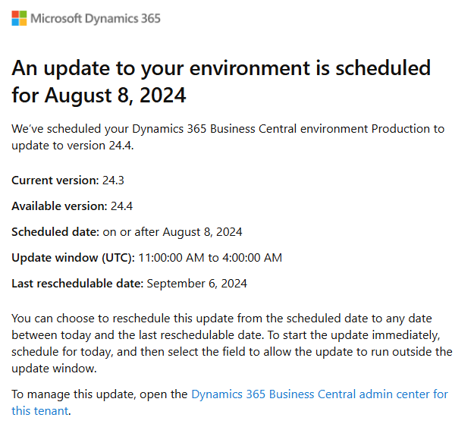
Example of notification for a new update
If you setup correctly the Notification Recipient, you will receive an email like the following when a new update is released and scheduled for each Environment (Production and Sandboxes)

Slide 10
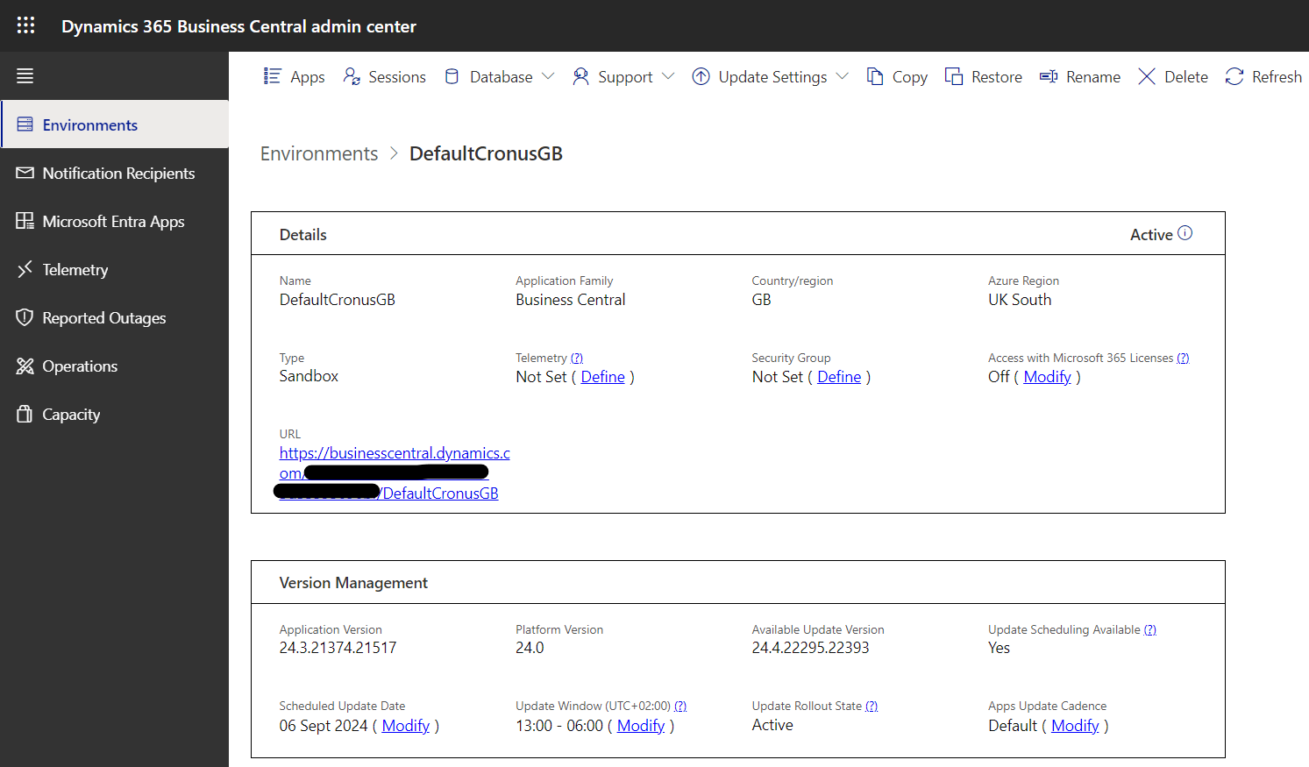

Setup: Set Update Window
Update Windows - Out of working hours
(it must be at least 6 hours)

Slide 11

Setup: Enable Telemetry

Slide 12
Setup: Enable Telemetry
Set up Azure Application Insights
If you don't already have one, get a subscription to Microsoft Azure
Sign in to the Azure portal
Create an Azure Application Insights resource by following the guidelines at Workspace-based Application Insights resources
  Create a workspace-based resource (Application Insights)
  Create a workspace (Log Analytics workspace)
Copy the Connection String
Click Define to paste the Connection String
Restart the Environment
(in a safe maintenance window)
Create Application Insights and Log Analytics in the same region of your Tenant
Source: https://learn.microsoft.com/en-us/dynamics365/business-central/dev-itpro/administration/telemetry-enable-application-insights

Slide 13
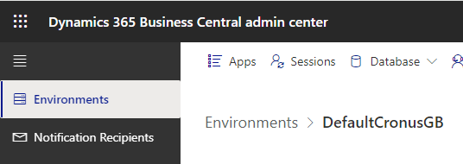
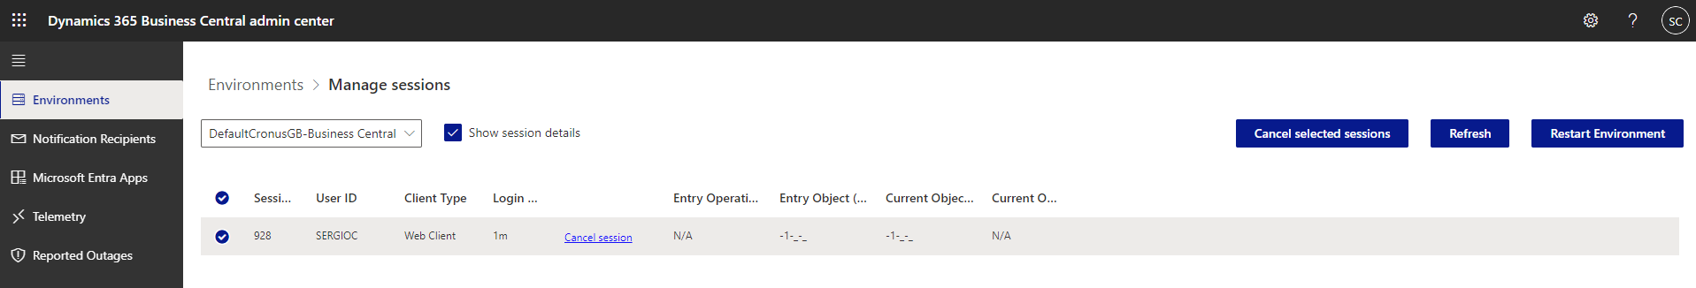
Kill Sessions and Restart Environments
Sometimes it could happen that you need to kill a session of a user or restart an environment, you can do it from the Dynamics 365 Business central admin center.

Slide 14
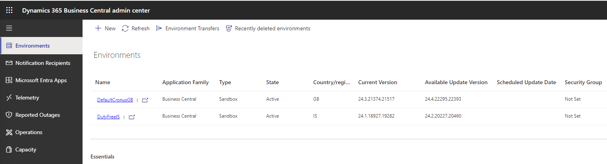
Check if new updates are available
If you setup correctly the Notification Recipient, you will receive an email when a new update is available. From the Dynamics 365 Business Central admin center you can monitor and schedule the updates
Empty when the update is scheduled by Microsoft

Slide 15
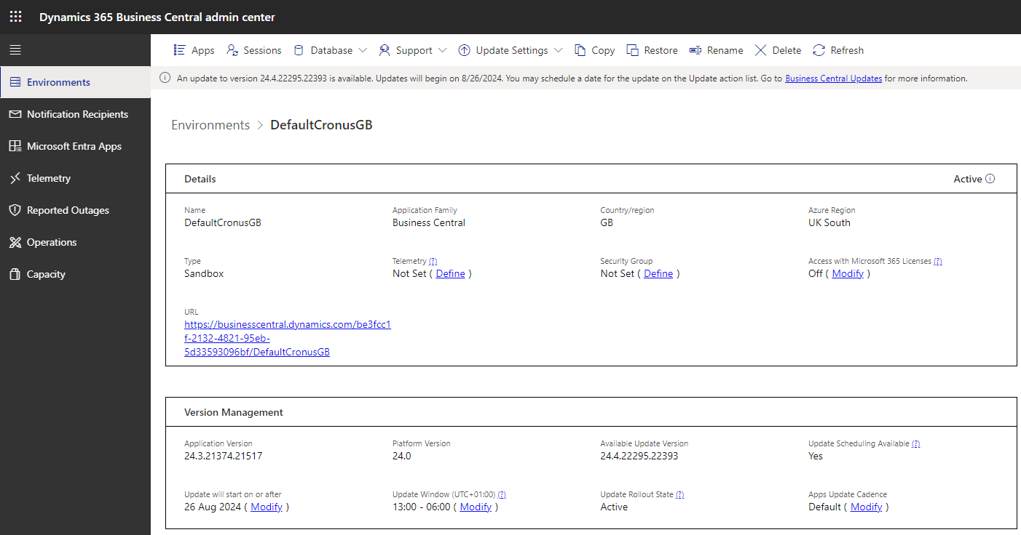
Update scheduled by Microsoft

Slide 16
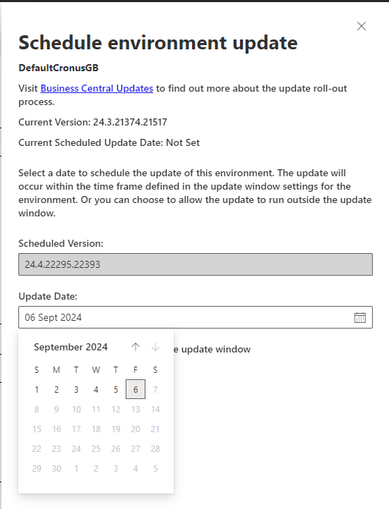
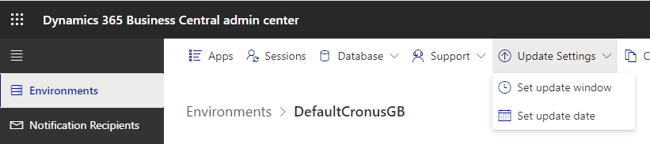
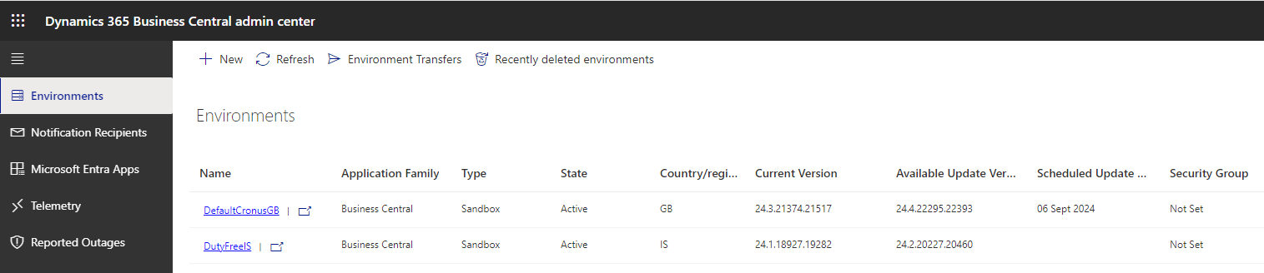
Schedule a date for the update

Slide 17
Timelines for Major updates
The following figure illustrates the key milestones and dates for rolling out a major update. The dates are loosely based on 2021 release wave 1 and 2021 release wave 2. The same timeline applies to all other major updates, though dates will differ.
Preview is available
Create sandbox
Upadate is available in your region
Last day to schedule update
Outside upgrade window
Release wave 1
March 1
March 1
March 1
May 1
Release wave 2
September 1
September 1
September 1
November 1
Source: https://learn.microsoft.com/en-us/dynamics365/business-central/dev-itpro/administration/preview-environments

Slide 18
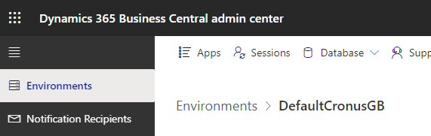
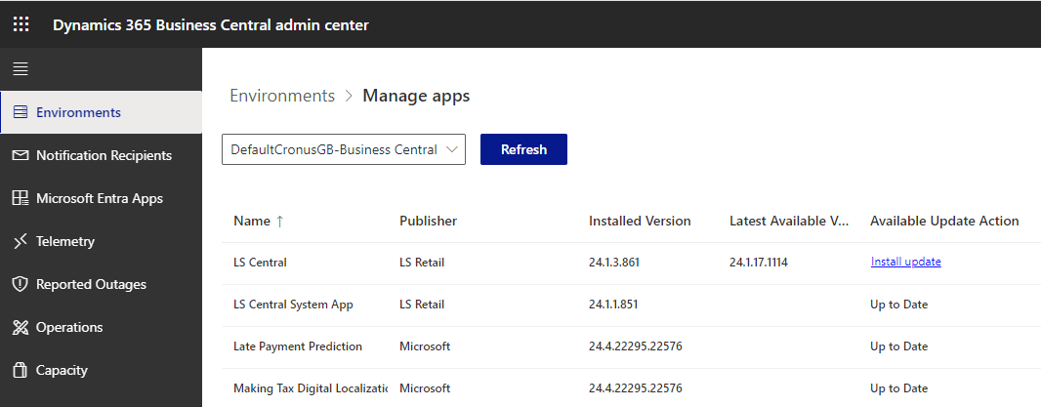
Hotfixes
How the are installed?
Automatically with every Next Minor and Next Major
Manually when needed

Slide 19
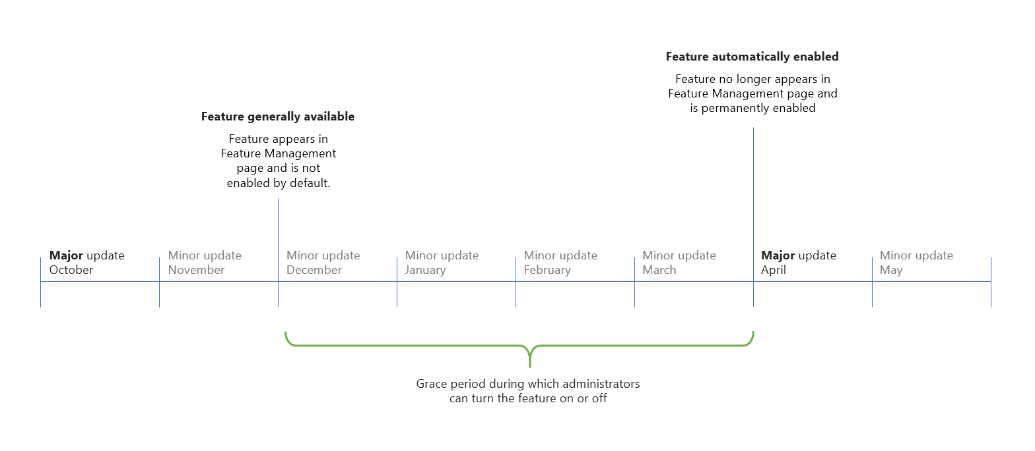
Managing optional features
Source: https://learn.microsoft.com/en-us/dynamics365/business-central/dev-itpro/administration/feature-management

Slide 20
How to enable an optional feature
Sign in to your environment and navigate to the Feature Management page, or use this link: https://businesscentral.dynamics.com/?page=2610.
If the page isn't editable, choose the Edit List action.
For the feature you want to turn on, in the Enabled for field, choose All users.
WARNING: Features that can't be turned off
Before you turn on an irreversible feature on a Production environment, we recommend that you first evaluate it in a Sandbox environment that is a Copy of the Production environment.
Source: https://learn.microsoft.com/en-us/dynamics365/business-central/dev-itpro/administration/feature-management

Slide 21
What’s new in Preview from October 2024
Feature details
Previously, relatively rigid update policies were in place for major and minor updates. This release introduces the following changes for much more flexibility:
Five-month update periods for major updates:
This change gives more time for thorough testing and preparation before implementing the update. Resellers can spread the workload of updating all customer environments over the entire calendar year to avoid peak periods for major updates. Developers have more time to ensure all apps are compatible with the update, and customers with specific testing and preparation requirements have more time to comply with those requirements.
Optional minor updates:
This change allows administrators to choose when and whether to implement minor updates based on their needs and schedule. The default behavior of environments receiving updates every month doesn’t change. Instead, a new environment-level setting makes it possible to opt out of monthly minor updates.
As part of these changes, the grace period after the update period for the next major update shortened to one month. As before, the update will run and can’t be postponed to a later date during this grace period. The update will be forced by uninstalling incompatible extensions once the grace period ends.
Source: https://learn.microsoft.com/en-us/dynamics365/release-plan/2024wave2/smb/dynamics365-business-central/manage-environment-updates-more-flexibly

