Slide 1
Technical session:
LS Central SaaS
Johann | Alejandro | Damir
making cloud dreams come true

Slide 2
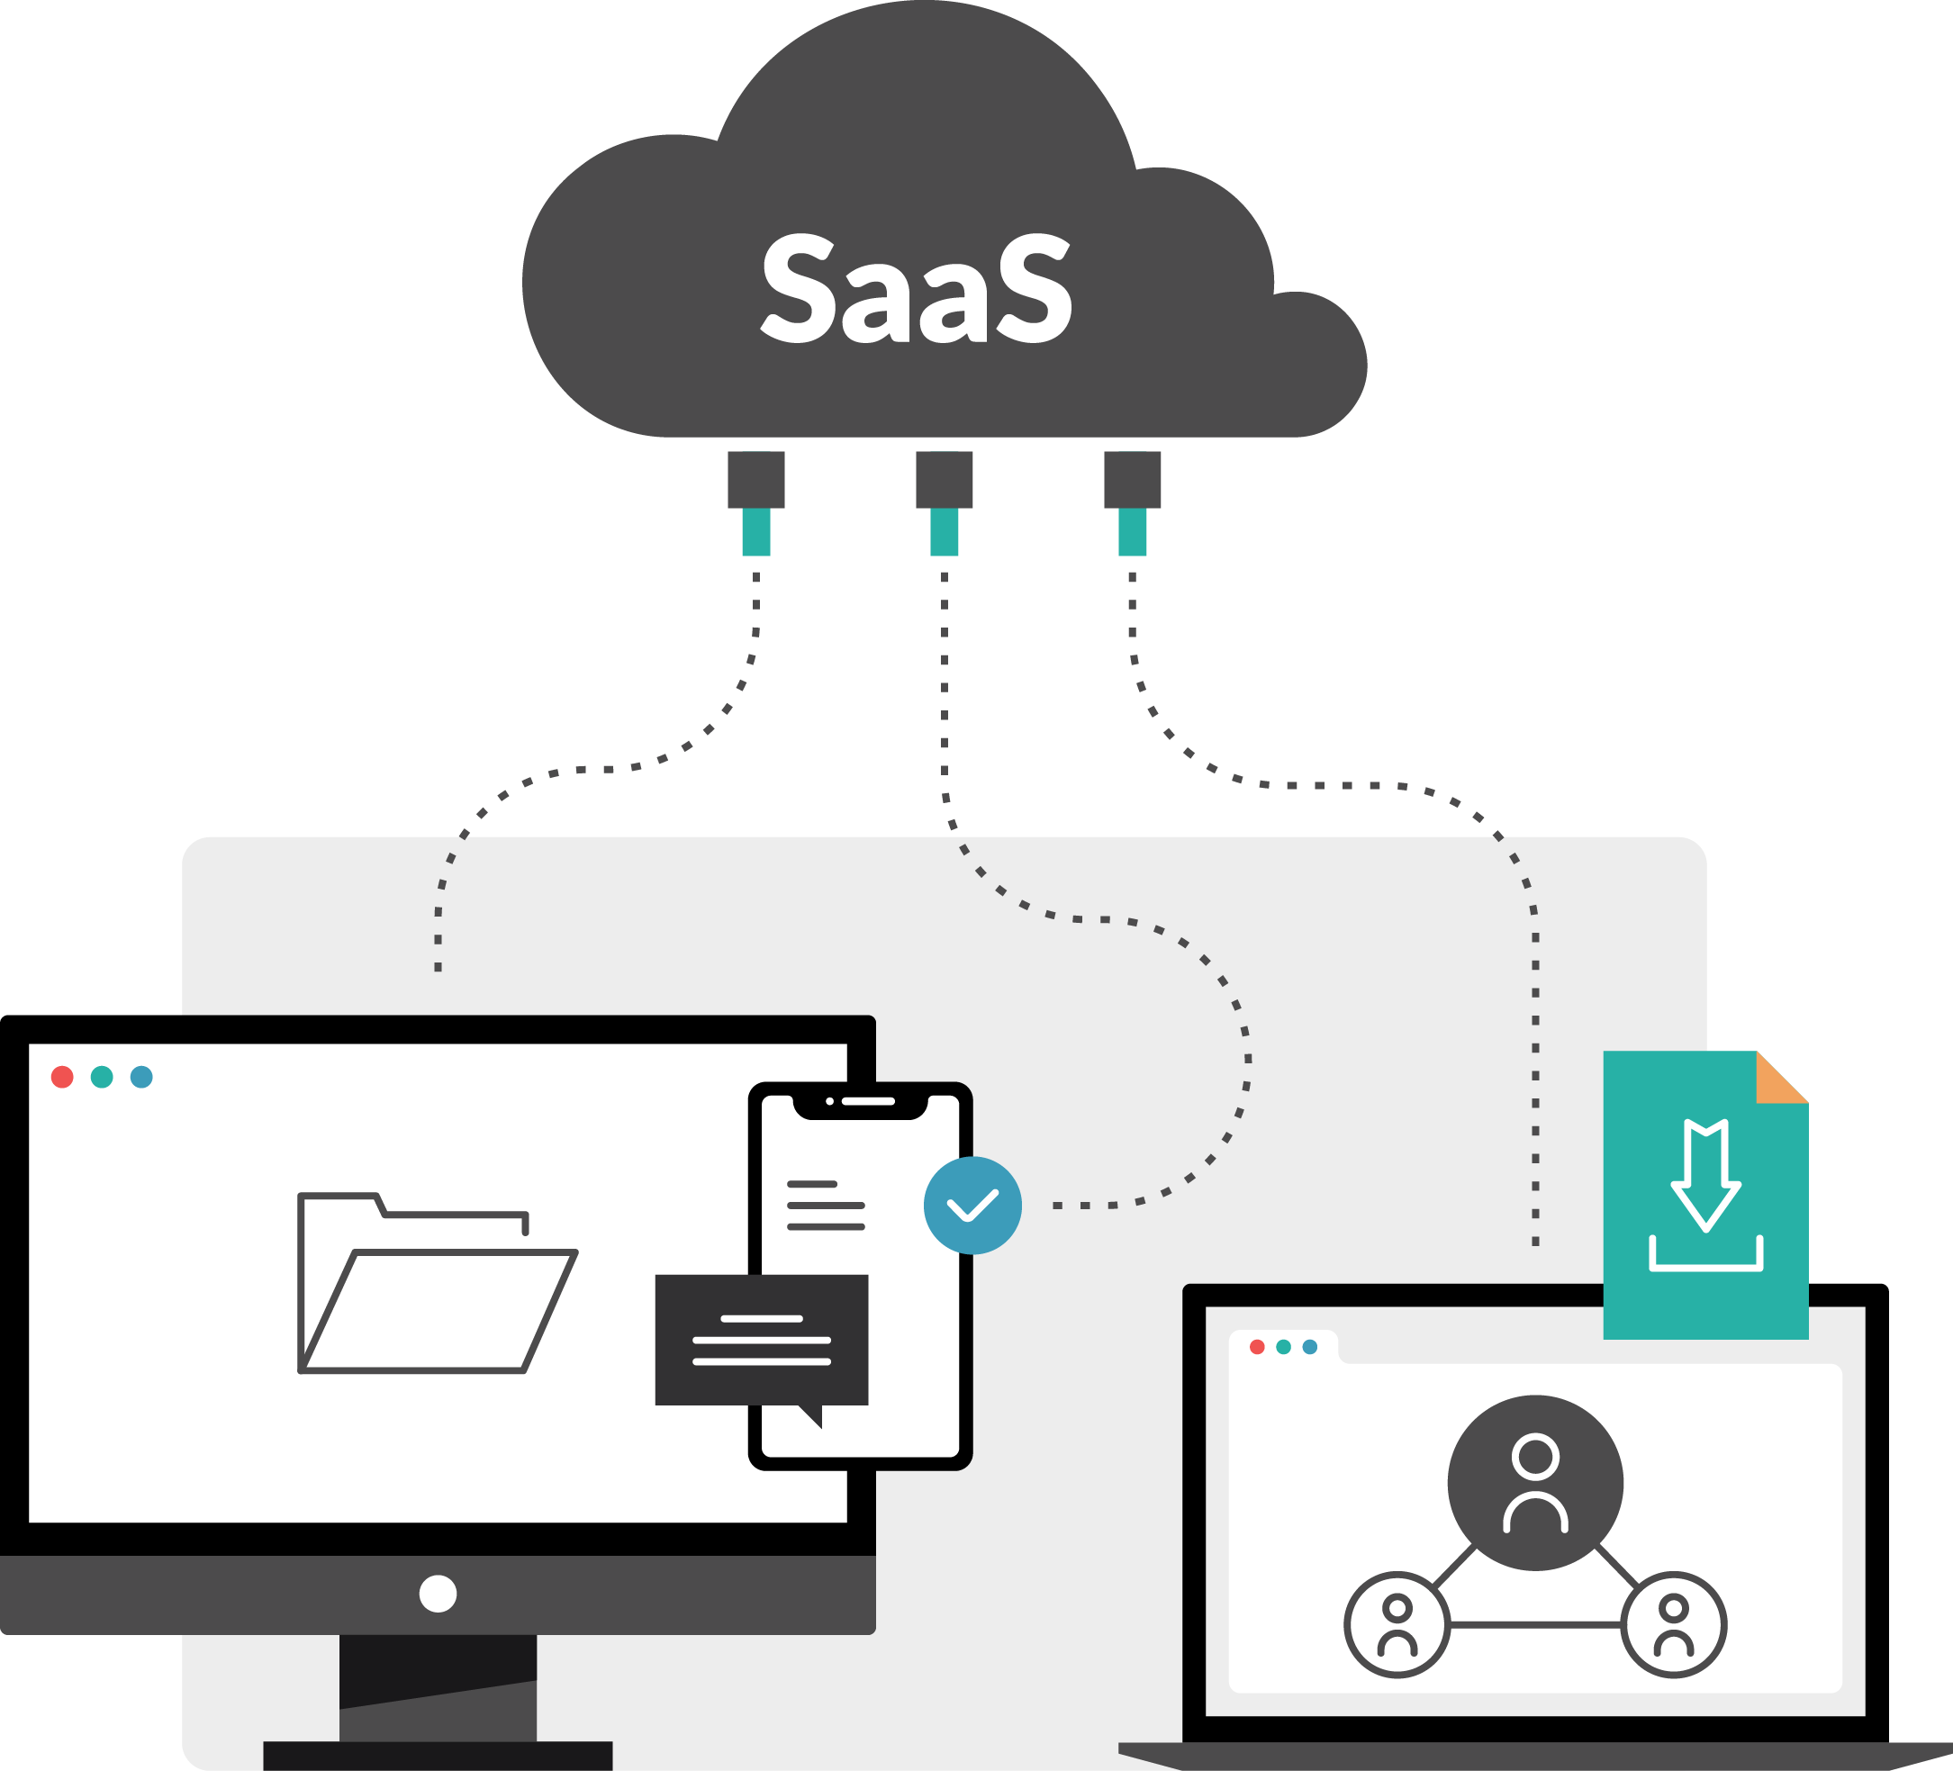



Agenda
Best Practices
Challenges
Data Director

Slide 3
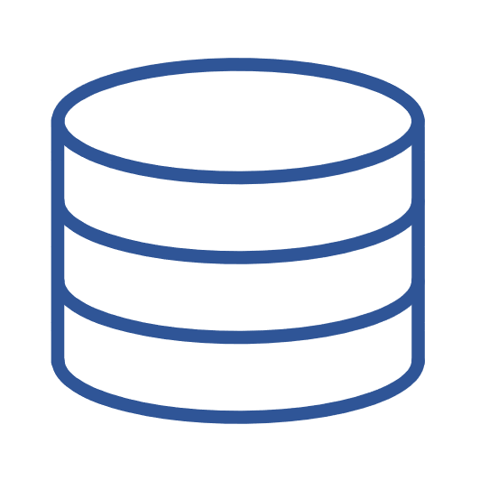


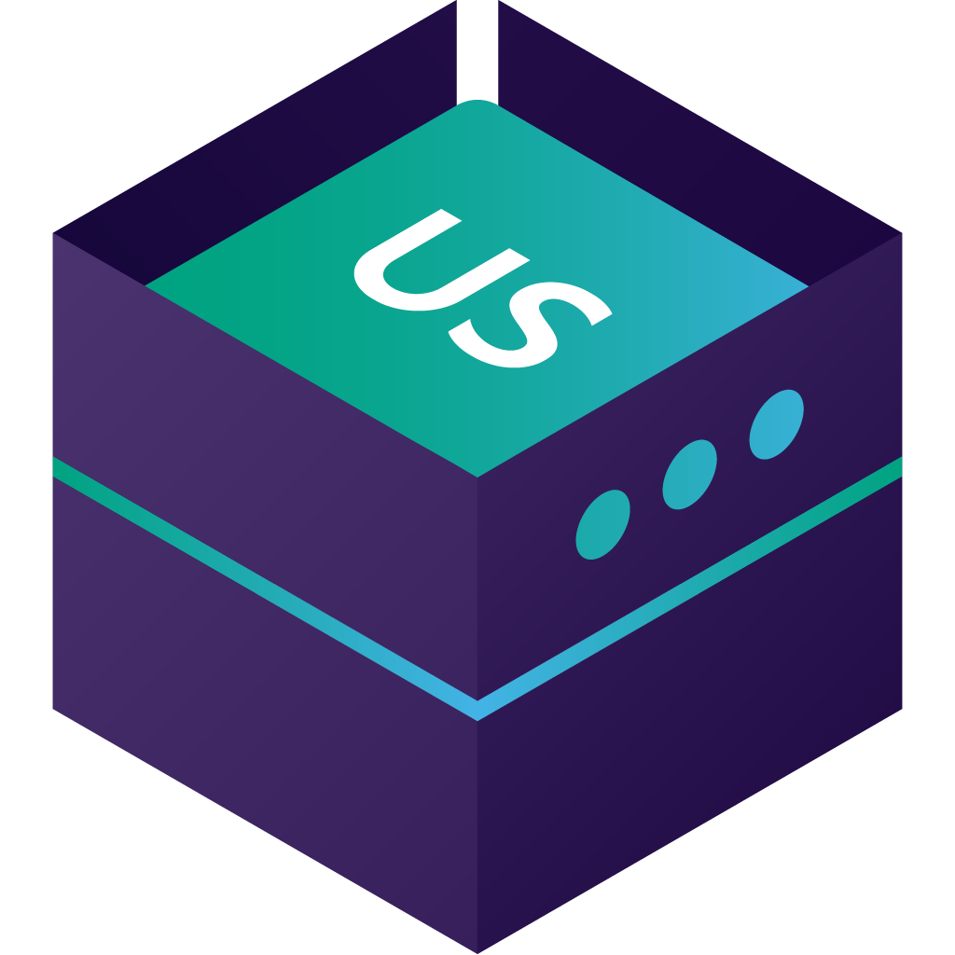
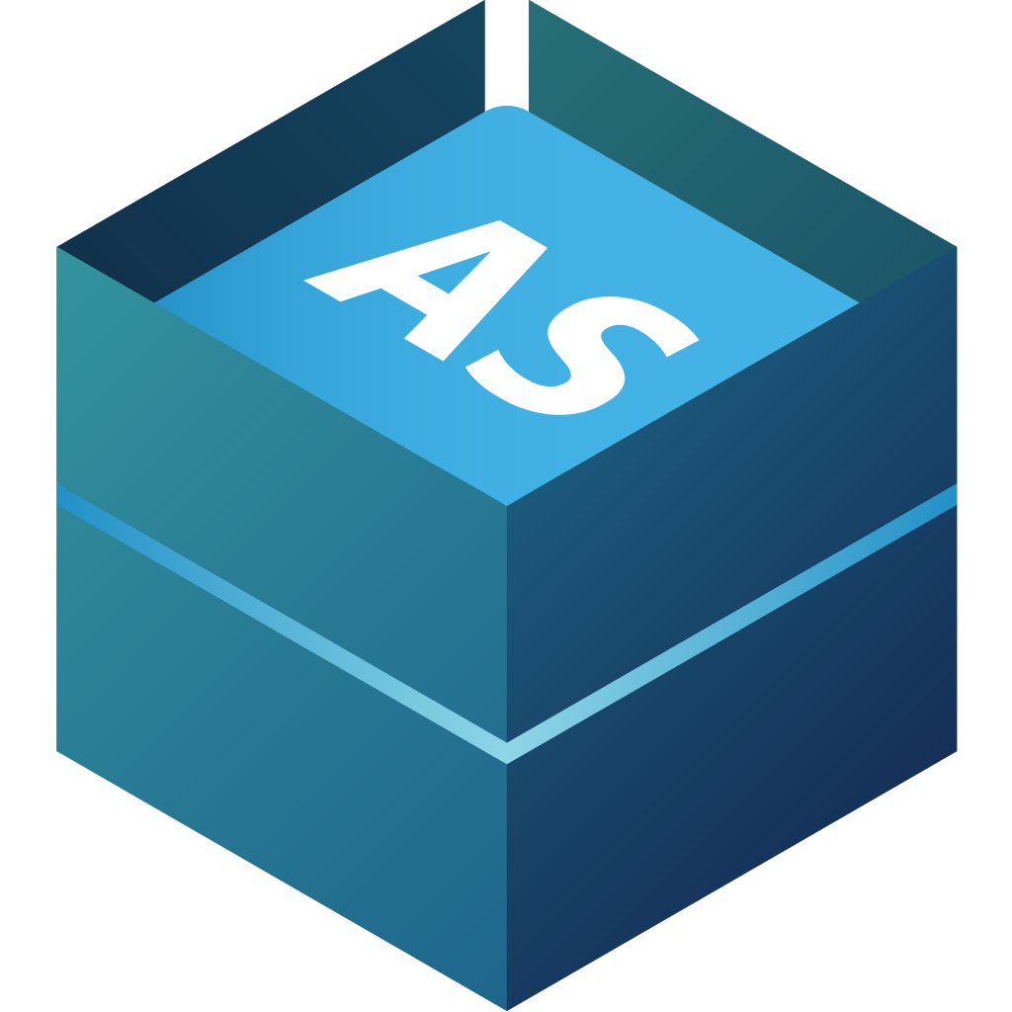



Architecture – Pure SaaS
Clients are web browsers
POS is using AppShell for LS Central
Hardware Station for LS Central
Update Service for LS Central and client
  Hardware Station
  Hardware drivers
  AppShell
Web Service Replication
SaaS
Update Server for LS Central
Web Service Replication
Master Date
Company 1
On-Prem
Company n
Update Service for LS Central
Update Service Client for LS Central
Hardware Station
Client
Client
App Shell for LS Central
POS

Slide 4
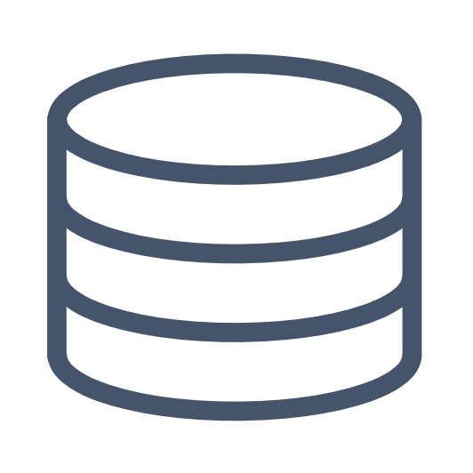

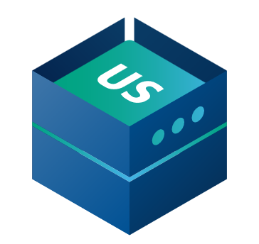


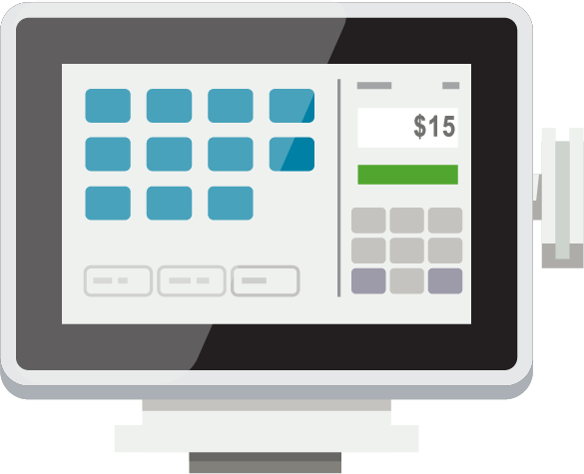
Hybrid Component Server
SaaS
HCS is an on-prem SQL database
Data Director for LS Central used to move data to and from the SaaS database
Web replication using Azure Storage
Online functionality with web services
Update Service for LS Central and client
  Hardware Station
  Hardware drivers
  AppShell
  LS Central BC versions
POS is a standalone SQL database
Web Requests
Hybrid Component Server
UPDATE SERVICE
DATA DIRECTOR
POS MASTER
STORE
Offline POS’s
BackOffice user
Offline POS’s

Slide 5
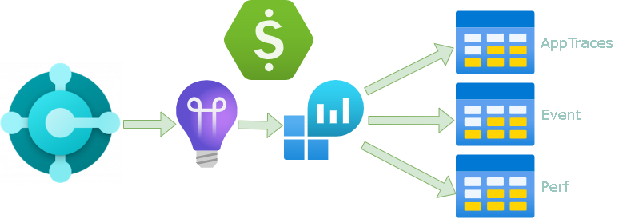
Let’s start with best practices
Architecture
Telemetry
  Environment and app/extension-level telemetry (BC2020+)
  Available telemetry (errors, database, long running, job queue, and more)
  Enabling
  Controlling cost
  Microsoft Power BI apps
  KQL – github.com/microsoft/BCTech/tree/master/samples/AppInsights
  Alerts
AppTraces
Event
Perf

Slide 6
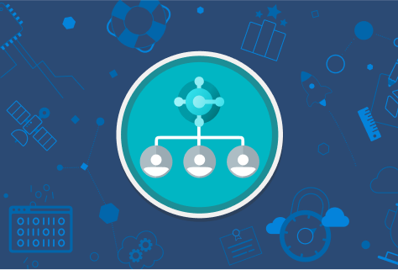
Authentication & connectivity
Admin Center
  Users
  Device users
Azure Portal
  S2S Authentication
  Webservices
  API's
  KDS (s2s OAuth)
  Azure Functions
  Replication
POS
  WebClient
  AppShell

Slide 7
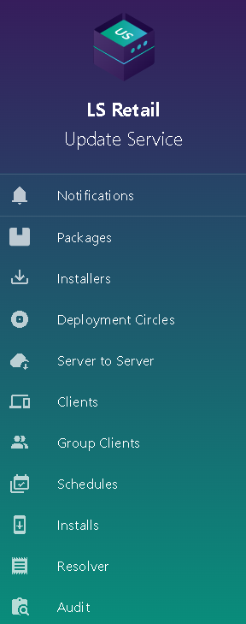
Let’s start with best practices
Architecture
Telemetry
Authentication & connectivity
Update Service for LS Central
  Package manager and deployment tool
  Server – Client
  Packages
  PowerShell Cmdlets
  VS Code extension
  LS Retail Update Service Workspace

Slide 8


SaaS Implementation
https://help.lscentral.lsretail.com/Content/Implementation-Guide/LS-Core/LS-Central-SaaS.htm
CAP & Onboarding process
Data Migration
Testing in sandbox
Hybrid model
Support
pops@lsretail.com

Slide 9
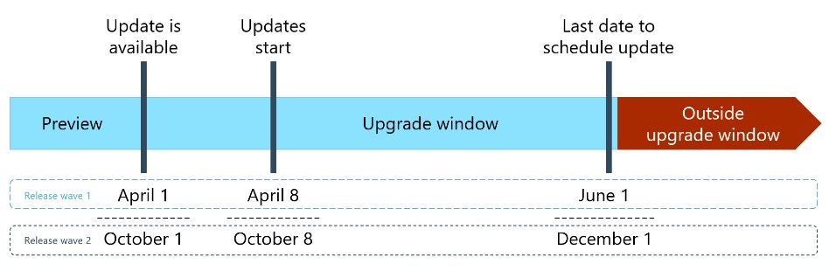
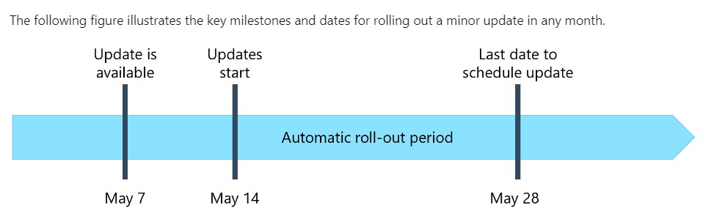
Automatic updates
https://learn.microsoft.com/en-us/dynamics365/business-central/dev-itpro/administration/update-rollout-timeline
Major updates
Minor updates
Notifications
Schedule update
Environments
Country availability
Hotfixes are released when needed
New events are released weekly

Slide 10
What do I need to do when a new update is released?​
Update is available
Last date to schedule update
Outside upgrade window
LS Central preview
Upgrade window
Day 1
Day 60
Get familiar with the new release
Test your add-ons on the new release
Set scheduled update date and define update time window in the Business Central Admin Center
Notify customers

Slide 11
And now about challenges
Implementation
Automatic updates
Achieving 24/7 operations, minimizing update impact

Slide 12
Large scale implementation
Operational limits of BC have been expanding constantly in the past years
Today there are no operational limits for:
  Number of users (sessions)
  Database size
  Transactions
Throughput is improved
  BC can handle 6,000 web service requests per 5 minutes per user
  Over 25,000 web requests per minute
There are continuous performance enhancements
More effective SQL compression
Microsoft Concierge Program
SaaS
Hybrid Component Server
POS’s Online
POS´s Offline

Slide 13

And now about challenges
Implementation
Automatic updates
Achieving 24/7 operations in SaaS, minimizing maintenance window impact
AppShell or not AppShell
Large scale implementations: 1000+ POS
LS Central is cloud ready (no DLL) - is your app ready?

Slide 14

Universal Code Initiative
Full extension. No customization in the base application.
Program for cloud (“target”:”Cloud”).
All .nets must be replaced with the Azure functions or some 3rd party application with the use of WebService.
For any file storage in the FTP must be switched to OneDrive or SharePoint.
No direct database access. Access through web service requests.

Slide 15
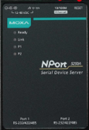


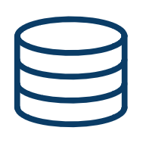
Cloud ready with no DLL - Example
Challenge
Read data from a device with socket communication through a DLL
Solution
Create a service that is executing the DLL task
Communicate with web service requests between the service and LS Central
Device
Telnet - IP address and port
Service
Web Service – Get Setup
Web Service – Send coordinates
LS Central

Slide 16

Data Director for LS Central
Various modes of operation, including Azure and new AWS storage options
Monitor Collection, Azure plug-in for Data Director
help.lscentral.lsretail.com/Content/LS-Retail/LS-Data-Director/Introduction.htm

Slide 17
Q&A

