Slide 1
Ivan Lee & Mohamed Mohsen
Consultants
Update Service for LS Central and New Hybrid Setup
Hands-on workshop

Slide 2
Update Service for LS Central
Simplify the process of installations and deployments of LS Retail’s products
  Including components/dependencies
Auto update of new version of LSC and/or extensions without accessing to individual app server

Slide 3

Getting started
Online help:
https://help.updateservice.lsretail.com/
PowerShell basics
Install LS Central with PowerShell
Project lifecycle
  Step by step guide
  Video series
  Do a test project

Slide 4

Requirements of Update Service Server
OS:
  Windows 10 Pro or later
  Windows Server 2012 or later
Disk Space:
  3 GB
  More disk space required for more packages stored
Additional software required:
  IIS
  SQL Server
  ASP.NET core runtime

Slide 5
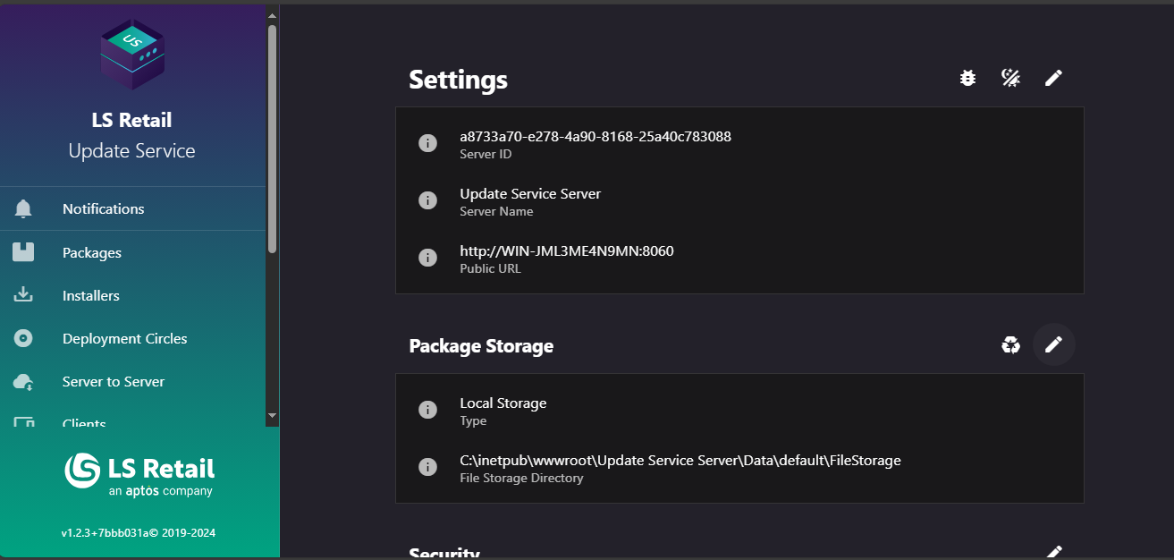
Update Service Server
Where the deployment manager works mainly
Configure package/bundle/installer to be used on client machine
Setup schedule, group of clients, and deployment circle of each bundle/apps
Deployment manager
  Responsible to publish of packages to the update service server
  Requires basic knowledge of powershell

Slide 6

Installation errors
Common errors
  First install fails – restart required
  Sensitive to Windows updates
  Configuration errors
    I.e. incorrect SQL server
  Apps incompatible
  Destructive schema changes
  Machine out of memory
Online troubleshooting page
help.gocurrent.lsretail.com/docs/ls-central/ troubleshooting.html

Slide 7

Need help?
Yammer group
  https://yammer.com/gocurrent
  Troubleshooting
  Consulting
  Feedback
  Community - anyone can help
LS Retail Partner Support
  Troubleshooting
  Urgent matters
  Customer specific

Slide 8
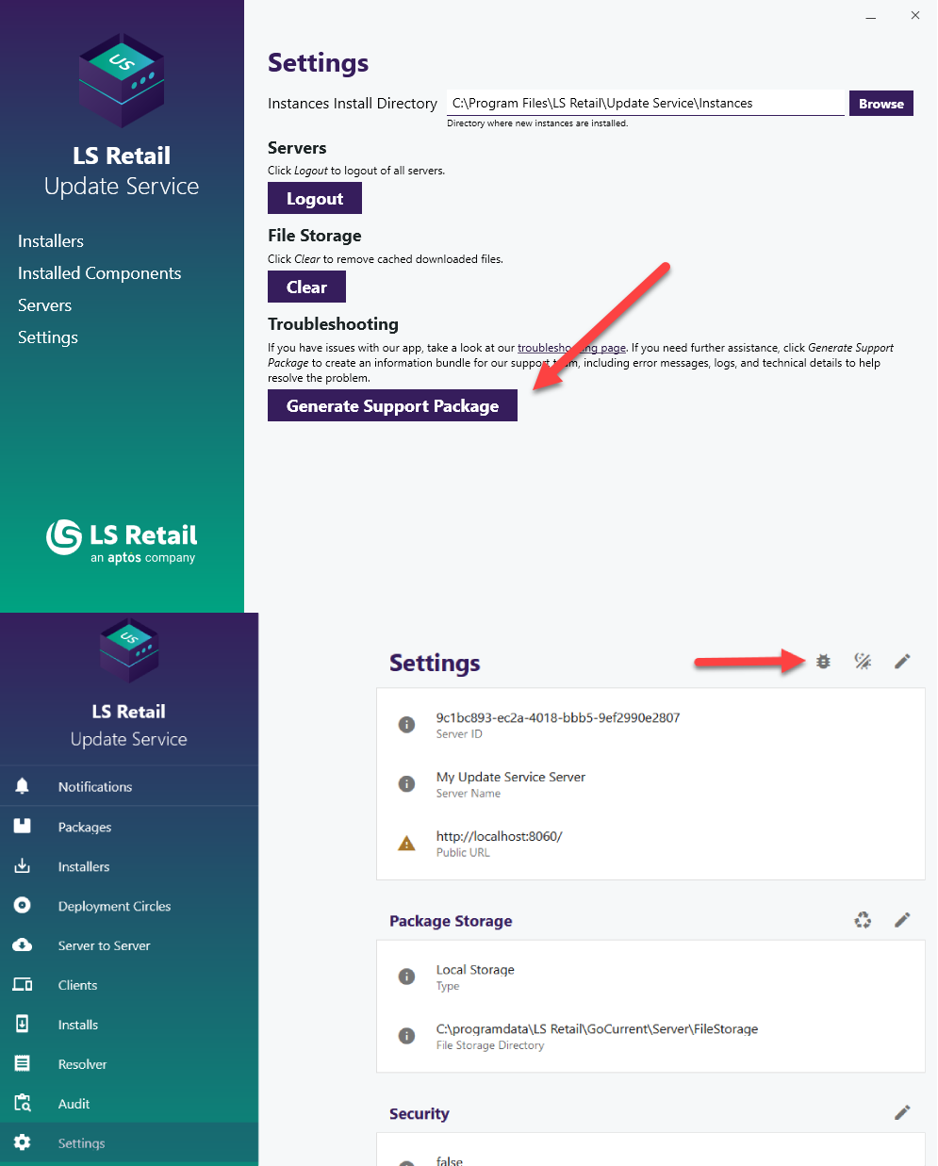
Support package
Client and server
Include necessary information for troubleshooting
  Application logs
  Event viewer
  Installed components
Reduces the time to resolve the issue

Slide 9
Hands-on

Slide 10
Get Started
Get latest Update Service Server installer here
Install pre-requisite SQLServer Express on server (included in installer)
Run powershell as admin and run the below command:
  Import-module UpdateService

Slide 11
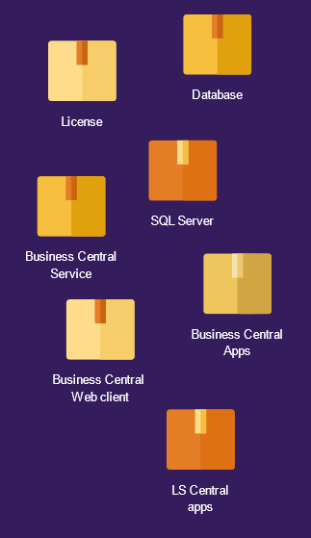
Packages
Components splits into multiple packages
Package is a zip archive containing:
  Installation files
  Installation scripts
  Manifest
Can have dependencies
Installing a package will install its dependencies
Deployment manager to ensure the dependencies are in update service server

Slide 12
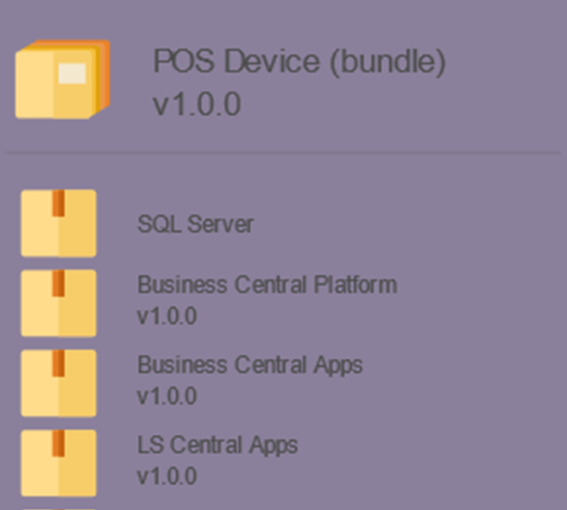
Bundles
Is a type of package
Imagine it as package of multiple packages
Able to select versions of packages within the bundle
Bundle a package with its dependencies

Slide 13
Installer
Executable files to be downloaded and install on Update Service Client.
Can consists of multiple selected packages (configured at Update Service Server)
Can have suggested instance name (BC Instance) and description for each of the package

Slide 14
Hands-on

Slide 15
Client
Where BC instance will be installed
Requirements of client is similar as requirement of BC Server
  SQL Server
  IIS
Additional windows service (LS Go Current Client Service) will be installed as well
  Logon user of this service is required to have dbowner to the database of the BC instance
    To configure this, we will need SQL Server Management Studio installed
Will be displayed as client in Update Service Server

Slide 16
New Features in 1.2.0

Slide 17
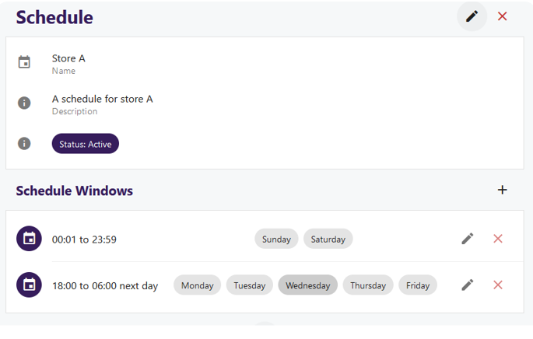
Schedule
Way to control when the client can install updates during the day of weeks
Multiple schedule windows per schedule

Slide 18
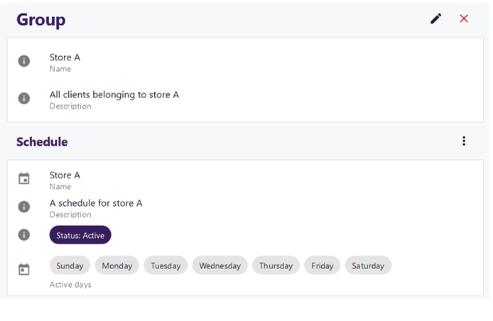
Group
To group multiple client as logical group
Can have one schedule assigned per group
Can be assigned to multiple deployment circles

Slide 19
Hands-on

