Slide 1

LS Central for hotels
What’s new?
Anna Dís Þorvaldsdóttir
Consulting manager

Slide 2
What makes LS Central for hotels a great product?
Complete view of the guest journey with unified modules and no integrations needed
  Powerful and visual POS makes serving guests quick and easy
  Packages can include room, services, items, and allowances
  Transparency of financial details
  All charges to one invoice from multiple locations
  Certified integrations to common OTAs

Slide 3


Slide 4


Slide 5

Reservation Management

Slide 6
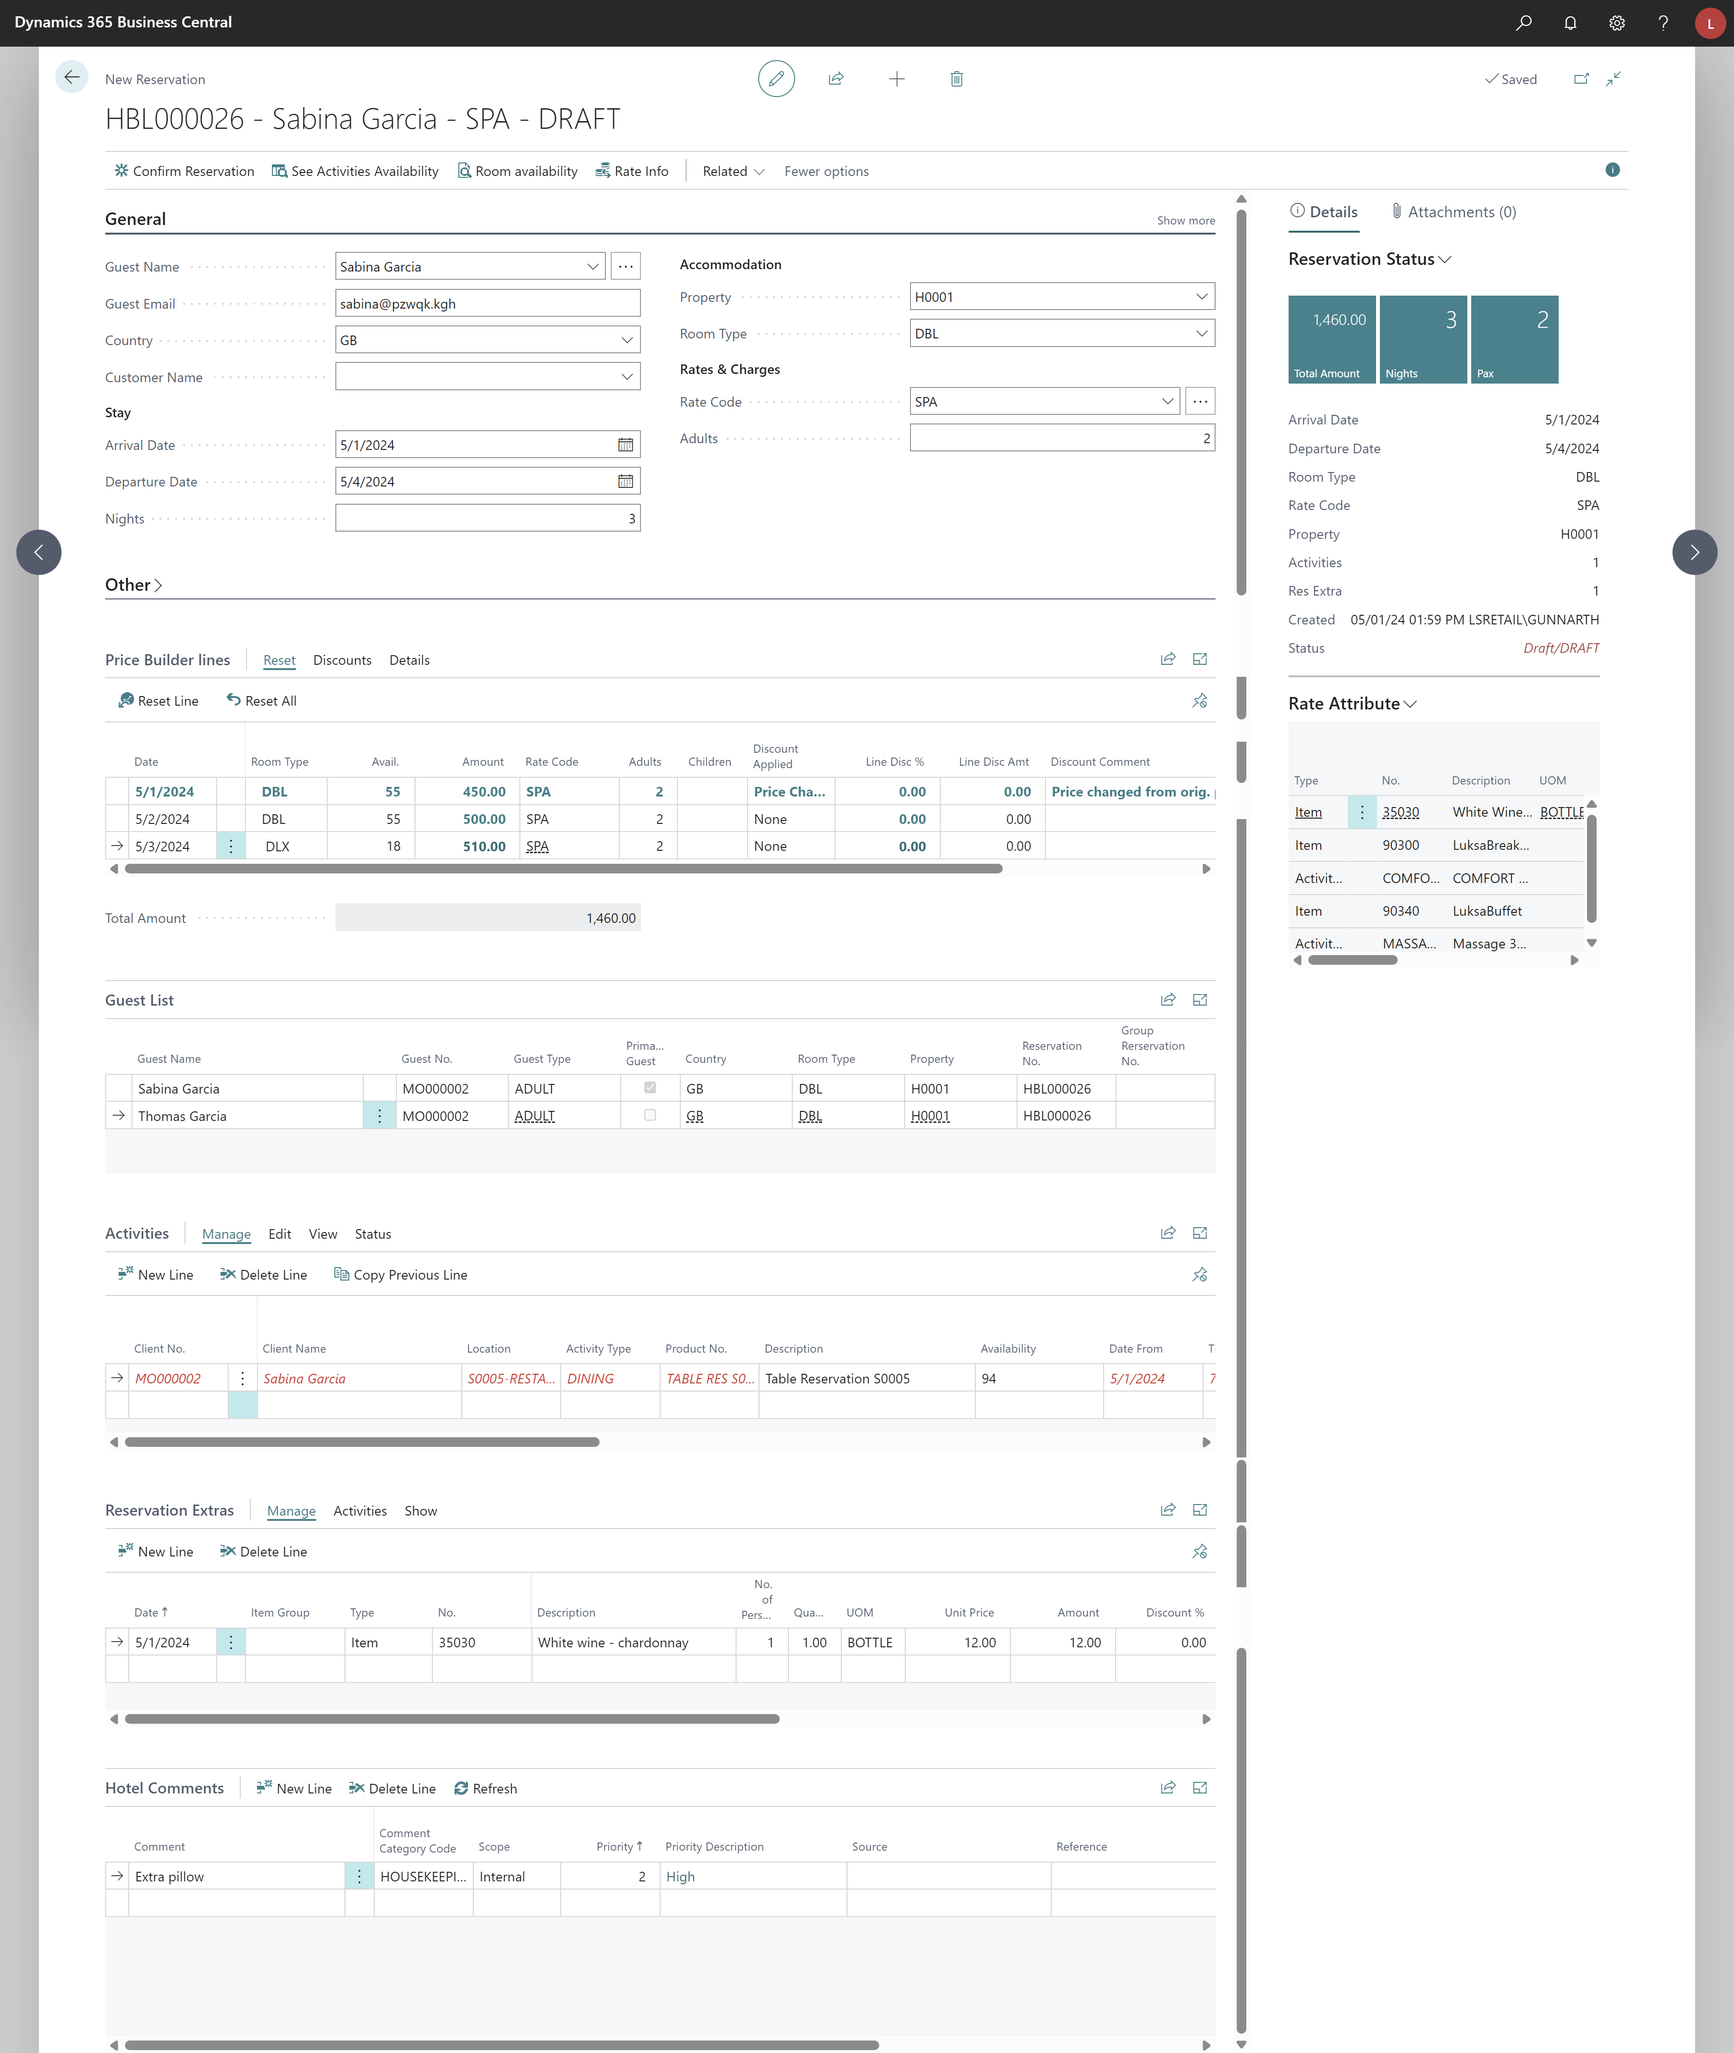
Reservation Management – Draft reservation
New reservation pages for individual
  Easier to work with reservations in draft-mode
  Better overview of the reservation in draft-mode
  Price builder lines for specific days
Plan room and room types for different days
  Draft reservation – plan for DBL room on Days 1-2 and then on Day 3 set in DLX
  Confirmed reservation – assign to different rooms on different days
Work with price lines
Manually change price
Assign another room type for a specific night
View what is included in rate
Edit the guest list
Add extra activities (activities from rate code are not created until on confirmation)
Add extras to the reservation
Work with comments

Slide 7
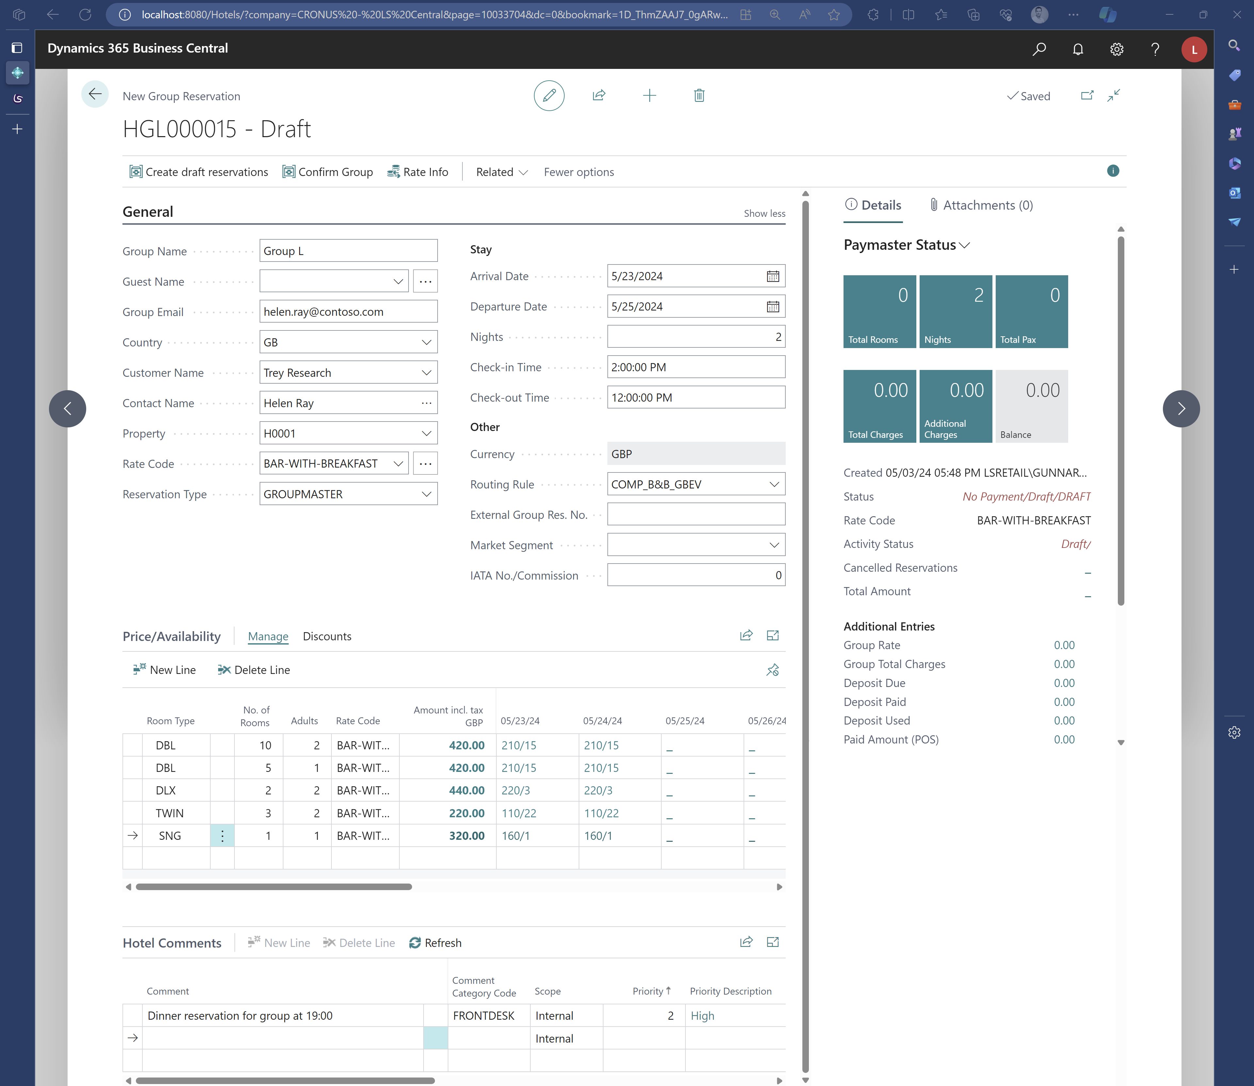
Reservation Management – Draft groups
New reservation pages for individual and groups
  Easier to work with reservations in draft-mode
  Create draft reservations for group reservations
  Easier to create group reservations with different room assignments
Create draft reservations to work in more details
Build up room list with no. of adults in each room type
Work with comments

Slide 8
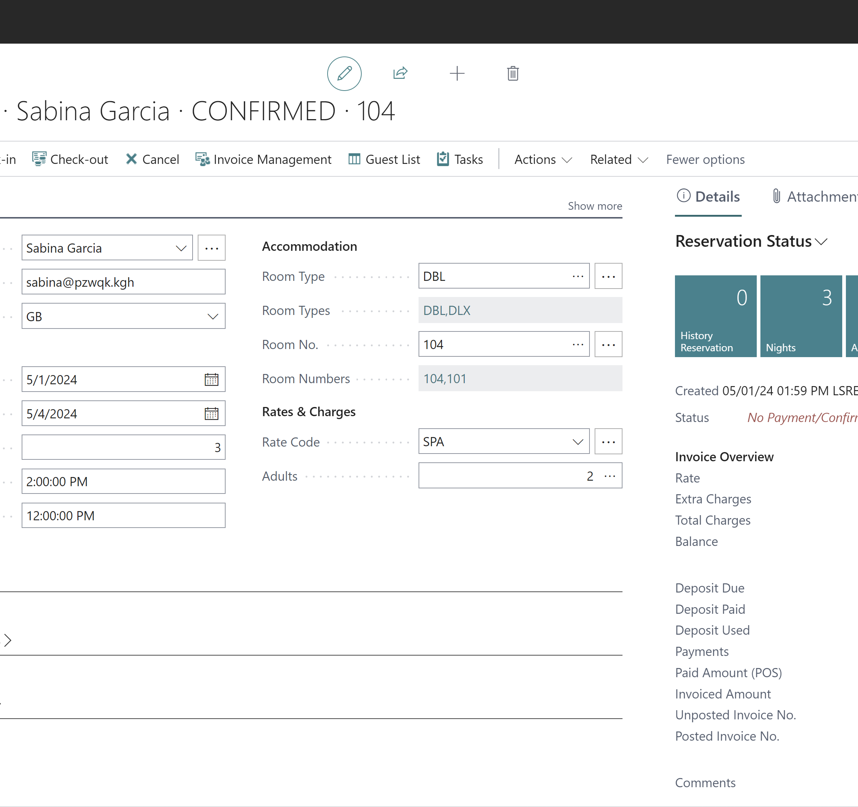
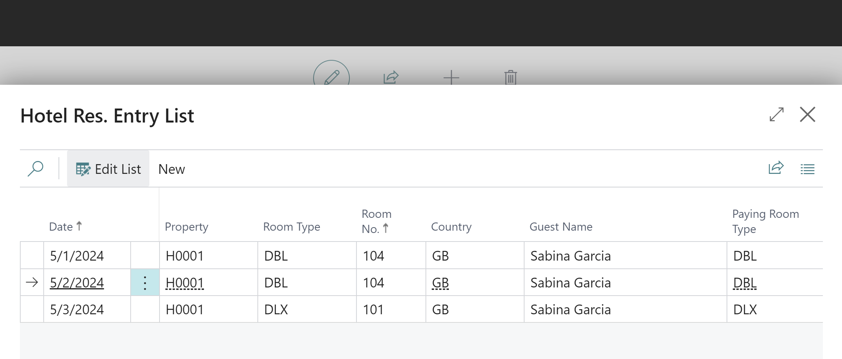
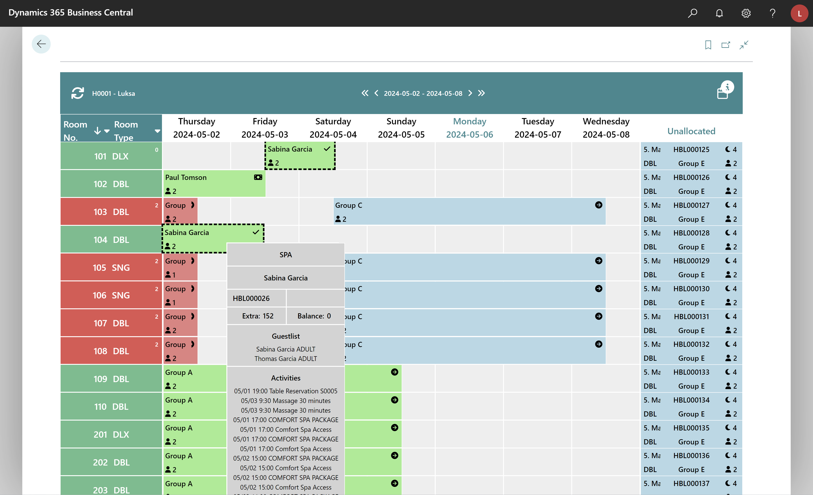
Reservation Management – Room assignment
Assign different rooms for different days
  Different rooms or room types per day
  If assigning to another room type, then the upgrade page opens
  View disparate room assignments on Tape Chart
Assign different room for different days
Disparate room assignments shown on Tape Chart
Assign to different room type on different days

Slide 9
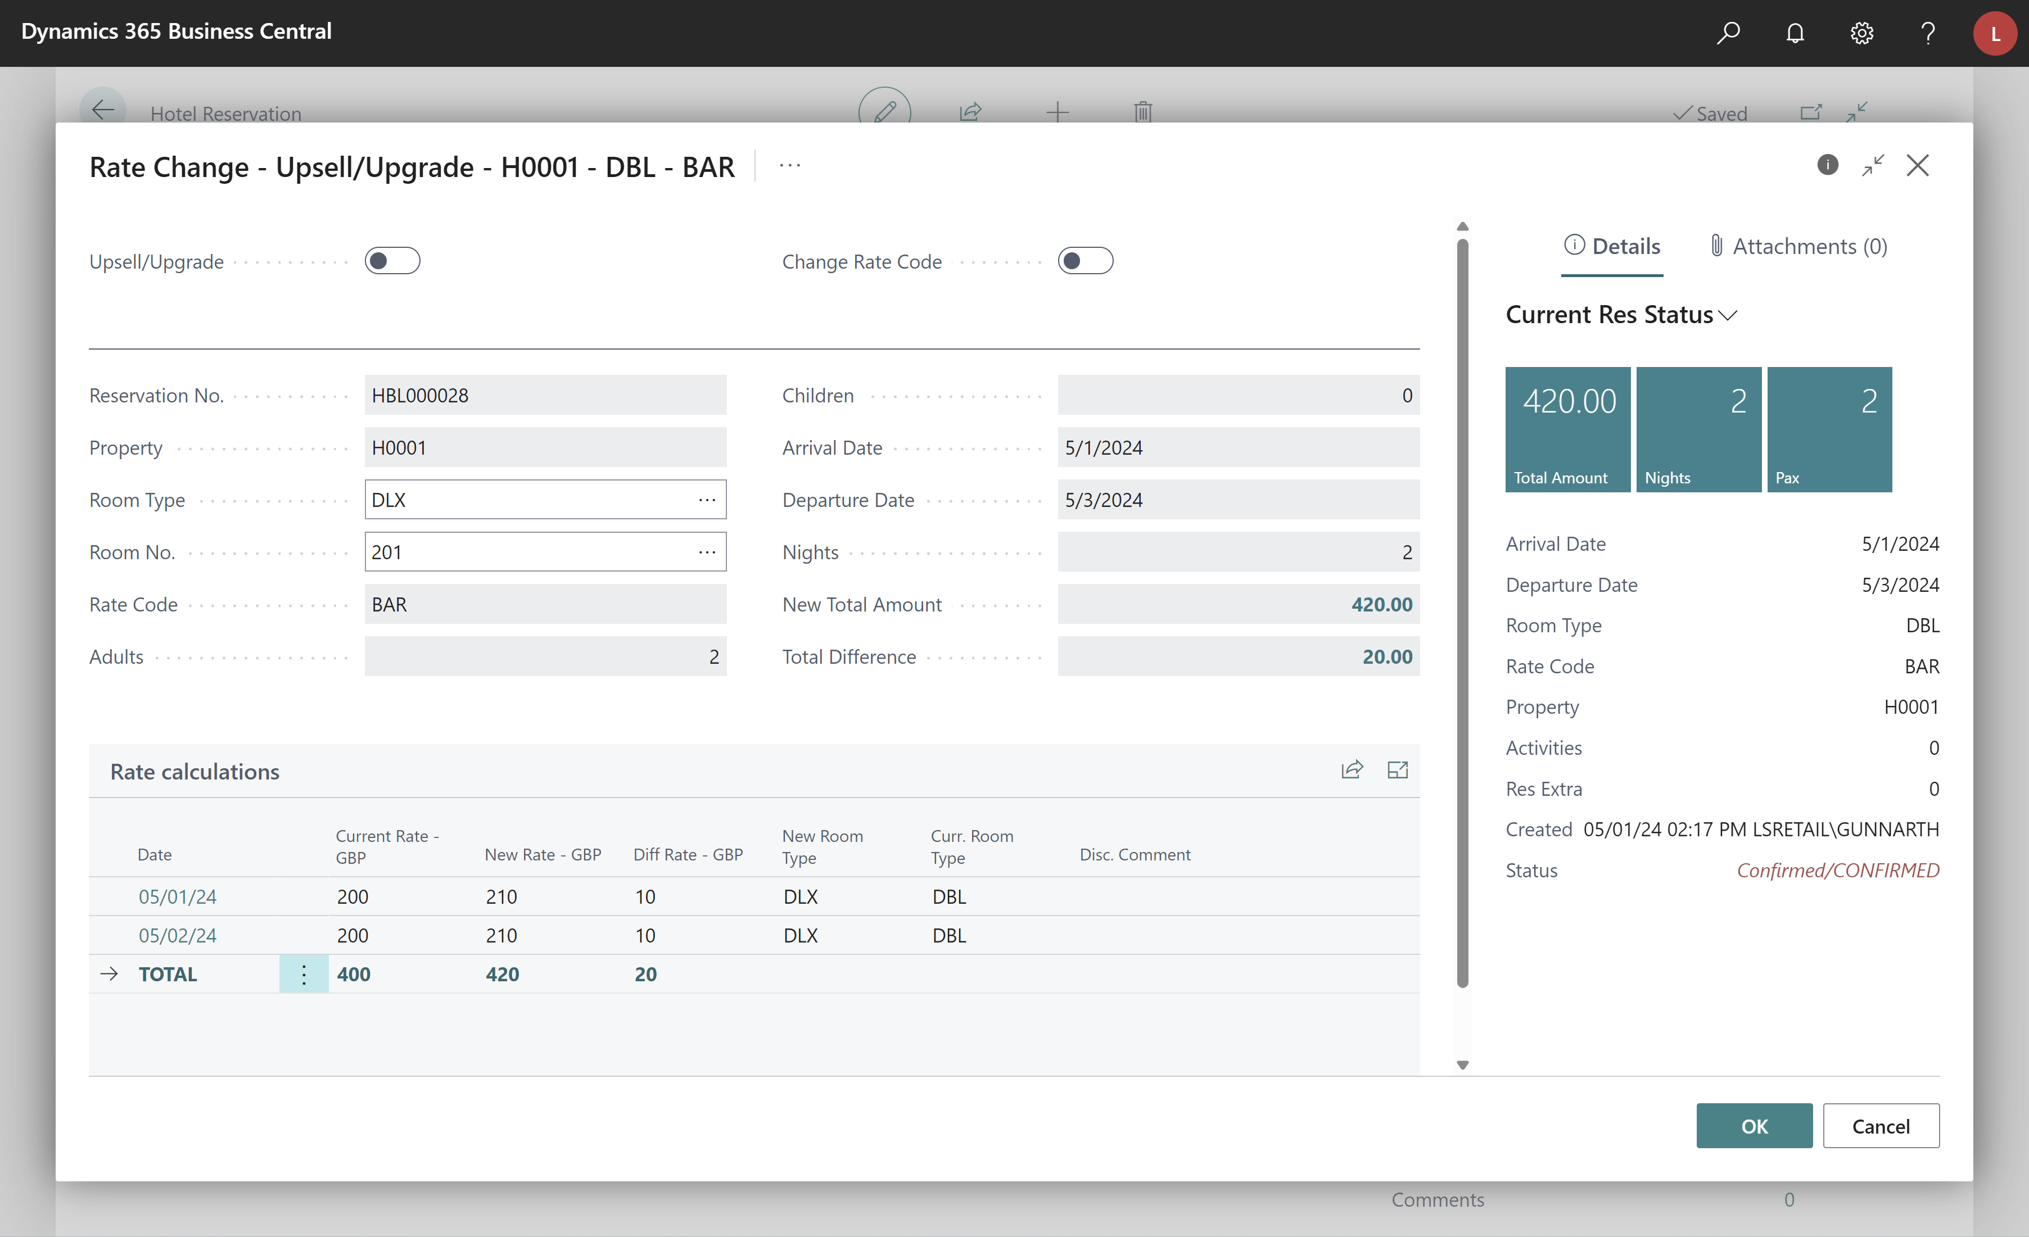
Reservation Management – Upgrade/Upsell
Upgrade/upsell process
  Code refactoring
  More detail on changes being made
View current information
Better view on what will be
Better view on what is changing

Slide 10
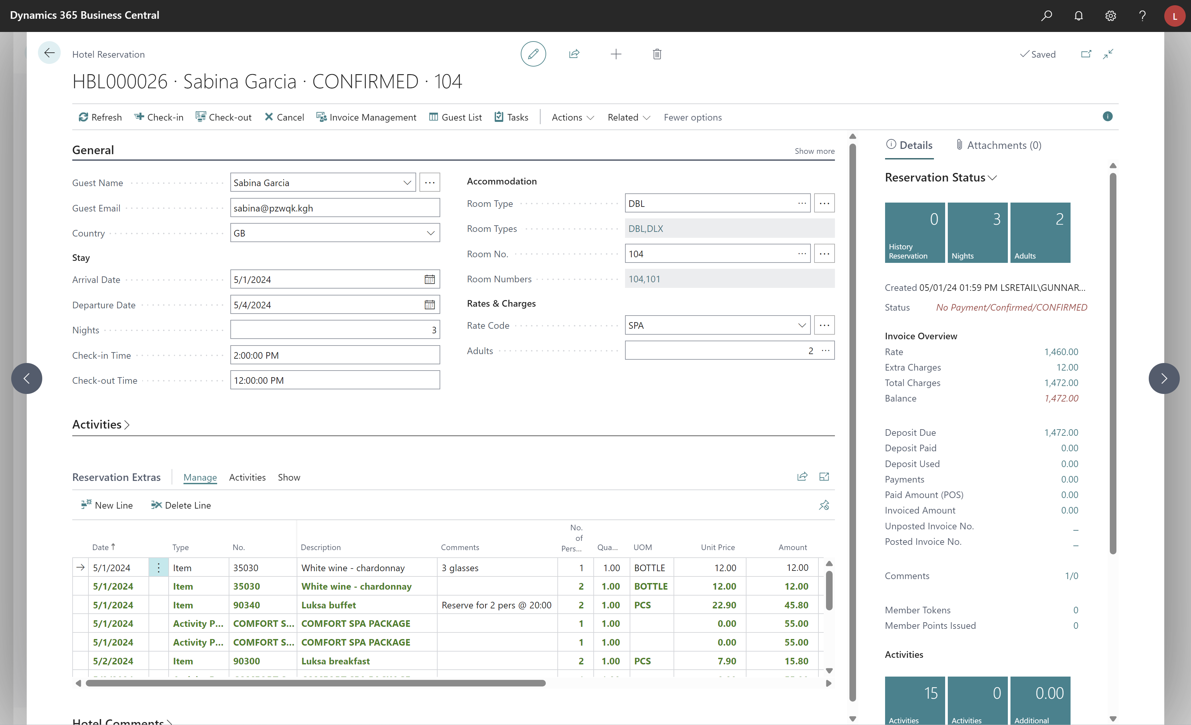
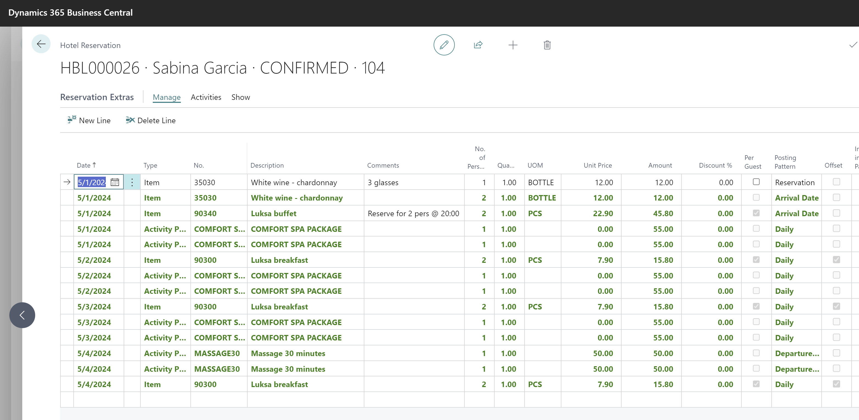
Reservation Management - Extras
Comments on reservation extras
  Better communication and detail on reservations
Offset on reservation extras posting patterns
  Ensures that reservation extras are posted and consumed on the correct day
Set offset to ensure correct posting date.
Example: Buffet on Departure date offset to consume on night before departure
Comments on reservation extras lines

Slide 11

Rate Management

Slide 12
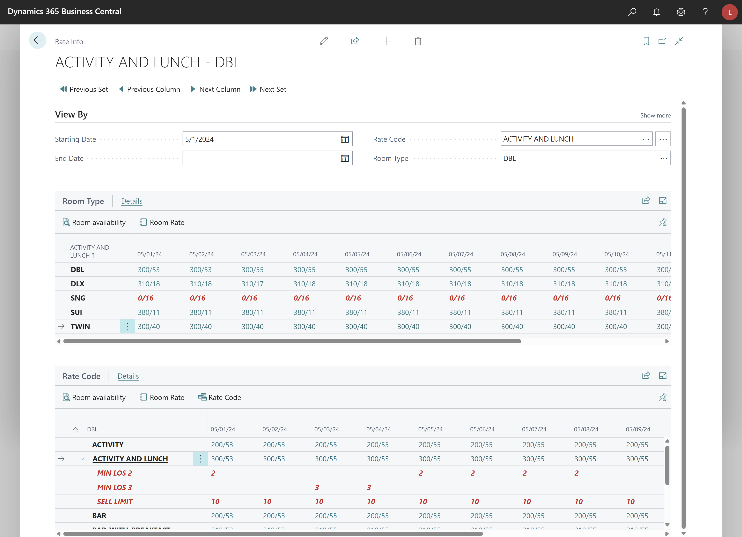
Rate management – Rate Info
Rate Info (Rate Matrix)
  One stop shop to view rates per room type for different rate codes
  View restrictions set on rate codes for a given period
  Open from Active Rates tile on Role Center
  Open from Rate Management -> Rate Info action
  Create reservation by clicking on a date/cell
Filter on Rate Code and Room Type
Click a room type to change the filter -> this will show the rates for this room type
Click a rate code to change the filter -> this will show the rate for room types for this rate code
Click on a date/cell to create a reservation from there
If there are restrictions on the rate, then these can be extended and shown

Slide 13
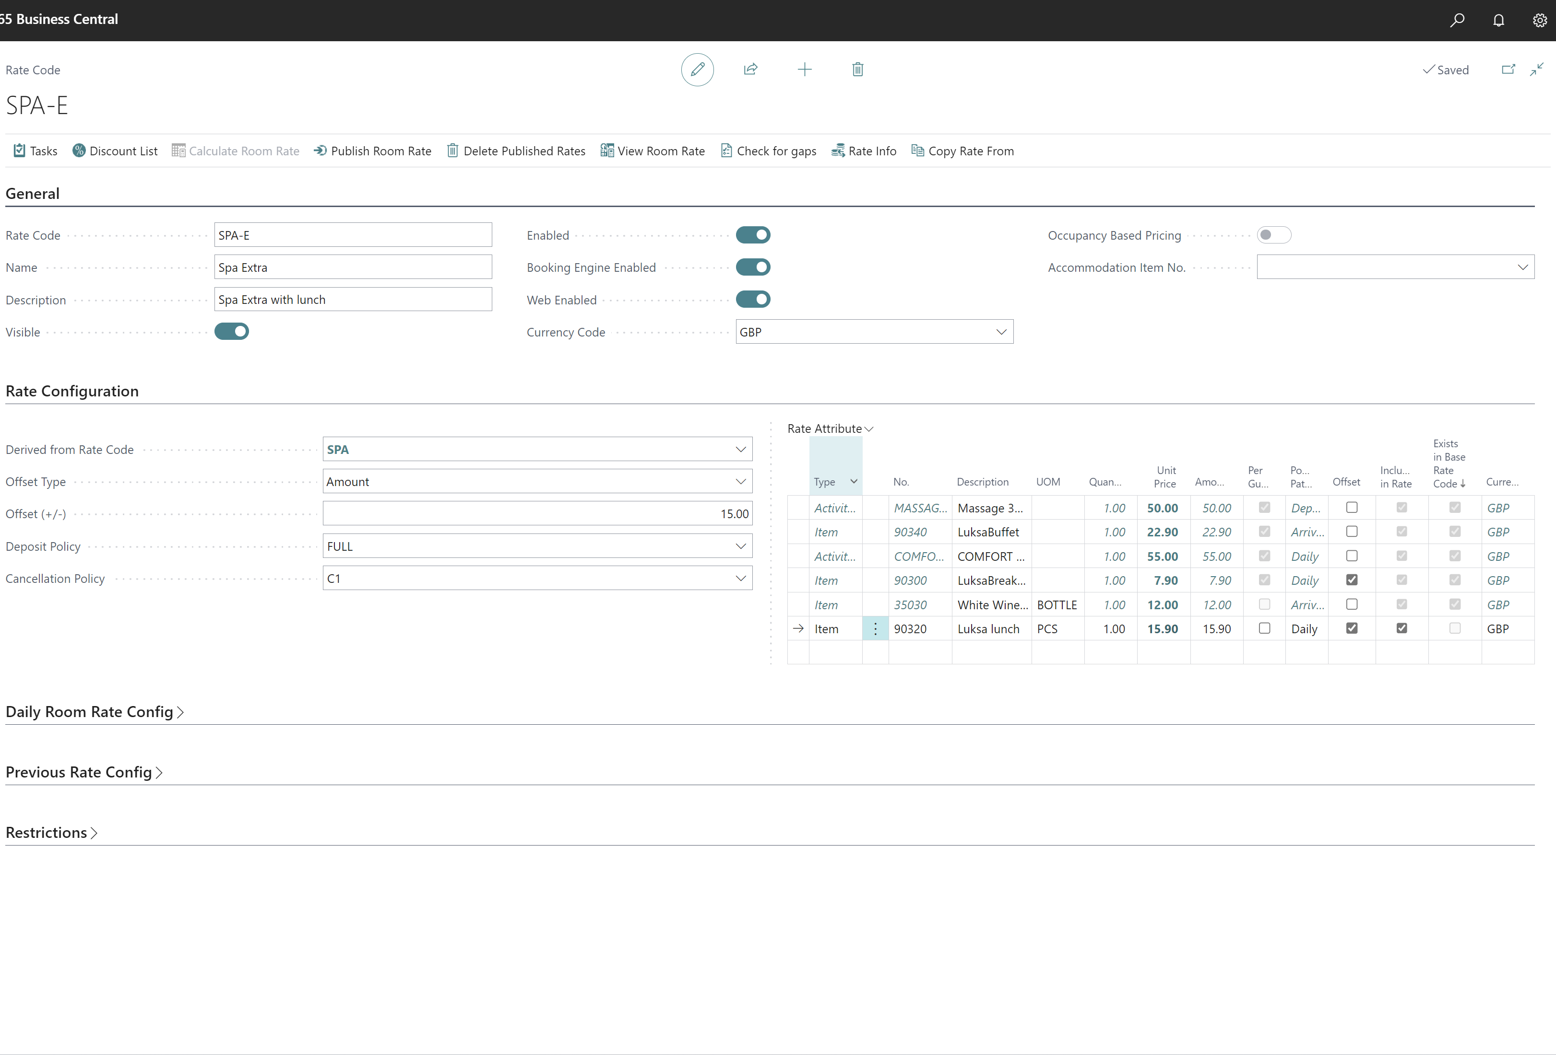
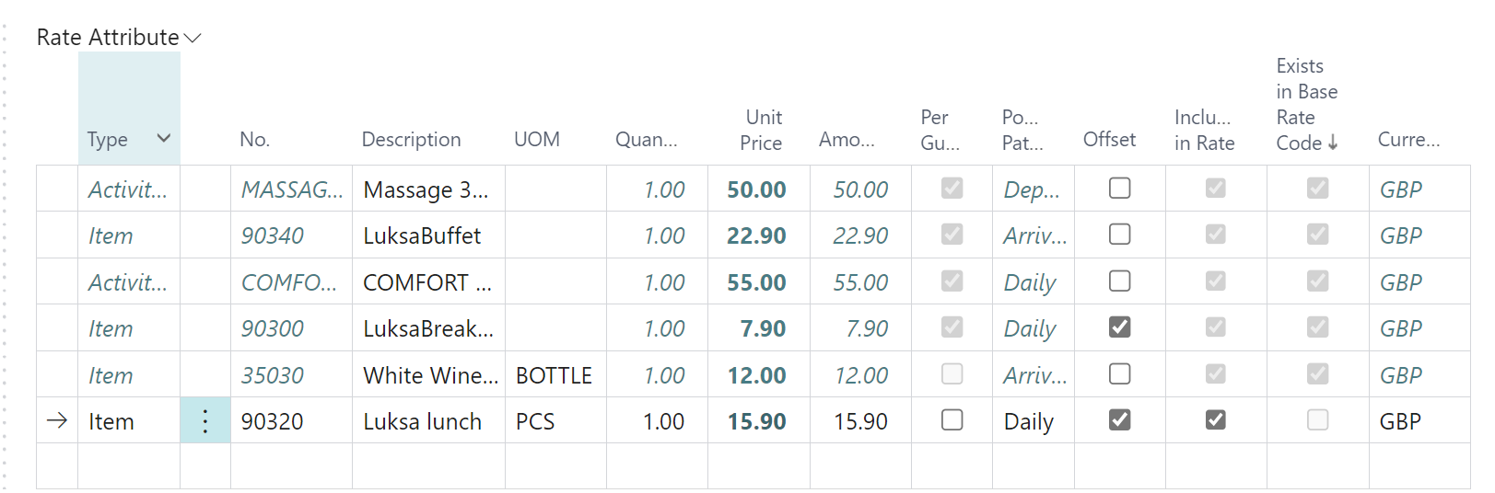
Rate Management – Rate Codes
UOM on rate attributes
  Unit of Measure for the rate attribute
View derived rate attribute lines
  View and change prices on rate attribute lines
Change rate attribute price
  Change Rate Attribute price on derived rate code
Offset on rate attributes
  All items within a rate must be posted on the same date.
  Set correct consumption date for rate attribute lines.
  An example is a rate with breakfast and here the breakfast is set for Daily with an offset.
  An example is a rate with breakfast and here the breakfast is set for Daily with an offset.
View rate attribute lines that are derived from the master rate code
Change price on derived rate attribute line
Set UOM on rate attribute – if not set then the base UOM is used
Set if rate attribute line is offset from the posting pattern

Slide 14
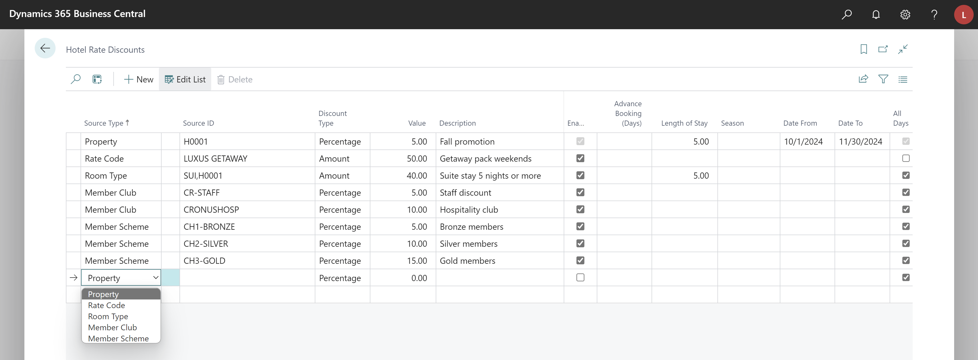
Rate Management – Rate Discounts
Rate discounts for members
  Member Clubs
  Member Scheme
Set discounts for member clubs and/or member schemes

Slide 15
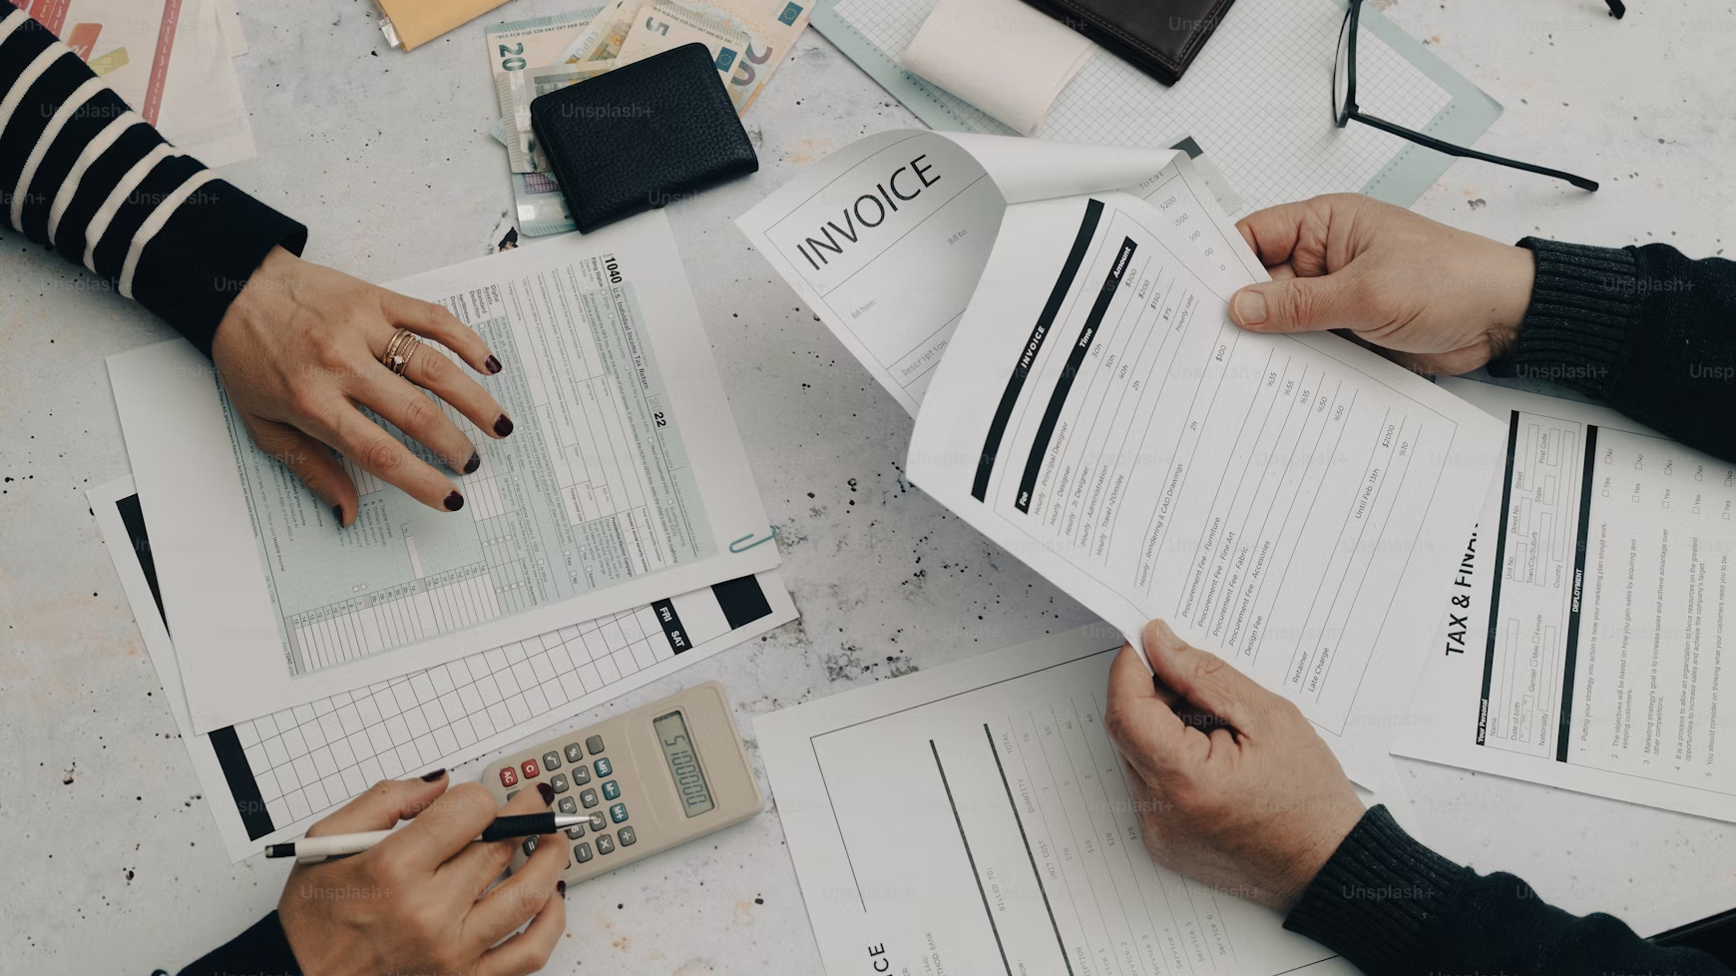
Financial Management

Slide 16
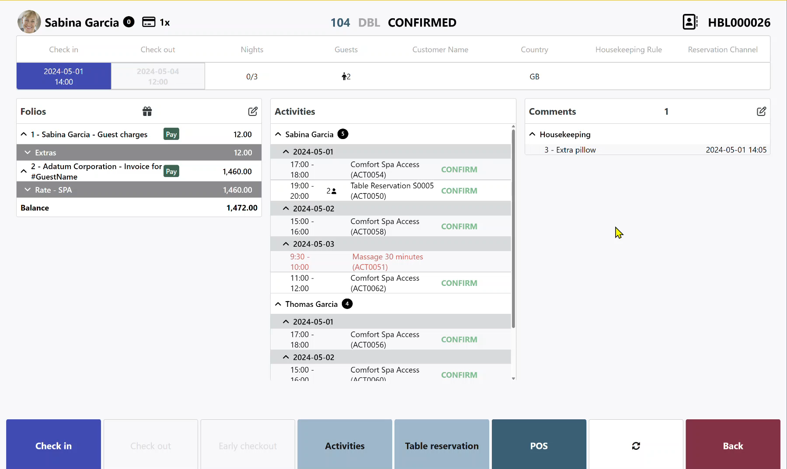
Financial Management – Tokens
Token support* (Card on file)
  Working with LS Pay
  Depends on Payment Service Provider
View number of tokens
  Reservation page in BO
  Reservation page on POS
Capture token on POS and store for member
  POS Command:
  ADDCARDTOFILE
  TIP: Can use POS POST Command: POST
Use card on file as payment method
  POS Command:
  CARDONFILE
  If multiple cards, then user is prompted for which card to use

Slide 17
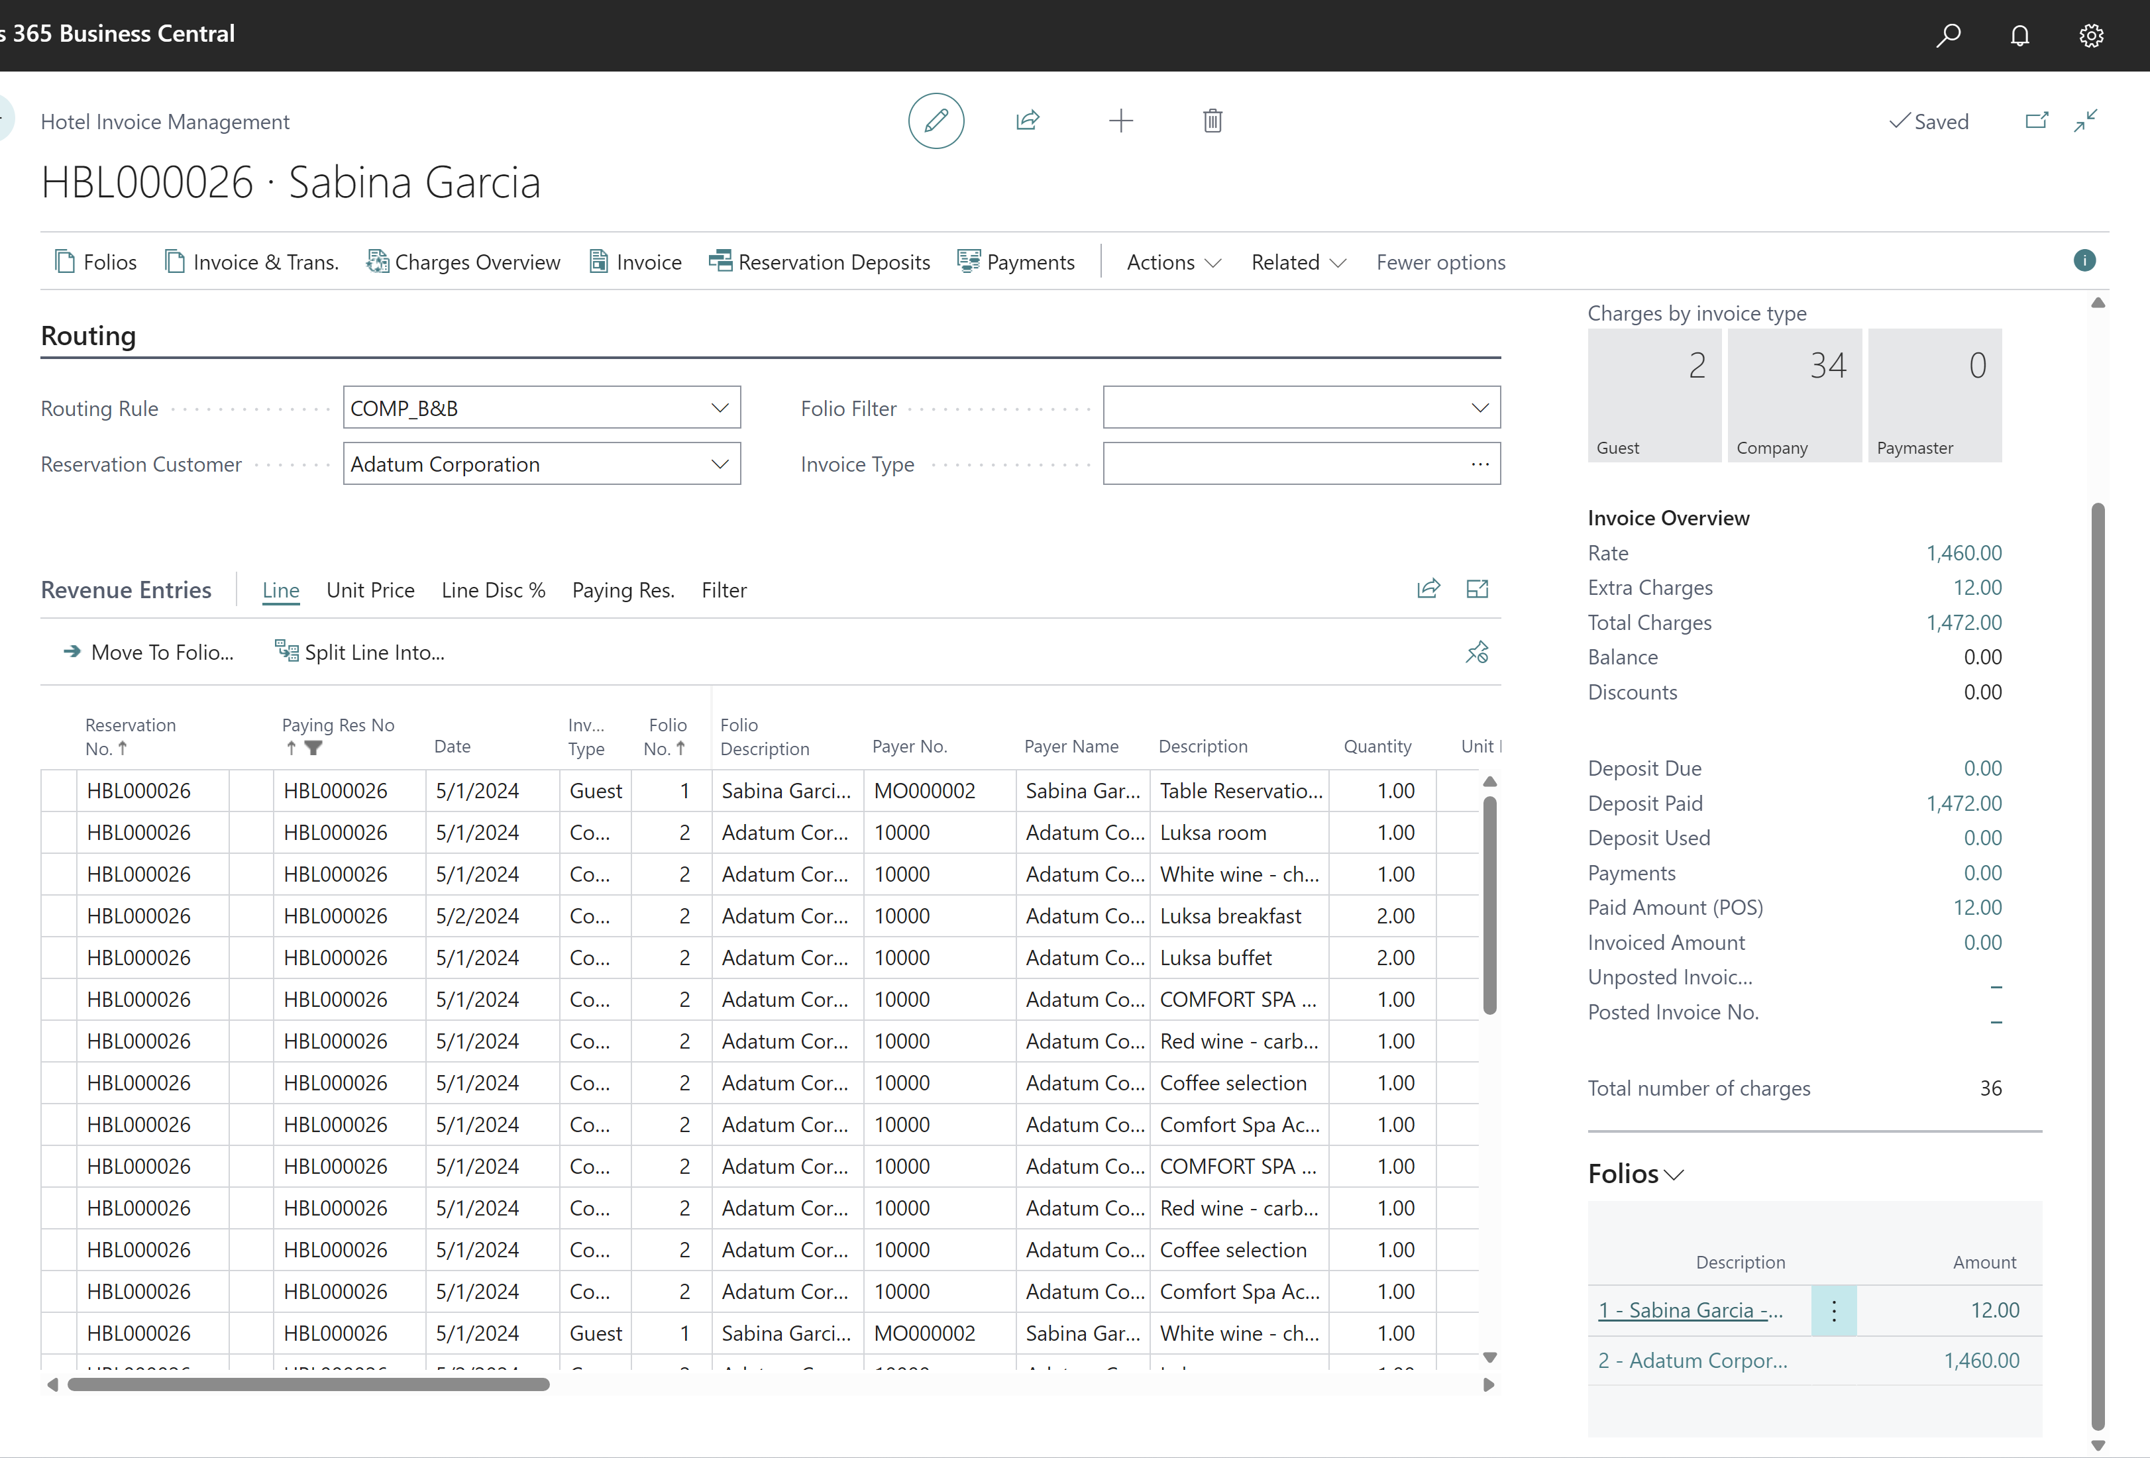
Financial Management – Folios
Filter on Invoice Type
  Easier to navigate and work with DRE lines
Folio overview in fact box
  New list part
Filter on Invoice Type
Folio Overview

Slide 18
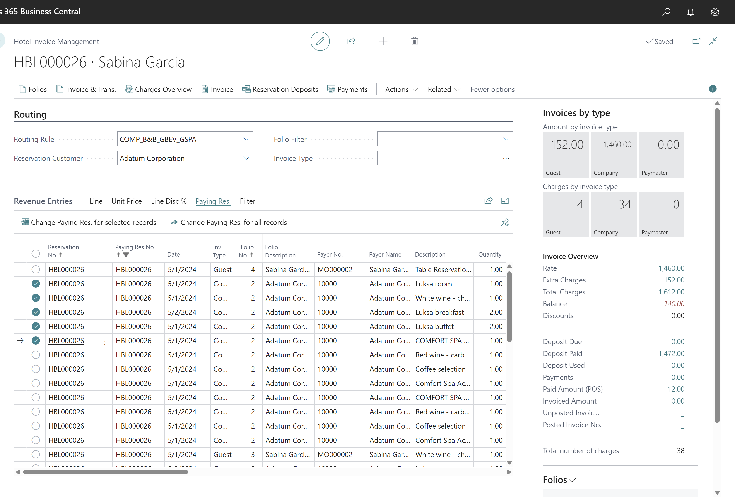
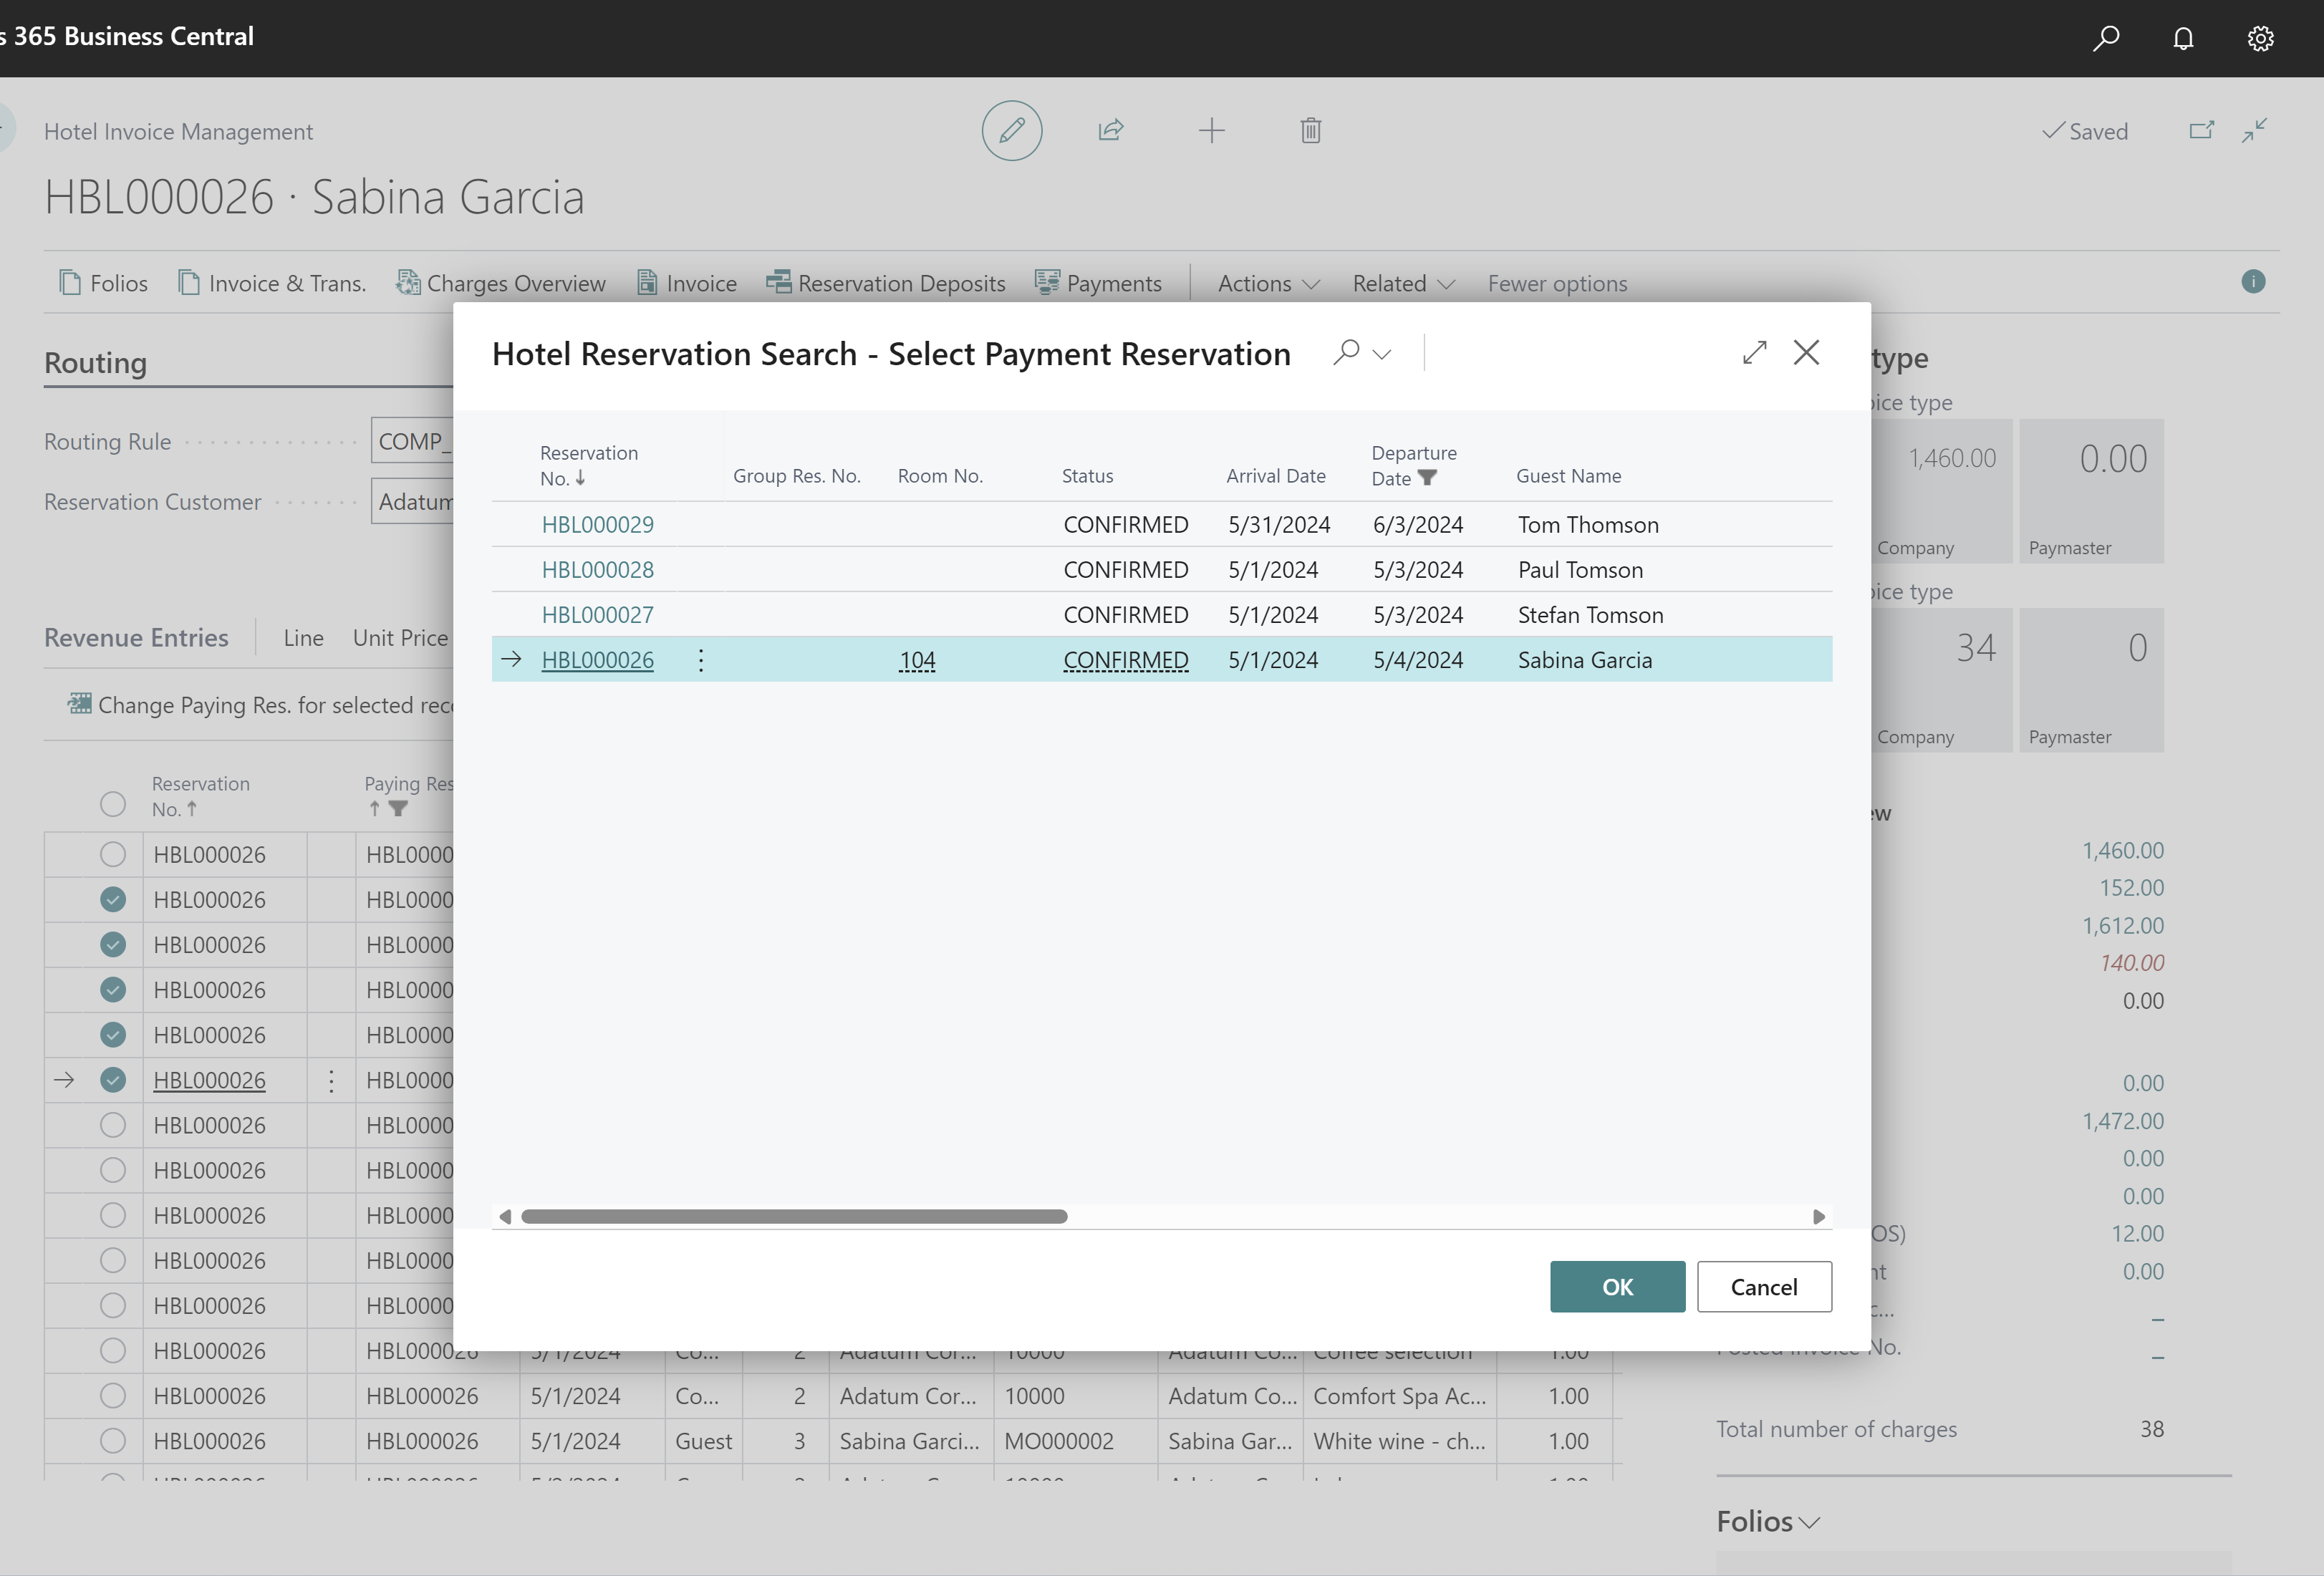
Financial Management – Paying Res
Paying Res
  Change paying res for selected records
  Change paying res for all records
Change paying res

Slide 19
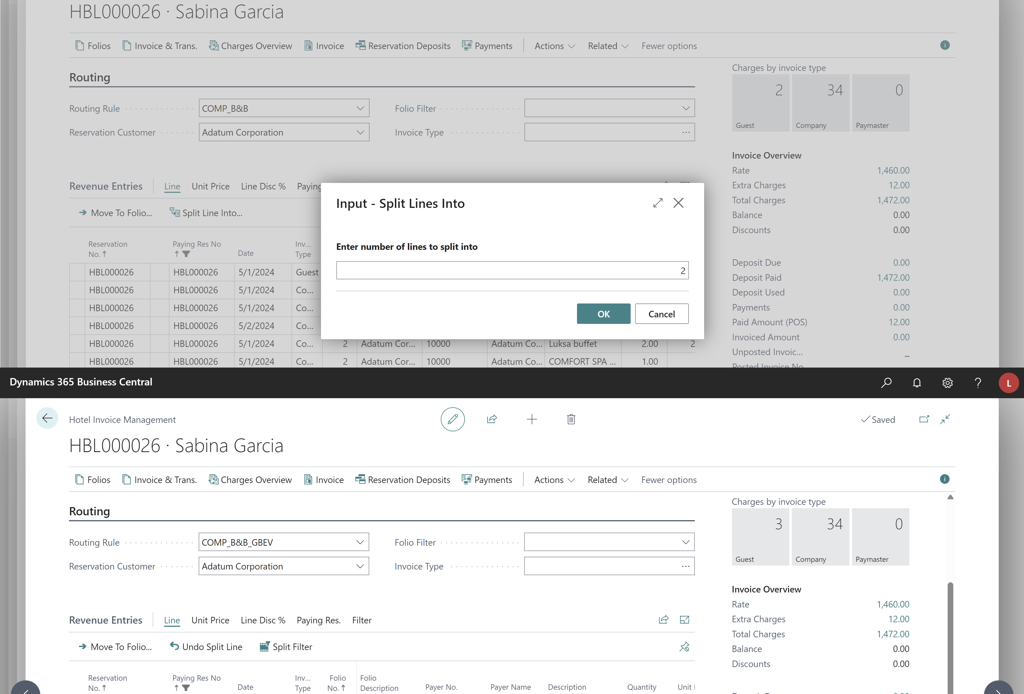
Financial Management – Split lines
Split Lines
  Split Invoice Management line in N parts
  Undo split line
  Filter on split lines
Split a line into N parts
Undo a split
Filter on split lines

Slide 20
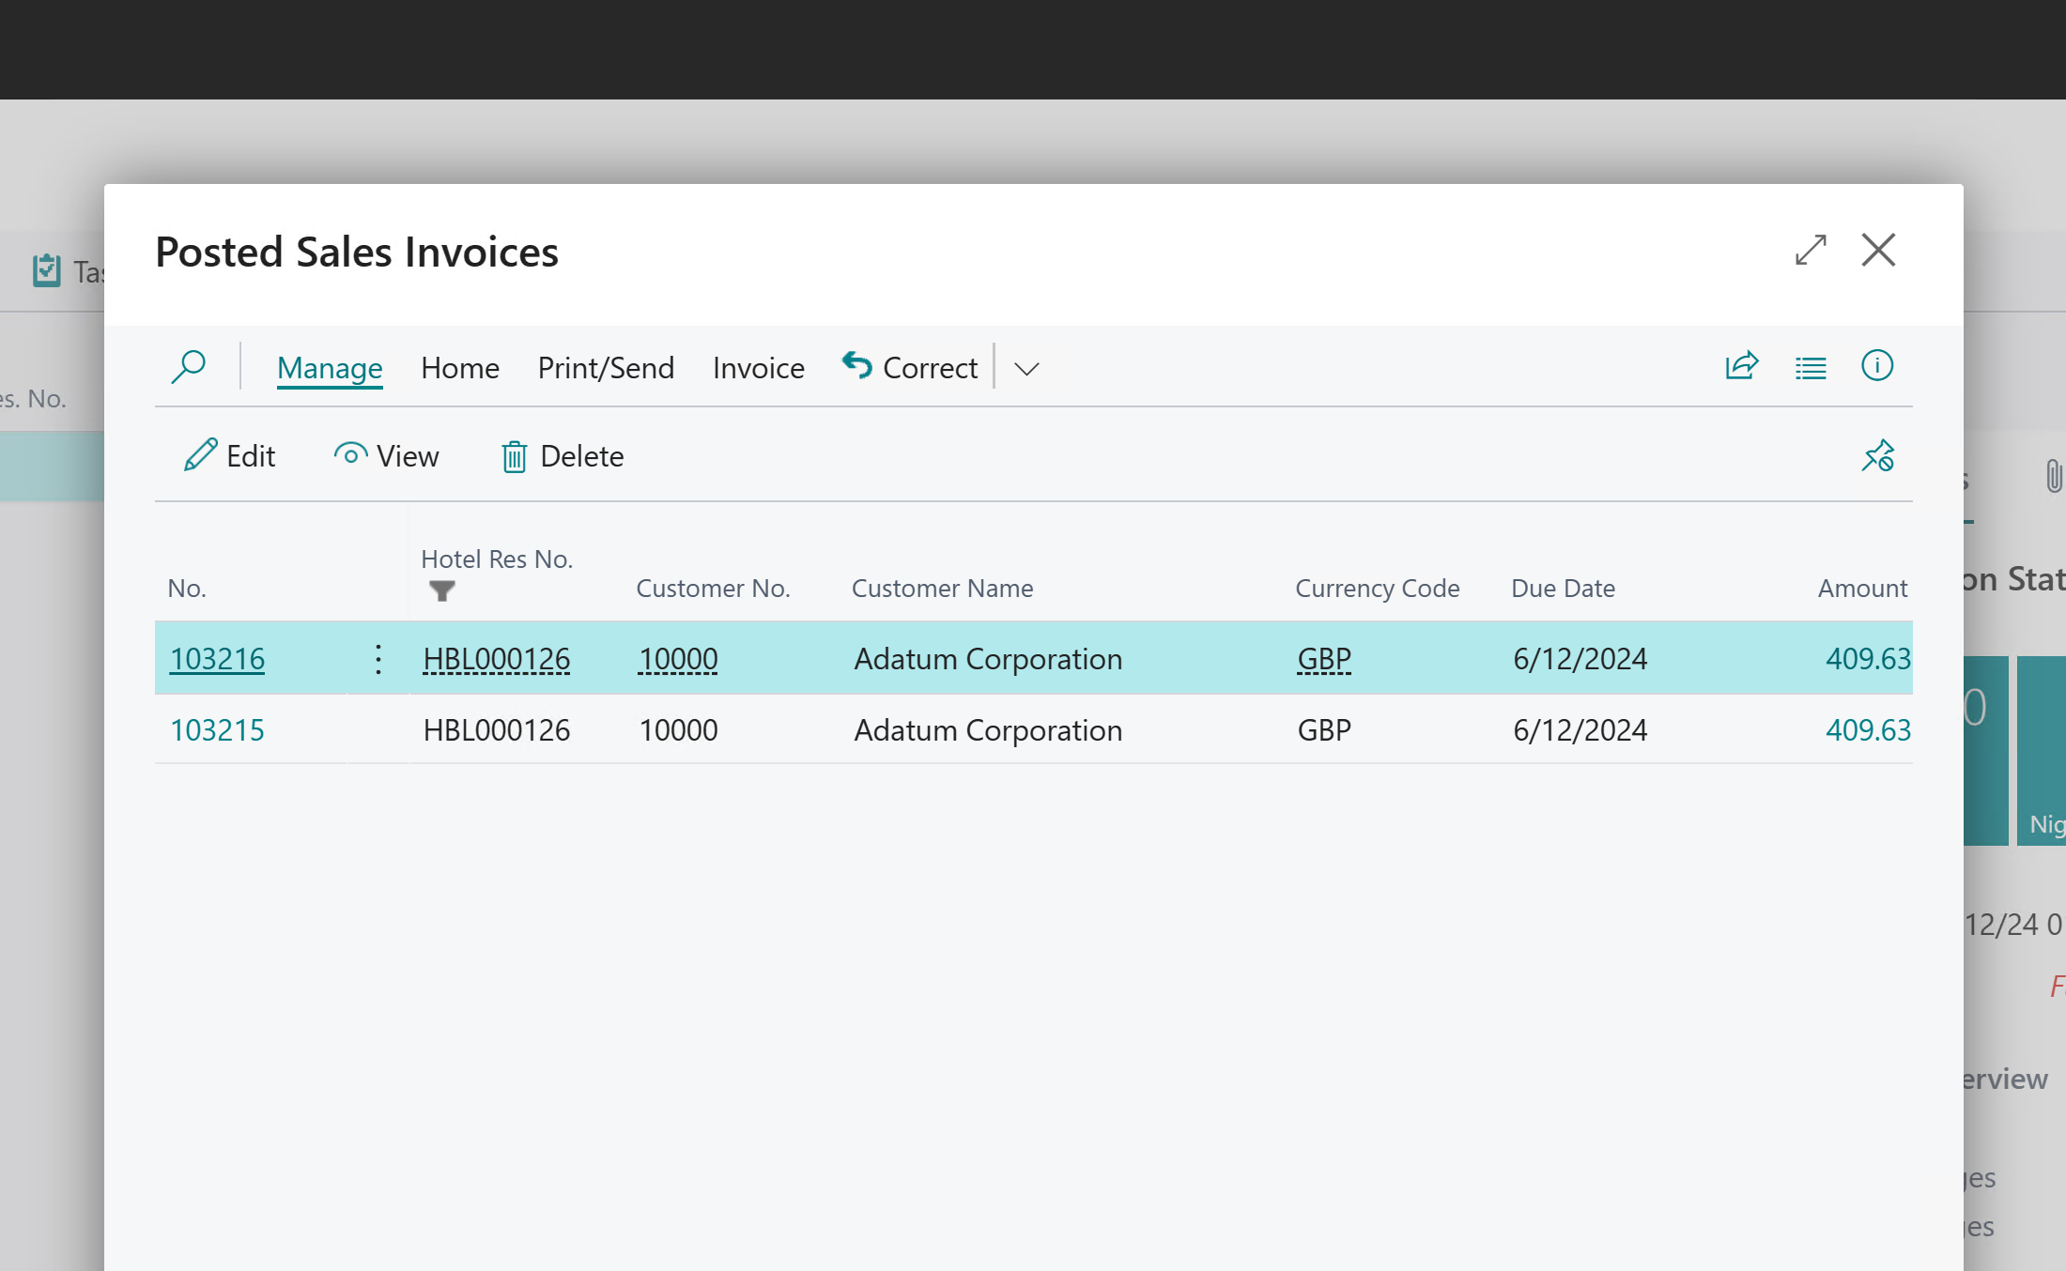
Financial Management – Changes when posted
Void and Copy on POS
Creates a credit line and new lines on folio in Detailed Revenue Entry in BO
Correct Sales Invoice
Creates a credit invoice line and new lines on folio

Slide 21
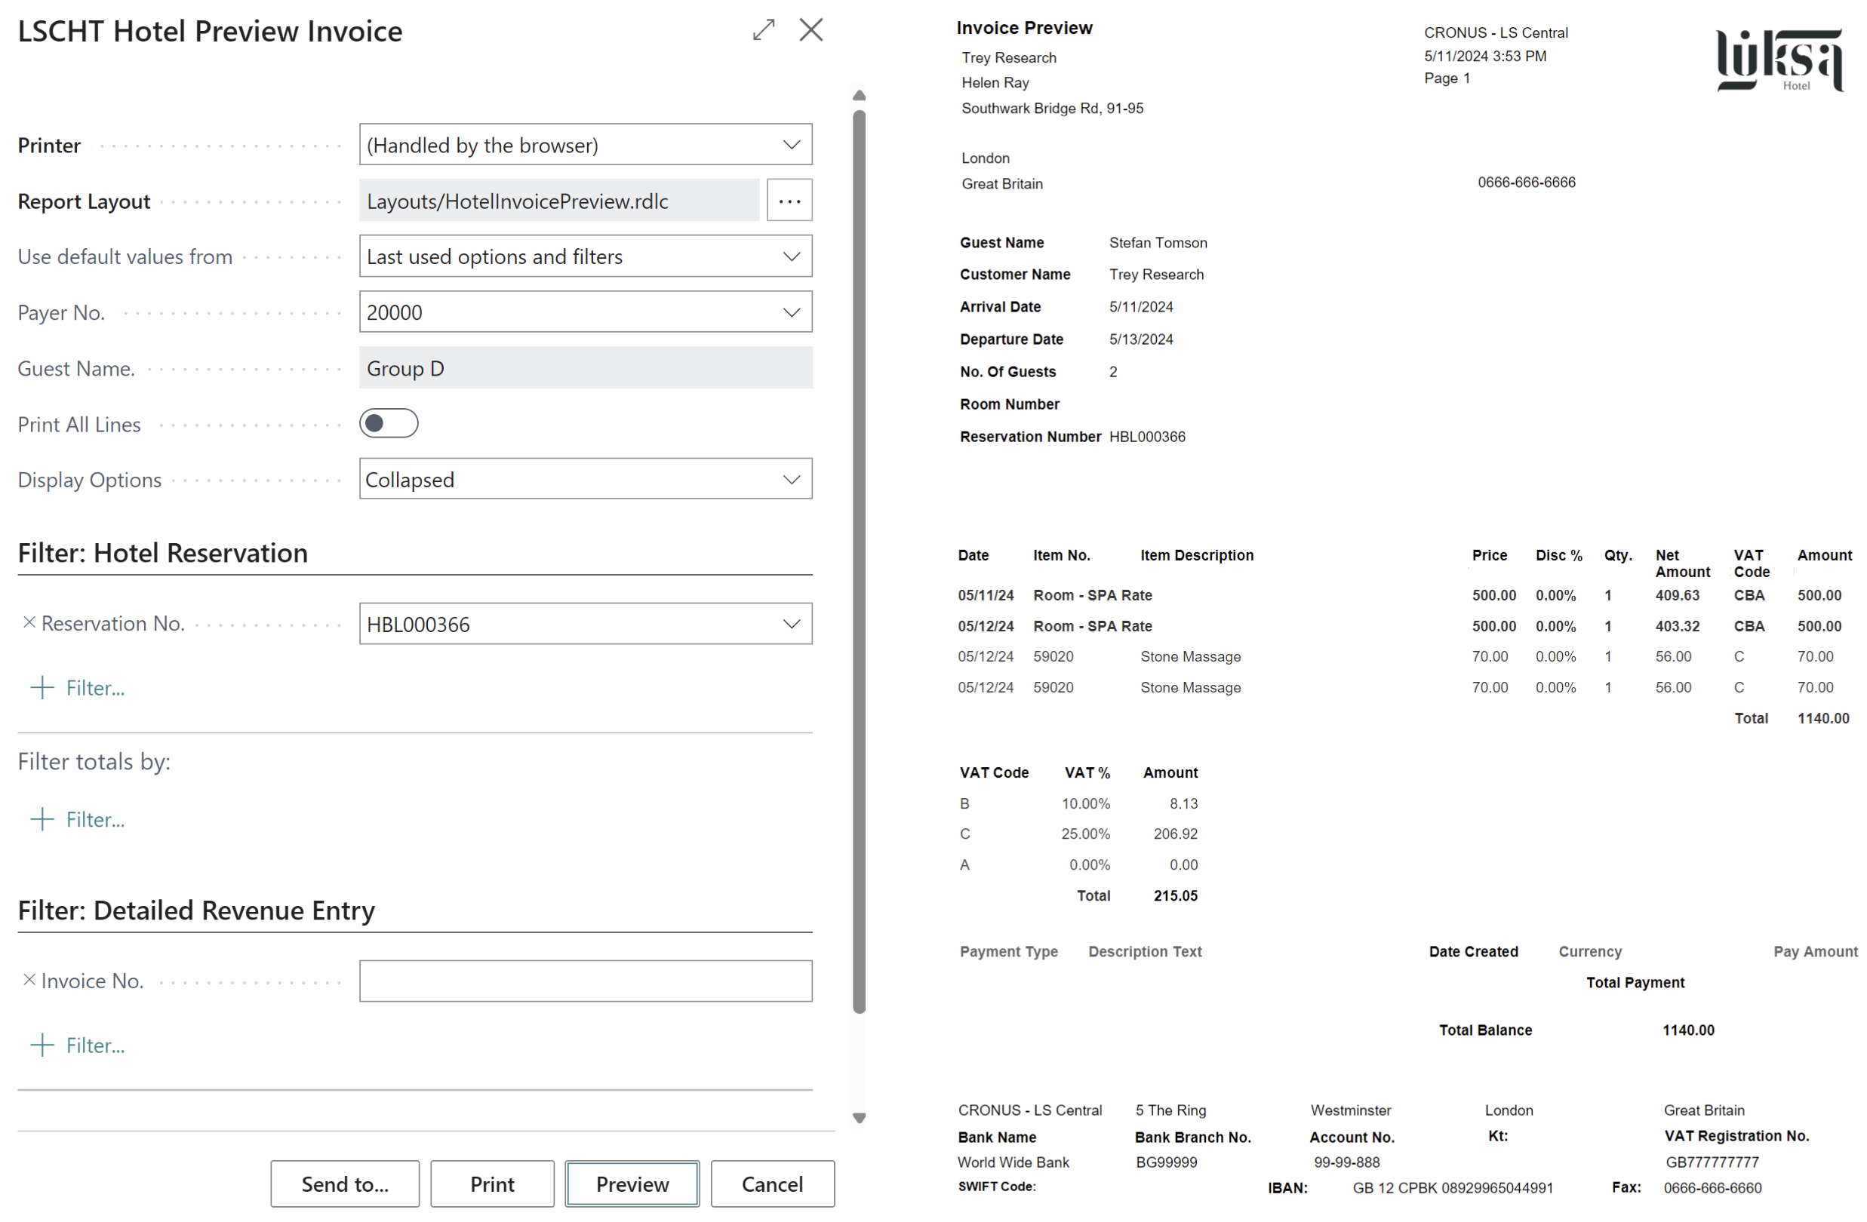
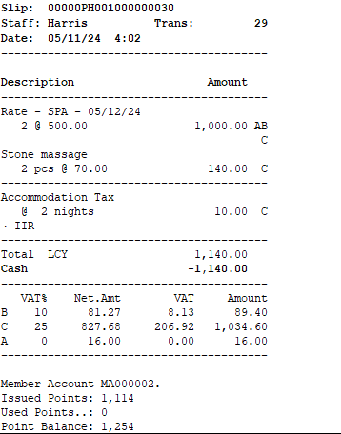
Financial Management – Sales invoices and receipts
Option on printing
  Both for POS and Sales Invoice
  Only header lines -> will only print a line for each night for the rate
  Lines with details -> will print header line and show what is included in the rate or package
Collapsed or Detailed

Slide 22
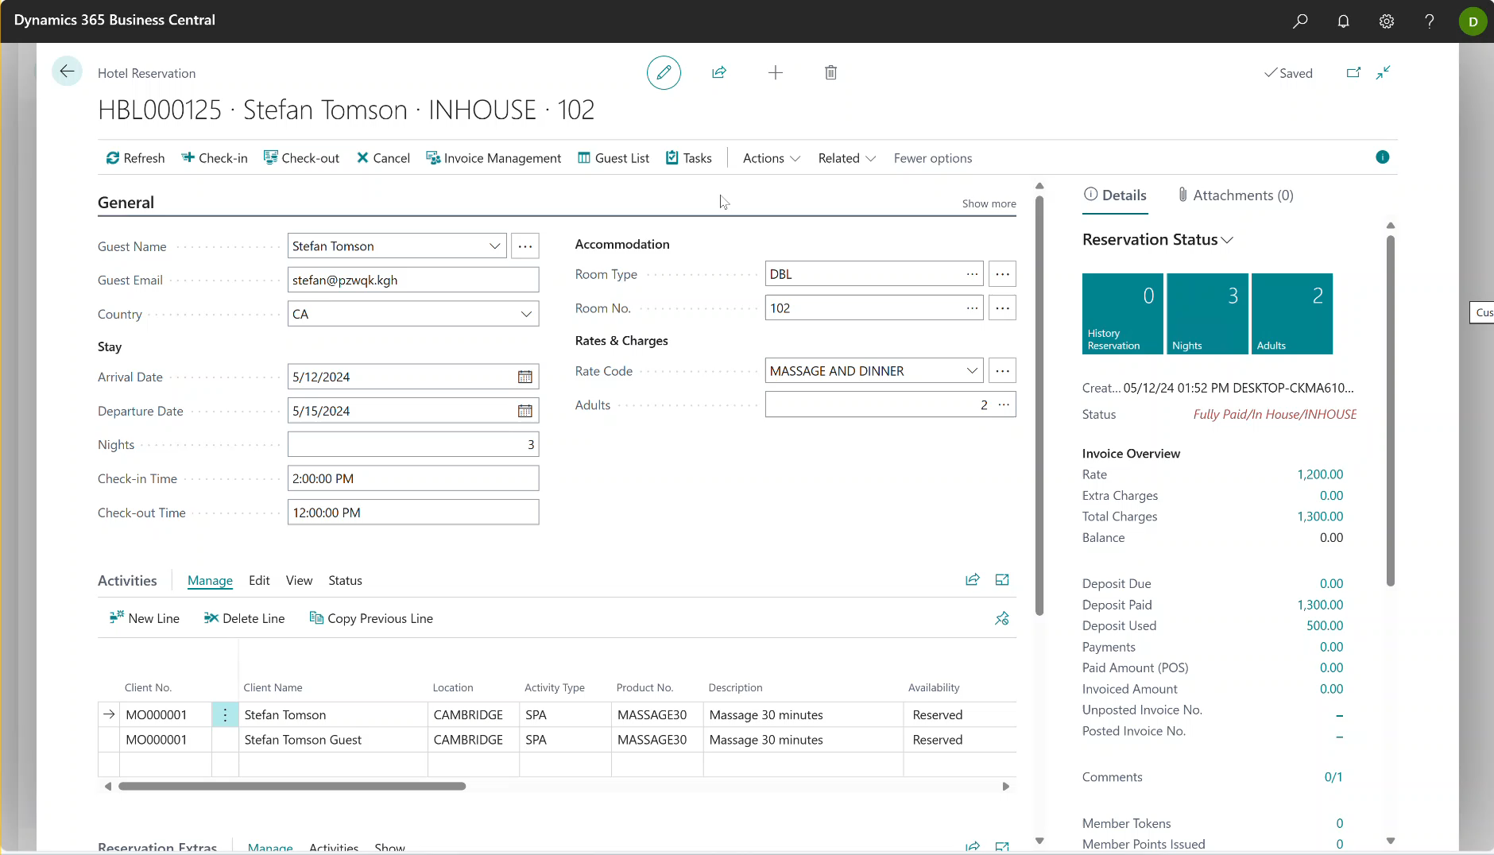
Financial Management – G/L entries
Enhanced tracking for night audit
G/L entries are tagged with reservation and folio number
View detail trial balance for reservation

Slide 23
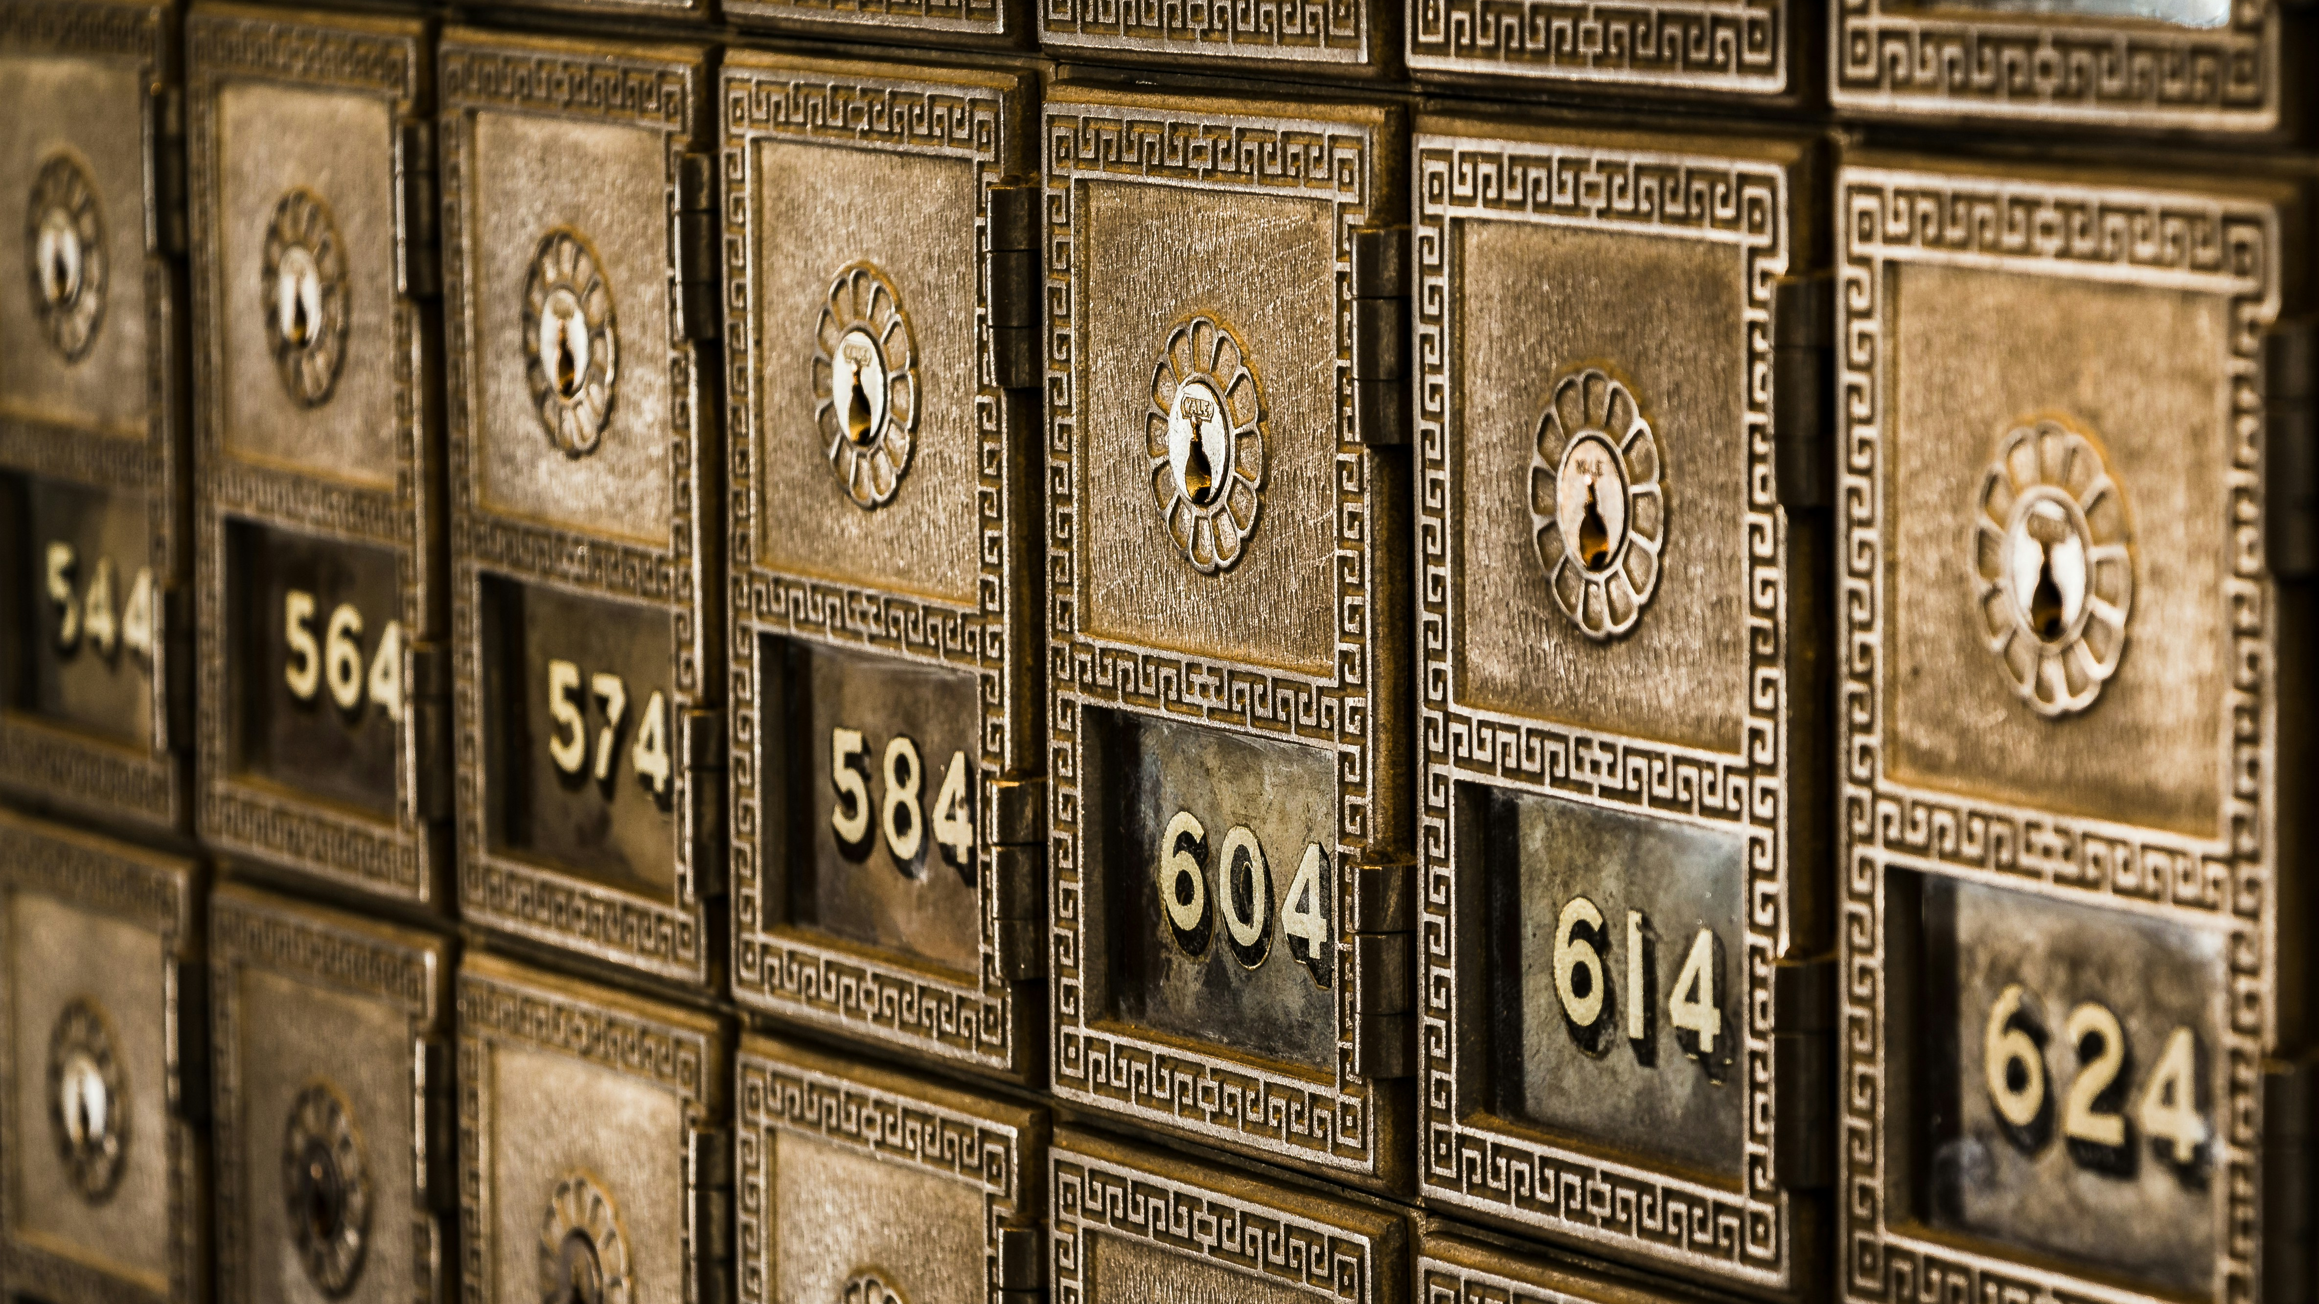
Deposit Management

Slide 24
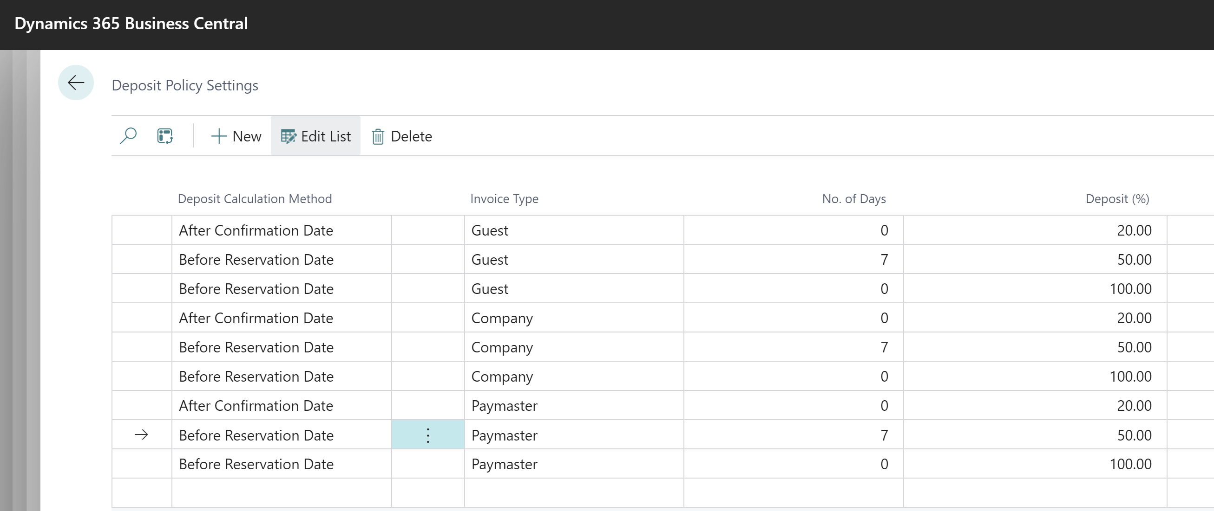
Deposit Management
Deposit policy
  Enhanced line validation
  Deposit Due Calculation page – simulates how deposit due lines are calculated and added

Slide 25
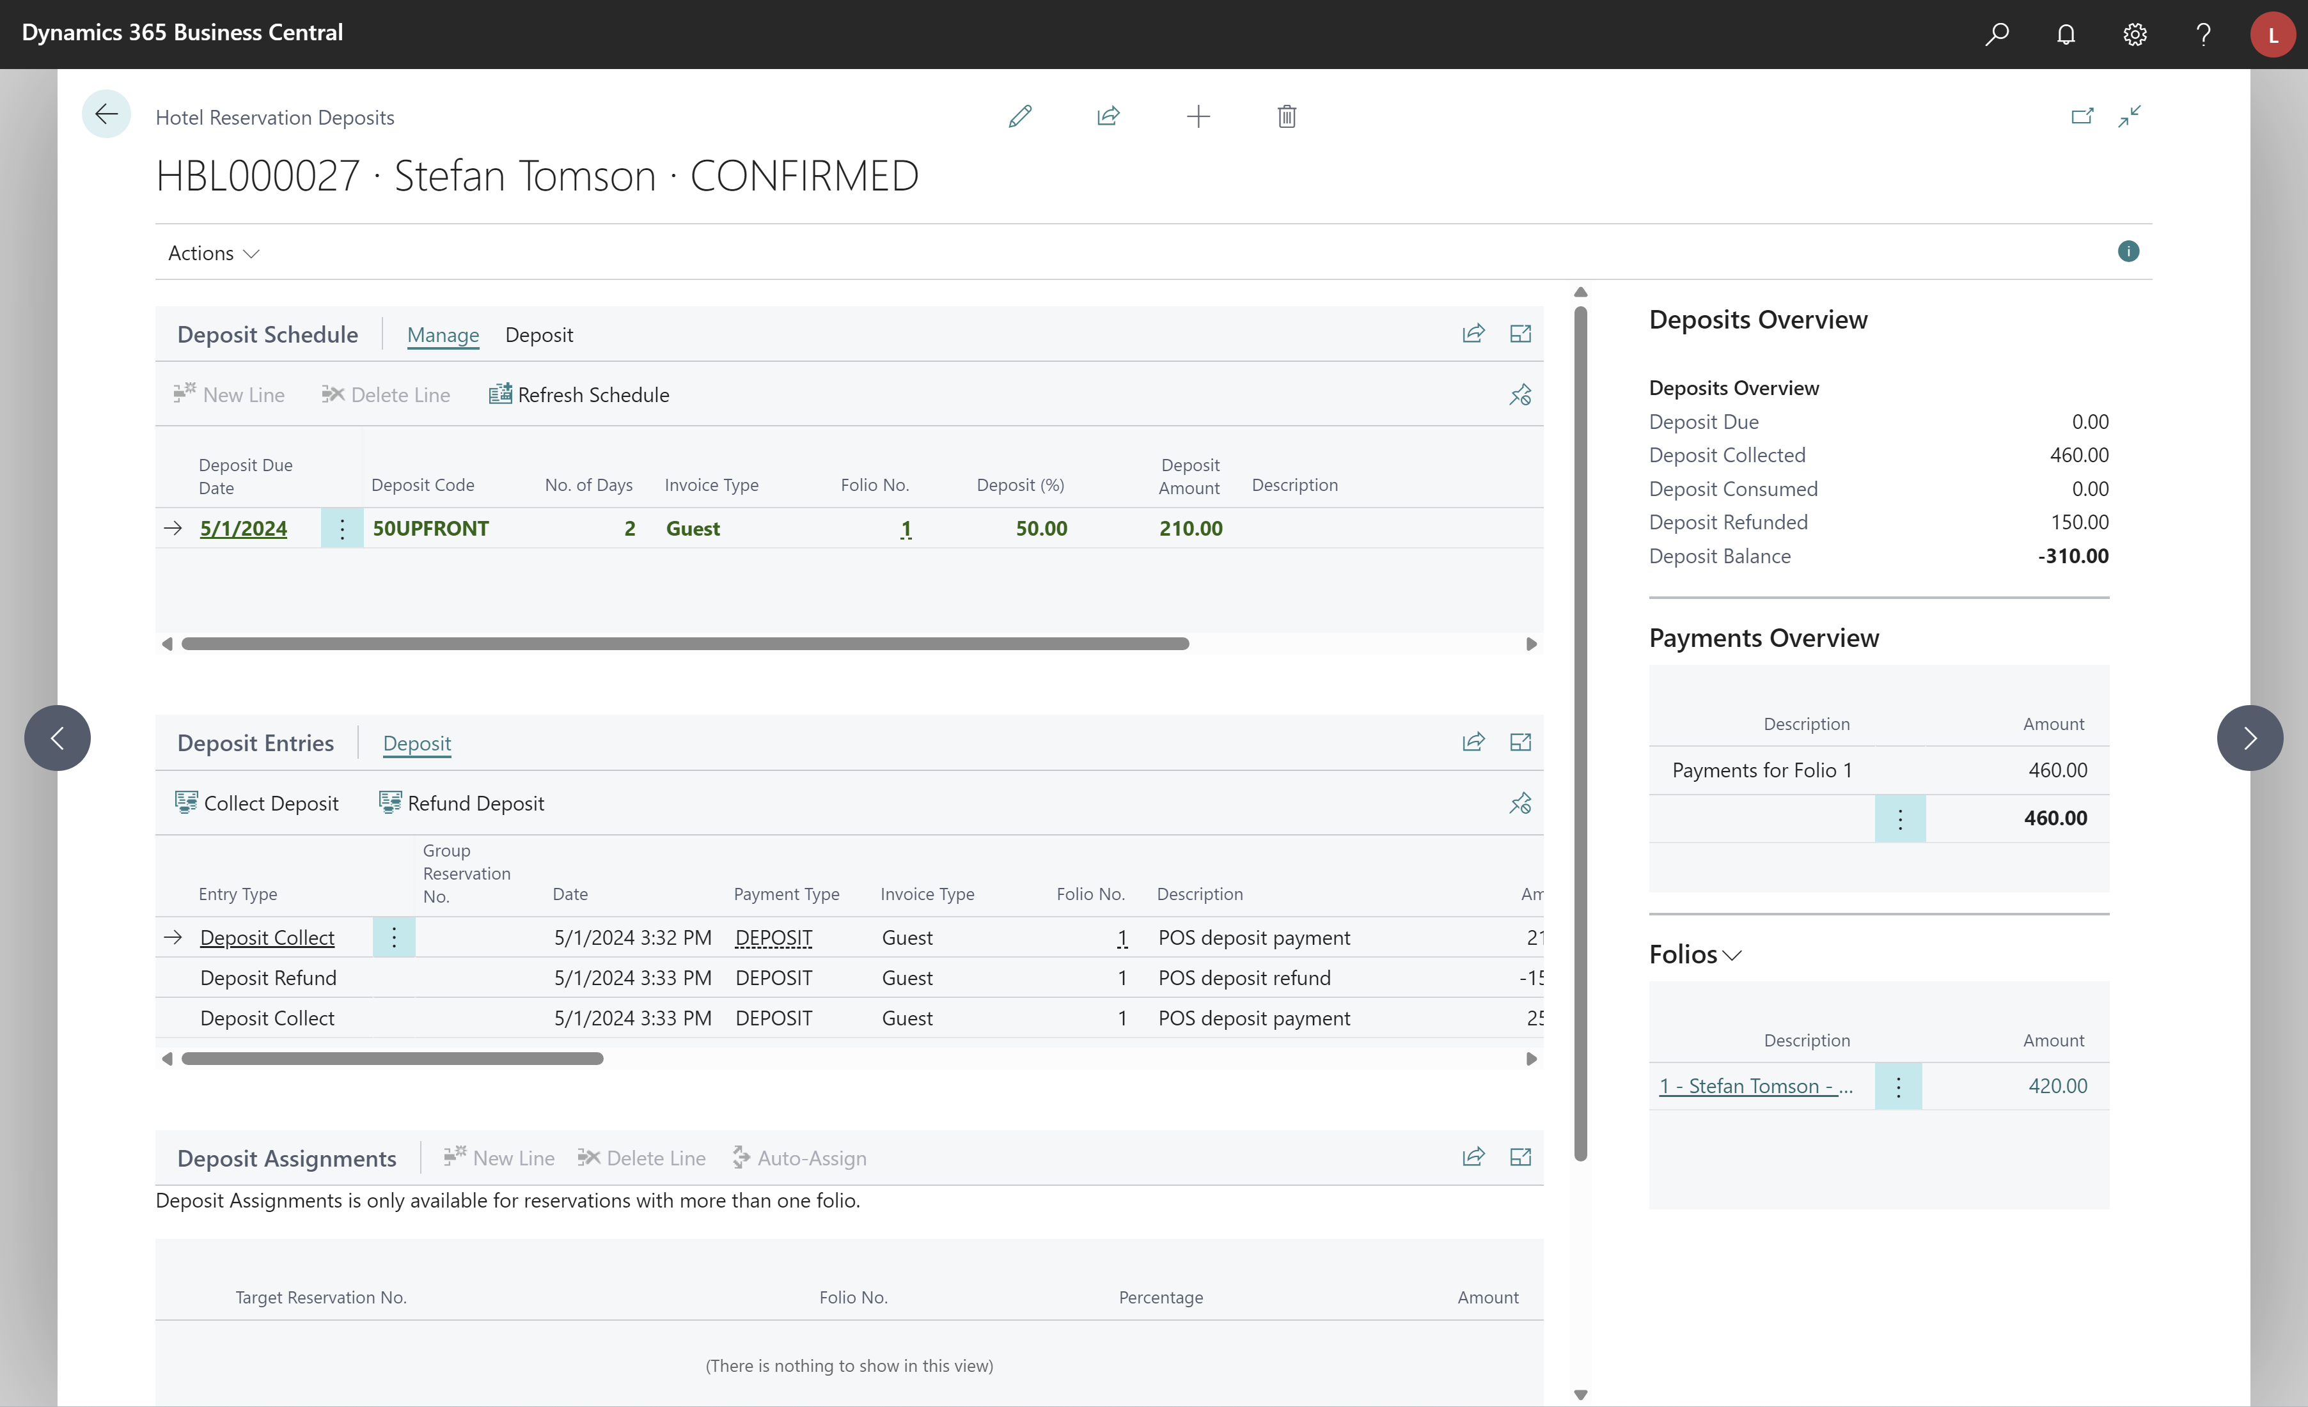
Deposit Management
Deposit Overview Page
  One page to show all deposit entries related to reservation
Deposit Schedule
  Collect deposit for a deposit schedule line
  Deposit schedule calculation details
Deposit Entries
  View all deposit entries in one place
  Collect or refund a deposit
Deposit Assignments
  Assign a deposit amounts to different folios
Deposits Overview
  View deposit amounts and balance

Slide 26
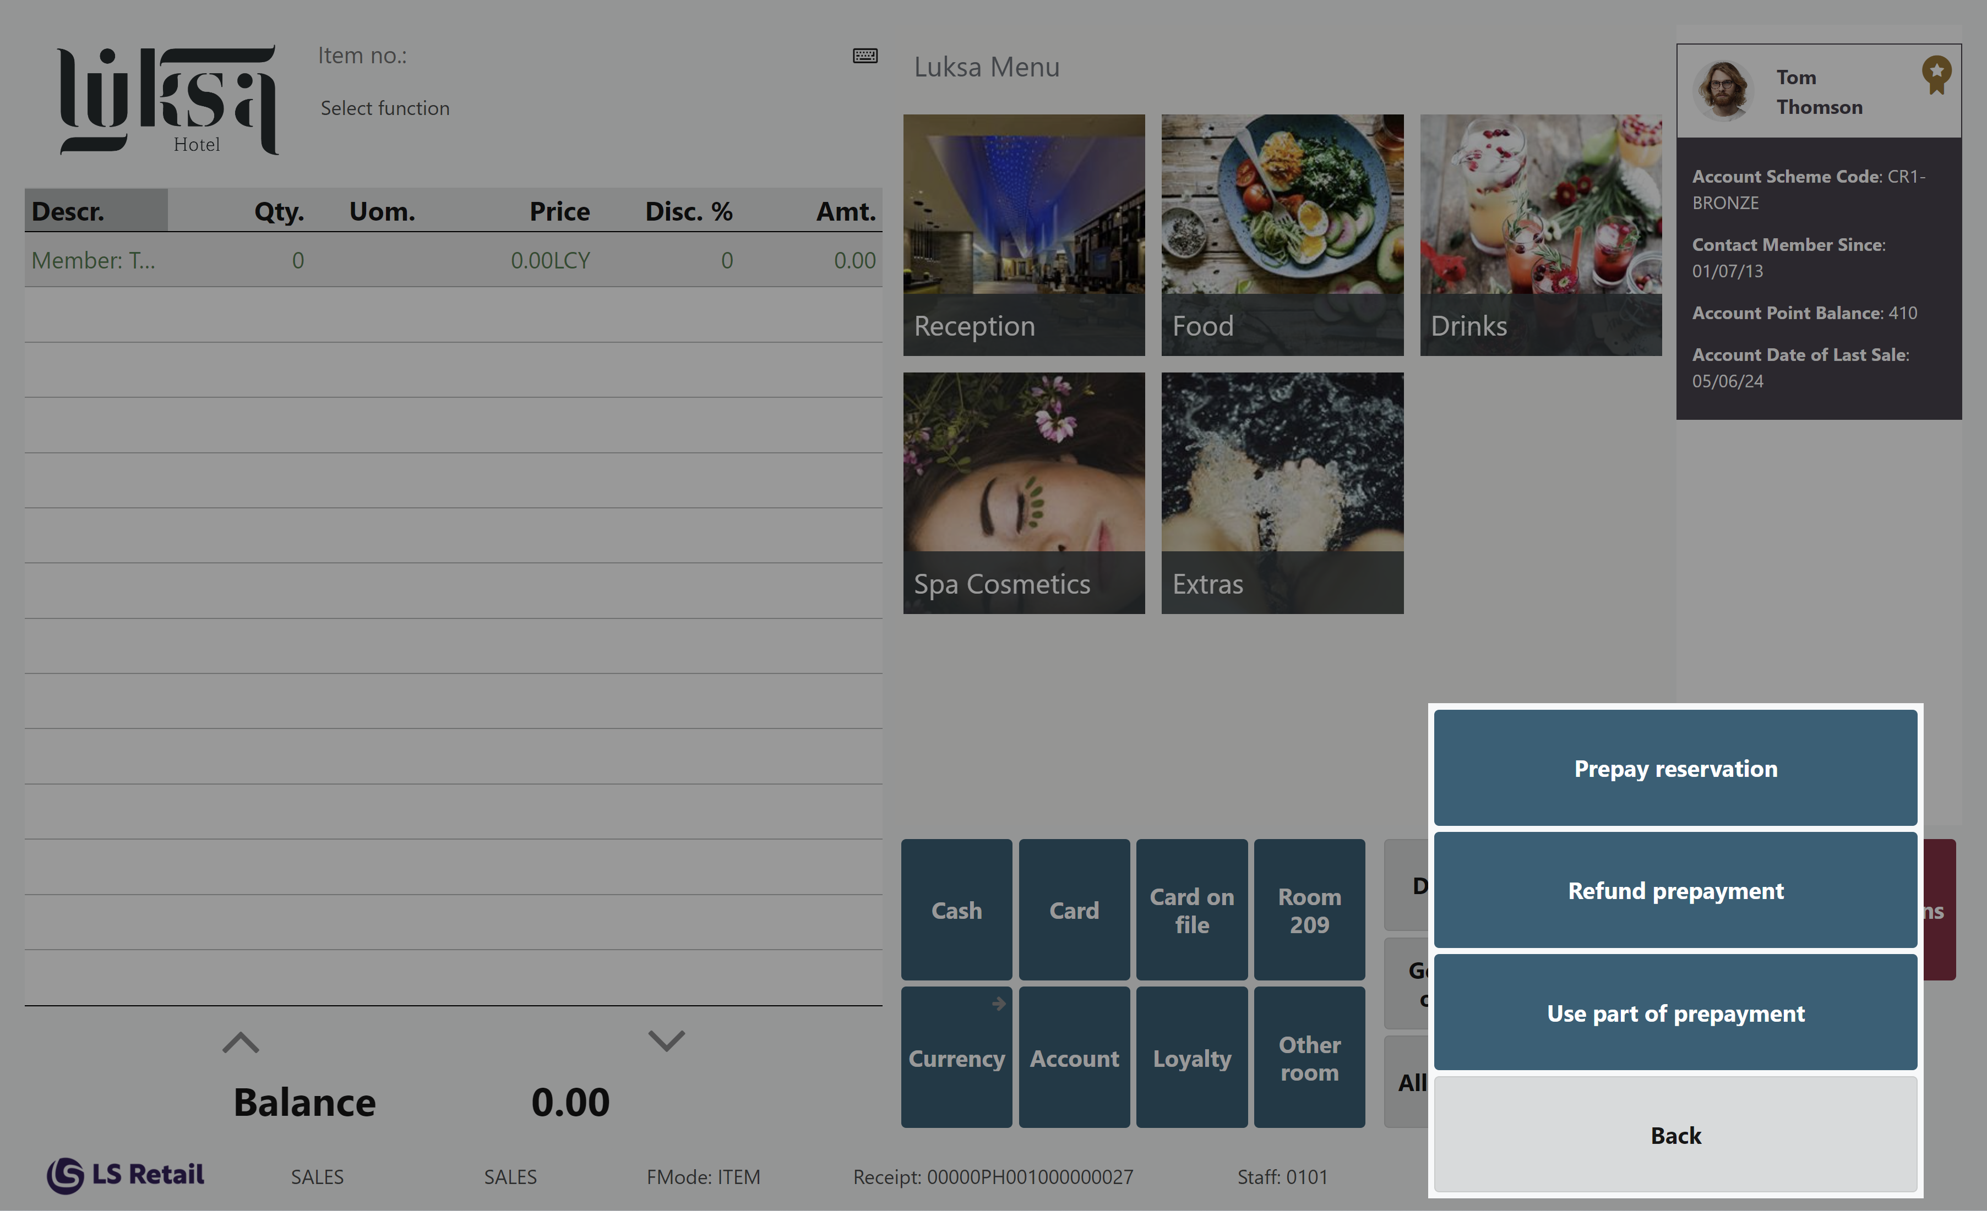
Deposit Management
Deposit on POS
Add more deposit to the reservation
  POS command: HOTELPREPAYRES
Return all or part of already prepaid deposit on the reservation
  POS command: HOTELRETDEPOSIT
Use all or part of already prepaid deposit as payment on reservation
  POS command: HOTELCONSDEPOSIT

Slide 27

General usability

Slide 28
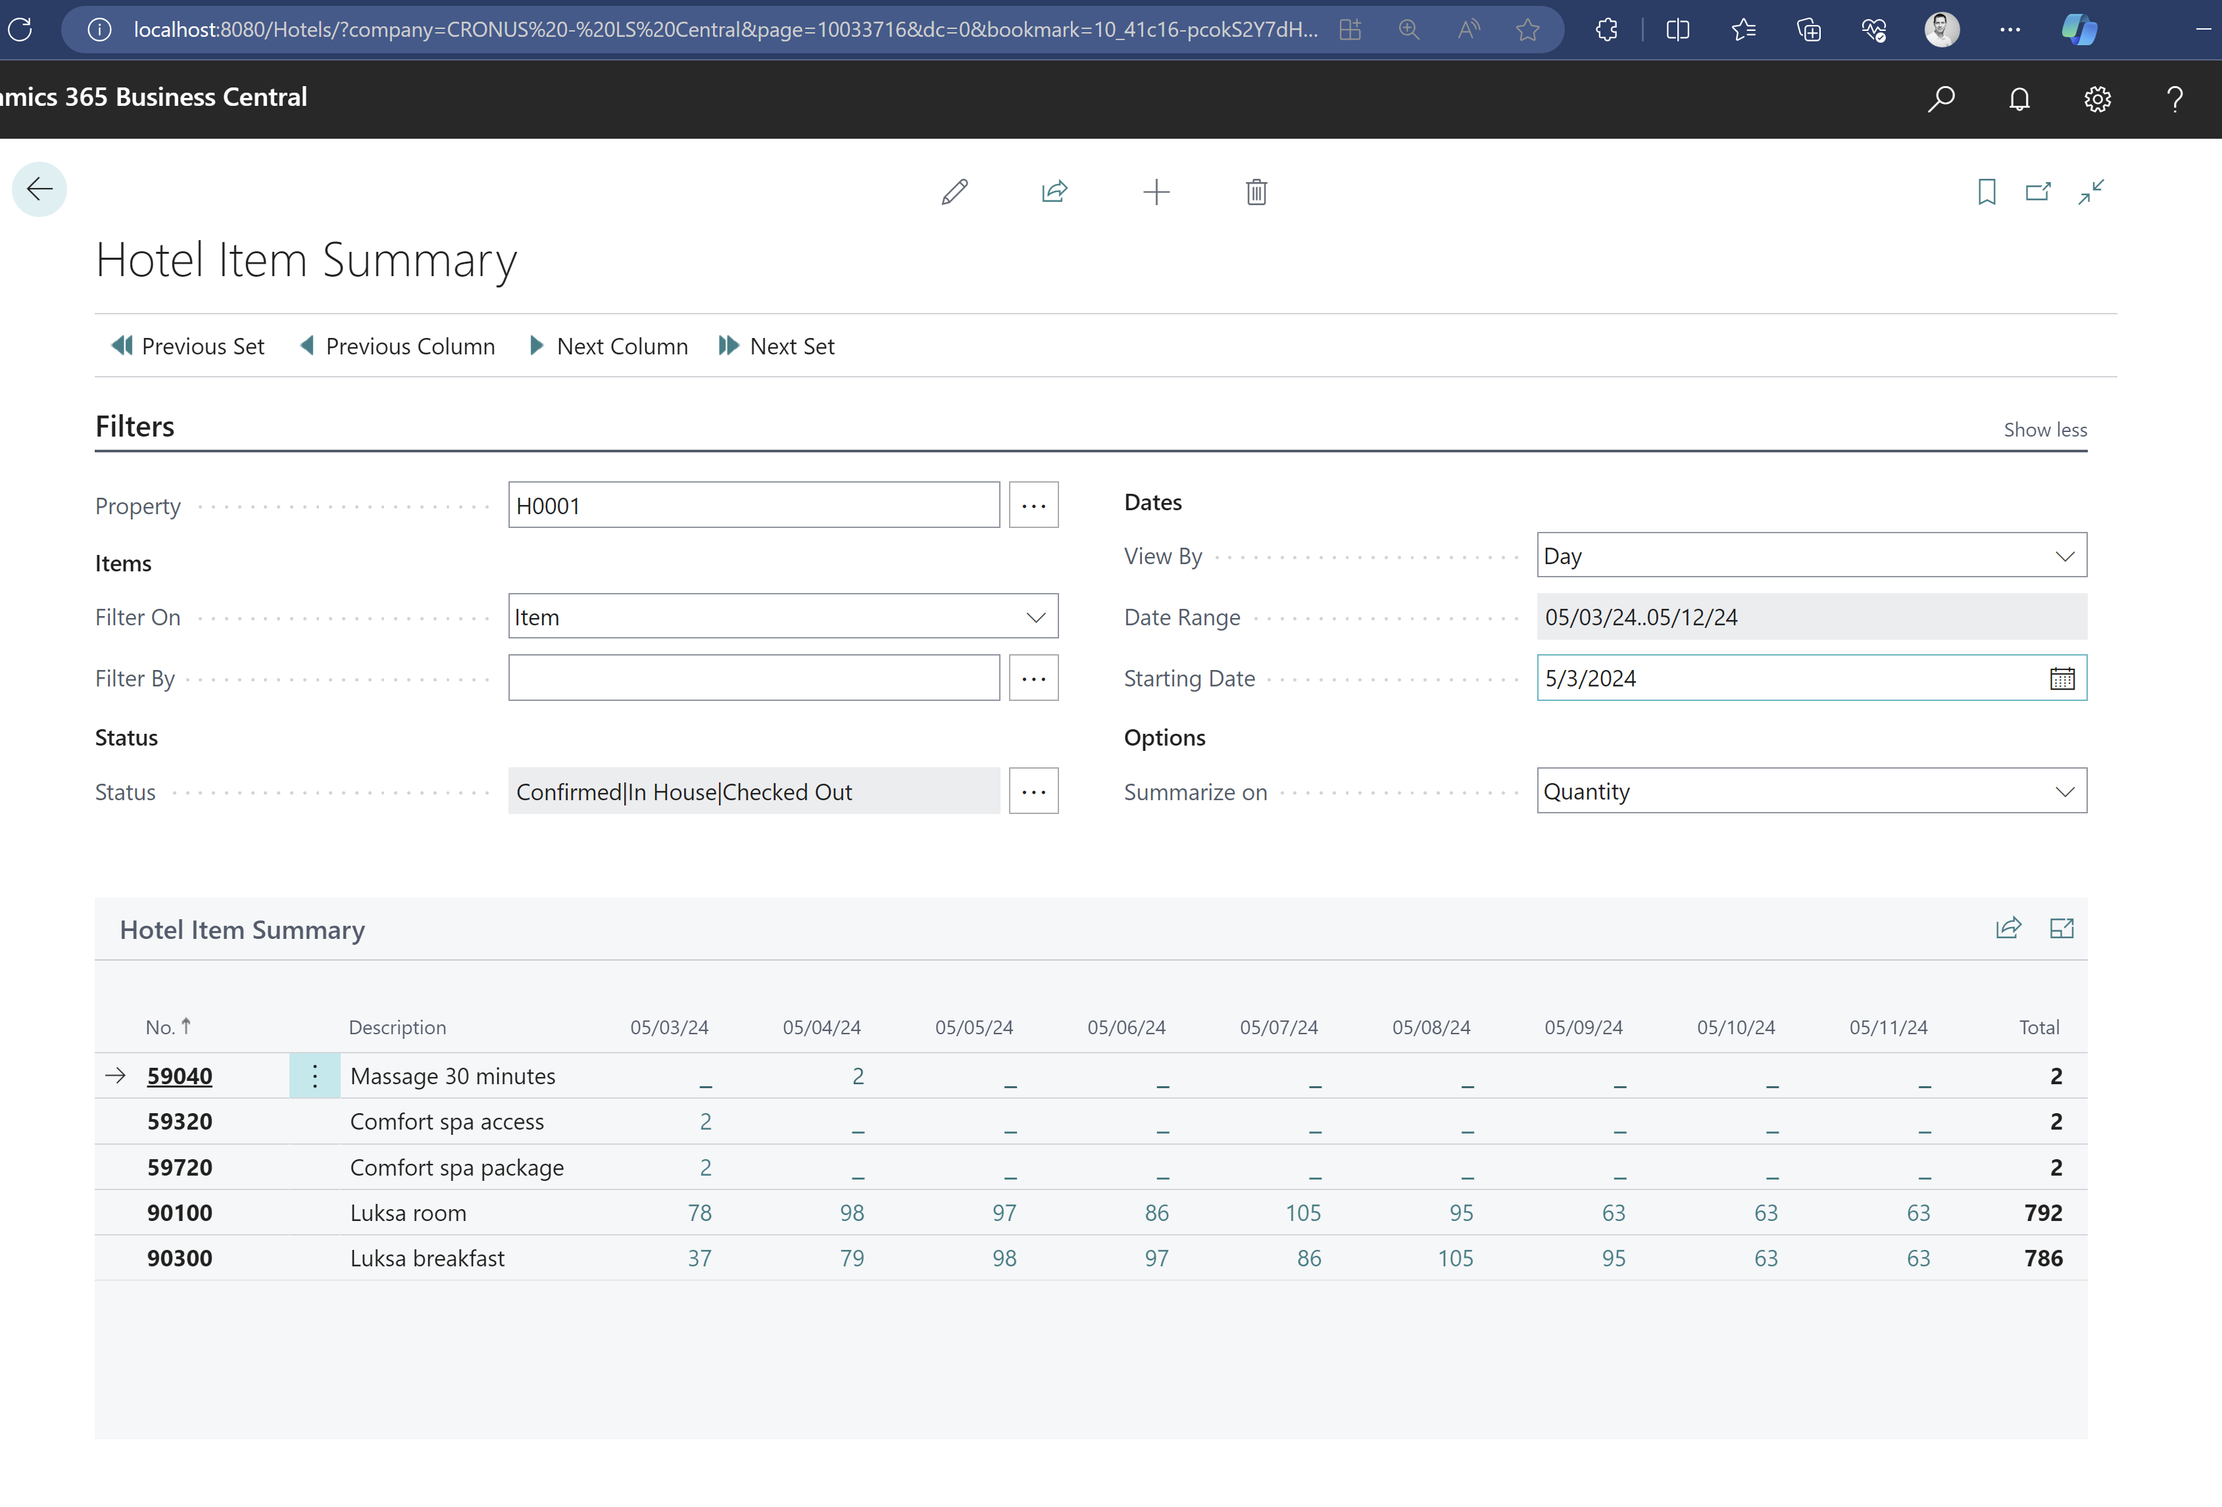
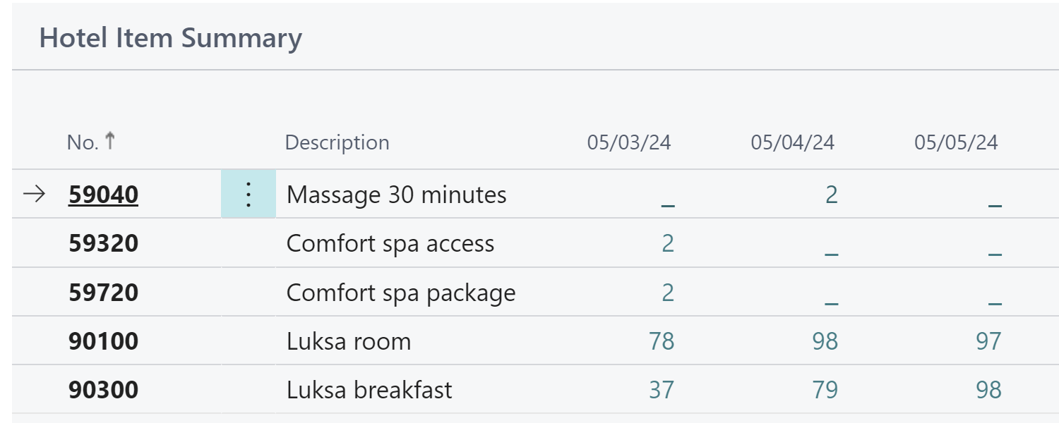
General usability - Item Summary
Item Summary Page
  Shows expected consumption of items for next 9 days
  Can filter on items, special groups, item categories or product groups
  Convenient to track how many breakfasts are scheduled (or any other item)

Slide 29
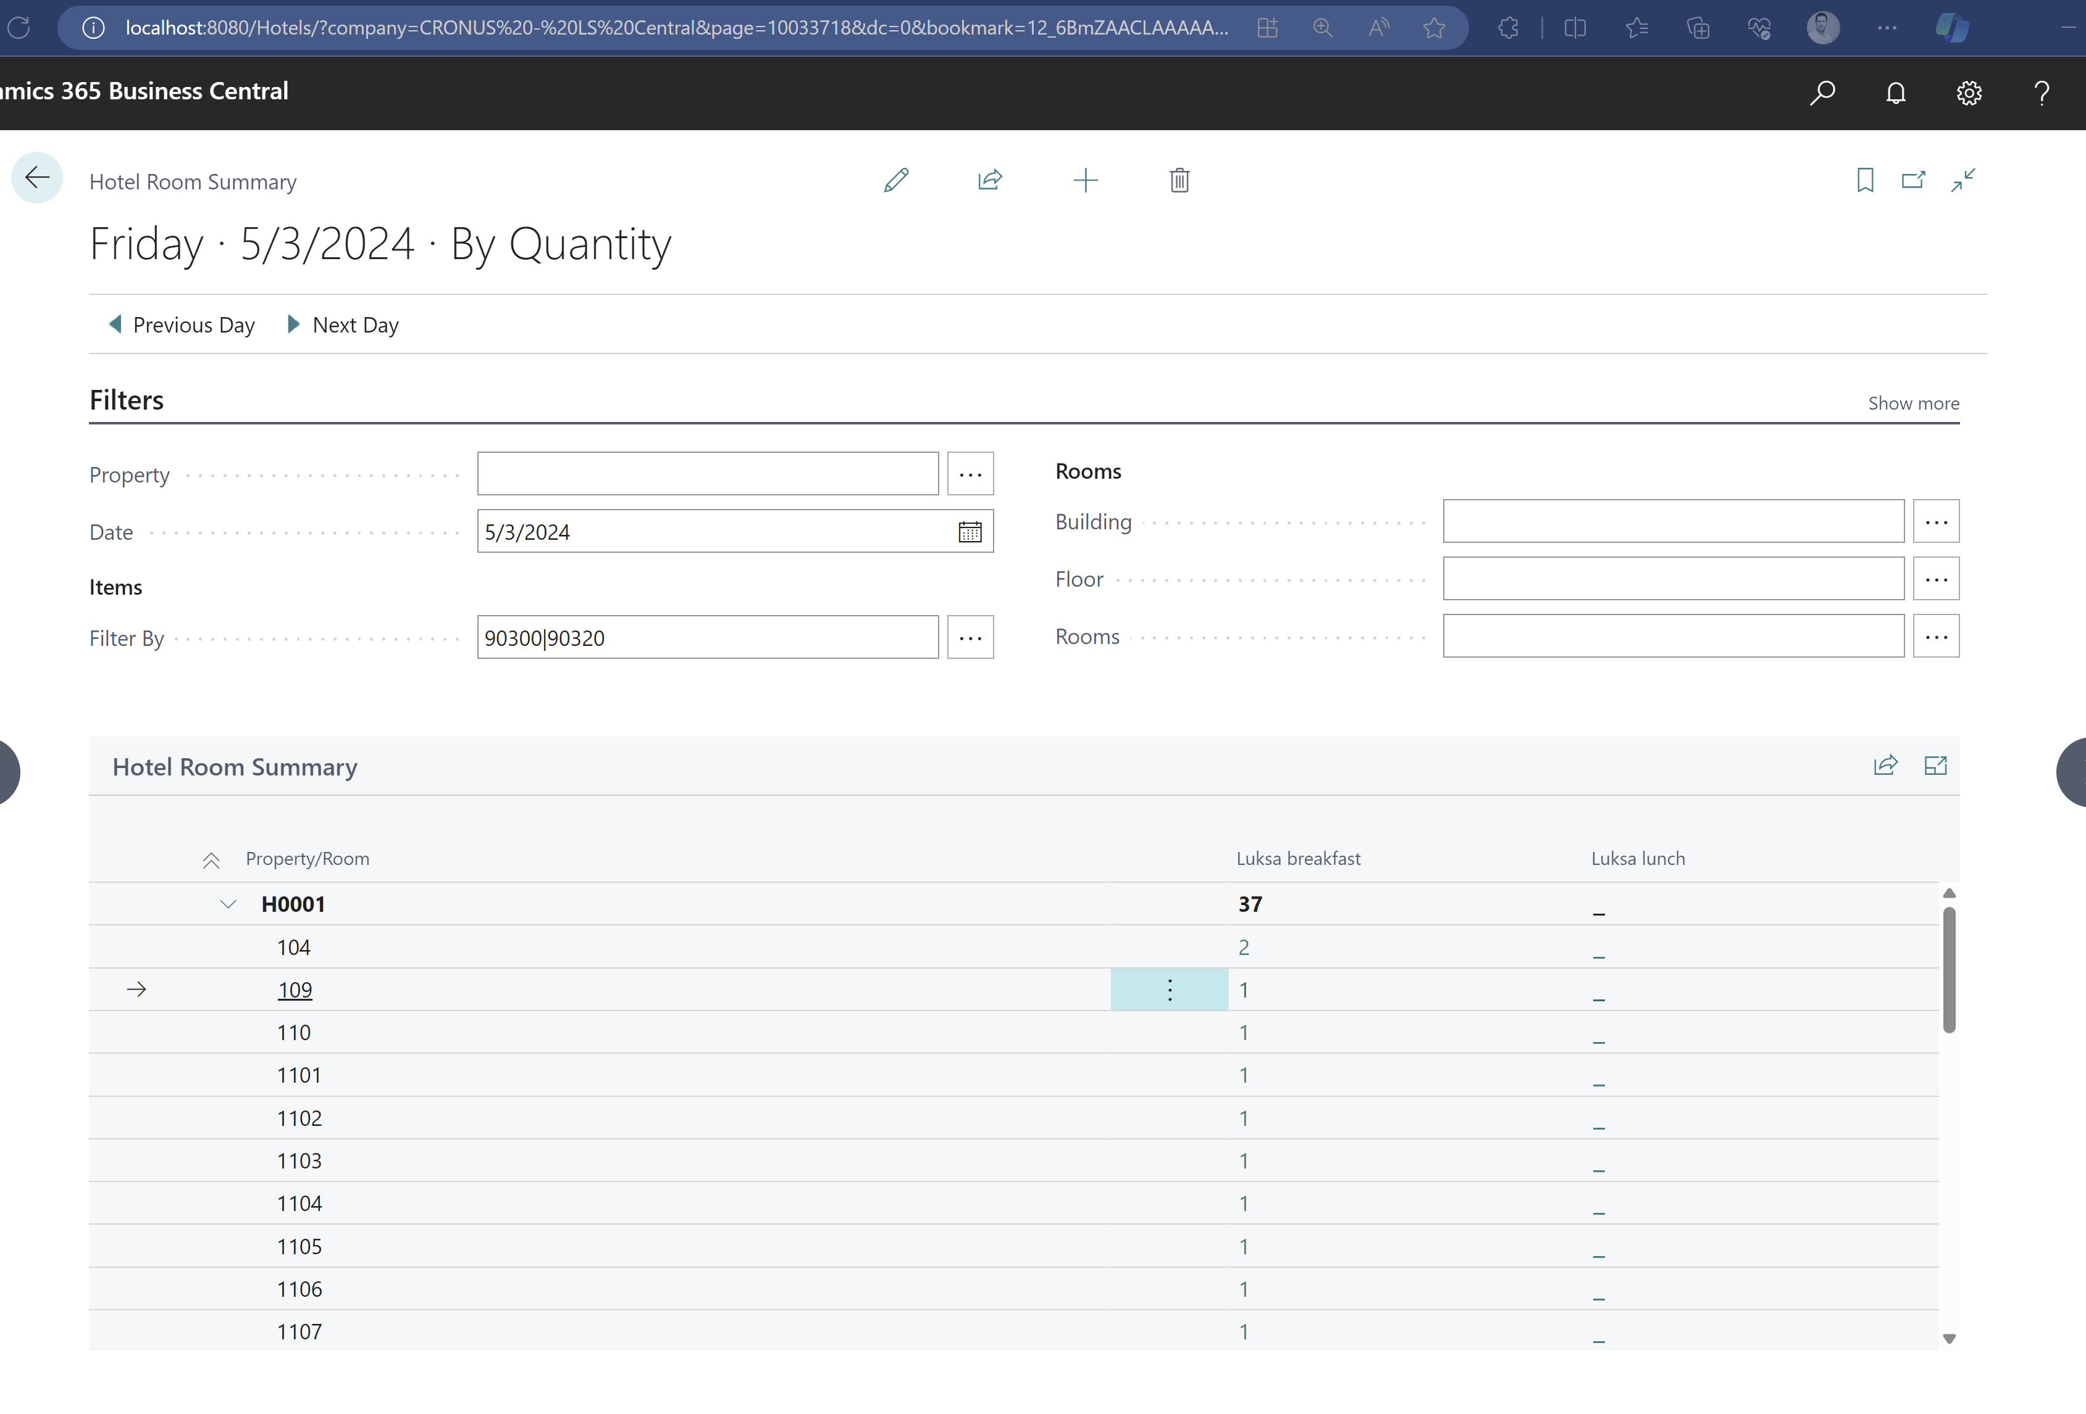
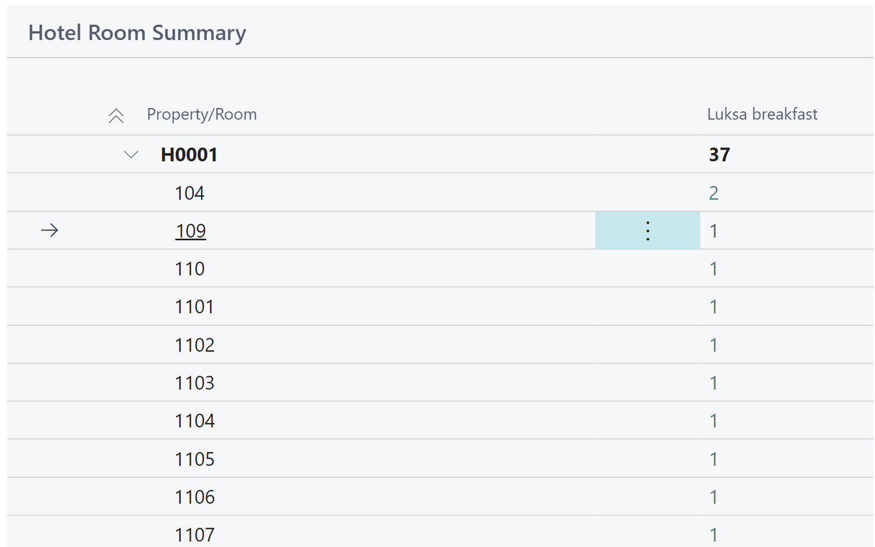
General usability - Room Summary
Room Summary Page
  Shows expected consumption of items in rooms for a given day
  Many filter possibilities
  Convenient for example to see which rooms are scheduled for breakfast or which are using shuttle service

Slide 30
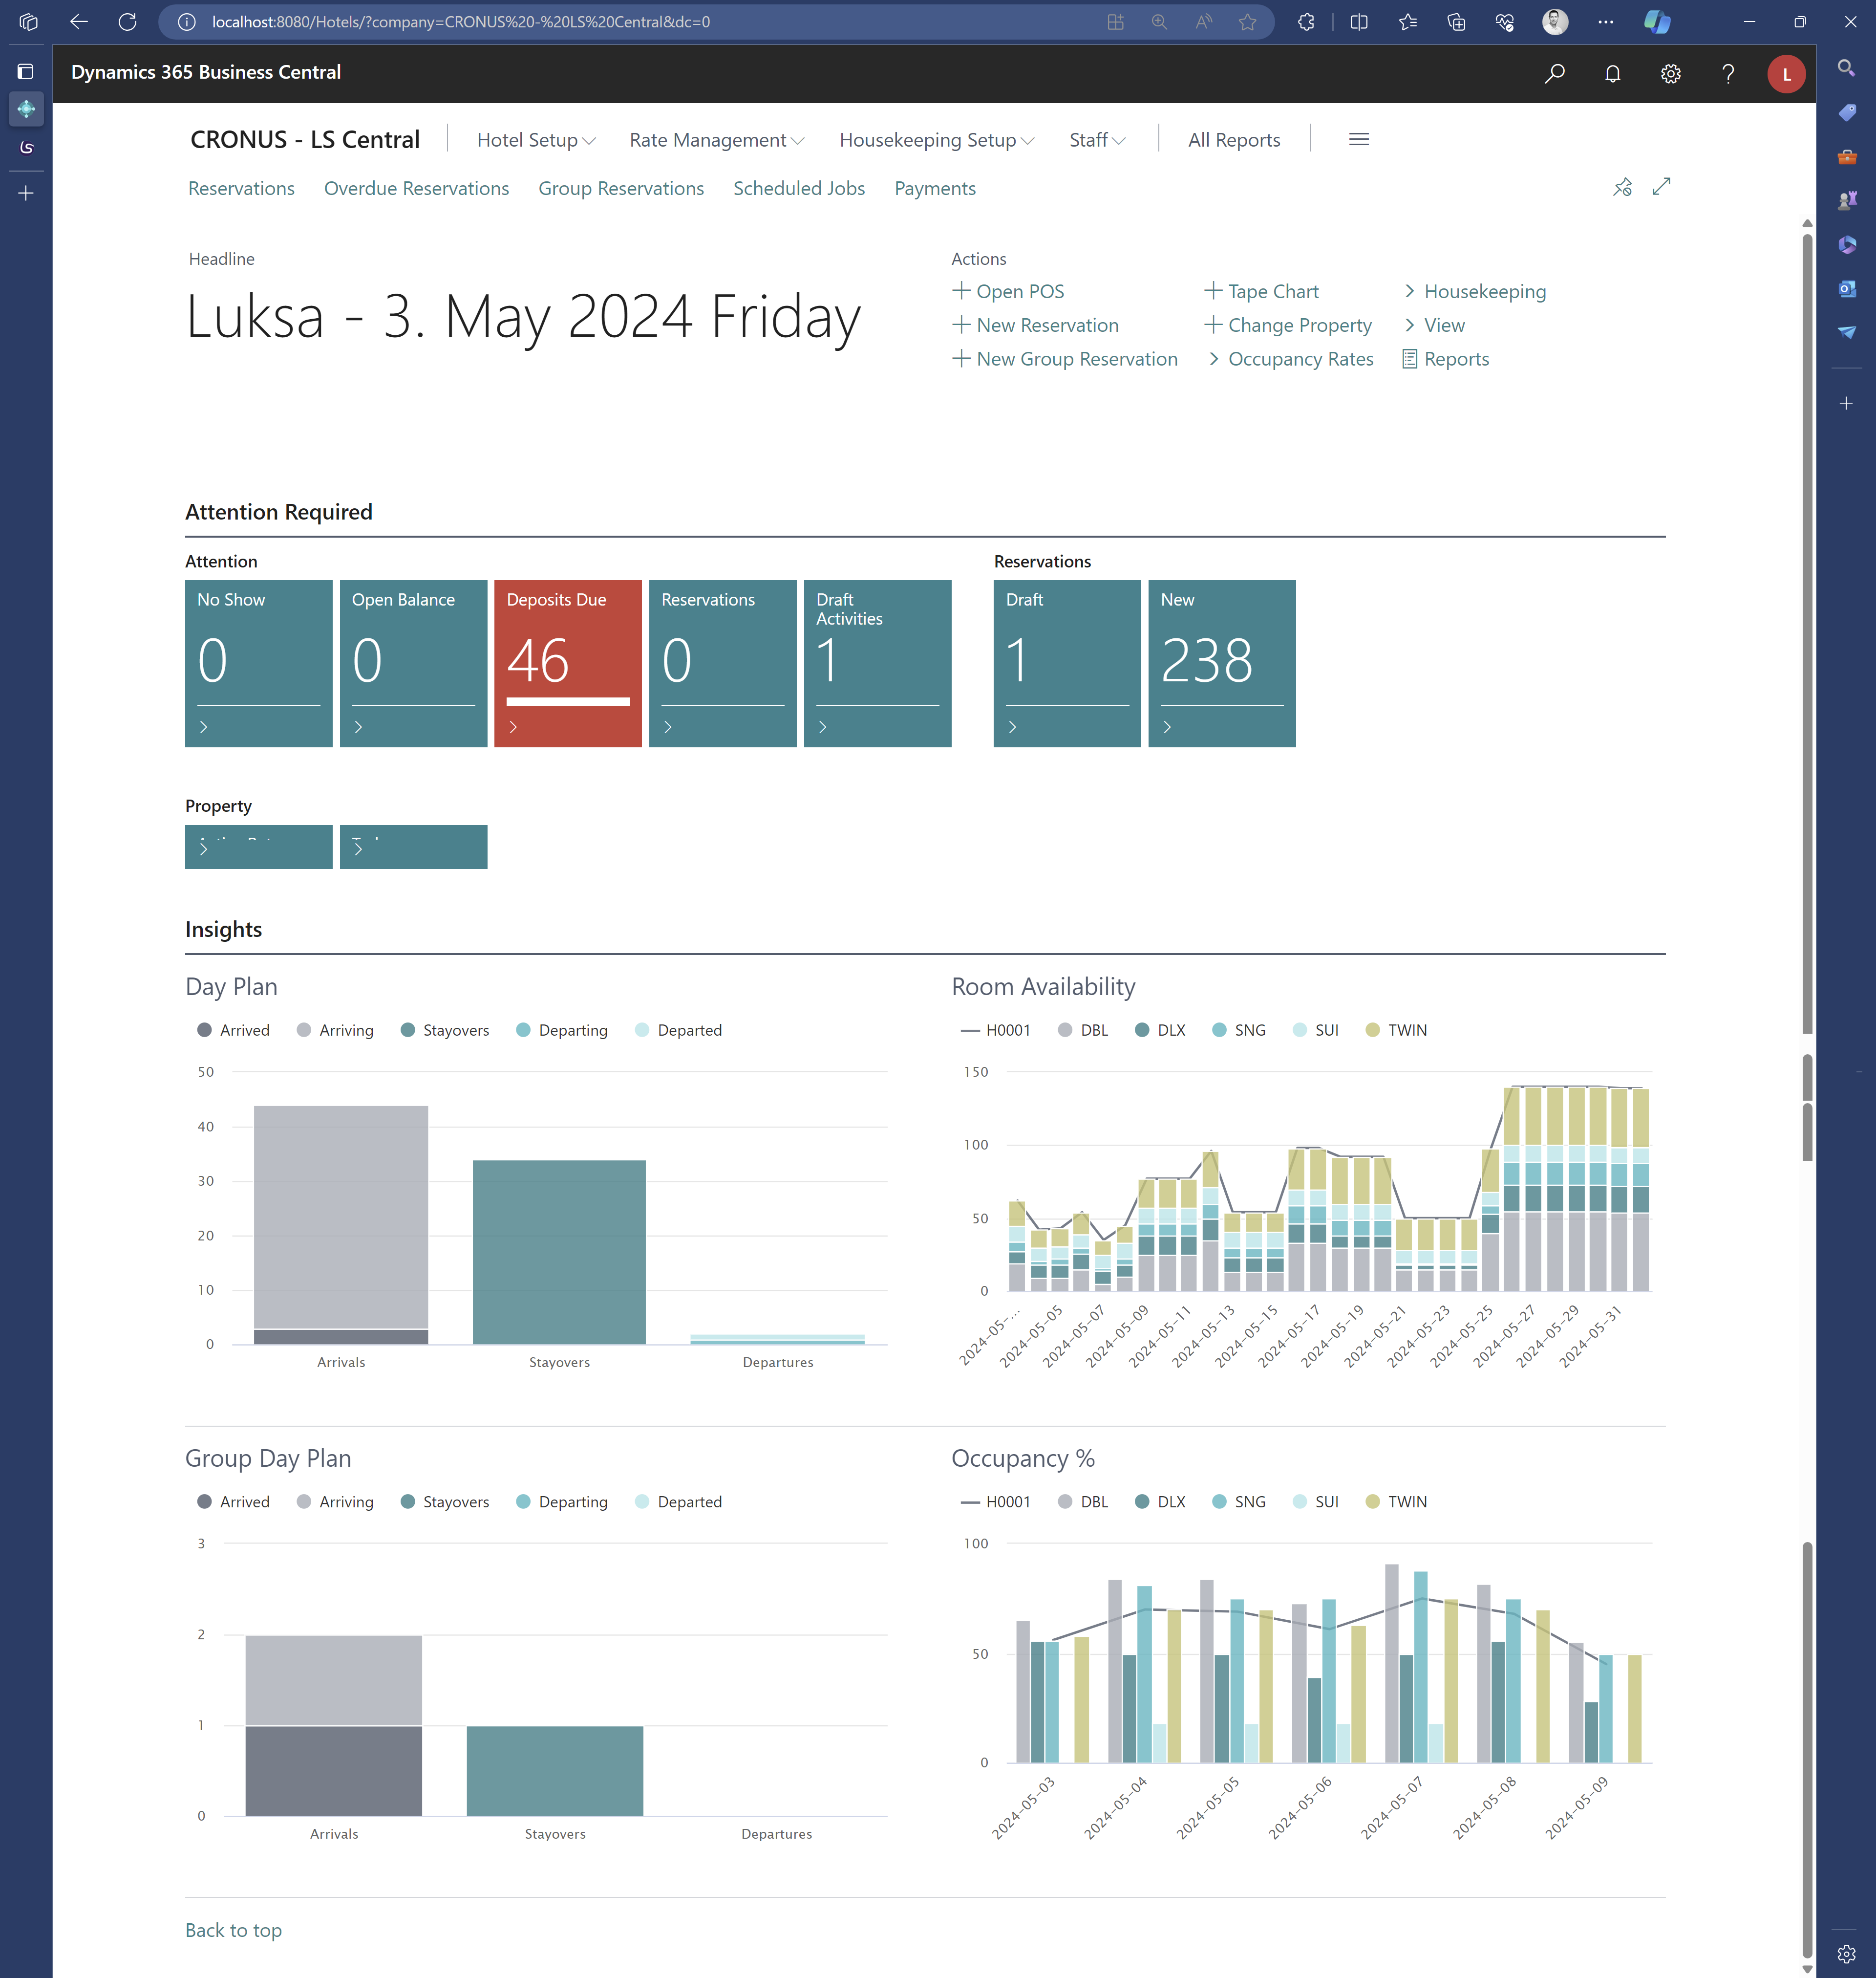
General usability
Role Center day plans
  Charts showing arriving, arrived, stayover, departing and departed reservations for individuals and groups
    Can drill down to reservations behind the numbers and filter on status
  Chart showing room availability for the next 30 days
    Can filter on room types and open Room Type Availablity information page
  Chart showing hotel occupancy percentage for the next week
    Can filter on room types and open Occupancy rate page

Slide 31
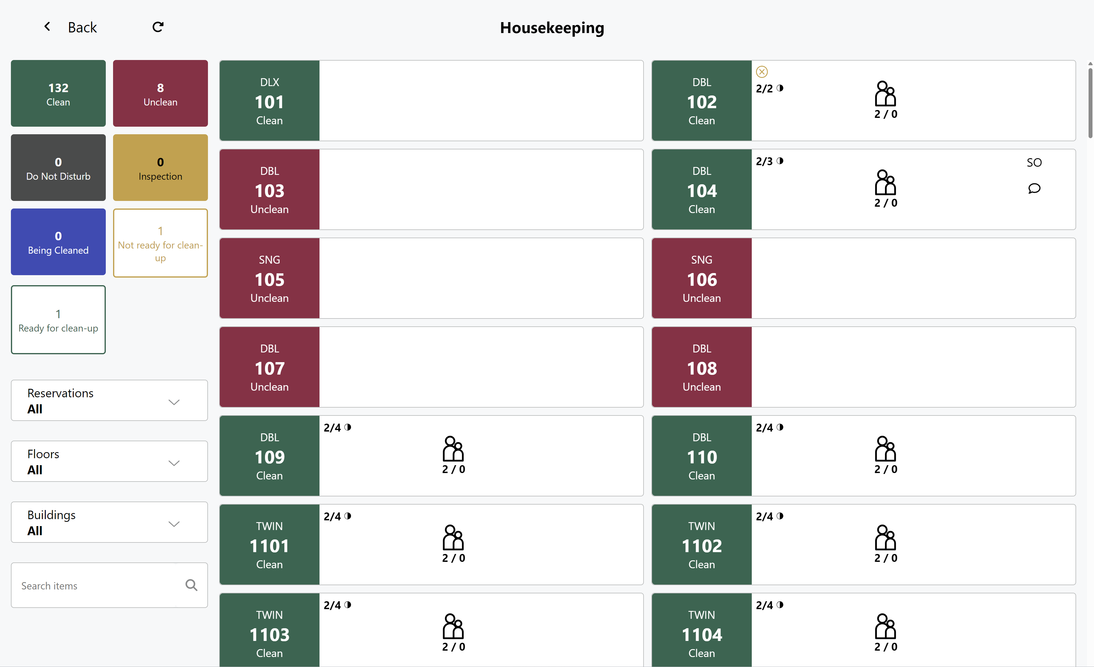
General usability
Improved navigation
Default member club for hotels
Room ranking for automatic allocation
Reservation history – more details tracked
Improved housekeeping POS
Improved online help

Slide 32


Slide 33
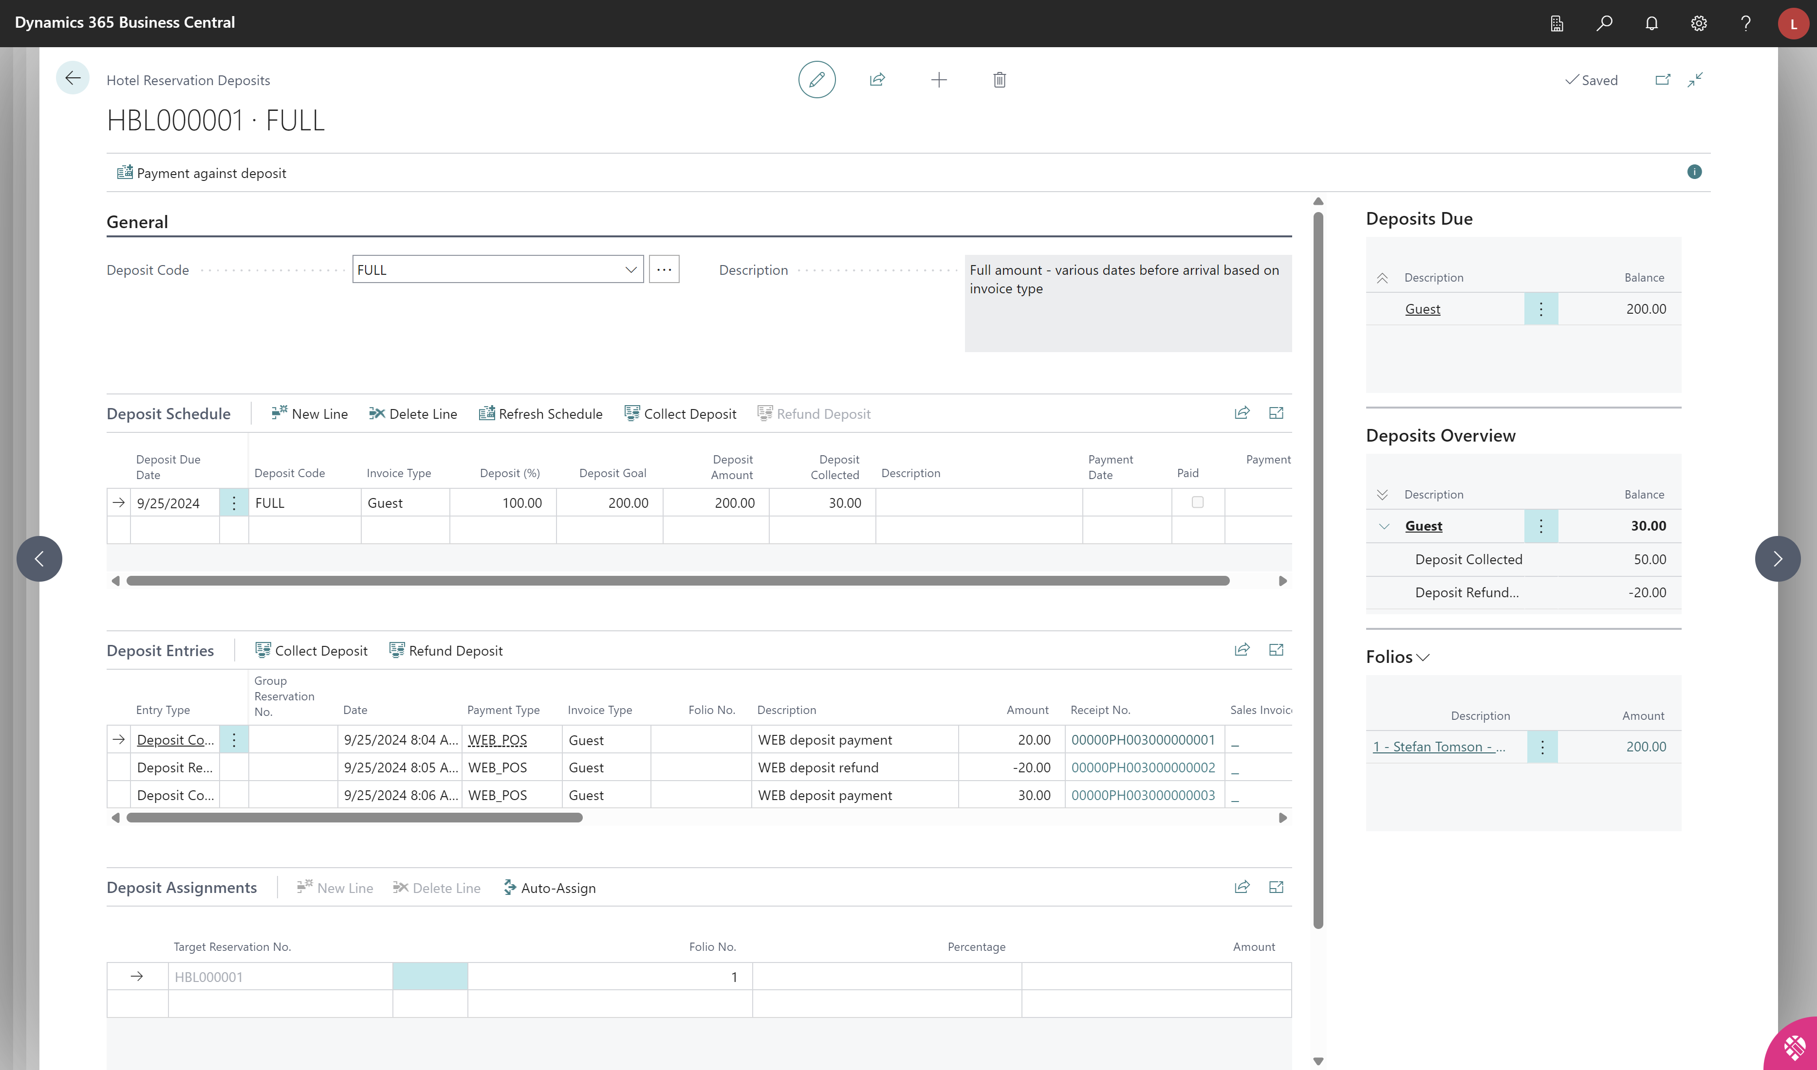
Deposit Management
Test Deposit Policy
Refactored Deposit Policy logic
One page overview
  Balances and statuses
Tax liability on prepayments
Night-Audit processes

Slide 34
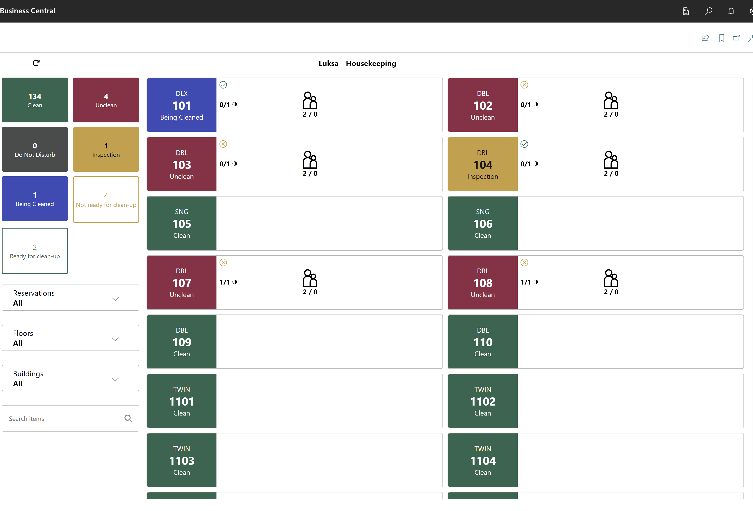
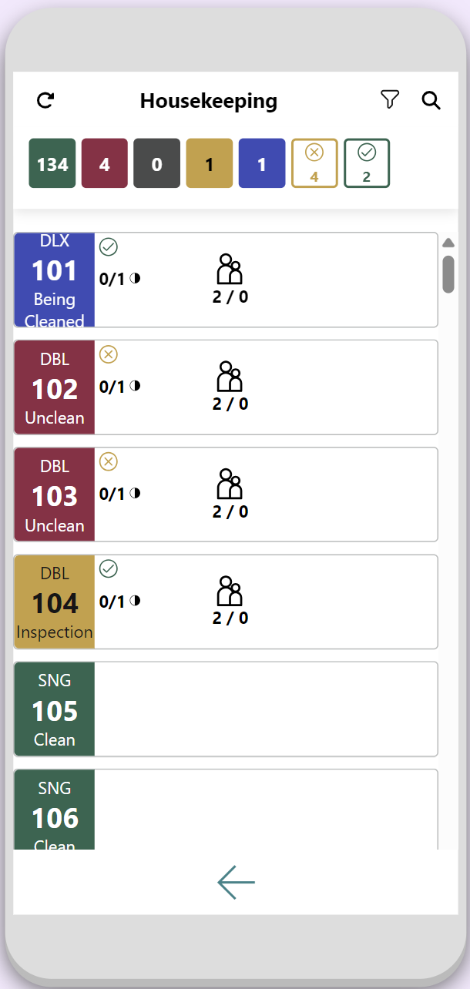
Housekeeping
Housekeeping Operation page in BC
Enhanced filters
  Statuses
  Ready or not ready
  for cleanup
  Filter on locations
  Reservations
    Arriving
    Departing
    Stayovers

Slide 35
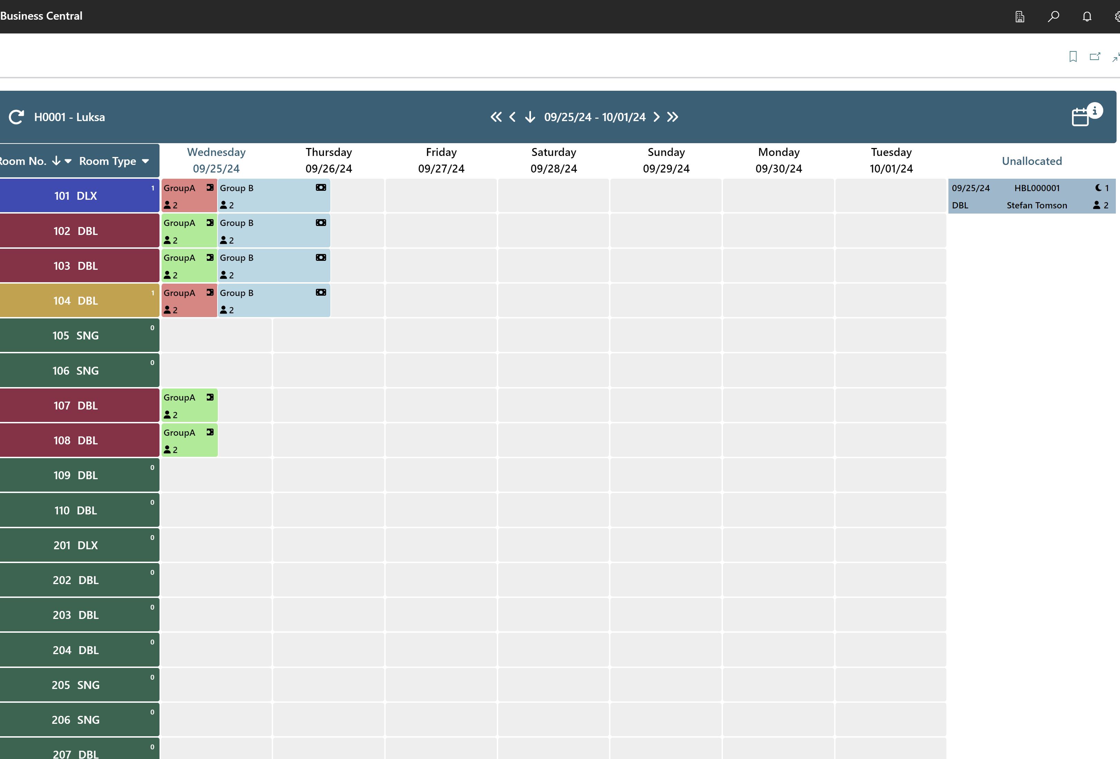
General enhancements
Job logging references
Date format consistency on Tape Chart and POS
Tape Chart
  Today button
  Color palette
Back Office
  Enhanced navigation and info
POS
  Member area on hotel reservation
API
  Check on restriction
Channex OTA
  Availability and rates
  Reservations (with correct ID on the reservation)
  Updates to BEC

Slide 36
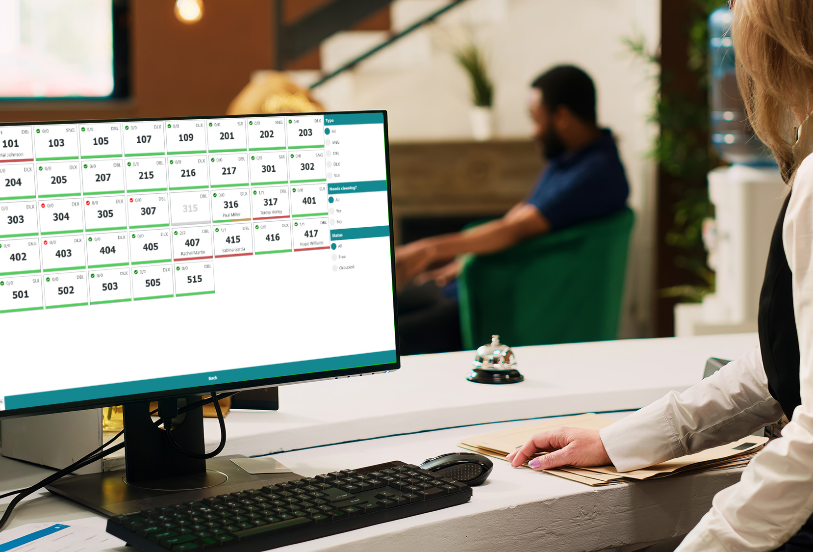
How to get started?
Setup for LS Central for hotels is not complex
“Plug and Play” for customers with BC and LS Central modules already
Configuration packages can be accessed on the LS Retail Partner Portal
Possibility to start small and add to existing setup

Slide 37
Fixed implementation packages
BASE
Implementation package
ADVANCED
Implementation package
ADD-ONS
  Client has BC
  Standard processes
  Migration of reservations with standard tools offered by LS Central
  No customizations
  No integrations to 3rd party
  Single OTA channel connection
  Standard reporting
  Fixed price rate codes
  Manual payment process
  No hardware setup
  Client has BC
  Standard processes
  Migration of reservations with standard tools offered by LS Central
  No customizations
  No integrations to 3rd party
  Multiple OTA channel connection
  Standard reporting
  Complex Rate codes
  Manual payment process
  No hardware setup
  HSK Power App
  Customization on specific processes
  Complex migration
  Enhancements for WEB API
  Integration to third party solutions such as:
    Marketing tools
    Payment providers
    Revenue management systems
    HSK services
    Door/Gate/Wristband Access systems
    CRM systems
    Etc.

Slide 38
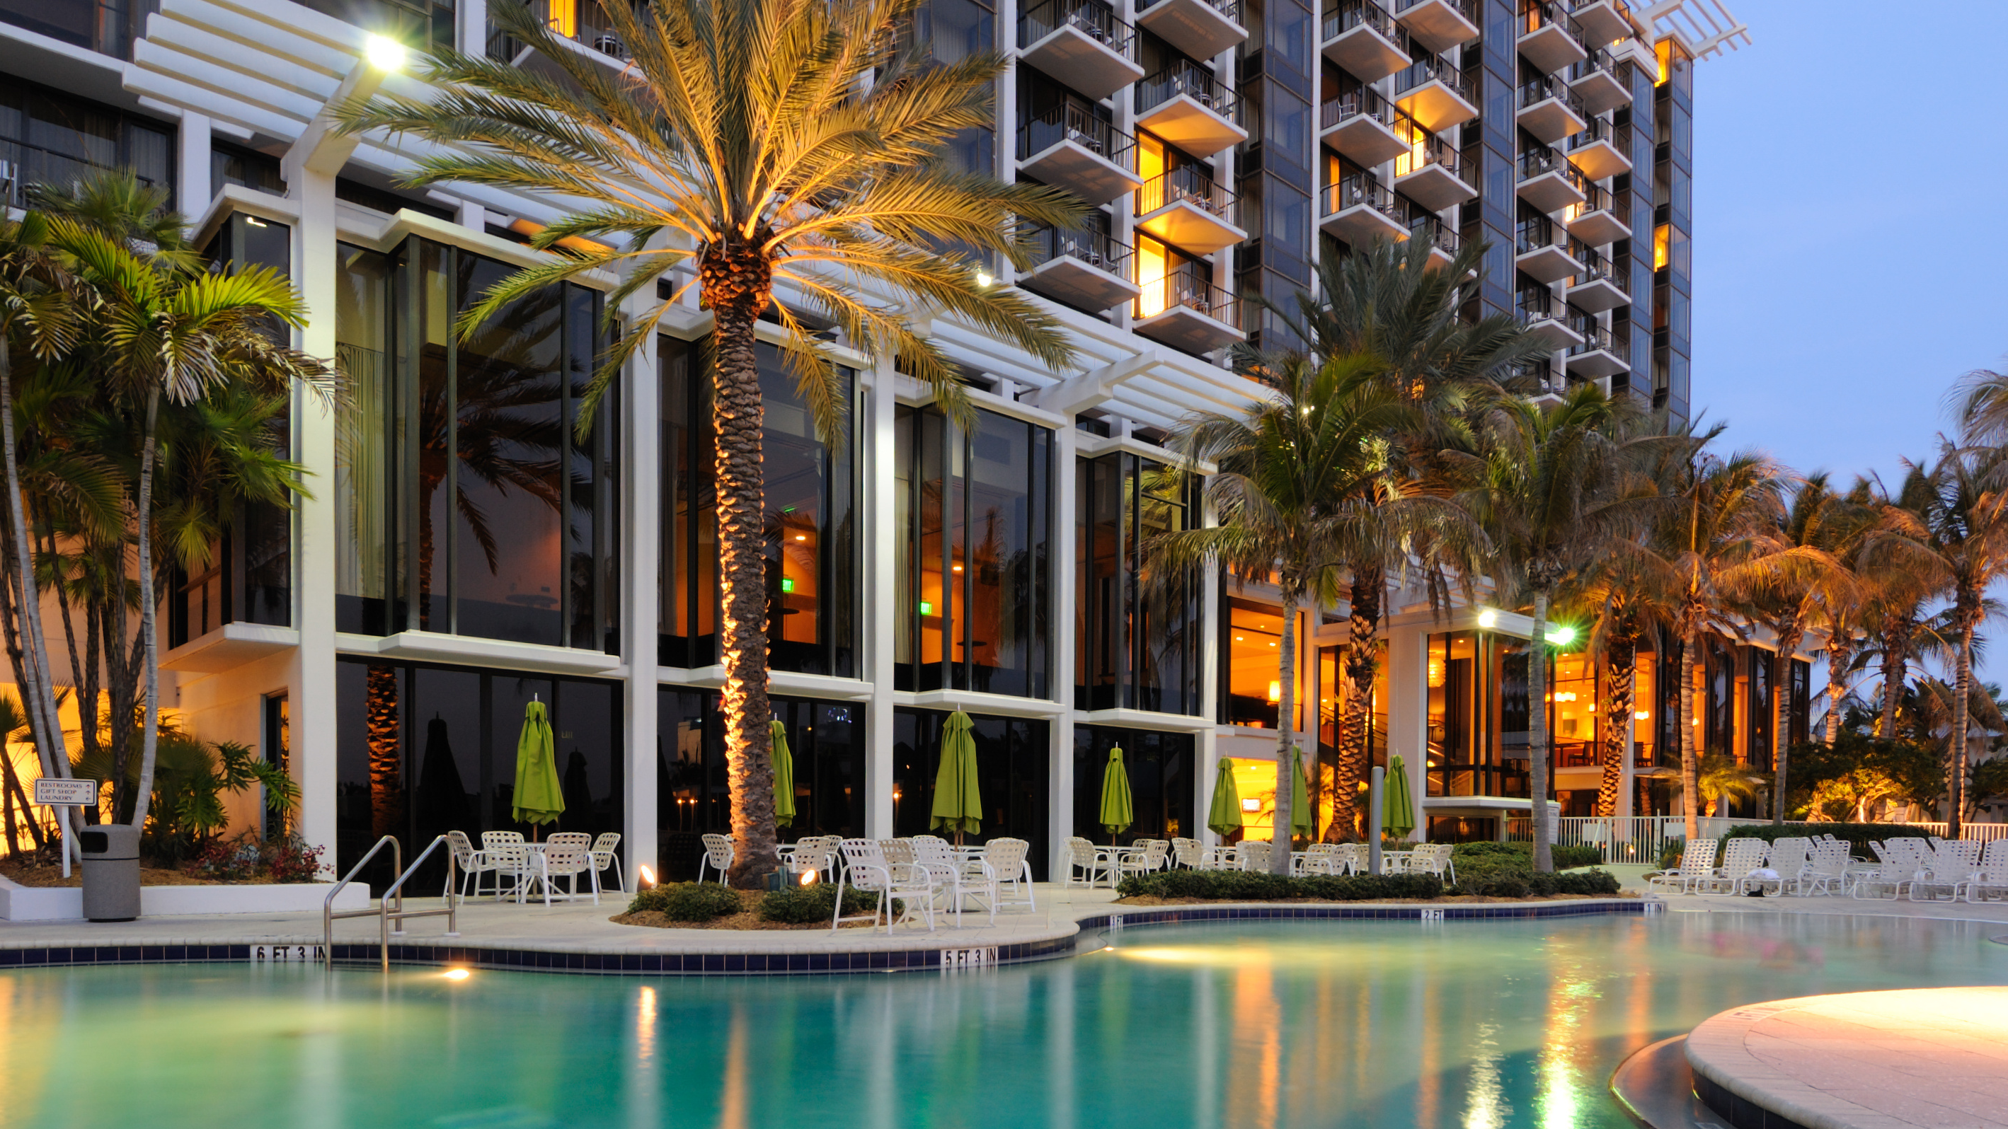
Can't get enough of LS Central for hotels?

