Slide 2
Sigurður Ari Sigurjónsson
VP Strategic Accounts
LS Central for pharmacies - Lite
The remedy for modern pharmacies

Slide 3






Specialized functionality
for your industry and your needs
Retail
Restaurants
Hotels &
resorts
Fashion and apparel
Fine dining
Grocery and supermarket
Quick service
Furniture
Cafés, pubs and bars
Pharmacy
DIY & garden centers
Catering and cafeterias
Dispensaries
Duty free and travel retail
Fast casual
Retail pharmacies
and many more...

Slide 4

A global POS solution
The LS Central Point of Sale solution has a unique market advantage
We have a global presence that is unmatched by competitors.
This global footprint makes LS Retail the ideal provider for retailers who want to work with the same solution in all the regions and countries where they operate
  Some competitors have good coverage in multiple regions with 1-3 verticals
  Some competitors have good coverage in multiple verticals with 1-3 regions
  But LS Retail is unique with coverage in multiple verticals in multiple countries

Slide 5

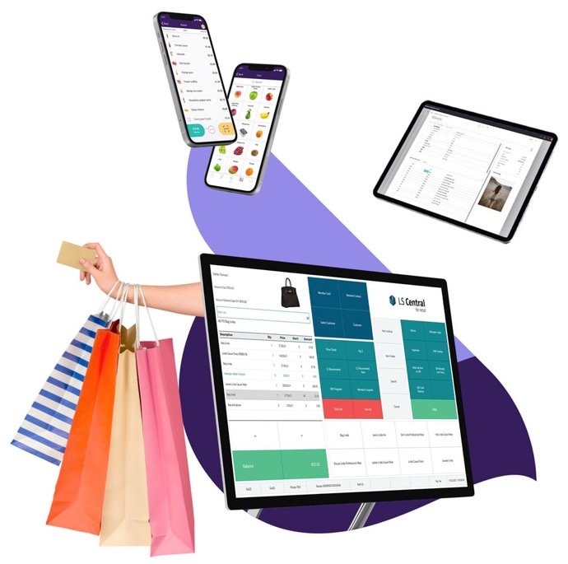
Back office
Front end
A feature rich solution for your retail operations
HQ
Store
Warehouse mgmt.
Supplier mgmt.
Inventory mgmt.
Multi-location/chain mgmt.
Analytics and reports
Point of sale (POS)
Self-checkouts
eCommerce integration
Online orders, click & collect, cross-channel returns
Visibility over stock
Store transfers
Stock mgmt. on mobile
Services (appointments, bookings, rentals)
Secure payments
Commercial
Loyalty program
Prices, offers and promotions
Sales analytics
End of day reports
Replenishment
Staff management
Sales commission
Back end (ERP)
Financials
Supply chain
Accounting
Human resources

Slide 6
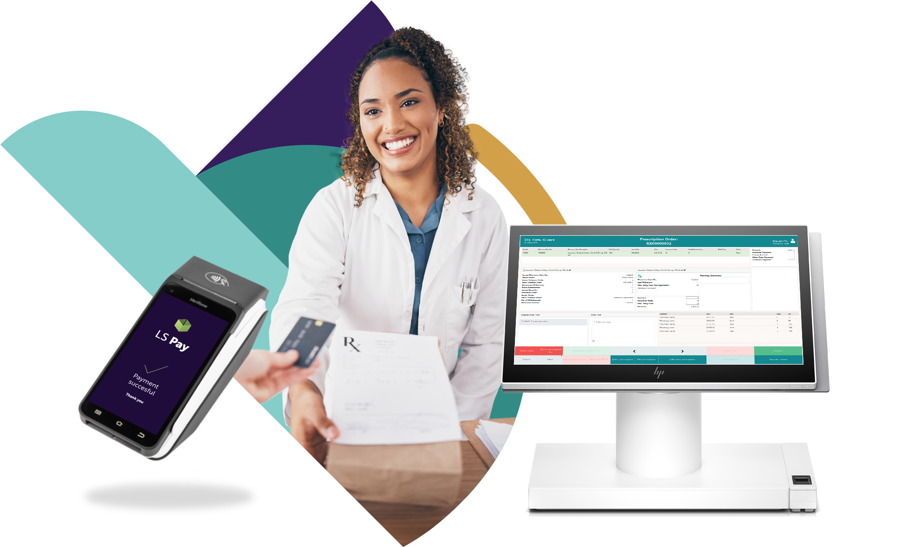
A feature rich solution for your pharmacy operations
Back office
Front end
Supply chain
Store
Warehouse mgmt.
Supplier mgmt.
Inventory mgmt.
Inventory mgmt.
for pharmacies
Point of sale (POS)
Cross-channel returns/exchanges
Unified view of stock/customers
eCommerce integration
Medication mgmt.
Rx insurance
Pharma-specific
staff management
Security and permissions system
Commercial
Loyalty program
Prices and promotions
Sales analytics
Customer notification
to refill Rx
Rx substitution
E-prescriptions
Back end (ERP)
Financials - Accounting - HR

Slide 7


Key functionality areas
All standard prescription processes
  Prescription handling
    paper, electronic, emergency, animal, etc.
  Generic substitution
  Pharmaceutical control
  Pick control
    FMD Control
  Order requests when item is not in stock and subscriptions
  Pharmacy specific user permissions
Customer identification
  Pharmacy customer database or link to national registry
  Handling of Power of Attorney and care units
Master data import and management
  Master data for prescription handling
    Pharmaceutical Items
    Item Groups including ATC and Substance Groups
    Health Personnel

Slide 8
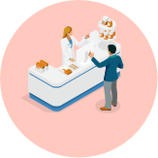



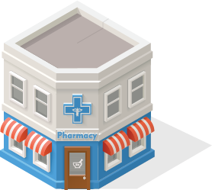
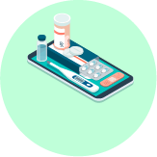
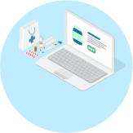
Our vision for innovation in pharmacy
Unified Pharmacy
All-in-one pharmacy suite
ERP
Finance
Warehousing
Advanced Shipping Notification
Dispensing
ePrescriptions
Rx master data
Dose dispensing
Integration
Localization for prescription & insurance gateways
Retail
Health and beauty
Loyalty
360-degree view of the customer
Clienteling
Personalized service on the pharmacy floor
Appointments and reservations
eCommerce
Retail and prescriptions
Prescription
Retail items
Click & collect
Traditional
Social media
Customer
App
Done
We know dispensing
Web

Slide 9
Our vision for innovation in pharmacy
LS Central for Pharmacies - Lite
Unified Pharmacy
All-in-one pharmacy suite
ERP
Finance
Warehousing
Advanced Shipping Notification
Dispensing
E-prescriptions
Rx master data
Dose dispensing
Integration
Localization for prescription & insurance gateways
Retail
Health and beauty
Loyalty
360-degree view of the customer
Clienteling
Personalized service on the pharmacy floor
Appointments and reservations
eCommerce
Retail and prescriptions
Prescription
Retail items
Click & collect
Traditional
Social media
Customer
App
Done
We know dispensing
Web

Slide 10

Modular design of LS Central
  Each component in the system is like a Lego brick with seamless data integration
  For customers, this means that it is now possible to update the system without a major upgrade project
  Works both as a standalone pharmacy solution and a complete ERP, retail, and pharmacy solution
  Unifies all channels & runs them from the same back-end solution
  Member management/loyalty program is an integrated part of the solution
Customer Integrations
Country
Integration
Pharmacy module
LS Central
MS Dynamics 365 Business Central

Slide 11
LS Central for pharmacies
Contains general processes commonly used by all localizations
Prescription handling with or without connection to centralized ePrescription entity
BC24/SaaS available
Fully integrated to the LS Retail product portfolio
Can be used as a standalone solution
Ready for localizations or integrations
Now available all over the world by LS Retail and the LS Retail Partner Network
Customer Integrations
Country
Integration
Pharmacy module
LS Central
MS Dynamics 365 Business Central

Slide 12
Localizations and integrations
Localizations developed by LS Retail and supported by LS Retail to include any changes needed as local regulations evolve
Available for
  Iceland
  Norway
  Sweden
  UK – England, Scotland and Wales
Next countries?
Customer Integrations
Country
Integration
Pharmacy module
LS Central
MS Dynamics 365 Business Central

Slide 13







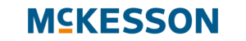







Pharmacy / Health & Beauty
Sweden
Iceland
Norway
Sweden
400 locations
30 Locations
300+ locations
Ca. 200 locations
United Kingdom
Iceland
Ireland
Norway
Ca. 1.300 locations
Ca. 40 locations
30+ locations
150 locations
Germany
Sweden
Norway
UK, USA and China
250 locations
220 locations
130+ locations
Read our success stories

Slide 14
Why LS Central for pharmacies?
Built on Microsoft Business Central and LS Central
  Browser based, low footprint
  Available as SaaS in Microsoft Azure
  Easy integration with Power BI and other Microsoft apps
  Continuous updates from Microsoft and LS Retail
  Security
  Built on server and client from Microsoft
  MS SQL database
  User traceability
    Possibility to use RFID and MFA
  Pharmacy access restricted by roles
  Barcode control for safety
Efficient flow for prescription
handling
Has been sold to nearly 3,000 pharmacies
A-Z single solution
  ERP, POS, retail, and prescriptions

Slide 15
Go to market strategy for LS Central for pharmacies
Available in selected countries
FULL sales strategy
Available in any country LITE sales strategy
Customers can buy the Prescription module on its own, without the Country Integration, the Retail module or the ERP.
Country Integration
Connected to local services with governmental certification ^{*)}
Prescription for LS Central
Dispensing software
Prescription for LS Central
Dispensing software
LICENSE SKU´s
Pharmacy base [Mandatory]
Pharmacy prescription per device [LITE - W1 version]
Pharmacy prescription per device
Pharmacy country integration per device
LS Central for
Retail
LS Central for
Retail
Microsoft Dynamics 365
Business Central (ERP)
Microsoft Dynamics 365
Business Central (ERP)
*) Currently supported by LS Retail for Norway, Sweden, Iceland and The United Kingdom

Slide 16


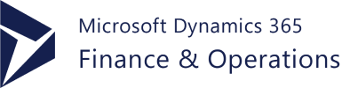


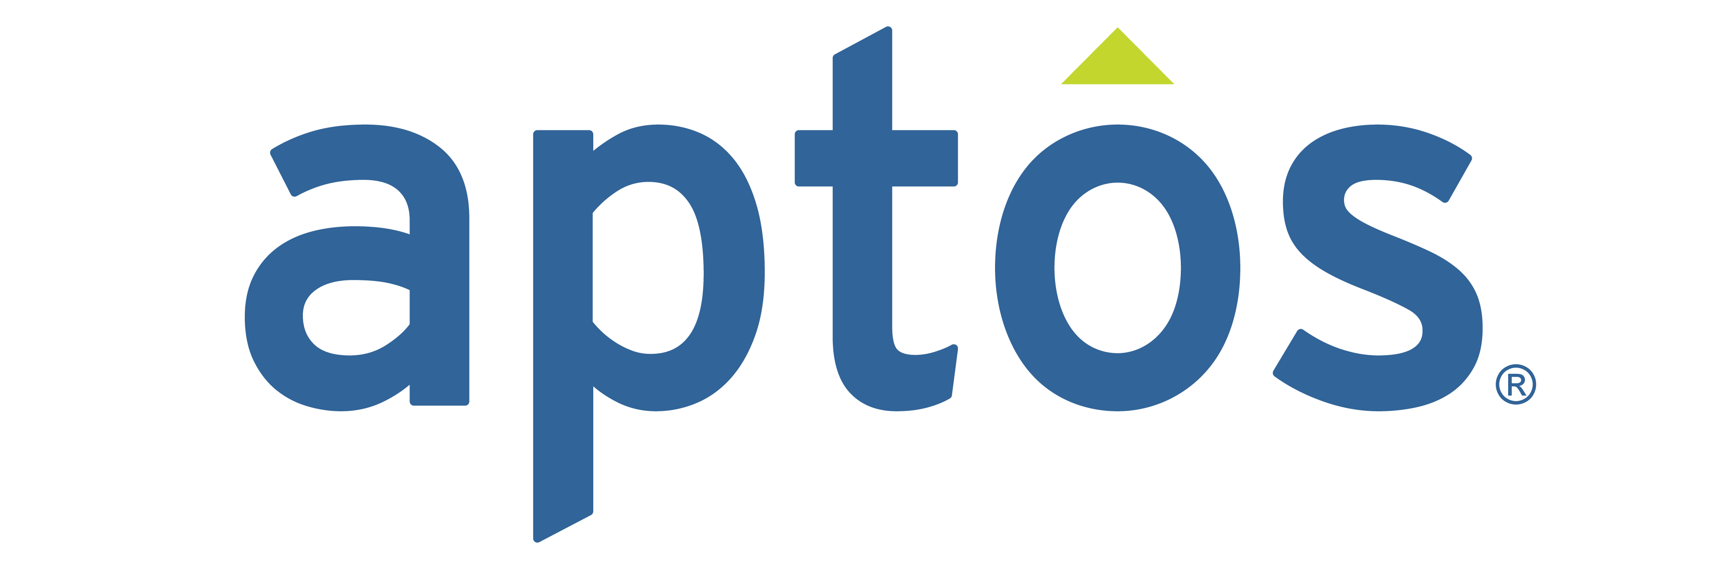
LS Central retail integrations with CentralConnect
Head-office platforms
Larger global customers
LS Central
as a retail solution
00
CentralConnect
LS Central
as a POS solution

