Slide 2
E-Commerce for LS Central
New Features and Integrations
Petur Thor Sigurdsson
Zeeshan Khuwaja

Slide 3

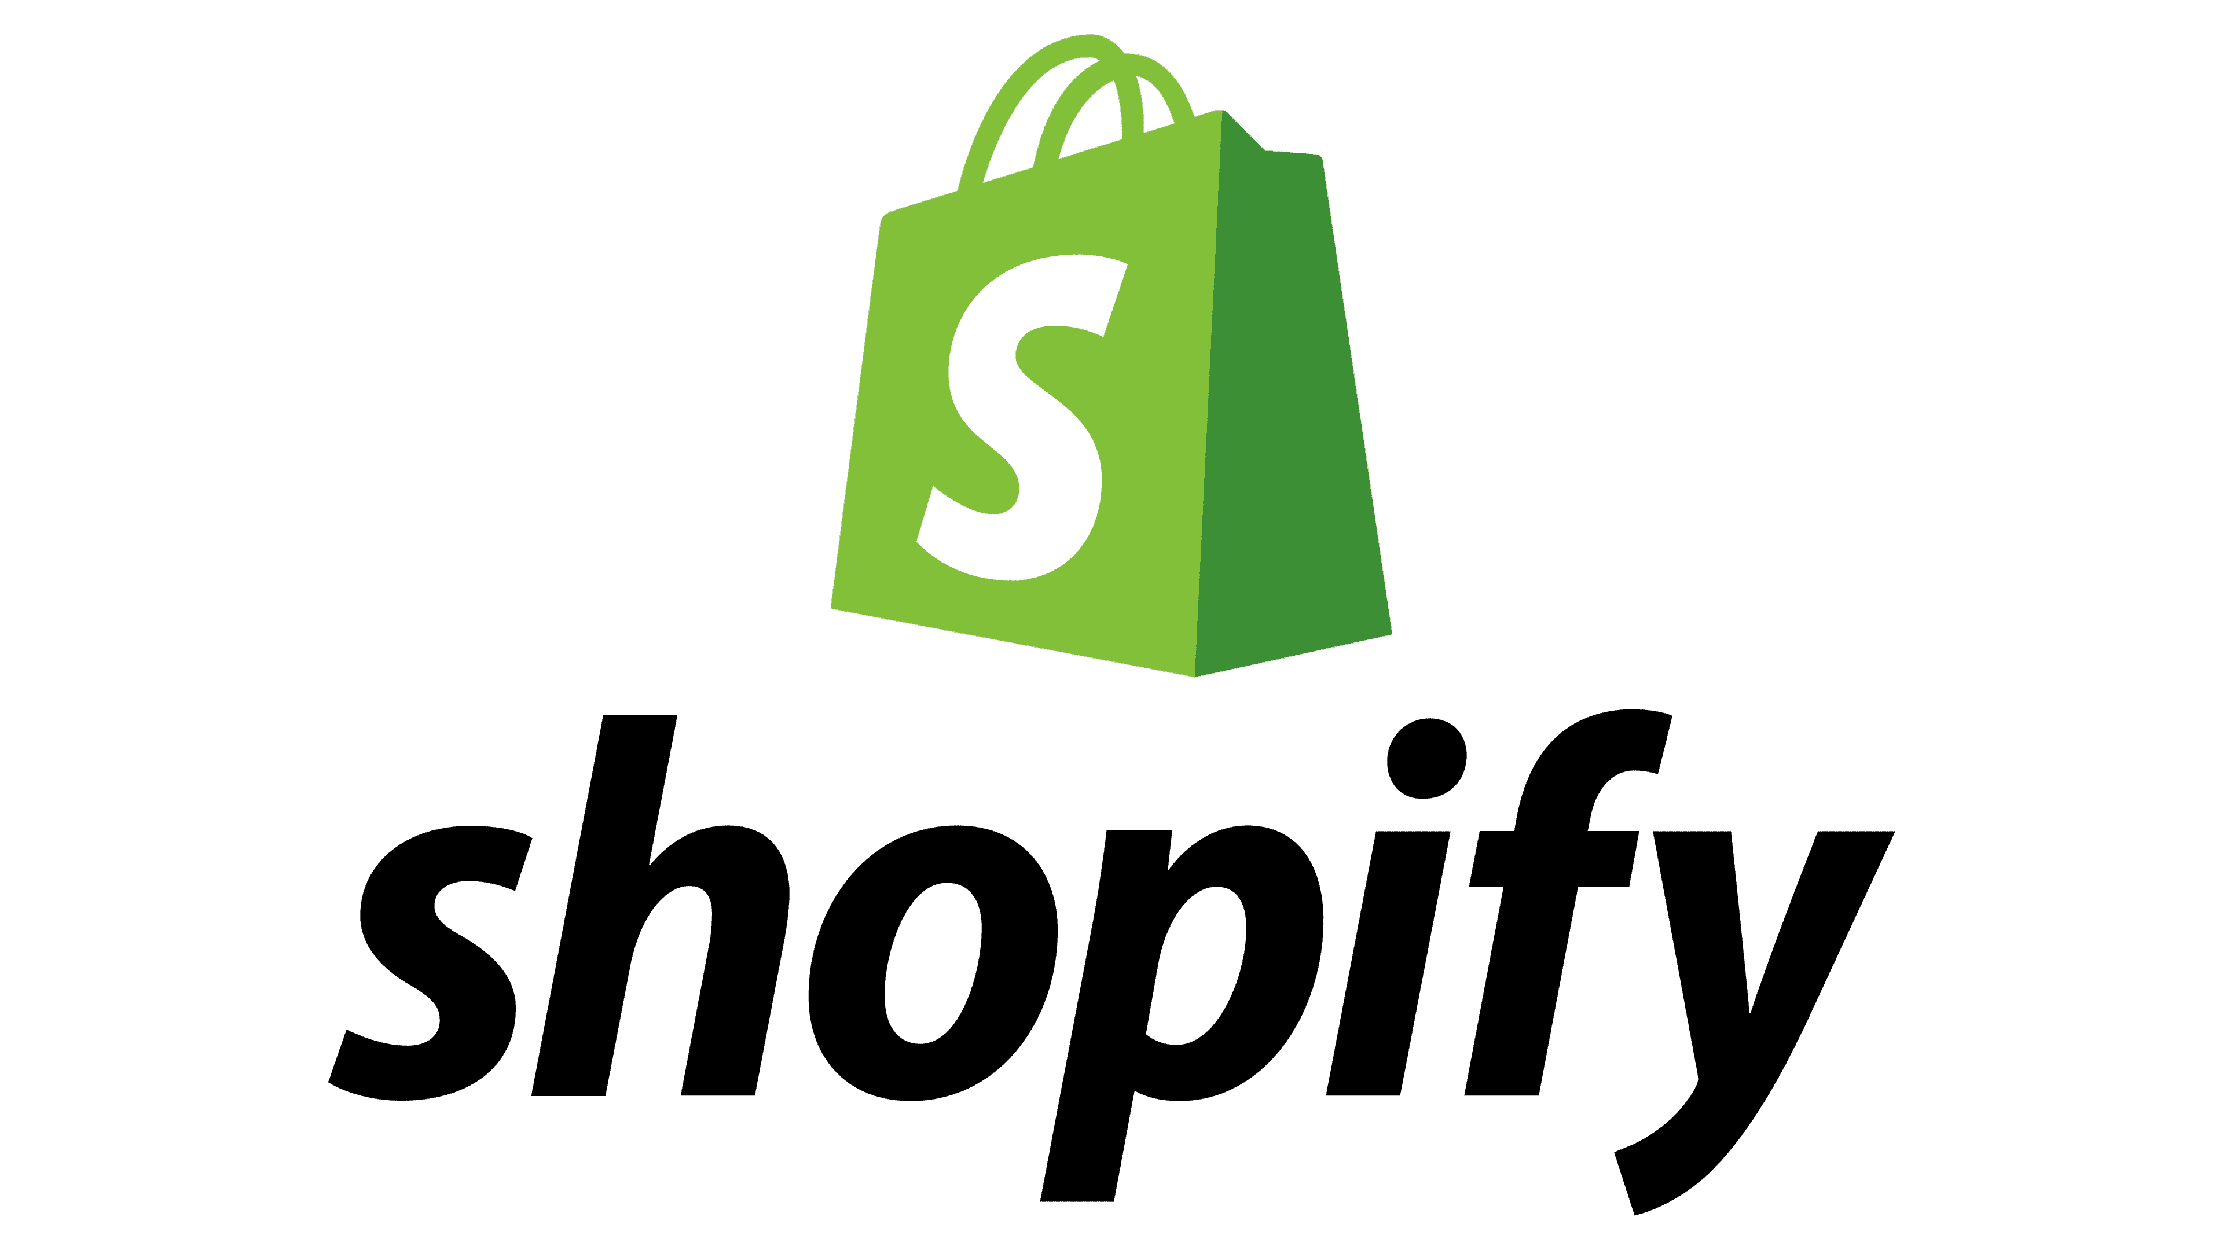




3rd party
eCommerce
providers
eCommerce API
Commerce Services for
LS Central

Slide 4



eCommerce
POS
Master Data
Inventory
Store Inventory
Point of Sale
Basket Calculation
Hospitality
Customer Loyalty
Click & Collect
Customer Orders
Transaction Repository
Token Vault
KDS
Pharmacy

Slide 5

Retail
LS Retail Academy course
Push Notification for Order Updates
Transaction based licensing
Customer Order Edit Support

Slide 6

Hospitality
Que Counter Support
Fully support for SaaS
Transaction based licensing

Slide 7

Items
Variants / Attributes
Prices
Basic Discounts
Inventory
Shopify Metadata
Sales
Customer Registrations

Slide 8


Smart Order Routing
Data Translation
Support for Collections
Large Data Import

Slide 9

Local Inventory

Slide 10
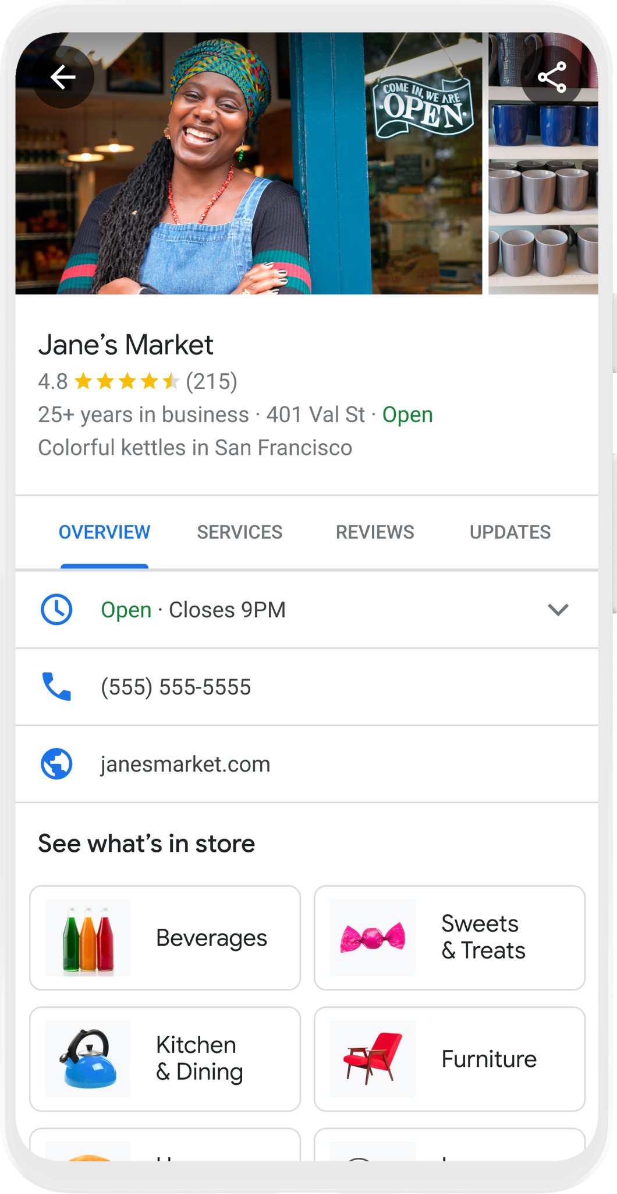
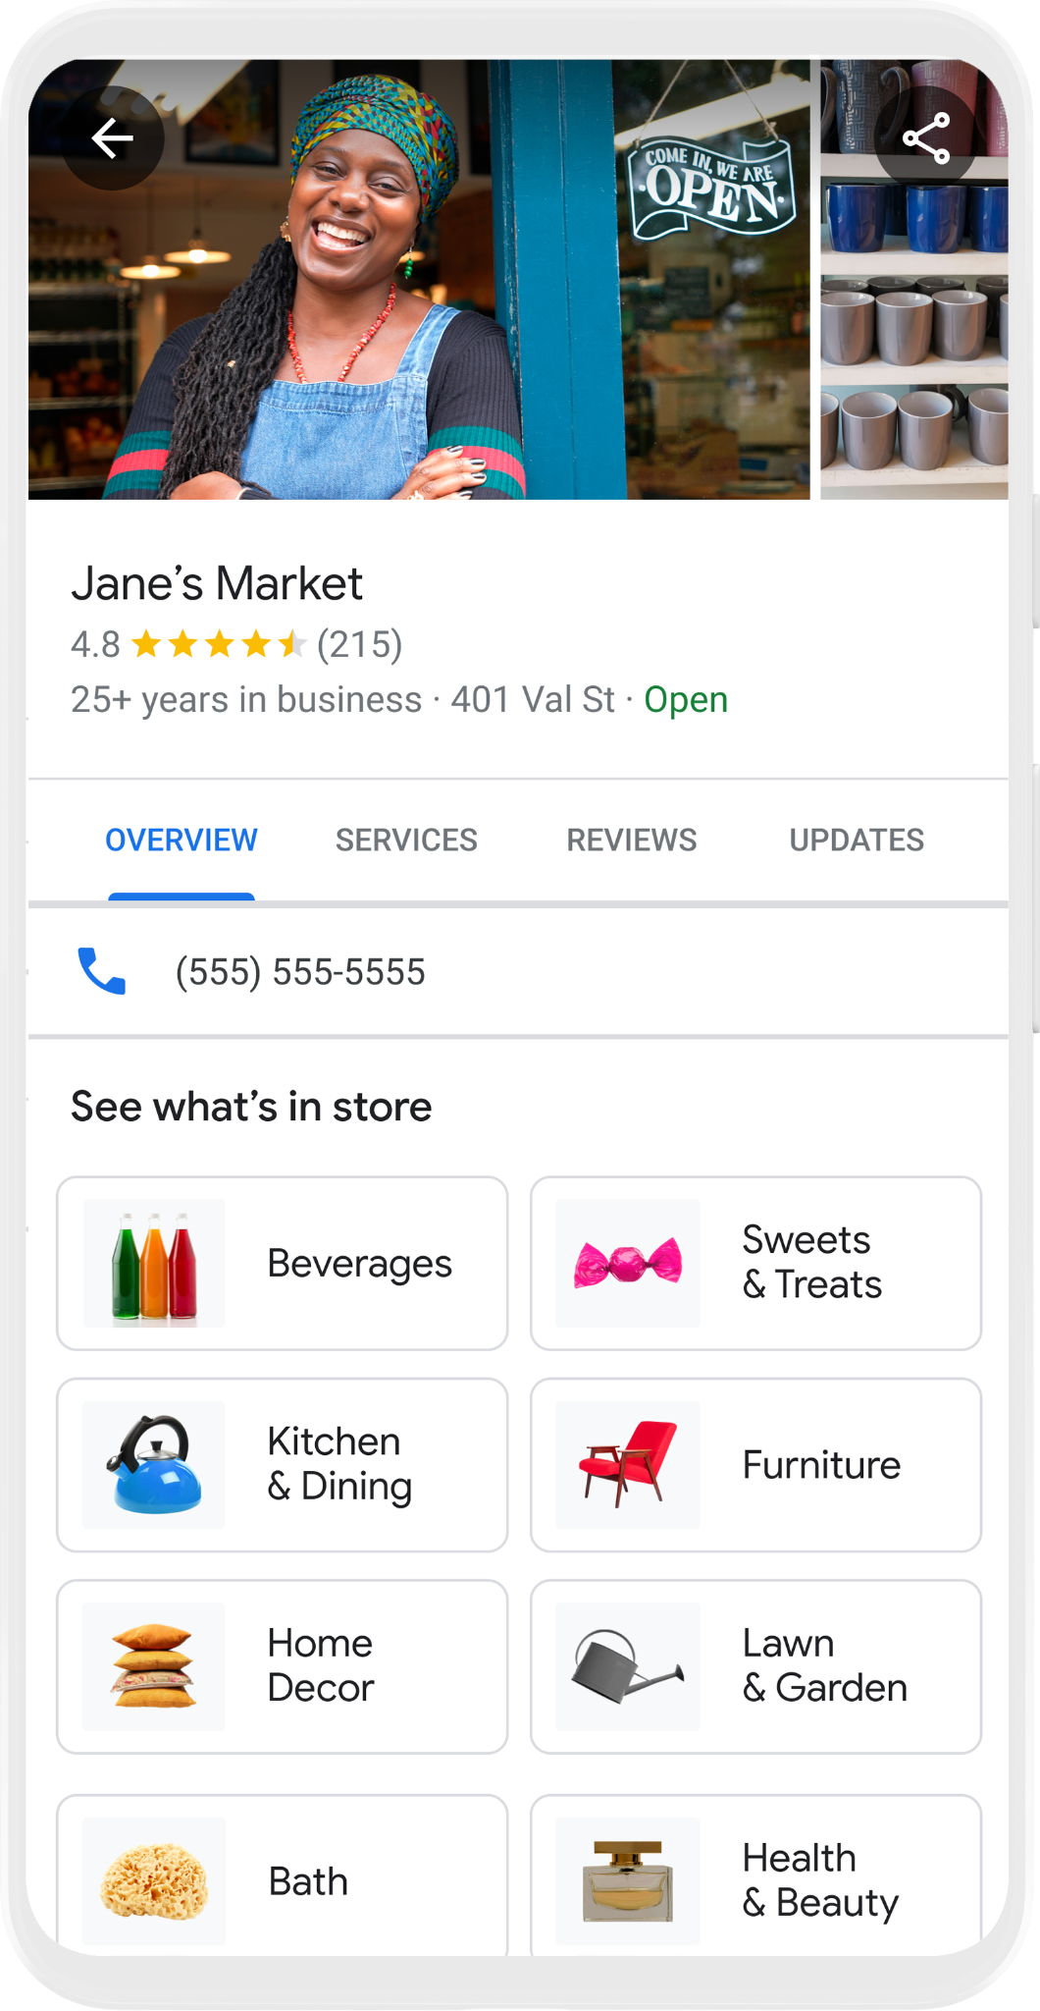


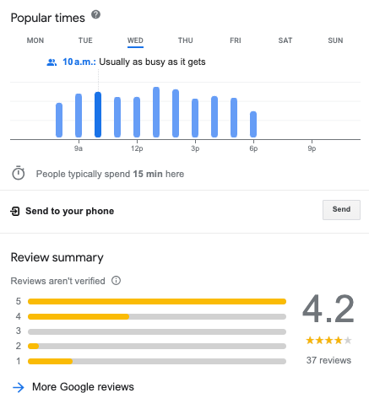
4.8
See What’s In Store

Slide 11
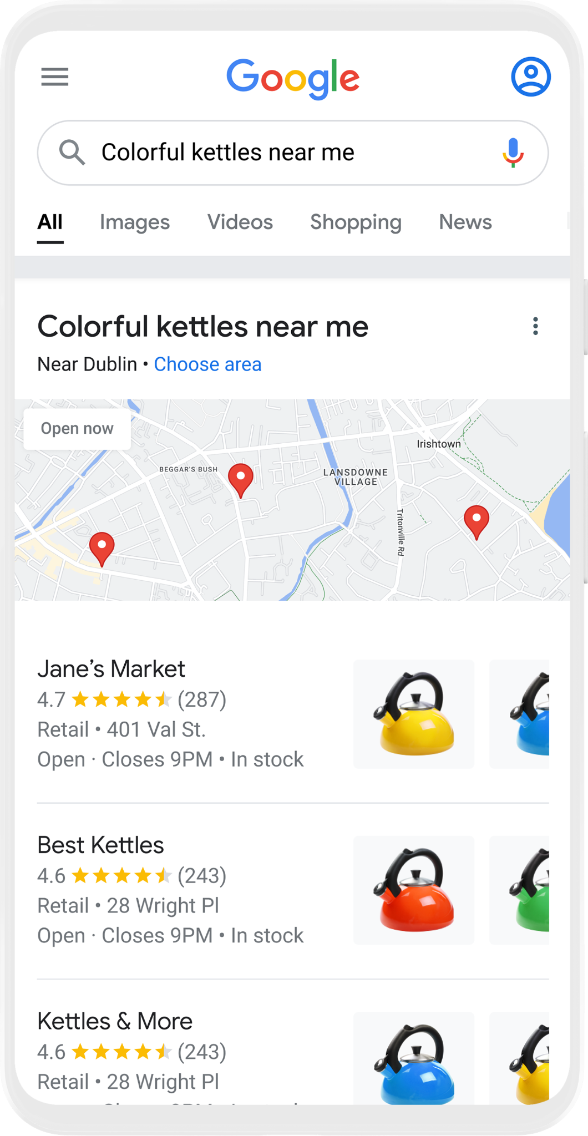
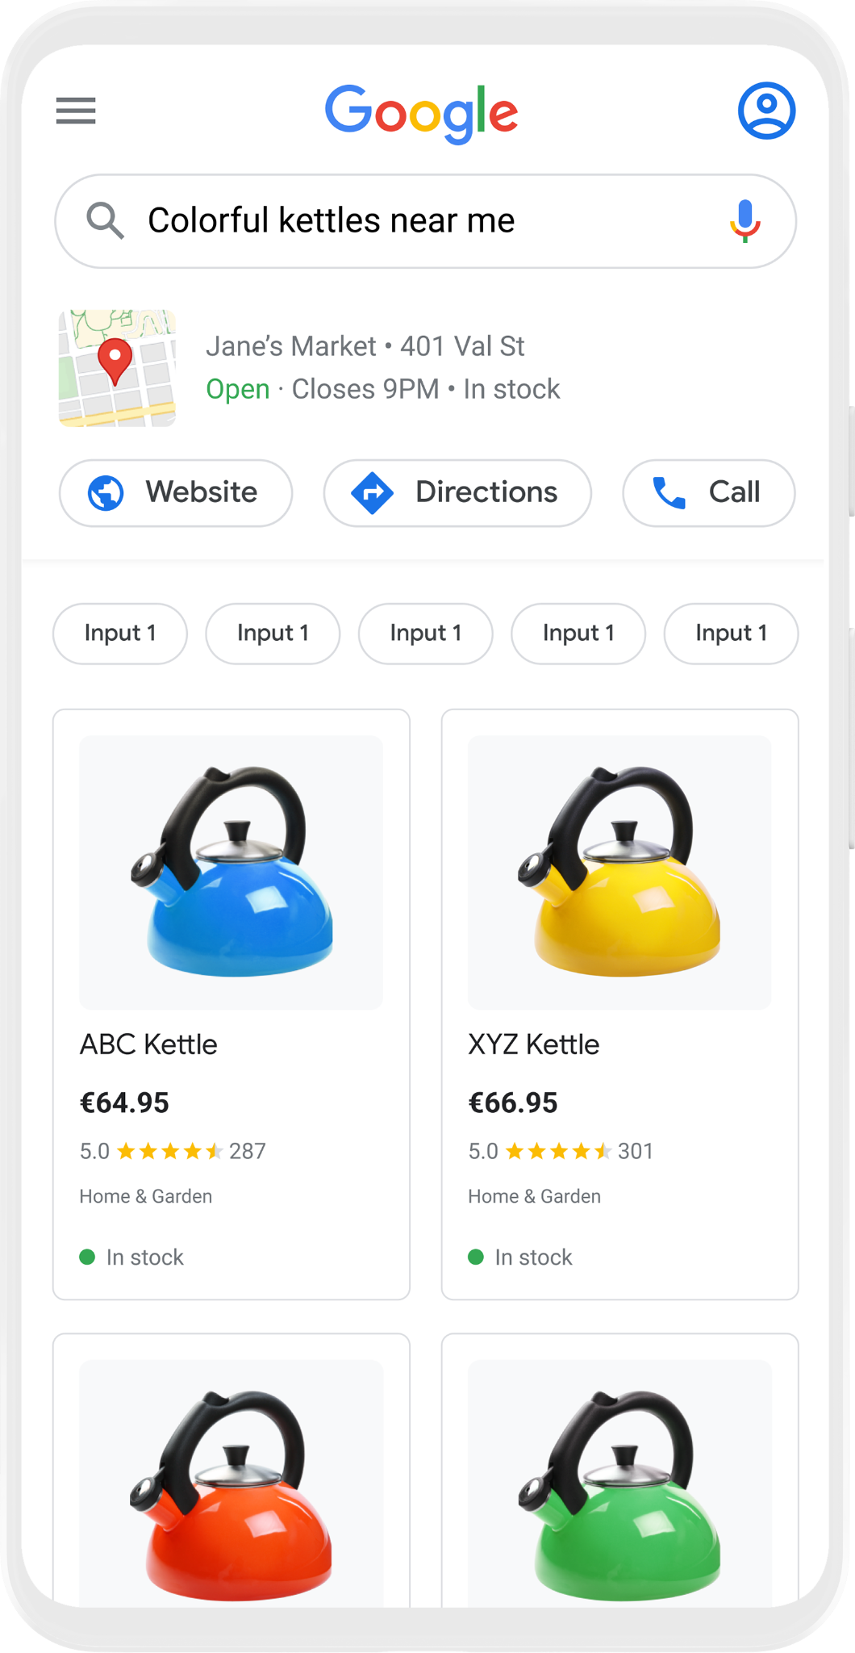

Free Local Product Listings
Showcase your store’s products for free on Google Search
Google Search
Shopping Tab
Google Business Profile
Red
Yellow
Large
Electric
Blue

Slide 12


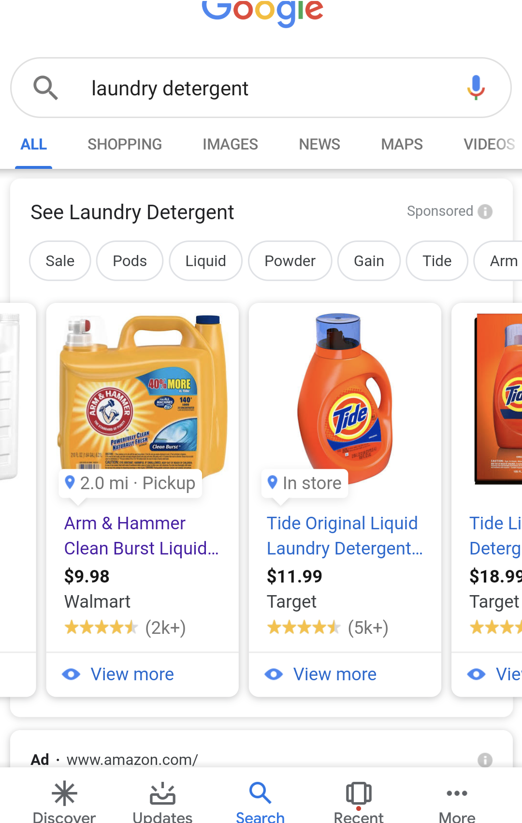
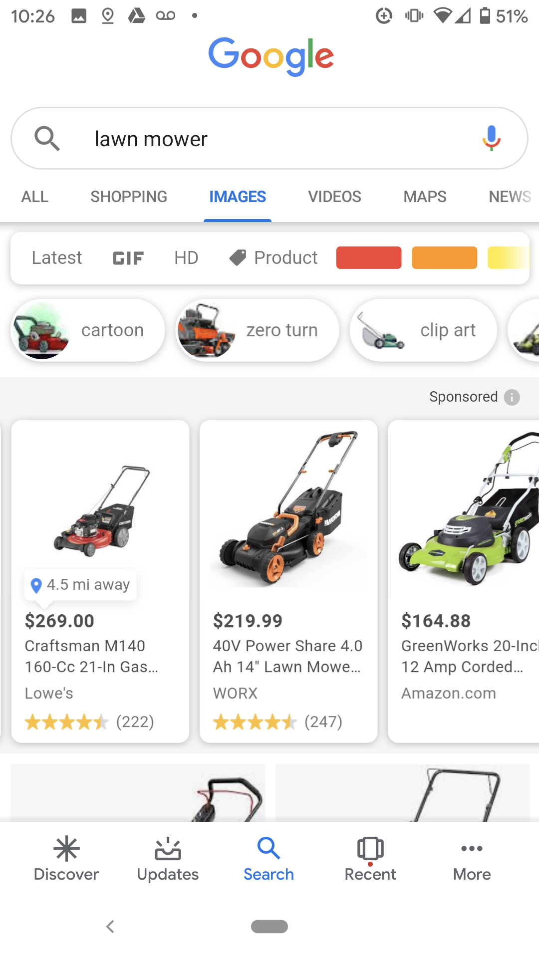
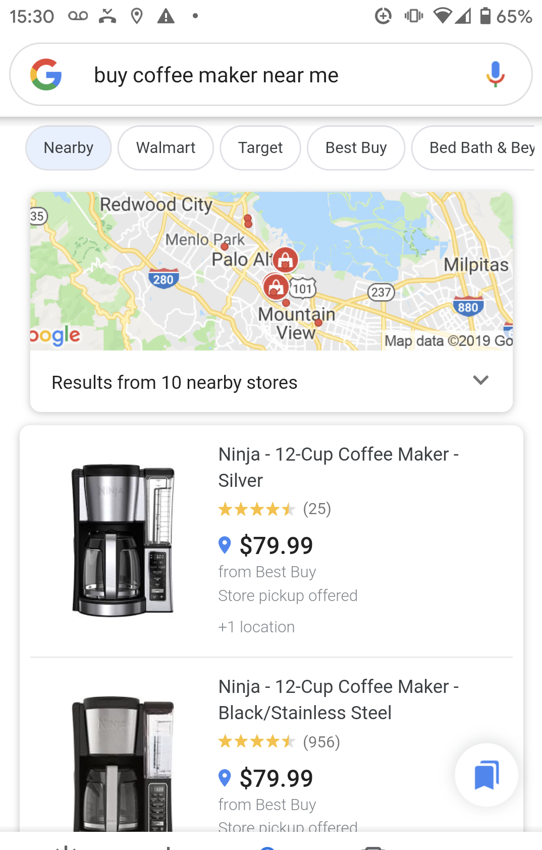
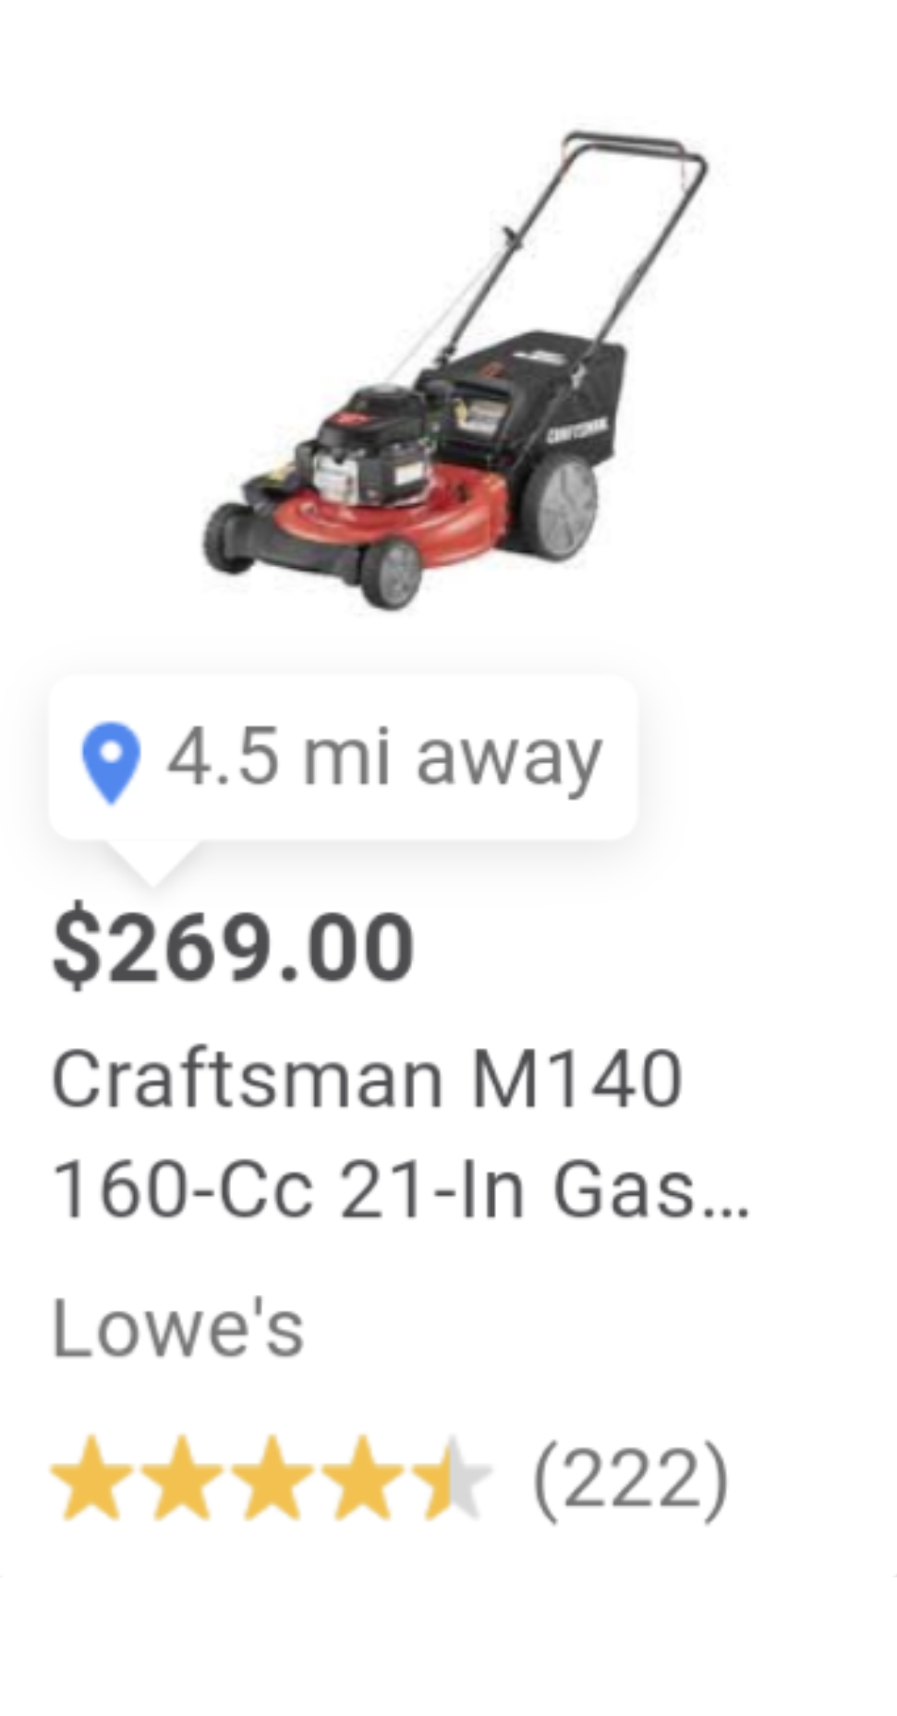
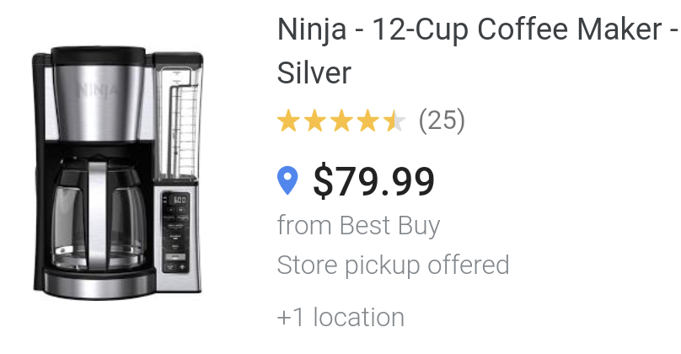
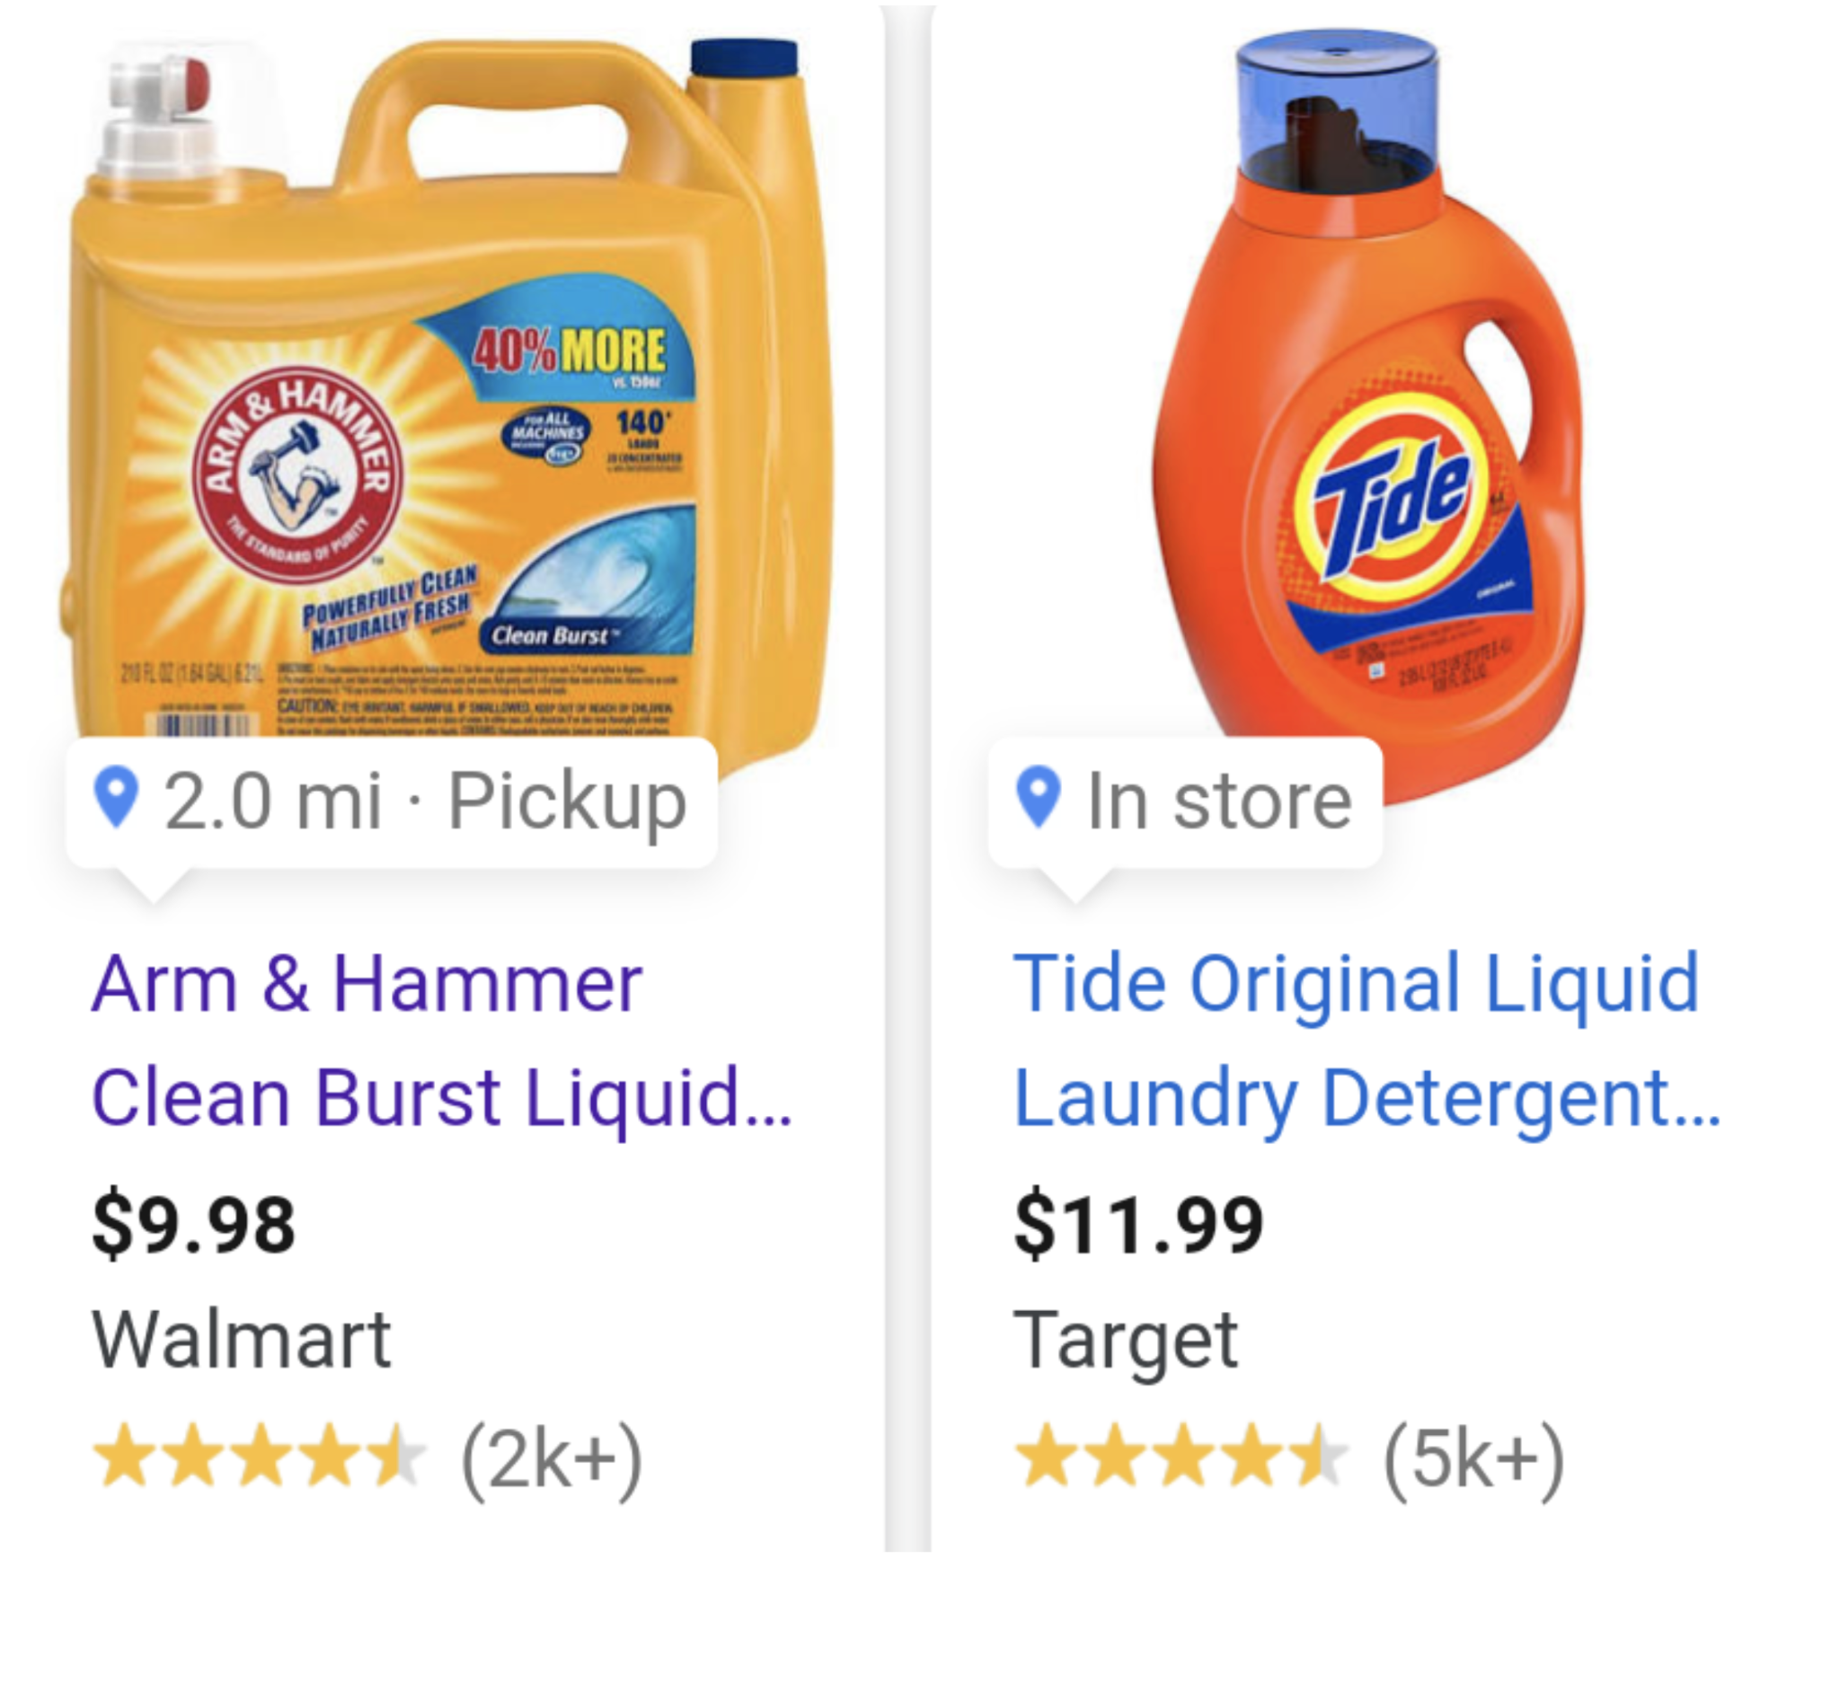


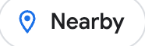


Local Inventory Ads
Drive more in store sales with highly targeted Ads campaigns
Top of Page Results
Image Search
Shopping Tab
2.0 mi · Pickup
Nearby
4.5mi away

Slide 13

3rd party
eCommerce
providers
eCommerce API
Commerce Services for
LS Central
Local Inventory

Slide 14
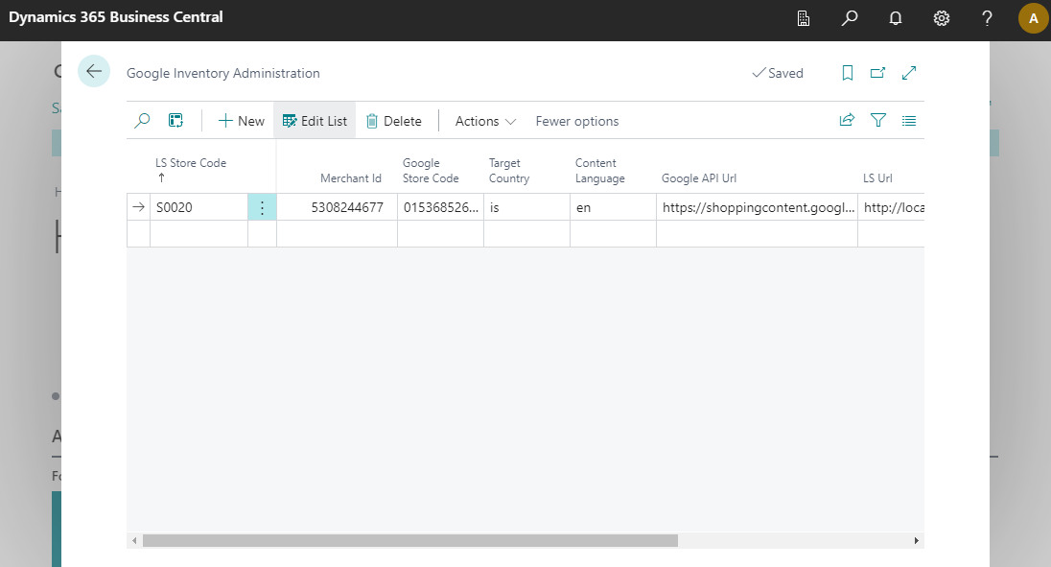
LS Central - Configuration
A role center menu item
First-time approvals – TBA
Merchant sign-up at Google
Configuration:
  LS Central Stores
  Merchant ID
  Google Store Code
  Country / Language
  URLs

Slide 15
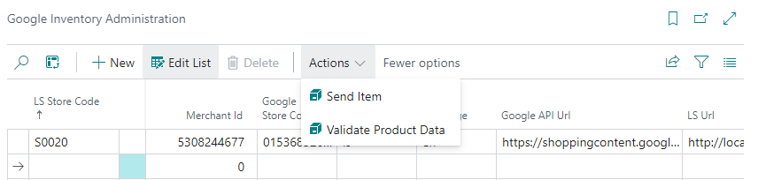
Replicating data to Google
Items
Variants
Prices
Inventory
Barcode number
Driven by a scheduler job
Standard distribution for the store
Manual data validation option
Items visible in Google’s Merchant Center

Slide 16

Released in LS Central v25
Base item replication is complete
Next focus:
Click and Collect
  Direct link from Google to the merchant’s check-out page
Promotion and discount replication
Simplifying the sign-on process for merchants

Slide 17

How to get started?
We seek “first movers”

Slide 18
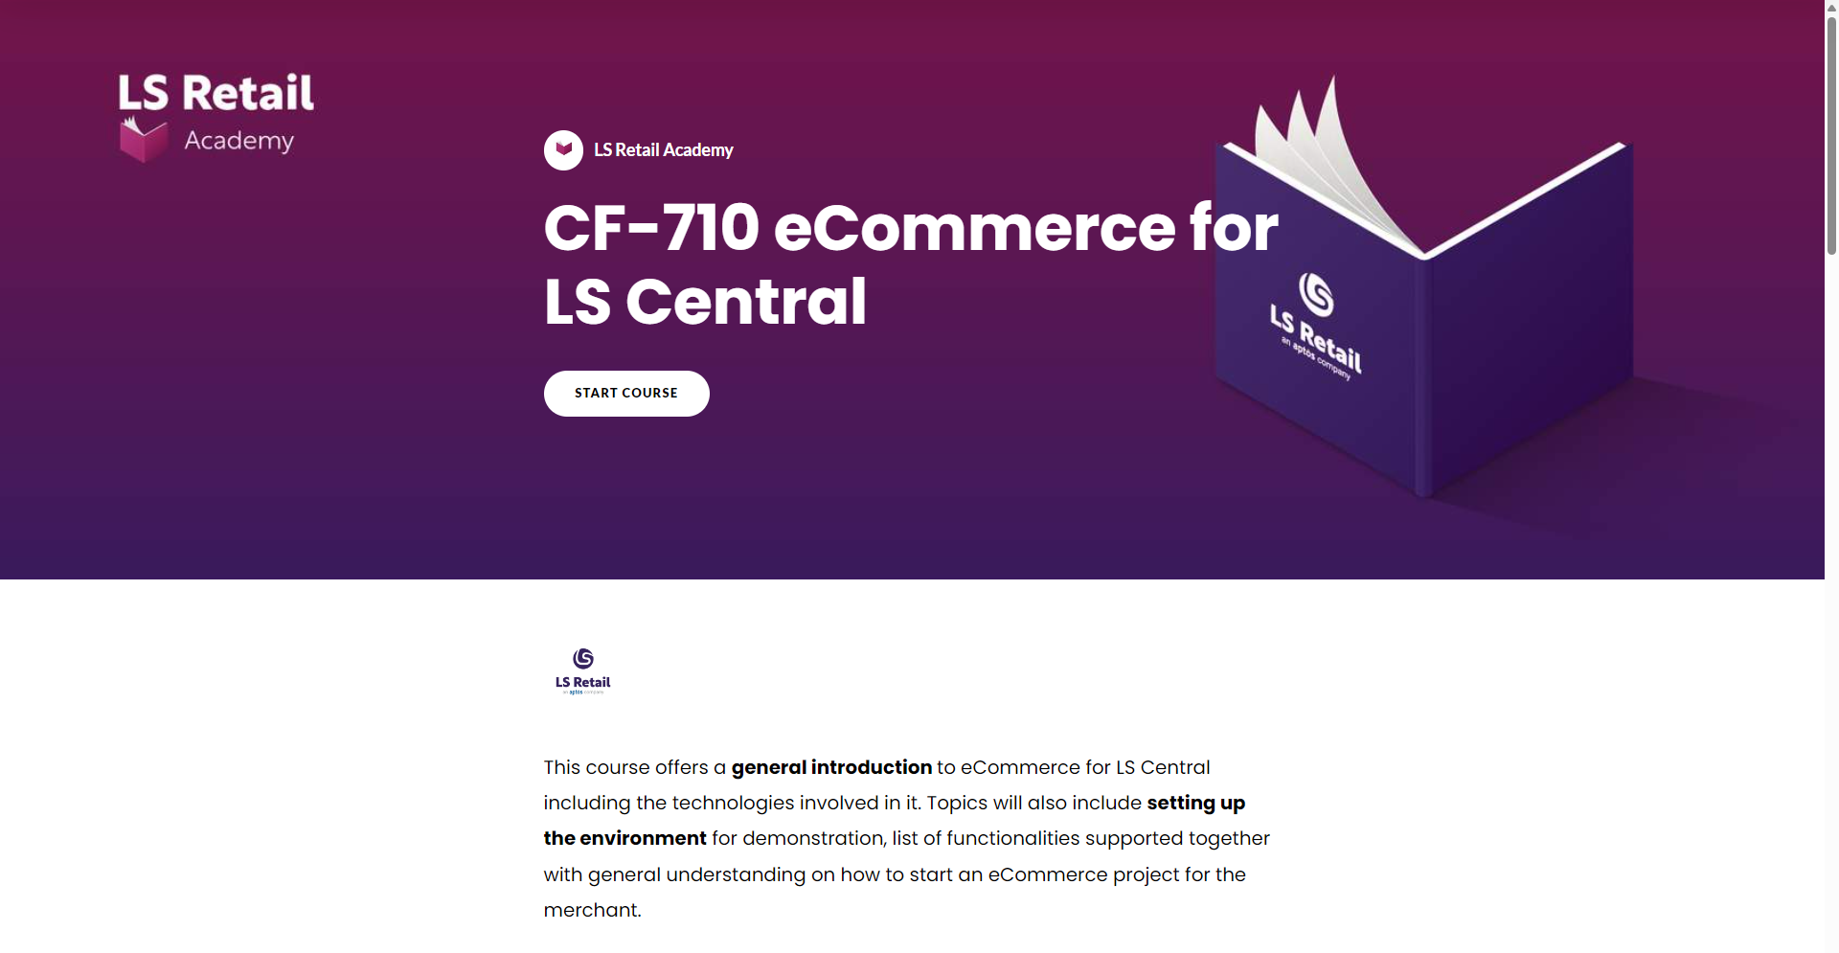
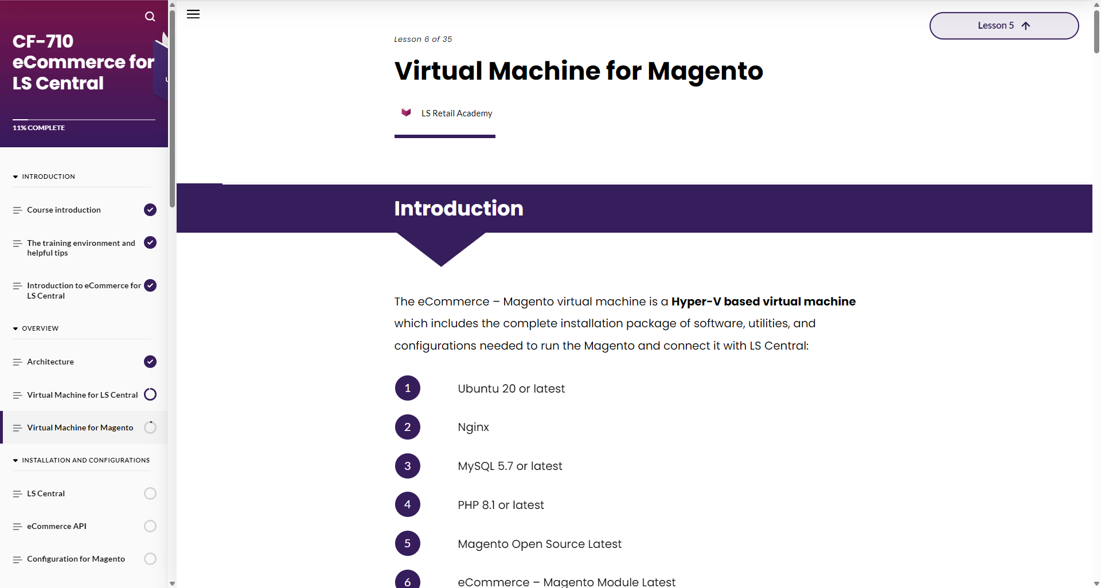
LS Retail Academy course
New on-demand course
CF-710 eCommerce for LS Central
is available on LS Retail Academy LMS
v

Slide 19

More courses to follow…
CF-720 eCommerce for LS Central – Shopify
CF-730 eCommerce for Hospitality
Released in LS Central v.26

Slide 20
Roadmap v26 - Retail
Google Local Inventory - Phase 2
Adobe Commerce/Magento:
POC – Integration to online marketplaces
Stand-alone

Slide 21
Roadmap v26 - Retail
Google Local Inventory - Phase 2
Adobe Commerce/Magento:
POC – Integration to online marketplaces
Stand-alone
Shopify:
LS Retail Academy course
General improvements to support partners

Slide 22
Q&A
Any questions?

