Slide 1



Update Service in real life
Arnthor Magnusson
Damir Babikov
Thorir Bjornsson
Product Owner
Senior Consultant
Customer Technical Lead

Slide 2
Update Service in real life
Arnthor Magnusson
Damir Babikov
Thorir Bjornsson

Slide 3

Packages
Components split into multiple packages
Package is a zip archive:
  Installation files
  Install scripts
  Manifest
    Name
    ID
    Version

Slide 4
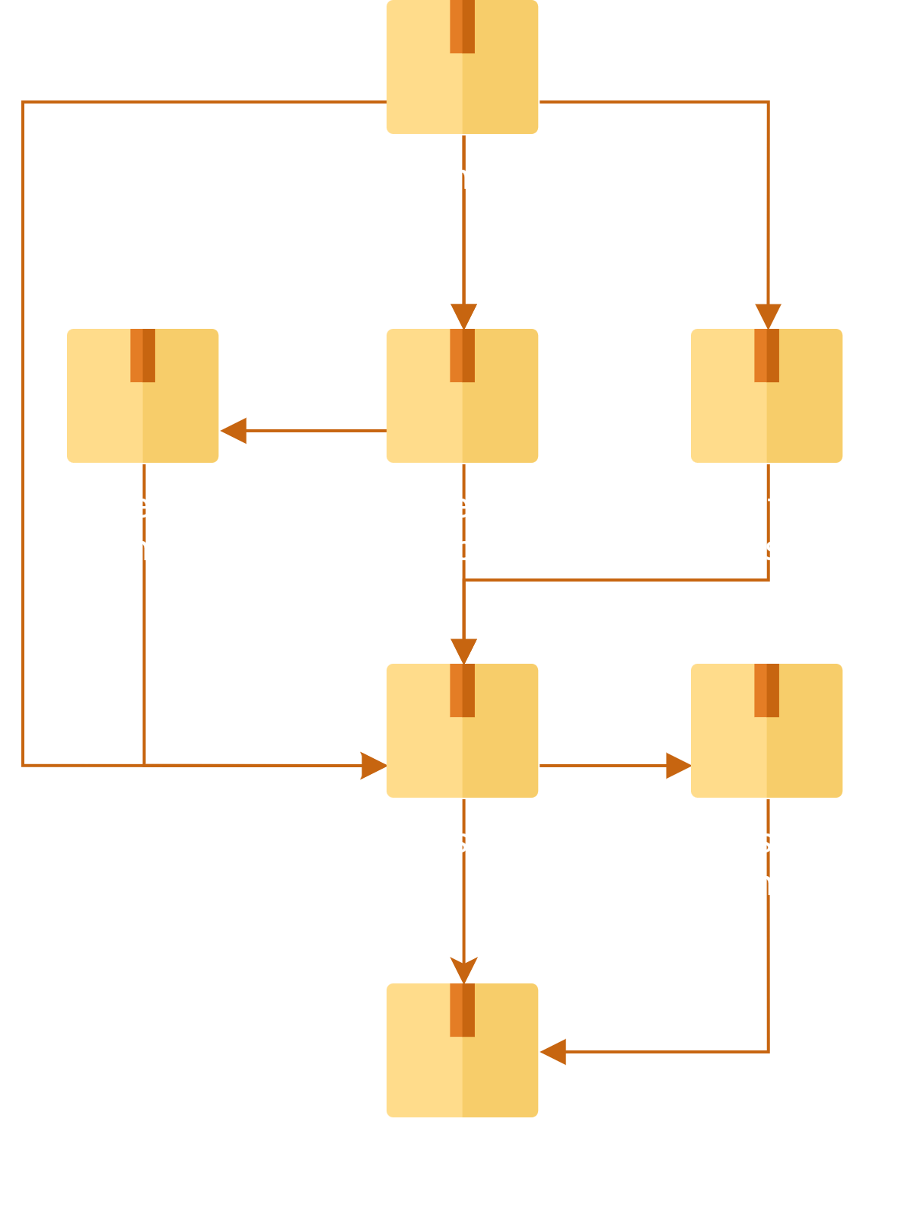
Dependencies
Package can depend on other packages
Installing a package will install its dependencies
Ensures correct order

Slide 5
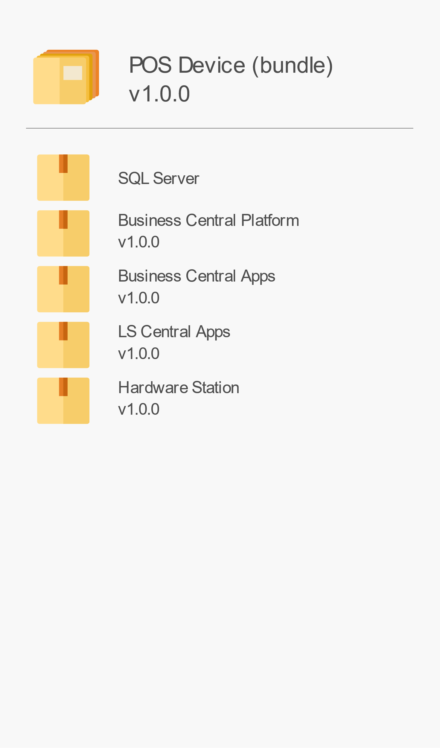
Bundle
Create a bundle to
  Pick components
  Select versions
  Set configuration
Installs all components
In correct order
Bundle a package with dependencies

Slide 6
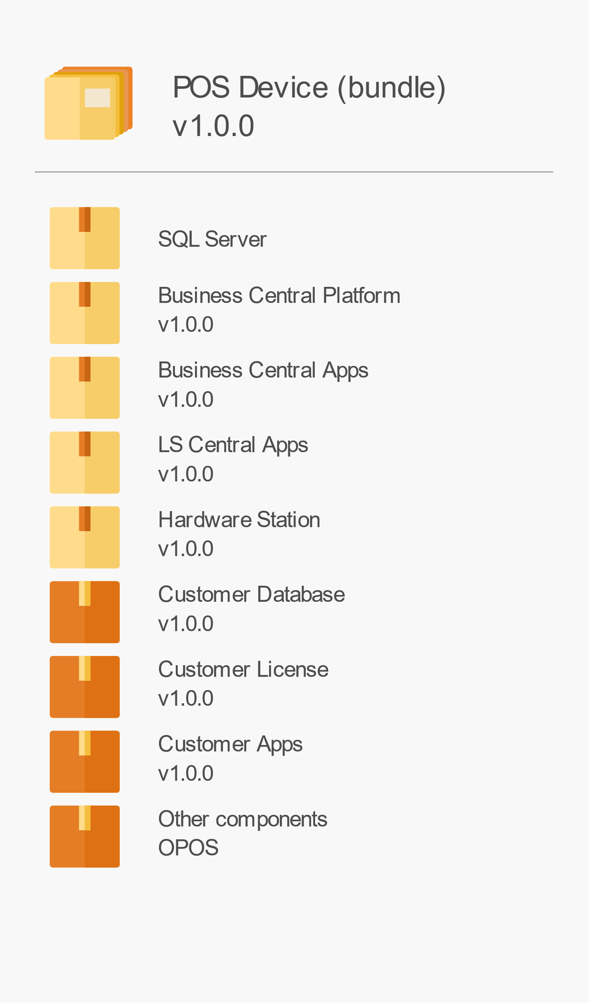
Bundle
Create a bundle to
  Pick components
  Select versions
  Set configuration
Installs all components
In correct order
Bundle a package with dependencies

Slide 7
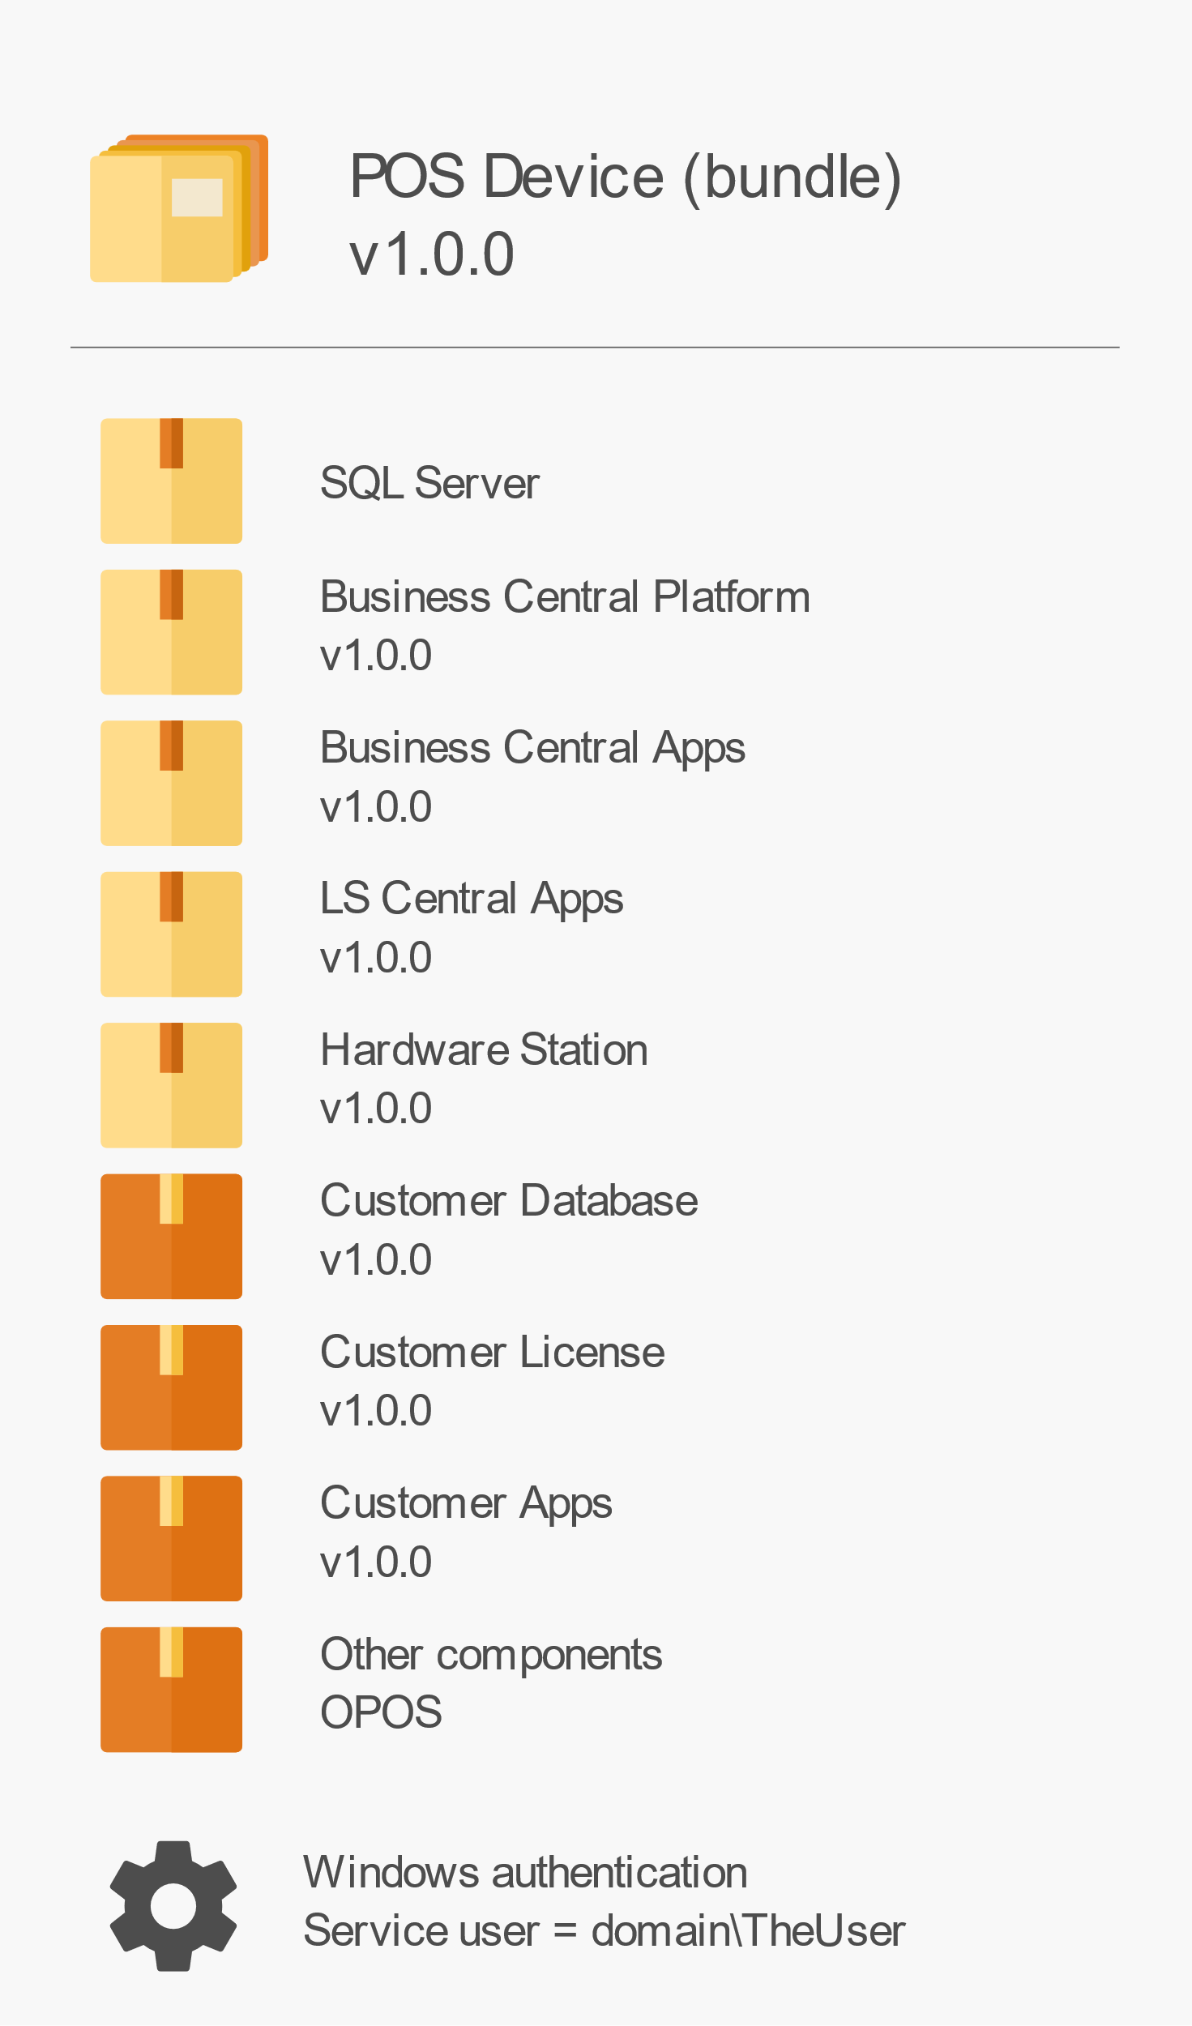
Bundle
Create a bundle to
  Pick components
  Select versions
  Set configuration
Installs all components
In correct order
Bundle a package with dependencies

Slide 8
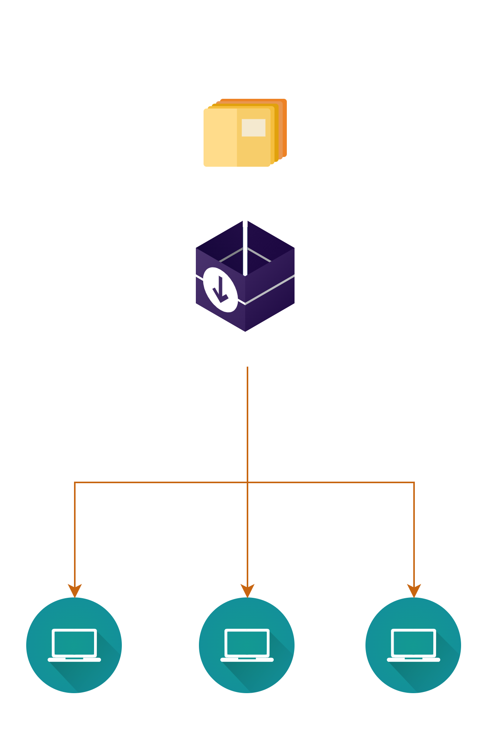
Install: Installer

Slide 9
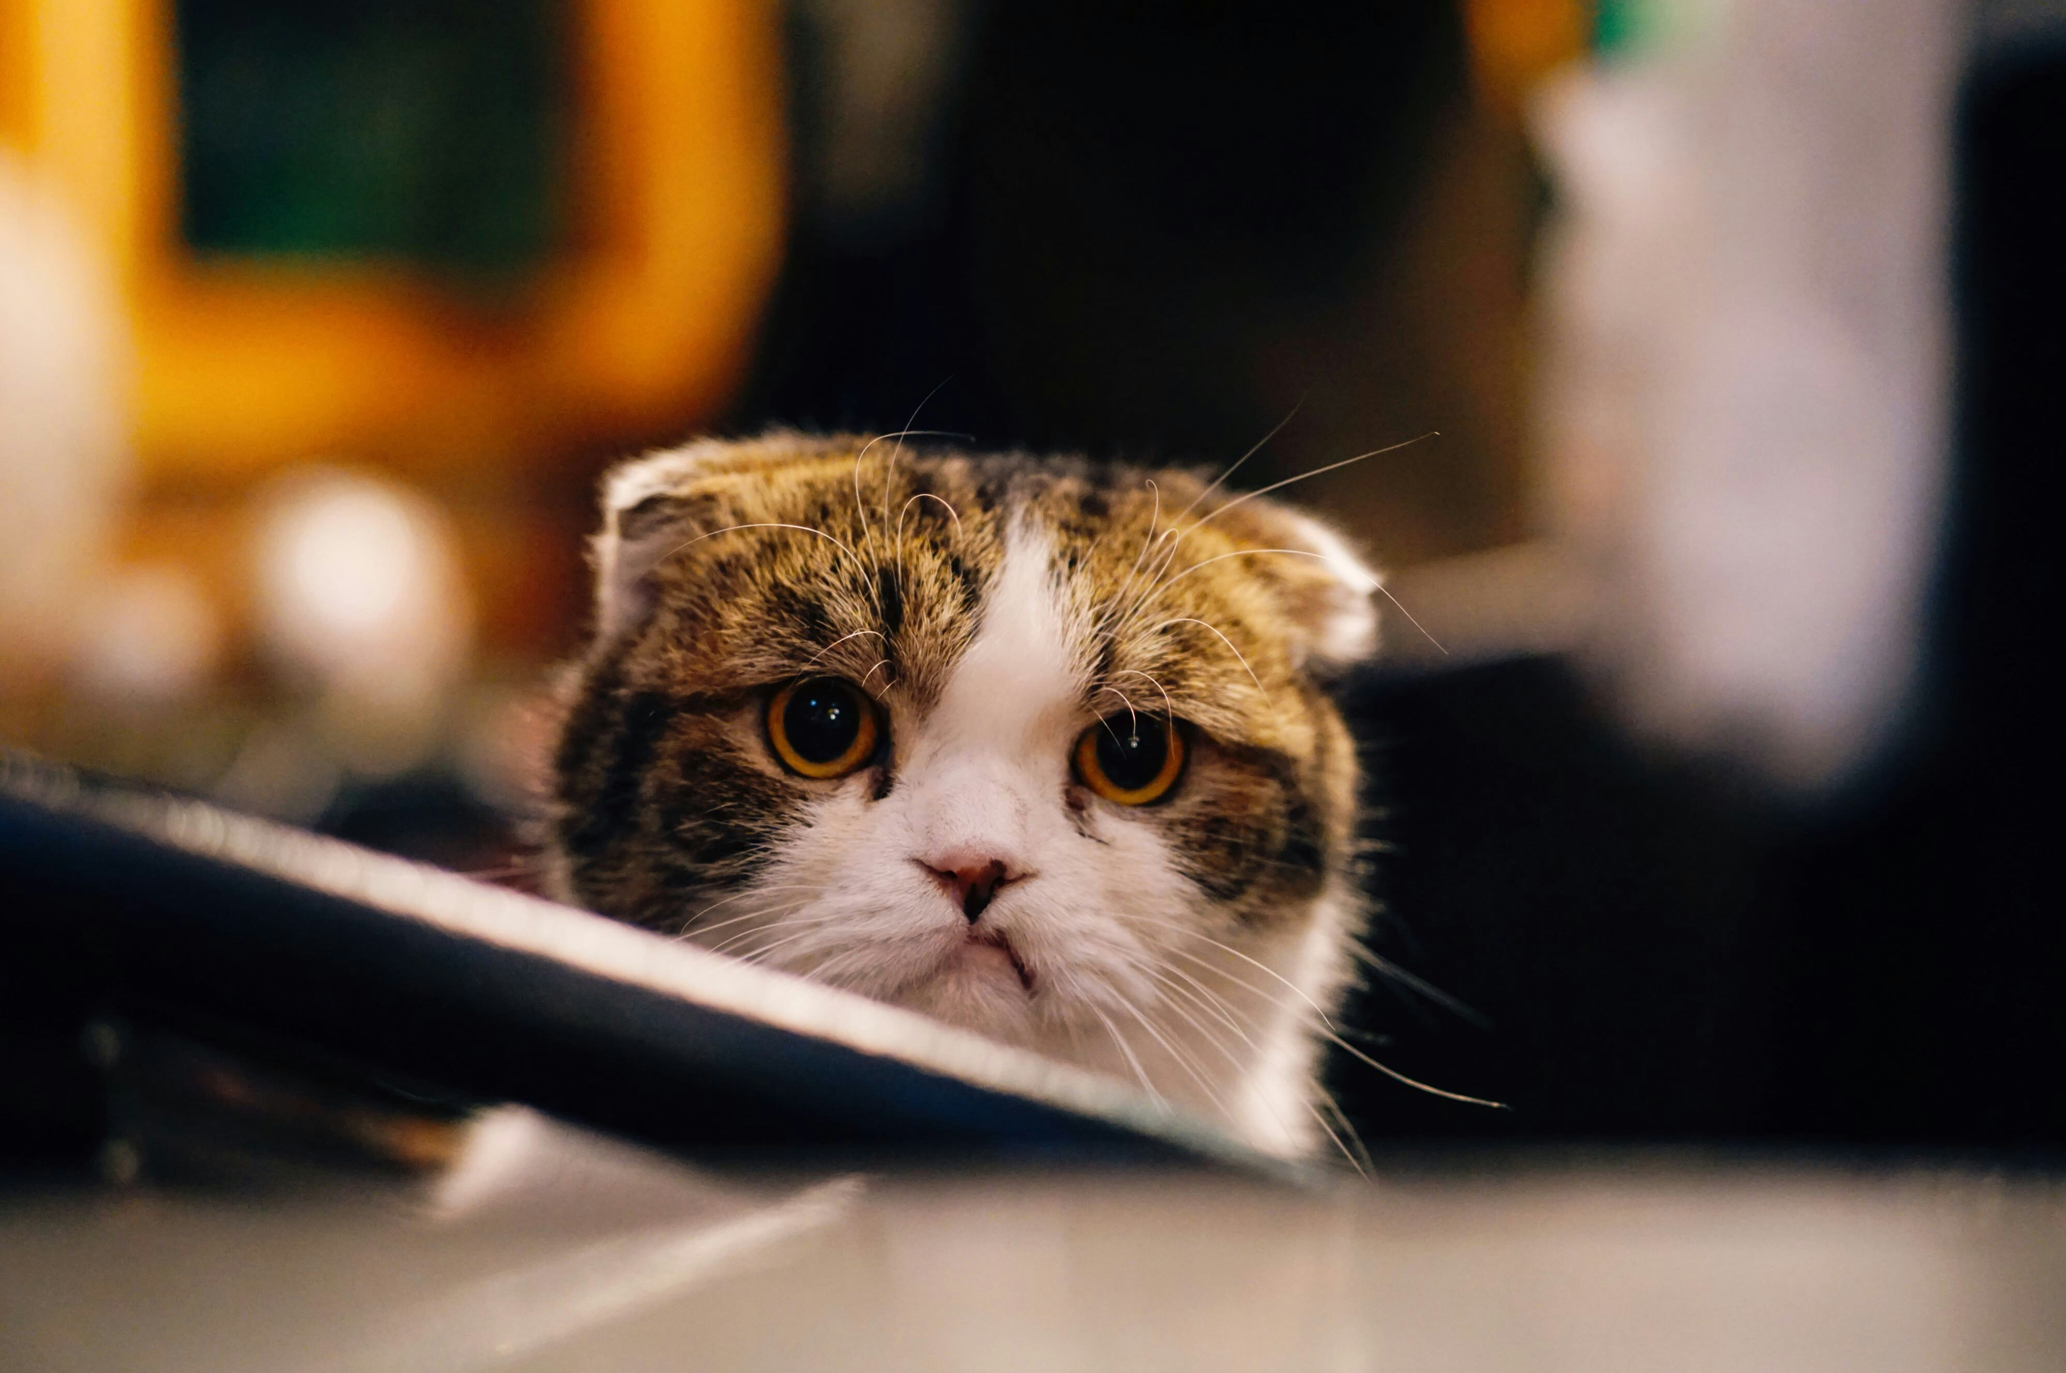
Installation errors!

Slide 10
Installation errors
Common errors
  First install fails – restart required
  Sensitive to Windows updates
  Configuration errors
    I.e. incorrect SQL server
  Apps incompatible
  Destructive schema changes
  Machine out of memory
Online troubleshooting page
help.gocurrent.lsretail.com/docs/ls-central/ troubleshooting.html

Slide 11
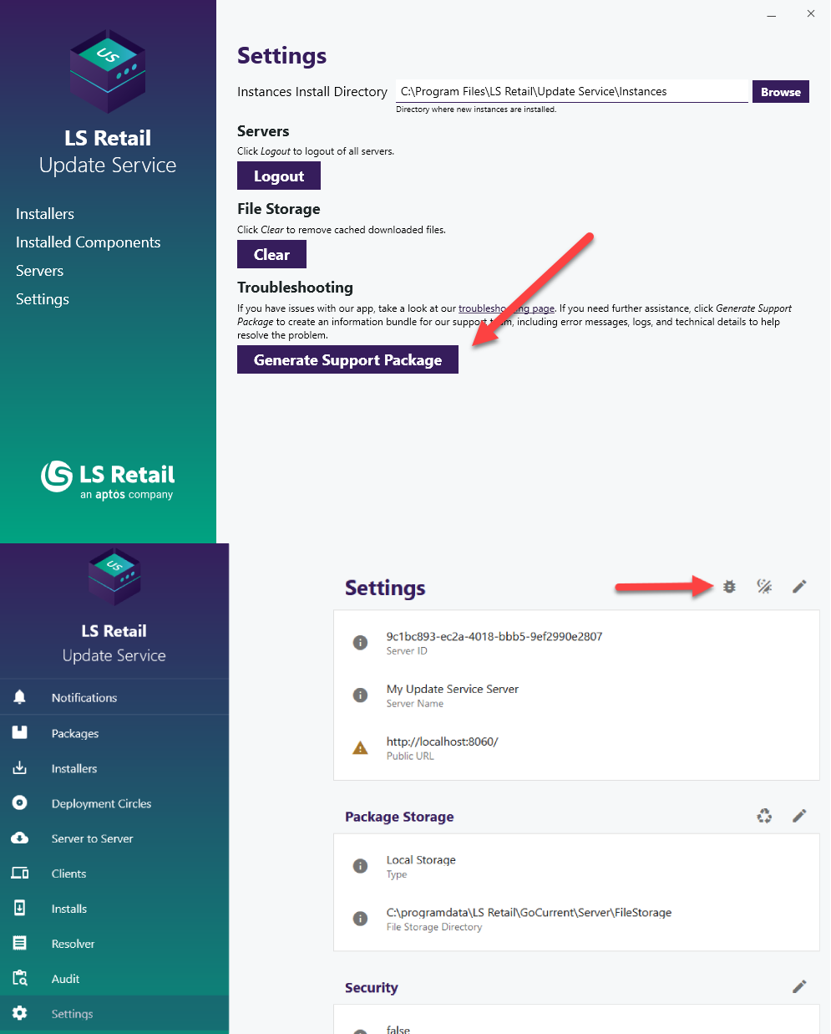
Support package
Client and server
Include necessary information for troubleshooting
  Application logs
  Event viewer
  Installed components
Reduces the time to resolve the issue

Slide 12
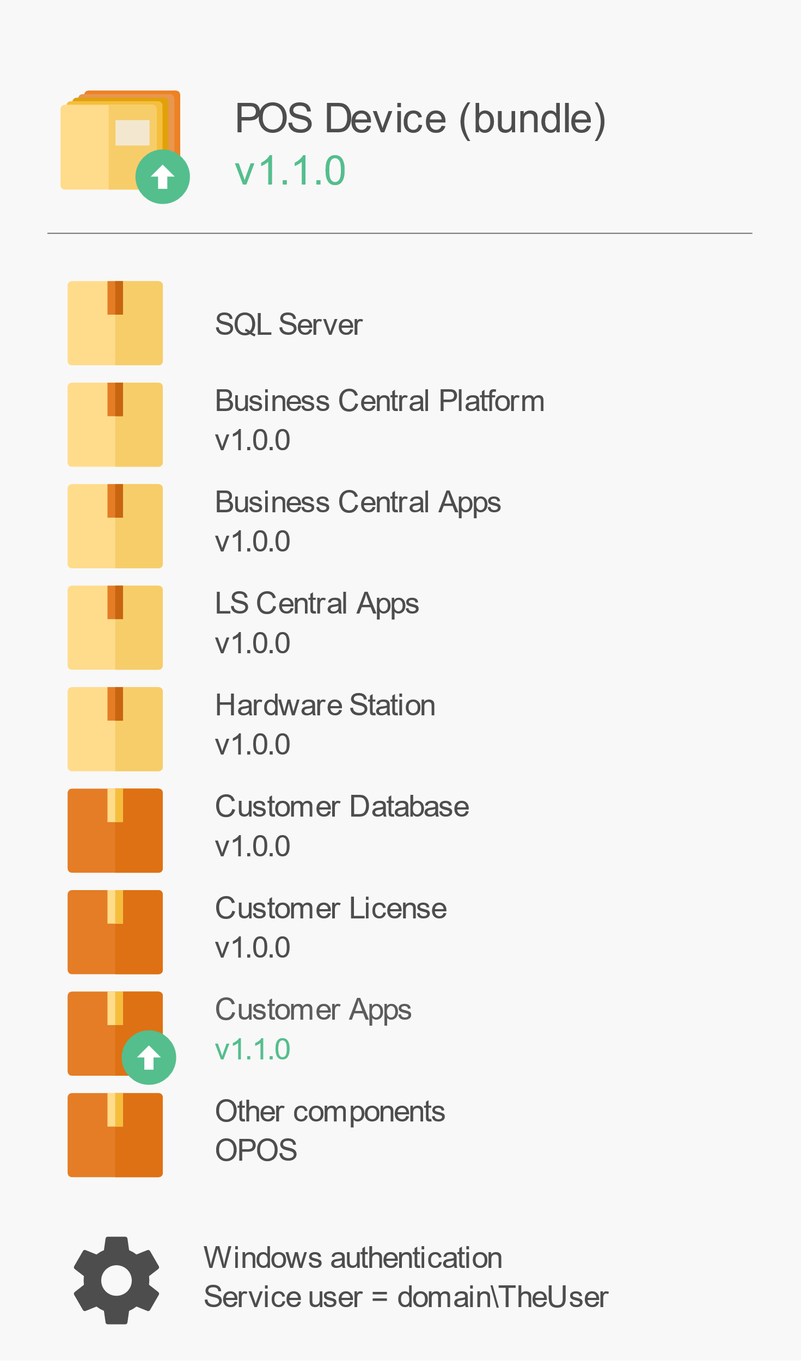
Update bundle
Update customer apps 1.1.0
Update bundle to 1.1.0

Slide 13
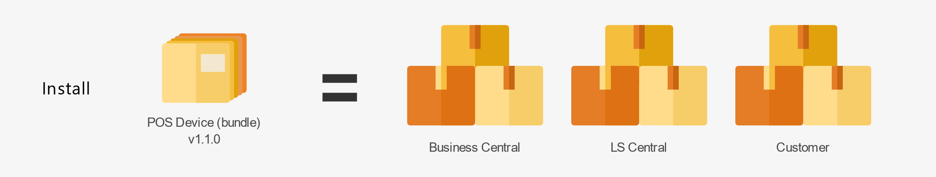
Update bundle
Update customer apps 1.1.0
Update bundle to 1.1.0

Slide 14
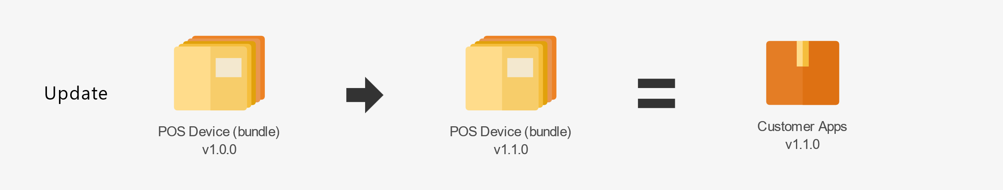
Update bundle
Update customer apps 1.1.0
Update bundle to 1.1.0

Slide 15
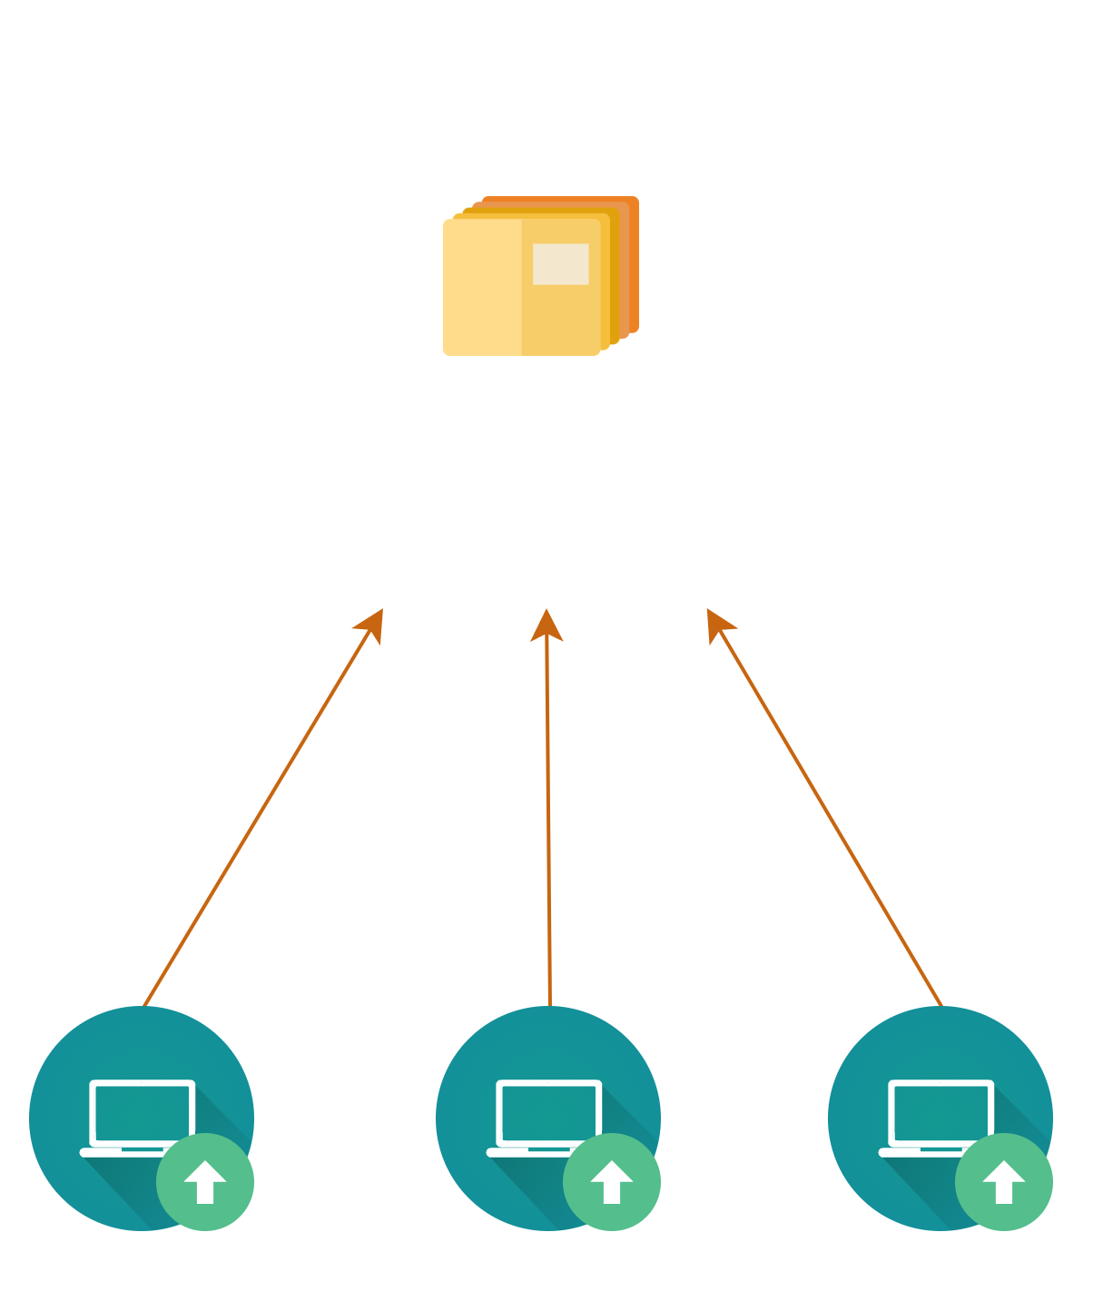
Update

Slide 16

Servers_

Slide 17
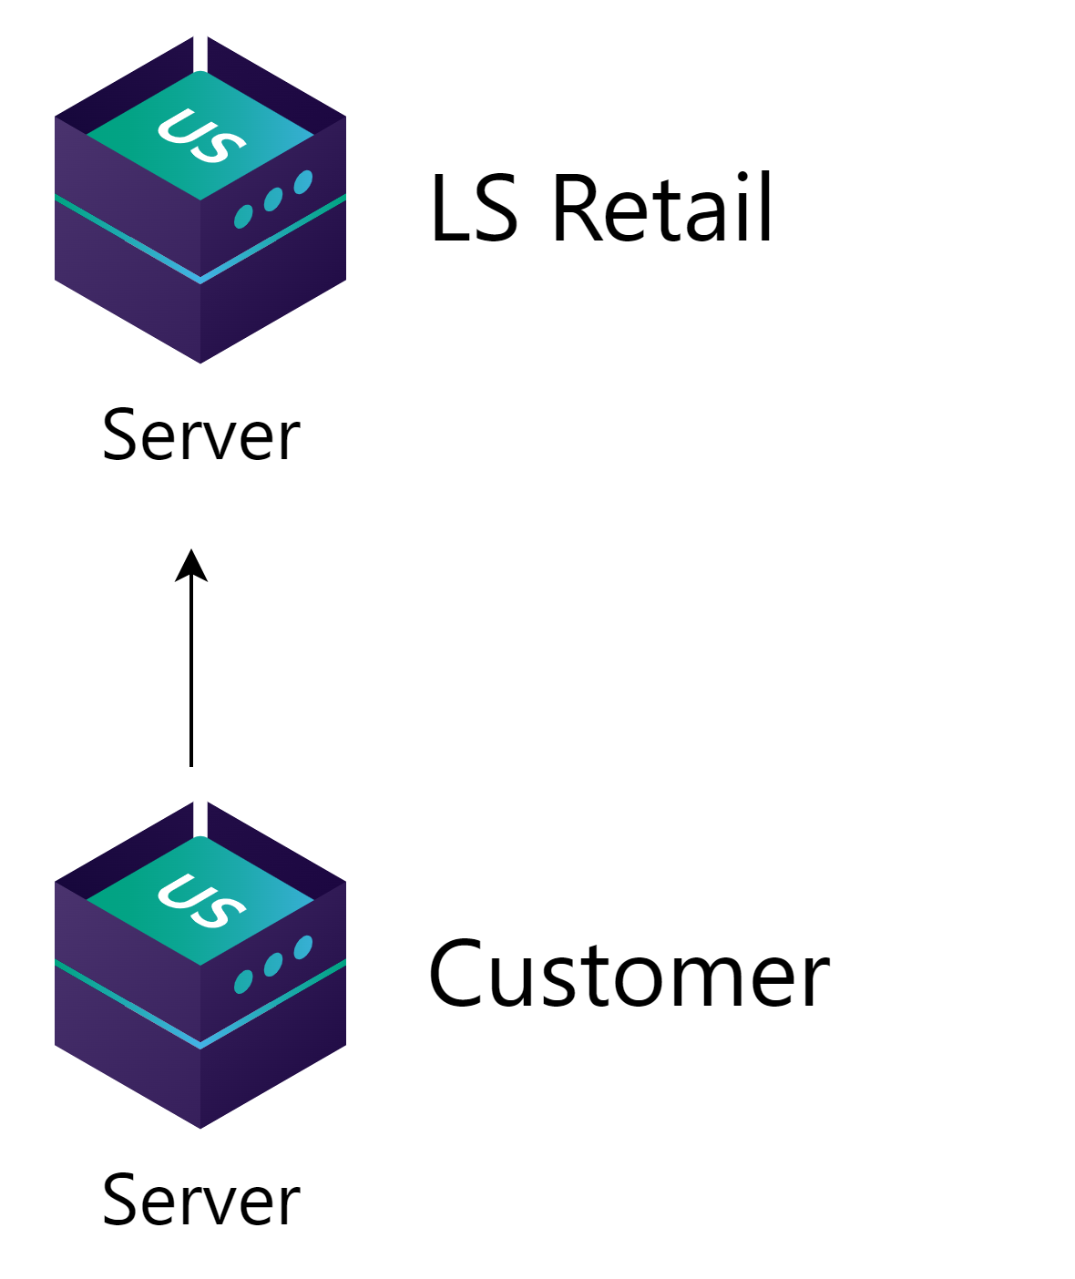
Customer setup
LS Retail provides standard packages
  LS Central
  Business Central
  SQL server
  And more
Adds any customer specific packages

Slide 18
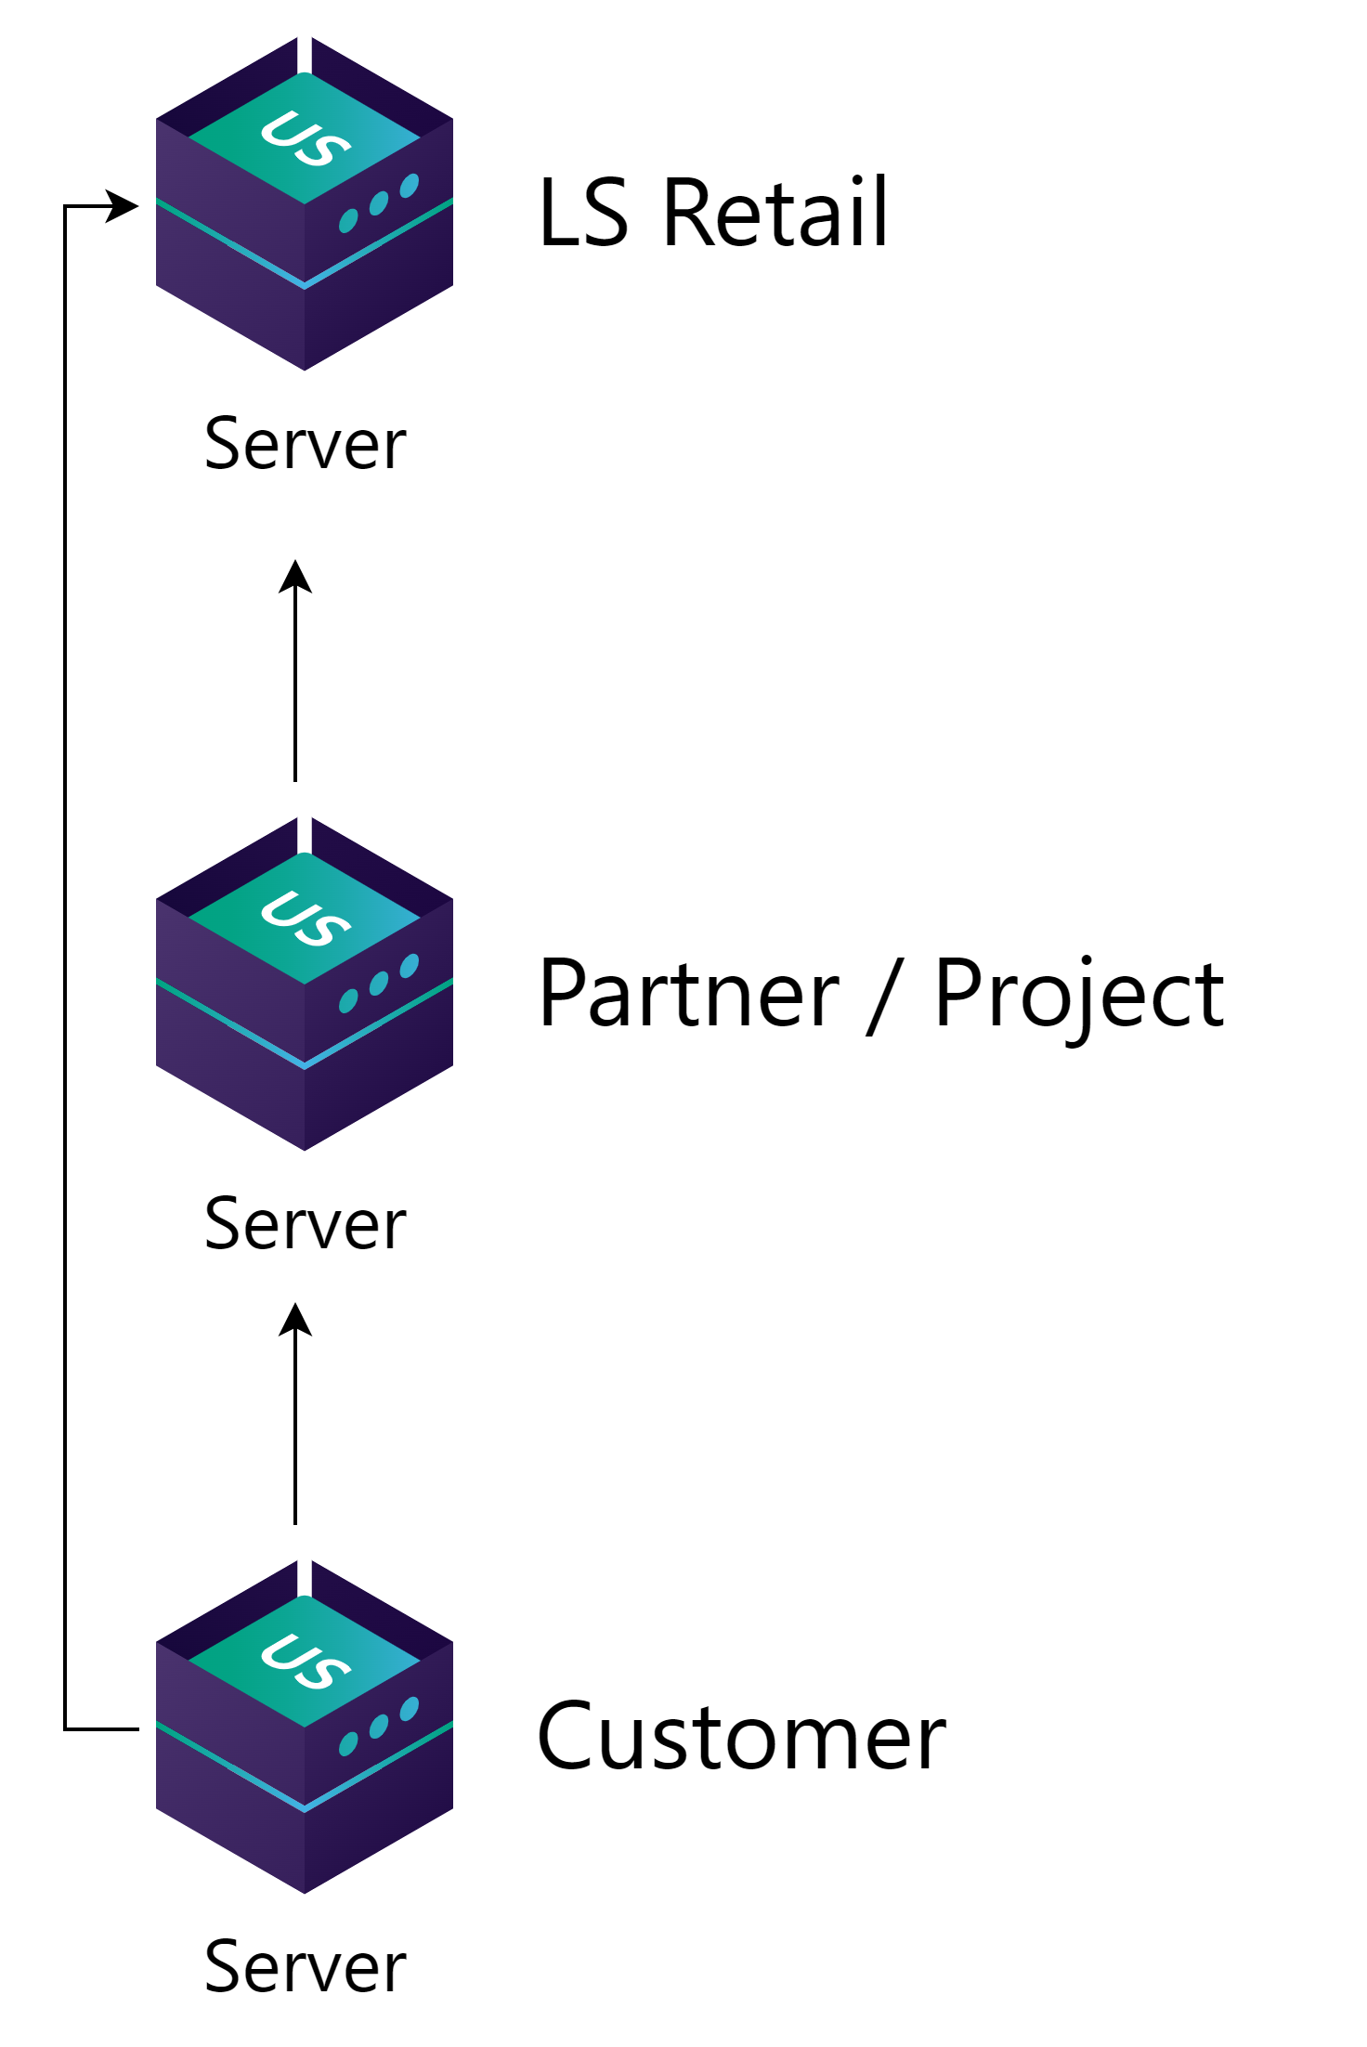
Partner to customer setup
Get standard packages from LS Retail
  LS Central
  Business Central
Develop and test apps and other packages on partner’s server
Deliver packages to customer server

Slide 19
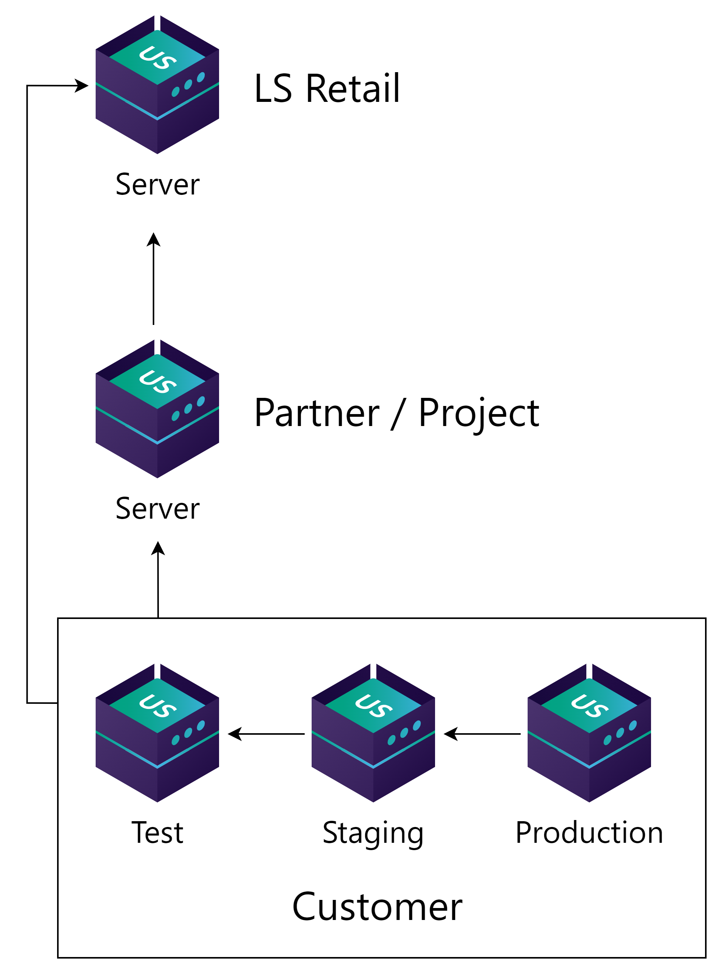
Partner to customer setup
Get standard packages from LS Retail
  LS Central
  Business Central
Develop and test apps and other packages on partner’s server
Deliver packages to customer server

Slide 20
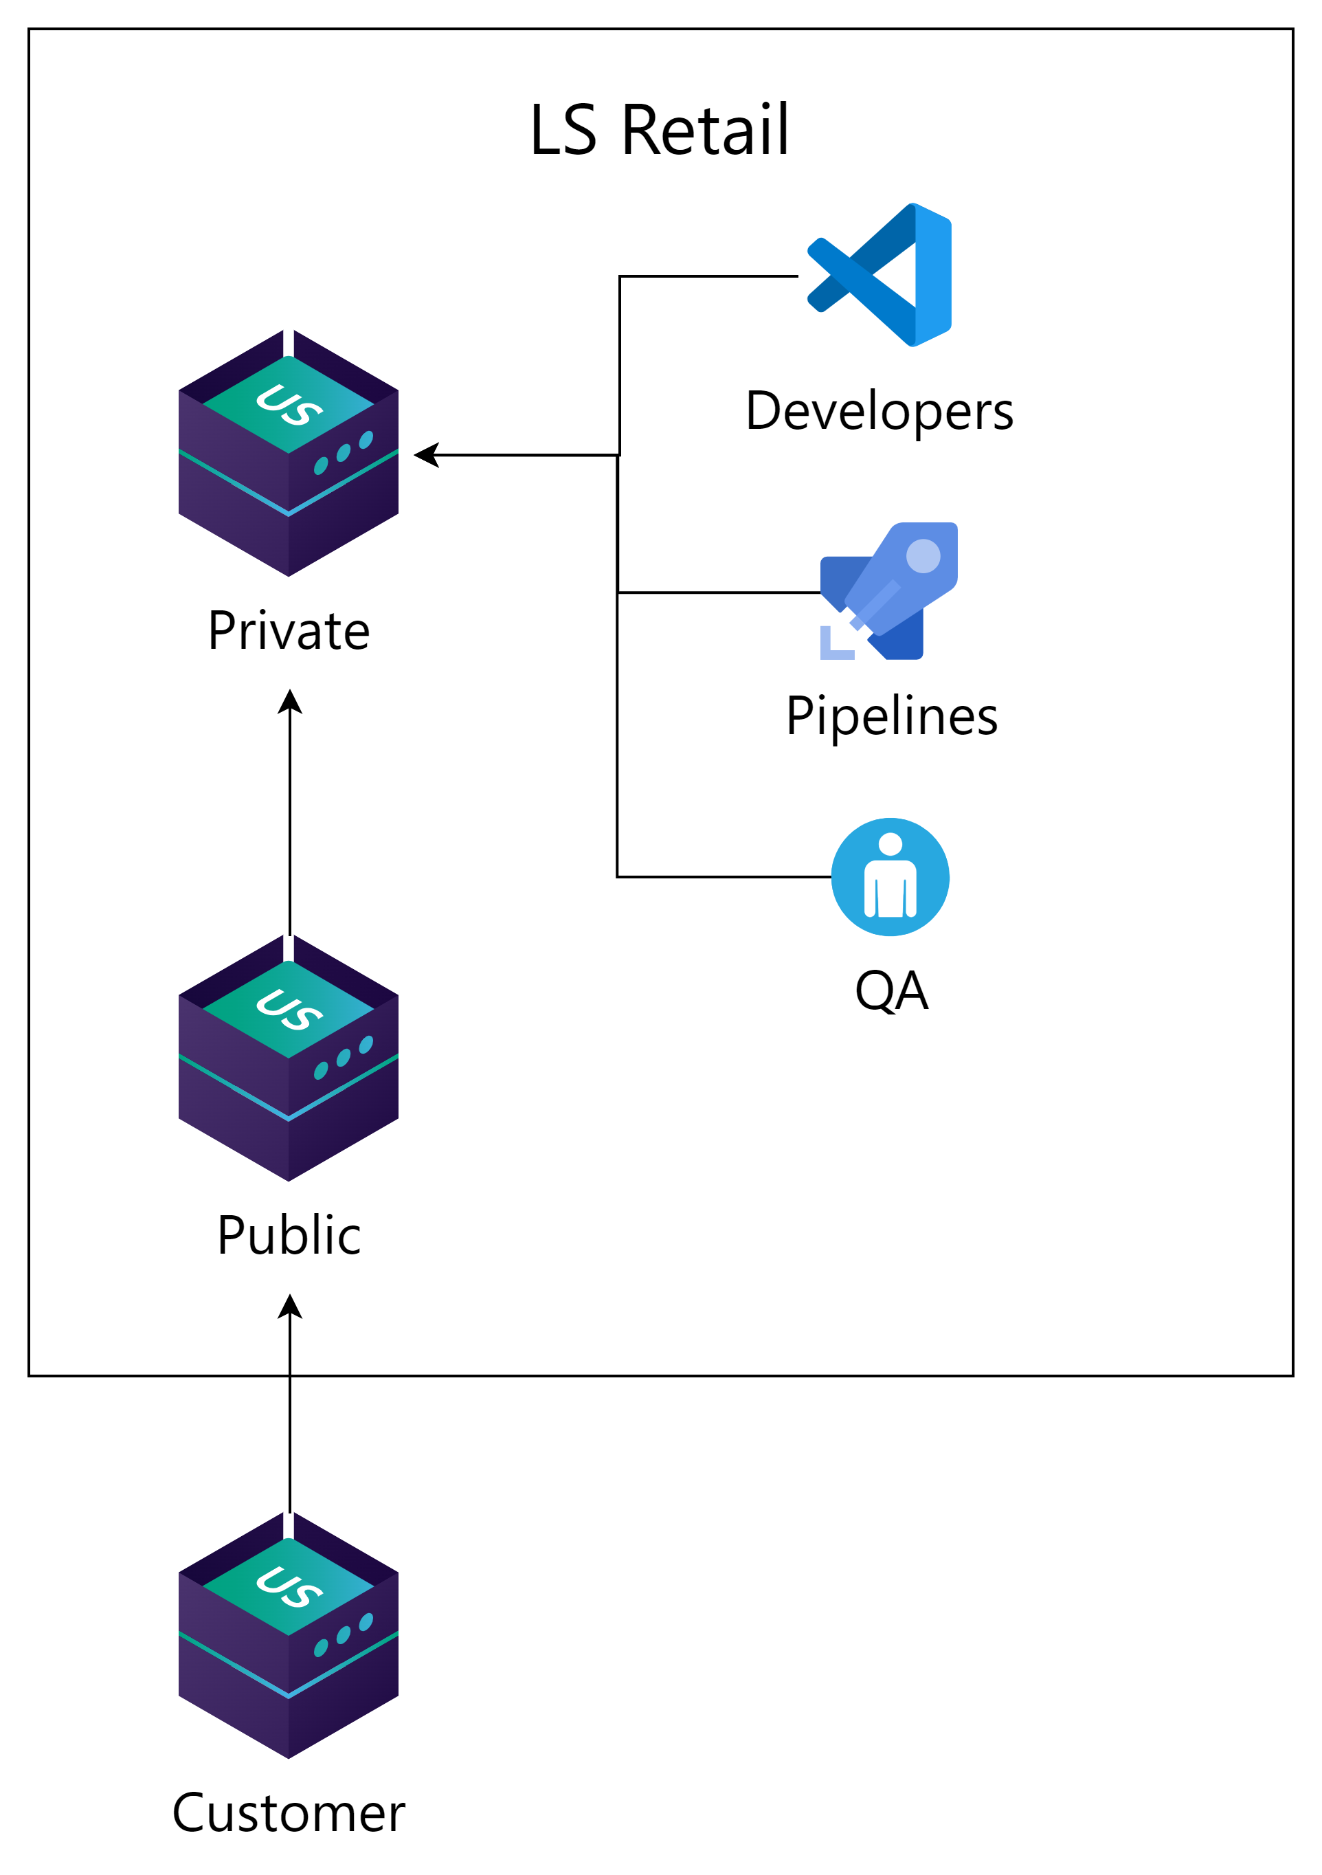
LS Retail setup
Get standard packages from LS Retail
  LS Central
  Business Central
Develop and test apps and other packages on partner’s server
Deliver packages to customer server

Slide 21

Release 1.2.0_

Slide 22
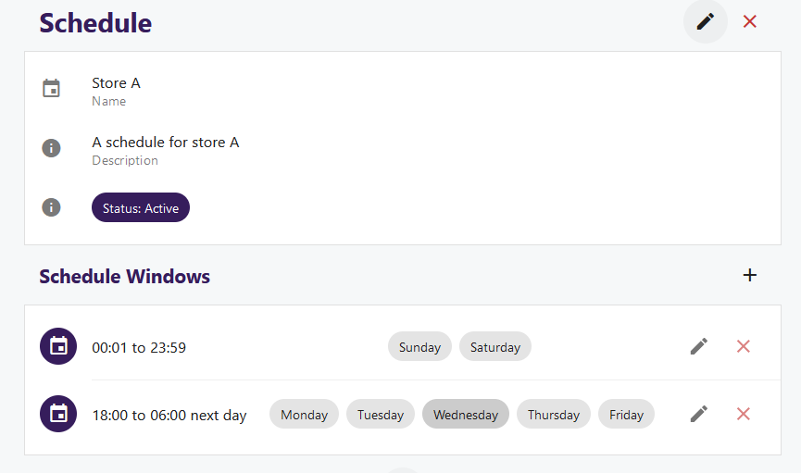
NEW: Scheduling window
A way to limit when a client can deploy updates during the day or week.

Slide 23
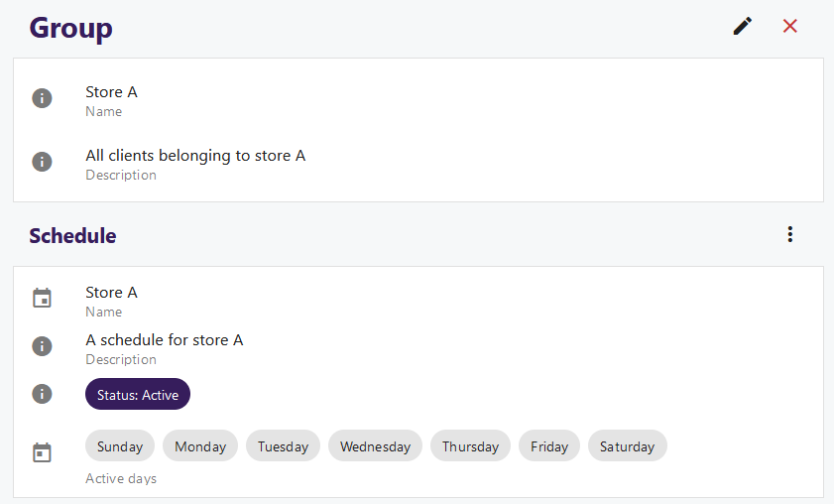
NEW: Groups
Organize clients into logical groups
Assign schedule windows to groups
Assign to circles

Slide 24

Update Service, as a service
In progress
Hosted by LS Retail
Update Service application support
Platform and infrastructure
  Manage multiple customers
  Commerce, KDS and other non-bc based services.
Rapid prototyping inhouse

Slide 25

Road ahead
Simplify Update Service
  Reduce the need for PowerShell
  Managing bundles, packages from UI
Improved deployments
  Deploy new installation from server
  Manage client software on server

Slide 26
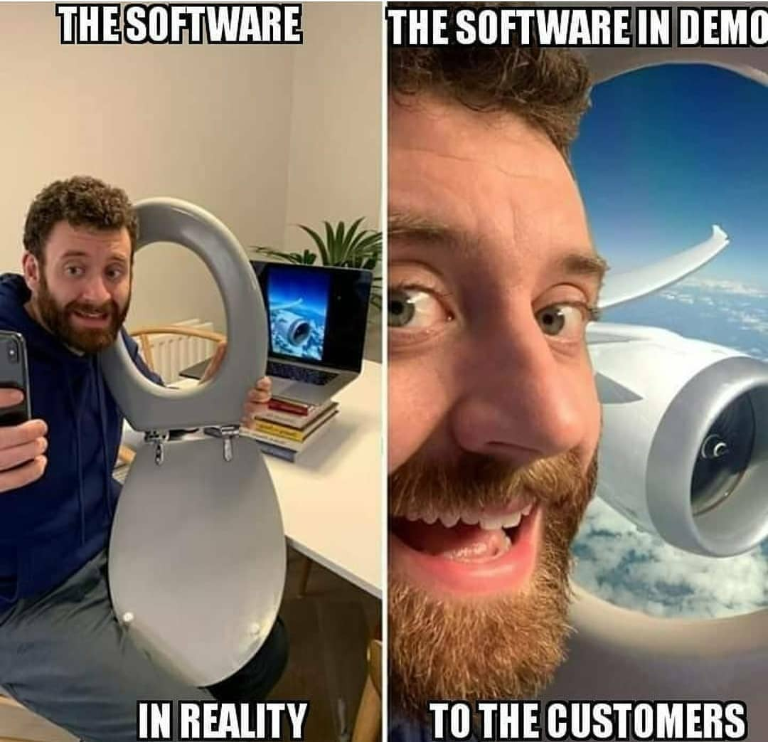
Demo

Slide 27

Getting started
Online help:
https://help.updateservice.lsretail.com/
PowerShell basics
Install LS Central with PowerShell
Project lifecycle
  Step by step guide
  Video series
  Do a test project

Slide 28

Need help?
Yammer group
  https://yammer.com/gocurrent
  Troubleshooting
  Consulting
  Feedback
  Community - anyone can help
LS Retail Partner Support
  Troubleshooting
  Urgent matters
  Customer specific

Slide 29

Questions?

