Slide 1
How to simplify offline POS for small and large SaaS implementations
Matthías Matthíasson
Director of Partner Experience
Thorir Björnsson
Customer Technical Lead

Slide 2




Offline POS history
Pre SaaS
  Data Director
HEAD OFFICE IN
on-premise
Direct SQL Access​
DATA DIRECTOR
STORE 1
STORE 2
Offline POS
Offline POS
Offline POS
Offline POS

Slide 3



Offline POS history
HEAD OFFICE IN
BC SaaS
Pre SaaS
  Data Director
SaaS
  Hybrid Component Server
DD Webservice mode​
HYBRID COMPONENT SERVER
POS MASTER
DATA DIRECTOR
UPDATE SERVICE
STORE 1
STORE 2
Offline POS
Offline POS
Offline POS
Offline POS

Slide 4
Offline POS history
Pre SaaS
  Data Director
SaaS
  Hybrid Component Server
The NEW replication
  Azure Storage Replication
    No more Hybrid Component Server
HEAD OFFICE IN
BC SaaS
UPDATE SERVICE
STORE 1
STORE 2
Offline POS
Offline POS
Offline POS
Offline POS

Slide 5

Offline POS history
Azure Storage Account
  Owned by customer
HEAD OFFICE IN
BC SaaS
STORE 1
STORE 2
Offline POS
Offline POS
Offline POS
Offline POS

Slide 6


Offline POS history
Azure Storage Account
  Owned by customer
Scheduler Replication Job
  Creates a package
  Registers destinations
HEAD OFFICE IN
BC SaaS
STORE 1
STORE 2
10
15
POS | Created | Inform. | Import.
10 | X
15 | X
Offline POS
Offline POS
Offline POS
Offline POS

Slide 7
Offline POS history
Azure Storage Account
  Owned by customer
Scheduler Replication Job
  Creates a package
  Registers destinations
POS inquires about data for that POS
  POS fetches package information from HO
HEAD OFFICE IN
BC SaaS
STORE 1
STORE 2
10
15
POS | Created | Inform. | Import.
10 | X
15 | X | X
Offline POS
Offline POS
Offline POS
Offline POS

Slide 8
Offline POS history
Azure Storage Account
  Owned by customer
Scheduler Replication Job
  Creates a package
  Registers destinations
POS inquires about data for that POS
  POS fetches package information from HO
POS fetches the package from Azure Storage Account
HEAD OFFICE IN
BC SaaS
STORE 1
STORE 2
10
15
POS | Created | Inform. | Import.
10 | X
15 | X | X
Offline POS
Offline POS
Offline POS
Offline POS

Slide 9

Offline POS history
Azure Storage Account
  Owned by customer
Scheduler Replication Job
  Creates a package
  Registers destinations
POS inquires about data for that POS
  POS fetches package information from HO
POS fetches the package from Azure Storage Account
Package imported to POS and marked as completed at HO
HEAD OFFICE IN
BC SaaS
STORE 1
STORE 2
10
15
POS | Created | Inform. | Import.
10 | X
15 | X | X | X
Offline POS
Offline POS
Offline POS
Offline POS

Slide 10
Offline POS - Standard
Azure
BC SaaS
Azure SQL
BC Environment
BC Company
Update Service
Transactions WebService
WebService
App updates

Slide 11
Offline POS - Standard
Azure
BC SaaS
Azure SQL
Master Data
BC Environment
BC Company
Azure Storage
Update Service
Transactions WebService
WebService
App updates

Slide 12


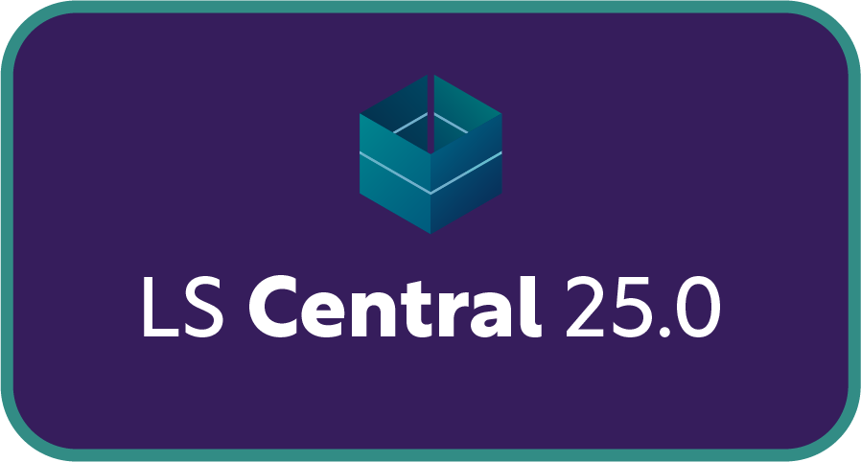
Offline POS - Standard
Azure
BC SaaS
Master Data Message
Service Bus
Azure SQL
Master Data
BC Environment
BC Company
Azure Storage
External Service/
entity
Update Service
Transactions WebService
WebService
App updates

Slide 13




Offline POS - Standard
Azure
BC SaaS
Master Data Message
Service Bus
Azure SQL
Master Data
BC Environment
BC Company
Azure Storage
WebService
External Service/
entity
Commerce Server
Update Service
Transactions WebService
WebService
App updates
WebStore
HHT
Phone

Slide 14

Offline POS - Standard
Azure
BC SaaS
Master Data Message
Service Bus
Azure SQL
Master Data
BC Environment
BC Company
Azure Storage
WebService
External Service/
entity
Commerce Server
Update Service
Transactions WebService
WebService
App updates
WebStore
HHT
Phone

Slide 15

Offline POS - Enterprise
Azure
BC SaaS
Master Data Message
Service Bus
Azure SQL
Master Data
BC Environment
BC Company
Azure Storage
WebService
External Service/
entity
Transaction
WebService
Commerce Server
Message
Queue
Update Service
Transactions
WebService
App updates
WebStore
HHT
Phone

Slide 16
Online POS – Distributed companies
Azure
BC SaaS
Azure SQL
BC Environment
Primary BC Company
BC Company B
Transactions
Master Data
BC Company C
Update Service
App updates
1
2
3
4
Online POS
Online POS
Online POS
Online POS

Slide 17
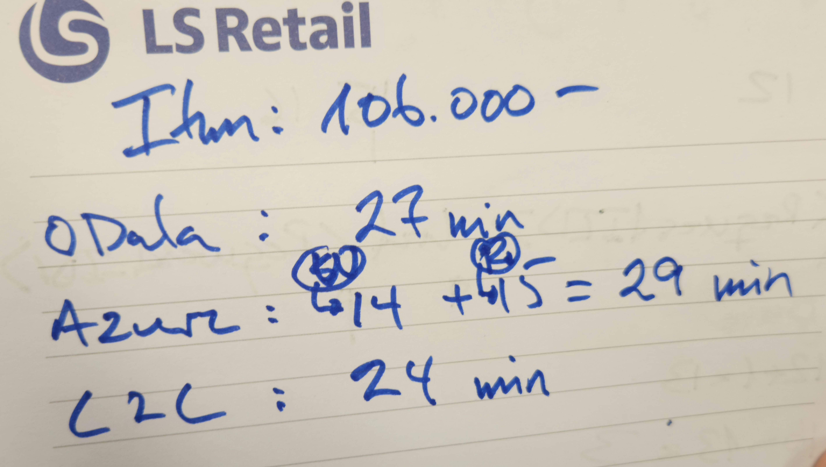
LS Central replication
Scheduler Replication Job
  Replication request
    Sent to Data Director through web service
    Request stored for the web replication process
    Scheduler Web Replication Process
  Request queue table
    Creates data package
    Runs defined method
      Odata Replication
      Azure Storage Replication
      Company Replication
Job
Repl.
Data
Data Director
Request Queue
Web Replication
- OData4
- Azure Storage
- Company

Slide 18
Online POS
BC SaaS
Azure
Azure SQL
BC Environment
Primary BC Company
Commerce Server
Update Service
WebStore
App updates
HHT
Phone
Online POS
Online POS
Online POS
Online POS

Slide 19
Online POS
BC SaaS
Azure
Master Data Message
Azure SQL
Service Bus
Master Data
BC Environment
Primary BC Company
Azure Storage
WebService
External Service/
entity
Commerce Server
Update Service
WebStore
App updates
HHT
Phone
Online POS
Online POS
Online POS
Online POS

Slide 20
Online POS – Distributed companies
Azure
BC SaaS
Azure SQL
BC Environment
Primary BC Company
BC Company B
Transactions
Master Data
BC Company C
Update Service
App updates
1
2
3
4
Online POS
Online POS
Online POS
Online POS

Slide 21
Online POS – Distributed environments
Azure
BC SaaS
Azure SQL
Azure SQL
Transactions
Primary BC Company
BC Company D
Transactions
BC Company B
BC Company E
Master Data
Master Data
BC Company C
Update Service
BC Environment A
BC Environment B
App updates
1
2
3
4
Online POS
Online POS
Online POS
Online POS

Slide 22
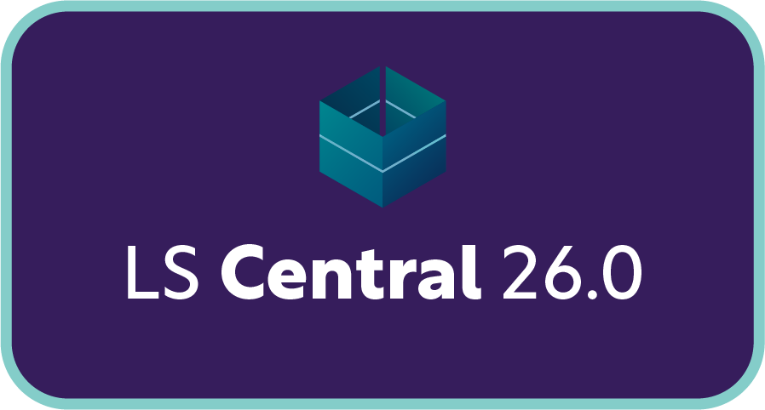

LS Central Cloud
AZURE
LS Central Cloud
BC SaaS
Service Bus
Message
Queue
Commerce Server
Update Service
Azure Storage
LS Central SaaS
Online POS
Online POS
Online POS
Online POS

Slide 23
Update service
Is the corner stone for continues updates
  Online
    Appshell / Hardwarestation / OPOS drivers / Registry files
  Offline POS
    Same as in online pos
    BC service tier
    DB
    SQL server
    Data Director

Slide 24
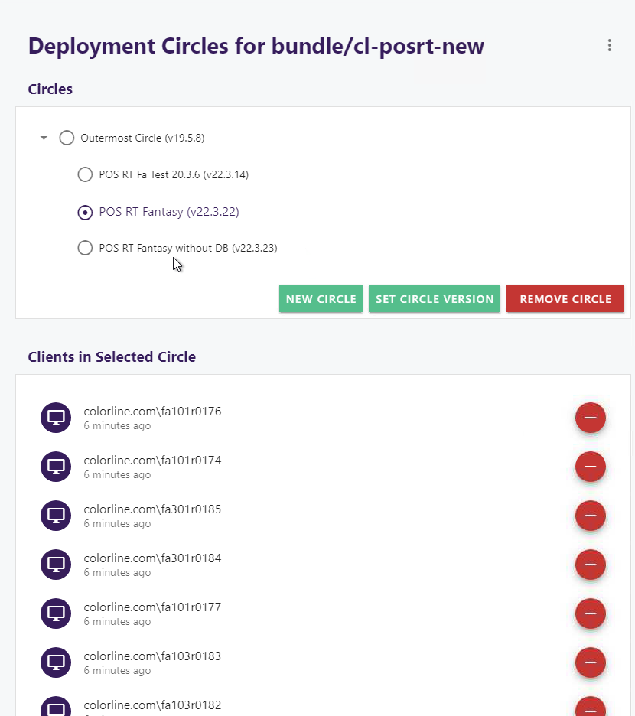
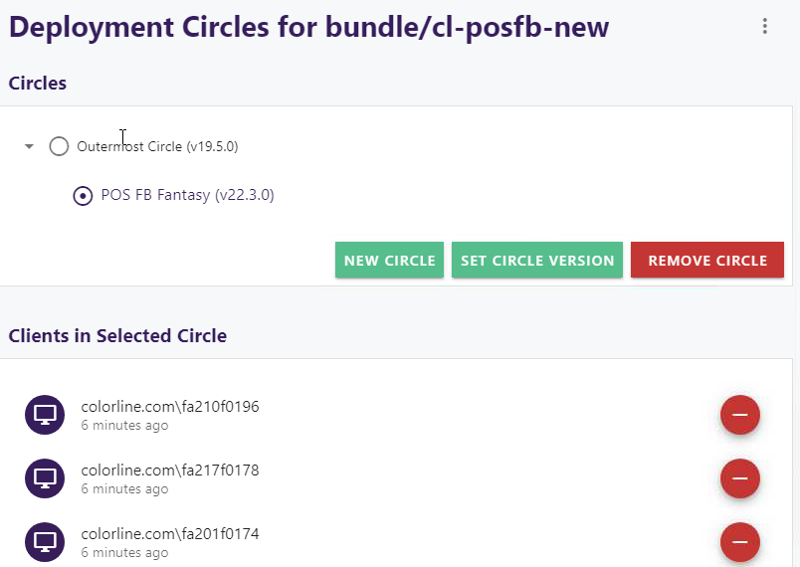
Update Service Deployment Circles

Slide 25



Update Service - Making things easier, simpler, faster

Slide 26
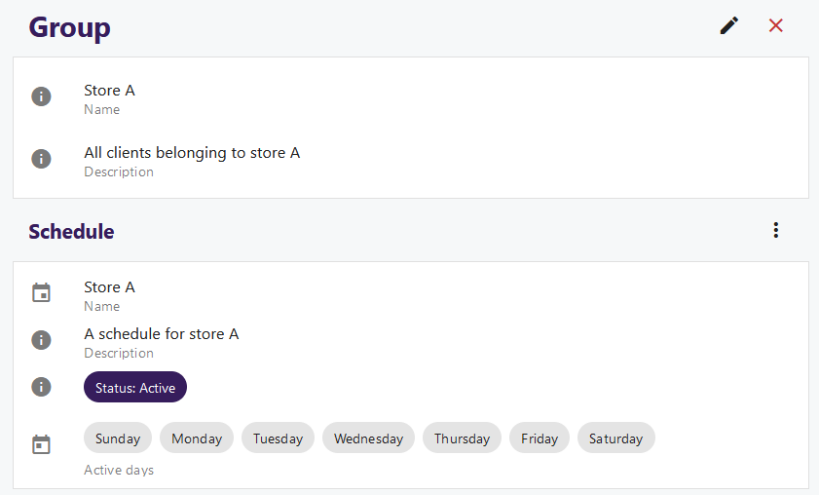
Groups
Organize clients into logical groups
Assign schedule windows to groups
Assign to circles

Slide 27
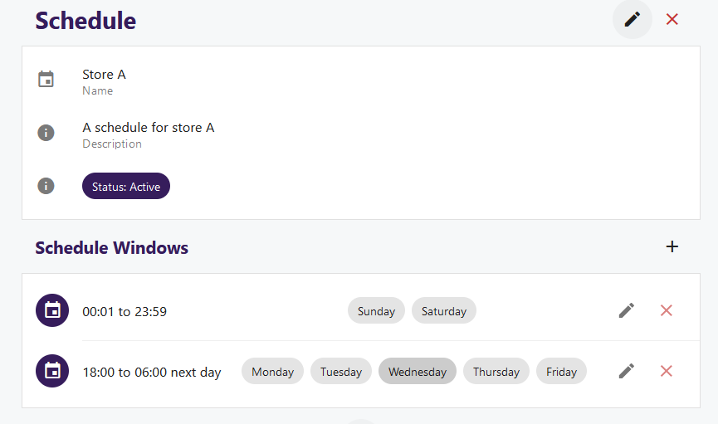
Scheduling window
A way to limit when a client can deploy updates during the day or week.
Create time slots for upgrade
Which day

Slide 28
Thank you
Matthías Matthíasson
Director of Partner Experience
Thorir Björnsson
Customer Technical Lead

