Slide 1


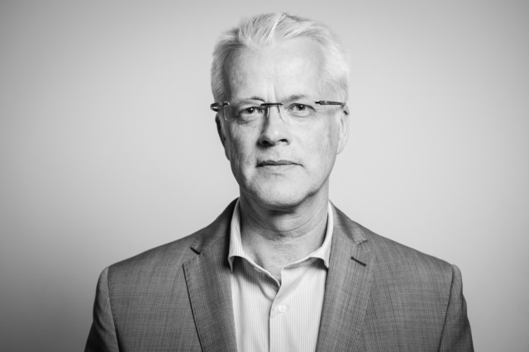
Run successful events with Bookings for LS Central
Anna Dis Thorvaldsdottir
Gunnar Orn Thorsteinsson
Eggert Gudmundsson
Consulting Manager
Product Director
Solution Lead

Slide 2
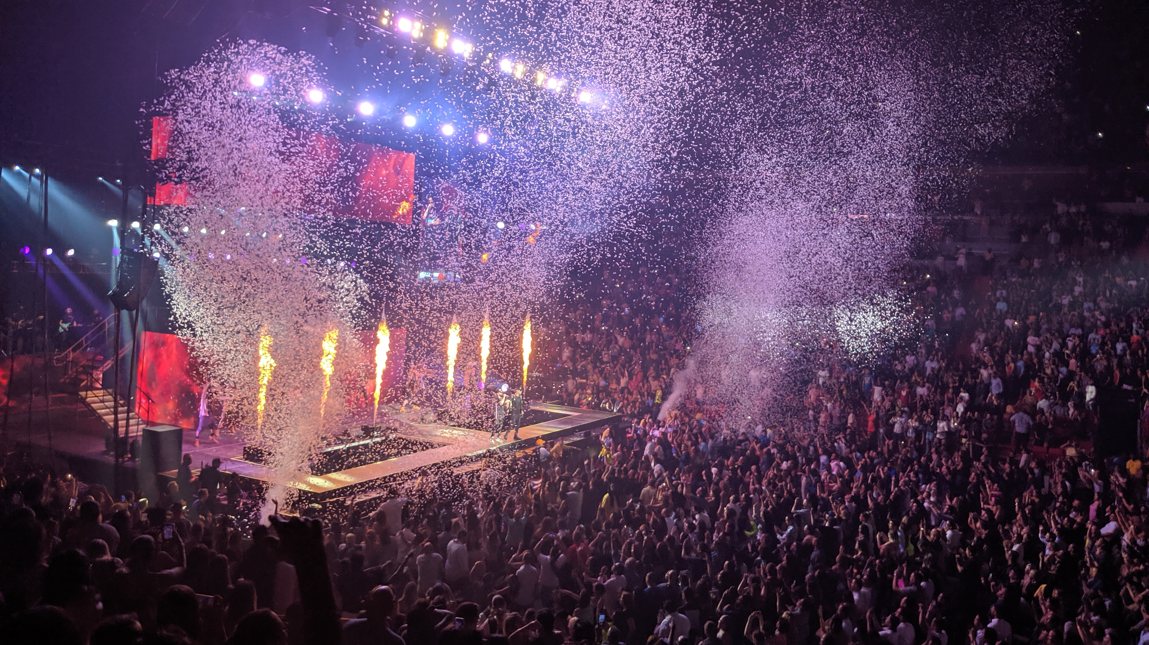

Slide 3




Managing an event
Quote
Reservation
Operating event
Payment

Slide 4
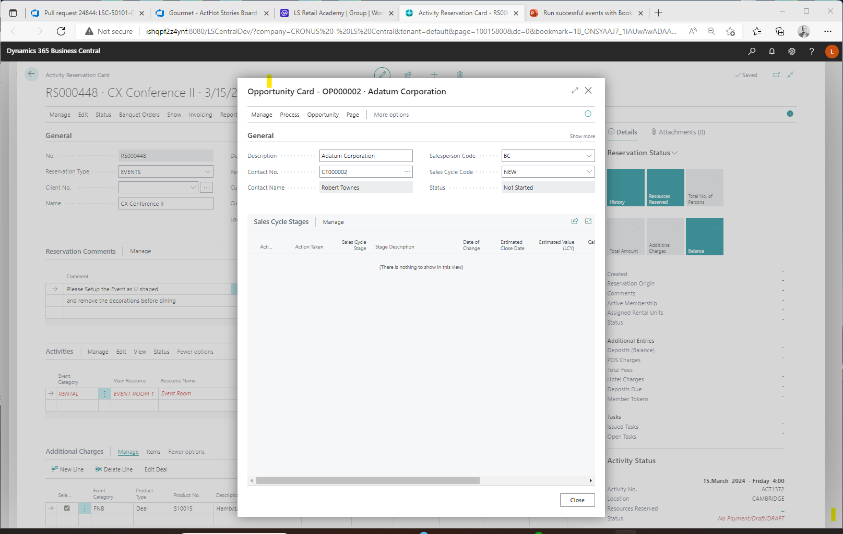
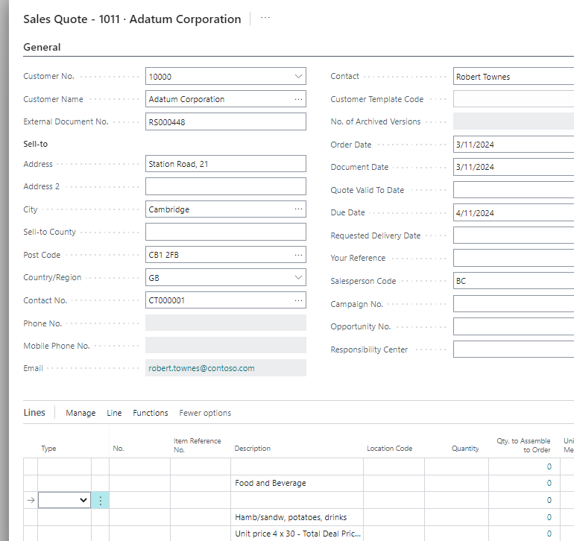
Banquet Events – The presale process
Standard BC functionality:
CRM (Opportunity)
  Create Opportunity
    Linked to a reservation
  Manage sales cycle
  To Do's/Emails
  Communication Mgmt
Quote
  Create BC quote

Slide 5
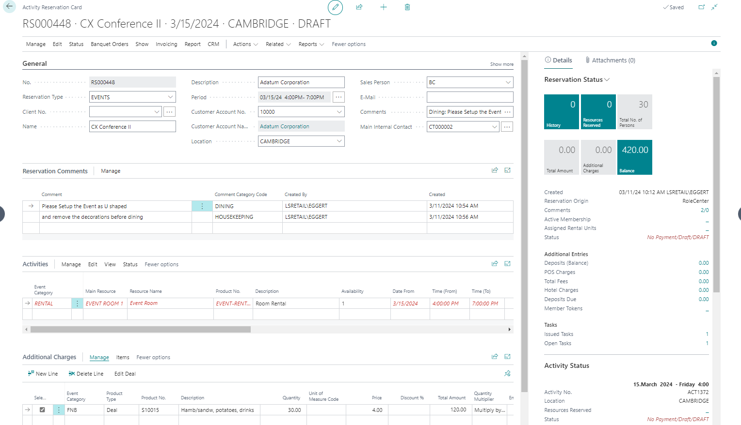
Banquet Events – The Reservation
Reserve and charge for
  Event Rooms
  Equipment
  Human Resources
  Items
  Food & Beverage
    Menus & deals
Track comments and requests
Assign responsibilities
Issue and monitor tasks

Slide 6
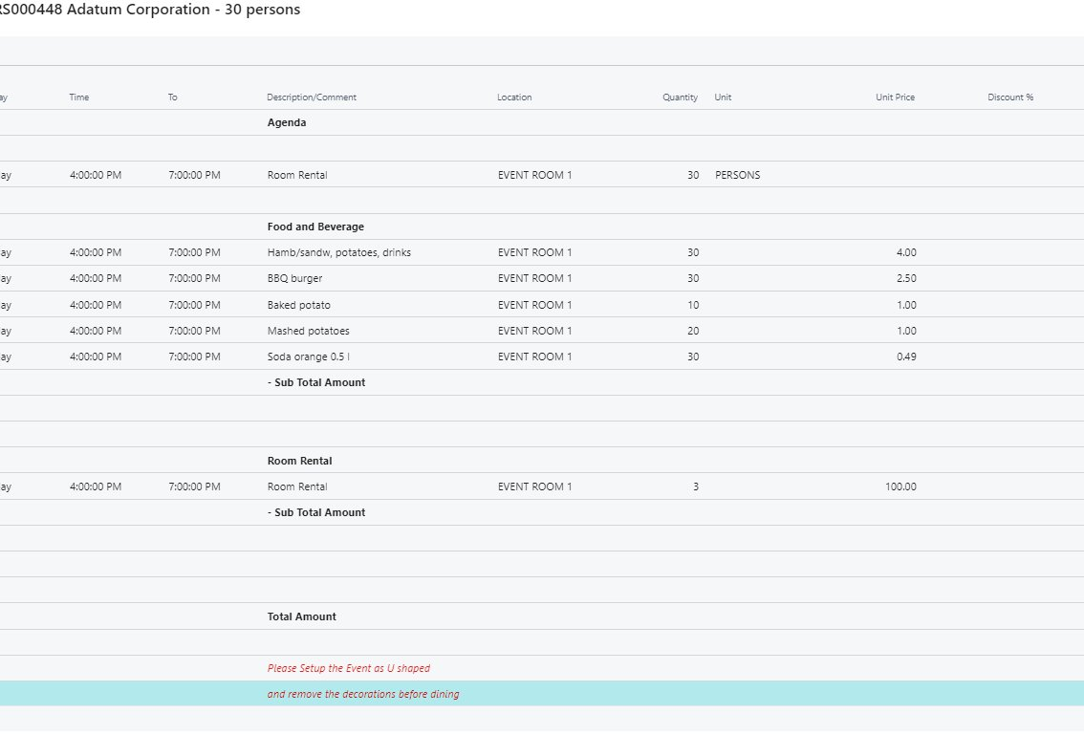
Banquet Event: Versioning and change tracking
Track all changes during the lifetime of the event reservation and notify the responsible parties if needed.
Group the reservation entries into Banquet Categories, i.e. AV, F&B, RENTAL, and define the layout of the BEO (banquet event order).
Version Control of the reservation and changelog of all reservation changes, including rooms, prices, quantities and comments.

Slide 7
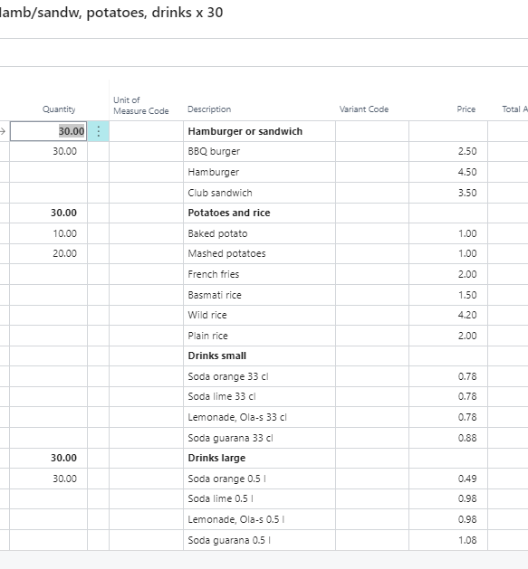
Menu & deal handling
Use F&B deals to setup menus and offers
Preselect menu options for catering
Client selects menu options for a la carte
  Using allowances
Cost calculations
Compress menu content details at POS

Slide 8
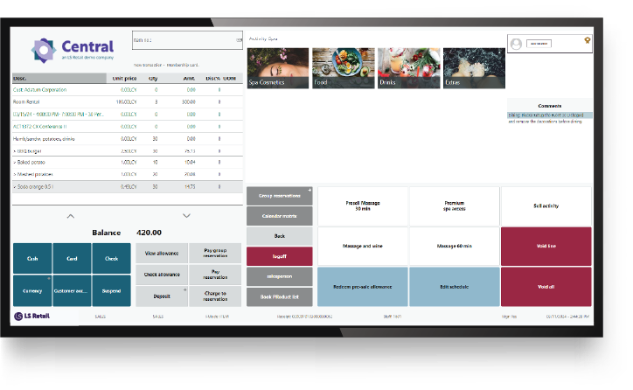
Finalizing and Payments
Finalizing of event reservations using
  Point of Sale
  BC Sales Invoice
Token (Pre-authorization) handling
Deposit management
  Deposit policies
Cancellation & refunds
  Cancellation policies

Slide 9
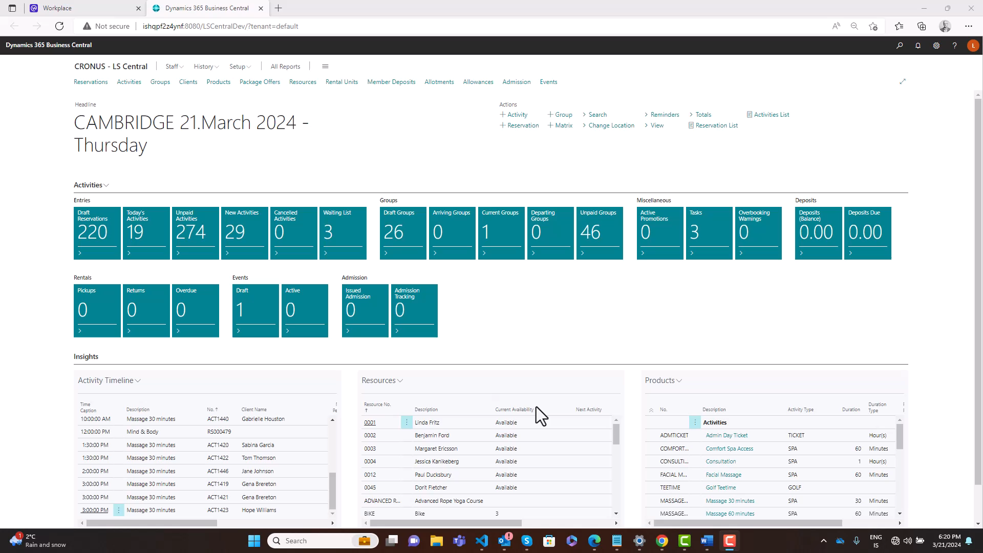

Slide 10
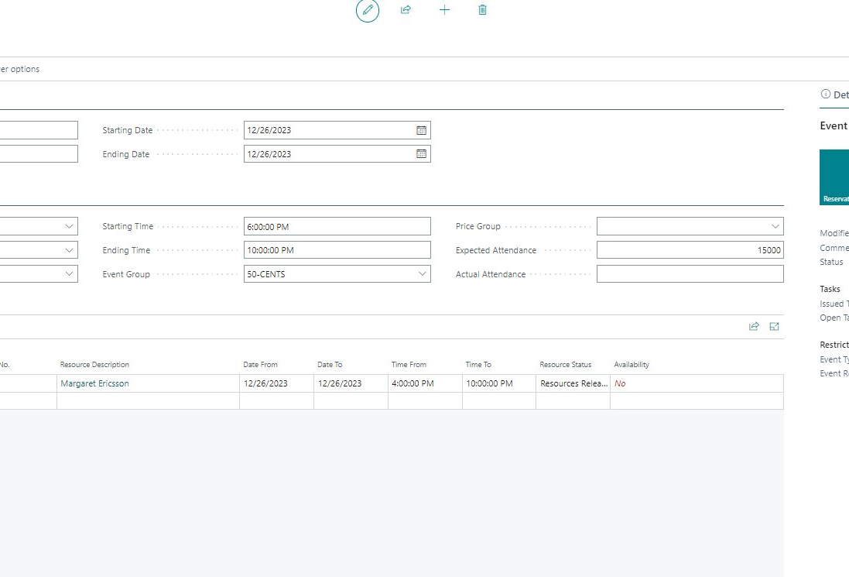
Event Management: Stadiums & shows
Reserve resources and charge for
  Suites
  Equipment rental
  Items
  Food & beverages
    Menus & deals
Keep track of multiple event related reservations under one "umbrella"
Pre-allocate resources
  Can then only be reserved by event related reservations
Issue and monitor tasks
Set charge restrictions based on event

Slide 11
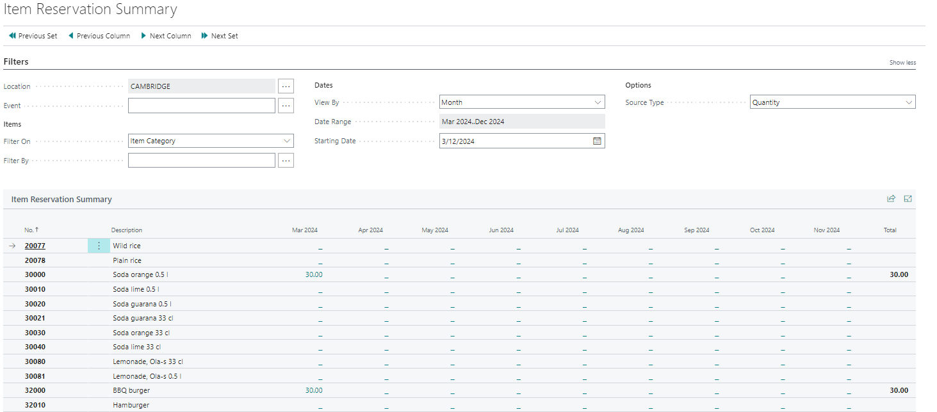
Analysis and summaries
Summary of item/deal reservations
  Cost Amount
  Quantity
  Sales Amounts
  Periods – years, months, weeks, or dates
  Per Event
  Per Item Category
  Per Product Group
  Per Special Group
  Per Deal / Menu
  Cost Reports
    Per Reservation
    Per Event
All general reports in BC/LS Central
  Sales
  Inventory

Slide 12

Roadmap
Analytics
Cost management
  Update & track cost changes in ongoing reservations
  Notifications of cost hikes
Menu/deal calculator
Event financial dimensions
Event purchase orders

Slide 13
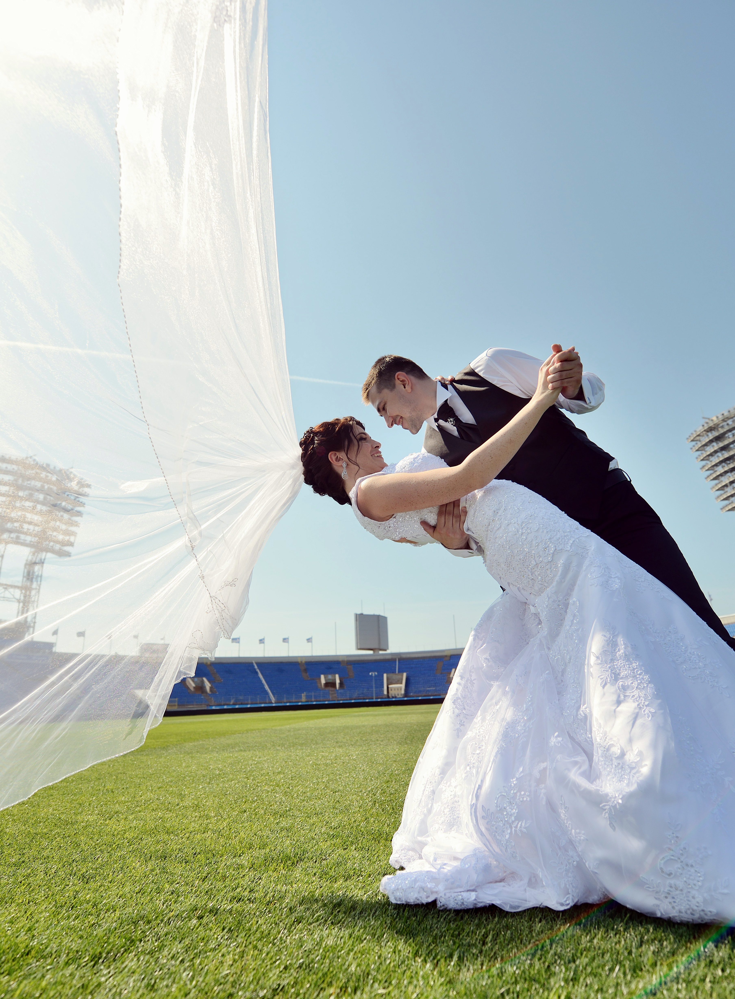
What are events?
Banquet Event Orders (BEO management)
  Conferences/Weddings
  Meetings/Celebrations
Event management (Stadiums/Venues)
  Concerts
  Sporting events
  Theater and shows

Slide 14
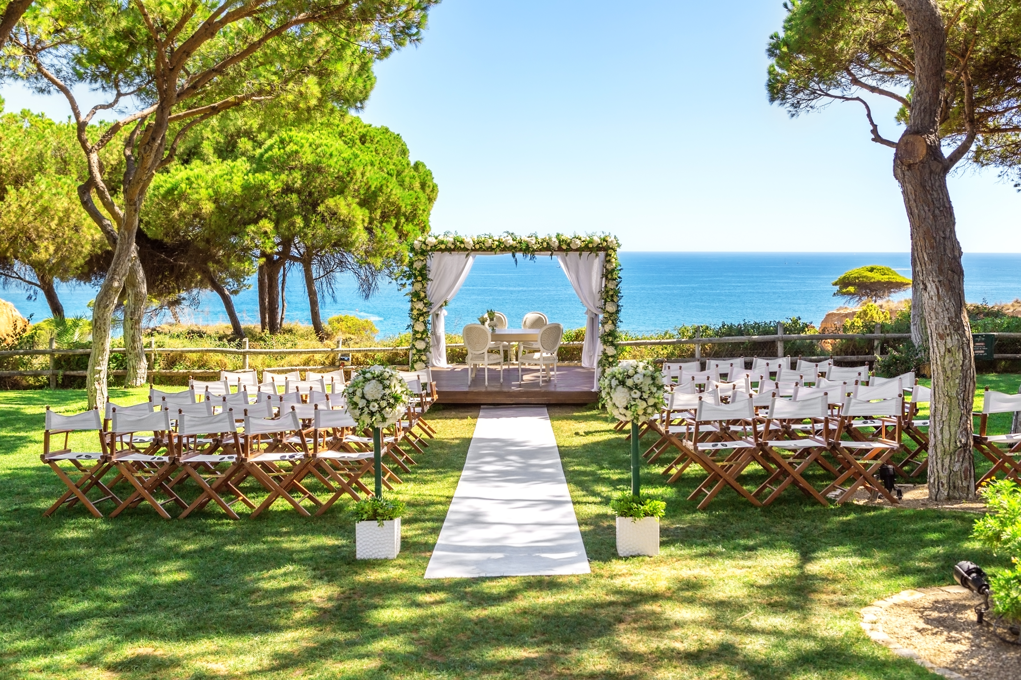
Questions?

