Slide 2

Jasvinder Singh (Jas)
LS Academy
Inventory Management with Mobile Inventory
Technical Consultant
Jasvinder.singh@lsretail.com
Notes:
Welcome, everyone! Thank you for joining today's webinar. My name is Jasvinder Singh; You can also call me Jas.
I am a member of the LS Retail APAC consulting team, I’ve been working as a Technical Consultant for almost 5 years, dealing with various projects within Inventory Management
Today, I am very happy to share some of my knowledge with you on the subject.
Just a little housekeeping before we get started.
Everybody is muted by default. So, if you have any questions during the presentation, please type them into the question box in your GoToWebinar control panel.
I will try to answer all of them, and any others you might have, at the end of the presentation.
In a few days we will send you a recording of this Webinar, with further information.,

Slide 3
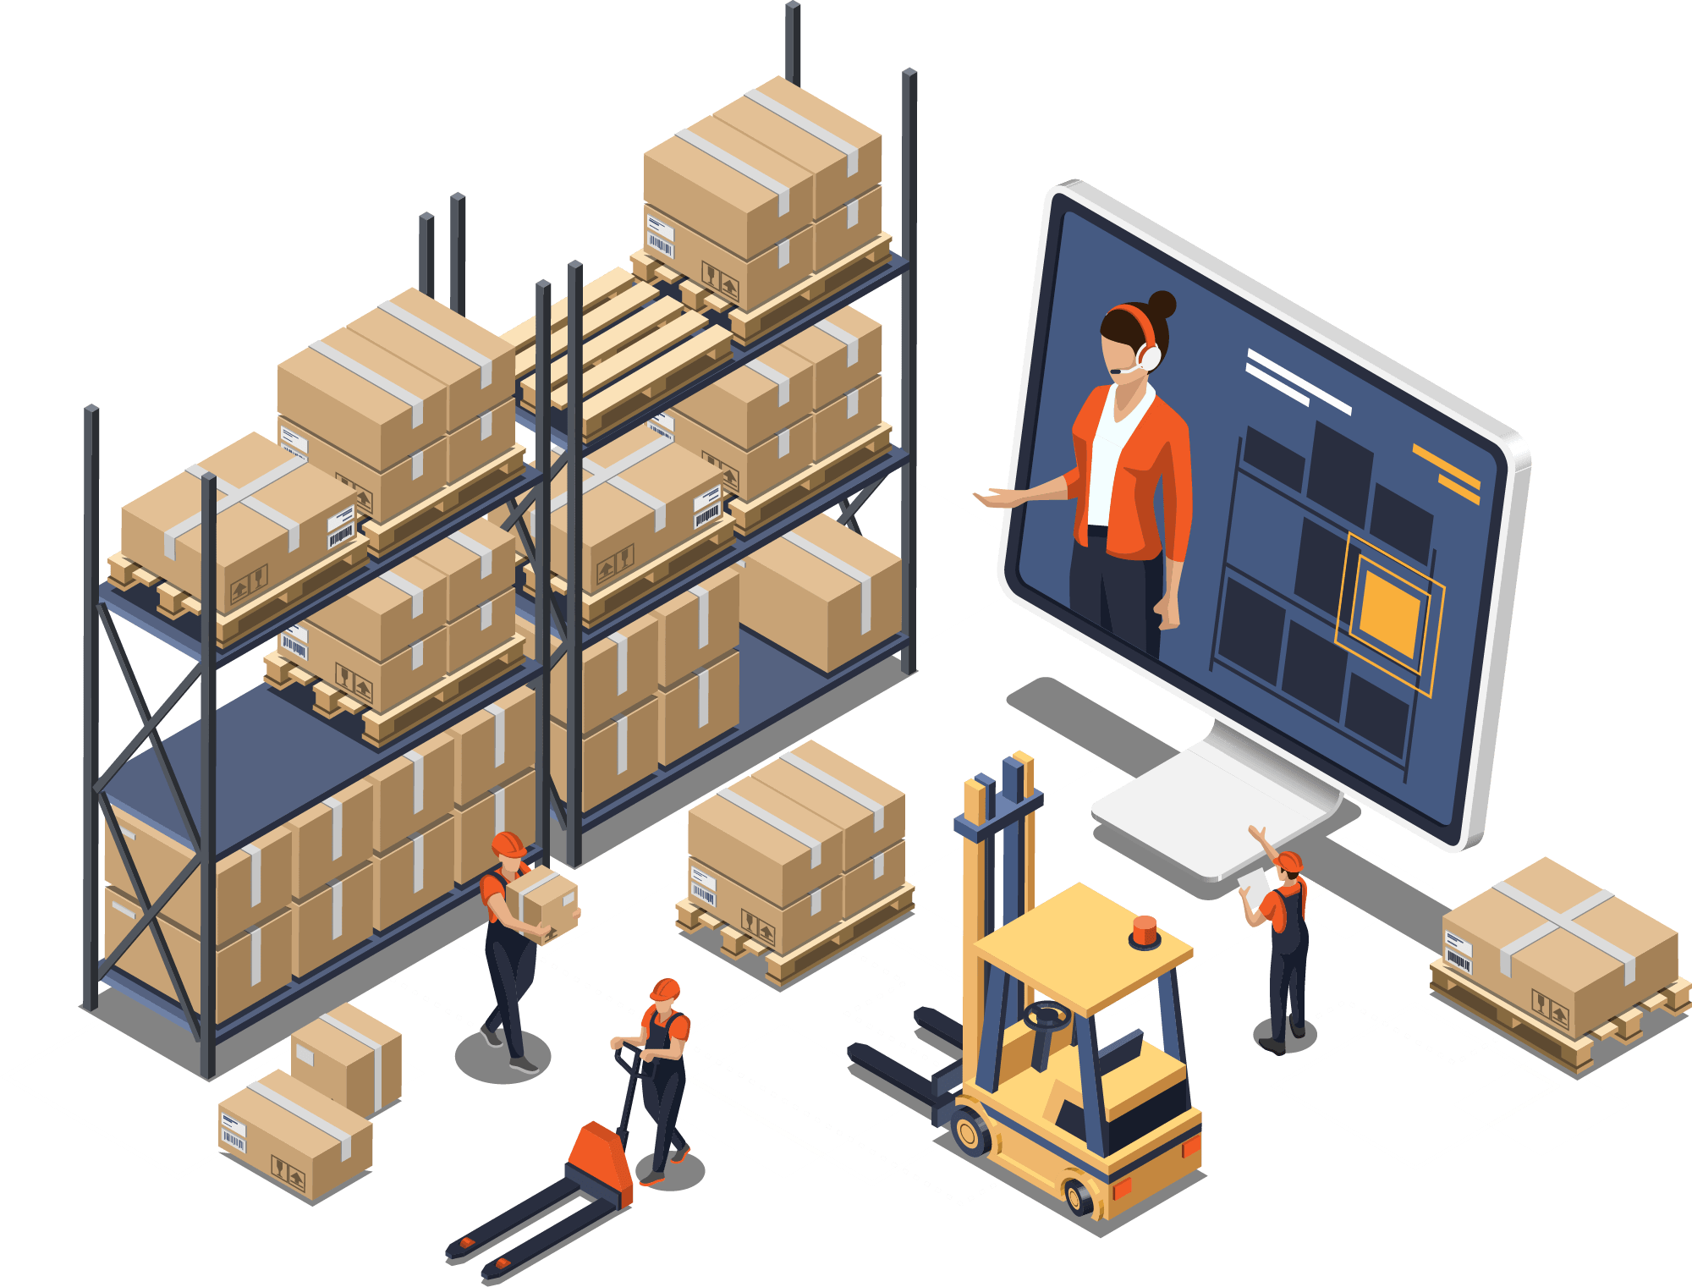
What is it?
It is a module within the LS Central solution that provides robust functionality in managing your inventory
Basic Functionality
  Stock Management
  Worksheets
  Documents
Mobile Inventory
Notes:
Managing your Inventory effectively is essential for any type of retailer, and whether they are big or small.
When tracking inventory accurately, you need to know how many of each item you have, you know when you’re running low on stock and whether you should purchase that item again to keep selling it.
And as a busy retailer, you should be able to do all of this instantly, and be ready to make good buying decisions quickly.
Stock Management
In stock management there are stock count, stock count with area, cycle count and stock request
There are various worksheets to facilitate orders such as
Purchasing
And Transfer orders
And finally documents such as receiving and picking to complete the module
In this webinar, we will look at the Mobile Inventory app as well and see the full process of worksheets and document

Slide 4
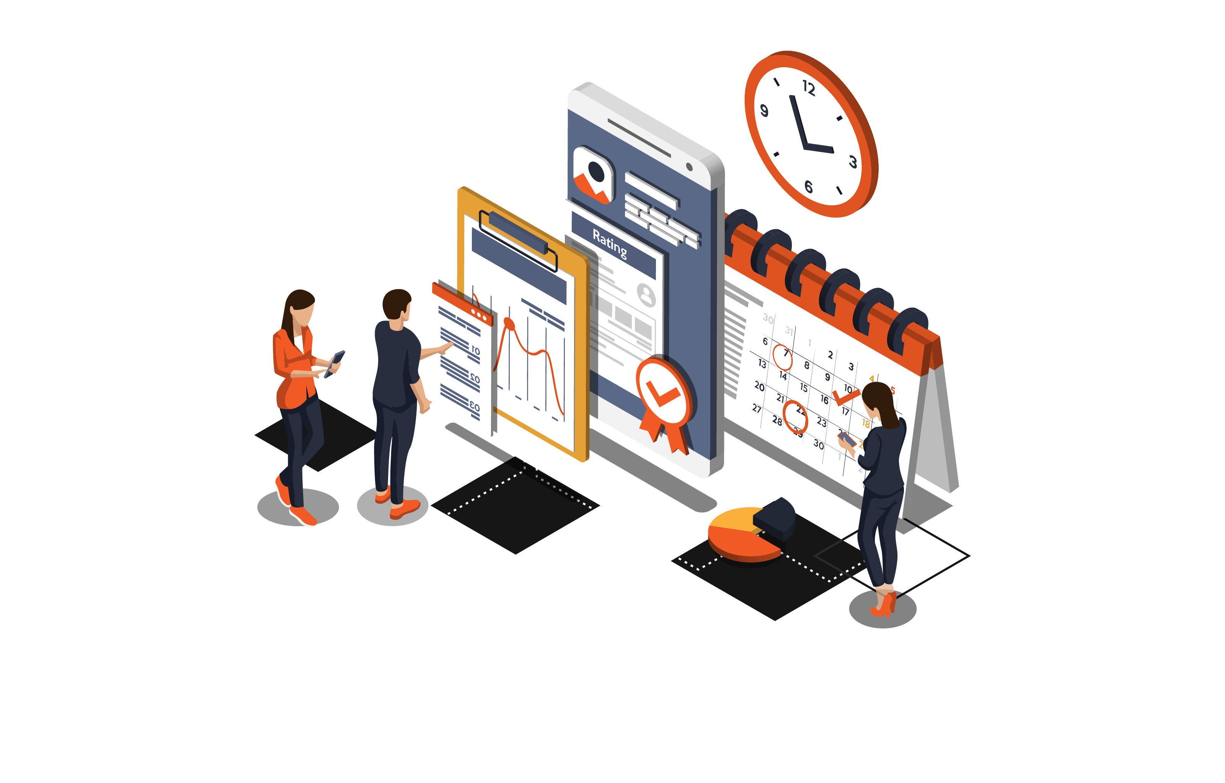
Just a little Theory
Full Count
  End of the financial year
  Busy periods
Periodic Count
  All the time
Notes:
I wanted to give a little theory on Inventory count
Full count: This is (usually) completed at the end of the financial year in order to provide your accountant with the exact value of the inventory. This type of count includes every item in the store, including the storeroom.
During a full count, you should close the store to ensure you get an accurate representation of the inventory levels. This generally means counts are done outside of normal business hours.
Periodic count: This type of count is normally done on a small section of the inventory, usually a particular brand, type, or supplier's items. Many retailers complete these counts during regular business hours in order to help keep the store's inventory accurate during the year. It is possible to run multiple partial counts simultaneously (just make sure not to have the same product in more than one count).
Completing a regular periodic inventory count helps you keep a good overview of the inventory, and ensures that the end-of-year inventory count will run smoothly.

Slide 5

Inventory Management & Replenishment
Often confused with Replenishment
How do we differentiate?
Notes:
This may come as a surprise to you: Inventory management is often confused with replenishment.
It is a separate module but does have an overlaying business process with Replenishment.
How do we differentiate these modules?
Inventory management is a set of inventory processes that manages your store inventory
Example of these processes are stock count, stock request and processing various worksheets
Replenishment is taking the data from Inventory management and applying various statistic calculation that will further improve the store inventory
Let’s take a quick look on an example to further understand this

Slide 6
An example
BO process the worksheet
BO applies replenishment
Store receives stock
Stock request from Store
Notes:
#1
In this example, a store is going to raise a stock request for a list of items
The store does that through a worksheet. This can be done manually or with the help of the Mobile Inventory app
#2
The worksheet is sent to the BO for review and processing
#3
Now at the BO, the staff applies various functionality from the Replenishment module
#4
- And finally, the store receives the goods

Slide 7
An example
BO process the worksheet
BO applies replenishment
Store receives stock
Stock request from Store
Cost effective delivery route
Shelf life
Inventory Management Process
Worksheets
Inventory Management Process
Documents
Notes:
#1
As we look at the items highlighted, these would be considered as part of the Inventory Management
Because in here, we are raising a worksheet based of Stock request from the Inventory Management module
#3
On the next item highlighted in orange, this process would be considered as part of the Replenishment module
The BO will take the data from the stock request made earlier and apply various actions.
#4
Actions here for example could be…..either calculating the most cost-effective delivery route for that stock request
Or applying certain calculation in order to deliver the goods at the right time. For example of goods that has a short shelf life span.
#5
Finally at the last item highlighted, this too will be part of the Inventory management
Because here the store would need to process the Retail Receiving document.
Again, this can be done manually or with the help of the Mobile Inventory app

Slide 8
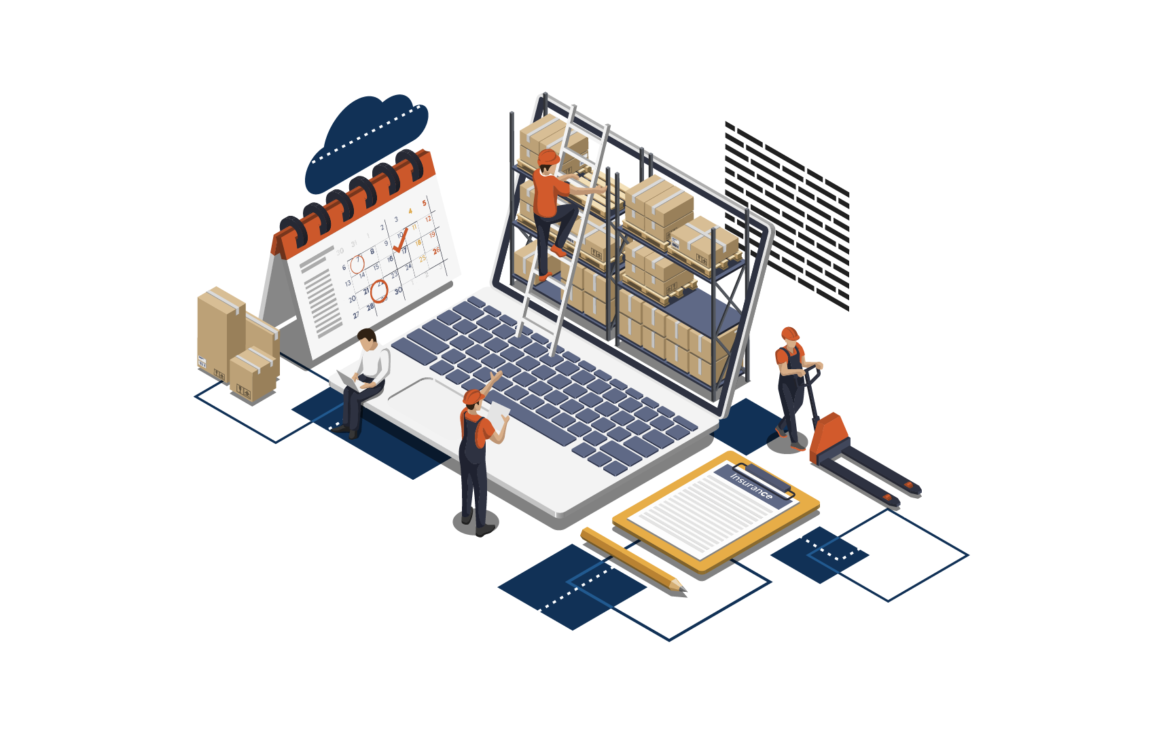
Store Inventory against InStore Management
The focus has now shifted to Store Inventory
What is Store Inventory all about?
  Build on new LS tables
  Allow concurrent processing
    Multiple worksheets can be processed together
  Build with the idea to support V2 webservices
Notes:
Let us look at the journey we have taken in moving InStore Mgmt to Store Inventory
#1
The focus now is to have your Inventory management processes in Store Inventory
#2
Therefore, what is Store Inventory all about?
#3
Store inventory is built on completely new LS Central tables
These tables no longer have the conventional table locks and processing is now done asynchronous
Therefore this allows multiple worksheets to be processed simultaneously
#6
- An important not to take into account is that these new tables and processing architecture follows the new V2 web services in LS Central

Slide 9
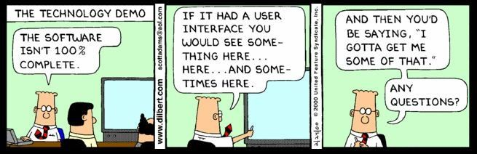
Demo Time

Slide 10

Questions?
Notes:
Please work on a nice image here
Avoid fingernails

