Slide 2



Kristinn, Jónheiður and Jón Halldór
LS Insight
Getting started on the path to your data insights
LS Insight development team

Slide 3

Why do I need it?
What is it?
How do I get started?

Slide 4

Data ≠ Information
Notes:
Every day, a retailer generates and gathers vast amounts of data. That data is the most important asset of the retail business, and it is becoming increasingly important that we transform it into insights that deliver true value. These insights can help us maintain momemtum and run a successful business in these times of uncertainty and evolving retail environment.
We would all like to move from

Slide 5


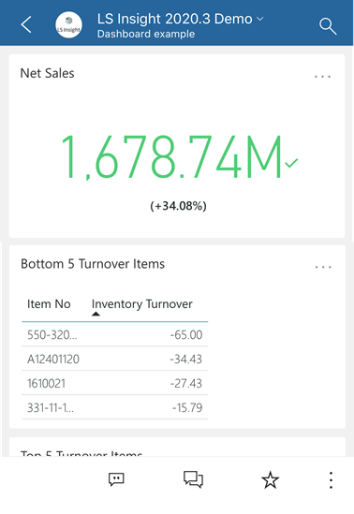
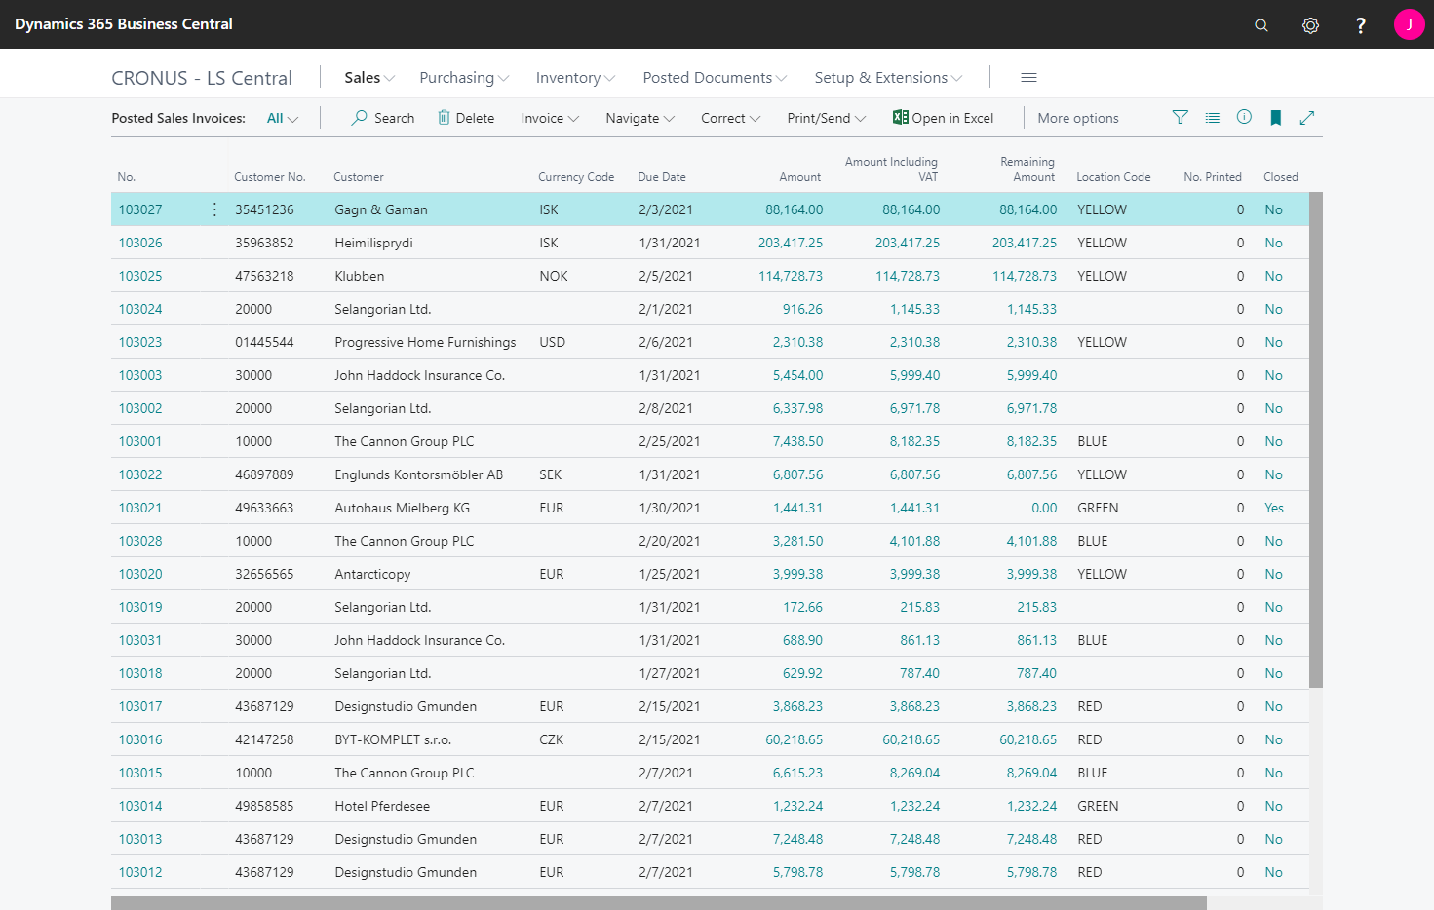
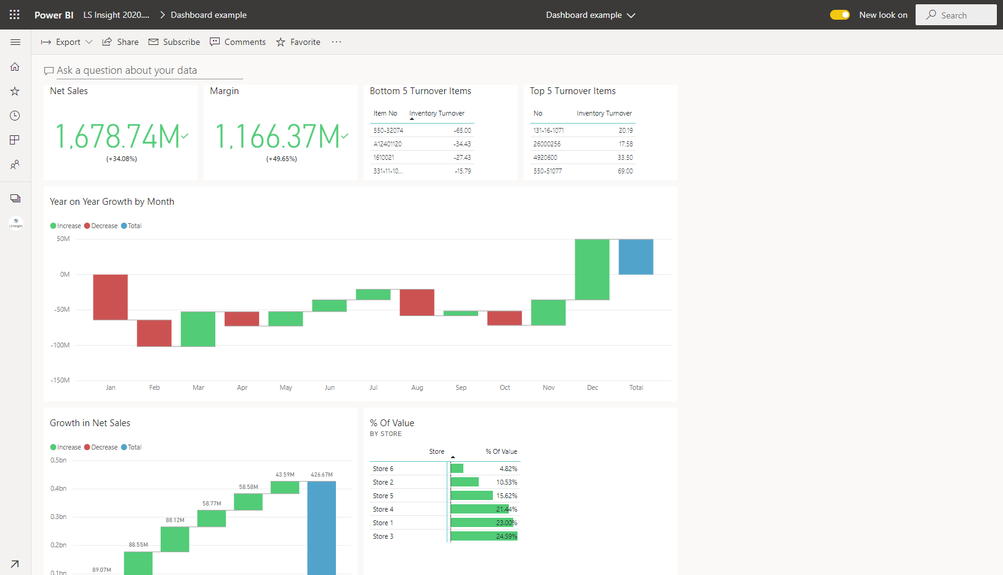





Magic BI button
Notes:
viewing our data in regular tables and reports in LS Central, (click) to (click) descriptive visuals and dashboards available from anywhere (click), even our smart phones and we want this (click) without the time, cost and complexity of creating a Business Intelligence Data warehouse and solution from scratch.
But how do we get there? (click) Is there a magic BI button somewhere we can press that turns our data into valuable insights for our business?
For LS Central the magic BI button is called (click) LS Insight!
But what it exactly?

Slide 6
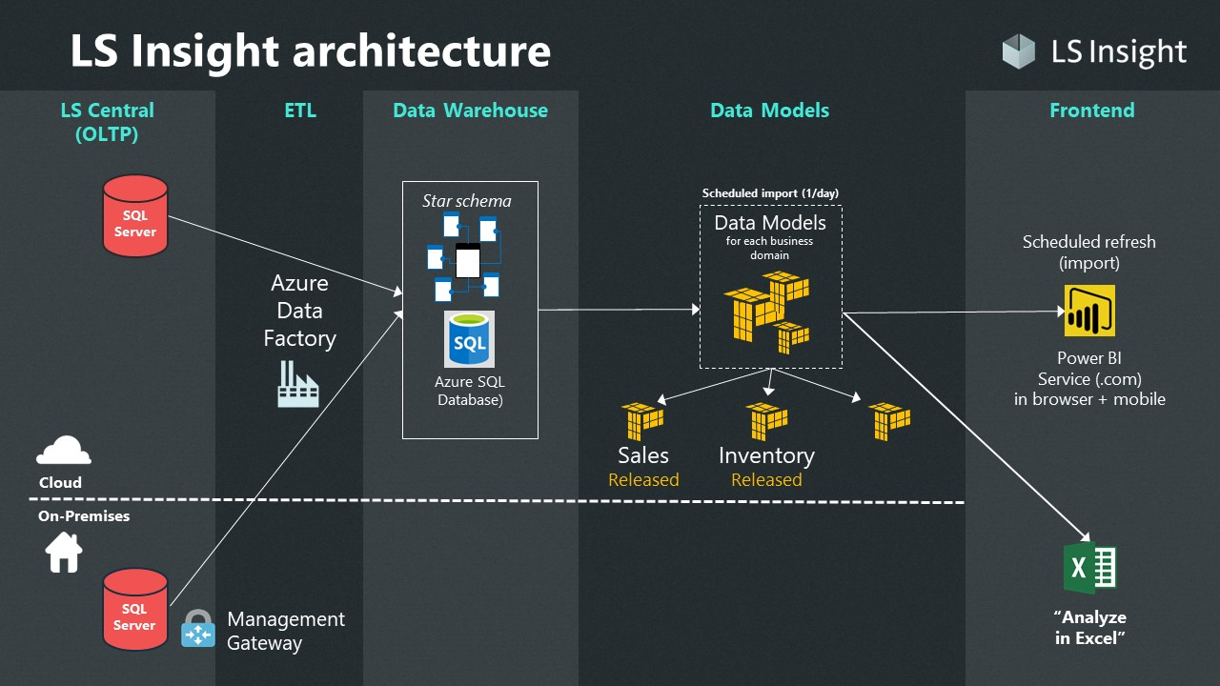
Notes:
Here we see an overview image of the LS Insight architecture. LS Insight is a complete BI solution with Sales and Inventory reports for LS Central and can be setup for LS Central on prem from version 8.4 to the current versions. And the best part is that it is free of charge to all LS Central partners and customers.
Like you can see here it consists of a few components.
First we have the LS Central source database (click). This is your Back office LS Central database and it can be located in Azure on a Virtual Machine or on an on premise server.
Next we have the Azure resources (click). The SQL server, the SQL Data warehouse database that has been designed in a star schema and the Azure datafactory that contains all the pipelines that load the data from LS Central into the Data Warehouse.
Then we have the Power BI templates (click) containing the data models and reports. Currently we have two standard templates for Sales and Inventory reporting and then we have the lates addition a template for the LS Central for Hotels extension that will be released in the near future.
The last component is the frontend. This is the power BI service where administrators can publish apps and share them with diffrent users within the organization, such as managers and those in charge of purchases and employees for example.
All of these components of LS Insight can be setup in a few simple steps that require no in depth knowledge of Data warehouses, report building or Azure. The data warehouse has been designed by LS Central BI experts and the reports are already created. So no time consuming design meetings or complicated integration is needed. We have done the work for you and now offer a solution that can be setup from beginning to end within a couple of days.
Now that we have covered the „why“ and the „what“ of LS Insight, lets move on to the „How“.

Slide 7
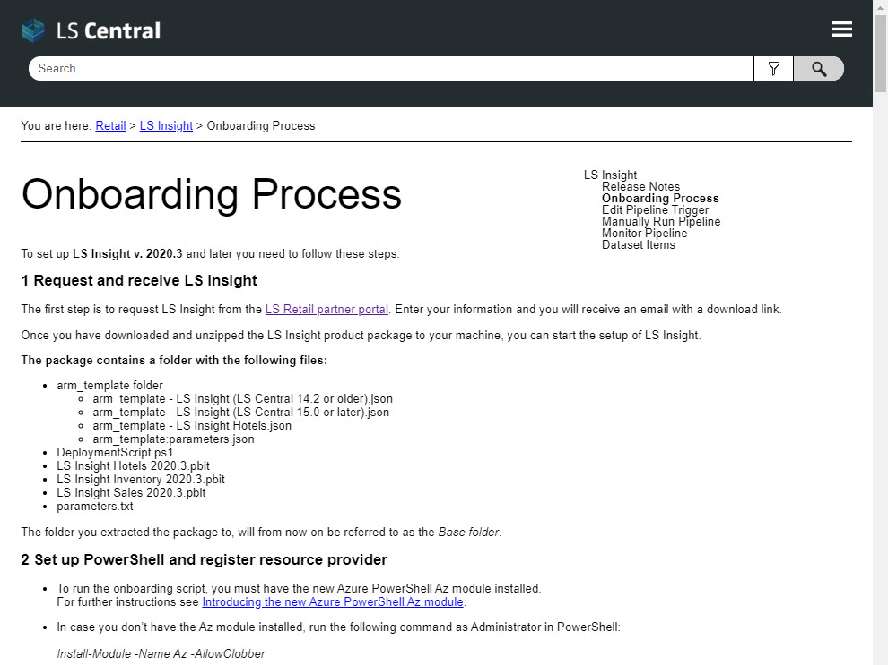
LS Insight setup
Create Azure resource group and power BI pro account
Download product folder
  https://portal.lsretail.com/Products/LS-Insight
  Onboarding documentation
Setup parameters and run Deployment script
Setup gateway and run pipelines
Connect report templates to DW and Publish reports to Power BI service
Notes:
The LS Insight setup consists of 5 steps that are described in detail (click) in our online Onboarding documentation, that is available to all in the LS Insight section of the LS Central online help.
(click) The first step in the setup process is to create the Azure account and resource group and the Power BI Pro account.

Slide 8
Azure account
and resource group
Power BI pro account
Notes:
You need to set up an Azure account with a resource group that gives you access to create SQL servers and databases, and a data factory. (click) We also recommend that you make sure that your Power BI account has a pro licenses so you can publish and distribute you reports. You can get by using only Power BI desktop for free but the service makes the distribution of reports within the organization so much easier. (click)

Slide 9
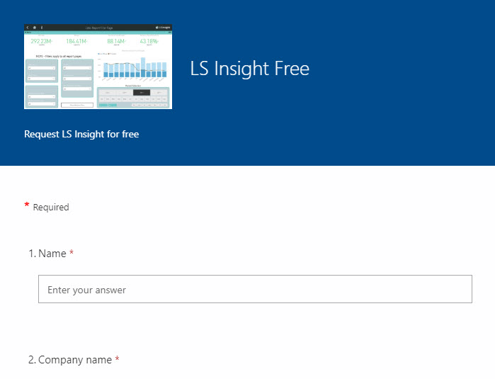
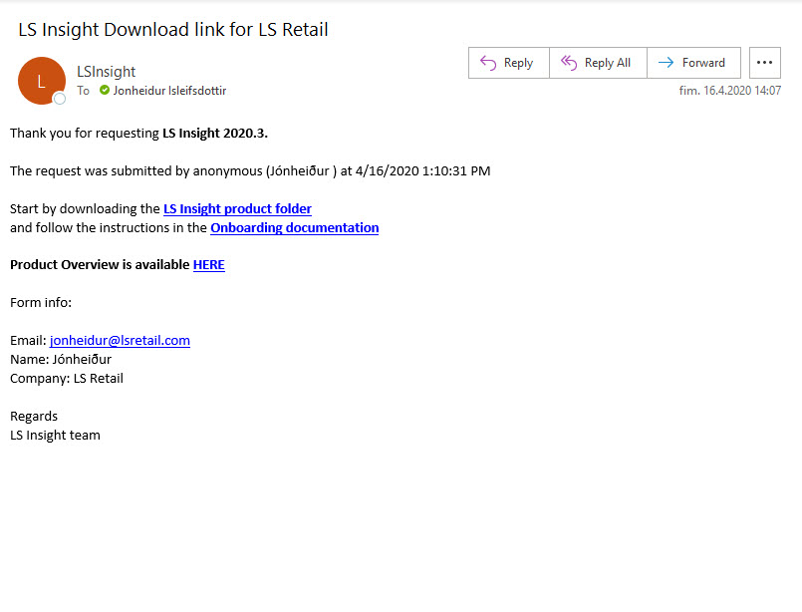
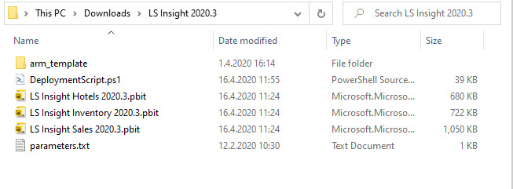
LS Insight setup
Create Azure resource group and power BI pro account
Download product folder
Setup parameters and run Deployment script
Setup gateway and run pipelines
Connect report templates to DW and Publish reports to Power BI service
Notes:
Step two (click) is to download the LS Insight product folder from the LS Retail partner portal. You fill out a simple form (click) and receive an email a few minutes later with download links to the product folder and a link to the Onboarding process.
The product folder (click) you download contains all the files needed to setup LS Insight. The arm_template files with the queries used in the data factory pipelines, the deployment script, the Power BI report templates and the parameter text file.

Slide 10
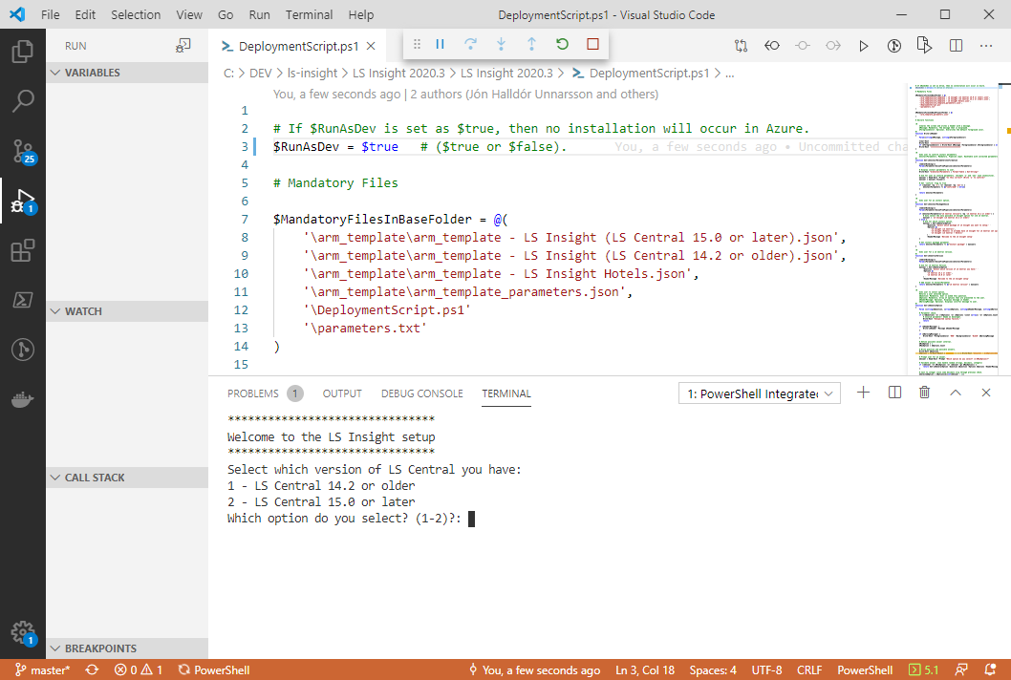
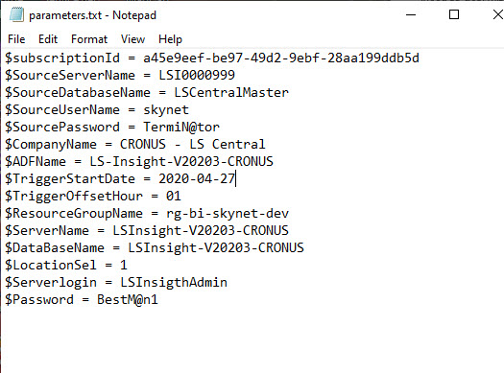
LS Insight setup
Create Azure resource group and power BI pro account
Download product folder
Setup parameters and run Deployment script
Setup gateway and run pipelines
Connect report templates to DW and Publish reports to Power BI service
Notes:
Step three (click) is to setup the parameter file and run the deployment script. In the (click) parameter text file you need to add information about your Azure subscription ID, the LS Central source database and server and choose names for the Azure resources, the Data factory, sql server and database, and you also need to select a login and password for the database admin user. Please note that none of the Azure resources exist at this point. They will be created later by the Deployment script using the parameters from the file. (click)
The Deployment script can be run using any Power Shell application, but we usually use VS Code or Power Shell ISE. The script prompts for the LS Central version you are running and for whether you want to setup LS Insight for LS Central only or include the LS Central for Hotels extension. The script also prompts for your Microsoft login that was used when creating the Azure account.

Slide 11
Notes:
The script then creates (click) the SQL server and SQL database for the Data Warehouse in Azure (click) along with the Azure datafactory containing all the pipelines that fetch the data from LS Central and feed it into the Data Warehouse.

Slide 12
LS Insight setup
Create Azure resource group and power BI pro account
Download product folder
Setup parameters and run Deployment script
Setup gateway and run pipelines
Connect report templates to DW and Publish reports to Power BI service
Notes:
(click) Step four is to set up a gateway and run the pipelines.

Slide 13
Notes:
If the LS Central database is on premises, (click) the Integration runtime management gateway needs to be set up on a machine that is always running. We recommend that this is not the same machine as the SQL server is running on. Once the gateway is up and running you can trigger a pipeline run (click) to load your data into the Data Warehouse.
If the LS Central database is located on an Azure Virtual machine there is no need for a gateway and (click) the pipelines can be run straight away.

Slide 14
LS Insight setup
Create Azure resource group and power BI pro account
Download product folder
Setup parameters and run Deployment script
Setup gateway and run pipelines
Connect report templates to DW and publish reports to Power BI service
Notes:
(click) Step five is to connect the report templates to the Datawarehouse and then publish the reports to the power BI service. (click)

Slide 15
Notes:
When the pipelines have done the initial load you can open the Power BI Template files (click). When you open the files you will be prompted for connection info to the Azure SQL server and Data warehouse database just created by the script. Once you have entered the info the data is loaded (click) from Azure to the Power BI data model and displayed in the reports and you can then finialize the process by publishing (click) your reports to a workspace in the Power BI service, ready to be viewed and shared with others in your organization.
To refresh your data on a regular basis we recommend setting up a schedule for incremental loading of data from LS Central to the Data warehouse (integration runtime) (click) and from Data warehouse to Power BI service (power BI gateway) (click).
This concludes the overview of the LS Insight product archiceture and onboarding process and Kristinn will now take over and continue to go over the options you have once you have published your reports to the Power BI service. (hand over to Kristinn)

Slide 16

How do I create a dashboard and share information with others in my organization using alerts and subscriptions?
(live demo)

Slide 17

Workspace is a place to create an app for the Organization
(live demo)

Slide 18
Getting insights to discounts and offers
(live demo)

Slide 19
Setting Member filters and generate a list for export
(live demo)

Slide 20
Asking questions not answered in provided visuals
(live demo)

Slide 21
Listing members who bought an Item or not
(live demo)

Slide 22
Getting insight to the members
(live demo)

Slide 23
Compare periods and Items
(live demo)

Slide 24
Inventory detail report
(live demo)

Slide 25
LS Insight for Hotels
Notes:
UNMUTE!
Hi there, so, the Hotels report is the newest member in our report portfolio.
(Click)

Slide 26
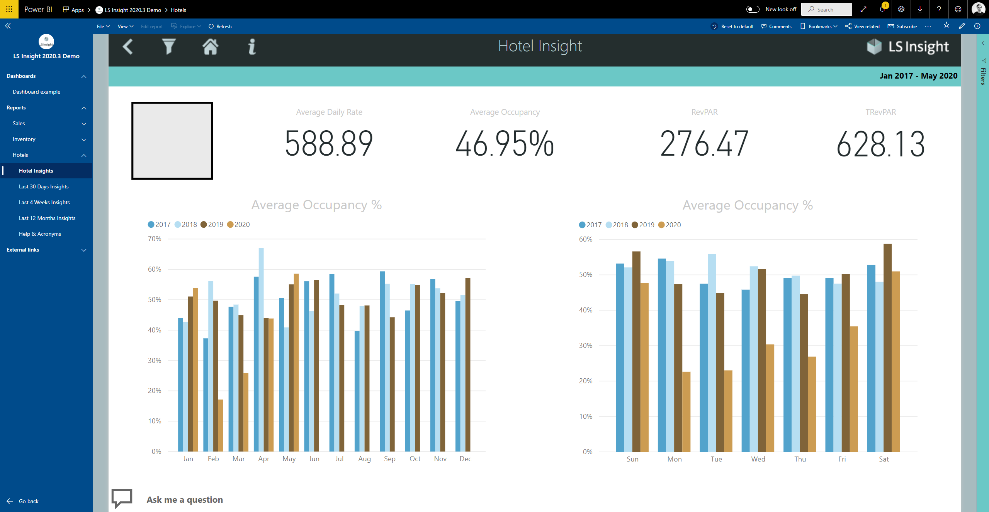
Notes:
And in this first edition of the report, the user is presented with four main pages.
The first page is an overview of four basic Hotel KPIs and the other three pages display historical values for the KPIs on three different date intervals.

Slide 27
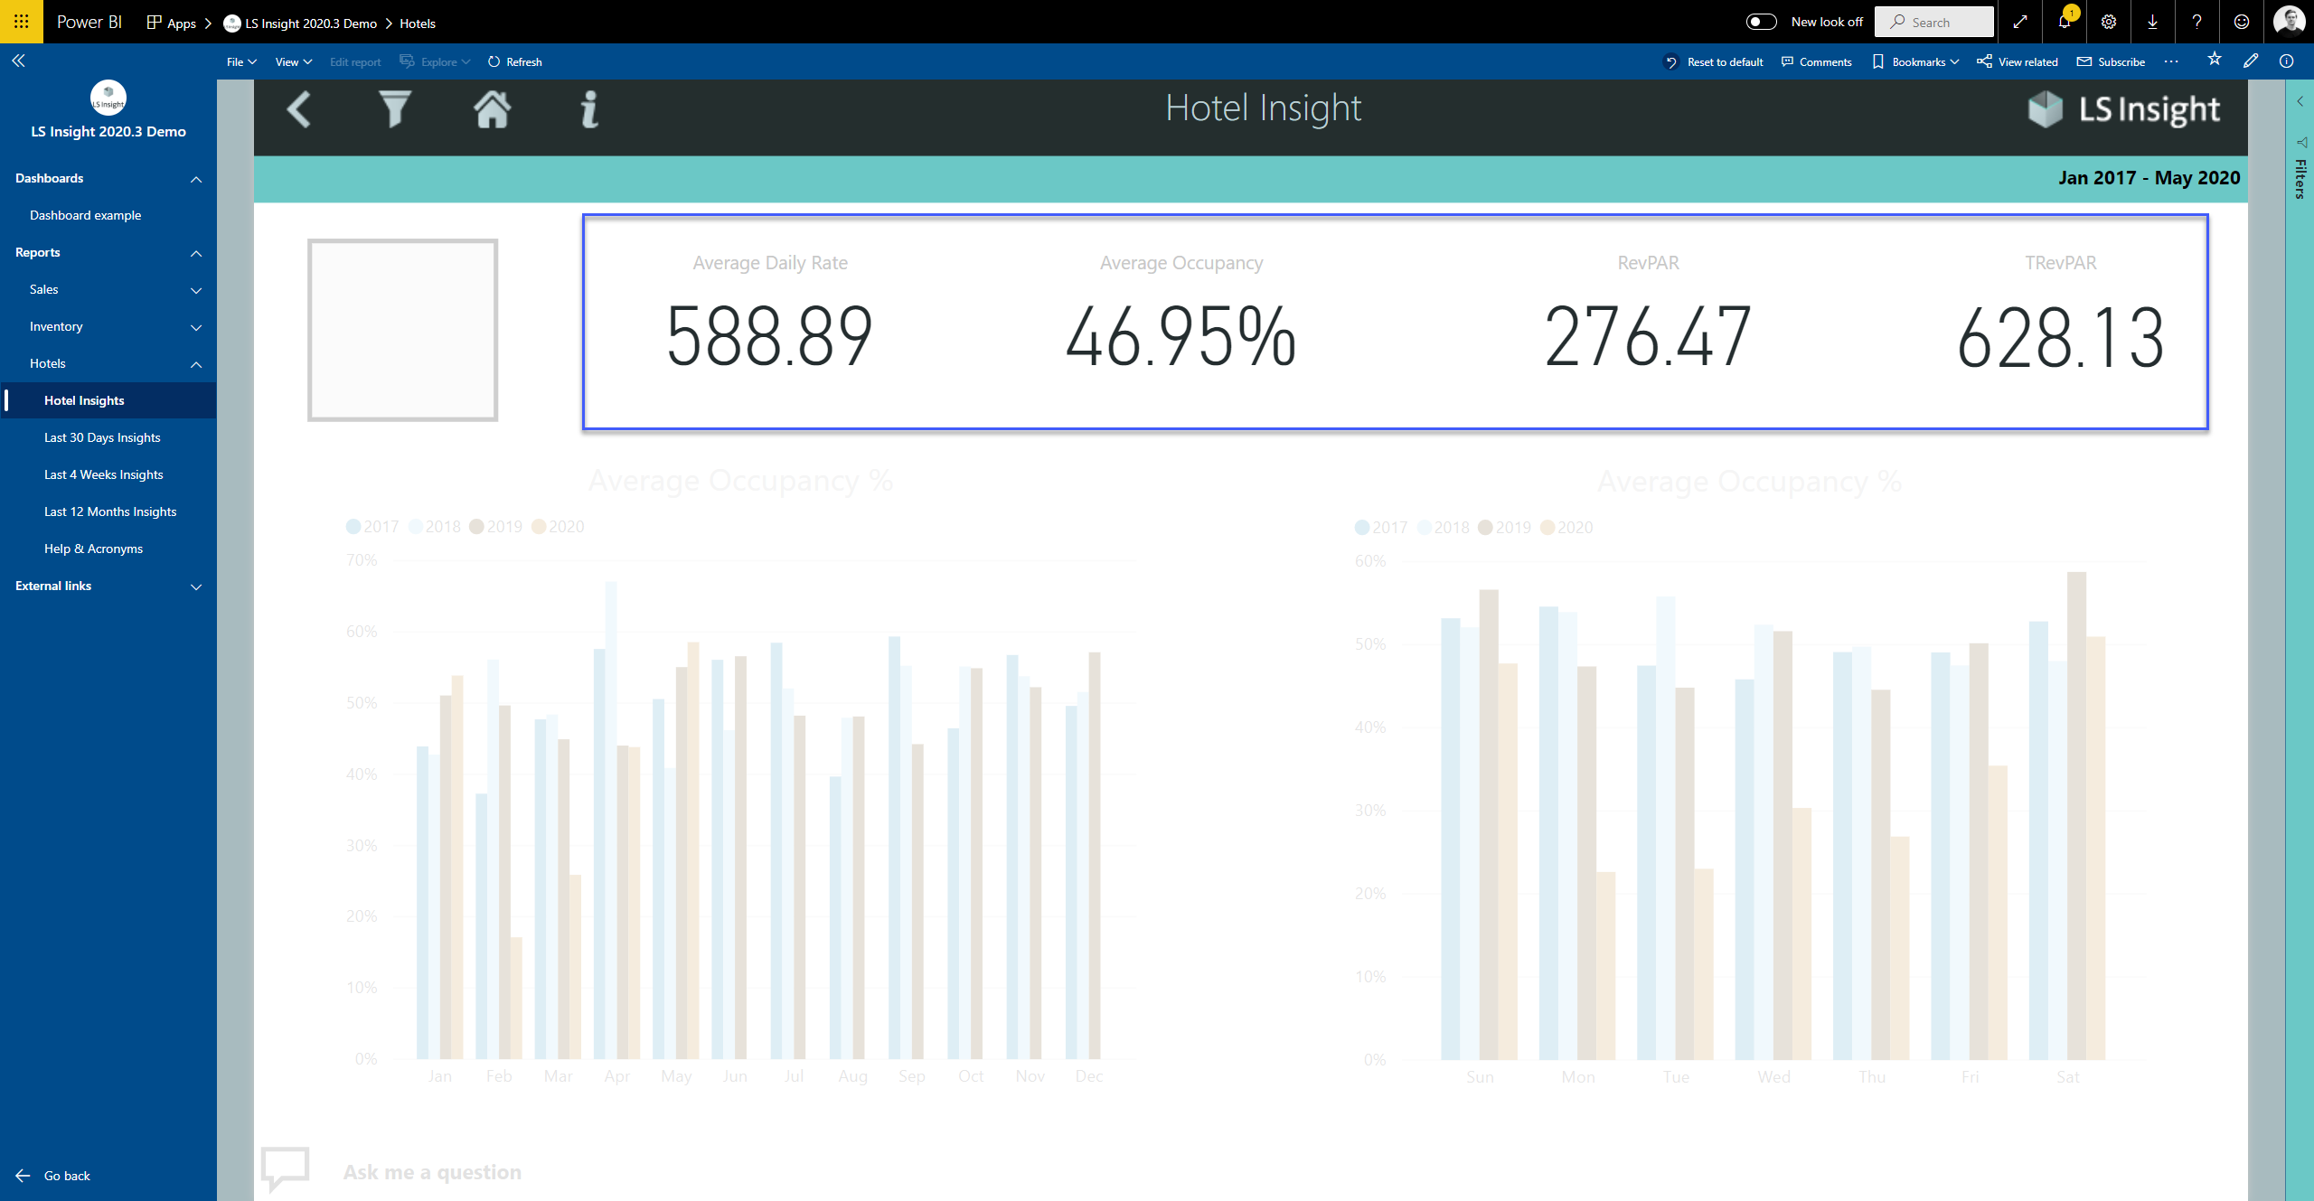
Notes:
Here we have the KPIs on top.

Slide 28
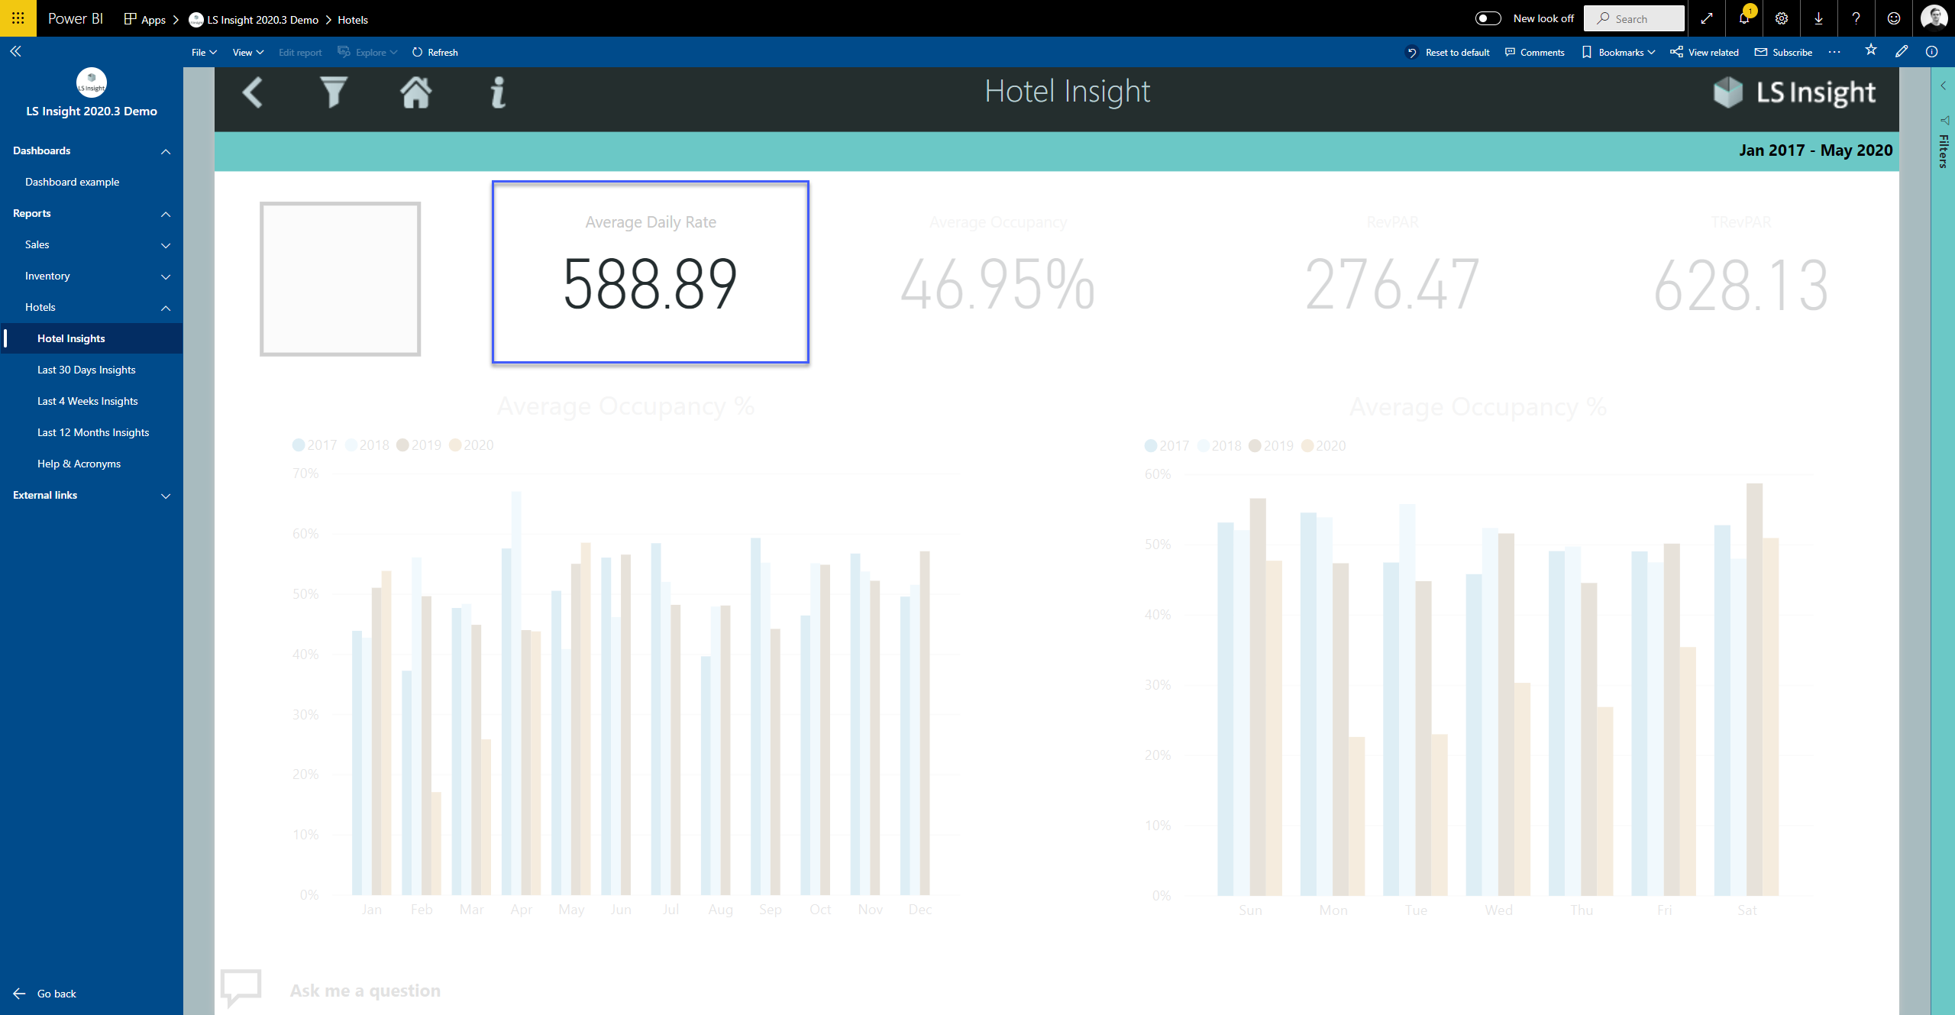
Notes:
First is the “Average Daily Rate” which is the average rental income per occupied room.

Slide 29
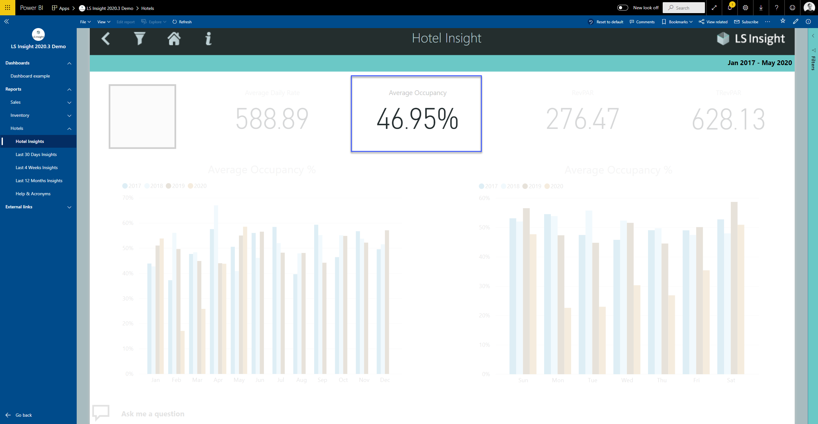
Notes:
Then we have the “Average Occupancy Rate” which is the ratio of occupied rooms to available rooms.

Slide 30
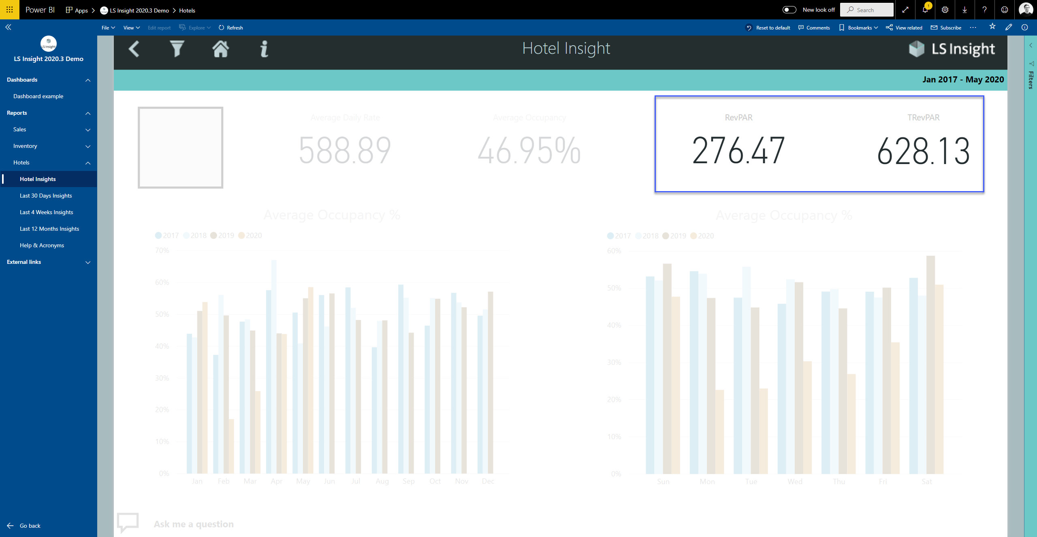
Notes:
The last two are the RevPar and TRevPar. Which stand for “Revenue Per Available Room” and “Total Revenue Per Available Room”. The difference is that RevPar accounts only for the room revenue but the TRevPar also accounts for food, beverages, and other types of revenues.

Slide 31
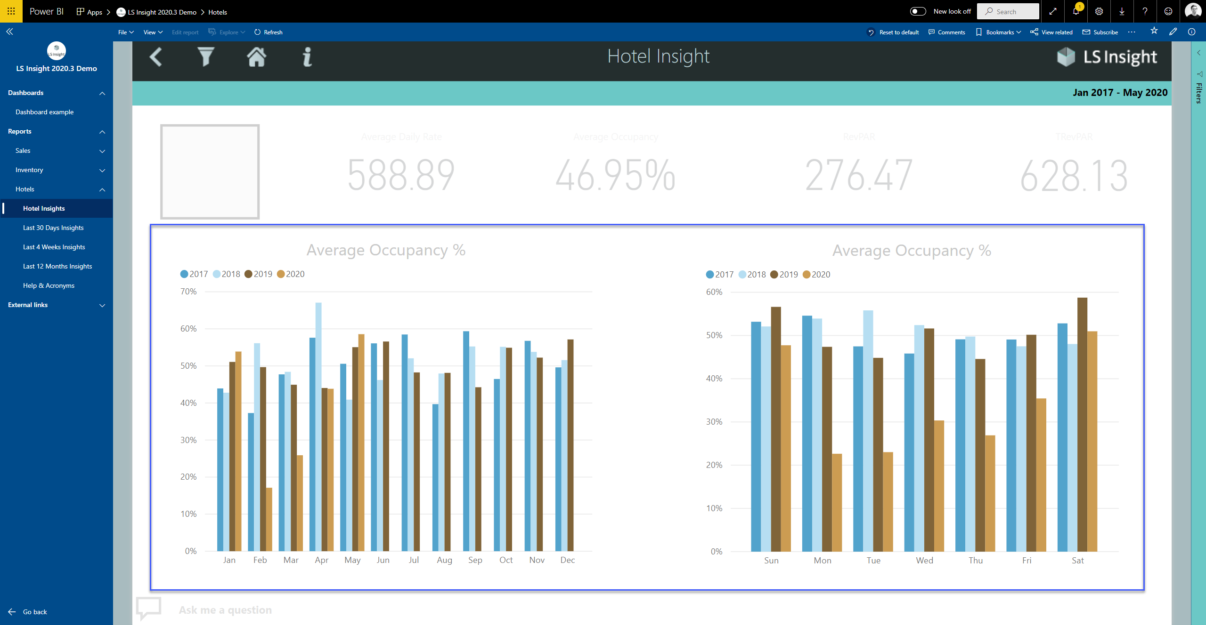
Notes:
On the graphs in the lower half of the page you can see historical values of the average occupancy rate. The graph on the left is split between months and the graph on the right is split between weekdays.

Slide 32
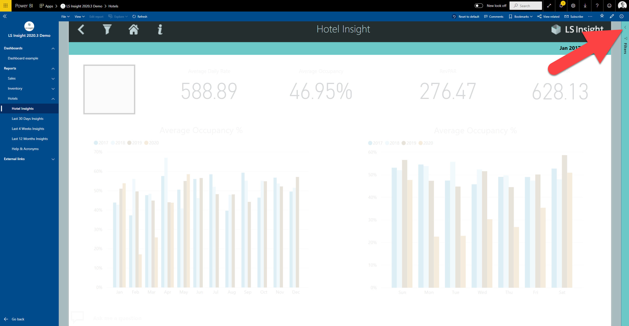
Notes:
Everything on this page is calculated using the whole dataset, but if you want to limit your dataset to a room type or specific dates, you can do that by applying filters.

Slide 33
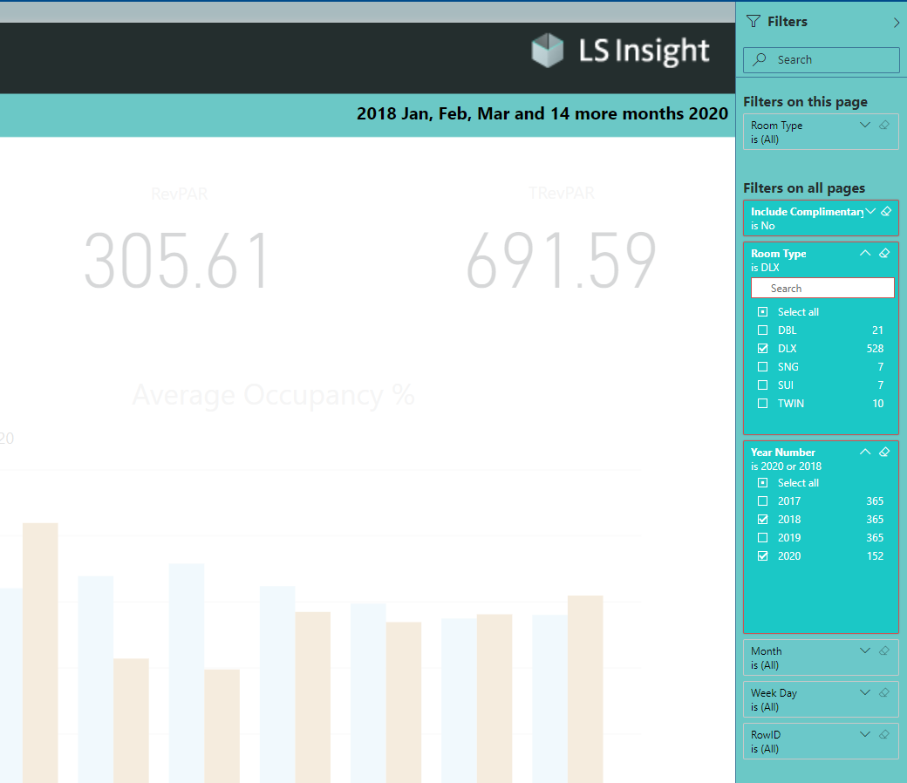
Notes:
Here I’ve filtered my dataset to deluxe rooms and the years 2018 and 2020.

Slide 34
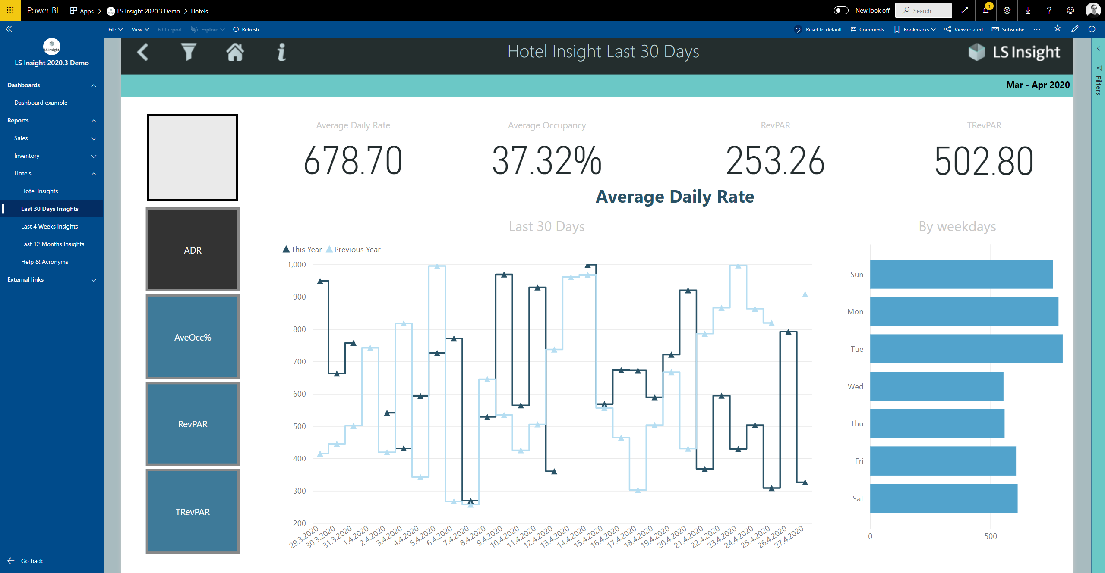
Notes:
The Second page gives the last 30-day insights.
Here you can switch between the KPIs and choose which one you want to display on the graphs.
Now displayed are the historical values of the “Average Daily Rate”.

Slide 35
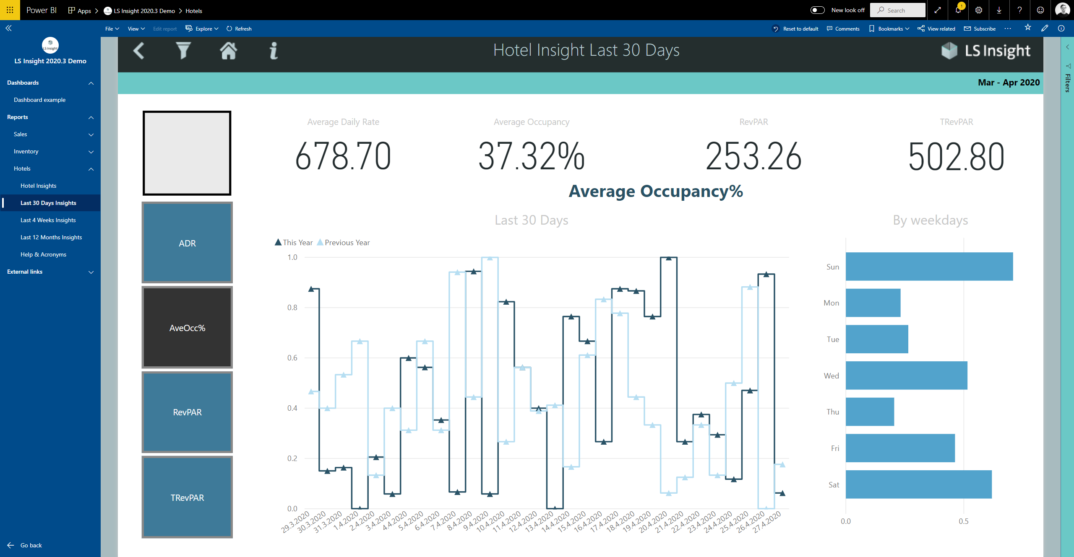
Notes:
Here we have the average occupancy rate.

Slide 36
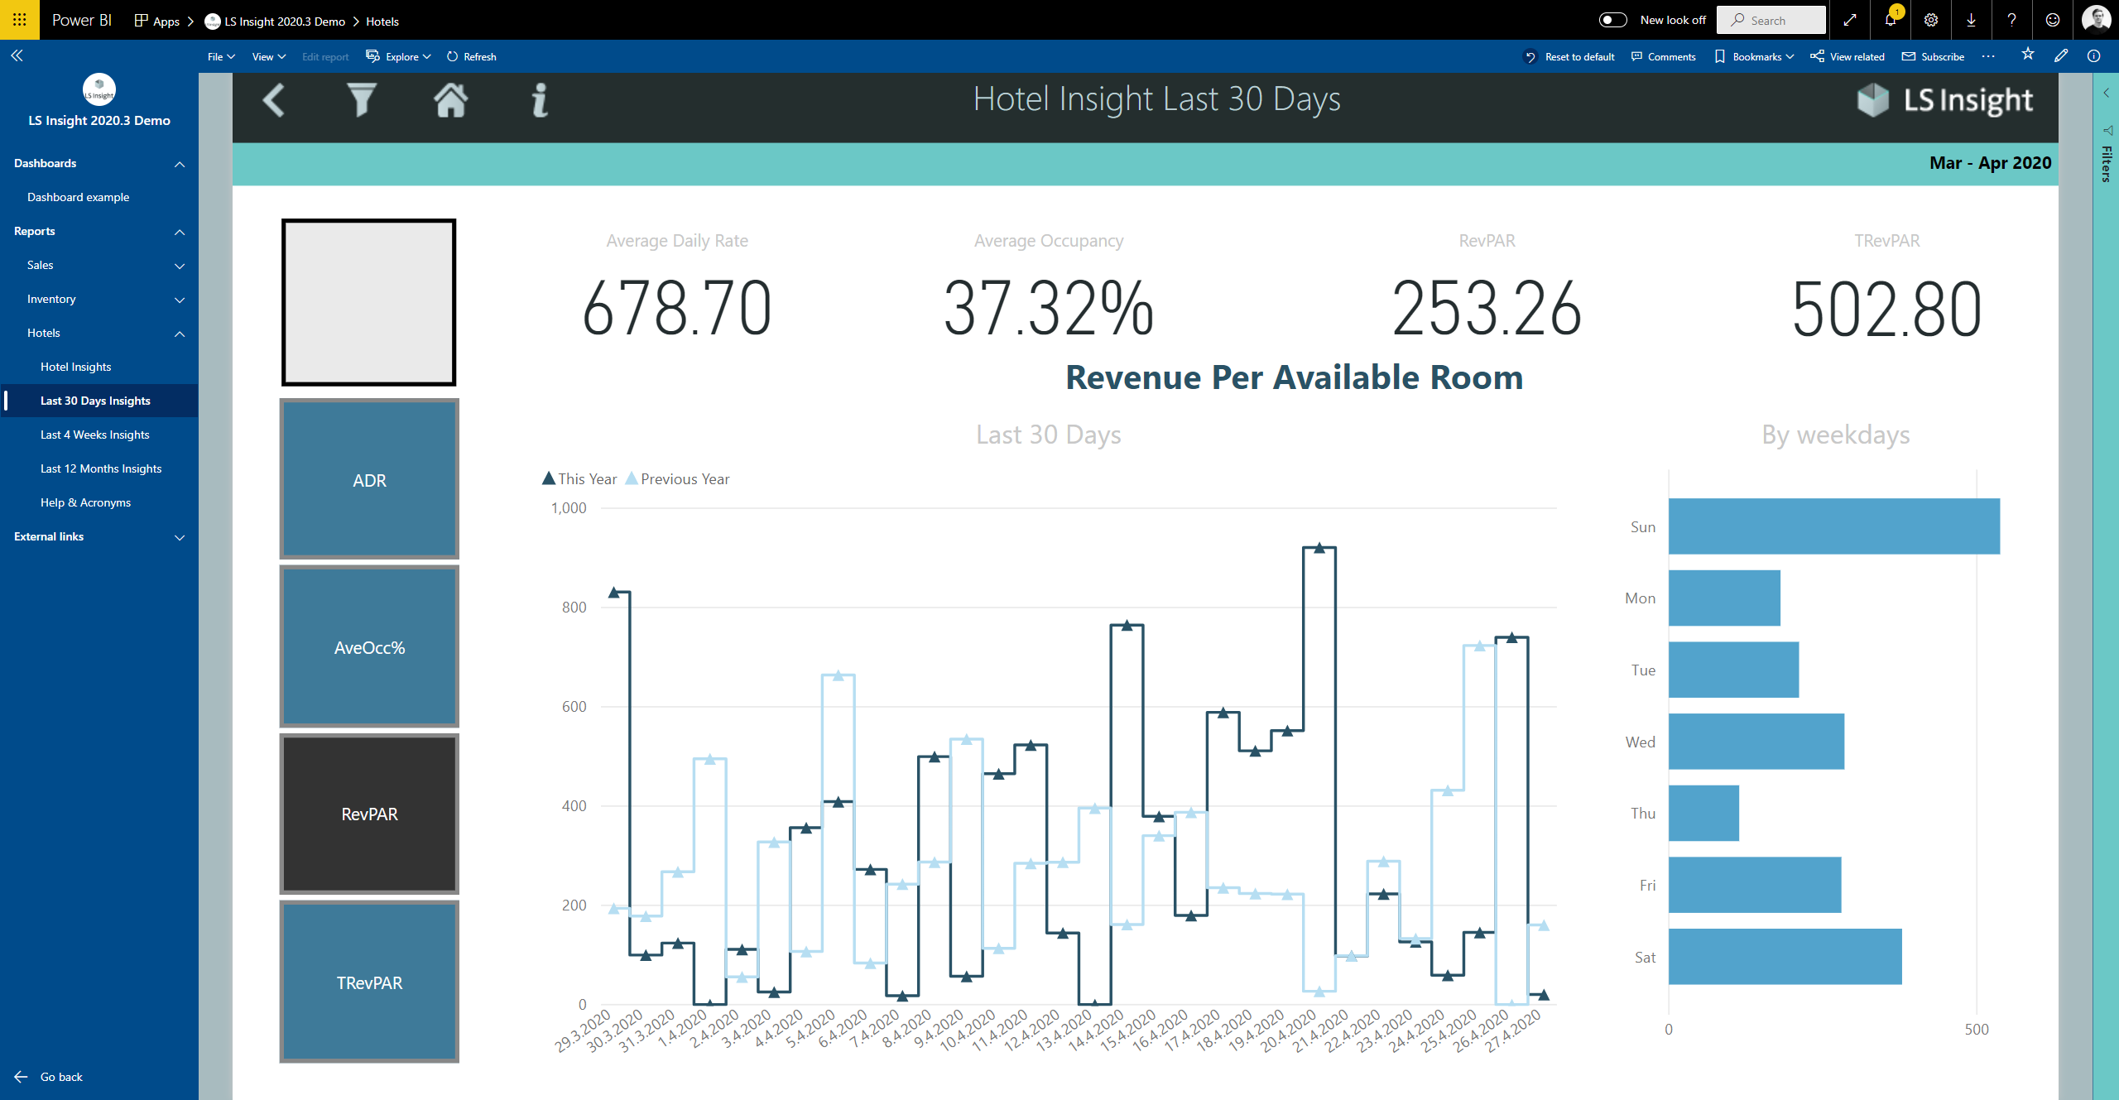
Notes:
RevPar
(Pause, 4 seconds)

Slide 37
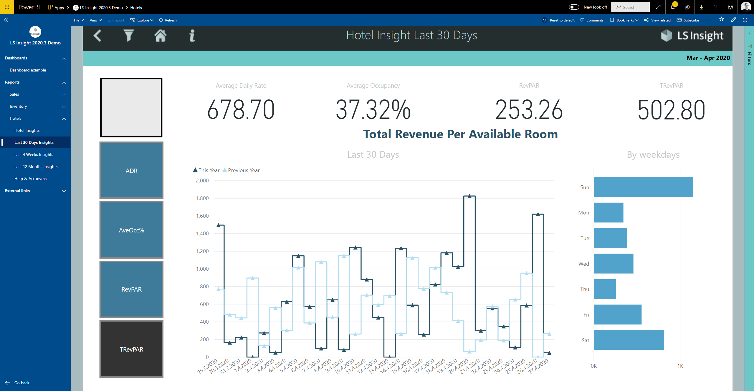
Notes:
And lastly the TRevPar.

Slide 38
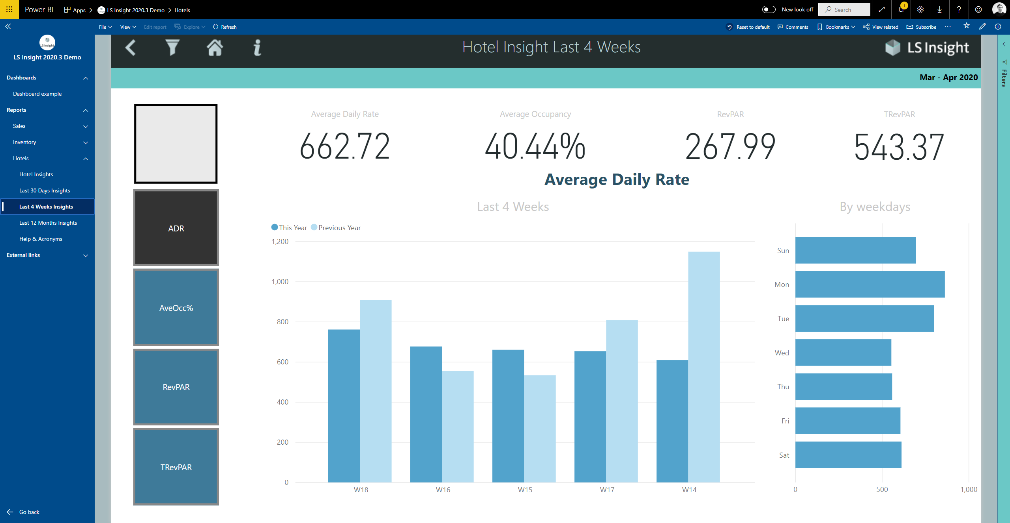
Notes:
The third page shares the same layout but displays the KPIs on a different date interval.

Slide 39
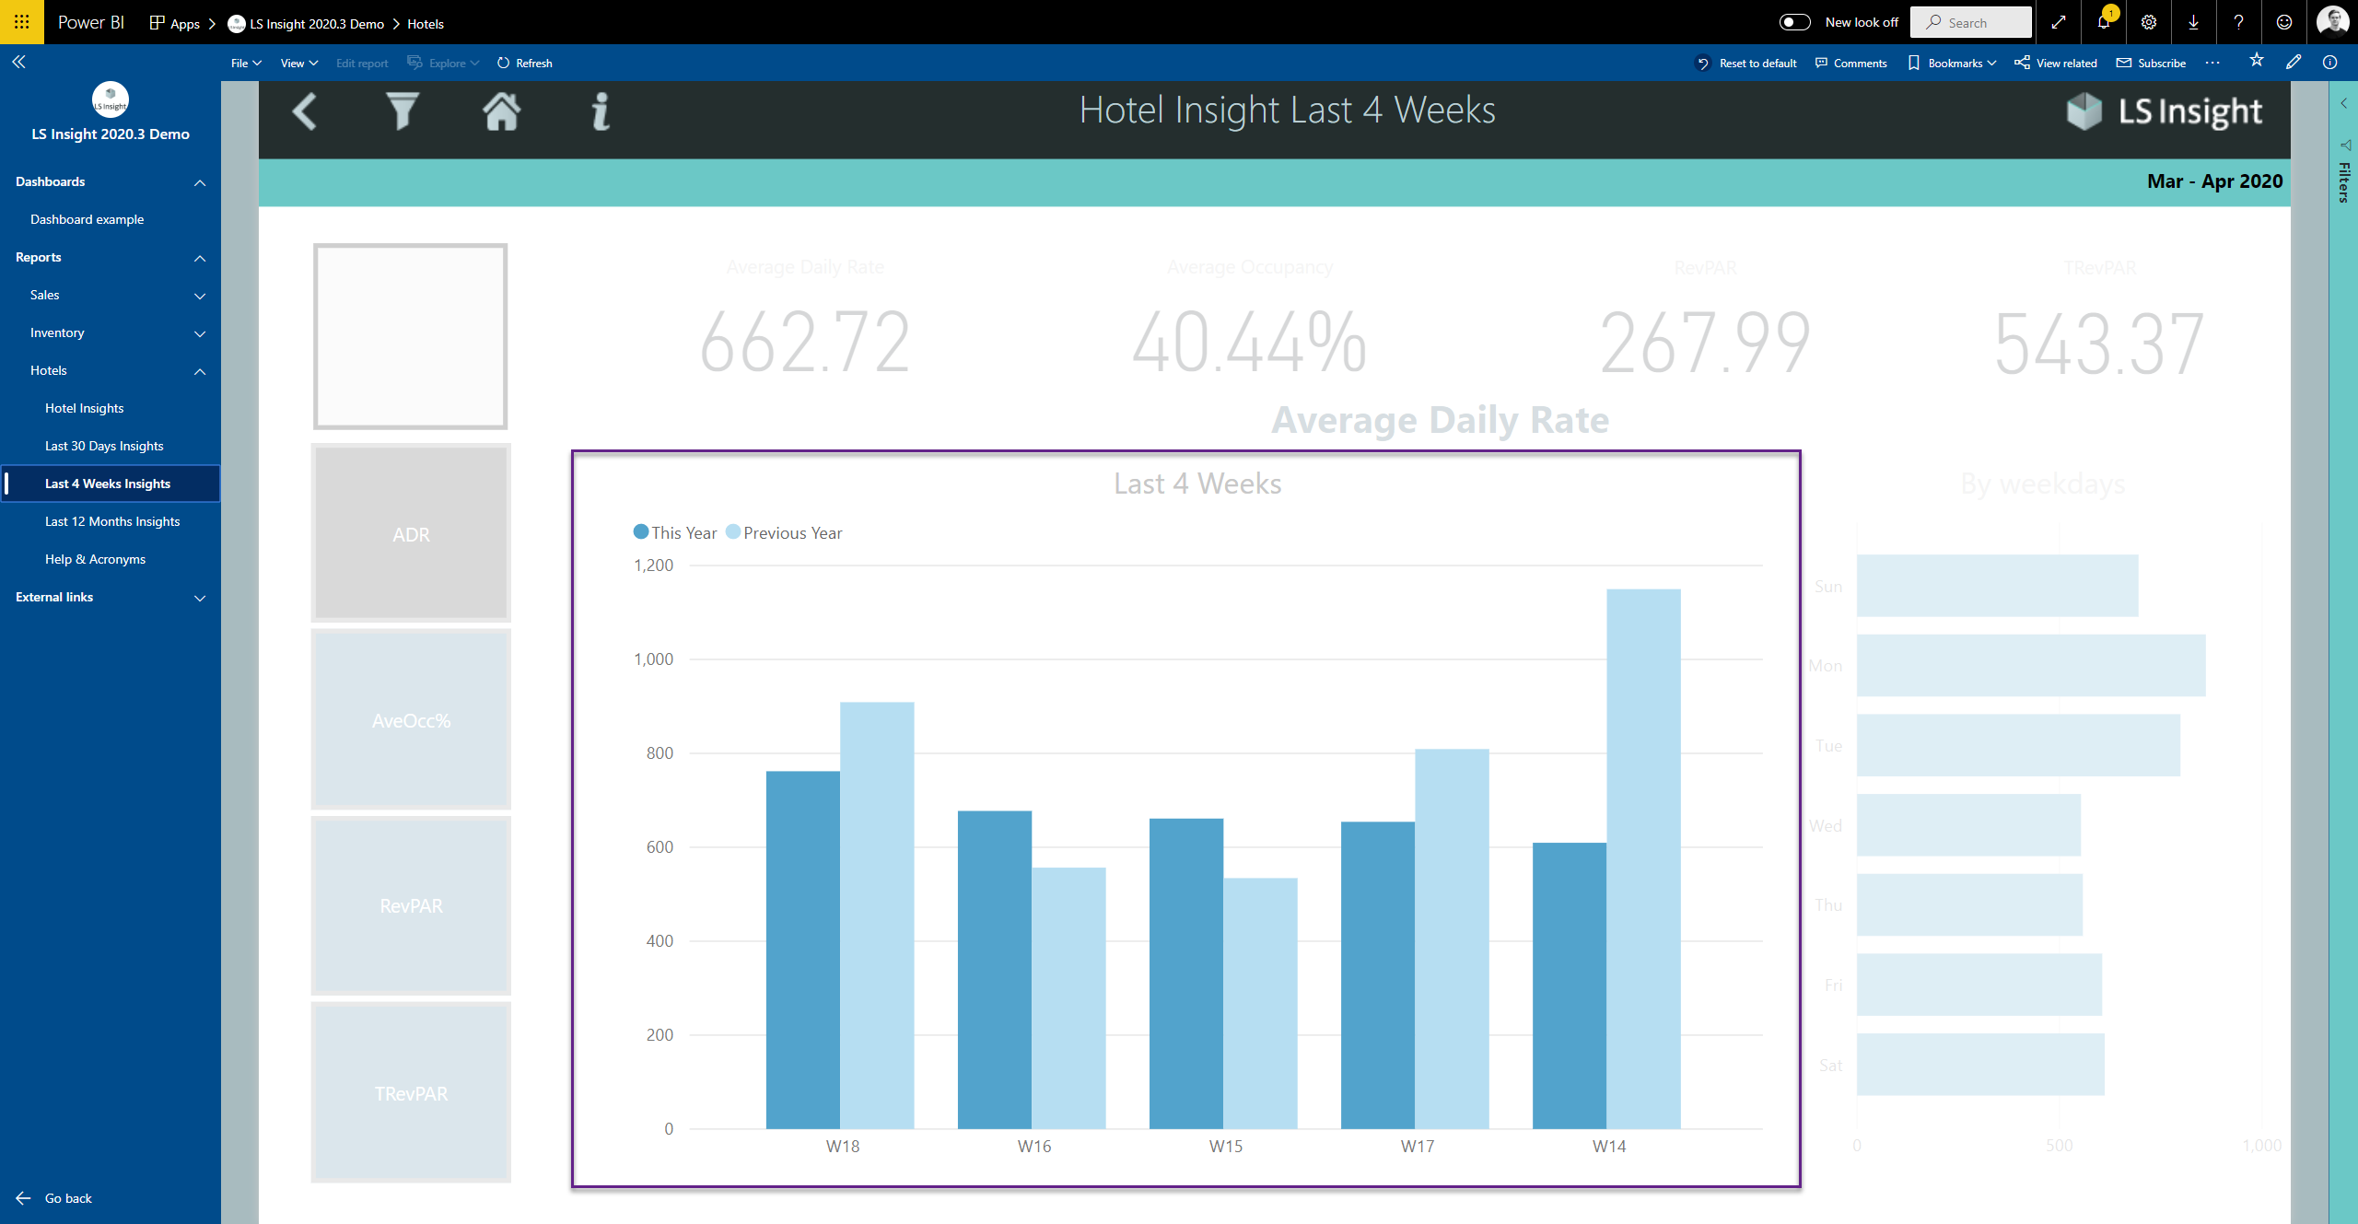
Notes:
The Second page had the last 30-day insights, but the third page has the last 4-week insights.

Slide 40
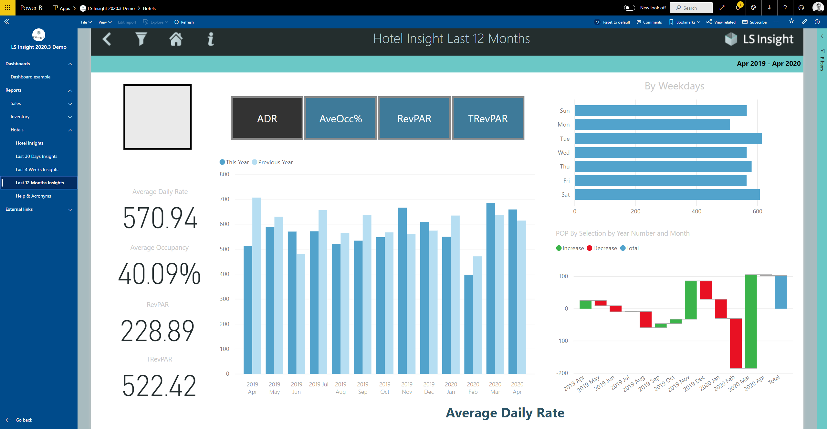
Notes:
The fourth page has similar insights as the previous two, but the layout has been changed

Slide 41
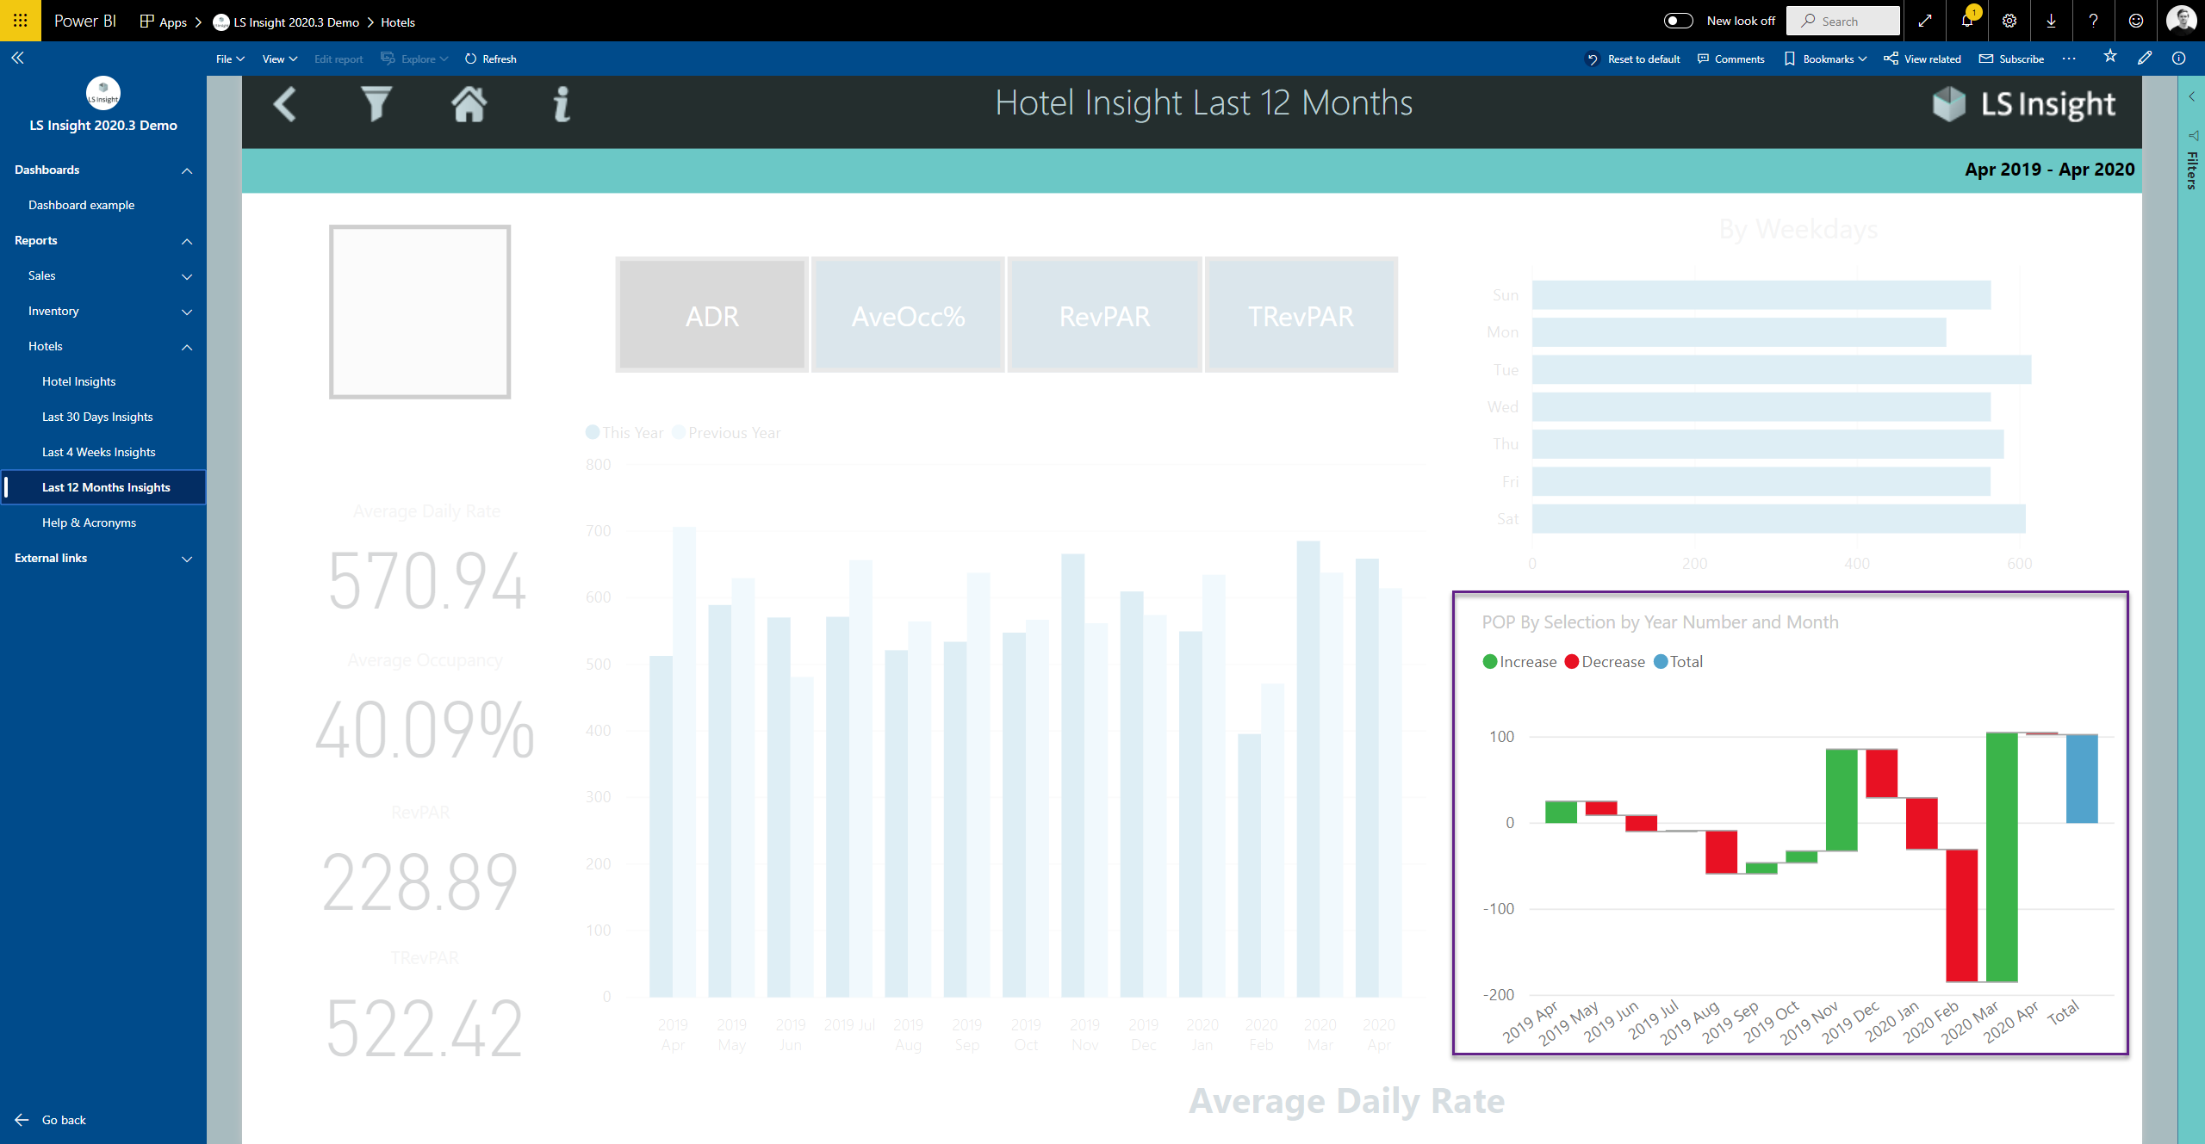
Notes:
and an additional visual has been added where the change between months is shown.
In future versions of the hotels report, you can expect to see improvements in most areas. That is, more KPIs, be able to manipulate your dataset with more filters and dig deeper into the data through the visuals.

