Slide 2
LS Pay
The payment solution for LS Central
Andreas Stenlund
Petur Sigurdsson
Solvi Hjaltason
Vlad Jacota

Slide 3


Offering EFT integrations to the leading PSPs, in all our main market regions
Allowing our customers
to have a choice

Slide 4




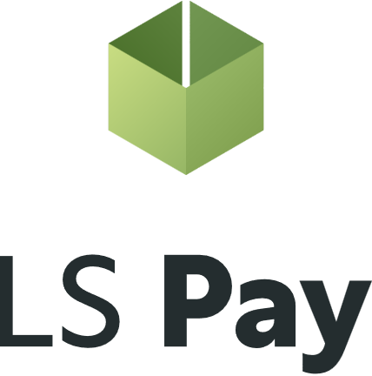


Adyen
Elavon
Planet
Freedom Pay

Slide 5




Adyen
Elavon
Planet
Acquiring/Processing:
Freedom Pay

Slide 6

















Slide 7
Joining us at ConneXion

Slide 8
60+
50+
Payment integrations
Supported countries
285
32
Customers
Countries

Slide 9
















Some of our customers

Slide 10
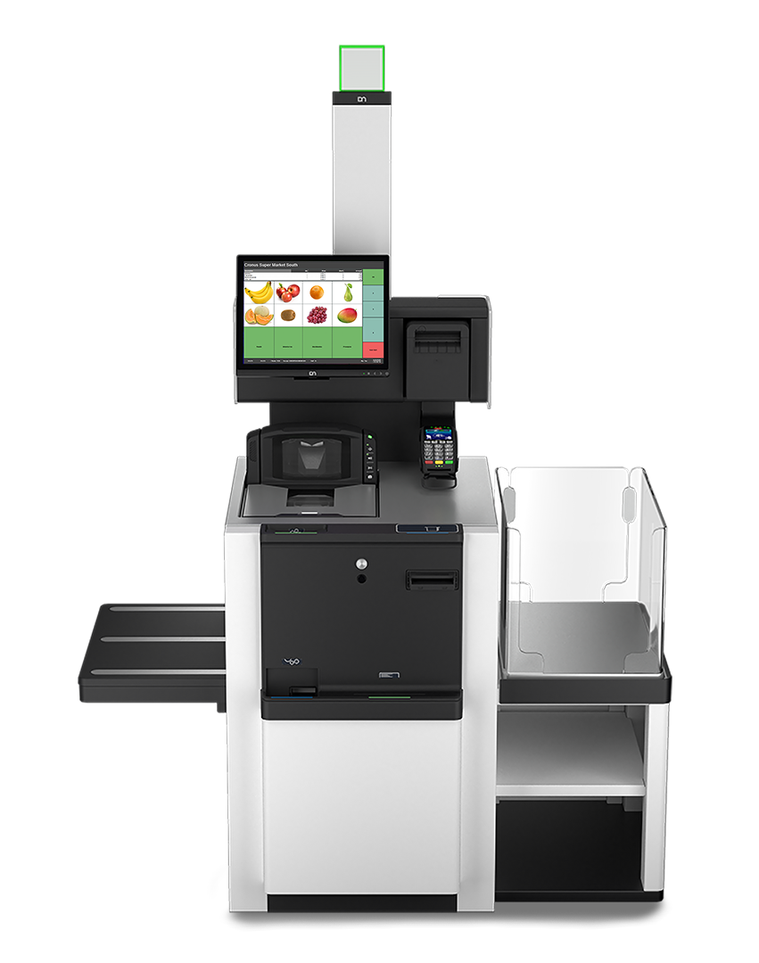
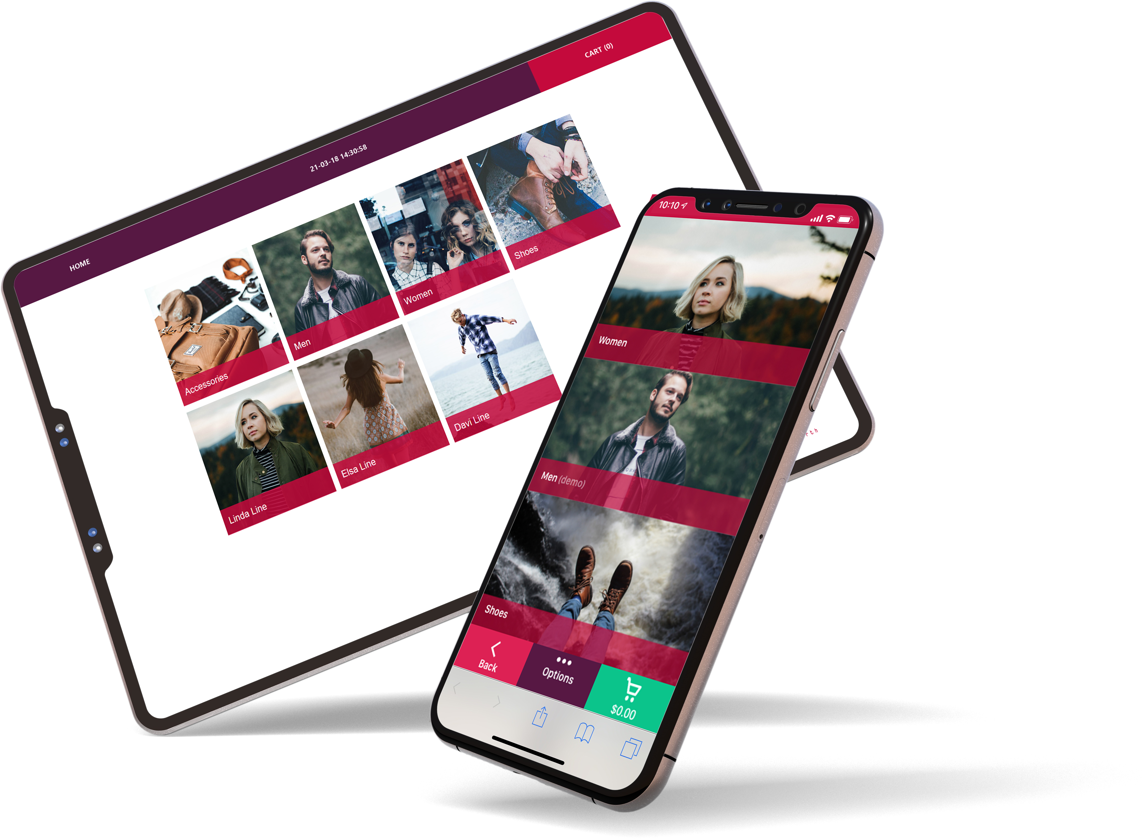
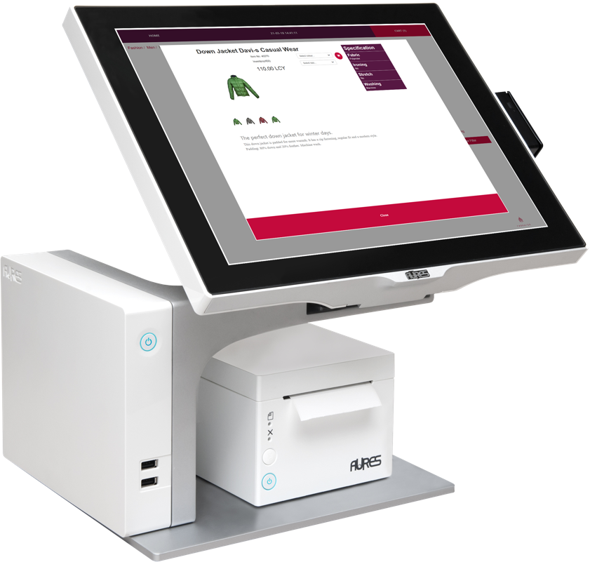
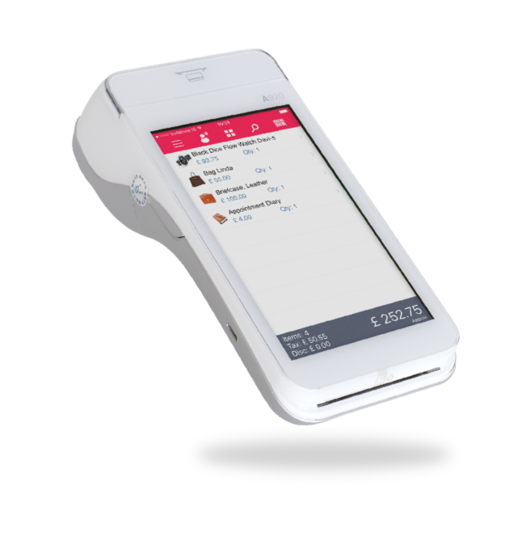
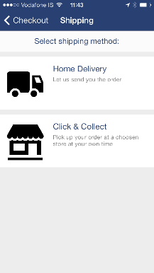
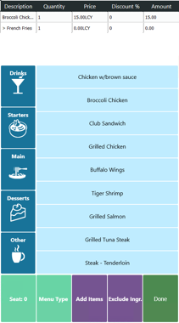
Supporting all platforms & form factors

Slide 11
Feature demo

Slide 12

LS Pay for
Business Central

Slide 13
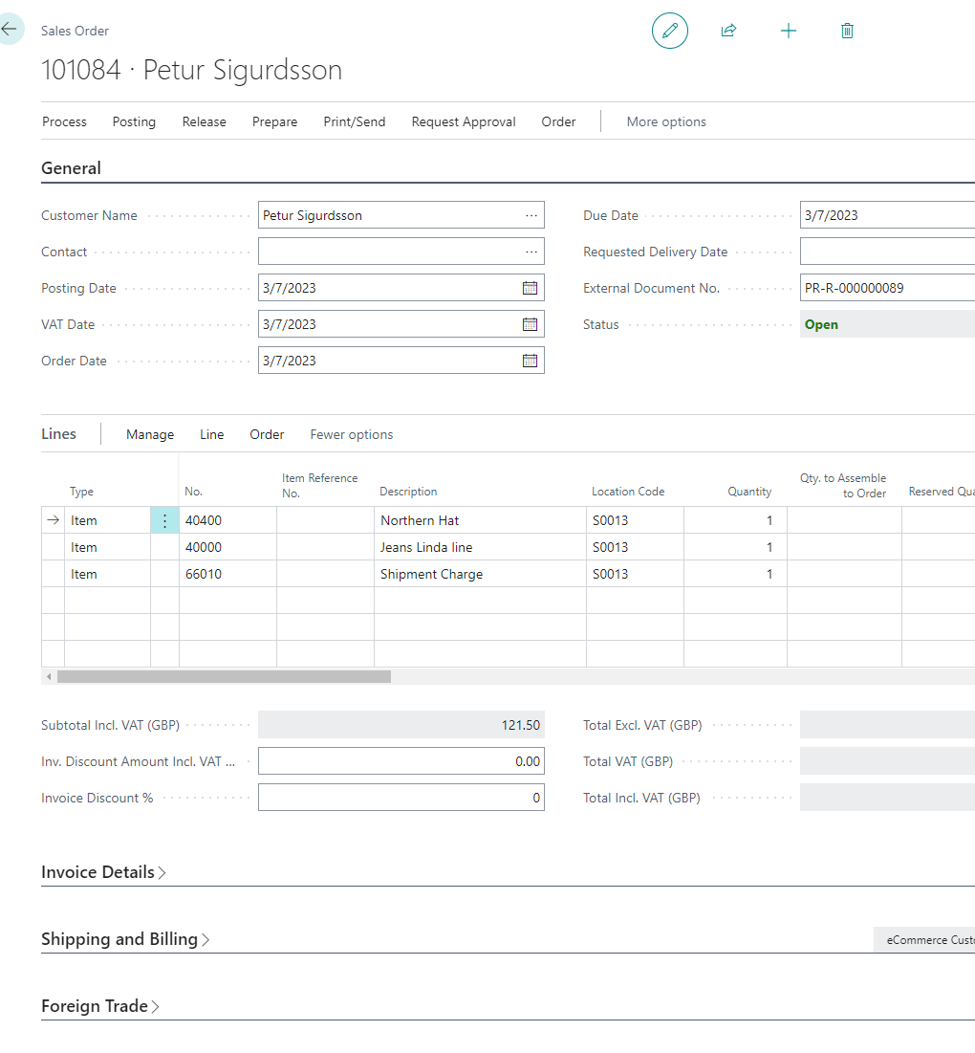
Sales Orders
Generic payment support
Full payment/capture on placing an order
Pre-auth on placing an order and full capture on shipping
Extending time periods of pre-auths
Adjusting pre-auth amounts to cater for shipping charges
Support for Card-on-File
Card not present
  Manual card number entry on PED
  Payment links via email and text messages

Slide 14

Sales Credit Memos
Voiding payments
Refunding payments
Cancelling pre-authorizations
Modifying pre-authorization amounts
Customer Accounts
Paying multiple invoices at once
Card-on-file
Online payment links

Slide 15

eCommerce orders
Many merchants use generic 3rd party eCommerce integrations for Business Central
Ability to do full captures, modifications and cancels of pre- authorizations that accompany eCommerce orders into Business Central
Triggering web hooks for execution by the respective eCommerce platform

Slide 16
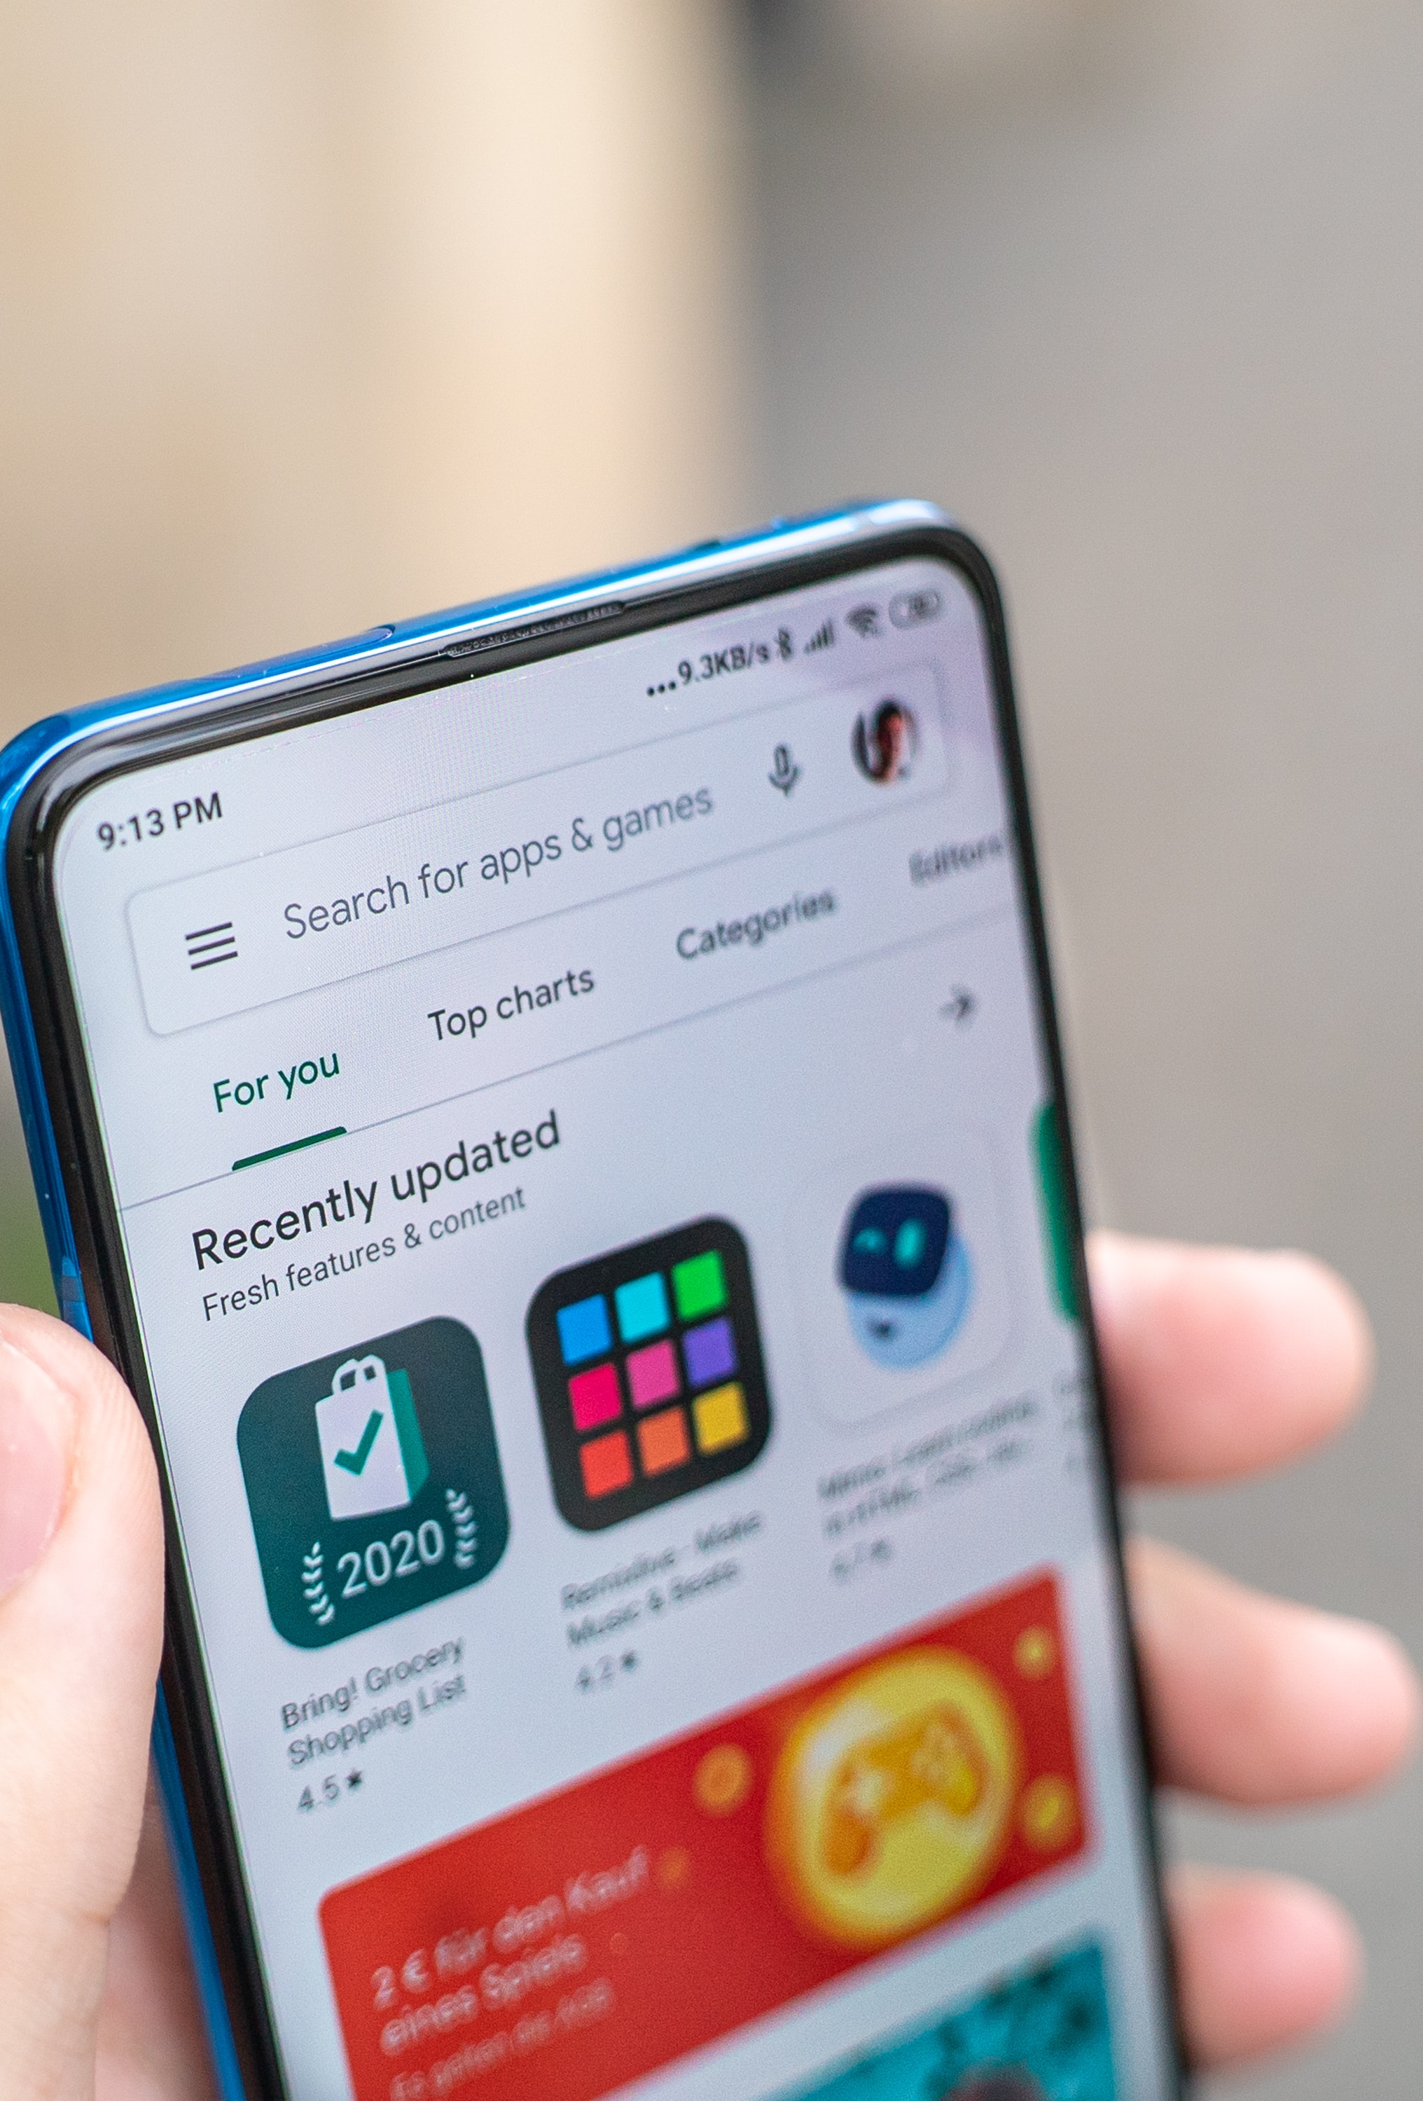
In summary…
A generic app listing on the MS AppSource
Target customers:
  LS Central merchants requiring back office and/or 3rd party eCommerce payments
  Any BC users selling into sales order and not requiring a POS system
Initially via LS Retail partners
Subsequently via generic MS BC partners
Estimated release summer 2024 – Phase I

Slide 17

Consulting Services

Slide 18

Custom integrations
Short lead time
  Next available consultant
Statement of Work (SOW)
  Time and materials or fixed price
Development
  We allow for 3 months
    Development and certification
  Full support from the LS Pay team
  Using LS Pay’s development processes

Slide 19
Custom integrations
The plugin becomes a default part of LS Pay
The LS Pay development team maintains the plugins going forward
We waive the LS Pay license fees, apart from BREP (maintenance)

Slide 20
Past and future

Slide 21
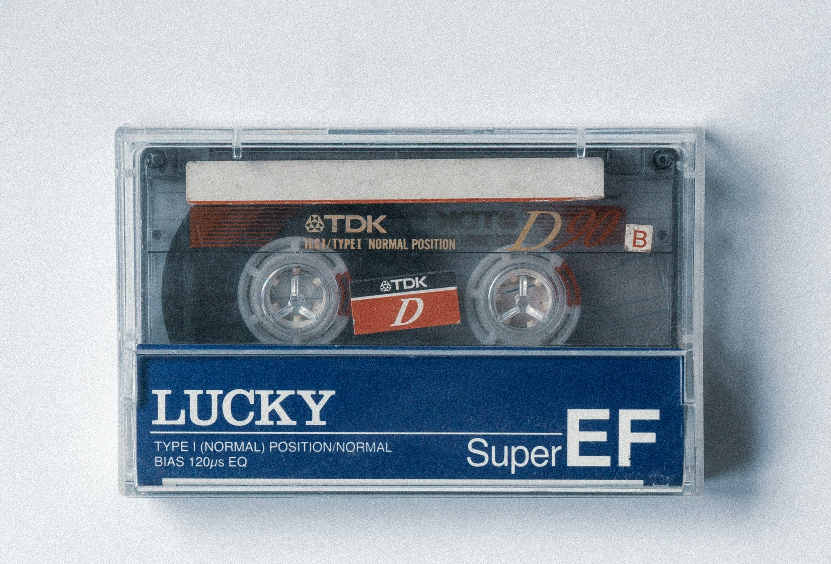
Backwards compatibility
All versions of LS Central supported
LS Nav EFT downgrade package available on our portal (FOBs)
  Default support for various versions of LS Nav
    14.02, 13.05, 11.05, 10.10, 9.10
Partners can use given FOBs as blueprint to add support for versions not supported by default

Slide 22






Roadmap
LS Pay for Business Central
Online payment links / QR code payments
LS Retail Academy: LS Pay course
Increased PSP documentation
PSP plugins and gift card support

Slide 23
Questions?

