Slide 1

Product roadmap review
Dadi Karason
Chief Technology Officer
LS Central versions 24 & 25

Slide 2
Development update version 24 (April 2024)
We continue to focus on the three main areas
  Onboarding and migrating our customers to SaaS
  Unified commerce – business processes on the same back-end platform
  Contactless shopping - self-service and automation in stores and restaurants
Main features
  LS Pay for Business Central
  RFID support for the POS
  Interactive Dual Display
  Aggregated Inventory
  LS Retail x Google Shopping
Ongoing efforts
Events and accessibility
Migration to public SaaS
SaaS load testing extension
Customer order enhancements
Invoice Management - Folios, Deposits and Tokens
POS UI and performance measurements
Forecourt enhancements
Self-service kiosk enhancements
Pharmacy localizations to SaaS
Localization refactoring - NA
eCommerce enhancements
SaaS based Update Service

Slide 3
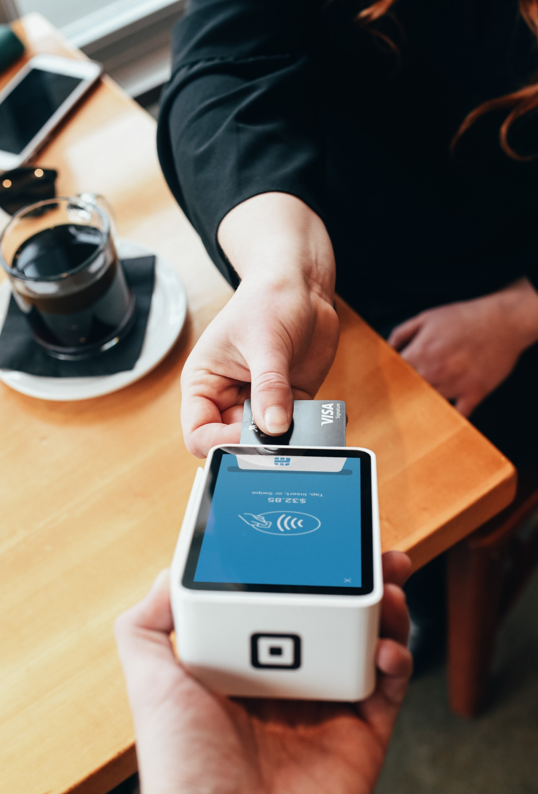

LS Pay for Business Central
Enabling LS Pay for standard Business Central
  55+ Integrations to the world’s leading Payment Service Providers
  Support in 50+ countries
Payment support for standard Sales Documents in Business Central
  Sales orders
  Sales credit memos
  Customer accounts
  Full capture of eCommerce payments
Available on the Microsoft AppSource
Estimated release in Q4-2024

Slide 4
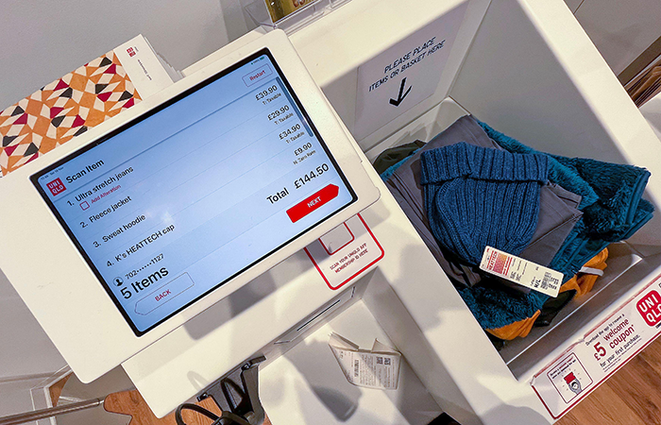
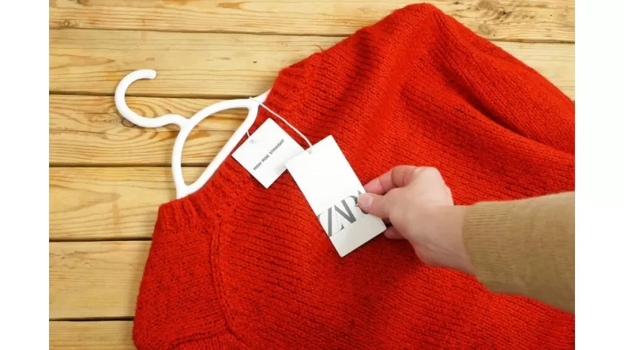
POS RFID Support
The next step in our un-attended POS journey
We are already able to receive orders by reading RFID tags with our Mobile Inventory
Focus on:
  Reading tags at the POS
  Marking tags as sold after payment
  Communication with external tags management systems
Not in scope – full inventory management using RFID

Slide 5
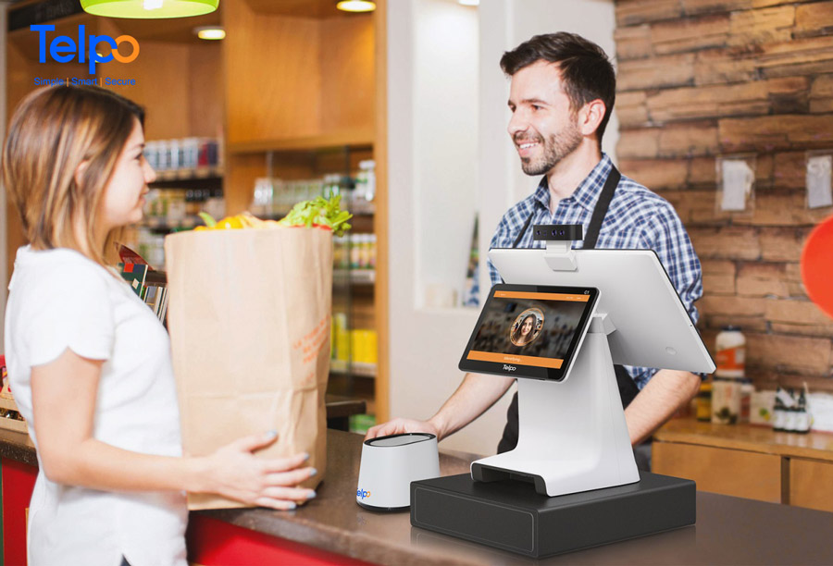
Interactive Dual Display for the POS
Allows the customer to interact with the second display
Use cases:
  Member Signup
  Enter and confirm shipping address
  Signature capture
  Waivers
  Tips & donations
  Customer satisfaction surveys
  Upselling during the sales process (hospitality)

Slide 6
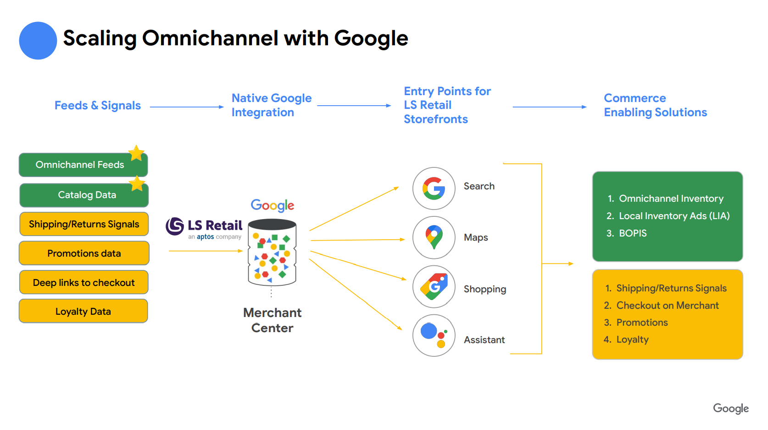

Slide 7
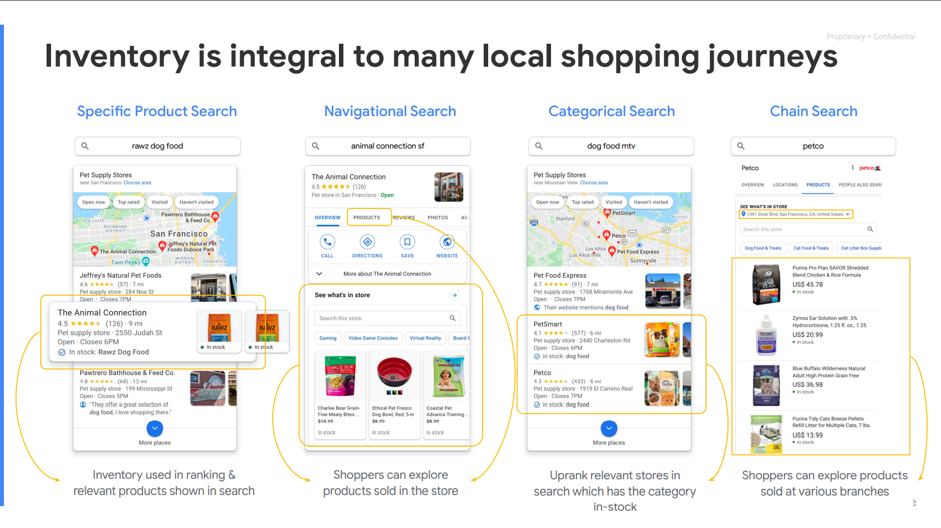

Slide 8
Aggregated Inventory
A new way to keep track of inventory in LS Central
Instead of keeping track of inventory levels in the Item Ledger Entry and Value Entry we move this data to a new set of tables
This gives us:
  Much faster end-of-day posting (Statement Post)
  Smaller databases
  Inventory data can be compressed and archived
  Processes such as posting COGS and adjust cost run 100x faster
  Not only for retail - compatible with other Business Central processes

Slide 9
Aggregated Inventory
Aggregated posting for store locations
Current approach – Statements
Item Ledger Entries for individual stores
One entry per item, per location, per day
New approach – Statements
Item Ledger Entries for aggregated
store location(s)
Details are stored in a new table
LSC Aggr. Inventory Entry (10059488)
Other Documents include
Purchase, Transfer, Sales
Item Ledger Entries
current
Aggr. Inventory
Entries
new
Store 1
---------------
---------------
Store 2
---------------
---------------
Store 3
---------------
---------------
Store 4
--------------- ---------------
Store 300
--------------- ---------------
Store 1
---------------
---------------
Store 2
---------------
---------------
Store 3
---------------
---------------
Store 4
---------------
---------------
Store 300
---------------
---------------
Store “RETAIL-1”
---------------
---------------
one day’s entries
Store “RETAIL-2”
---------------
---------------

Slide 10
Other documents, processes, and integrations
Purchase
Purchase Orders
Purchase Quotes
Sales Orders
Sales Quotes
Transfer Orders
Drop Shipments
Integrations
Sales
Blanket Orders
Purchase Return Orders
Blanket Orders
Sales Return Orders
Other
Special Orders
Analytics for
LS Central
Store Worksheet
(Count, Pick, Recv)
POS Lookups (Availability check)
eCom Integration (Availability check)
Web Services
Mobile Inventory
Replenish-
ment
Assembly Orders
Production Orders
Future Versions
Item Revaluation
Item Reclassification

Slide 11
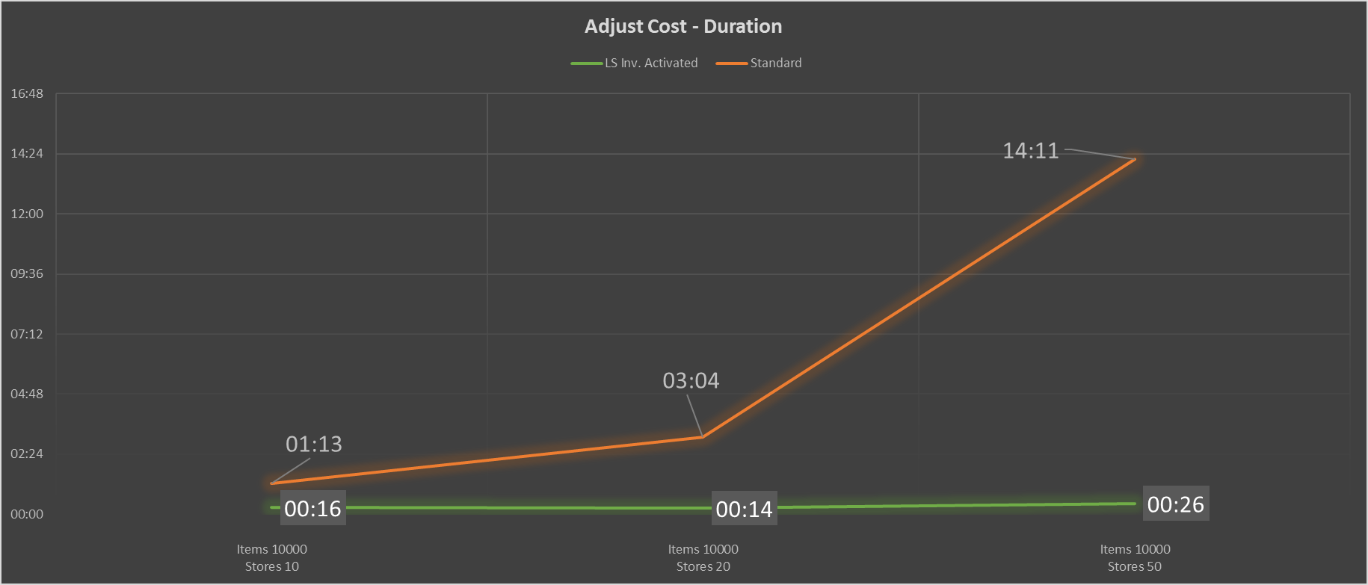
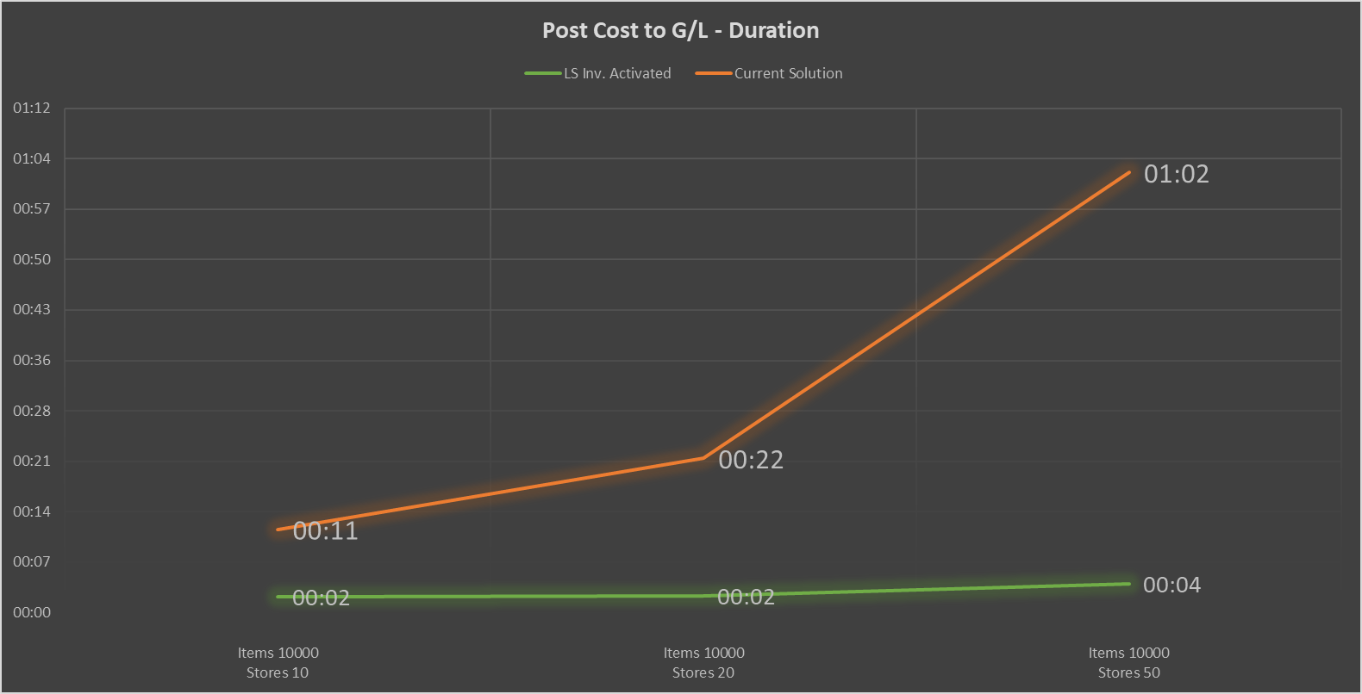
Your benefits
Faster processes
(Example: 10.000 items, 200 stores)
  ILE & VE (record count): -99%
  Adjust Cost (duration): -97% (14hours to 26min)
  Post Cost (duration) : -94% ( 1hour to 4min)
Adjust Cost
Post Cost to G/L

Slide 12
GitHub contributions
This is the fastest way to get event requests processed
260 requests processed since last event
http://github.com/lsretail/ls-central
You need to apply to get access:
  lscentralgithub@lsretail.com
  Partner name
  Name
  Email address
  GitHub ID

Slide 13
Online POS performance in SaaS
The test is run on a non-scaling development environment
Each POS generates 500 transactions
Max throughput is 50.000 transactions per hour – 13.9 per second
Additional environments provide the same throughput
Number of POS sessions | Transactions per POS | Total Number of transactions | Duration in minutes | Transactions per hour | Transactions per minute | Transactions per second
25 | 500 | 12.500 | 18 | 41.667 | 694 | 11,6
50 | 500 | 25.000 | 42 | 35.714 | 595 | 9,9
75 | 500 | 37.500 | 47 | 47.872 | 798 | 13,3
100 | 500 | 50.000 | 60 | 50.000 | 833 | 13,9

Slide 14
Data Director & Replication
Data Director will stay in the current form
  We will not migrate it to Azure Services - optimized for on-premise environments
We will incorporate other Azure services for data exchange in SaaS
These services are high-performance, scalable and fault tolerant (affordable)
  Azure Storage Web Replication (LS Central)
    Used for replication to offline Store/POS
    Uses JSON as document format
    Allows us to track the delivery of every package in LS Central
  Message Queue (Microsoft)
    Can be used for integration purposes (standard pattern)
    Can be used to receive data from offline POS (high volume environments)
  Azure Service Bus (Microsoft)
    Used for integration and message delivery to multiple receivers
  Company-to-company replication

Slide 15
Hybrid-cloud component server sunset
Current usage | Replaced by
Replication by Data Director | Azure Storage Web Replication Released in v24
Update Service | Azure Service based Update Service Beta release in v25 - scheduled for release in v26
POS master database | Azure SQL if needed
Commerce Server | Will migrate to Business Central API

Slide 16



Copilot
Copilot for GitHub has changed the way we develop software
All LS Retail developers have access to this
  Helps with refactoring
  Makes repetitive tasks super easy
  Helps with the creation of unit tests
We have not measured the productivity improvement, but it is significant
Next step is to use Copilot for the online help
Microsoft is planning to release support for Copilot and ISV knowledge bases in v25

Slide 17
Development update for version 25 (Oct 2024)
Focus on SaaS, Unified Commerce & store automation
Main features
  SCO custom plugin support
  RFID support on the POS
  NFC support for Member Management
  Web-based KDS & new pop-up framework for F&B
  Multi-warehouse & BOM-in-BOM replenishment
  Advanced price management for variants
  Replenishment for Aggregated Inventory
Ongoing efforts
Events and accessibility
Migration to public SaaS (1H)
SaaS load testing extension
SaaS based Update Service (Beta)
Web-replication for Azure Storage
ASB & Message Queue support
Company-to-Company replication
Microsoft Copilot for Online Help
Automatic test coverage
Dual Display enhancements
eCommerce enhancements

Slide 18

Self-checkout plugin support
Allows partners to write their own plugins for self-checkout devices
Uses the same framework that LS Central uses for self-checkout integrations
Gives customers the ability to manage multi-type self-checkout environments via a unified interface
Suitable for high-frequency scanning environments such as grocery and convenience stores
Enables a simple way to use features in the Hardware Station for payments, etc.

Slide 19

Web-based Kitchen Display Service
The KDS is now capable of running in a browser and does not need a Windows based client to operate
This opens up the possibility of using lower-cost hardware devices built on platforms such as Android or iOS
The Web-version also includes:
  Better load balancing between similar stations
  Support for offline POS
  Support for ghost stations
  Configurable printouts per item or order
  Printing on demand

Slide 20

New pop-up framework for Food & Beverage
We can now allow users to edit items with modifications
Previously, the user had to delete the modifier line and create a new one in order to make changes
The new framework allows users to make changes in place without having to delete the item modifier lines
We can also allow orders to be changed after they have been sent to the kitchen
Item modifiers can now also be linked to the parent item based on UOM
The new framework is also extendible by default by partners (700 unit tests)

Slide 21
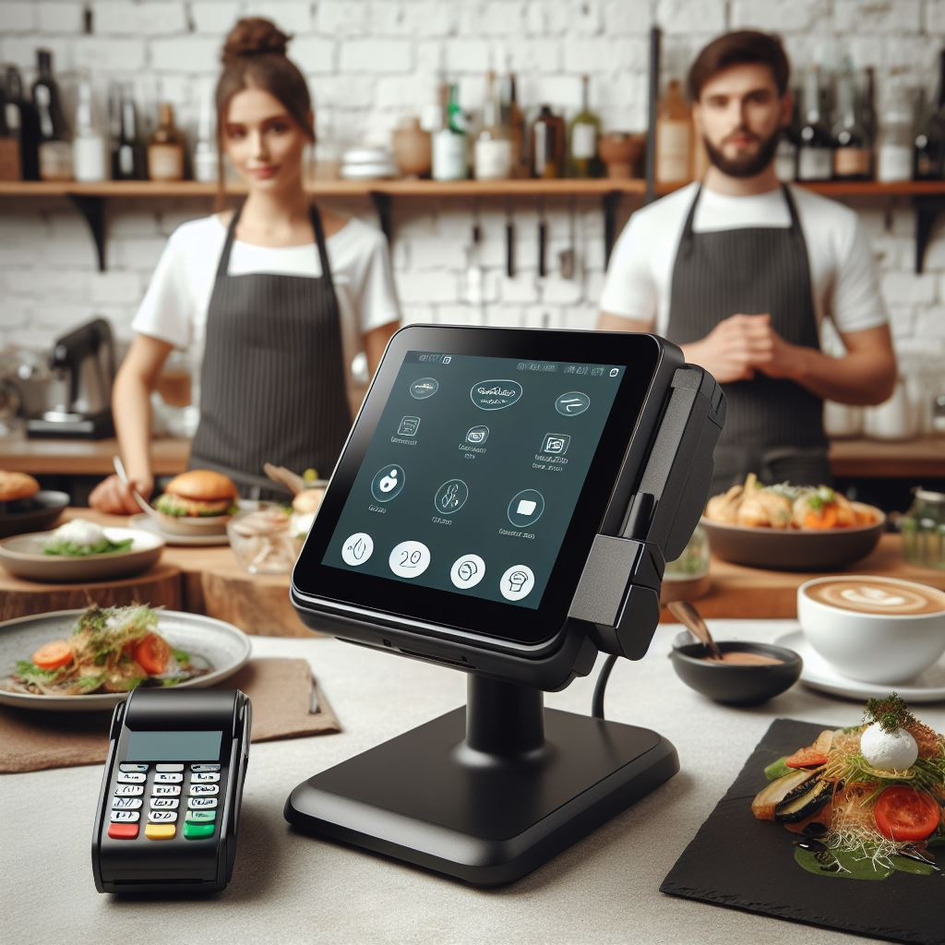
Self-service kiosk enhancements
Accessibility – operation to change the layout of the kiosk for users who cannot reach the typical top of the screen (often used by children and wheelchair users).
Cross-selling modifiers which can be linked to individual items or triggered during the checkout process. This is useful for adding additional high-margin items to the transaction at the end of the sale and will be designed to be able to consume results from a recommendation engine.

Slide 22
Replenishment & Fashion
Multi-warehouse replenishment
  Source from different warehouses based on parameters such as availability, distance or other parameters
  Allows us to configure more than one warehouse for each store
BOM-in-BOM replenishment
  We are selling cakes which are made from many ingredients such as dough which can be made both locally and centrally. We need 100 cakes. We have 20 dough on stock. So, when we do replenishment, we would include the 20 pcs that we have and source rest of the ingredients to make the remaining 80. (Focus groups)
Automatic release of purchase orders (Pharma)
Advanced price management for variants
  We need to be able to price many variants differently with a simple process.

Slide 23
Development update for version 25 (Oct 2024)
Focus on SaaS, Unified Commerce & store automation
Main features
  SCO custom plugin support
  RFID support on the POS
  NFC support for Member Management
  Web-based KDS & new pop-up framework for F&B
  Multi-warehouse & BOM-in-BOM replenishment
  Advanced price management for variants
  Replenishment for Aggregated Inventory
Ongoing efforts
Events and accessibility
Migration to public SaaS (1H)
SaaS load testing extension
SaaS based Update Service (Beta)
Web-replication for Azure Storage
ASB & Message Queue support
Company-to-Company replication
Microsoft Copilot for Online Help
Automatic test coverage
Dual Display enhancements
eCommerce enhancements

Slide 24






LS Central retail integrations with CentralConnect
Head-office platforms
LS Central
as a retail solution
CentralConnect
LS Central
as a POS solution

Slide 25
Discussions
Q&A

