Slide 1
Webinar
LS Central for pharmacy
May 5th 2020
Henrik O. Thordarson Pharmacist, Senior Consultant
Stefán Georgsson, Product Director Pharmacy

Slide 2
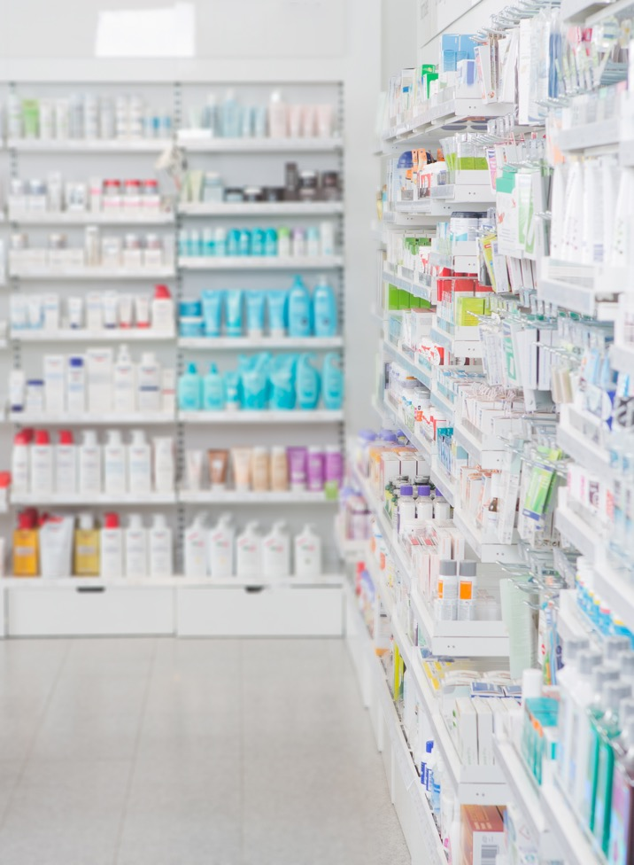
Pharmacy software for pharmacies of all sizes
It manages various types of prescriptions, handles drugs effectively and keeps track of the pharmaceutical stock across all stores
It covers the daily routines in a pharmacy, from back office to POS
It supports effective data structure for medications and efficient handling of pharmaceuticals
Users can enter and search products in the system through different dimensions from substance, ATC group, strength and classification to warning text, product description, quantity in pack, daily dose and more
Based on LS Central and Business Central
LS Central for pharmacy - Overview

Slide 3
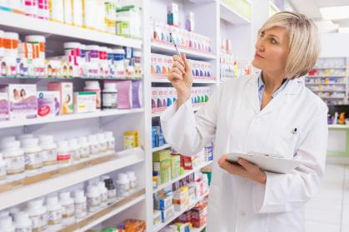
All standard Prescription processes
  Prescription handling
    Paper, Electronic, Emergency, etc
  Generic substitution
  Integration framework for e-Prescriptions and Insurance
  Pharmaceutical control
  Pick control & FMD Control
  Animal Prescription
  Order requests when item is not on stock and Subscriptions
  Pharmacy specific user permissions
Customer identification
  Pharmacy customer database or link to national registry
  Handling of Power of Attorney and Care units
Master data import and management
  Master data for Prescription handling
    Pharmaceutical Items
    Item Groups including ATC and Substance Groups
    Health Personnel
Key Functionality Areas

Slide 4

Country
Integration
LS Central for pharmacy
Modular design of LS Central and LS Central for pharmacy
LS Central
MS Dynamics 365 Business Central
Overview - Lego methodology

Slide 5
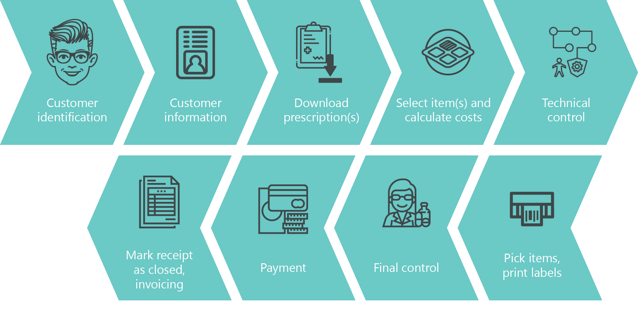
ePrescription flow in LS Central for pharmacy

Slide 6
Demo – Classic UI

Slide 7
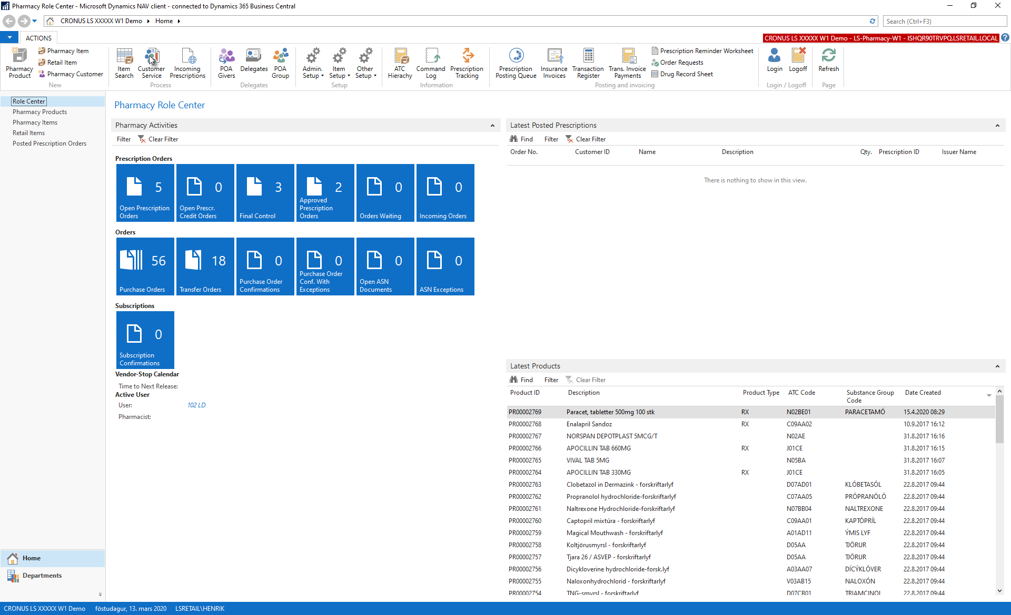

Slide 8
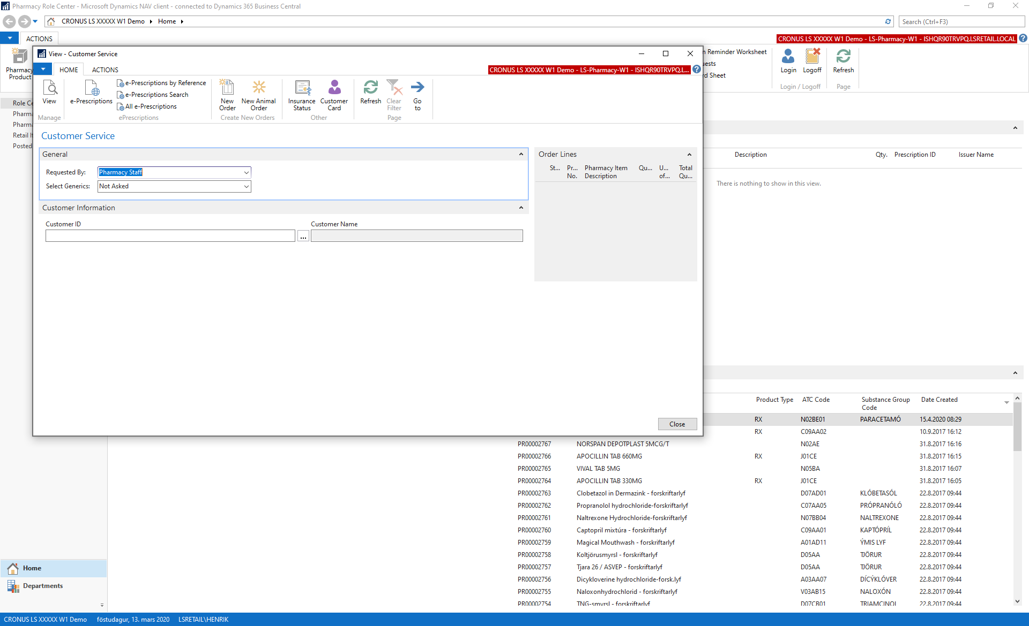

Slide 9
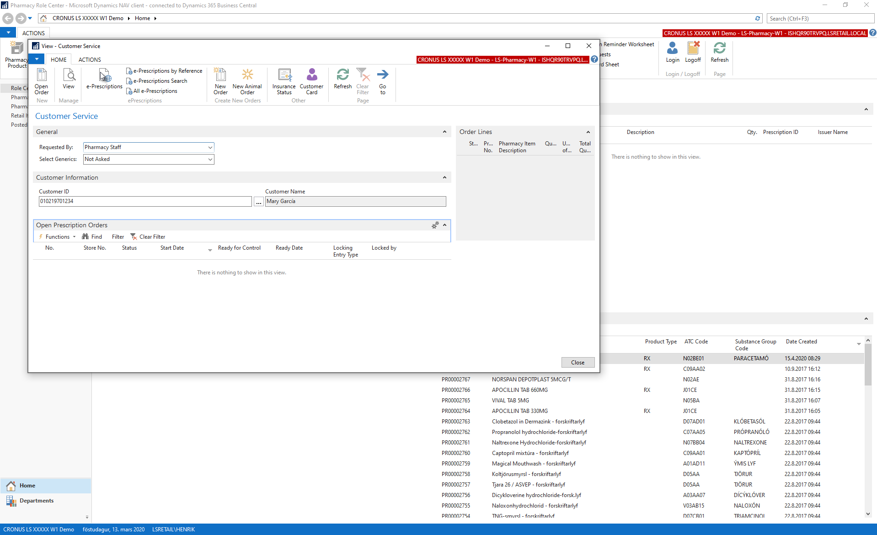

Slide 10
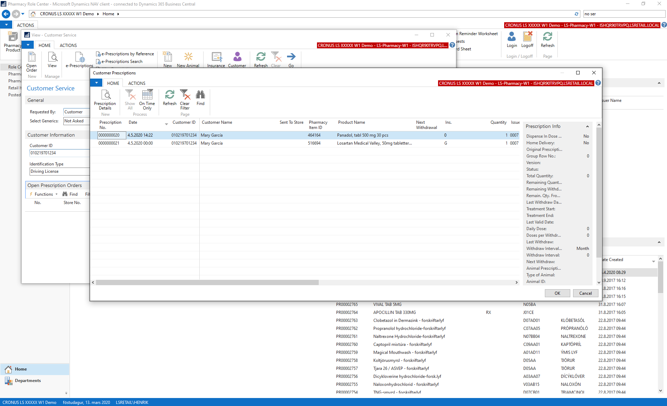

Slide 11
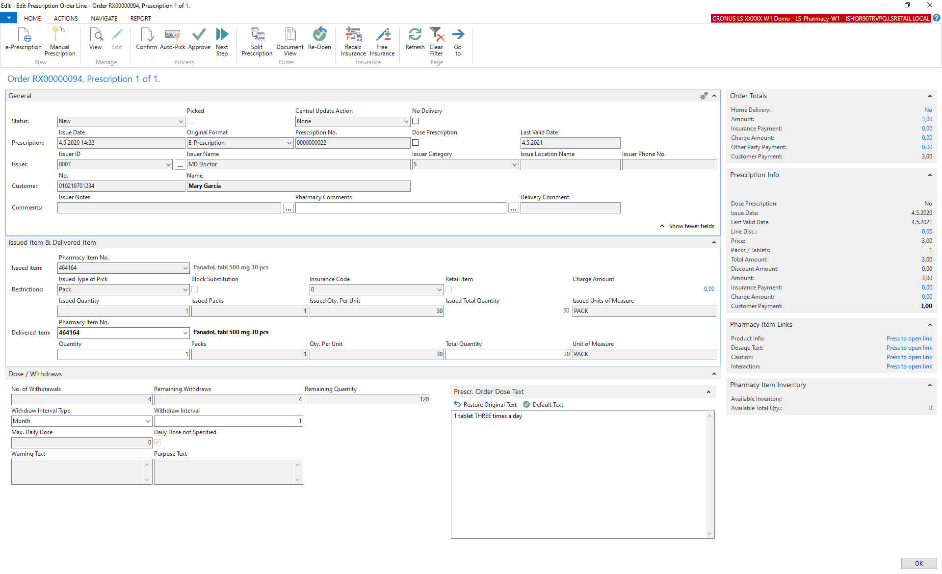

Slide 12
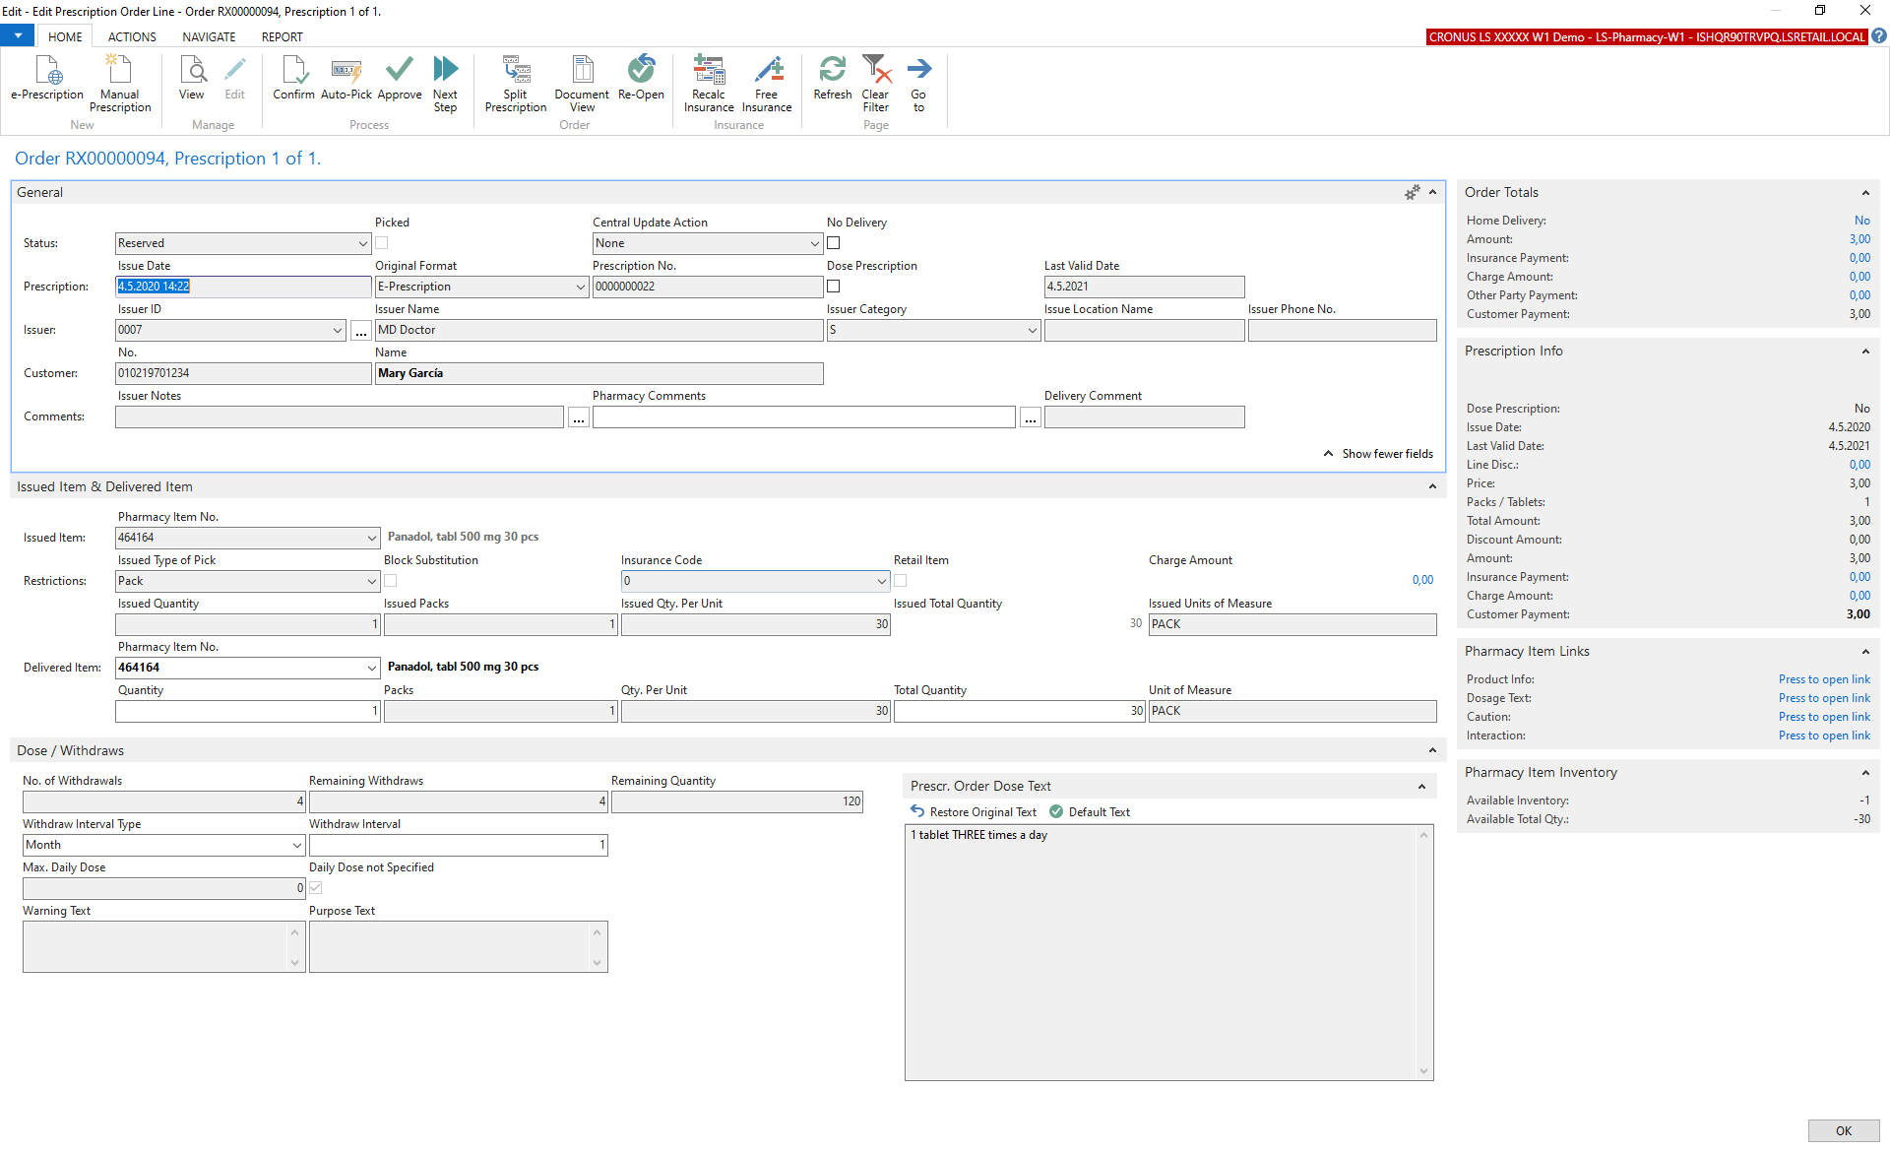

Slide 13
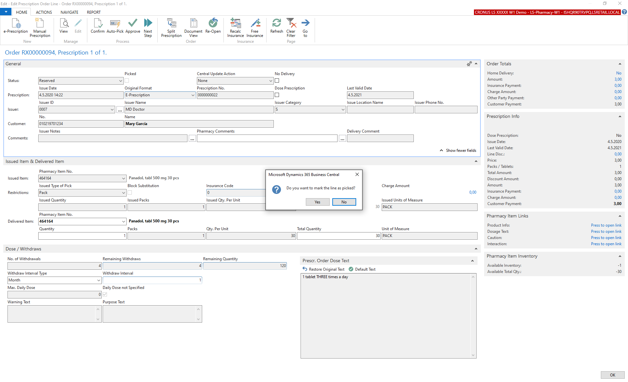

Slide 14
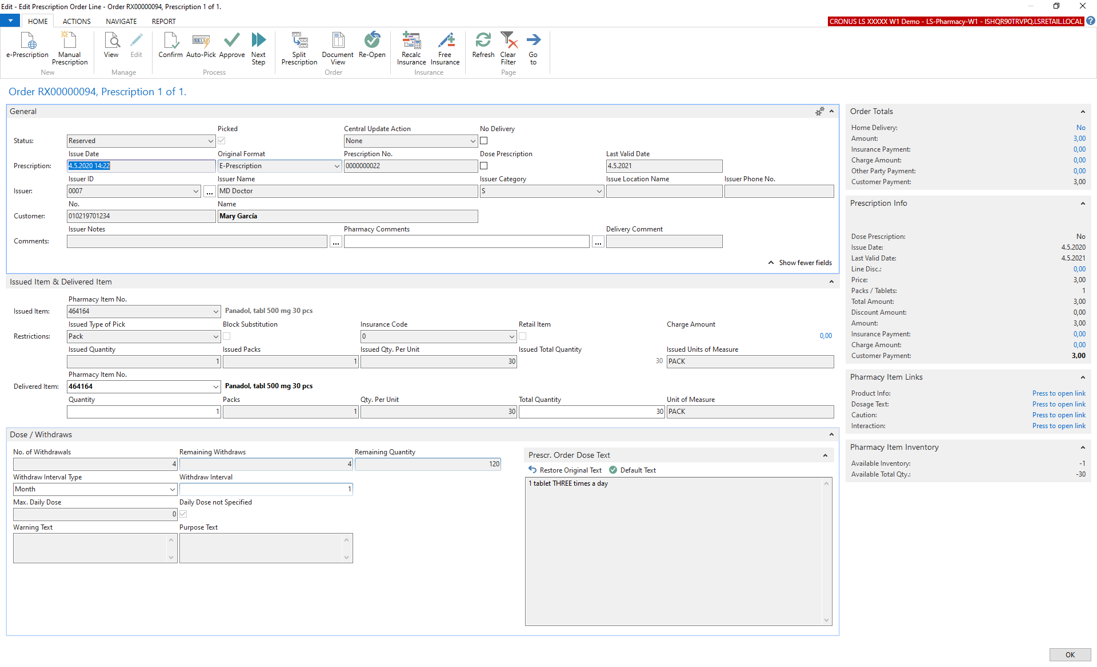

Slide 15
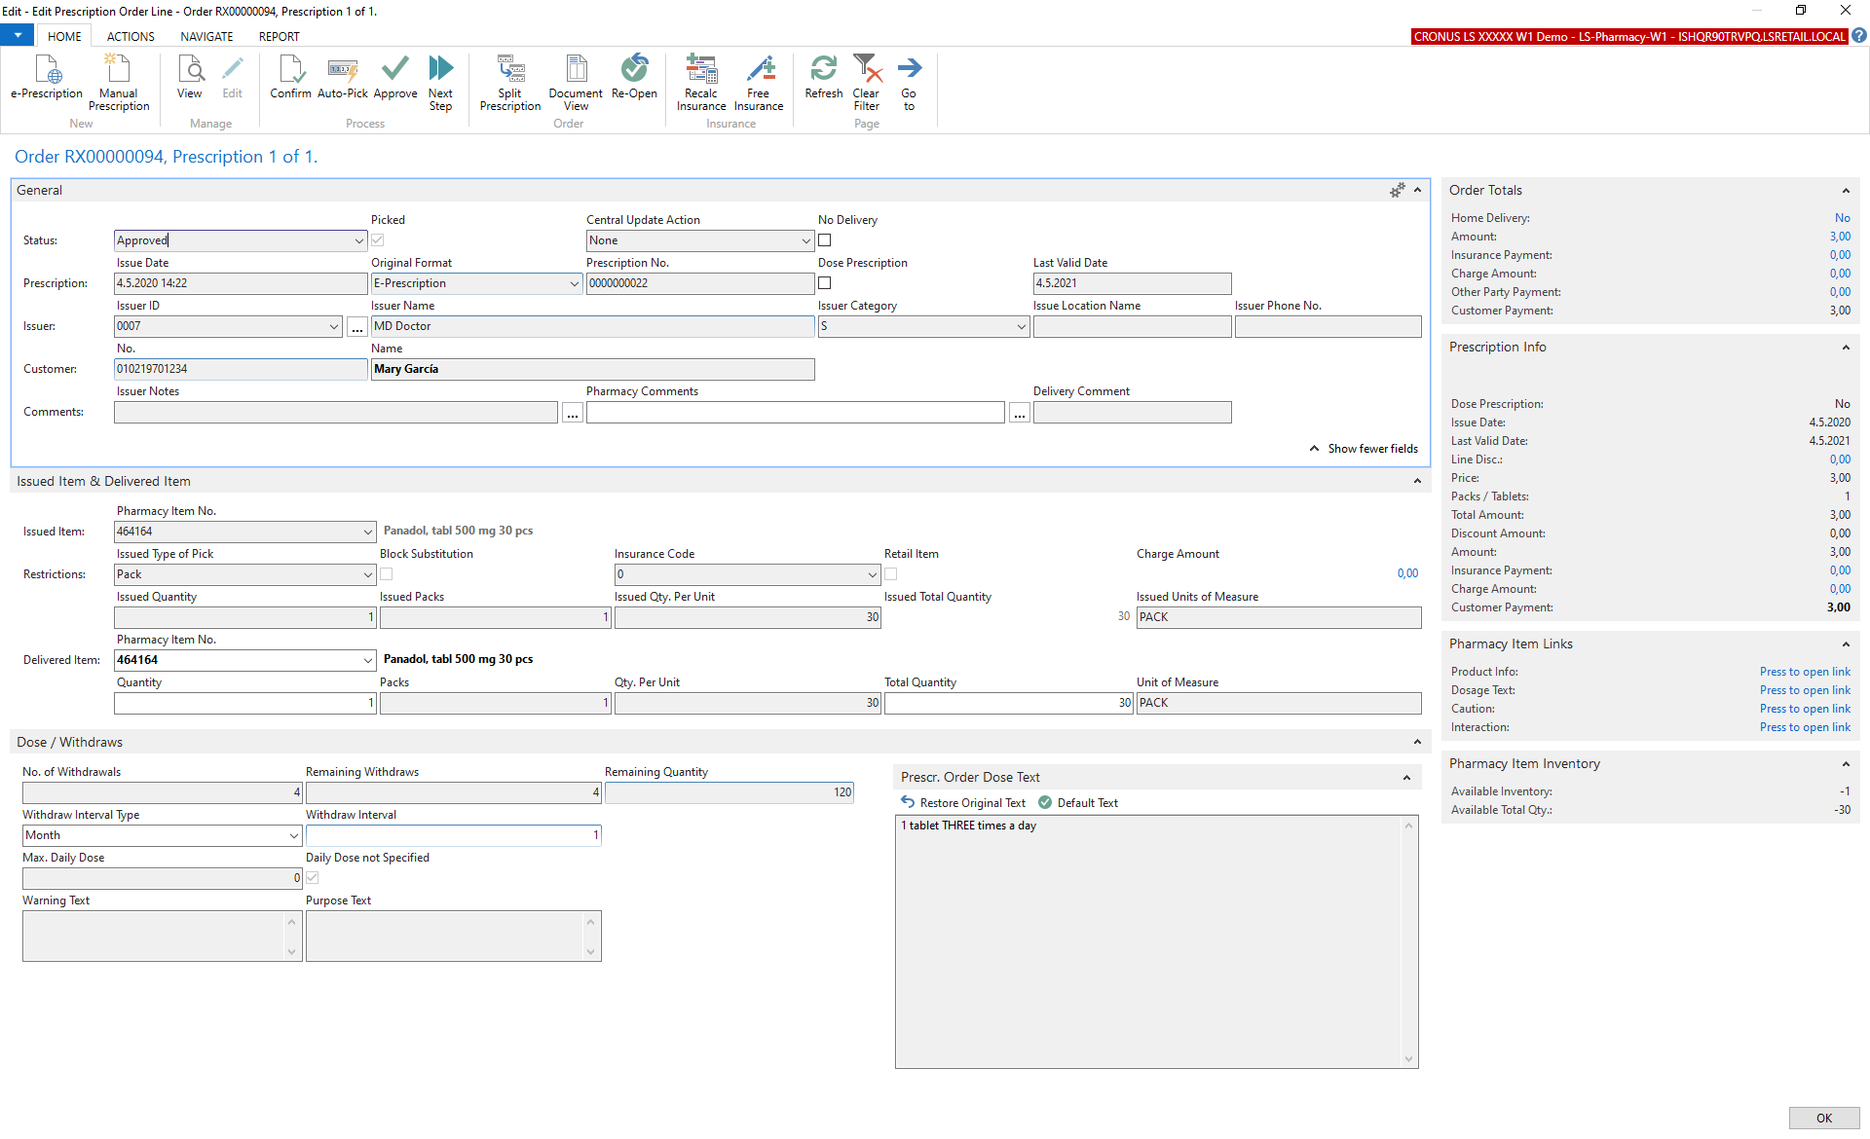

Slide 16
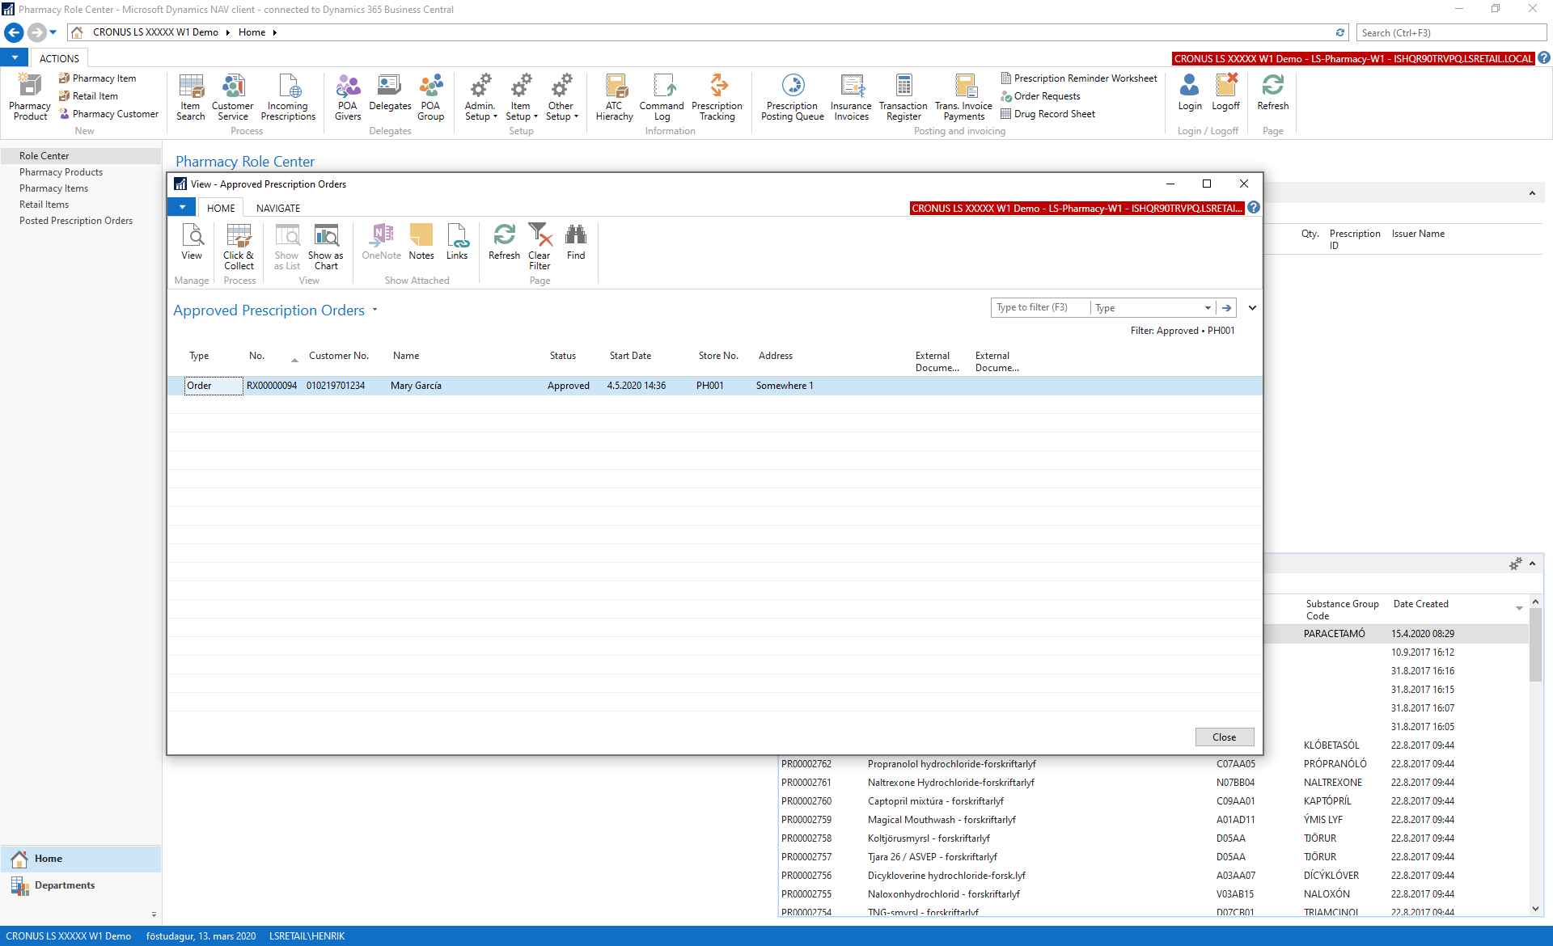

Slide 17
Demo – POS UI

Slide 18
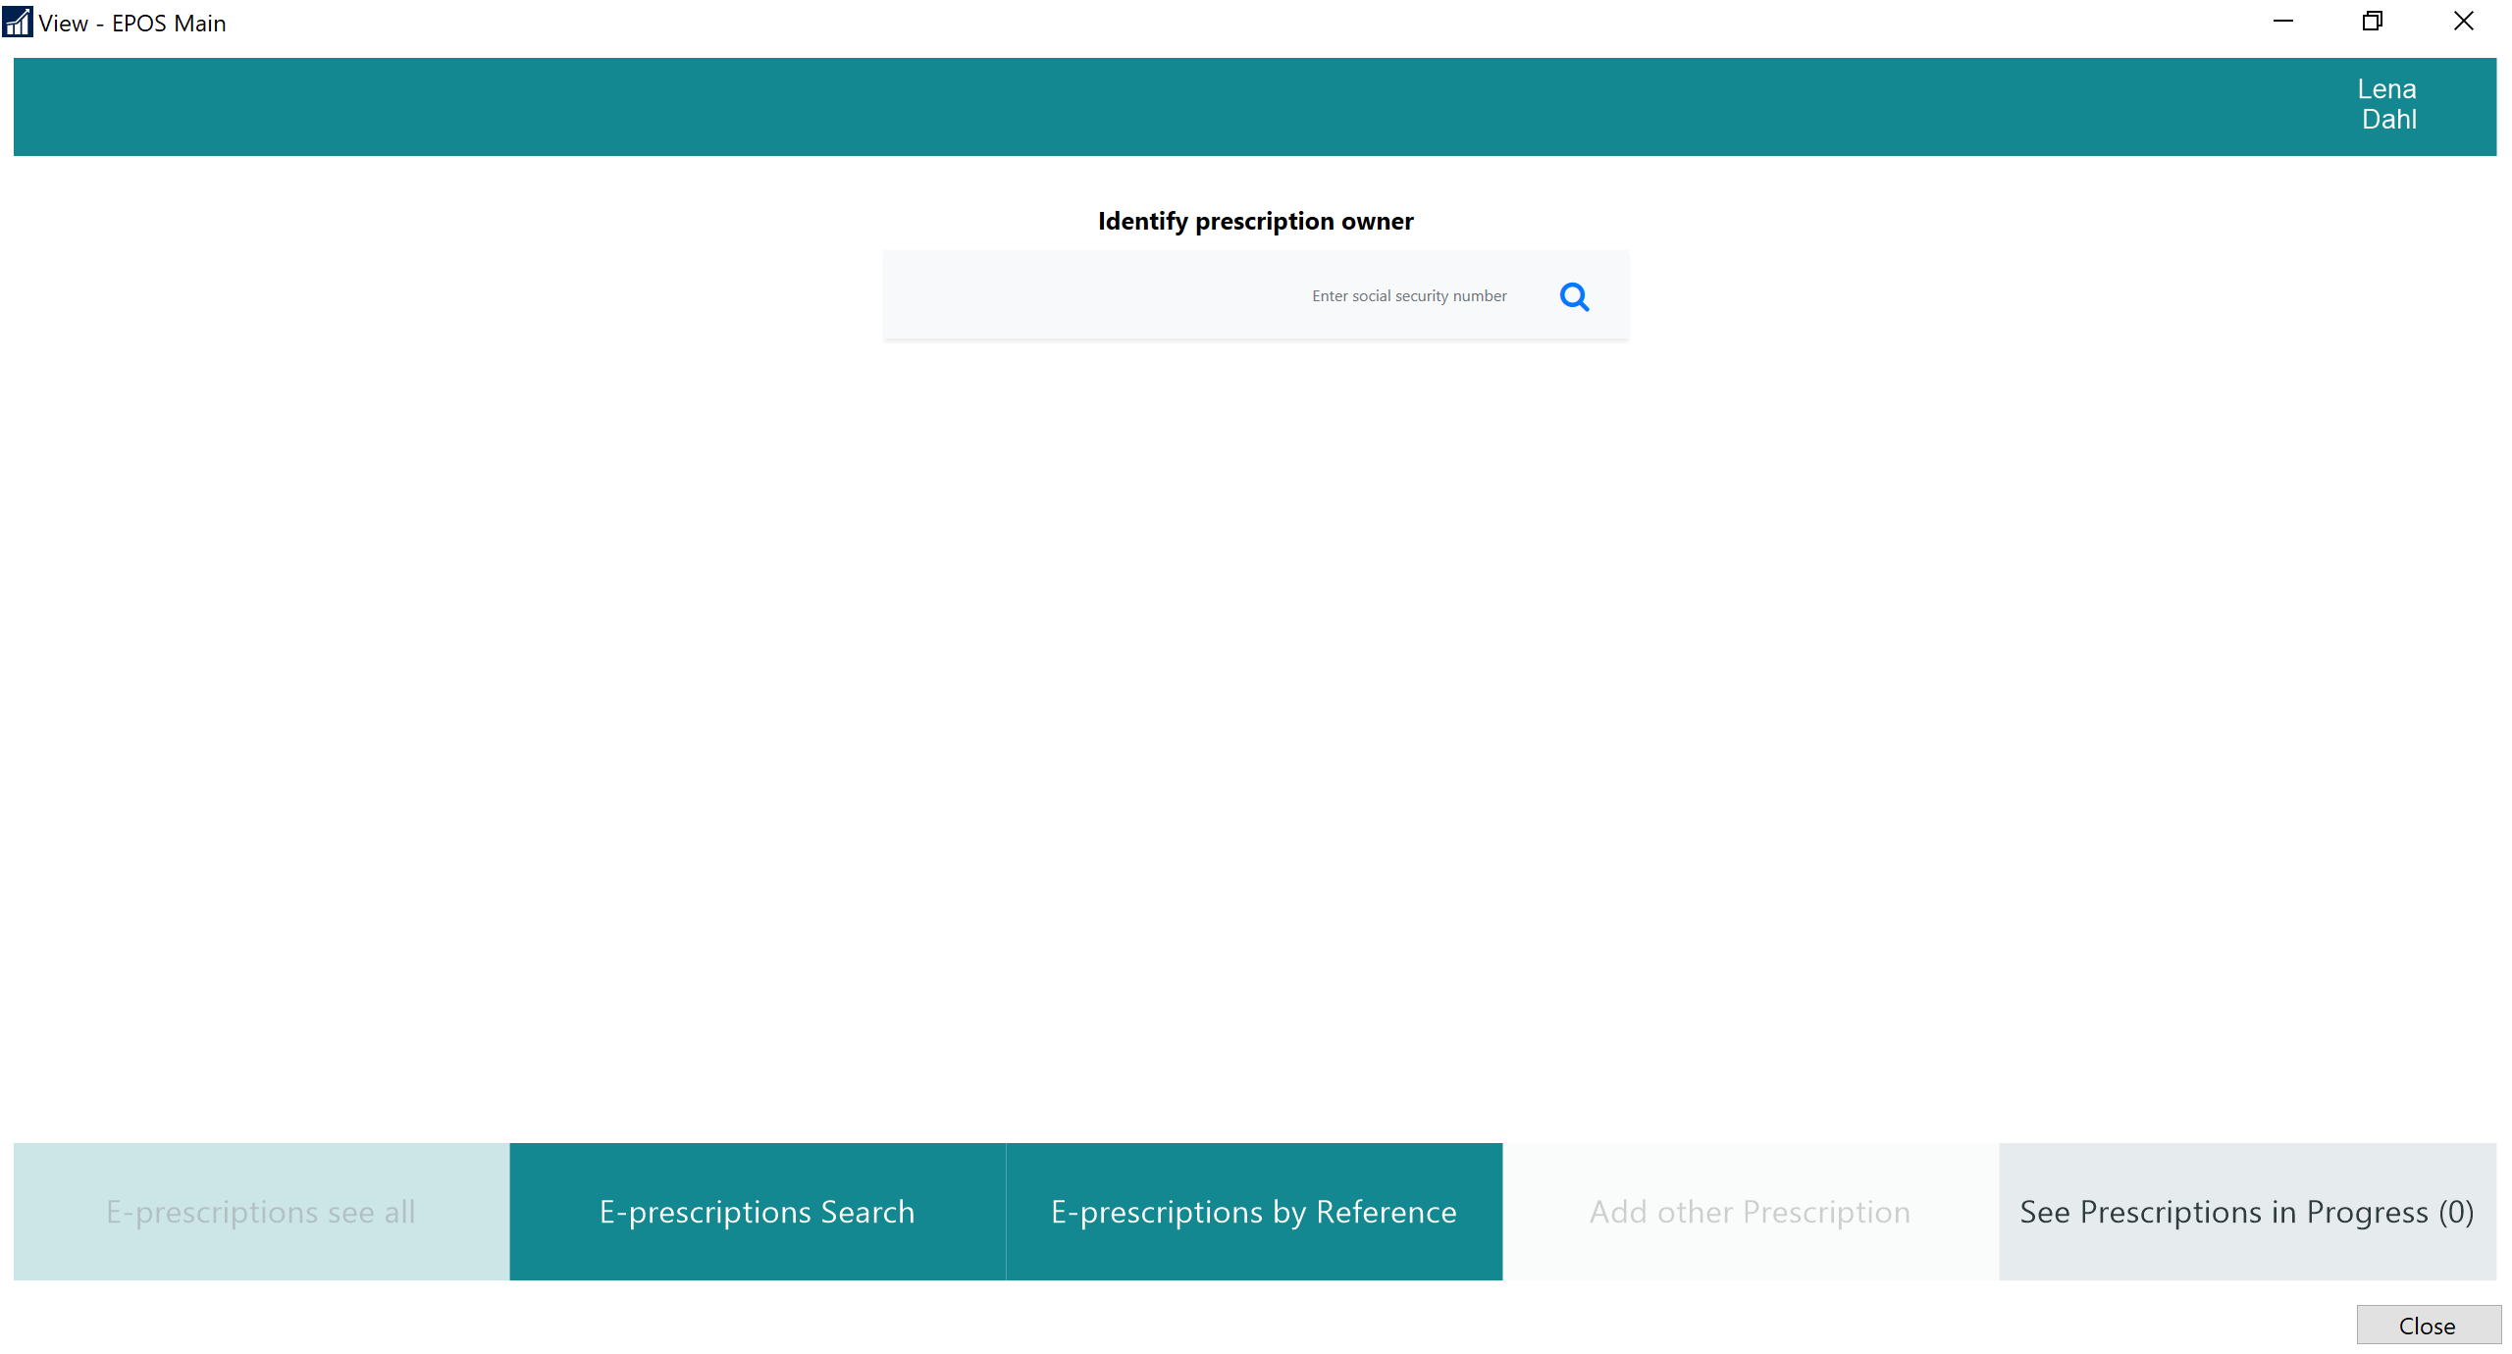

Slide 19
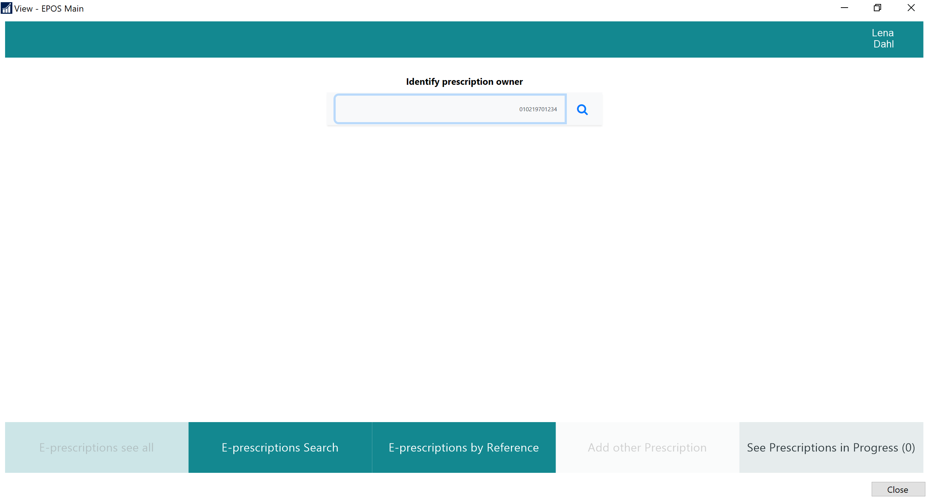

Slide 20
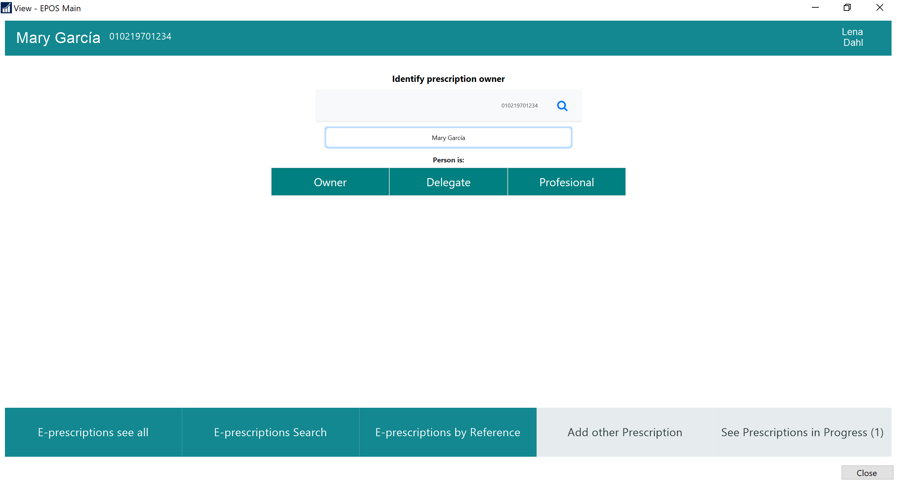

Slide 21
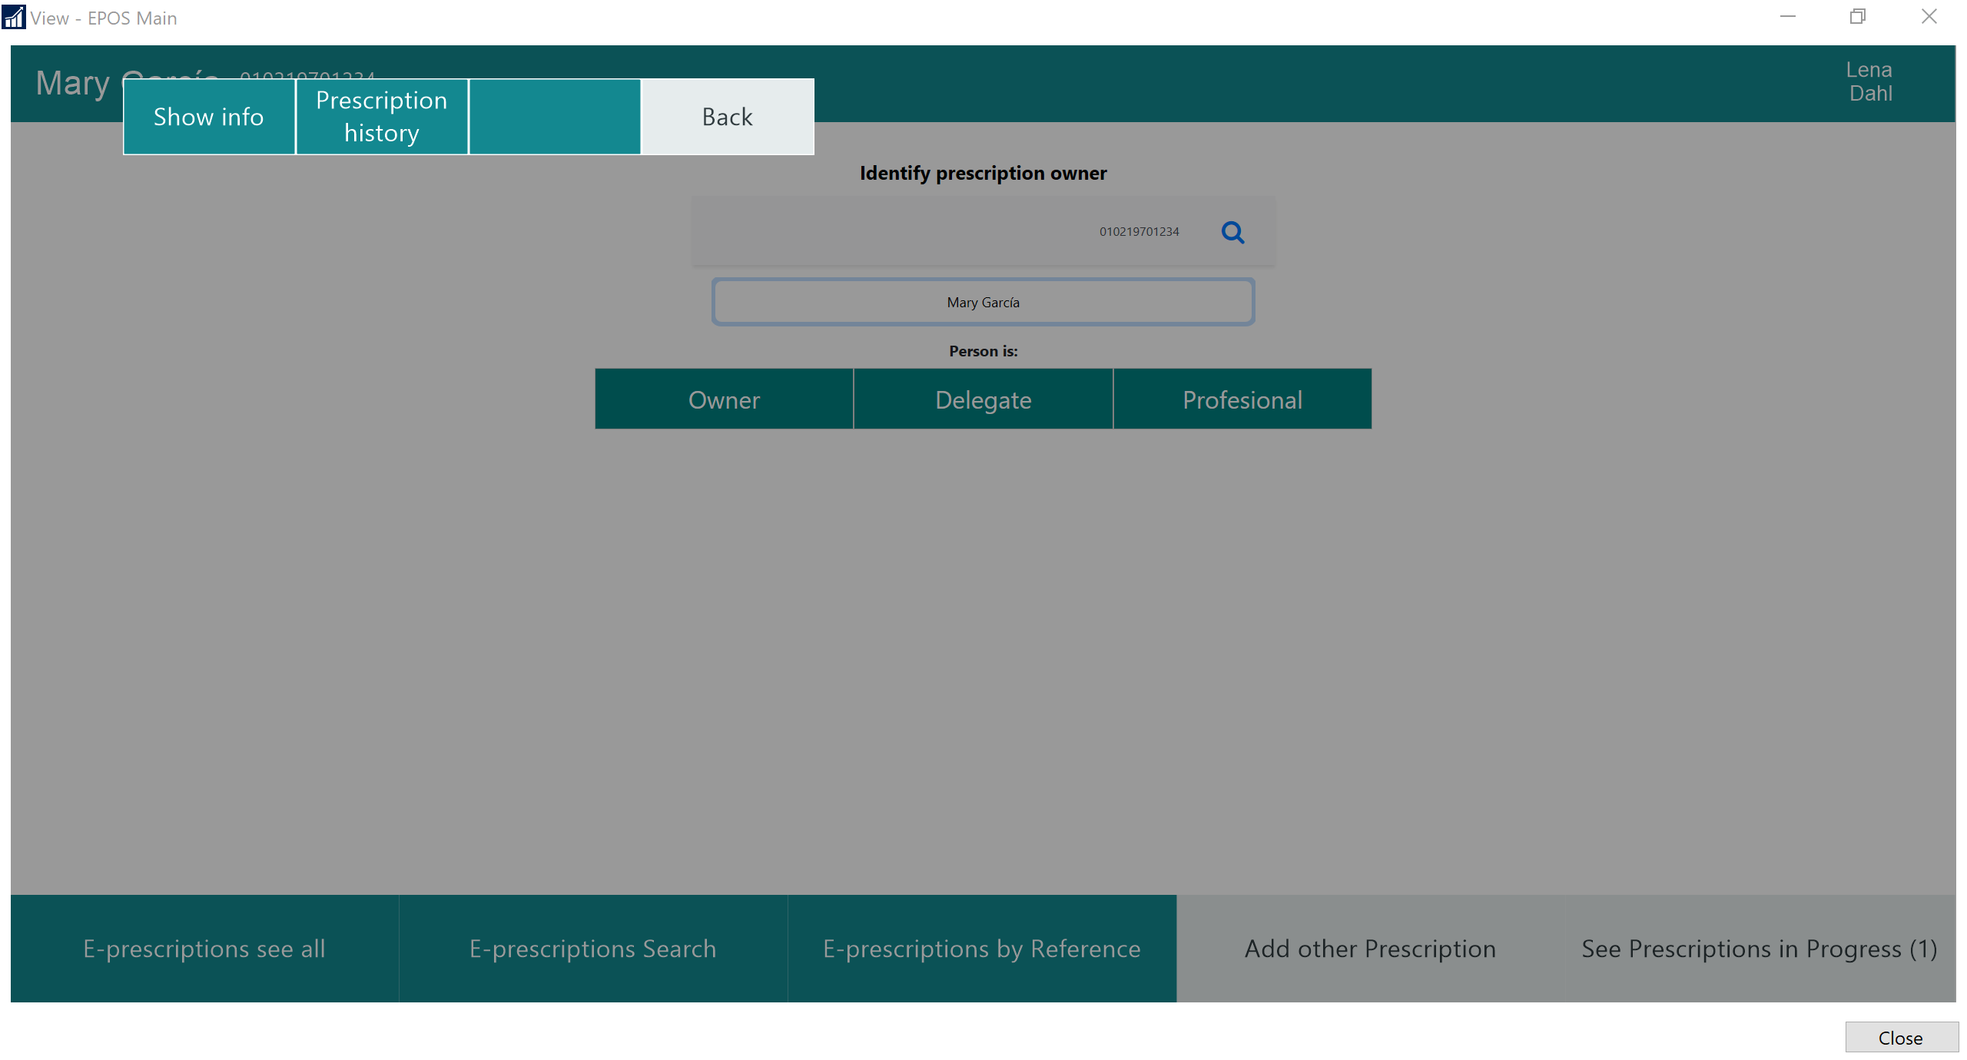

Slide 23
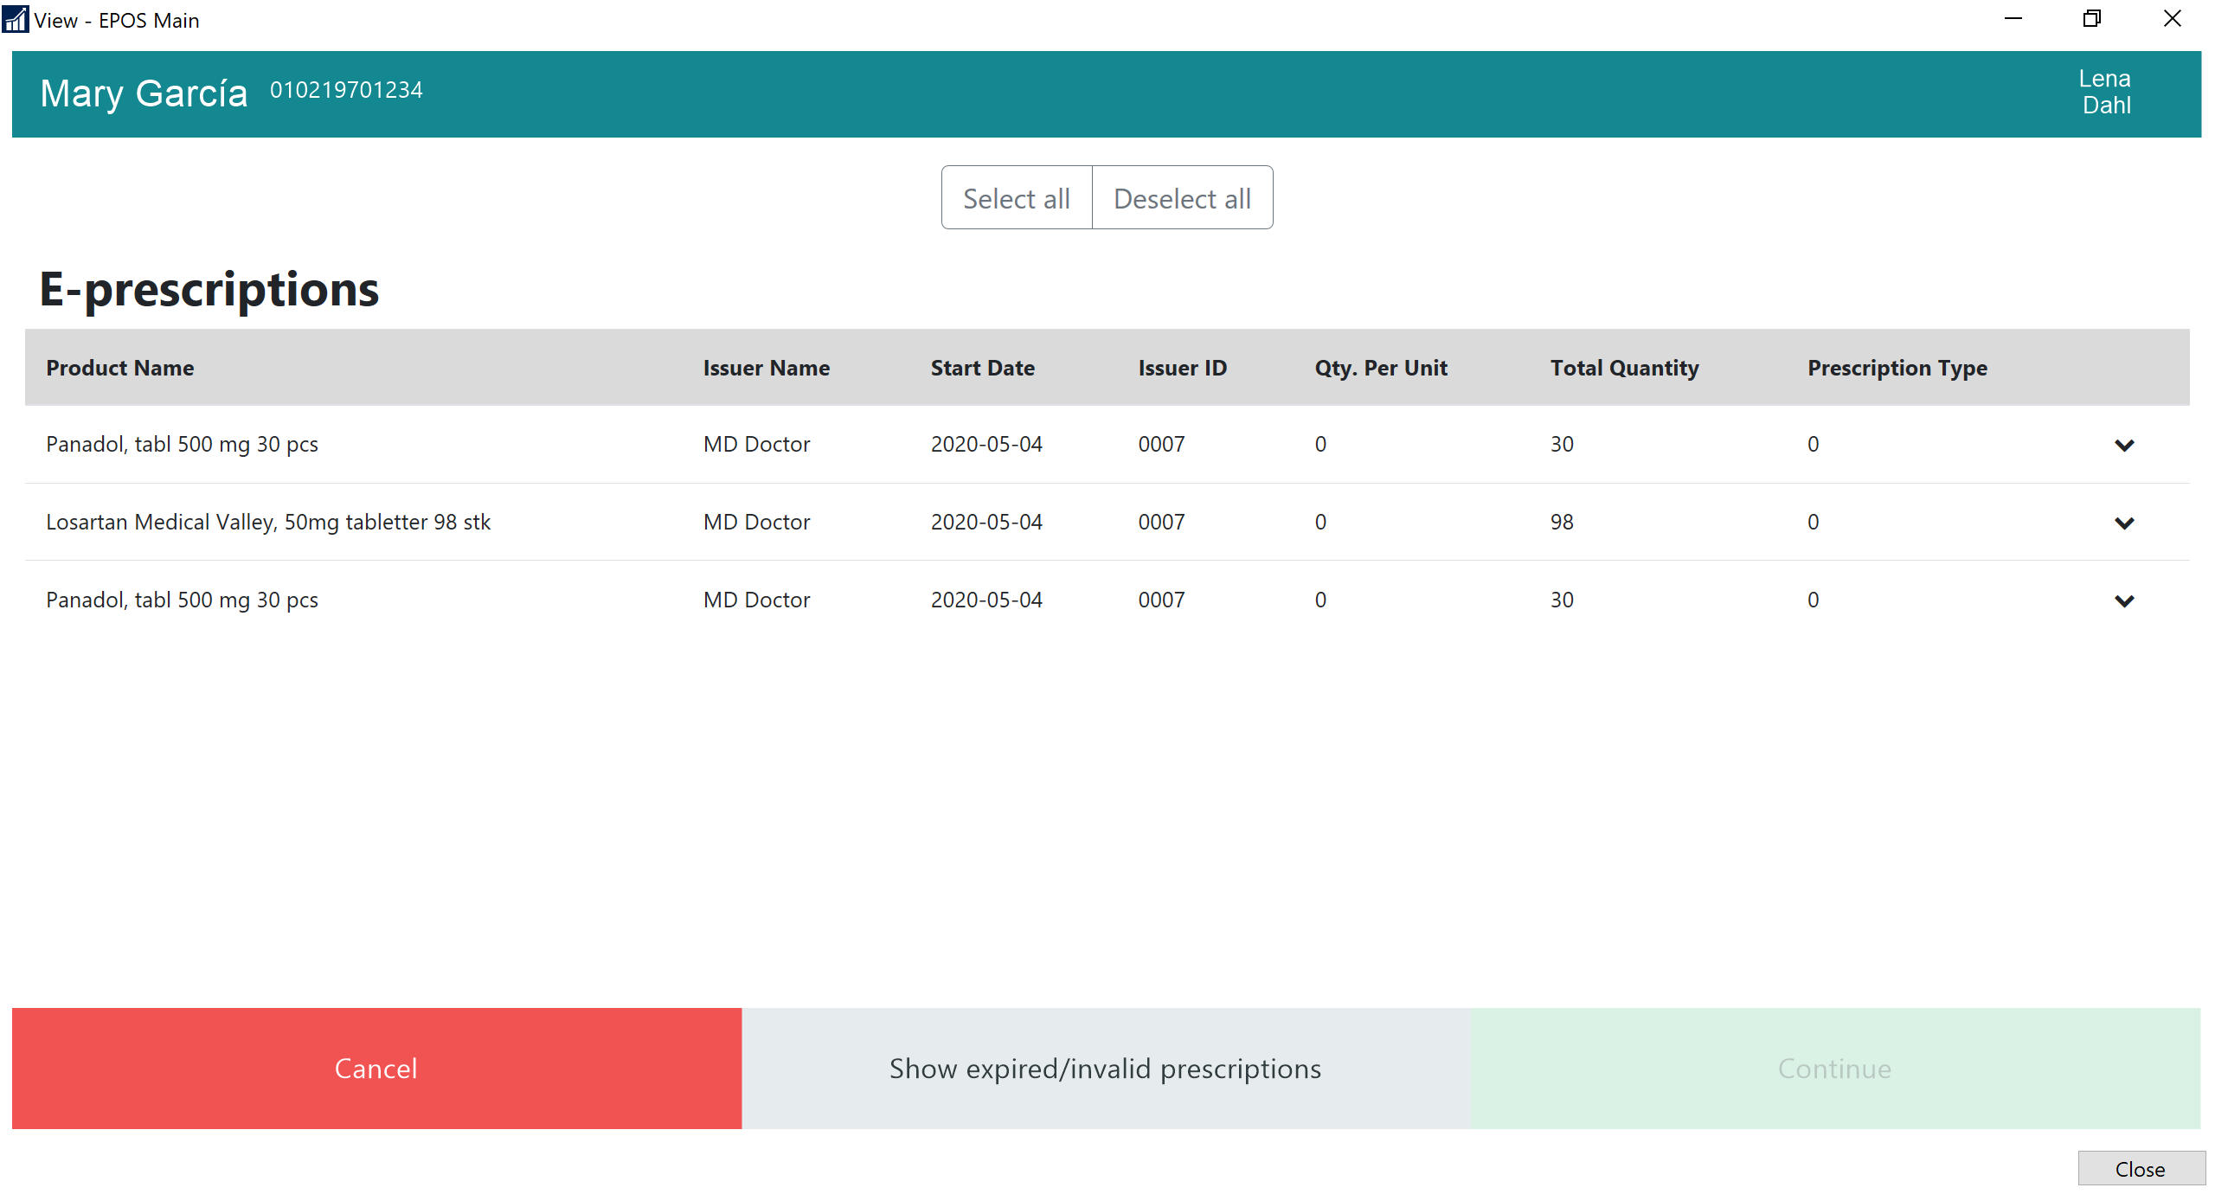

Slide 24
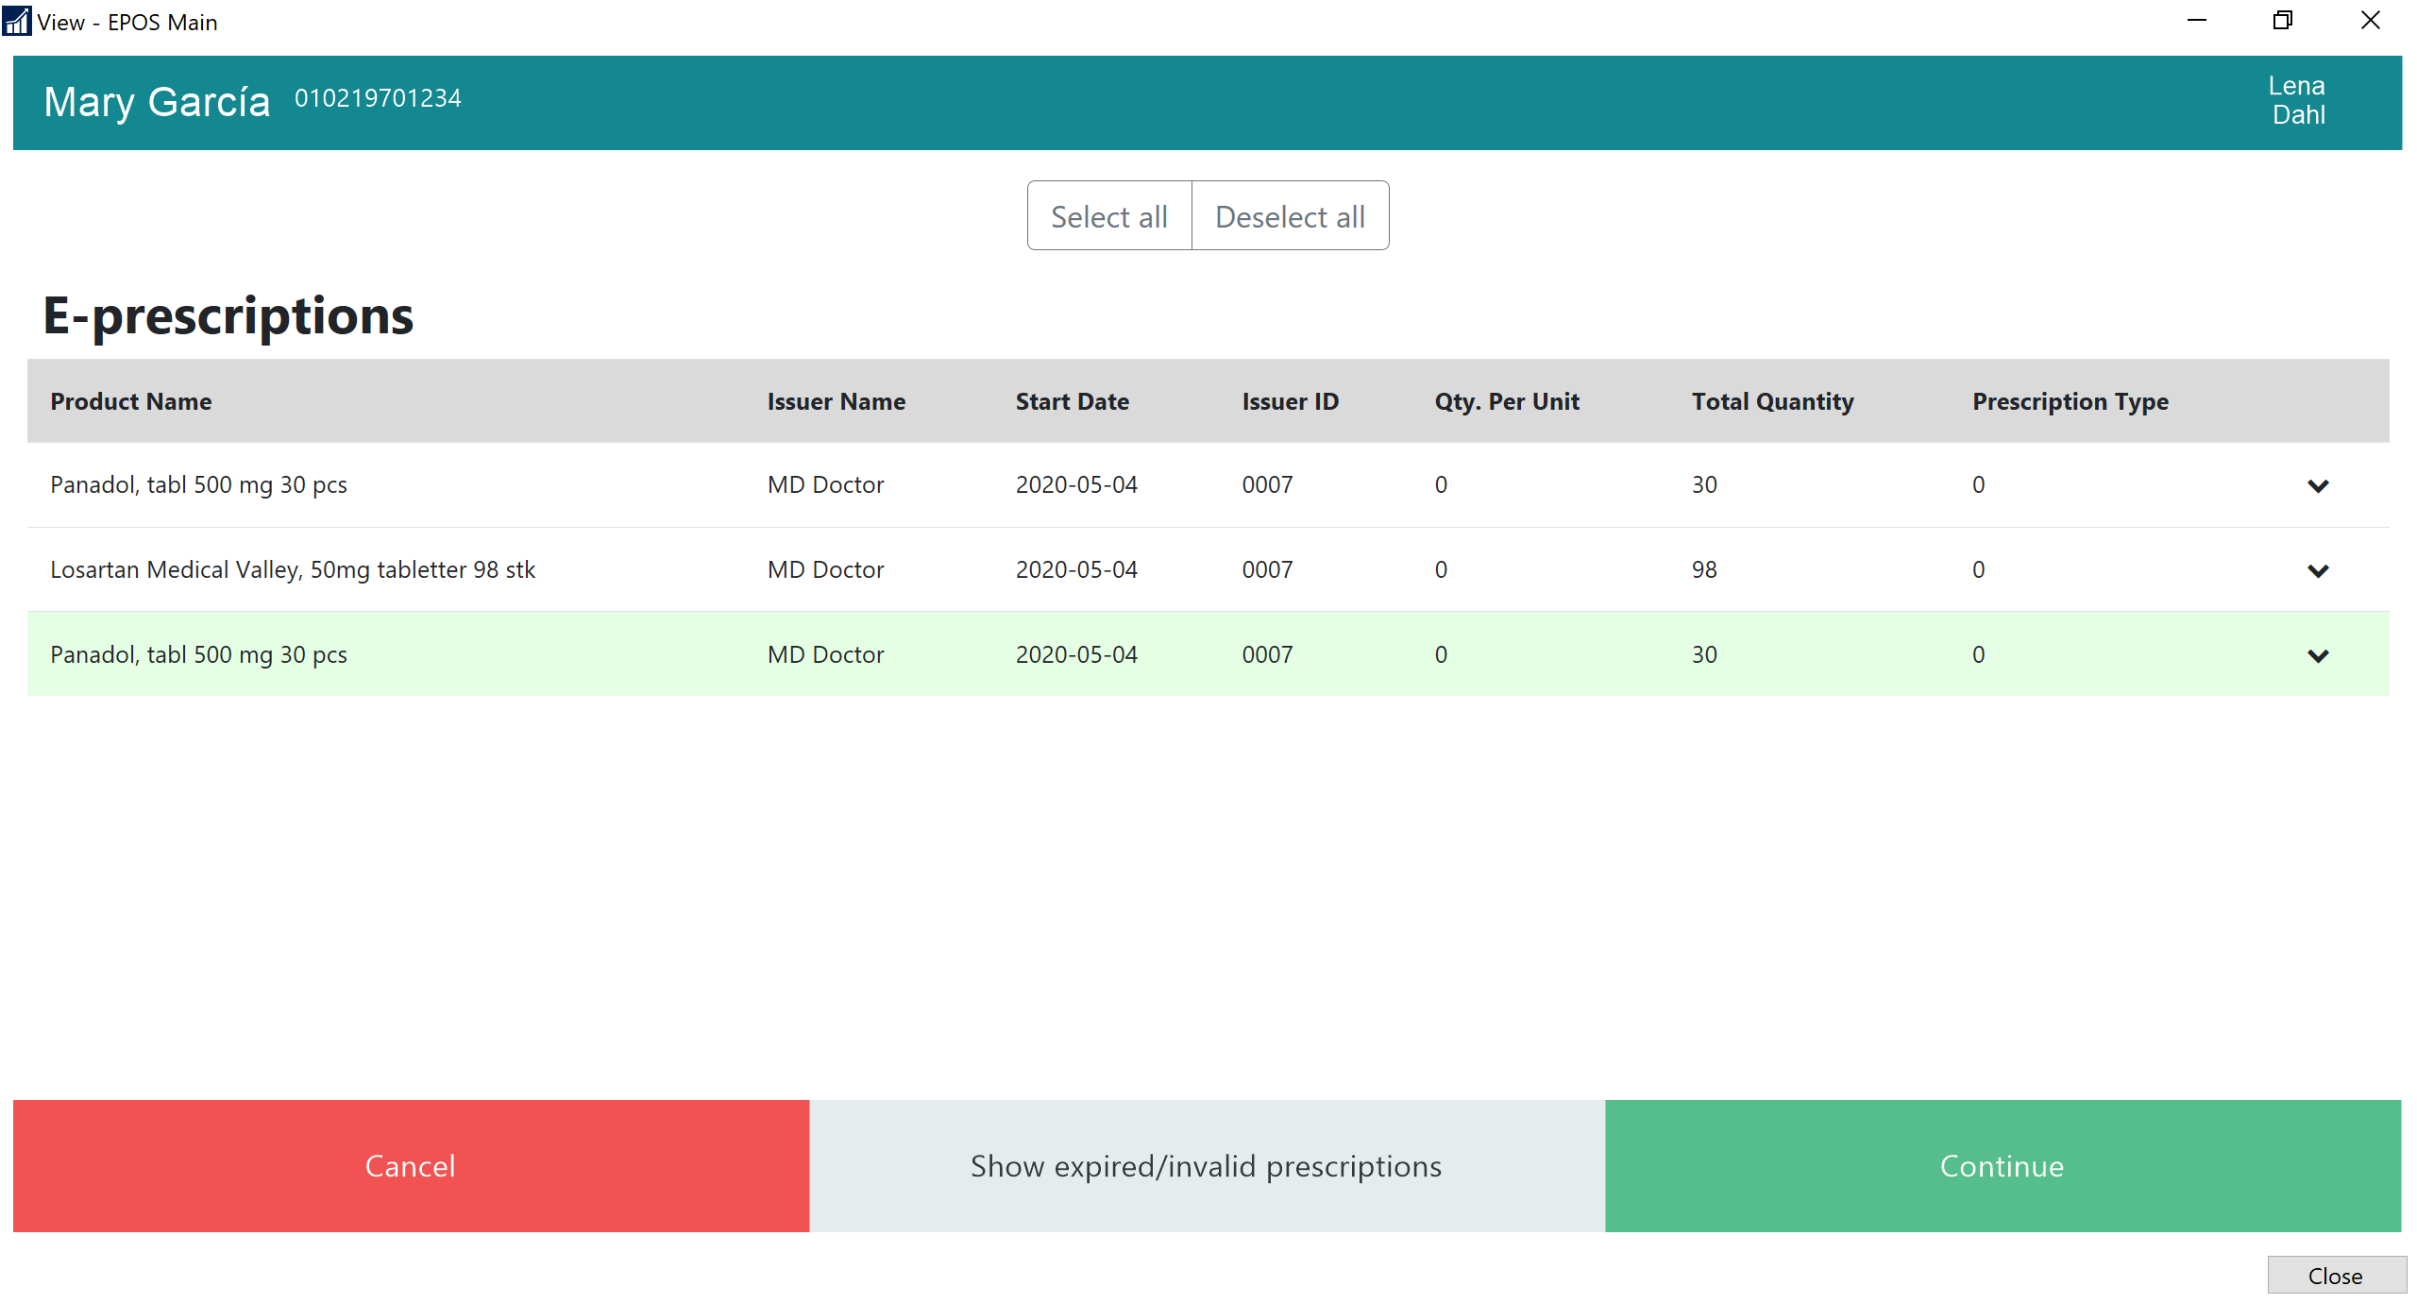

Slide 25
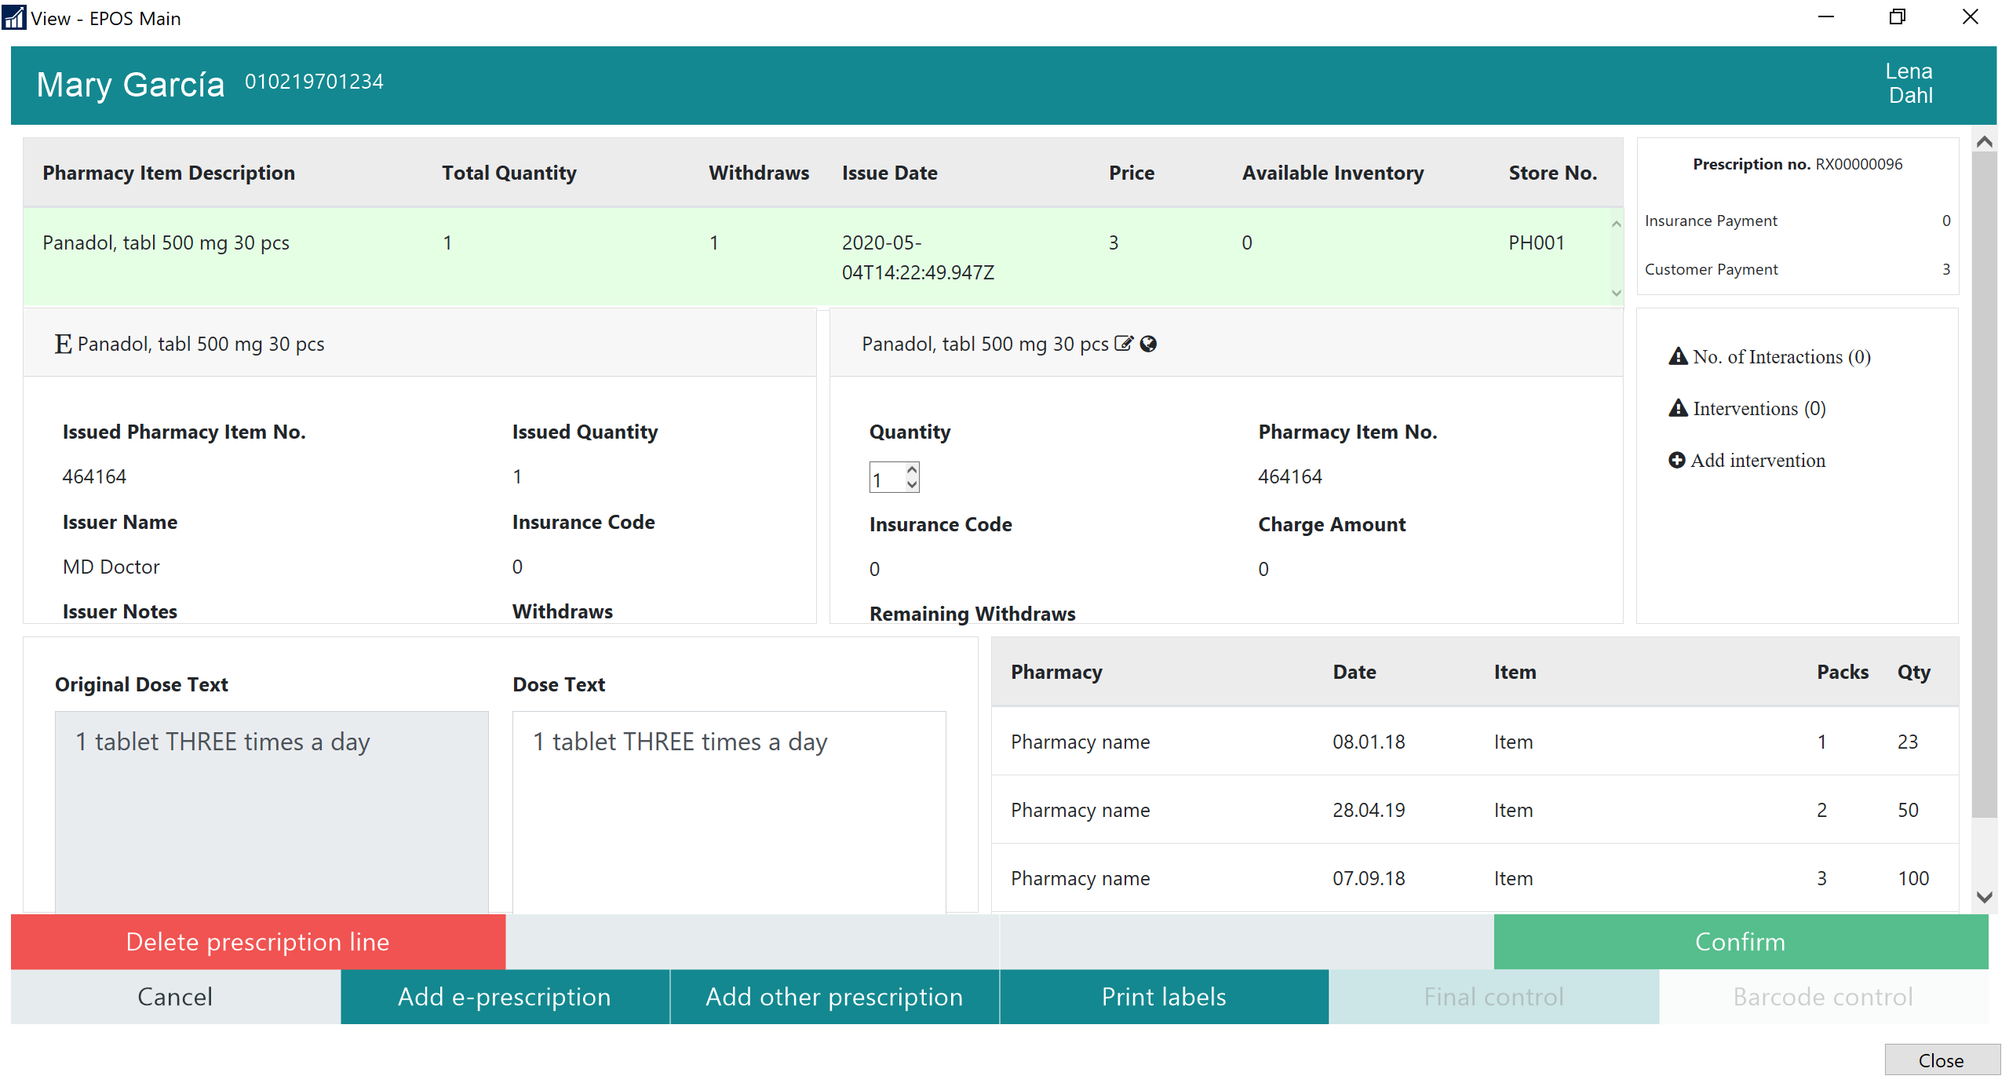

Slide 26
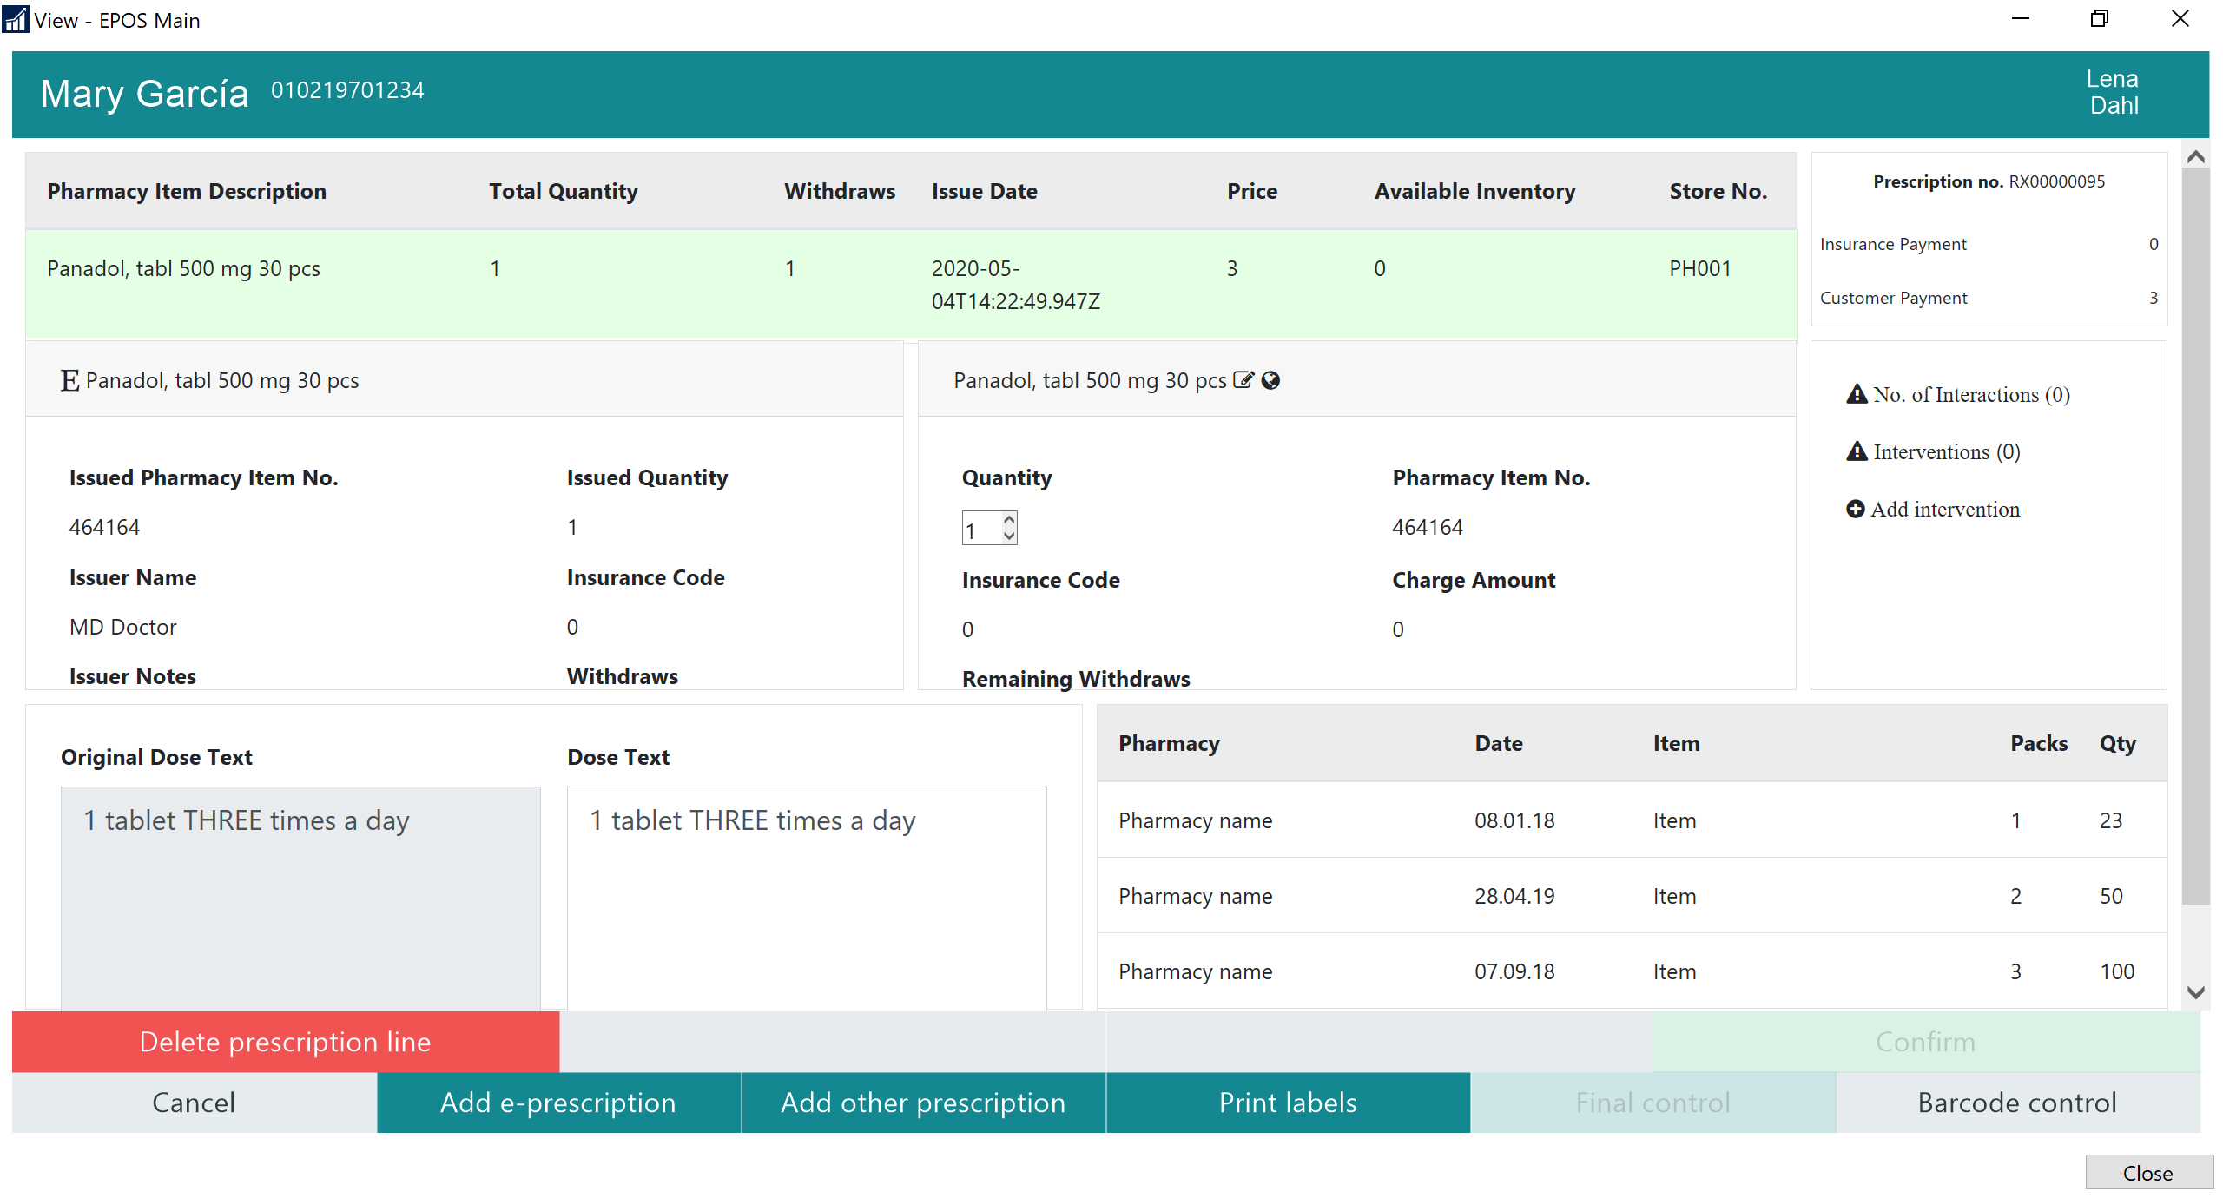

Slide 27
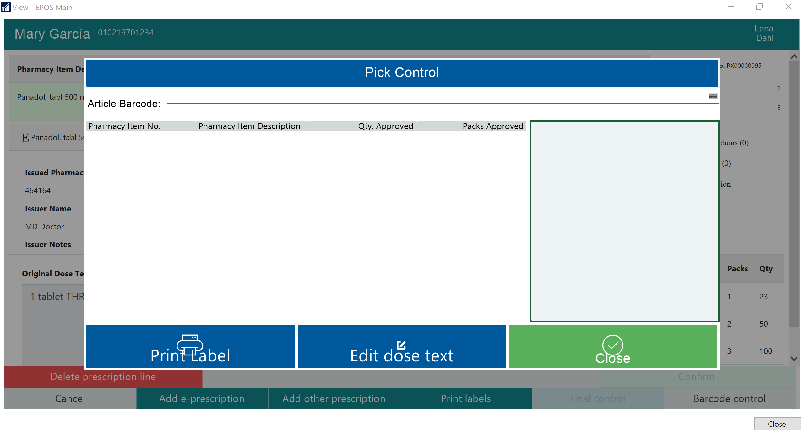

Slide 28
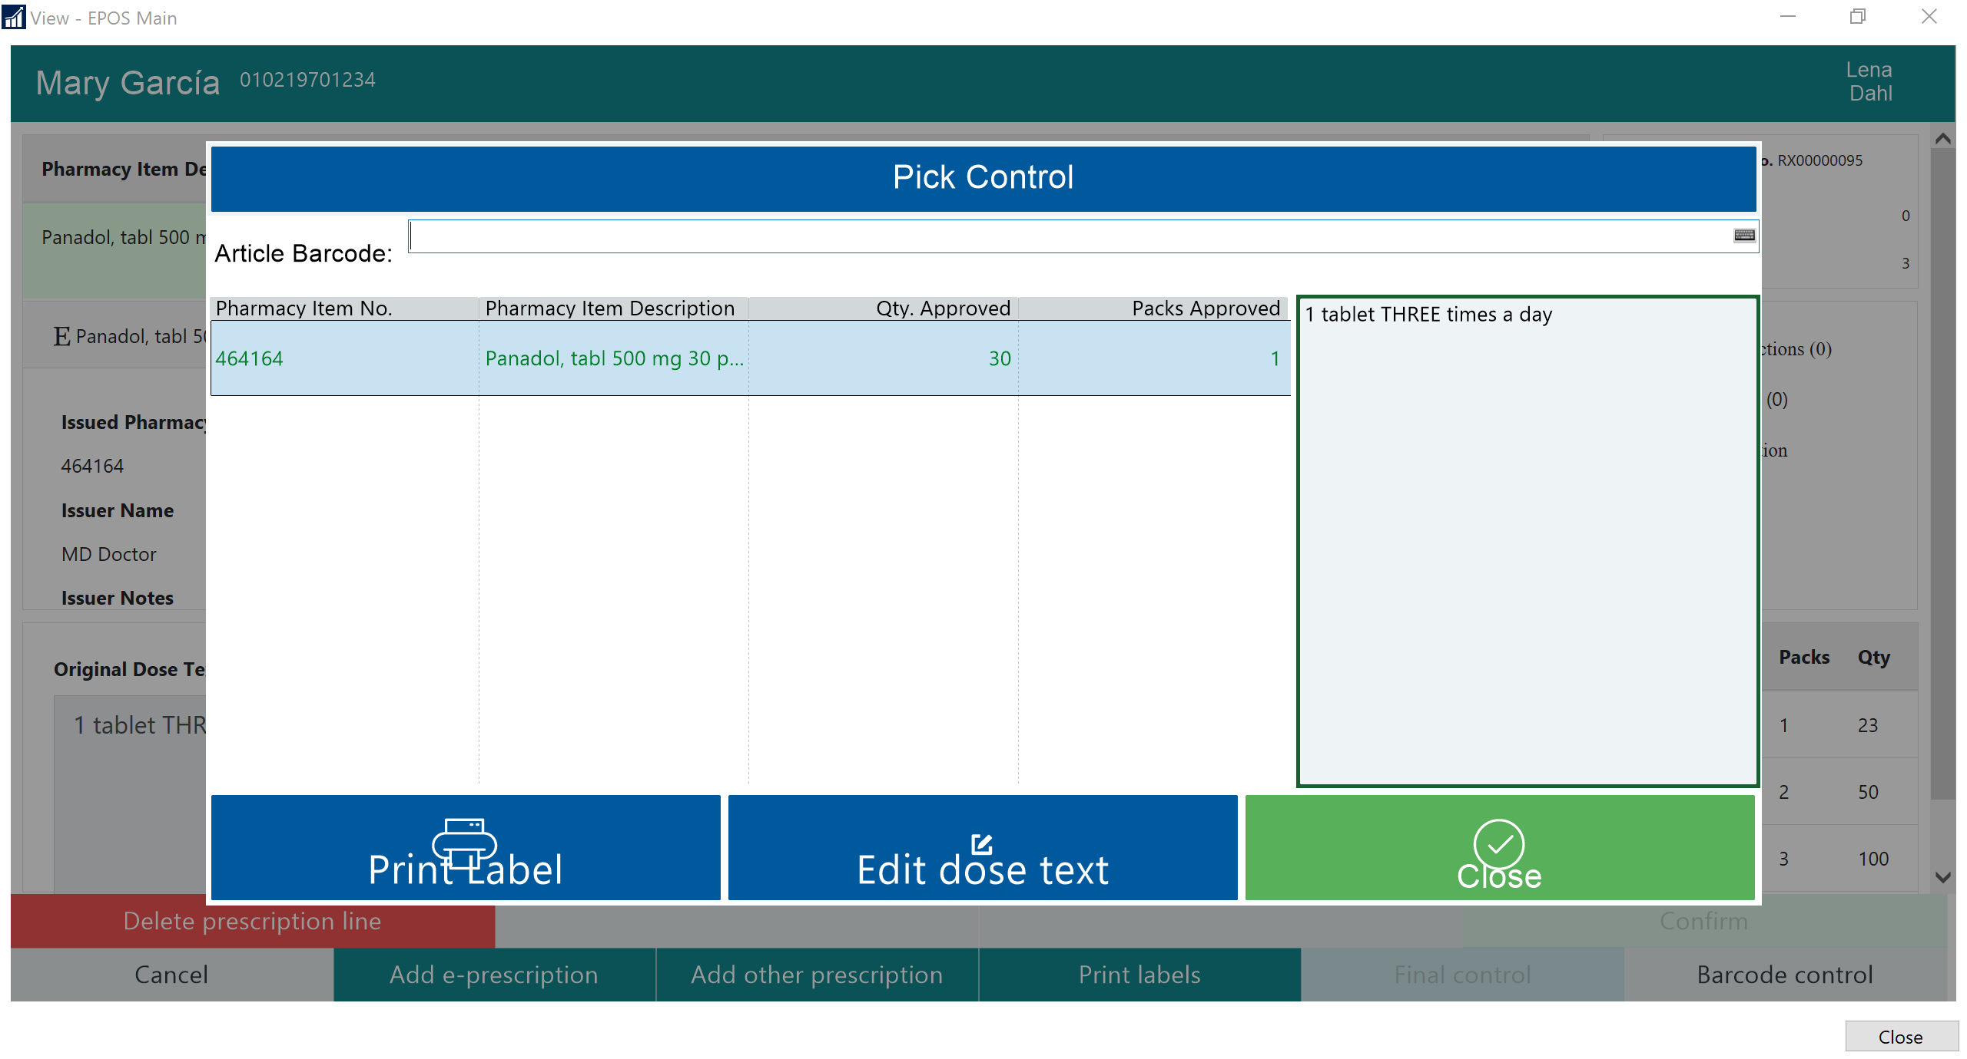

Slide 29
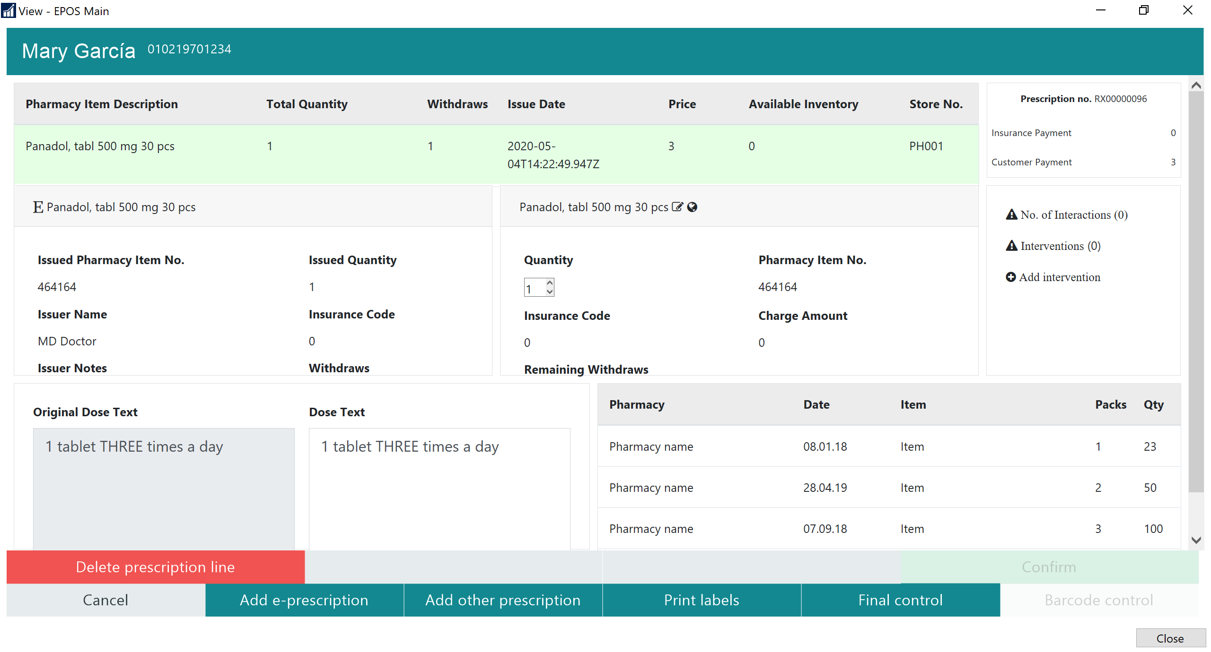

Slide 30
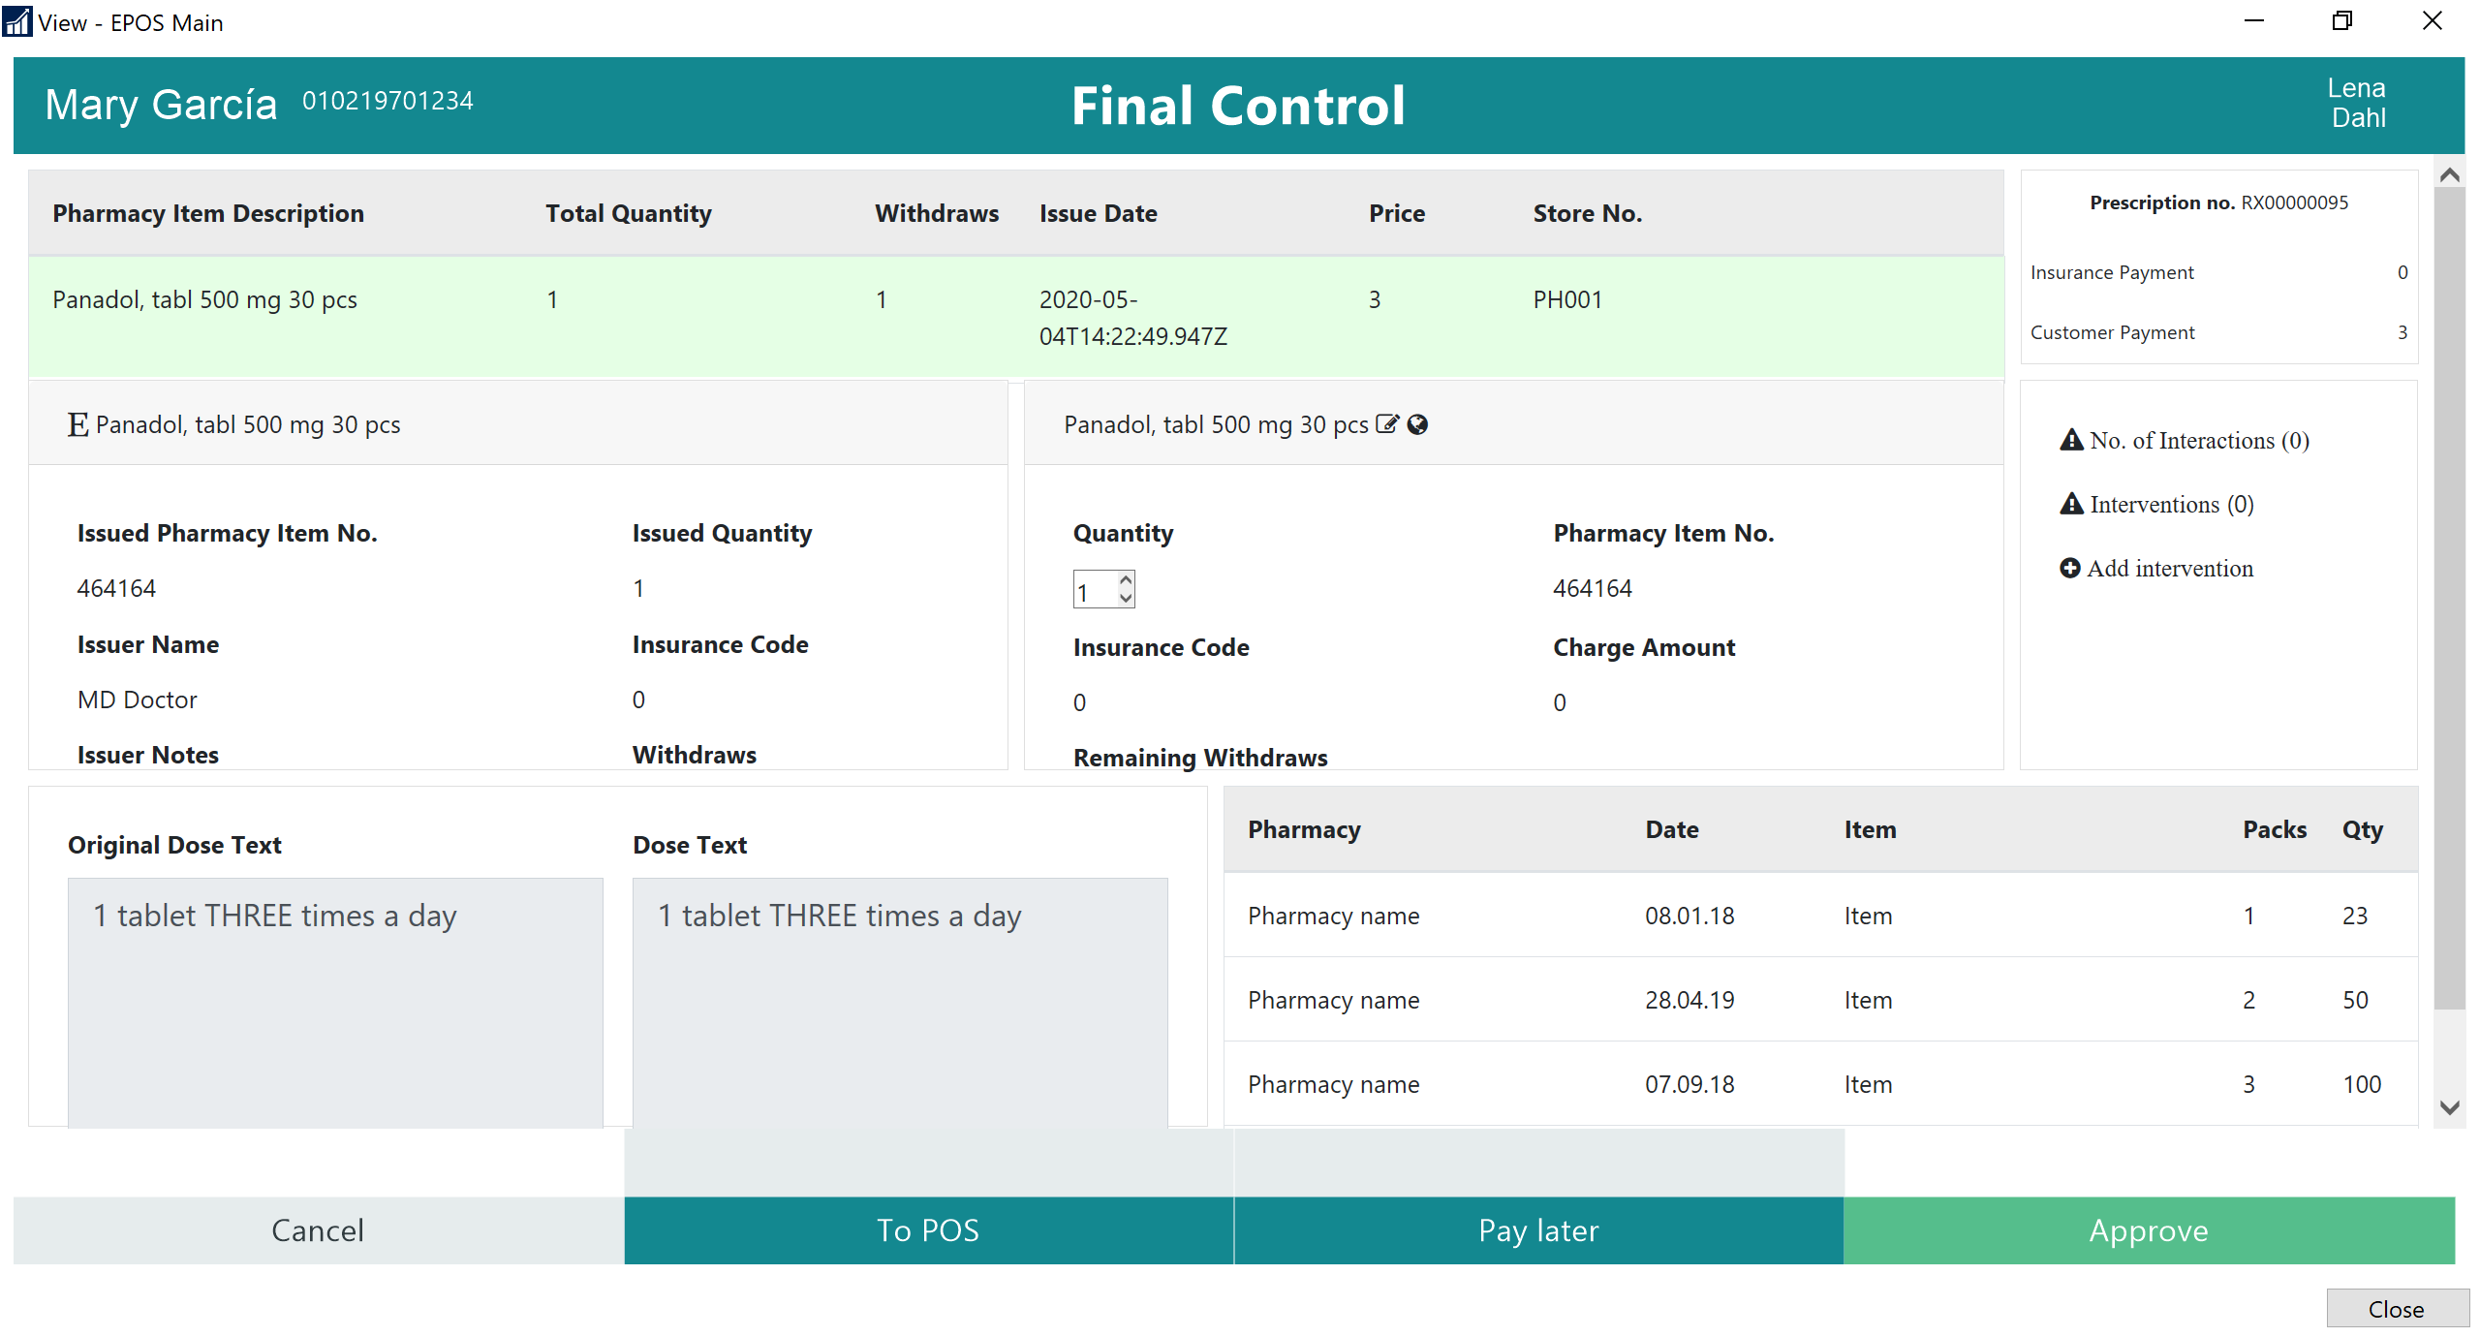

Slide 31
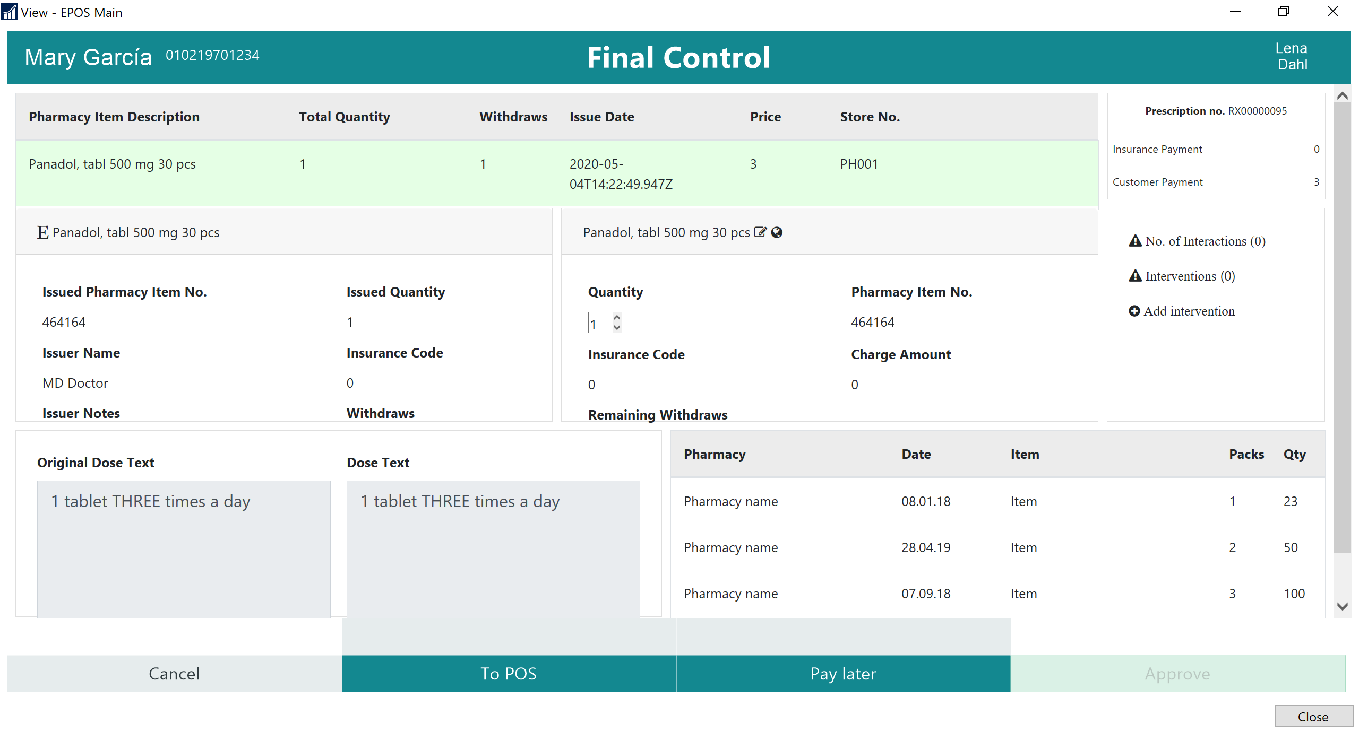

Slide 32
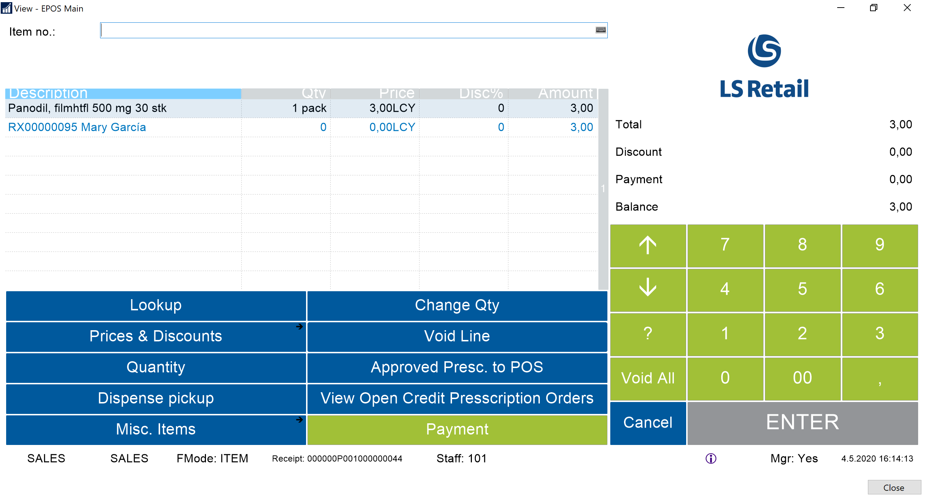

Slide 33
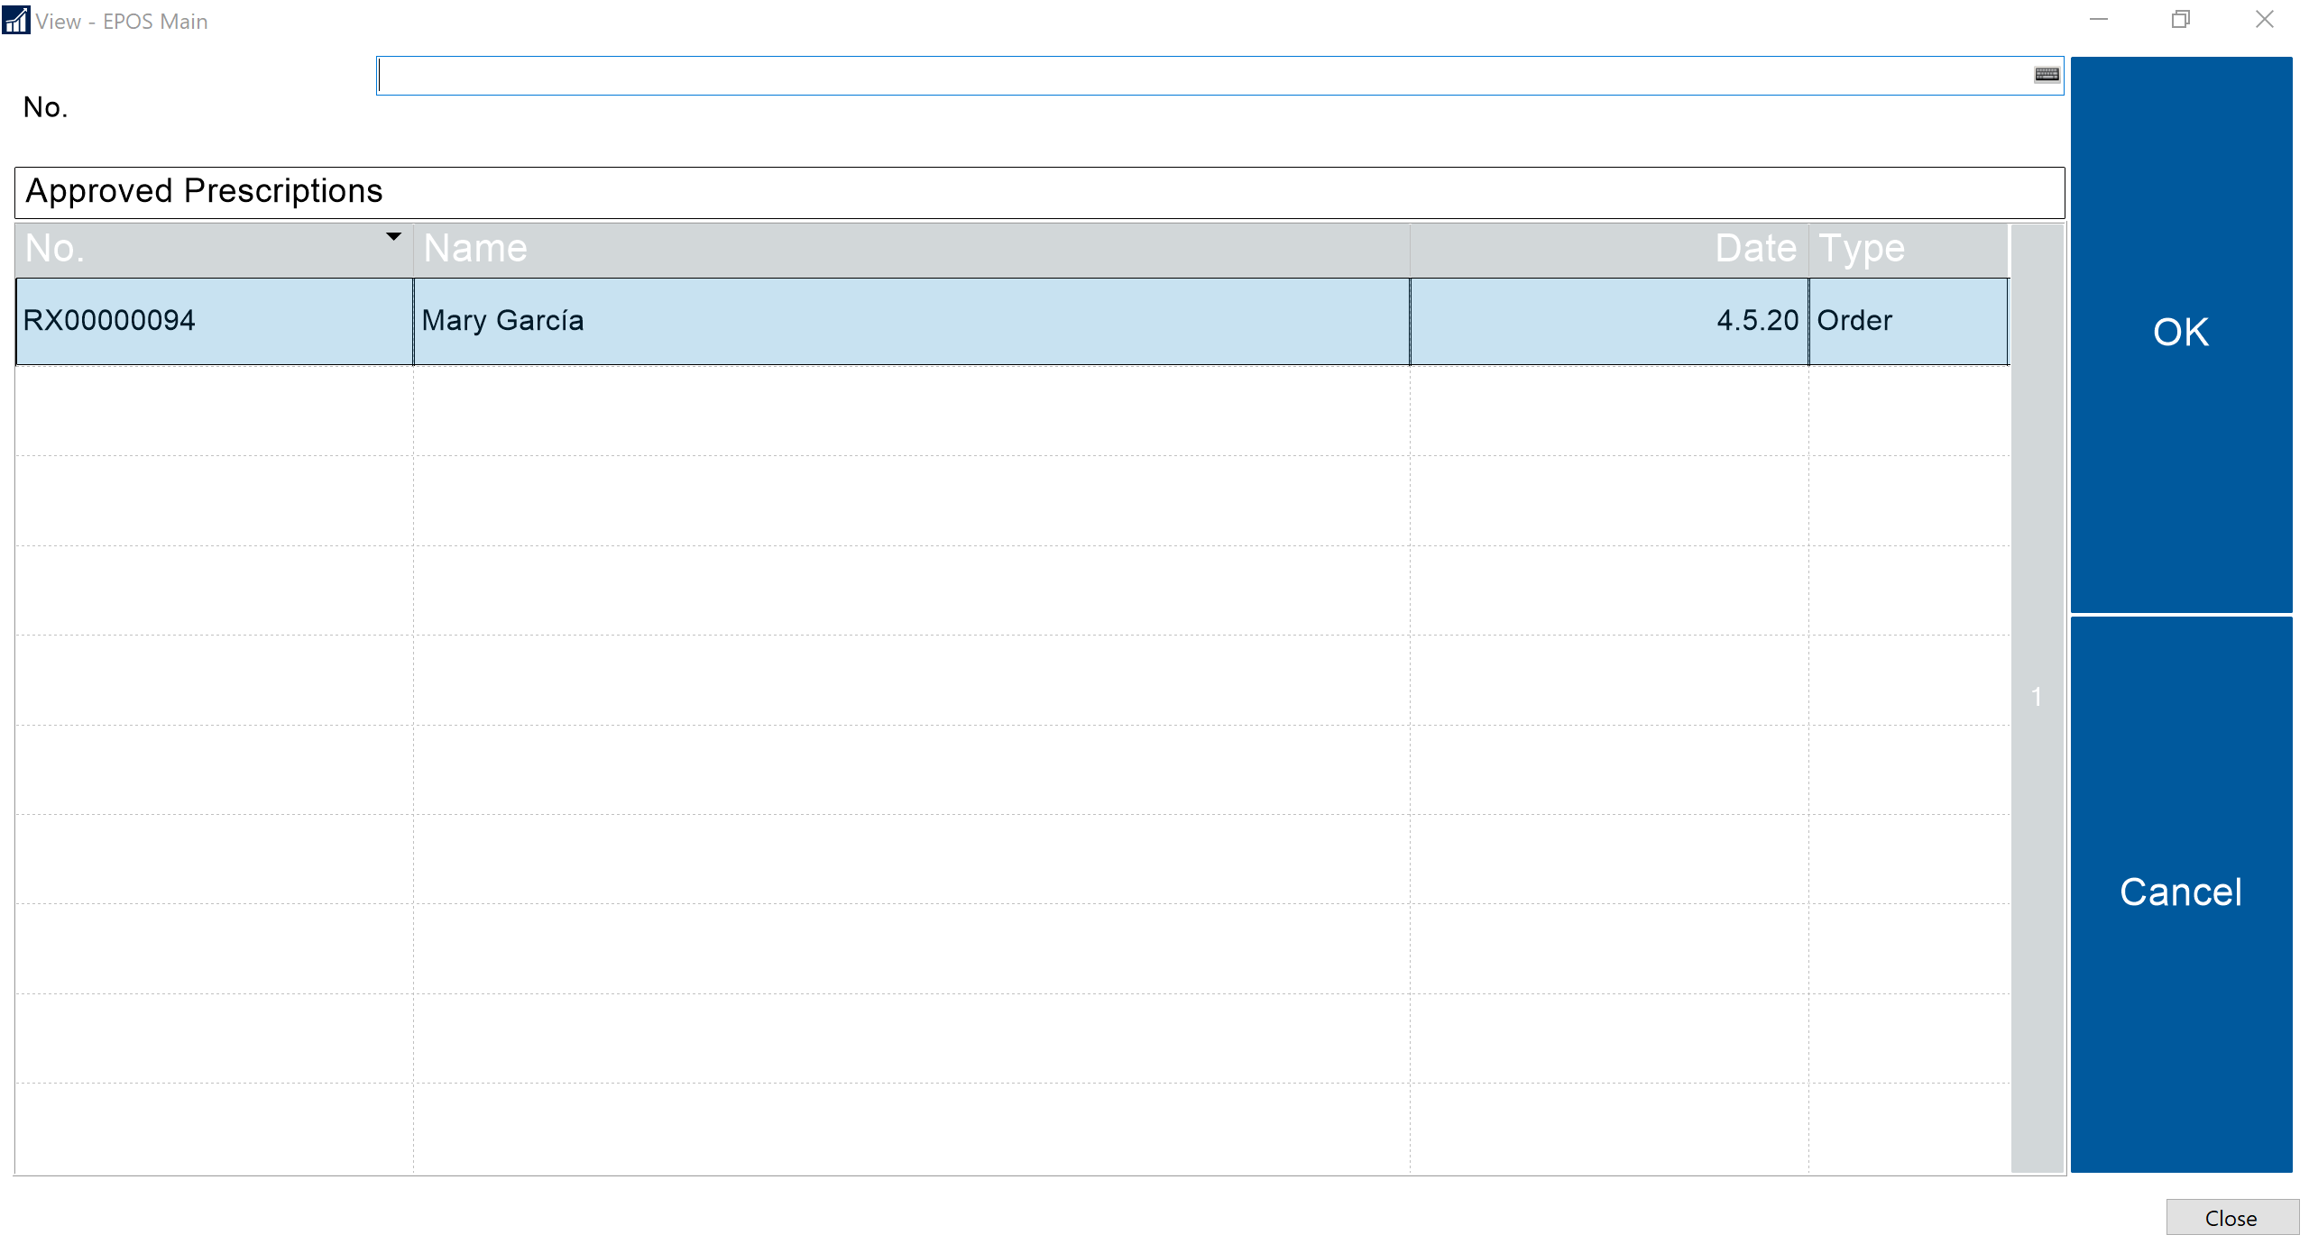

Slide 34
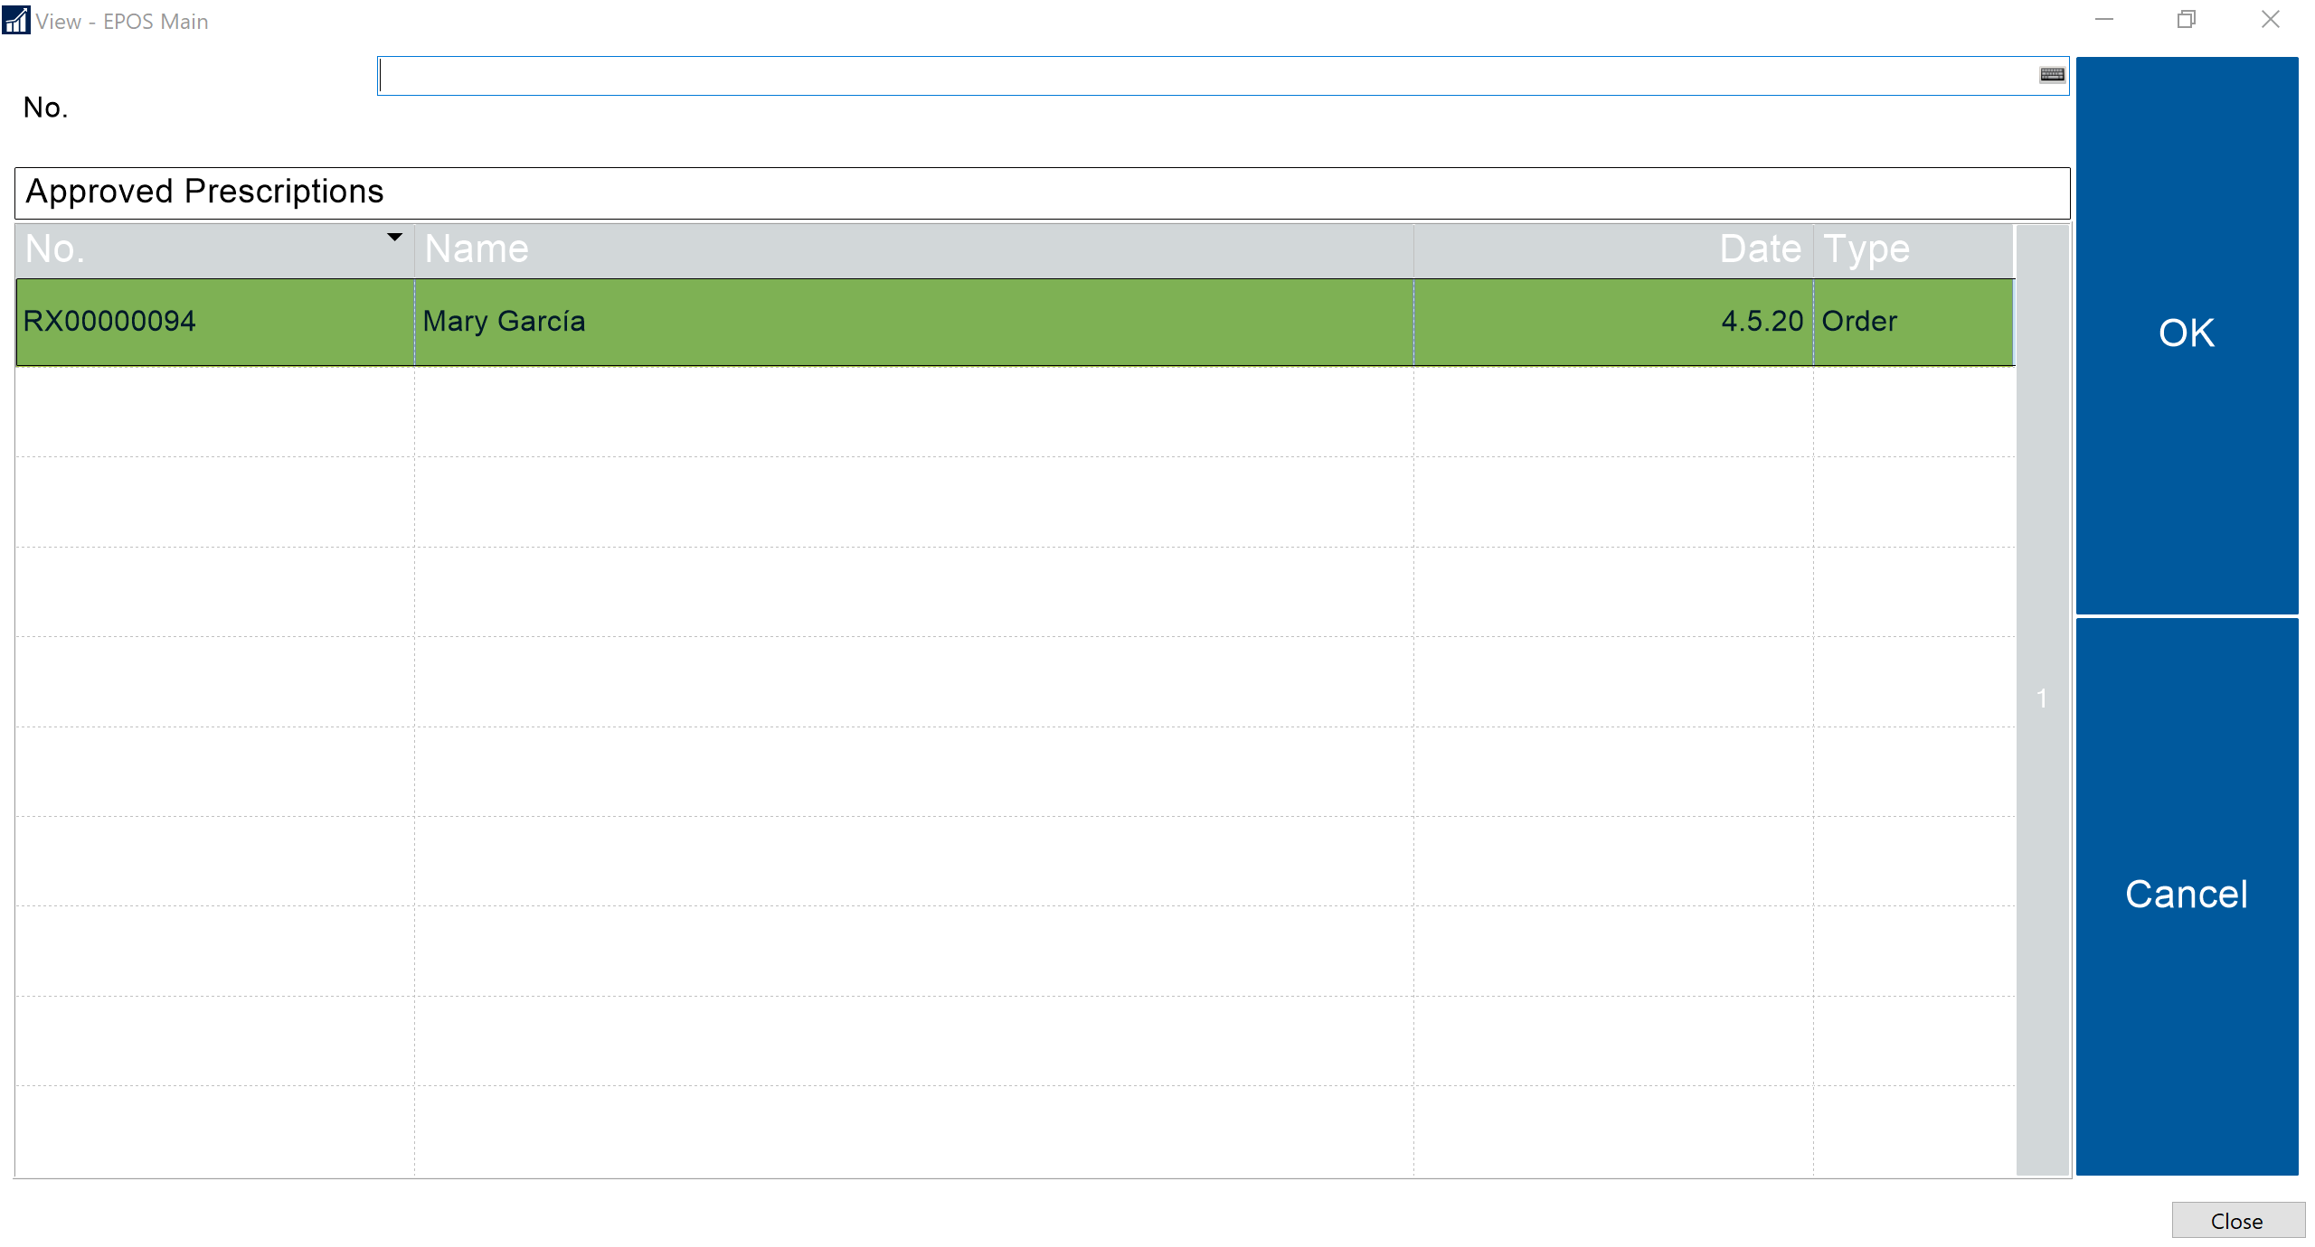

Slide 35
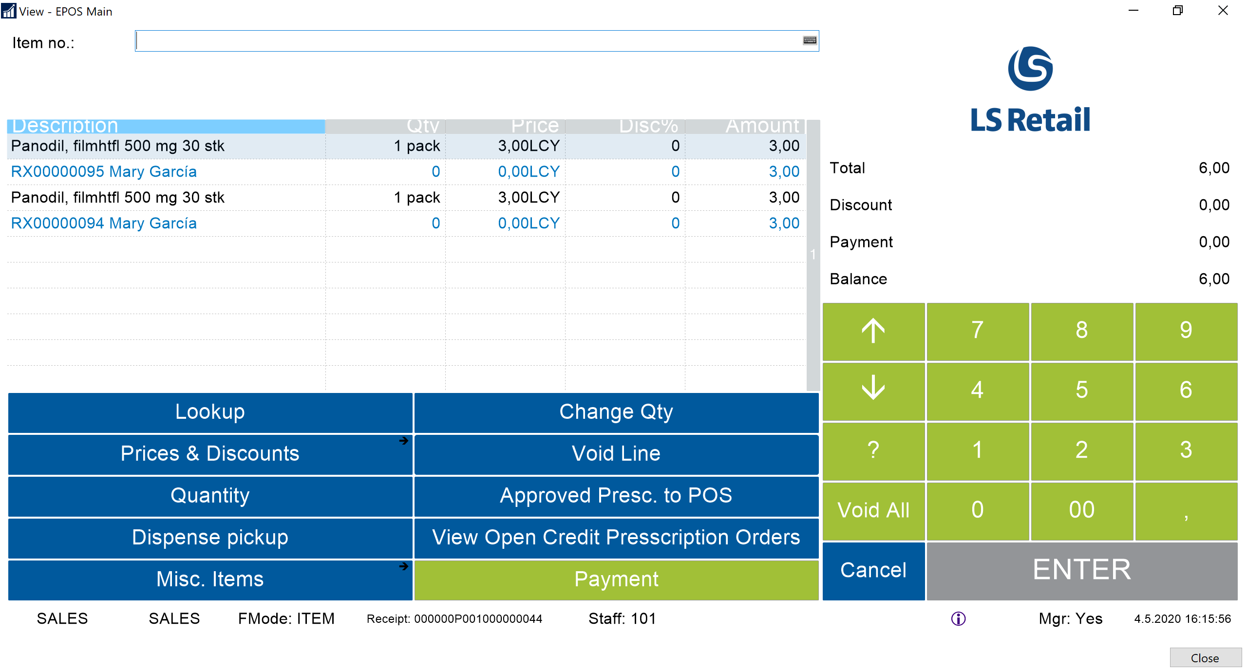

Slide 36
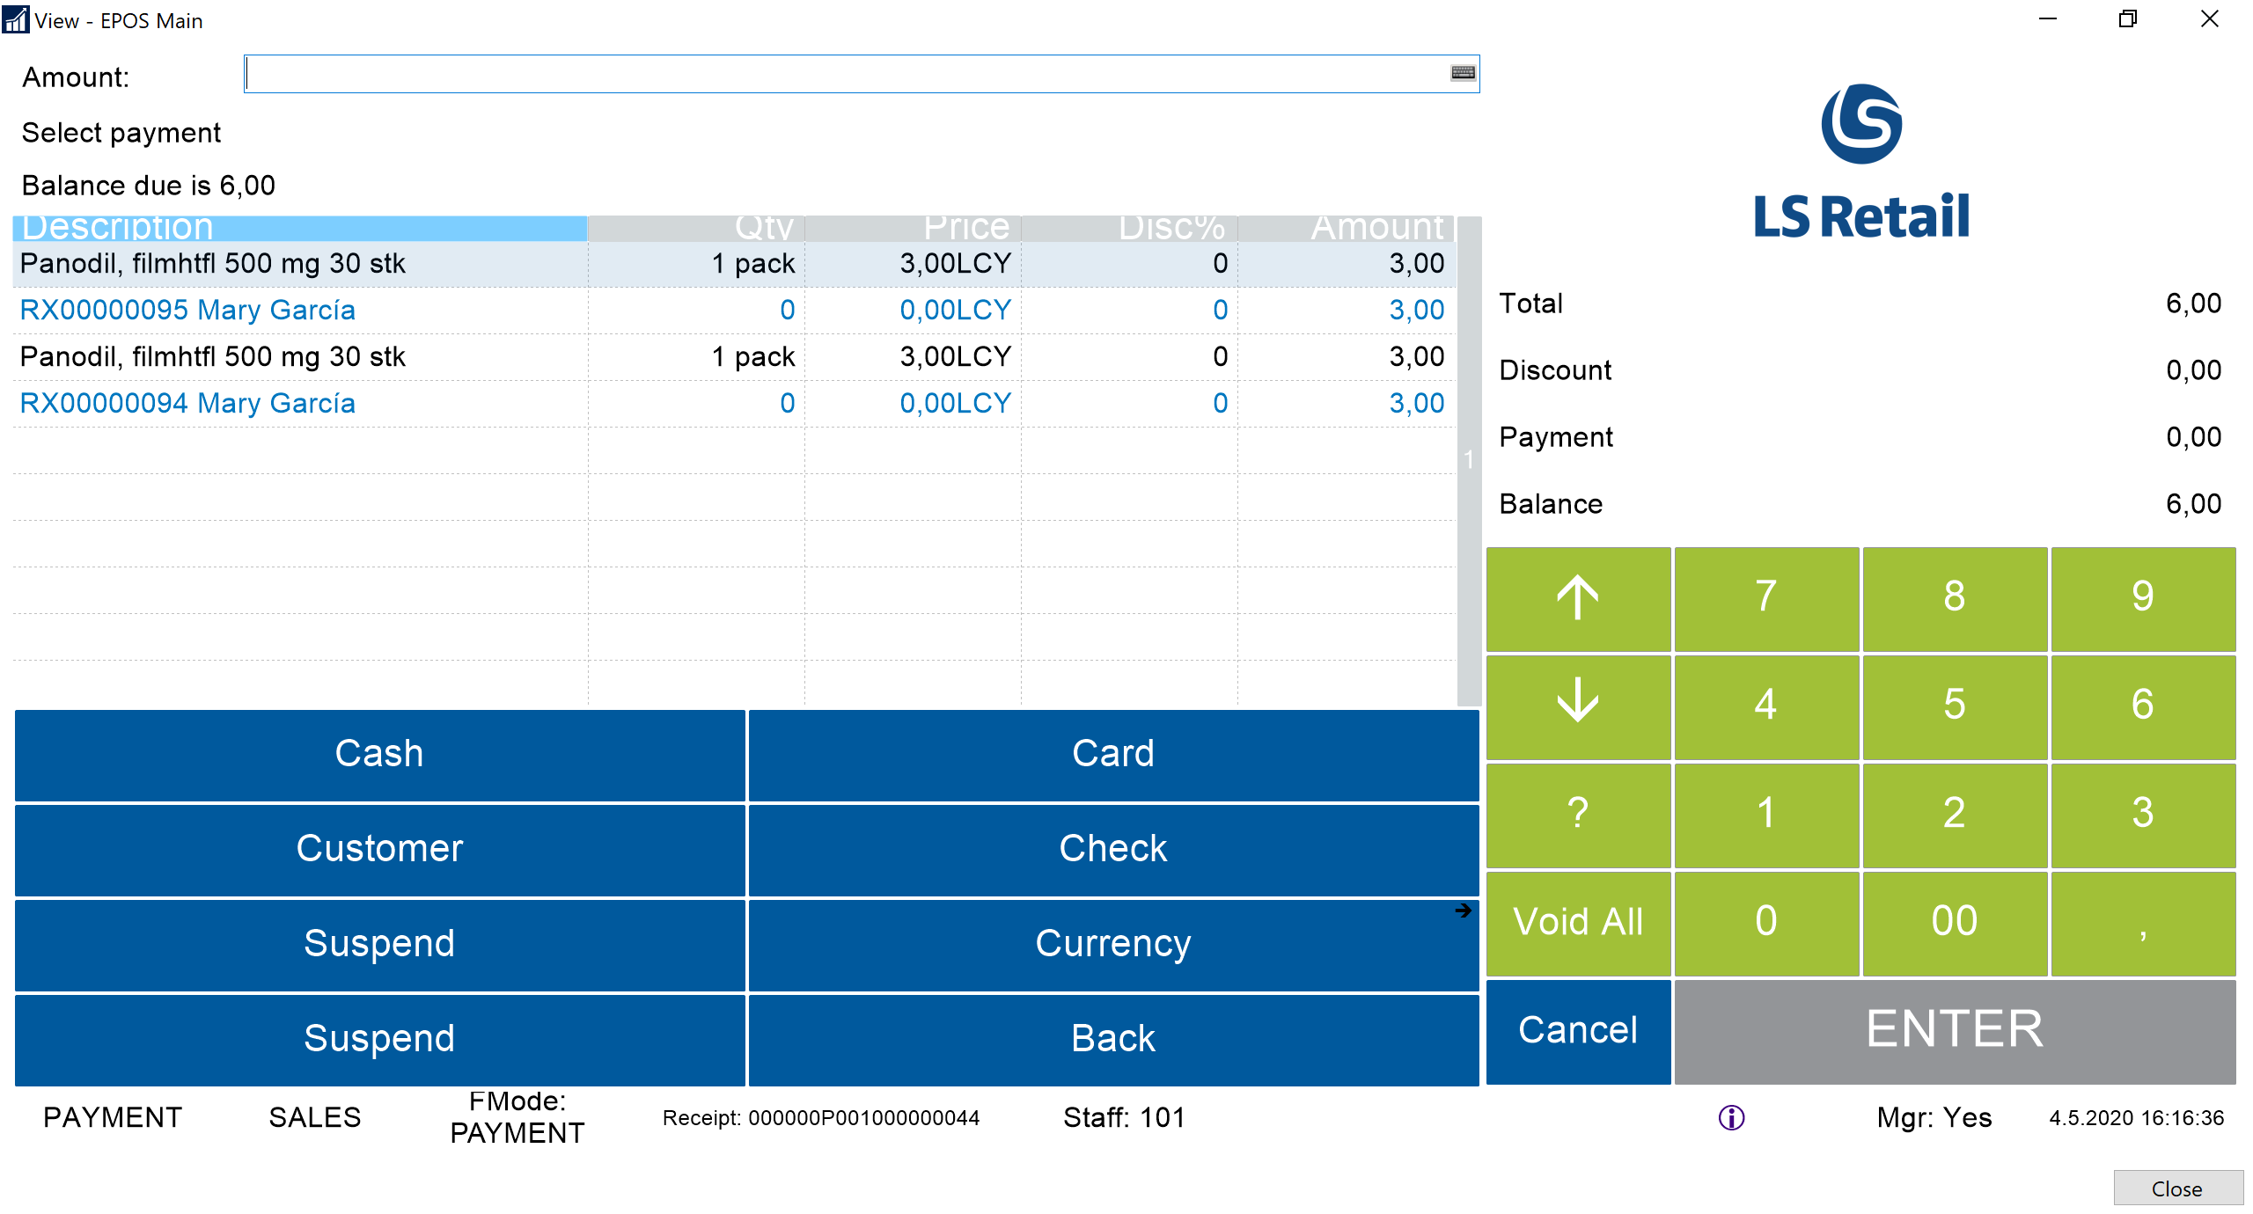

Slide 37
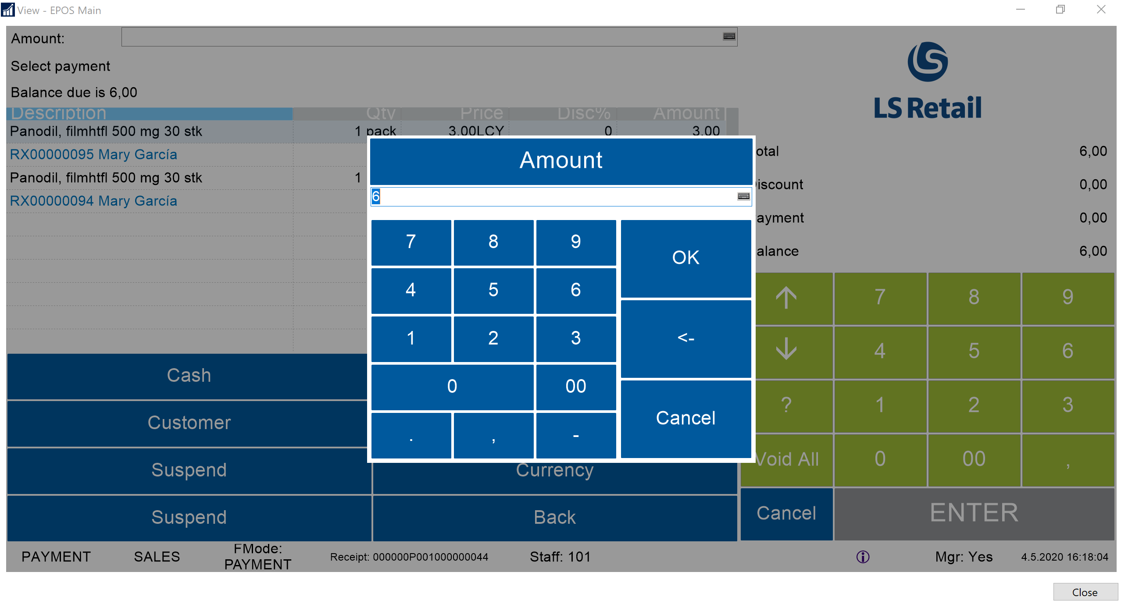

Slide 38
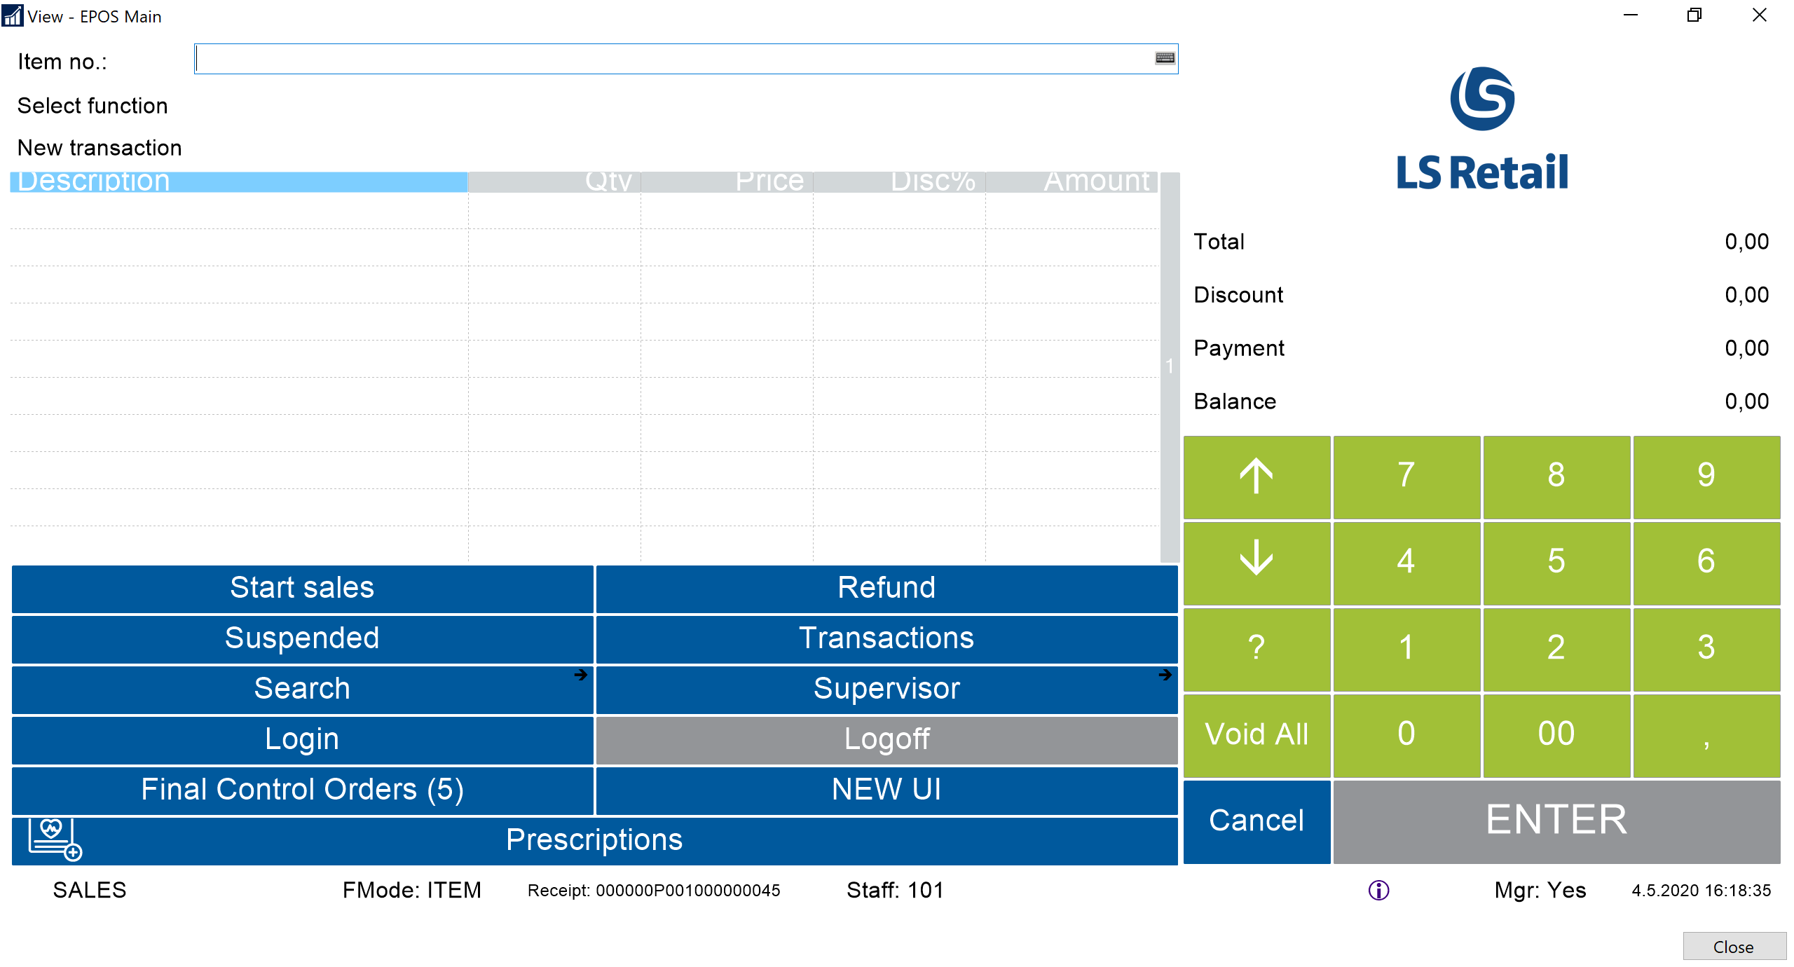

Slide 39
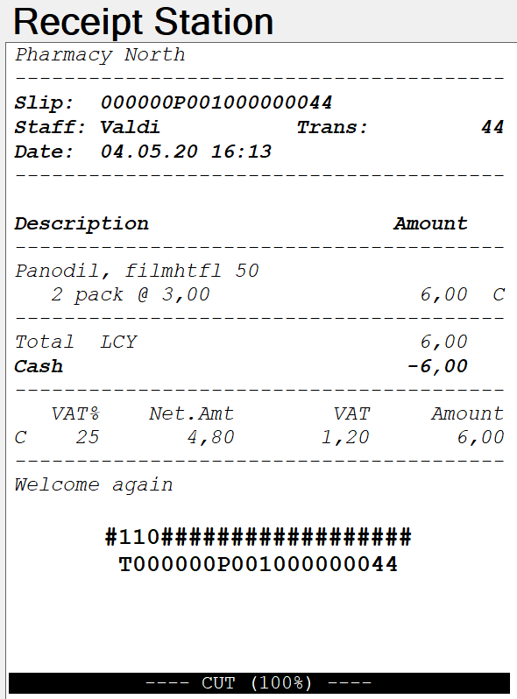

Slide 40
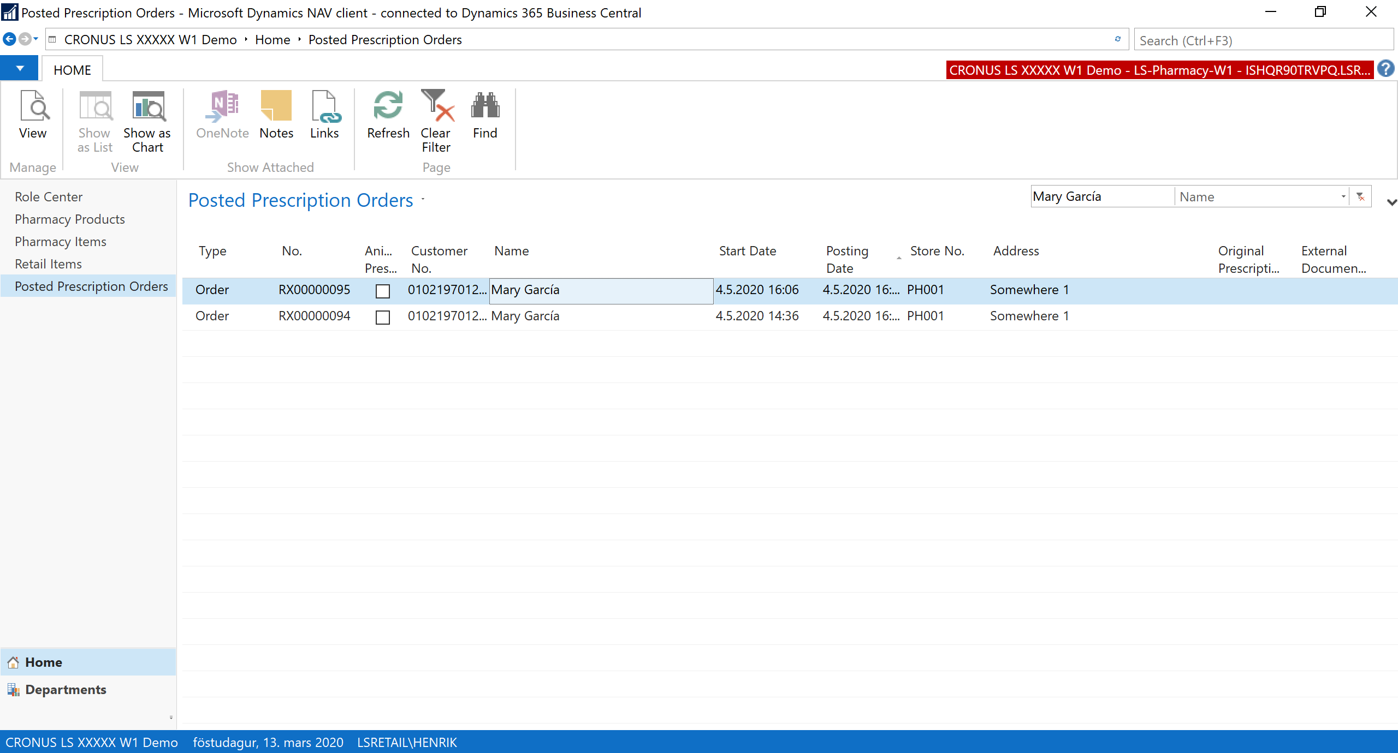

Slide 41
Integrations

Slide 42





Customers of a modern pharmacy
Young families
Active
Chronic illness
Seniors
Simple medications
OTC and Retail items
Frequent visits
Online?
Convenience
Retail items
-Health and beauty
-Nutrition
High income?
Self-service
Online?
Lifestyle related?
Income?
More complex medication?
Regularity / subscriptions
No hurry
Price focus?
Often using multiple drugs and items
Advice
Customer Profile

Slide 43






Online ordering
Advisory role
Health and beauty
Easy check-out
Subscriptions
Services
LS Central for pharmacy

Slide 44
Goal
  Possible to handle prescriptions ordered in different channels
Solution
  Extend Customer Orders in LS Central to support prescriptions
  Pharmacy process is needed before the Customer Order can be delivered and posted
  Regular Customer Order posting from POS or Sales Order
  Basic web services provided, but some customization to be expected
  Connection to e-Prescriptions and insurance either via LS Central or from the customer‘s solution
Unified commerce

Slide 45
Modular design of LS Central and LS Central for pharmacy
Country
Integration
  Each component in the system is like a Lego brick with seamless data integration
  For customers, this means that it is now possible to update the system without a major upgrade project
  Can function as a standalone pharmacy solution or a complete ERP, retail and pharmacy solution
  Supports Unified Commerce unifying all channels & running them from the same back-end solution
  Member management or loyalty program is integrated part of the solution
LS Central for pharmacy
LS Central
MS Dynamics 365 Business Central
Overview - Lego methodology

Slide 46
People
  Pharmacy Customer
  Issuer (doctors etc)
  Staff
Items
  Pharmacy Item and Pharmacy Product
Prescriptions
  Prescription Order and Order Line
  e-Prescription for integrations
Functions
  Payments using POS
  Pricing based on LS Central (POS basket calculation)
  Subscriptions
  Event publishers
    Get Customer
    Get e-Prescription
    Calculate Insurance
Building blocks of LS Central for pharmacy

Slide 47
LS Central for pharmacy
  Based on LS Central 14.02
  Currently Windows client only
  Upgrade to AL in 2021
  Around 900 objects
Localizing the solution
  Integrate with e-Prescriptions, insurance and customer registry
  Item master data import
  Implement local rules (reimbursement, generic substitution)
  Label printing
Licensing and localization
  LS Central + LS Central for pharmacy
  Localization is licensed from LS Retail in some markets
  Localization consists of
    New event subscribers (Codeunits)
    Other new functions
    New fields in tables
    New tables and pages
    (10-20) modified pages
    Translation
Localizing the solution

Slide 48
Core LS Central for pharmacy
Identify customer Ask for Present Download
e-Prescriptions List single e-Presc
LS Localization
Subscriber Response Subscriber
Request Request
External Web Service
Get Send List Lock Presc.
e-Prescriptions
Example: e-Prescription

Slide 49
With LS Central for pharmacy you can:
Handle all daily routines in a pharmacy - from back office to POS
Manage various types of prescriptions and handle drugs effectively
Keep track of your stock across all stores and do replenishment
Search products and packaged items based on various parameters
Manage user-access and permissions
Define your own user interface in a modern way
Govern the data structure for medications and efficient handling of pharmaceuticals
Have a fully integrated dispensing, Retail and ERP solution in ONE software suite and/or decide which areas to use
Get access to many add-on solutions like for activity, staff management and rostering
Rely on a standard Microsoft & LS Retail Platform securing a modern and future proof solution
Use international and modular solution which can be used in multiple countries
Summary - Why LS Central for pharmacy?

