Slide 1

Customer stories: Retailers who implemented LS Retail software on their own
Chris Rayment & Þorarinn Þor
Moderated by Kathryn White

Slide 2




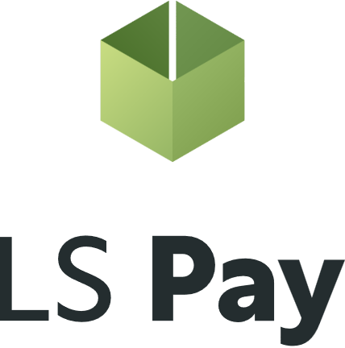




How do you implement an elephant?
Mobile Inventory
Analytics
Data Director
Hardware Station
Commerce Service
ScanPayGo

Slide 3
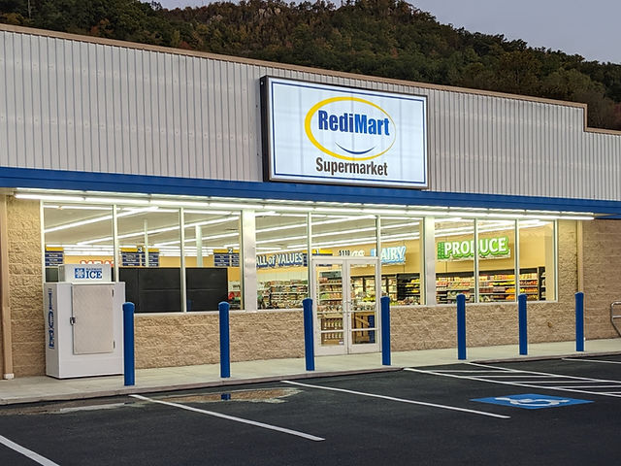
Redi-Mart Story
17 retail stores
  Convenience
  Grocery
  Tobacco
Implemented LS Central
on-prem in 2021 with a partner
  Accounting
  Warehouse management
  Retail backoffice
  Replenishment
  POS & LS Pay
  Mobile Inventory
  ScanPayGo (coming soon)

Slide 4
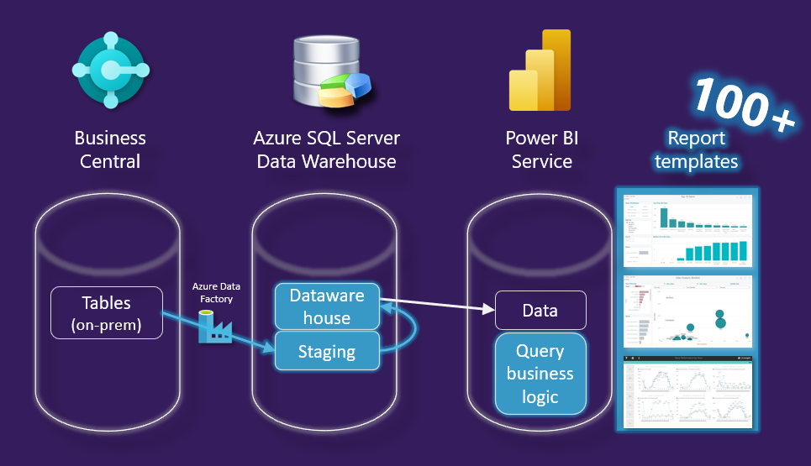
Analytics for LS Central
Demand for reporting and dashboarding above and beyond
out-of-the-box BC
Compliance reports
Time sensitive

Slide 5
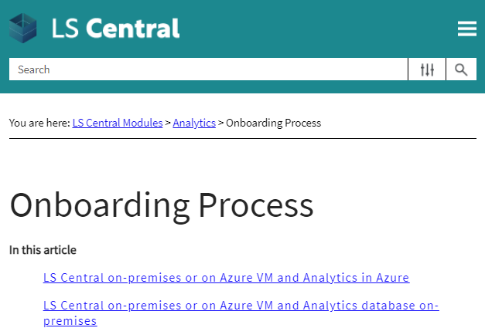
Self-implementation experience
Wanted to avoid lengthy project with costly consulting
Step-by-step documentation explains:
  Prerequisites & licensing
  Architecture overview
  Setup parameters
  Onboarding walkthrough/wizard
Set up in a couple of hours
Immediate user adoption

Slide 6

Encouragement & Advice
There’s nothing to lose
Your partner and LS Retail Consulting will be there if you need them.
Analytics reporting is only as good as your data integrity.
Use best practices for:
  Item maintenance
  Inventory control
  Purchasing & Sales

Slide 7


Dýraríkið Story
2 pet stores + ecommerce site
Reimplementation from LS NAV 2016
on-premise
Self-implemented LS Central SaaS in 2021
  Accounting
  Retail backoffice & POS
  Replenishment
  LS Pay
  Warehouse management (in progress)

Slide 8

Self-implementation
Previous experience with LS NAV
Bought licenses from partner
No consulting assistance
Implementation took ~5 weeks
Testing, trial & error

Slide 9


Elding Story
Tourism
  Whale watching tours
  Northern Lights cruises
  Puffin watching
Family-owned, founded in 2000
  Operate from Reykjavík and Akureyri
  Focus on sustainability
  Partner updated NAV 18 to BC
LS Central SaaS
  Retail backoffice, POS, LS Pay
  Bookings for LSC (in progress)

Slide 10

Words of wisdom
Analyze & prioritize
  Nice to have
  Want to have
  Need to have
Always have a test system for trial-and-error learning
Bring everyone together for end-to-end testing
Allocate time to work without multitasking

