Slide 1
Irina Cristiana Olaru
Licensing Partner Relation Specialist
Sven Kappe
Principal Sales Executive Sales Europe
Smart SaaS licensing

Slide 2
Agenda
Licensing Prices as of October 1st, 2024
Changes in LS Retail Price List for SaaS
Plans for the LS Retail License Manager
NCE Midterm Subscription Transfer
Universal Code Initiative

Slide 3
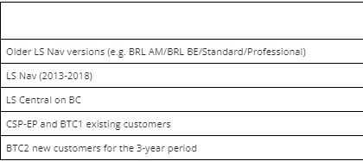
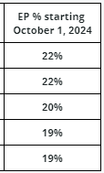
Pricing - Factor and EP% changes – As of October 1, 2024
Factor Changes – onPrem only-LS Central/LS Nav on-premises perpetual and on-premises subscription pricelists updates, effective October 1, 2024 (lsretail.com)
The changes are only for on-Prem, not for LS Central SaaS.
No New on-Prem licenses after April 1, 2025
LS Central SaaS - NO Price increase as of October 1, 2024
BTC2 promo has been extended until December 31. 2025
  Calculation tool on our portal for EP 19%
  Sell or move to SaaS – What support is available

Slide 4
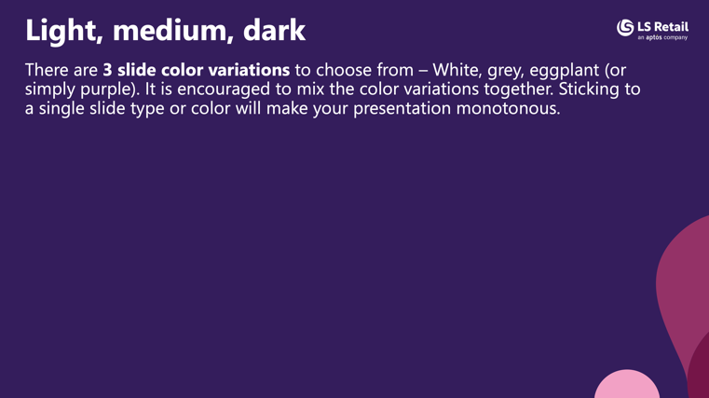
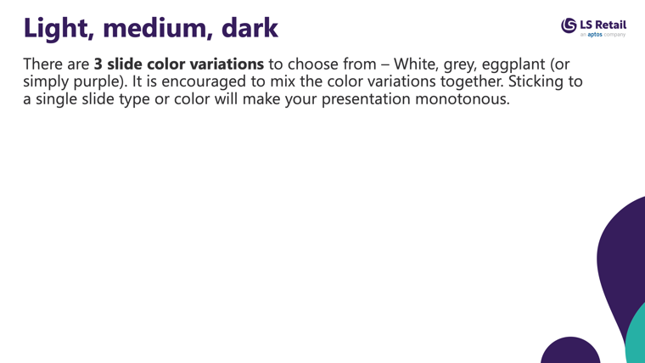
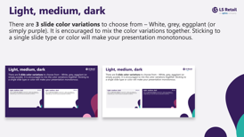
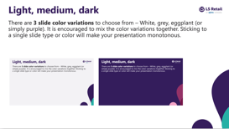

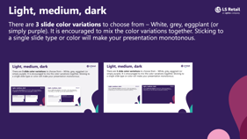
Light, medium, dark
There are 3 slide color variations to choose from – White, grey, eggplant (or simply purple). It is encouraged to mix the color variations together. Sticking to a single slide type and/or color will make your presentation monotonous.
This current slide is the medium(grey) option and below you see the other two.

Slide 5
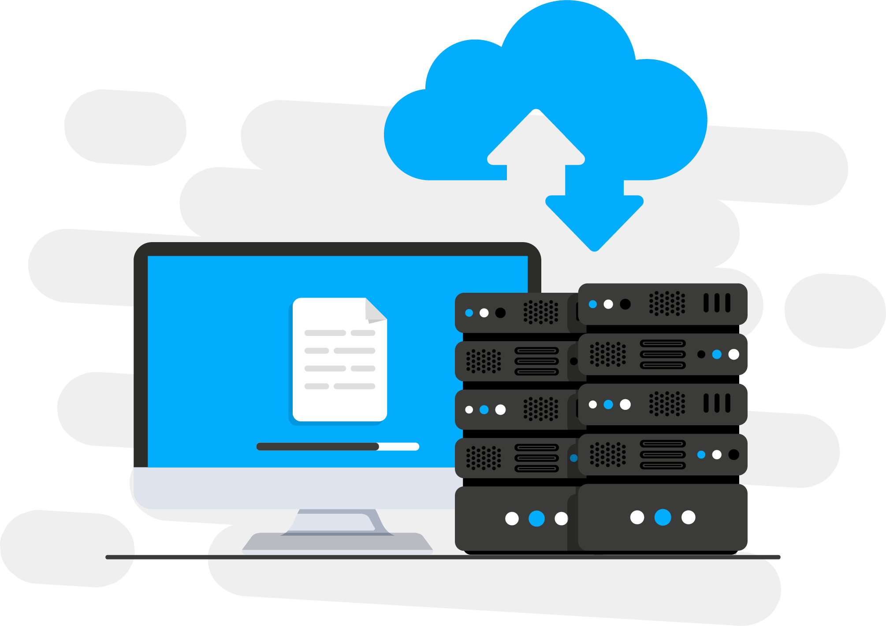
Sell or move to SaaS – What support is available
  Partnership with Seer365, see webinar
  Bridge to Cloud 2 promo
  Business Central Migration Assessment Program
  BC Deployment Accelerator
  CAP team

Slide 6
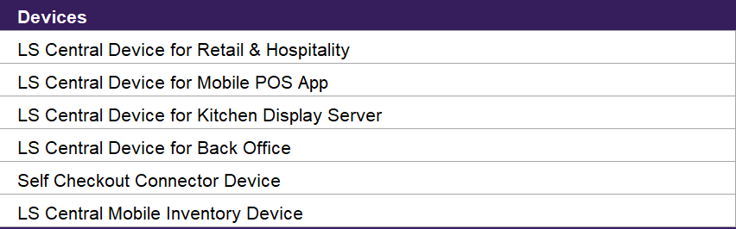
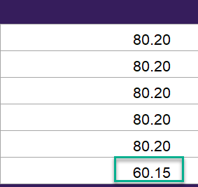
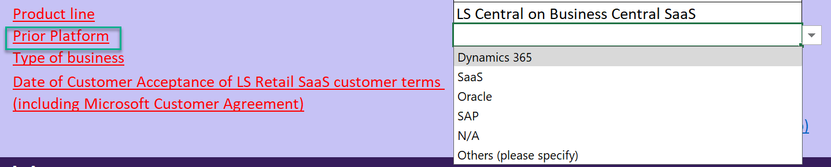
Changes in LS Retail Price List for SaaS
Device SAL for Mobile Inventory App pricing- 25% lower than Regular POS
LS Central Base- only order as per needed (removing the requirement to order= Full user)
Mid-term cancelations are accepted with the proof that the customer has upgraded to version 25
New field on the Pricelist - Prior Platform field

Slide 7
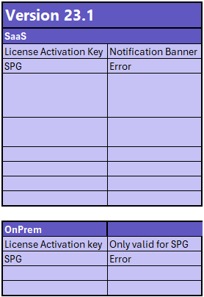
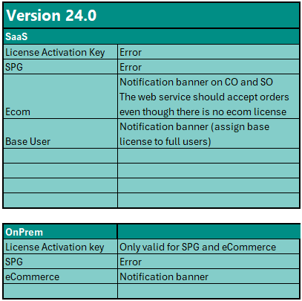
LS Retail License Manager
License Activation Key- Visible in Business Hub both for customers and partner licenses
License Manager setup instructions:
Operational Guidelines (lsretail.com)
How to: Set Up License Manager (lsretail.com)

Slide 8
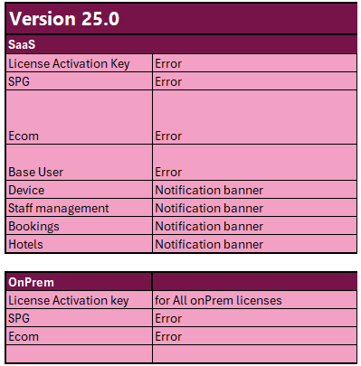
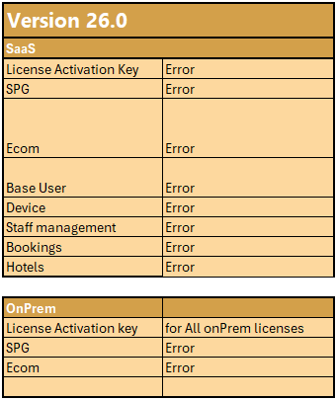
LS Retail License Manager
License Activation Key- Visible in Business Hub both for customers and partner licenses
LS Central Base- only order as per needed
As of LS Central version 26 we want to change how we sell devices and offer 1 LS Central Device and open for that device to be either a Device, Back Office Device or a Mobile Inventory in 1 Device.
Mobile inventory pricing

Slide 9
NCE midterm subscription transfer between CSP´s
NCE BTC2 sku transfer (NOT CSP-EP or BTC1 skus)
NCE per pricelist skus
Based only on the approval from the current CSP Provider
Different conditions apply, depending on the NCE sku type

Slide 10
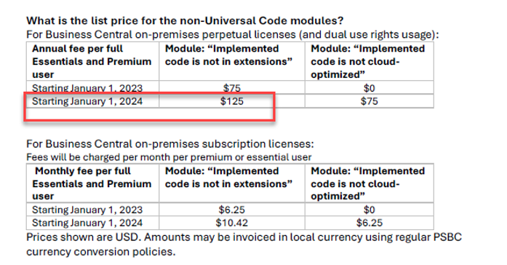
Universal Code Initiative (UCI)
1
LS Nav versions – No Fee
2
LS Central version 21.4 and newer – no Fee*
3
Ensure all code is done in UC extensions
4
All partner add-ons published in AppSource
5
Fee starting as of EP Renewals in 2025
!
Reply to the emails from Licensing

Slide 11
Questions
&
Answers

