Slide 2


How to implement Replenishment
in 45 minutes
Christina Cheng
Martin Kleindl

Slide 3


Slide 5


Slide 6

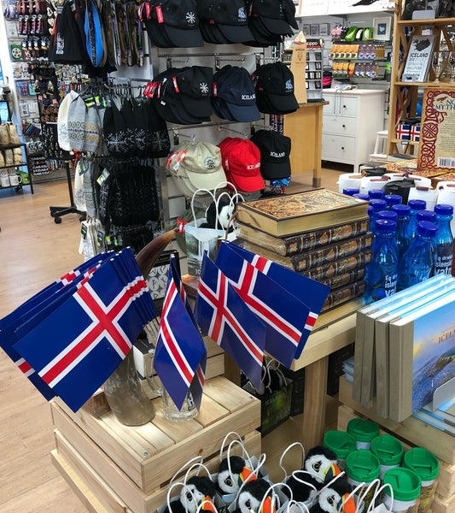

Slide 7
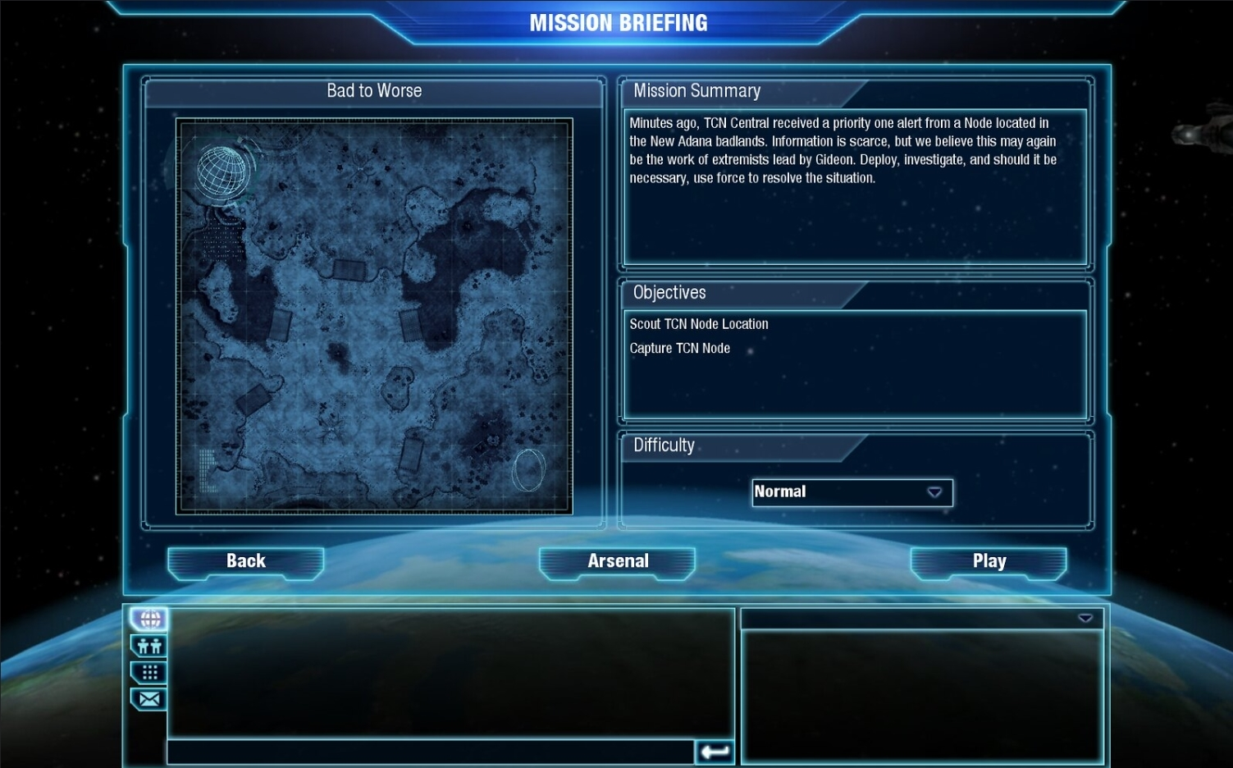

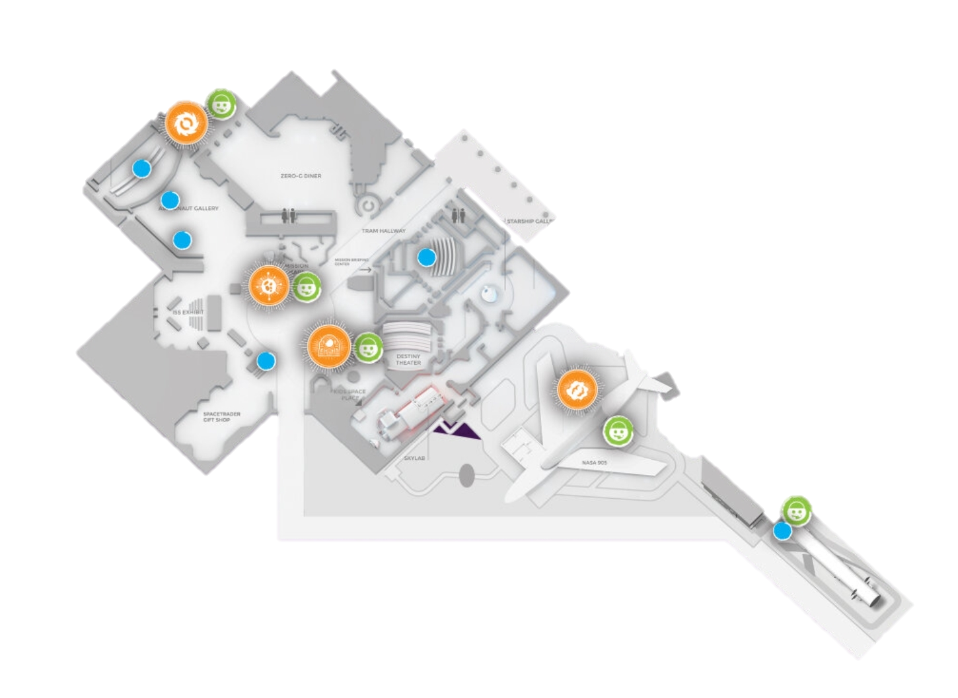
MISSION: BREAK the ICE!
Small Warehouse
Activate Replenishment for
Christina’s Iceland Gift store
→ for 2 Stores
Store
Cafe
Automatic PO & TO creation for Stores
- based on Stock
- based on Sales History
Store
Low/Medium. Time = 45 minutes
Hint 1: Use Replenishment Implementation Guide
Hint 2: Focus on a couple of items before you
setup all items

Slide 8

Replenishment
Setup
Basic
Setup
Warehouse,
Store Locations
Items,
Basic calc. rule
Replen.
Journals
Advanced calc. rules (sales history)
Sales History Adjustment
Automation (Scheduler)
G.O.A.L.
Document Creation

Slide 9
Replenishment
Setup
Basic
Setup
Warehouse,
Store Locations
Items,
Basic calc. rule
Replen.
Journals
Advanced calc. rules (sales history)
Sales History Adjustment
Document Creation
Automation (Scheduler)
G.O.A.L.

Slide 10
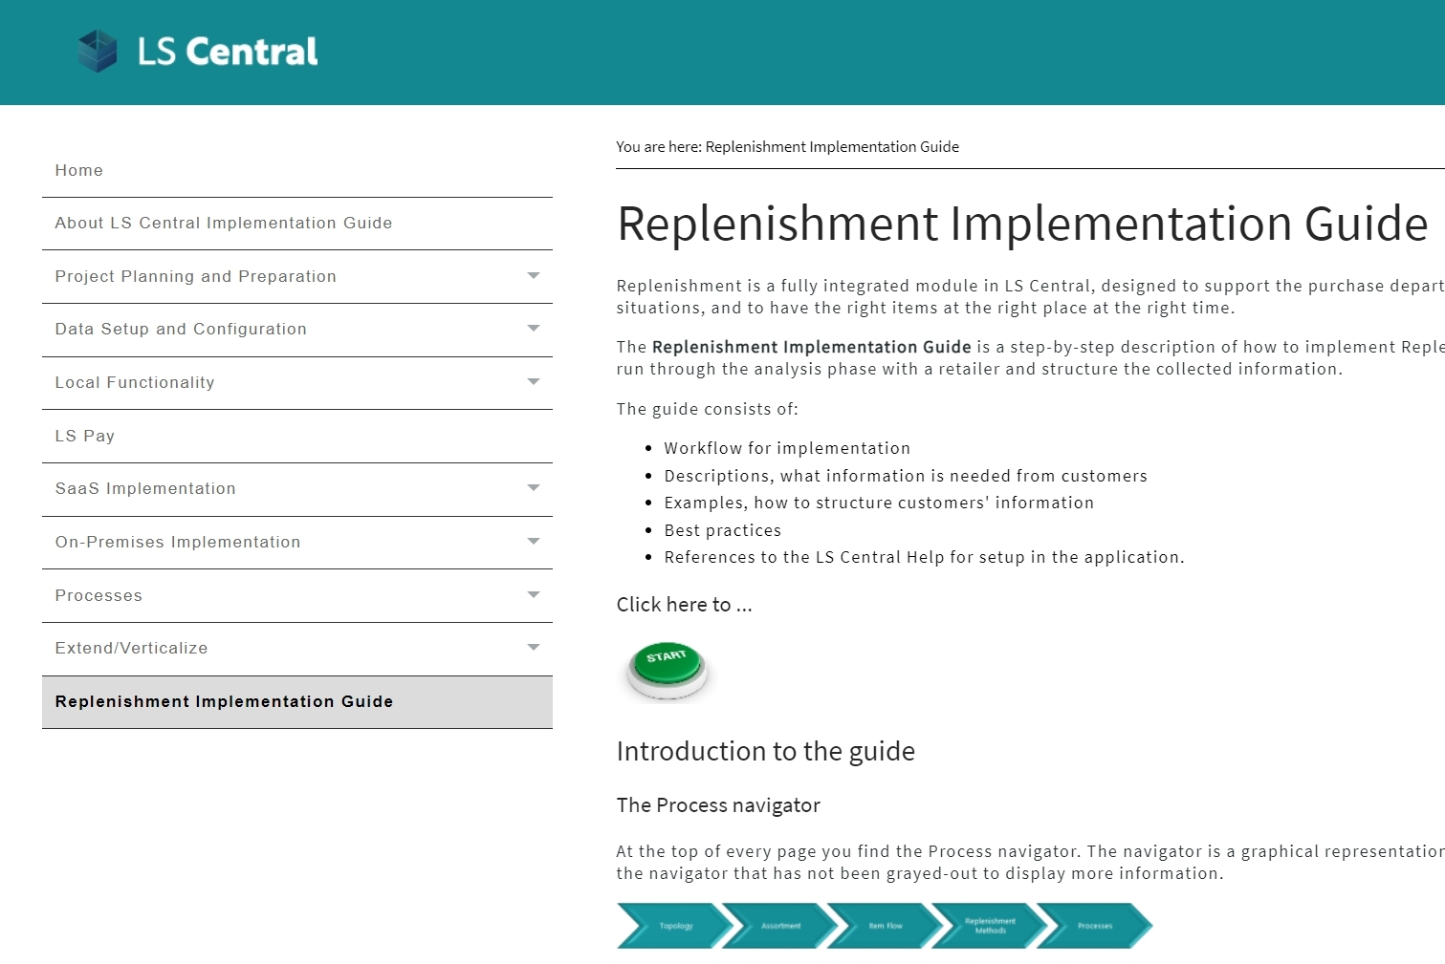
Basic setup, warehouse, store locations
How to start?
→ Replenishment Implement. Guide
Provides:
  Workflow for implementation
  Description what information is needed
  Explains different use cases/scenarios
  Best practices
  References to LS Central Help

Slide 11
Let’s set up …
Warehouses and Stores for Replenishment

Slide 12
Replenishment
Setup
Basic
Setup
Warehouse,
Store Locations
Items,
Basic calc. rule
Replen.
Journals
Advanced calc. rules (sales history)
Sales History Adjustment
Document Creation
Automation (Scheduler)
G.O.A.L.

Slide 13
Item setup
Needed steps to activate items:
Select in which stores the items should be replenished
Select the replenishment calculation method
Specify parameters for the chosen method
Stores
Store 1
Store 2

Slide 14
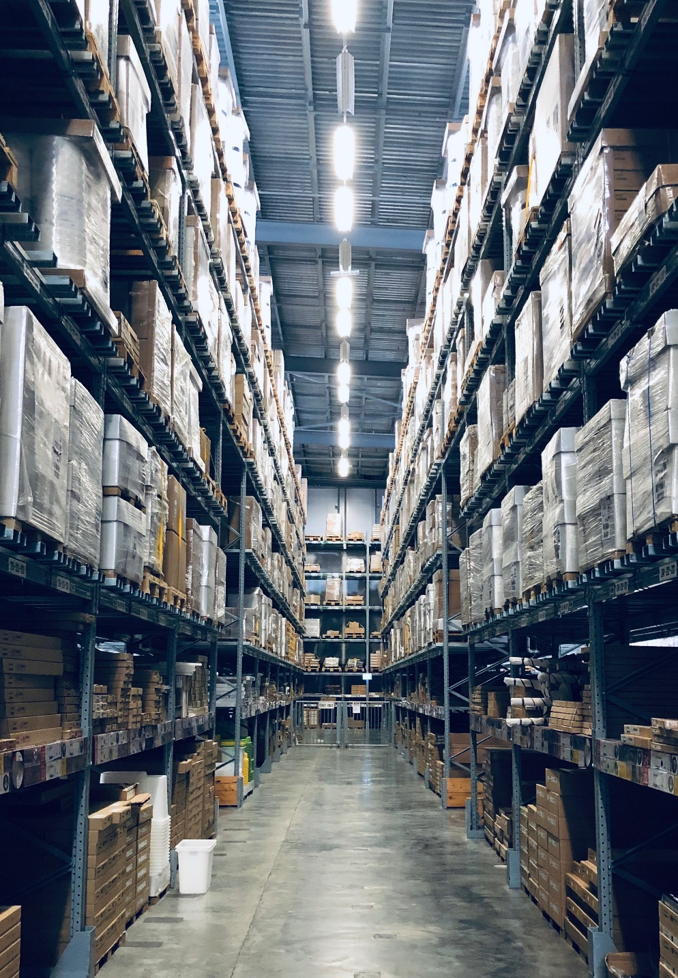
Replenishment calculation
Demand calculation methods
Supported methods:
Reorder point/Max. inventory
Like for like
Manual estimate
Average usage
Adaptive models
  Seasonality (Forward Profiles)
  Replenishment Calendars
  (moving events like Easter)
Retail forecast
  Integration to 3rd party forecasting engines

Slide 15
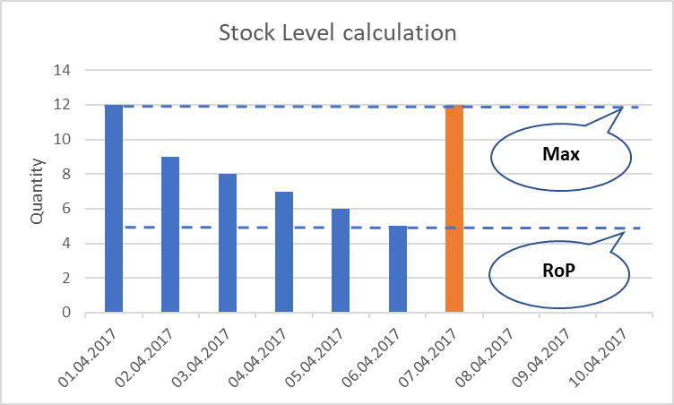
Item setup
Needed steps to activate items:
Select in which stores the items
should be replenished
Select the replenishment calculation
method
Specify parameters for the
chosen method
Stores
Store 1
Store 2
Stock Level
ordering based on existing store stock
Fields
Vendor
Reorder Point
Max. Inventory

Slide 16
Let’s set up …
Items for Replenishment

Slide 17
Replenishment
Setup
Basic
Setup
G.O.A.L.
Warehouse,
Store Locations
Items,
Basic calc. rule
Replen.
Journals
Advanced calc. rules (sales history)
Sales History Adjustment
Document Creation
Automation (Scheduler)

Slide 18

Replenishment journals
The place where we calculate
the proposals for:
  Purchase Orders
  Transfer Orders
Elements
  Template
  Defines what should be calculated
  in the Journal and how (rules)
  Batch
  Defines when (in which interval)
  the Journal should be calculated

Slide 19
Template types
Warehouse 1
Store 1
Store 2
Store 3
Warehouse 2
Store 4
Store 5
Vendor A
Vendor C
Vendor B
Types
Purchase Order
  Vendors to stores
Purchase Order
  Vendors to warehouses
Transfer Order
  Warehouses to stores
Purchase Order
  Vendors to warehouses
  with Cross Docking (warehouses to stores)
Redistribution
  Stores to stores
To store
To warehouse
To warehouse
with Xdocking
(A)
(B)
(D)
(C)
(E)

Slide 20
Template Types
Warehouse 1
Store 1
Store 2
Store 3
Warehouse 2
Store 4
Store 5
Vendor A
Vendor C
Vendor B
Types
Purchase Order
  Vendors to stores
Purchase Order
  Vendors to warehouses
Transfer Order
  Warehouses to stores
Purchase Order
  Vendors to warehouses
  with Cross Docking (Warehouses to Stores)
Redistribution
  Stores to stores
To Store
To Warehouse
To Warehouse
with Xdocking
(A)
(B)
(D)
(C)
(E)

Slide 21
Let’s set up
Replenishment Templates
(and do our first calculation)

Slide 22
Replenishment
Setup
Basic
Setup
G.O.A.L.
Warehouse,
Store Locations
Items,
Basic calc. rule
Replen.
Journals
Advanced calc. rules (sales history)
Sales History Adjustment
Document Creation
Automation (Scheduler)

Slide 23
Replenishment
Setup
Basic
Setup
Warehouse,
Store Locations
Items,
Basic calc. rule
Replen.
Journals
Advanced calc. rules (sales history)
Sales History Adjustment
Document Creation
Automation (Scheduler)
G.O.A.L.

Slide 24
Replenishment calculation
Demand calculation methods
Supported methods:
Reorder point/Max. inventory
Like for like
Manual estimate
Average Usage
Adaptive models
  Seasonality (Forward Profiles)
  Replenishment Calendars
  (moving events like Easter)
Retail forecast
  Integration to 3rd party forecasting tools

Slide 25
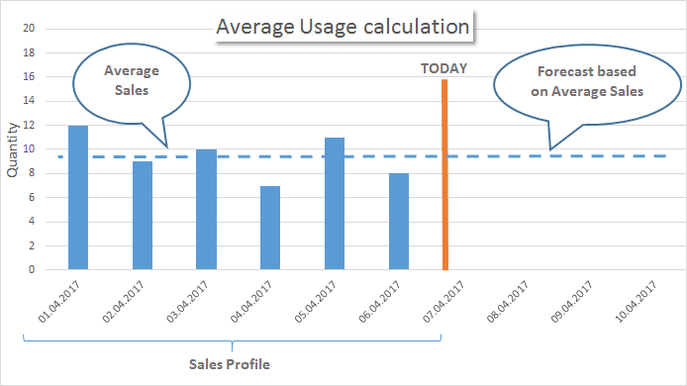
Calculation methods
Historical sales: Average usage
Transfer Orders and/or Purchase Orders are proposed based on sales history.
Needed fields:
Sales profile defines time horizon how far we look back
Coverage period
Warehouse: based on purchase interval
  Stores: based on store replenishment interval

Slide 26
Let’s change our
Item’s setup to use
Average Usage
(and do another calculation)

Slide 27
Replenishment
Setup
Basic
Setup
Warehouse,
Store Locations
Items,
Basic calc. rule
Replen.
Journals
Advanced calc. rules (sales history)
Sales History Adjustment
Document Creation
Automation (Scheduler)
G.O.A.L.

Slide 28
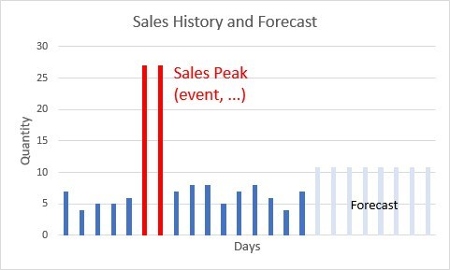
Sales history adjustments
Simulation or adjustment of sales history
Methods:
Simulate sales history for new items or stores
(from other item’s sales history with factors)
Correction of sales history
- Automatic outlier detection
- Planned demand event/promotions tracking
- Manual corrections

Slide 29
Let’s simulate sales history for our new item
(and do another calculation)

Slide 30
Replenishment
Setup
Basic
Setup
Warehouse,
Store Locations
Items,
Basic calc. rule
Replen.
Journals
Advanced calc. rules (sales history)
Sales History Adjustment
Document Creation
Automation (Scheduler)
G.O.A.L.

Slide 31
Let’s create
Purchase Orders
(from the Template)

Slide 32
Replenishment
Setup
Basic
Setup
Warehouse,
Store Locations
Items,
Basic calc. rule
Replen.
Journals
Advanced calc. rules (sales history)
Sales History Adjustment
Document Creation
Automation (Scheduler)
G.O.A.L.

Slide 33
How to automate this process?

Slide 34

Replenishment
Setup
Basic
Setup
Warehouse,
Store Locations
Items,
Basic calc. rule
Replen.
Journals
Advanced calc. rules (sales history)
Sales History Adjustment
Document Creation
Automation (Scheduler)
G.O.A.L.

Slide 35
MISSION: BREAK the ICE!
Small Warehouse
Activate Replenishment for
Christina’s Iceland Gift Store
→ for 2 Stores
Store
Cafe
Automatic PO & TO creation for Stores
- based on Stock
- based on Sales History
Store
Low/Medium. Time = 60 minutes
Hint 1: Use the Replenishment Implement. Guide
Hint 2: Focus on a couple of items before you
setup all items

Slide 36
Replenishment
Planning & Data Maintenance
Manual Replenish- ment
Automatic Replenish- ment
Execution
Monitoring
Sales & Purchase Budgets
Allocation
Plans
Buyer‘s Push,
Stock Recall
Allocation Rules
Variant Weight Dim. Pattern
Demand Forecasts
Store Stock
Redistribution
Purchase & Transfer
Orders
Stock Requisition
Buyer‘s Workbench
Inventory and Demand
Store
Capacity
Stock Coverage
Vendor Performance
Open to Buy
Assortment Mgmt.
Lifecycle Mgmt.
Replenishment Journal Calculation
Threshold Mgmt.
Lifecycle Planning WS
Cross Docking
Manual Purch. & Transfer Orders
Replen. Item Quantity Calculation
Out-of-Stock Calculation
Item Import

Slide 37
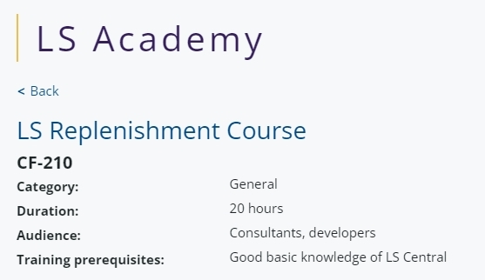
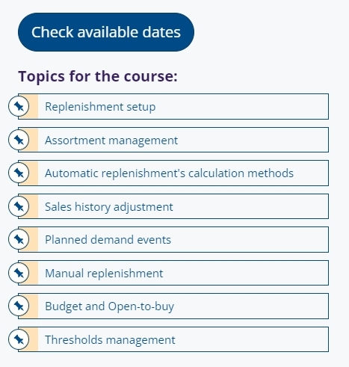
How to get started?
LS Retail Academy
Training
  LS Retail Academy – training course
  https://www.lsretail.com/ls-academy/
  Individual training through LS Retail Consulting
  Webinars and LS Central Help
Sales support
  Presales, solution design, concept reviews
  by LS Retail Consulting
Implementation support
  by LS Retail Consulting

Slide 38


Feature Improvements
Effective Inventory calculation
New rule to specify horizon of back periods
Consideration of Purchase Return Orders
New rule to handle Negative Eff. Inventory (nullify or keep)
Transfer Unit of Measure
New field on Item Card; allows conversion of UoM for Transfer Orders
Replen. Journal Cross Docking improvements
Enhanced calculation for better results with Transfer Multiples
New field: Inb. WH xDock Handling Time (Date Formula)
Reorder Point and Max. Inventory for WHs
New setup fields to specify different RoP/MaxInv for stores and warehouses
Further performance improvements & process enhancements

Slide 39
Feature Improvements
Exclude Item Groups from Out-of-Stock calc.
Option for users to exclude items from Out-of-Stock calculation
to reduce calculation time
Further improvements
Stock Recall
Replen. Control Data list
Sales History Adjustment
Advanced Date handling for Purchase Orders
Performance improvements

Slide 40
Replenishment - performance
Improvements for the
core Replenishment processes
Out of Stock Calculation
Replen. Item Quantity Calculation
Replen. Journal Calculation
Detect current OOS situations
4,0h → 38 min
-84,5 %
Calculate current stock situation
Calculate historical sales performance
6,5h → 78 min
-79,0 %
Calculate demand
Calculate proposals for Purchase or Transfer
1,0h → 10 min
-82,0 %
Document
Creation
Purchase Orders
Transfer Orders
Assembly Orders
-15,0 %

Slide 41

Replenishment - performance
Improvements for the
core Replenishment processes
Out of Stock Calculation
Replen. Item Quantity Calculation
Replen. Journal Calculation
Detect current OOS situations
4,0h → 38 min
-84,5 %
Calculate current stock situation
Calculate historical sales performance
6,5h → 78 min
-79,0 %
Calculate demand
Calculate proposals for Purchase or Transfer
1,0h → 10 min
-82,0 %
Document
Creation
Purchase Orders
Transfer Orders
Assembly Orders
-15,0 %
LS Central version 24

Slide 42

The future
Multi-Warehouse Replenishment
  Improved processes for scenarios with multiple warehouses
  Secondary and tertiary warehouses for items
  Warehouse to warehouse transfers
Replenishment for Bill of materials (BOM)
  Handling of BOM in BOM
  Assembly Order creation
Further performance improvements & process enhancements

Slide 43
Your Questions please!
(or feedback ☺)

Slide 45


Slide 46
Thank you

