Slide 2

Bjarni Asmundsson
Introduction to Solution Architecture
Regional Director
bjarni@LSRetail.com
Notes:
We will wait a minute as there are more people joining the webinar
Okay, let us start
Hi
My name is Bjarni Asmundsson and I am a Regional Director for LS Retail, located in Kuala Lumpur Malaysia
and I would like to welcome you to todays webinar, which is Solution Architecture for LS Central

Slide 3
Introduction to LS Central Solution Architecture
Join this 2 hours webinar on 29th May at 1 pm (UTC+8) and learn about the architecture aspects of LS Central installations (On-Premise/Azure, Hybrid, or Cloud), general housekeeping and must-do’s and don’ts. The main focus will be on On-Premise/Azure setups, but we will cover Hybrid and Cloud setups as well.
Key takeaways:
  Get basic overview on the existing solution architecture and environment of LS Central installations.
  Get general housekeeping rules, things that should and should not be done.
Audience:
  Sales, pre-sales and consulting professionals
  Customers and LS Retail partners
  Host: Bjarni Asmundsson, Regional Director
Notes:
Before we get started – little reminder on what this is about …
And this Webinar will be recorded, and we will share the recording as well as slide deck after the session
You can ask questions today by typing questions into the question pane, you can send the questions at any time during the presentation and I will try to address those in the Q&A session after the webinar All questions and responses will e shared as well with the other material

Slide 4
What are we going to talk about?
When looking at Solution Architect there are at least two aspects:
  Which Services are we running and Where
  What do we need to run those Services
During this webinar, I will try to address both aspects – but probably only on high level
I am assuming, I might not be able to address all questions during the Q&A, but keep posting them and feel free to drop me an email afterwards
bjarni@LSRetail.com
Notes:
During this webinar we are both going to be looking at Which Services we are running and Where we run them
as well as What is needed to run those Services
If you get way to techy on me, I will potentially need to defer answering those questions until after the session – but don’t hesitate to post those questions here in the question panel – or if you miss it, you can email me later on

Slide 5
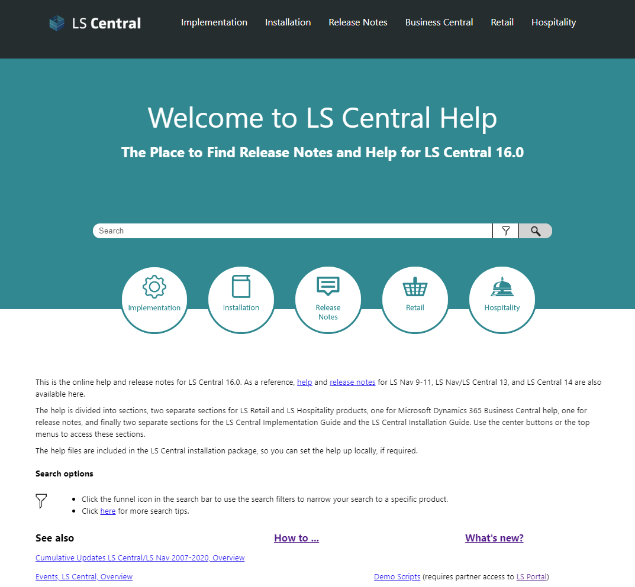
There is some information out there
Notes:
Just for warming up, then there is actually some information available

Slide 6
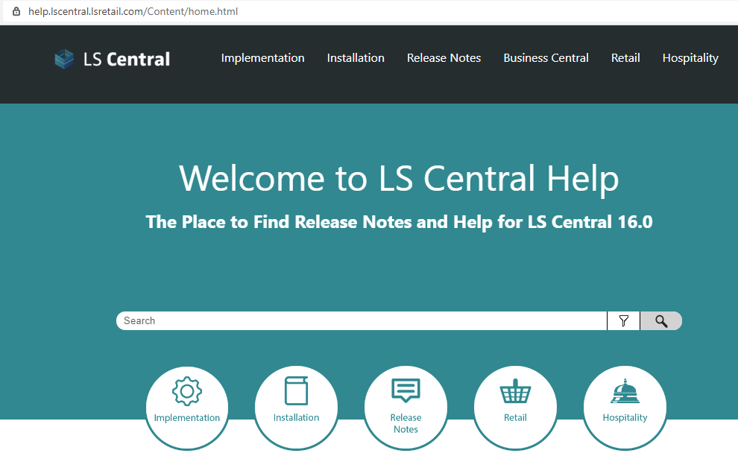
LS Central Help
Everyone are or should be familiar with our online Help
https://help.lscentral.lsretail.com/Content/home.html
You can use our URL, or install the help locally at client side
Notes:
All of you know and actively use our online help. You know also, you can refer directly to it from client installation or install the help locally

Slide 7
LS Central Help
But had you noticed this new thing? Implementation in the menu
Notes:
But had you noticed this new thing there?

Slide 8
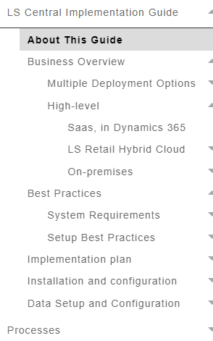
LS Central Implementation Guide
Work In Progress, but already useful guide
Best Practices for Deployment
Architecture
System Requirements
Basic Business Processes
Solution Walk Around
See more info from our prior Webinar
  https://portal.lsretail.com/Marketing/Webinars
  https://youtu.be/tw4hXsi8304
Notes:
It is WIP but here we are gathering wealth of information and best practices. Including with some info on Architecture and System Requirements. Application introductions – or Walk Around as we call it – as well as basic business process review

Slide 9
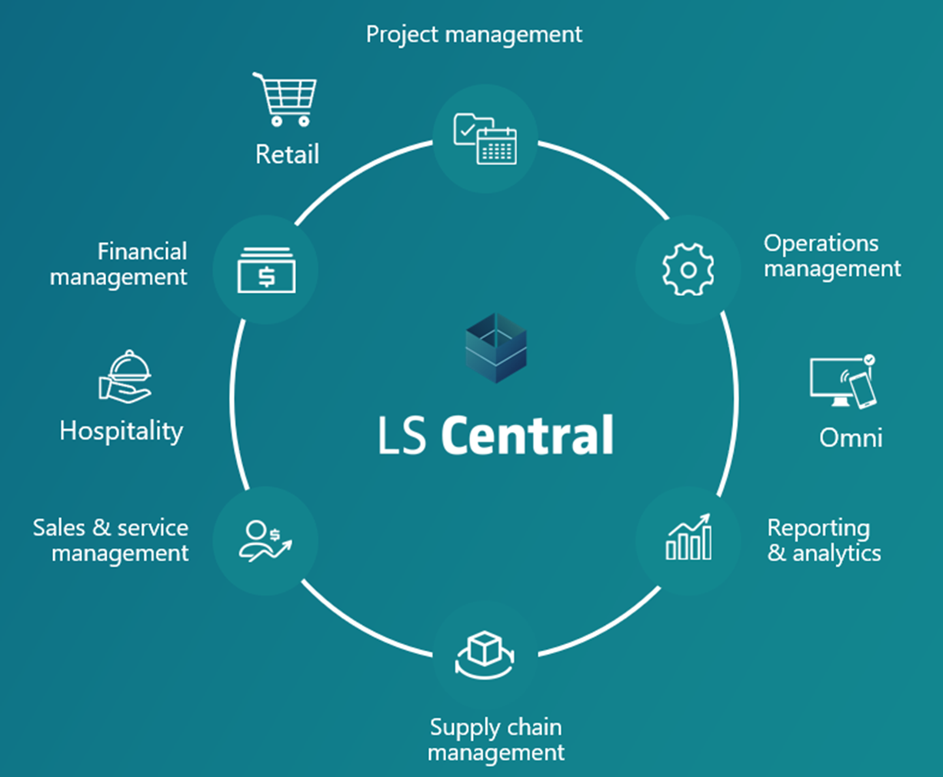
Back to Solution Architecture
Notes:
Then to get us back on track

Slide 10
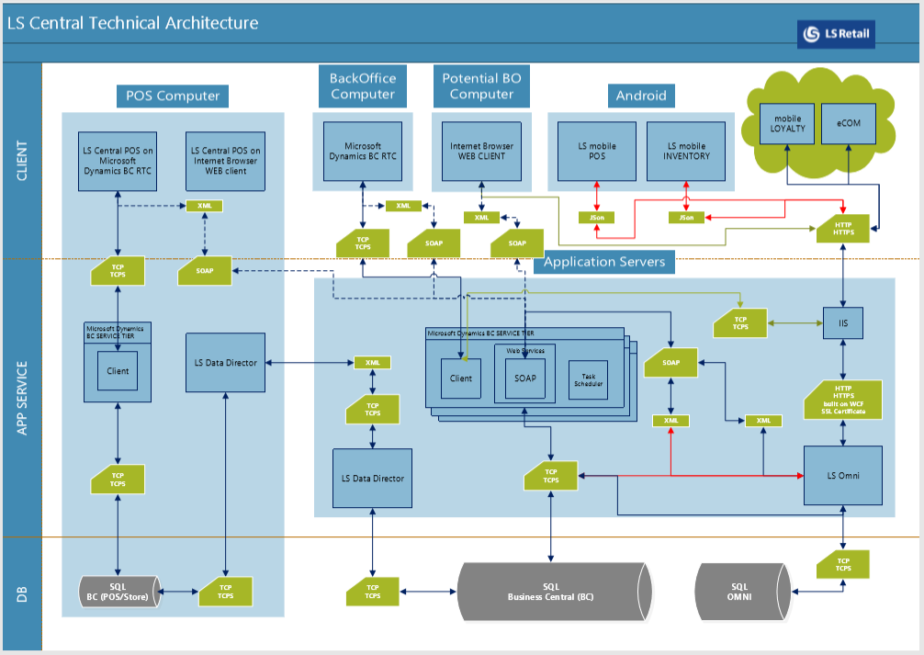
What options are there?
Cloud HQ
  SaaS
Cloud HQ and offline POSs
  SaaS and Hybrid Cloud Component Server (HCCS)
On-Prem HQ
  Azure / AWS / Datacenter / Hosting service
  Own hardware in the basement
More?
  Store Server
  Resilient POS
  LS Omni, Hardware Station, KDS …
Notes:
Regarding Solution Architecture, what options do we have…
Cloud or SaaS
OnPrem – and note that hosed on Azure or in Datacenter, is by Microsoft definition On-Prem installation
Then there are other things to look into … but all of these we are going to try to cover in this webinar

Slide 11
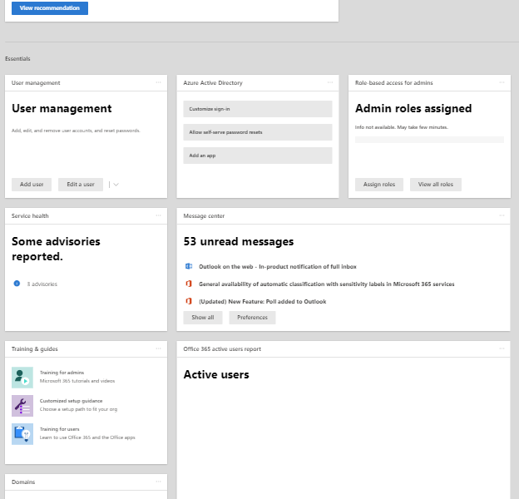
In the Cloud/SaaS
…or SaaS with Hybrid
Notes:
We will start with the Cloud and then add the HCCS / Hybrid option to that scenario

Slide 12
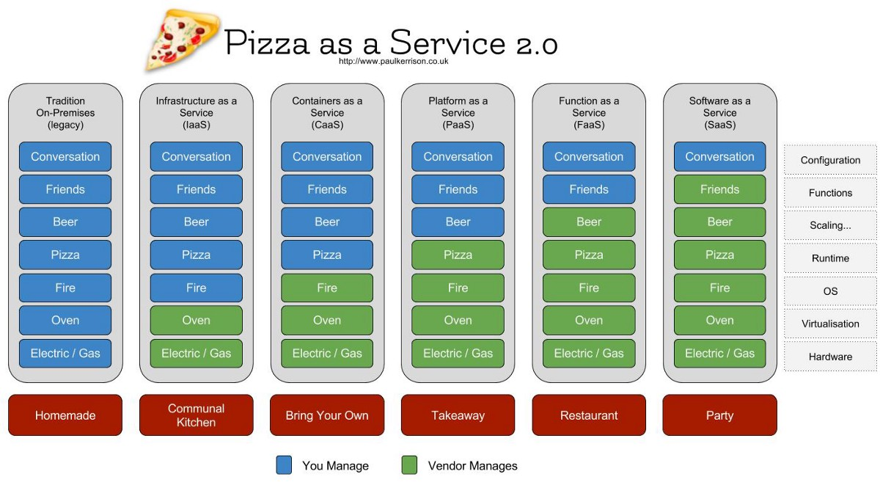
What is all this …aaS?
Notes:
But what are these aaS’s?
Sometimes, it has been difficult to explain – but I have found the Pizza approach most successful. Using this, everyone can relate
It is not my picture, but still good
You have the Homemade Pizza fanatic far left – that is the On-Prem guy that wants to have full control. Own Infrastructure – hardware, own Container – operating system/resources, own Platform etc.
And then, far right you have the guy that just meets up for a party to chat with people. He did not bring anything with him, everything is provided – that is, he just adopts and configures SaaS and uses it.

Slide 13
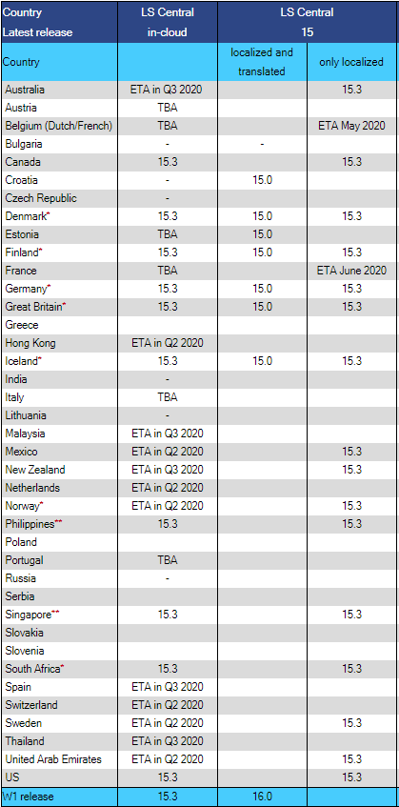
LS SaaS
First it would be availability
Then is localization needed
LS SaaS is provided based on demand and readiness
See info from our SaaS Webinar
  https://portal.lsretail.com/Marketing/Webinars
  https://youtu.be/Mq--O9BL5Zs
https://portal.lsretail.com/Products/LS-Nav/Downloads/Localization
Notes:
Basically LS SaaS is available where there is demand and we along with our partner make sure it is ready or localized
Some localizations we handle directly, but others are provided by partner
Last week we had a webinar on SaaS specifically and here I have included links to it, accessible for our partners.

Slide 14


















LS Central SaaS country availability
Denmark (DK)
Great Britain (GB)
South Africa (ZA)
Available now
Iceland (IS)
Canada (CA)
United States (US)
Finland (FI)
Philippines (PH)
Germany (DE)
Singapore (SG)
Australia (AU)
New Zealand (NZ)
Sweden (SE)
Available soon
Hong Kong (HK)
Norway (NO)
UAE (AE)
Mexico (MX)
Spain (ES)
More information: https://portal.lsretail.com/Products/LS-Nav/Downloads/Localization
Notes:
Touching on current status and readiness, then we are up and running in 10 countries with 8 others nearly finished – potentially only waiting for clients
If the partners need support in the SaaS process, we both provide guidance and support from our development department as well as our consulting can take on migration projects – either supporting the partner or performing the whole migration

Slide 15


LS Central SaaS Architecture
Head Office in cloud
Online POS
Notes:
How would pure SaaS architecture look like?
Online POS, only running browser. And all back-office users as well – although they are not shown on the picture
There is nothing more to talk about, smile and relax!
But this would potentially only fit for very small retailer … and a simple one … even non-existing client!
Don’t they need resiliency?

Slide 16

LS Central SaaS Architecture
Head Office in cloud
Hybrid Cloud
Component Server
Offline
Store Server
Online POS
Offline POS
Online or Offline POS
with store server
Notes:
… then this would be more like it. Here we have introduced the HCCS, which the customer would need to host on-prem either in Azure or own hardware somewhere.
And we have introduced resilient POS, running fully offline or e.g. restaurant running POS clients against store or restaurant server. We can lose network connection to the cloud and still sell our merchandize
But does this then cover it? No….it does not

Slide 17



LS Central SaaS Architecture
eCommerce / mobile Loyalty
Head Office in cloud
LS Omni / IIS
Hybrid Cloud
Component Server
Hardware
Station
Offline
Store Server
KDS
Hardware
Station
Hardware
Station
Mobile Inventory
Online POS
Offline POS
Online or Offline POS
with store server
Notes:
We forgot peripherals … they are needed. You want to print receipts, might have barcode scanner, use the MSR and how about your electronic payment solution or LS Pay? … then we need Hardware Station installed On-Prem.
Next how about mobile Inventory for some stock processes? We surely want to do stock takes and receiving at least. That adds LS Omni along with the needed IIS
If this is restaurant, KDS and some Display stations might be needed
And today it might be all about eCommerce and Loyalty which also requires LS Omni

Slide 18
LS Central SaaS Architecture
eCommerce / mobile Loyalty
Head Office in cloud
LS Omni / IIS
Hybrid Cloud
Component Server
Hardware
Station
Offline
Store Server
KDS
Hardware
Station
Hardware
Station
Mobile Inventory
Online POS
Offline POS
Online or Offline POS
with store server
Notes:
So this is the picture … pink/red is on-prem, but we are still running LS SaaS. That is, our HQ is in the cloud and all the users connect to the cloud for their work.
And I really hope I am not scaring you with this slide, as that was not the intention.
LS SaaS is really a viable option and really good fit for certain retailers.

Slide 19
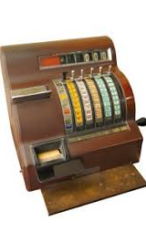
Conclusion in words
You can have your BO users and POSs connected to your SaaS but…
Hardware Station is needed
  if you have any peripherals on the POS
    HWS is installed on the POS if the peripherals are directly connected to the POS hardware
    or can be installed on central computer on the LAN,
    if the peripherals are network connected
LS Omni service is needed if you have…
  Mobile Inventory
  eCommerce
KDS also needs to be installed locally
LS Central APP on the other hand connects to SaaS
Notes:
Just in words, to emphasize what we have seen
The LS Central APP connects directly to the Service Tier – it wraps the web client in and gives access to peripherals via Bluetooth or WiFi.
And for SaaS, I am not going to talk about the second aspect of the webinar: “What do we need to run those Services”. As for SaaS you do not need anything. You need it for your On-Prem setups, either being part of HCCS or pure On-Prem

Slide 20
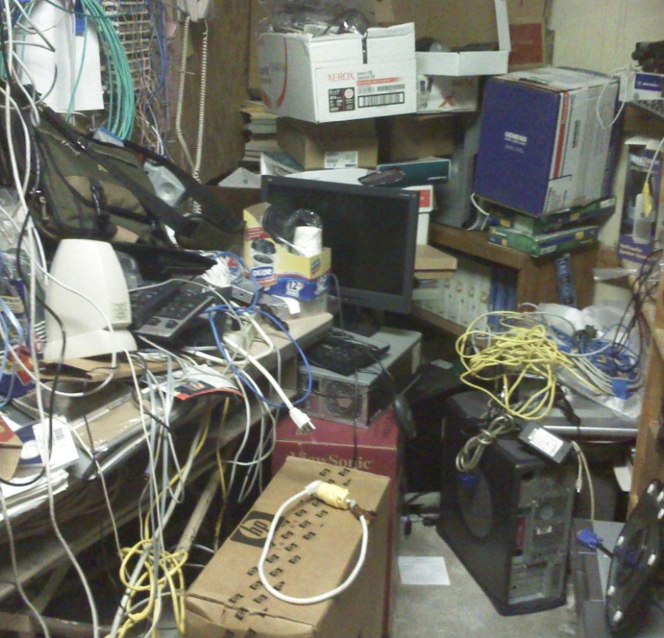
OnPrem

Slide 21
LS Central SaaS Architecture
eCommerce / mobile Loyalty
Head Office in cloud
LS Omni / IIS
Hybrid Cloud
Component Server
Hardware
Station
Offline
Store Server
KDS
Hardware
Station
Hardware
Station
Mobile Inventory
Online POS
Offline POS
Online or Offline POS
with store server
Notes:
Do you remember this slide? We probably can re-use this for On-Prem installation
Just replace the header, remove the HCCS and simplify the connection lines

Slide 22
LS Central
On-Prem Architecture
SaaS Architecture
eCommerce / mobile Loyalty
Head Office in cloud
Head Office On-Prem
LS Omni / IIS
Hybrid Cloud
Component Server
Hardware
Station
Offline
Store Server
KDS
Hardware
Station
Hardware
Station
Mobile Inventory
Online POS
Offline POS
Online or Offline POS
with store server
Notes:
Do you remember this slide? We probably can re-use this for On-Prem installation
Just replace the header, remove the HCCS and simplify the connection lines
The Head Office On-Prem can be hosted on Azure or kept in the basement.
We are not showing the Data Directory, should have been on all the diagrams as there should be one installed minimum on every LAN
The HCCS is gone, but more or less this looks the same. It is not more complicated that this.
But this leaves out the second topic … What is needed to Run these Services?

Slide 23

Solution Architect
…sizing and …?
Notes:
But this leaves out the second topic … What is needed to Run these Services?
This will be addressed in the next few slides

Slide 24
Doing things right…
Choose the right hardware for each Tier
  CPU
  Disks
  RAM
Do not just always use “default” installation of software
  Microsoft SQL Server
  Microsoft Dynamics 365 Business Central Service Tier
  LS Retail’s
    LS Hybrid Cloud Component Server
    GoCurrent
    Hardware Station
    Data Director
    LS Omni
Notes:
The most important is choosing the right setup and then configuring the software to utilizing that setup as well as possible.
Here are so many options we cannot give a plain answer. But we can generalize to certain extend
And when it comes to software installation, Install – Next – Next – Finish does not necessarily give optimal setup, or never does!
The SQL server needs nurturing and needs to be aligned with it is running Business Central
The BC Service Tier can be scaled-out
And finally are the LS Retail components – which potentially need the least attention of these

Slide 25
Doing things right…
What kind of client / installation do we have?
  Small client, few users, little load
    all in one server
  Small to Medium client, more users
    split SQL and Service Tier
  Medium client
    scale up
  Medium+ client
    scale out
  What to look for
    Concurrent users
    Integrations
    Data
Notes:
And the Solution Architecture and Environment needs to be based on the client being deployed. What kind of load are we expecting, how many concurrent users, how does peak hour look like, are there integrations that affect performance etc.
When to we settle on 1 server, potentially scale it up a little. When do we need to split different services on different machines. What calls for scaling the SQL out (multiple SQL databases or SQL Cluster), and when do we scale the service tier out.
The BC Service Tier is normally scaled out way before there is any need to do anything with the SQL Server.
Is it viable to split service and / or will we benefit from using Load Balancer
And what do I mean by Small, Medium and Medium+ clients? Absolutely nothing, it is just words to distinguish between something.
A client with 2 stores and 5 POSs can be Medium++ while another client with 50 stores and 80 POSs is small. It is complexity of all parameters, concurrent users, reporting usage, data quantity, size and flow and integrations … and probably some more.
The number uses here are not fabrication – I have actual example that fit this, live clients.

Slide 26
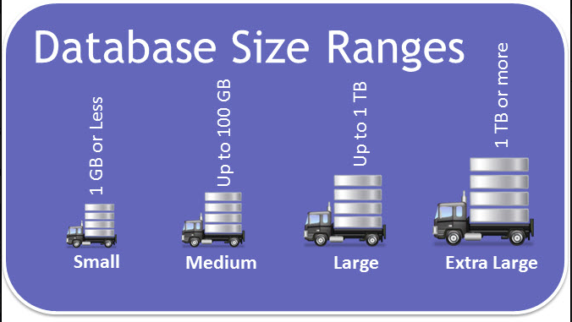
Microsoft SQL Server
Needs RAM … then more RAM
Premium SSD, nothing less
  DATA and LOG should not be on same physical drive, P10/P15… on Azure
  OS on another drive
Configuration
  Distribute database files correctly
  Watch out for file growth
  Allocate RAM
  Server and DB Collation
  MaxDOP and CTfP
Housekeeping
  DBCC_CHECKDB
  Index maintenance
  VLFs
Notes:
Just a note … the picture is from 2013
The SQL Server is probably the most significant part of the solution, what can have biggest impact performance in both good and bad way. That is given the assumption your wires are hanging ok together and your routers not in deep water.
Reviewing live installations around the world, has been eye-opener for me – in a bad way. Way too many installations are not using hardware configuration that suit SQL server – lack of RAM or mechanical drives.
Do you know what Microsoft states on their Azure website for Standard SSD? “Web servers, lightly used enterprise applications and dev/test”
What about mechanical HDD? “Backup, non-critical, infrequent access”
Still we are seeing both used for retail systems, that are almost always considered high volume performance sensitive installations.
And that is not addressing that DATA and LOG should never reside on the same physical drive.
Max Degree of Parallelism
Cost Threshold For Parallelism
Housekeeping
Not only backups
Virtual Log Files

Slide 27

How about the database itself?
Housekeeping
LS Central log tables
Business Central Log Tables
Archive Transactions
Common sense
Change Log
SQL Change Tracking
Obsolete tables
“Test” Companies
Notes:
But with the right hardware and properly installed and maintained SQL server – we are not home yet.
Inside the LS Central database, there is housekeeping needed.
Clean up the LOG files
Do not use Change log or SQL Change Tracking – unless you are sure you want, and accept the performance loss
Don’t fill the database, or the SQL server with databases, that are for test purposes.
And in performance sensitive environments – take these to separate test server.

Slide 28
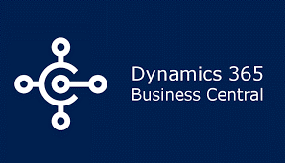
Microsoft Dynamics 365 Business Central
CPU demanding
faster is better
RAM
How much is enough?
Parameters like Data Cache Size
Scale Up
More CPU and faster CPU
and Scale Out
More service tiers
More VMs
Notes:
Then we are arrived and the next layer – the Service Tier
Where the SQL hungers for RAM and fast disk system, the service tier starts with the CPU.
RAM is also important but is more based on what you have done with Data Cache Size and then number of concurrent users and the processes they are running.
The Service Tier, we often see more benefits when scaling out – adding service tiers or even new VMs with additional service tiers – than scaling up – which is adding CPU, faster CPU, more RAM etc.
Isolating the service tiers, also gives meaning. Especially if you are on Azure, where you can choose to spin the service tiers up only when needed during peak days.

Slide 29
Scaling Business Central
On compute (Business Central Server and Web servers), it's possible to scale horizontally by separating Business Central Server instances and Web servers on different nodes.
It's also common on larger installations to separate traffic based on client type (direct UI and OData traffic to different Business Central Server instances); possibly cohosting Business Central Server instances and Web servers on the same nodes.
The Business Central Server has a built-in thread dispatcher for AL execution. If you have more cores available, then the dispatcher allows for more parallel execution. But keep in mind that AL execution is single-threaded until the Business Central 2019 release wave 2 (when we introduced async processing). For long running operations, such as heavy reports, using faster CPUs will give better performance.
On the database side, make sure SQL Server has enough resources for sessions (both CPU and memory) and try to optimize the setup of SQL Server to Business Central
https://docs.microsoft.com/en-us/dynamics365/business-central/dev-itpro/performance/performance-onprem
Notes:
I copied this directly from Microsoft … I think they added this like a month ago, but this fits really well with what we have been preaching the last months or years.
Scale Horizontally – or Scale Out
Separate traffic
And nurture your SQL server

Slide 30
Conclusion
Number 1, 2 and 3 is configuring the applications properly, then…
SQL
  Plenty of RAM and use Premium SSDs
  Scale out if or when needed – e.g. new standard Read-Scale Out option
  Of course CPU as well
Service tier
  CPU / cores
  Multiple Service Tiers
  Additional VMs for additional Service tiers to cope with peak loads
    Azure, think about you can spin up additional VMs when needed
Other
  IIS, LS Omni, LS Data Director – normally not heavy load, can often be on either SQL or Service Tier but sometimes good to have on separate server
Network – LAN – WAN – latency – bandwidth
Notes:
Collecting this together, then the far most important part is configurating your application properly. Then choosing the right hardware resources for each task or service.

Slide 31
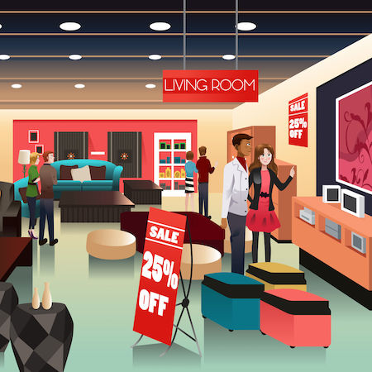
But we did not mention…
HCCS / Store Server / POS hardware!
  Check out the LS Central Implementation Guide
  There is no correct answer for all
    High Volume -maybe- Resilient POS
    Fine Dining -maybe- Store Server, POS only client
    Few transactions -maybe- Store Server or even SaaS
More Common Sense
  Don’t have TEST Service Tiers in live env.
  Don’t RDP to servers just to eat up RAM
  Use hardware resources where they are
  supposed to be used

Slide 32

Finally, I cannot emphasize enough:
State of the art Hardware will not help much
if the Software is not configured properly
… it is like buying a muscle car, but not
pumping up the tires
And state of the art Software (aka LS Central)
does not work if there are no Hardware
resources under it

Slide 33
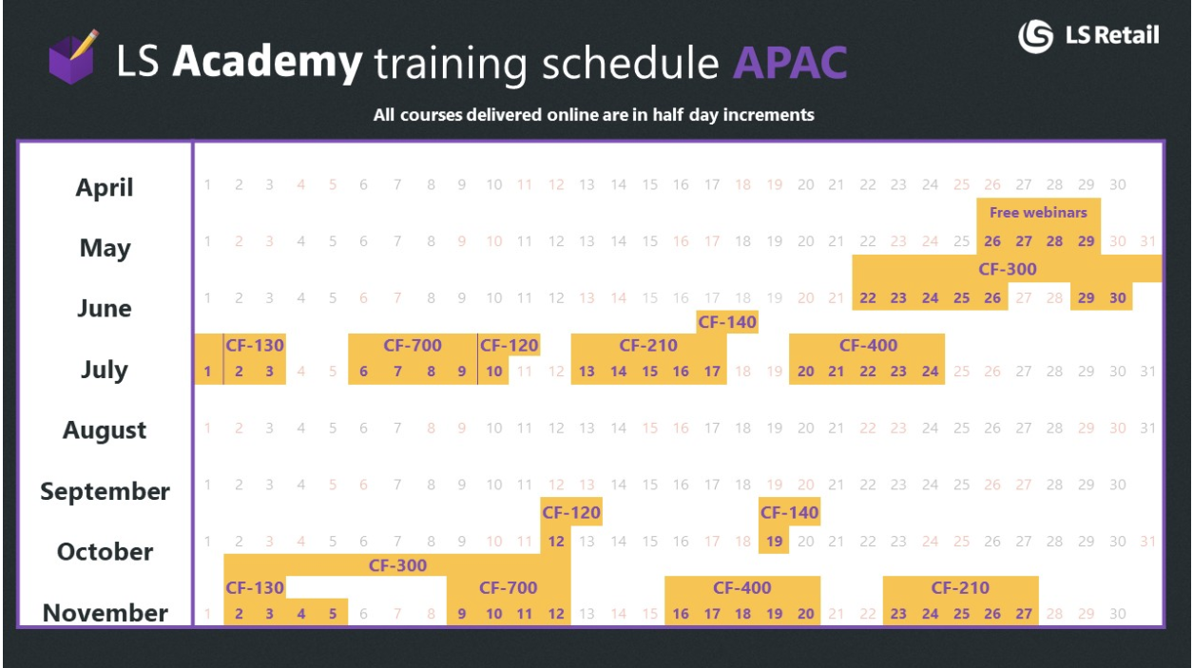
LS Academy
https://portal.lsretail.com/LS-Academy
Upcoming online trainings:
LS Central Base Training
Inventory Management
LS Activity
Solution Architecture
LS Replenishment
Member Management
LS Central Base Hospitality
Notes:
This is for registered partners only

Slide 34
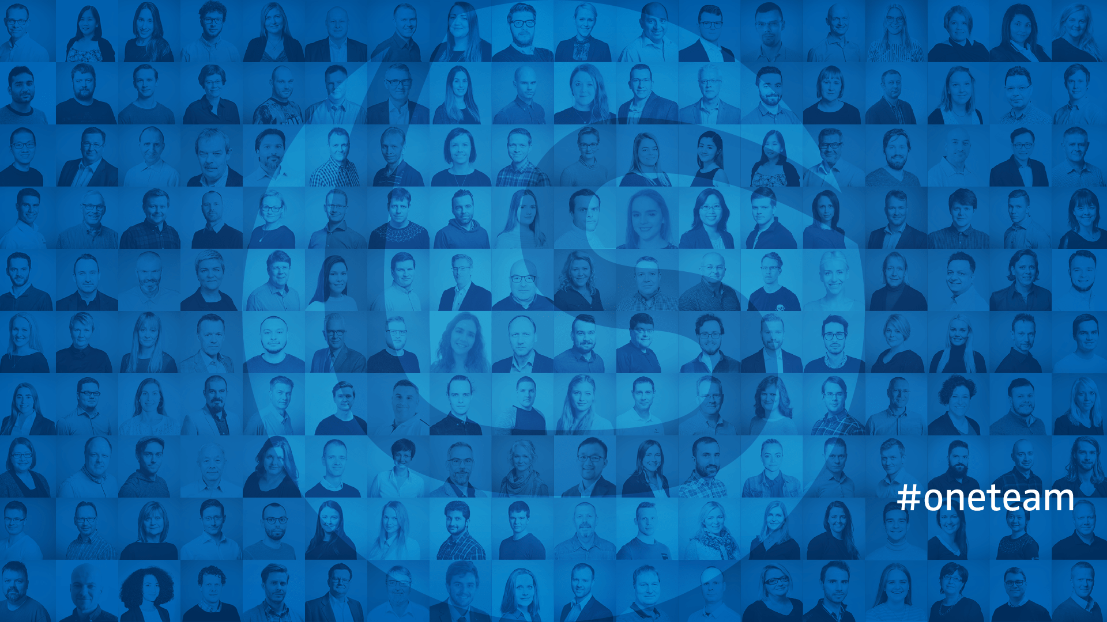
Introduction to Solution Architecture
Q&A
And if you need support, want to
audit your current installation,
seek help on sizing or Solution Architecture
- Don’t hesitate to reach out to us.

