Slide 2

How to run a thriving grocery chain with
LS Central
Sigurður Ari Sigurjónsson
VP Strategic Accounts

Slide 3

How to run a thriving grocery chain with
LS Central
Jóhann Sveinsson
Senior Consultant

Slide 4
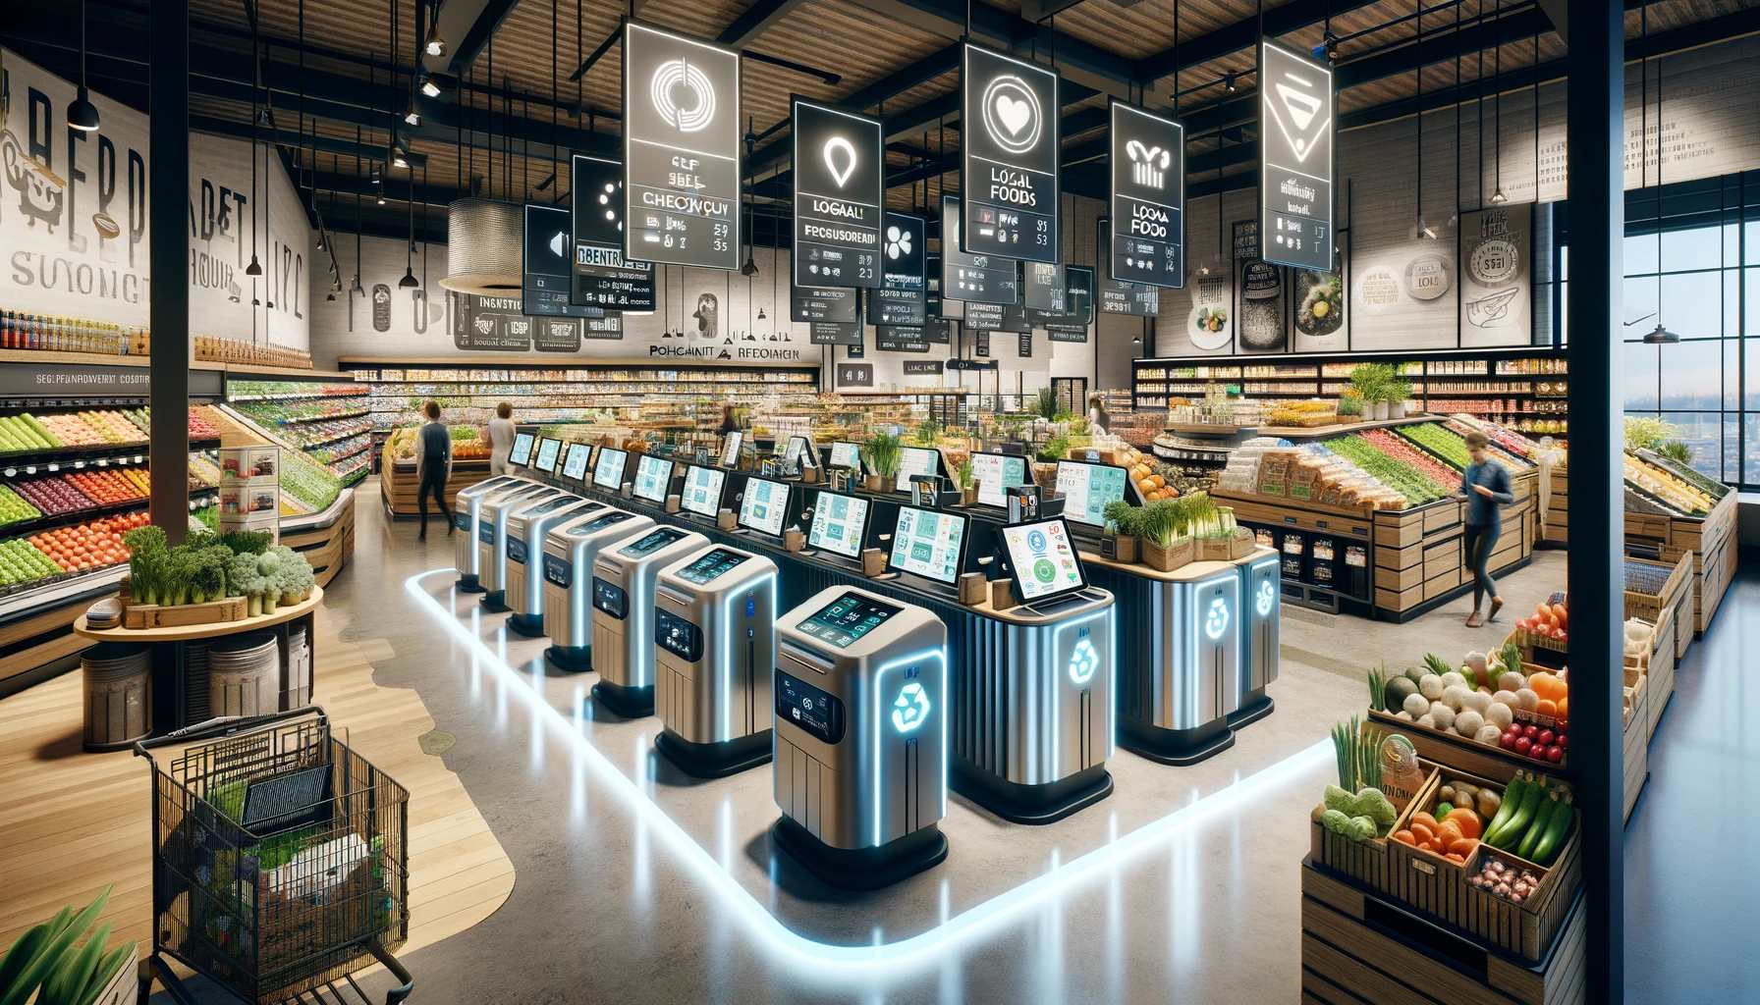

Slide 5
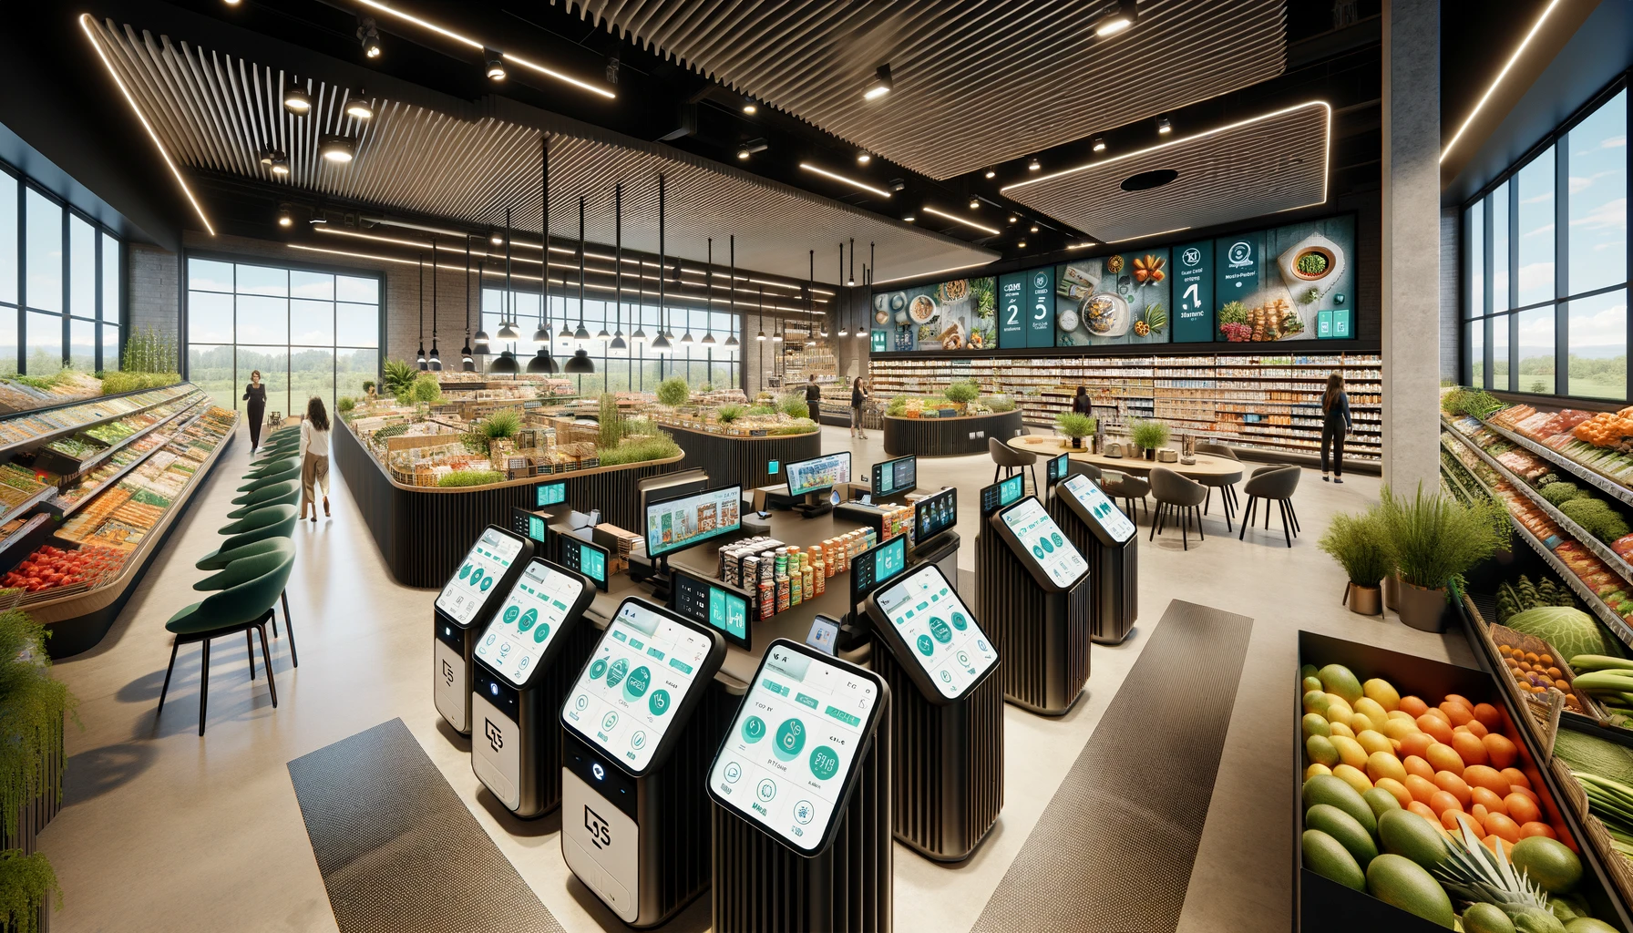

Slide 6


Slide 7


Slide 8
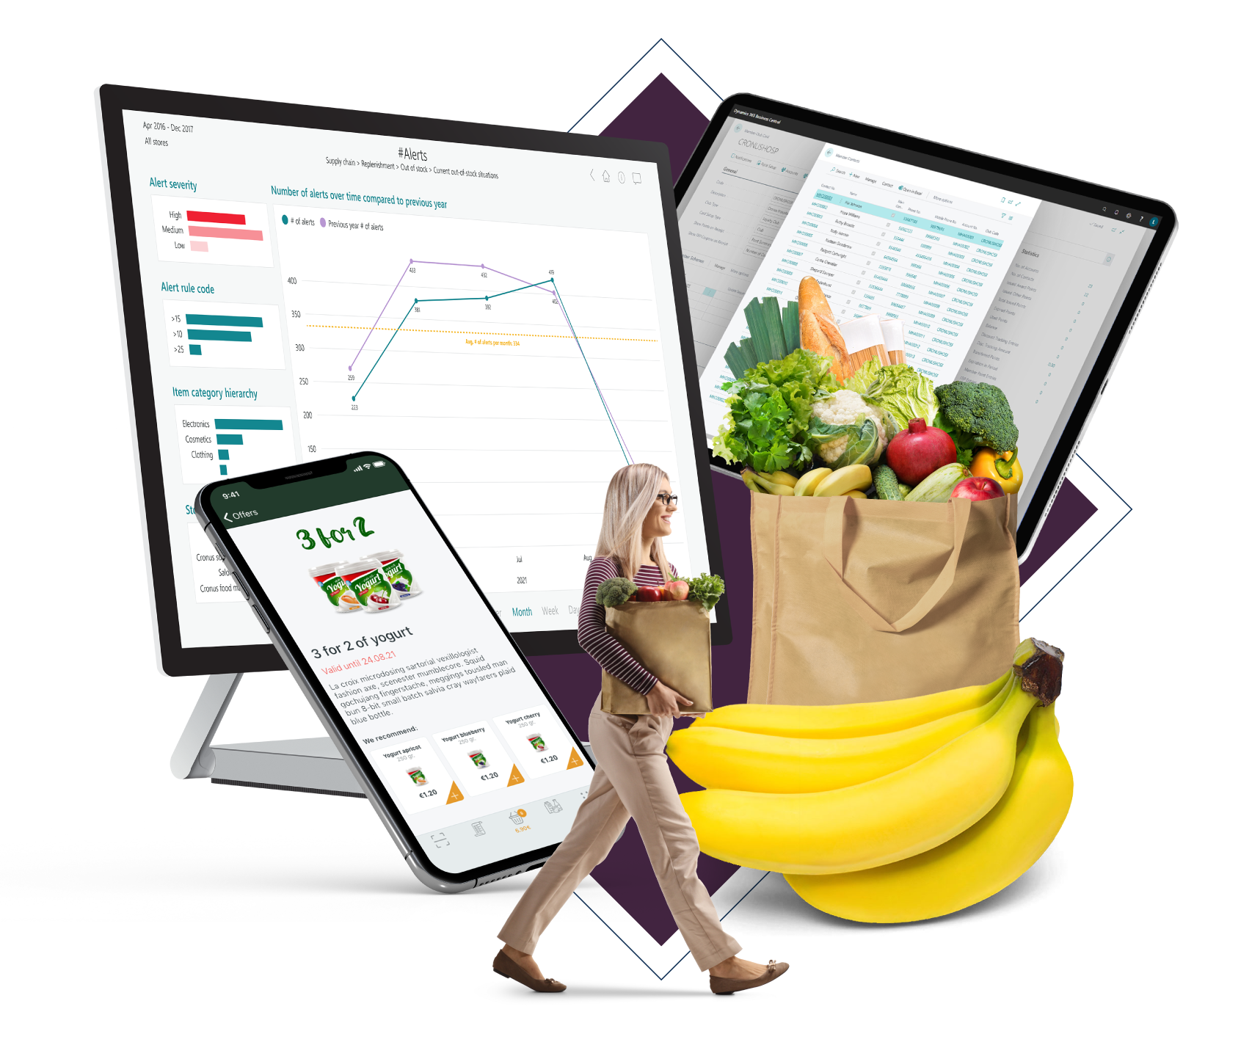
Cost control

Slide 9
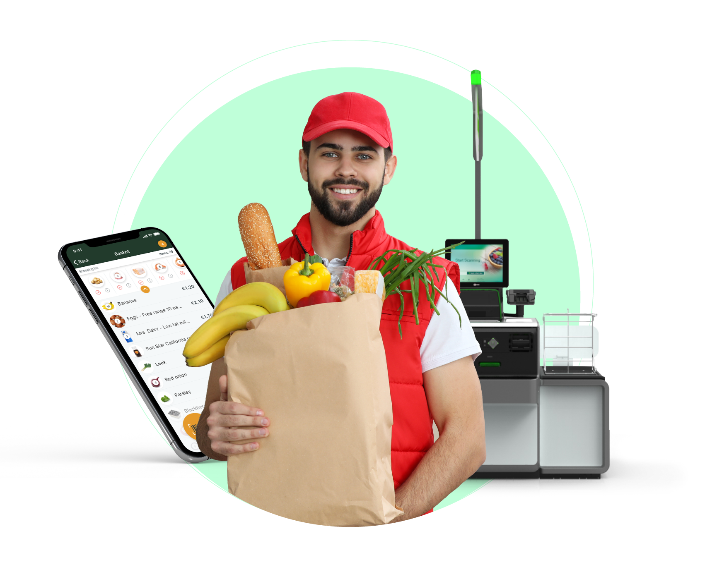
Brand and image

Slide 10
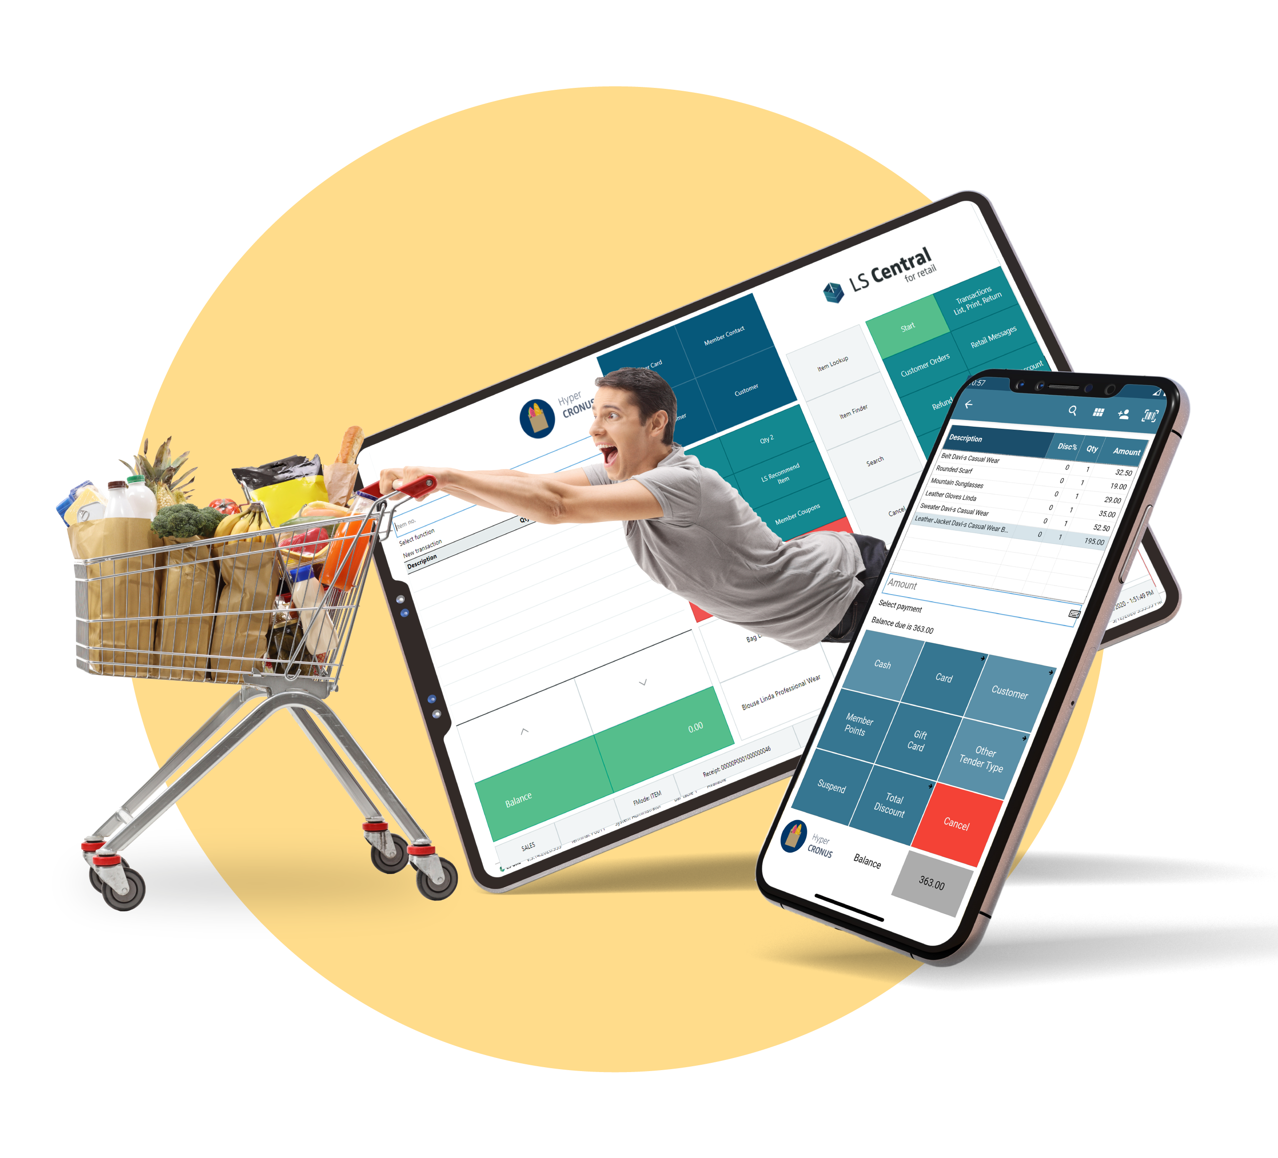
Location

Slide 11



In-store experiences

Slide 12

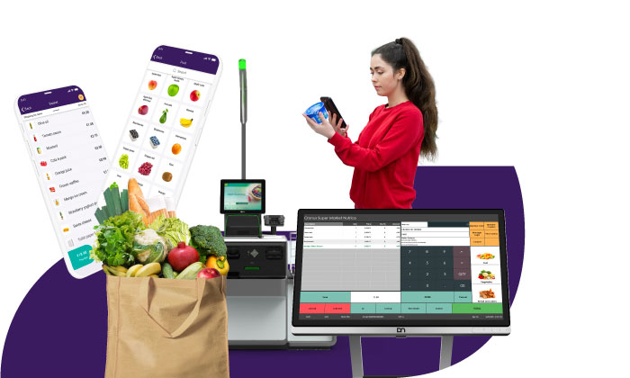
Back office
Front end
A feature rich solution for your grocery operations
HQ
Store
Warehouse mgmt.
Supplier mgmt.
Inventory mgmt.
Reporting and analytics
Multi-store with different store formats
Point of sale (POS)
Self-checkout and ScanPayGo app
Electronic shelf labels
Real-time view of stock
eCommerce integration
Scale integration
Stock mgmt. on mobile (receiving, picking, counting, labelling)
Secure payments
Commercial
Complex pricing and promotions
Loyalty programs
Sales analytics
Replenishment
Shrinkage mgmt.
Retail + deli/food service functionality
Fresh food mgmt.
Back end (ERP)
Financials
Supply chain
Accounting
Human resources

Slide 13

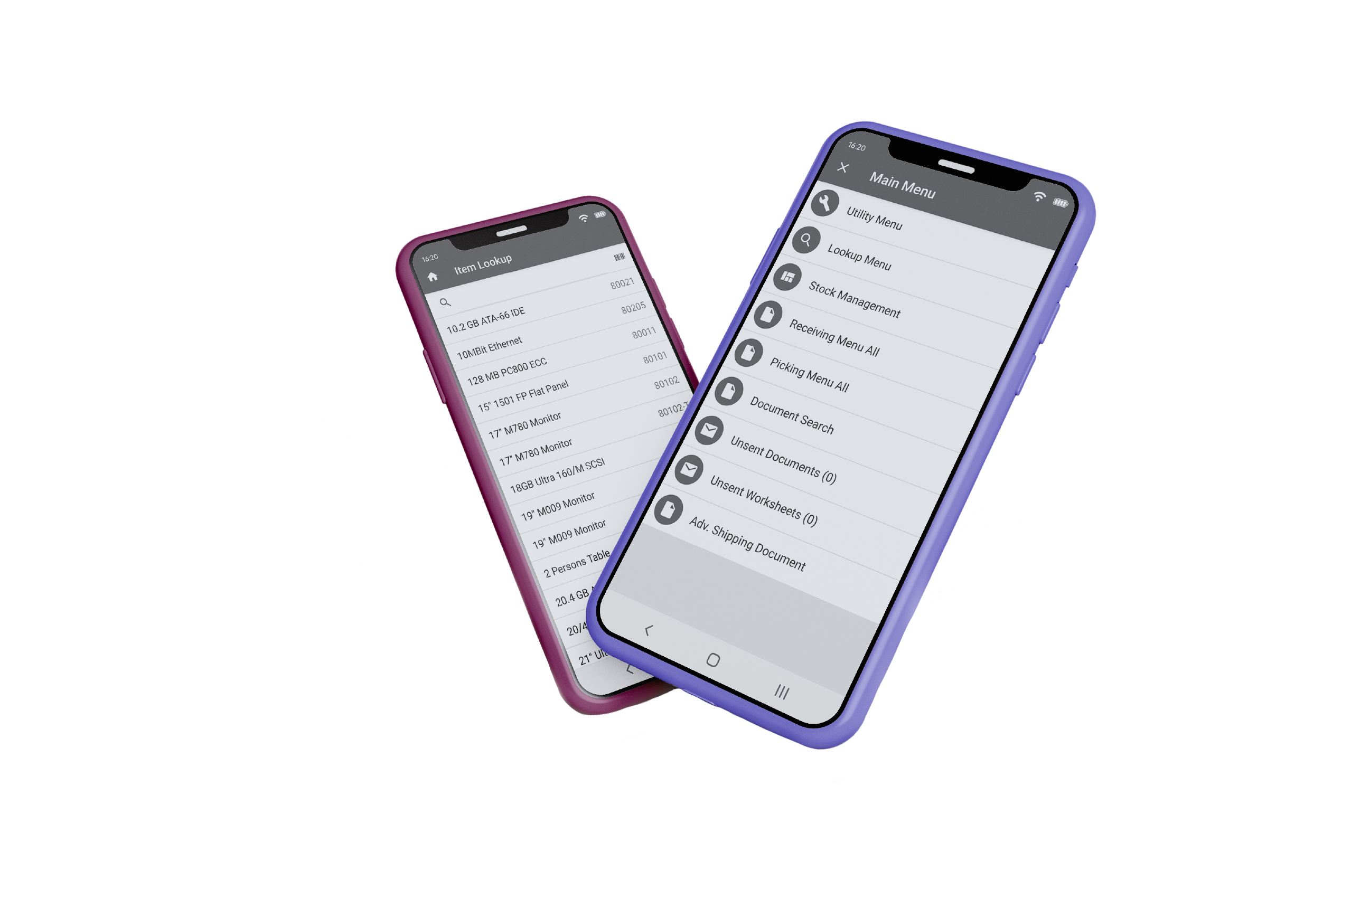

How does LS Central support this journey?
Mobile inventory

Slide 14
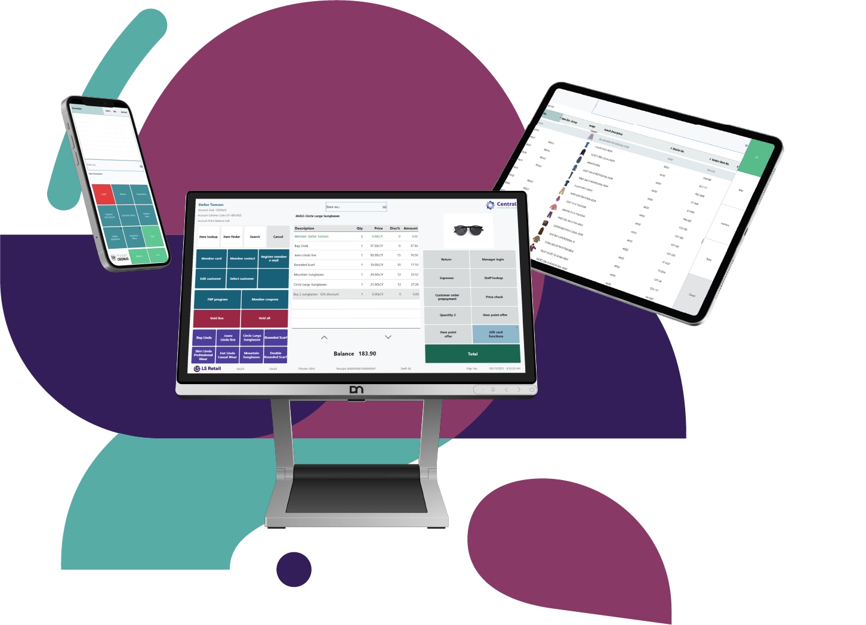
How does LS Central support this journey?
Mobile inventory
Standardized checkout

Slide 15
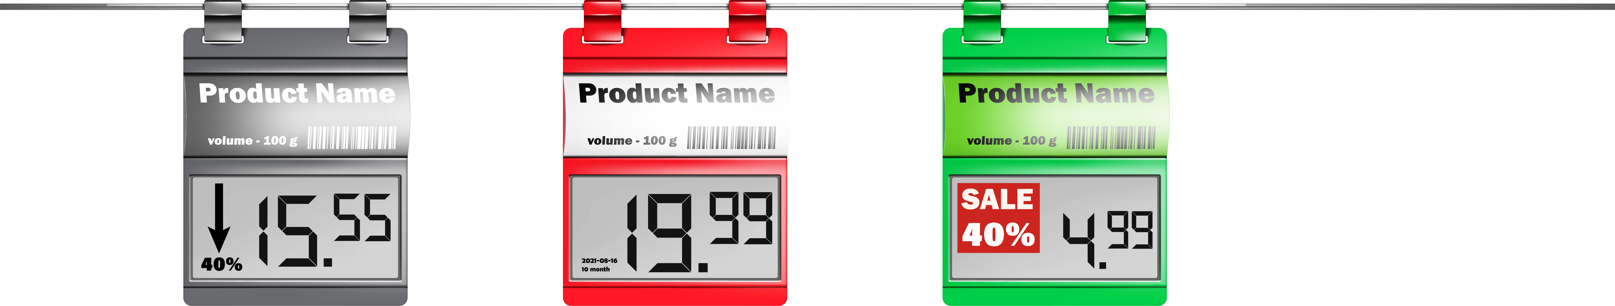
How does LS Central support this journey?
Mobile inventory
Standardized checkouts
Electronic shelf labels

Slide 16
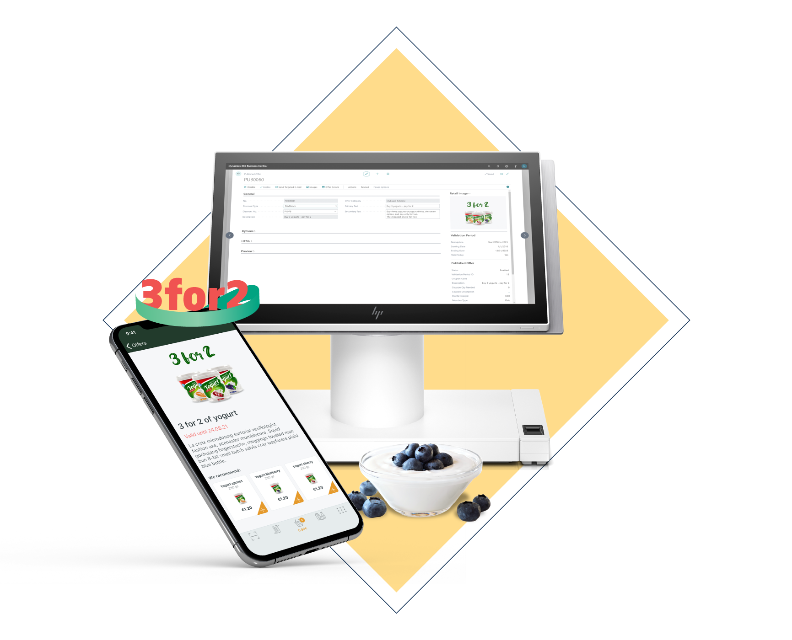
How does LS Central support this journey?
Mobile inventory
Standardized checkouts
Electronic shelf labels
Promotion engine

Slide 17

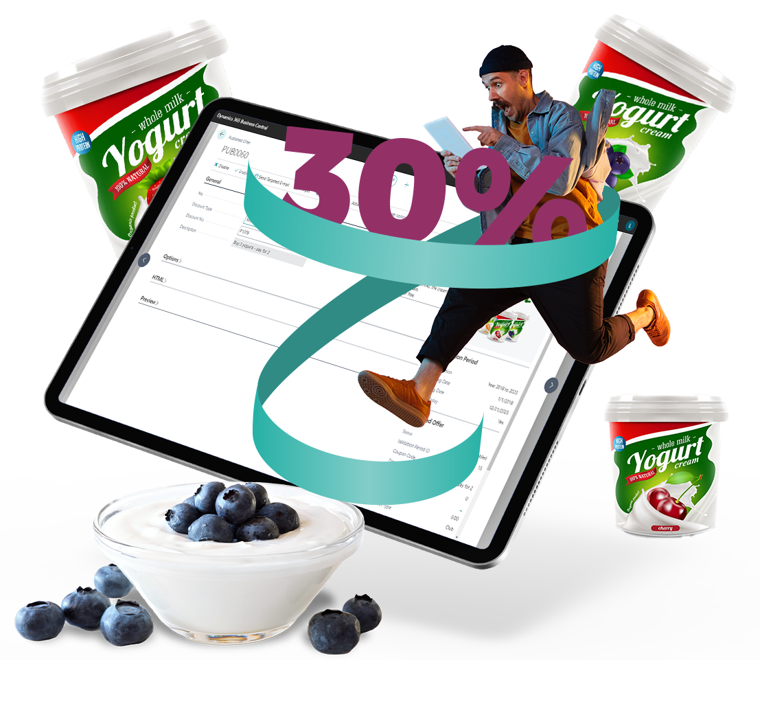
How does LS Central support this journey?
Mobile inventory
Standardized checkouts
Electronic shelf labels
Promotion engine
Loyalty Management

Slide 18

How does LS Central support this journey?
Mobile inventory
Standardized checkouts
Electronic shelf labels
Promotion engine
Loyalty Management
Robust solution – simple to support

Slide 19
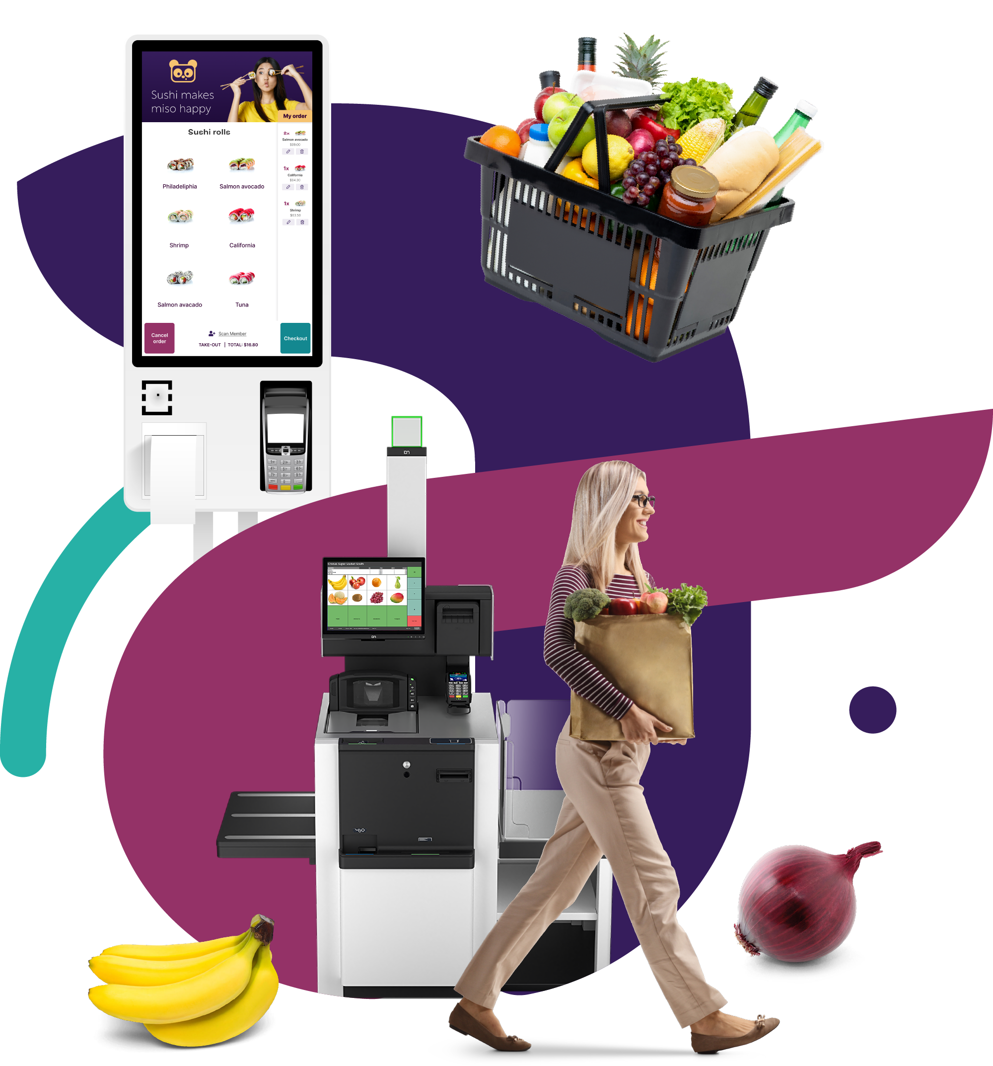
How does LS Central support this journey?
Mobile inventory
Standardized checkouts
Electronic shelf labels
Promotion engine
Loyalty Management
Robust solution – simple to support
Easy to rollout – also as hybrid

Slide 20
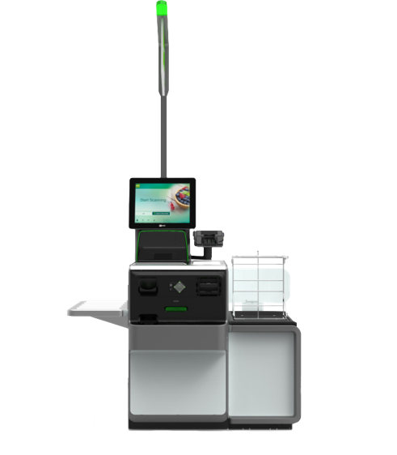
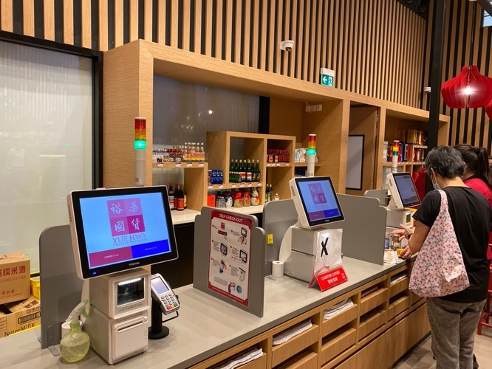
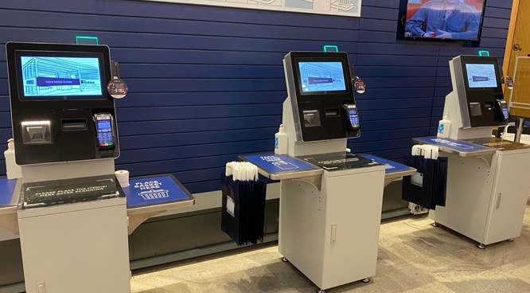
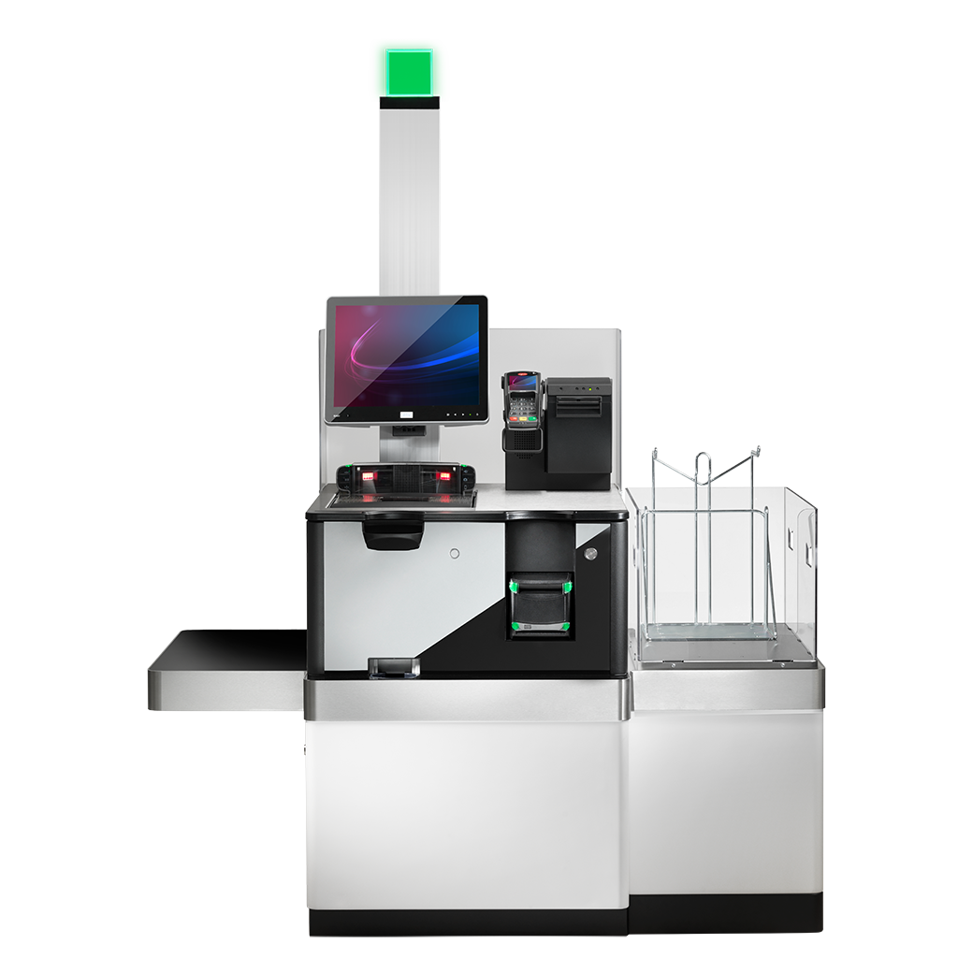

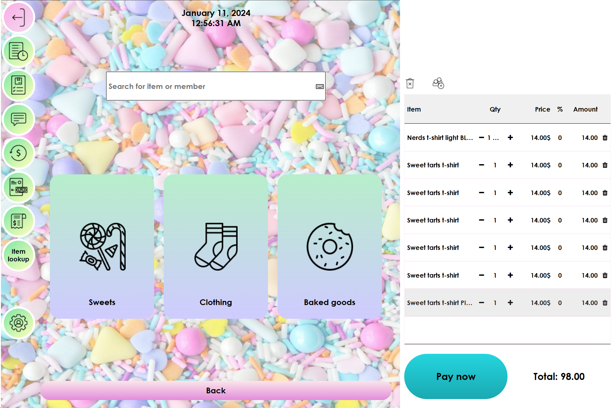
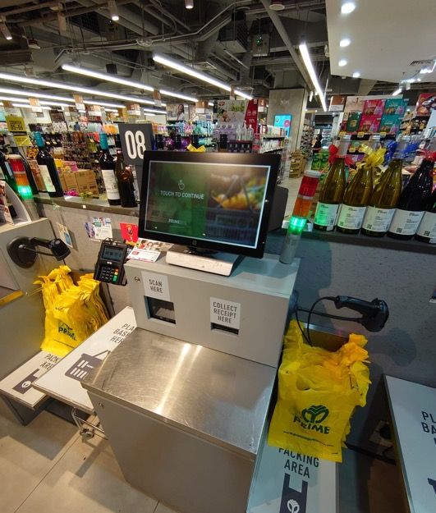
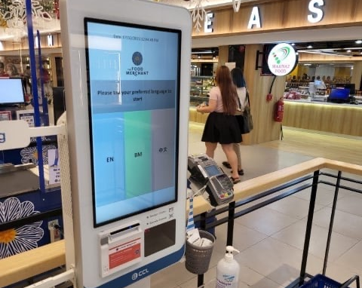
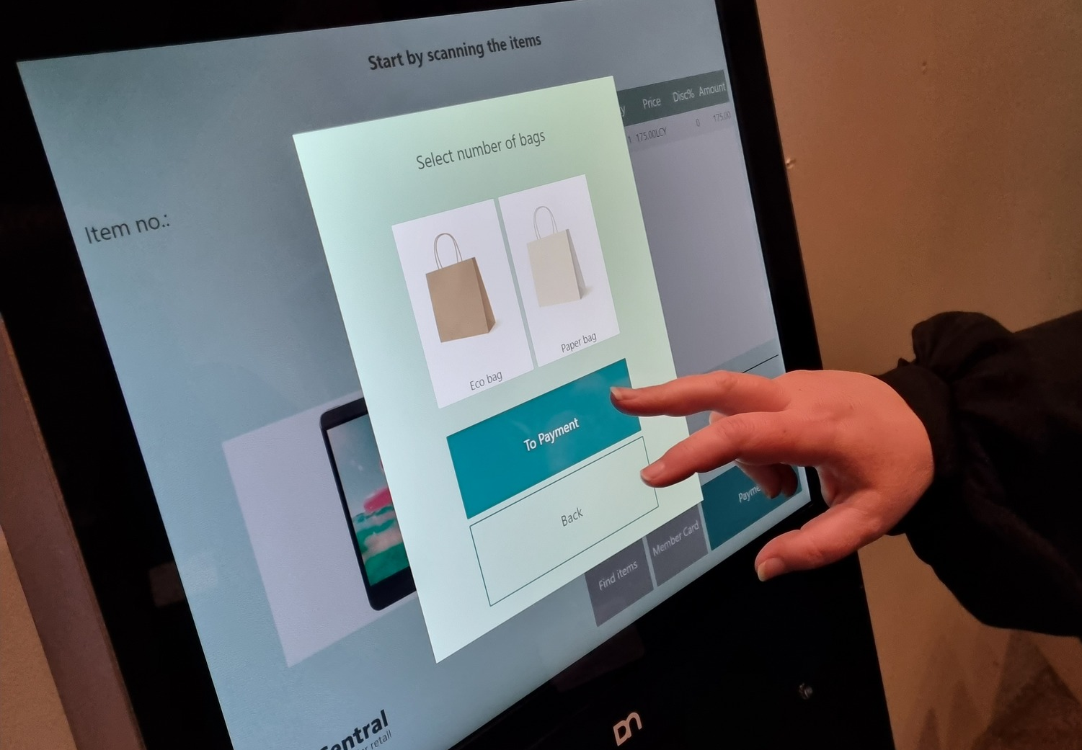
How does LS Central support this journey?
Mobile inventory
Standardized checkouts
Electronic shelf labels
Promotion engine
Loyalty Management
Robust solution – simple to support
Easy to rollout – also as hybrid
Self-checkout integrations & displays
LS Retail
SCO

Slide 21

How does LS Central support this journey?
Mobile inventory
Standardized checkouts
Electronic shelf labels
Promotion engine
Loyalty Management
Robust solution – simple to support
Easy to rollout – also as hybrid
Self-Checkout integrations & displays
One solution in the center

Slide 22
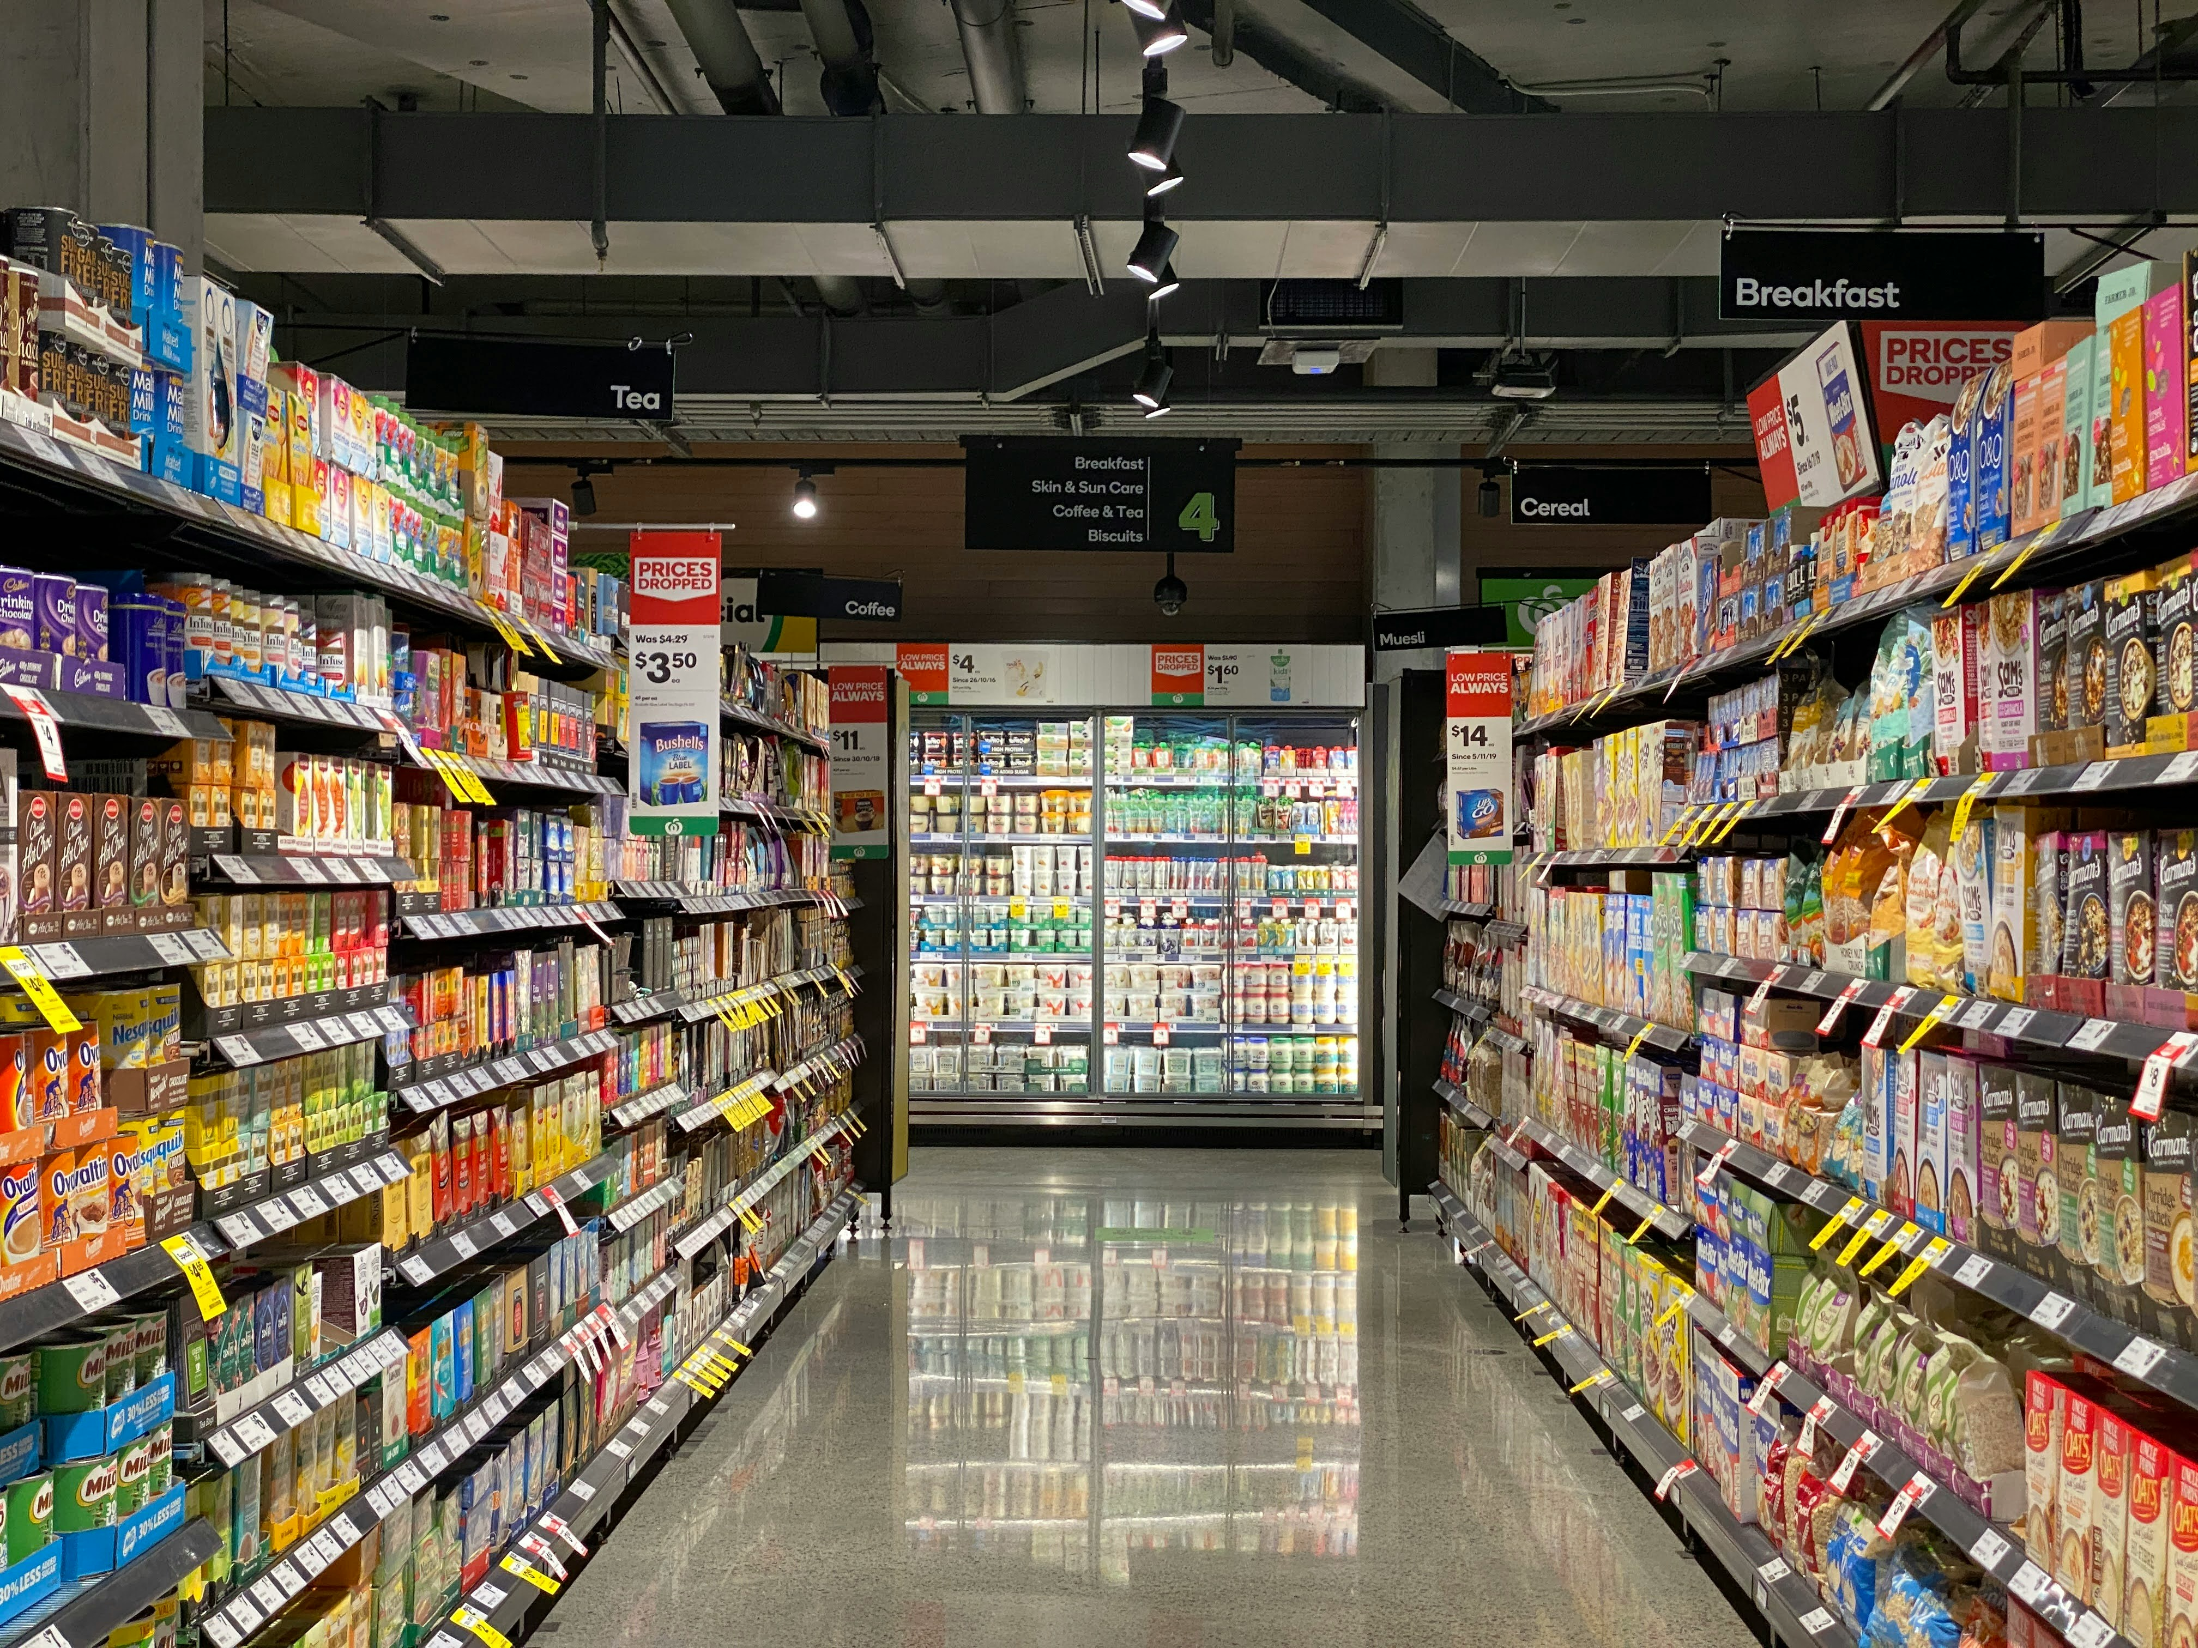

Slide 23

And where to next on our journey?
AI – help to order the right qty within the day

Slide 24

And where to next on our journey?
AI – help to order the right qty within the day
Markdown on products

Slide 25
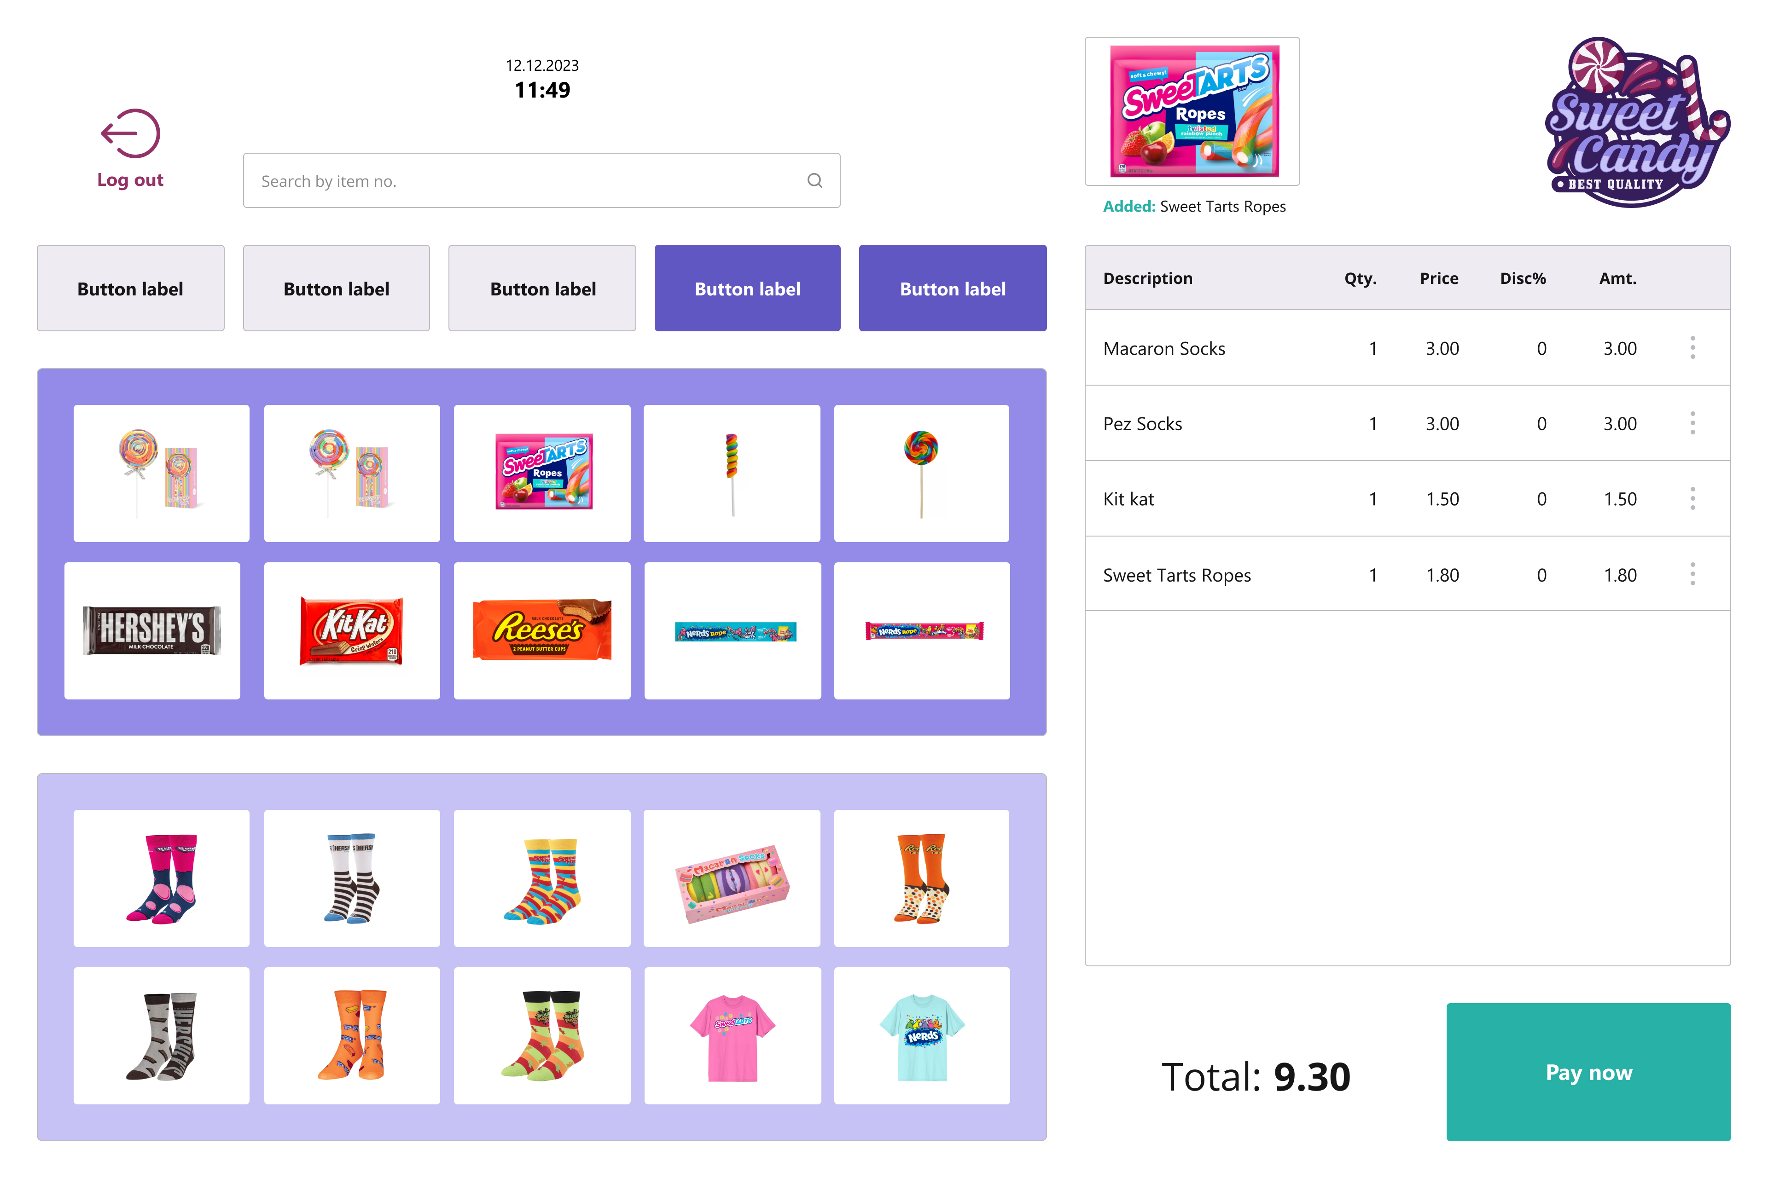
And where to next on our journey?
AI – help to order the right qty within the day
Markdown on products
Standard SCO layouts

Slide 26
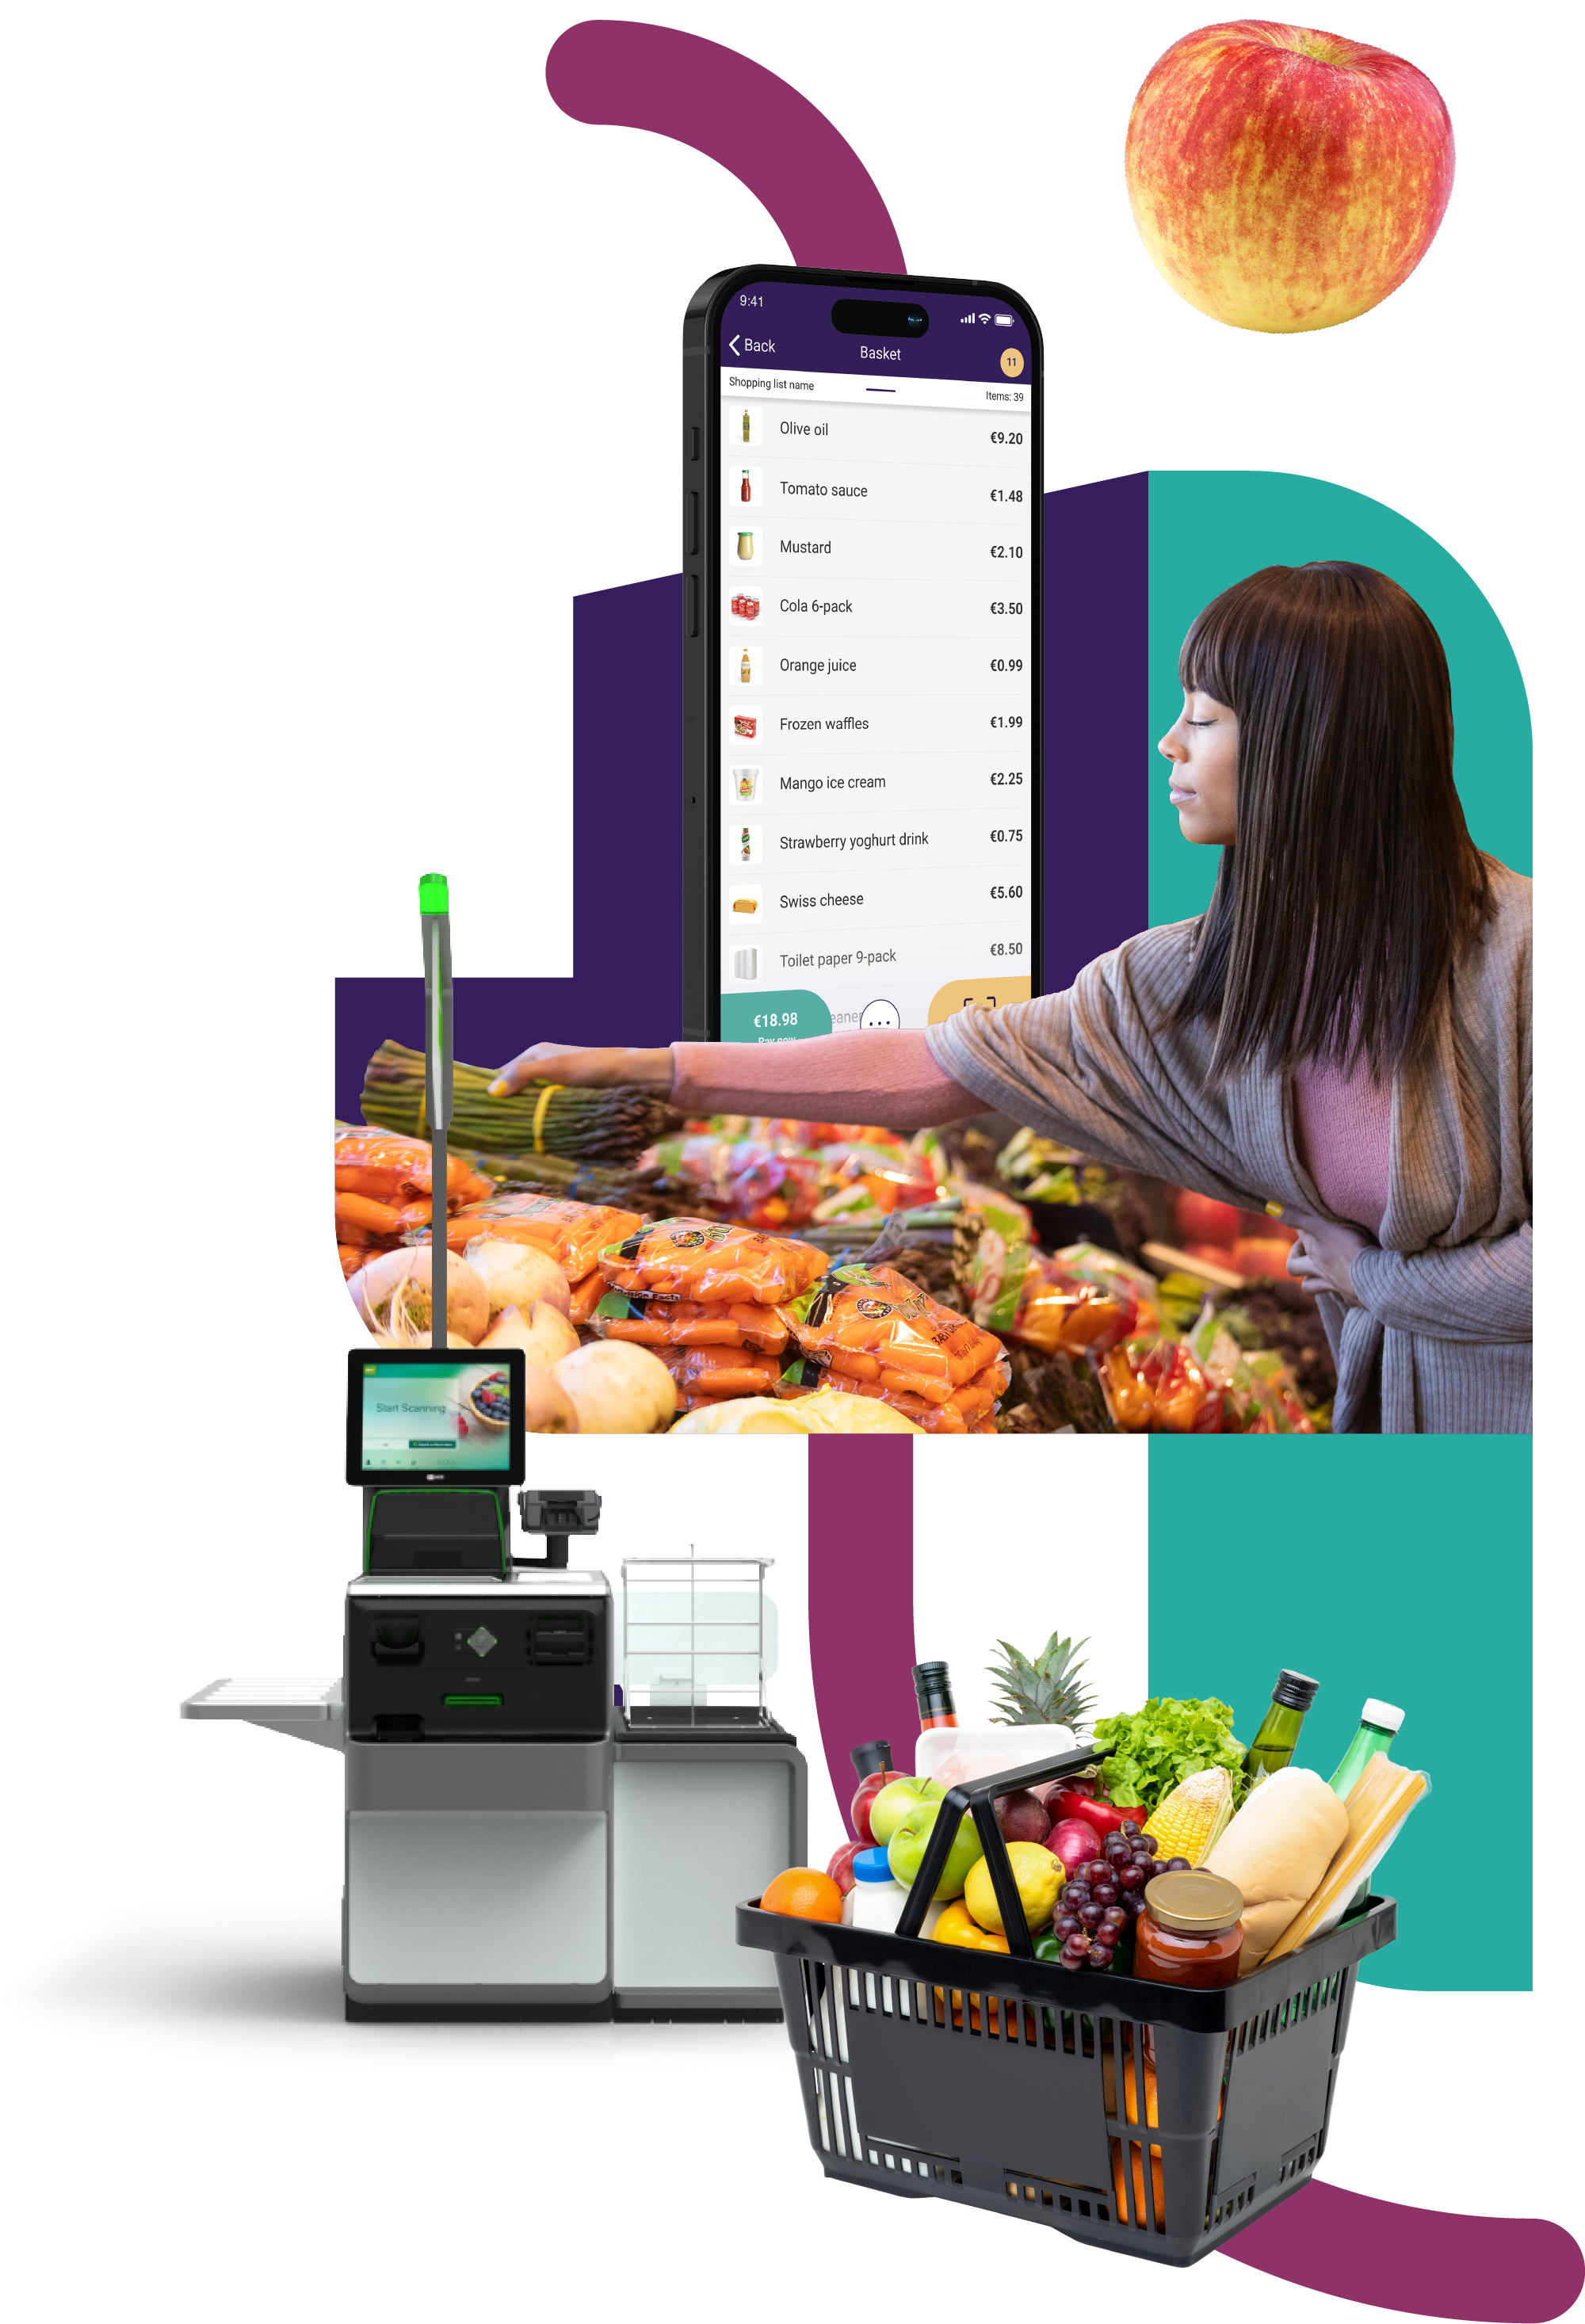
And where to next on our journey?
AI – help to order the right qty within the day
Markdown on products
Standard SCO layouts
Focusing on in-store grocery experiences

Slide 28


Slide 29
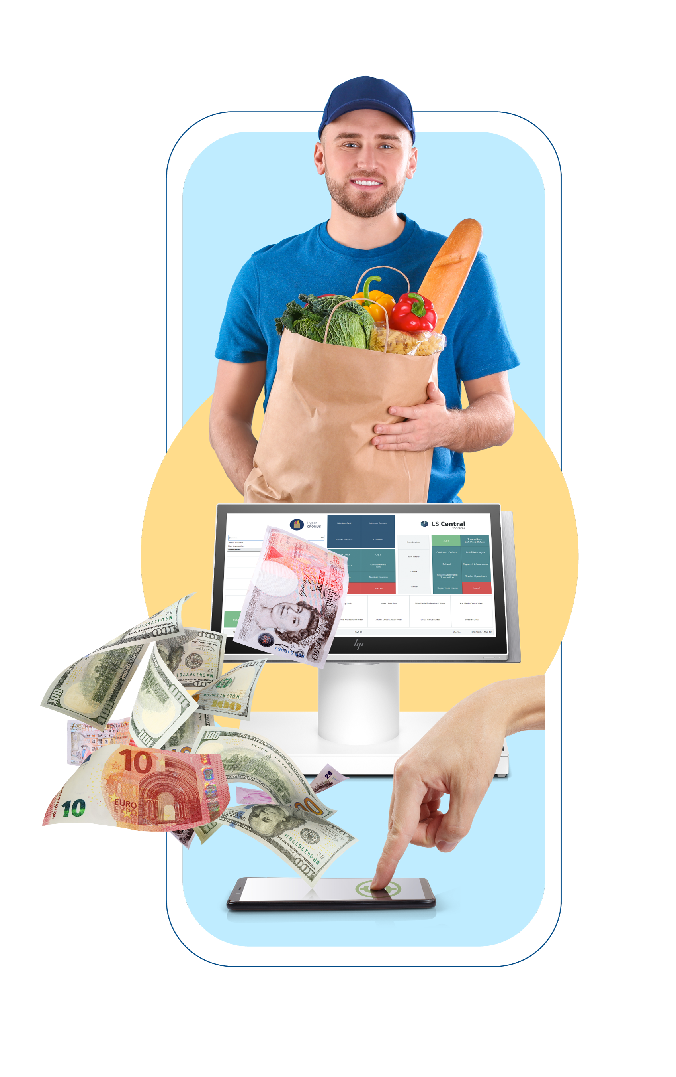
Examples from grocery projects
Examples and challenges from the field:
  Lot no. and expiry date on products
  Discount on individual product (barcode)
  Fast and stand-alone POS
  Store Inventory Management
  Master Data import from vendors

Slide 30

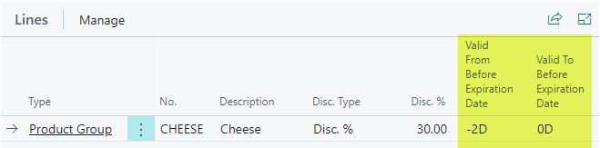
Lot number and expiry date on products
Challenge
Warning when selling product that is almost on expiry date. The food product have a GS1 code containing Lot no. and expiry date
Give 30% discount on a product that expires in two days
Solution
Define the identifiers for the GS1 elements
Define GS1 action for the product
  Lot No.
  Expiration
Create a discount offer for the product and use “Valid From Before Expiration Date” -2D
01007865985478501724050610a0001
01 – Barcode
17 – Expiry Date
10 – Lot No.

Slide 31

  Discount on individual product (barcode)
Challenge
Food product (cheddar cheese) is sold with a discount when it is near to expiry date
Solution
Create new barcode mask and a barcode for the product.
Define discount % on the new barcode
Normal barcode mask
26IIIIIQQQQQM
2610060000000
Price reduction barcode mask
29IIIIIQQQQQM
2910060000000 – 25% discount

Slide 32
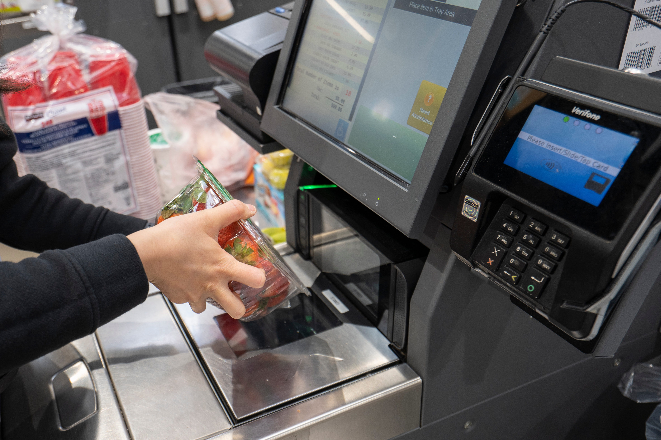
  Fast and stand-alone POS
Challenge
Grocery POS must be fast when scanning barcodes and selling items
Solution
POS Profiles: Don’t copy ##DEFAULT
Do we need to “Register Logon/Logoff”
Purge old transactions on the POS
Disable and delete discount offers from the POS

Slide 33

  Store inventory management
Challenge
Manage the store inventory
Solution
Define all needed processes for the store
  Purchase
  Positive Adjustment
  Negative Adjustment
  Transfer
  Stock Counting
  Price Check
  Label Printing
  Stock Request
  Receiving
  Picking
Run Mobile Inventory for LS Central

Slide 34




  Master Data import from vendors
Challenge
Import item data from vendors. Vendors have different file layouts.
Solution
Define item import settings for each vendor
Import item file into Item Import Journal
Check for error in the Journal
Create or update Items
Vendor Items
Import

