Slide 1
Effective customer scenarios for successful SaaS deployment
Radu Ghelmez
Convex Network Dynamics

Slide 2
Customer Scenario 1
Ukrainian Retail chain expanding to Romania
Multimarket Concept
Three Months from Start to Store Opening
No people, no hardware, no requirements, no locations, no warehouse
Just four containers of goods in customs and a deadline
Let’s go to cloud
Localization and fiscalization
4 things we need to Go Live

Slide 3
Customer Scenario 1
A year later – 25 Stores up and running
15 more planned for this year
Fairly stable
Adjust cost is still a pain
LS Analytics deployed
Next step - telemetry
We are considering transitioning to hybrid

Slide 4
Customer Scenario 1
New Company – no legacy data
No legacy hardware
Good out of the box coverage
None to low code customization
None to low integrations to third parties
Two POS per store
High number of tickets per hour at rush time
Pictures!!

Slide 5
Customer Scenario 2
Romanian fancy fashion designer
Old NAV used for manufacturing (tailoring)
Upgrade project initiated
Fancy Showroom in fancy Mall
Two weeks in total
Could have been faster
New instance with integrations to old one

Slide 6
Customer Scenario 2
New instance – no legacy data
No legacy hardware
Good out of the box coverage
None to low code customization
None to low integrations to third parties
Low number of tickets per hour
Low number of items and master data in general

Slide 7
Two things to always consider for Online
Connectivity
Concurrency

Slide 9
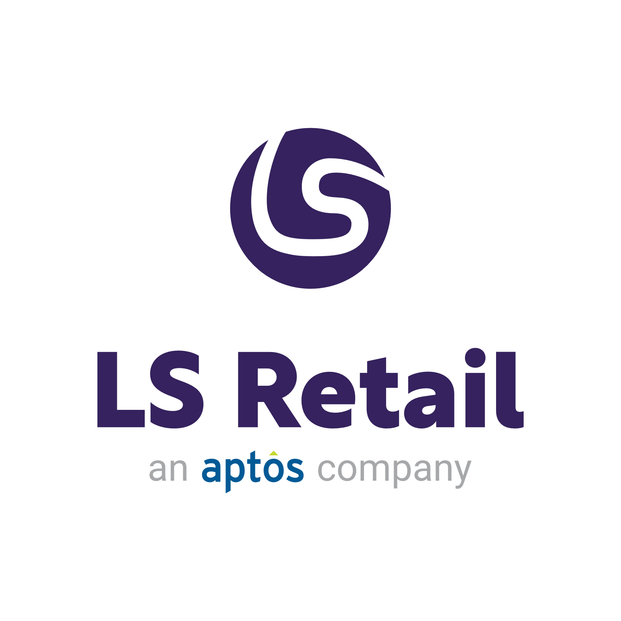



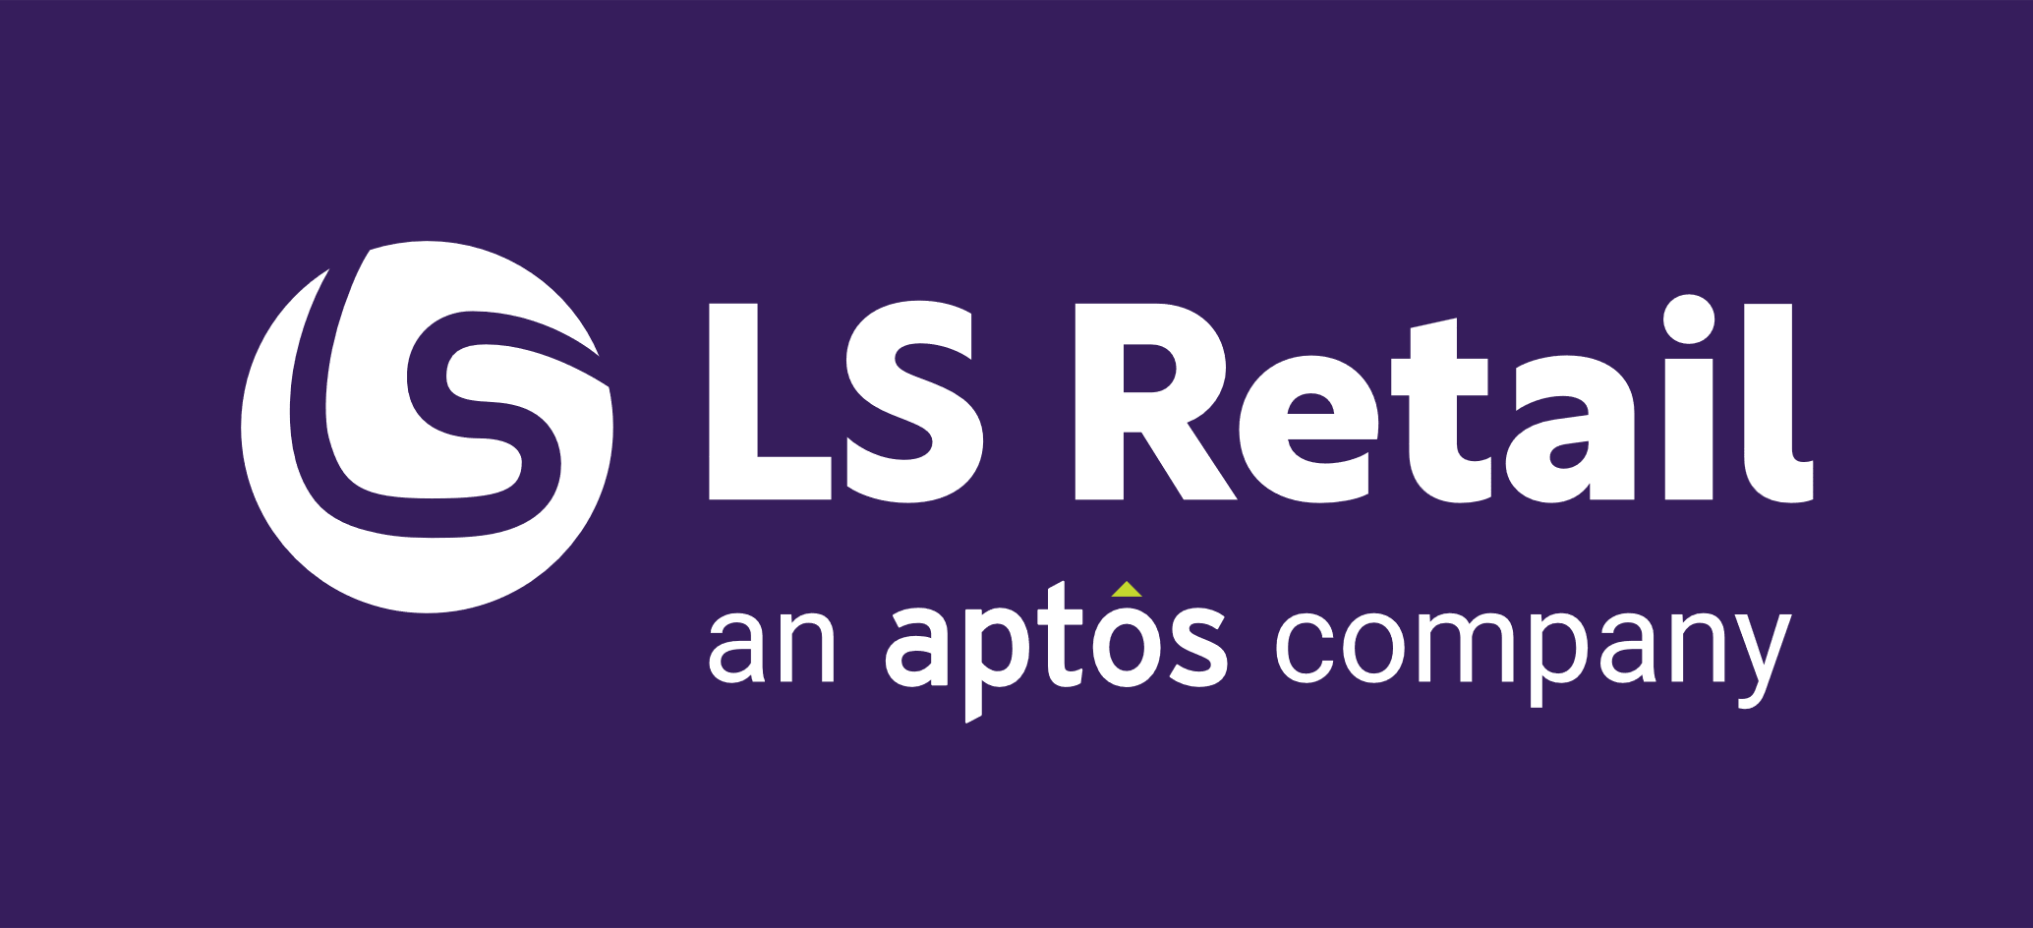
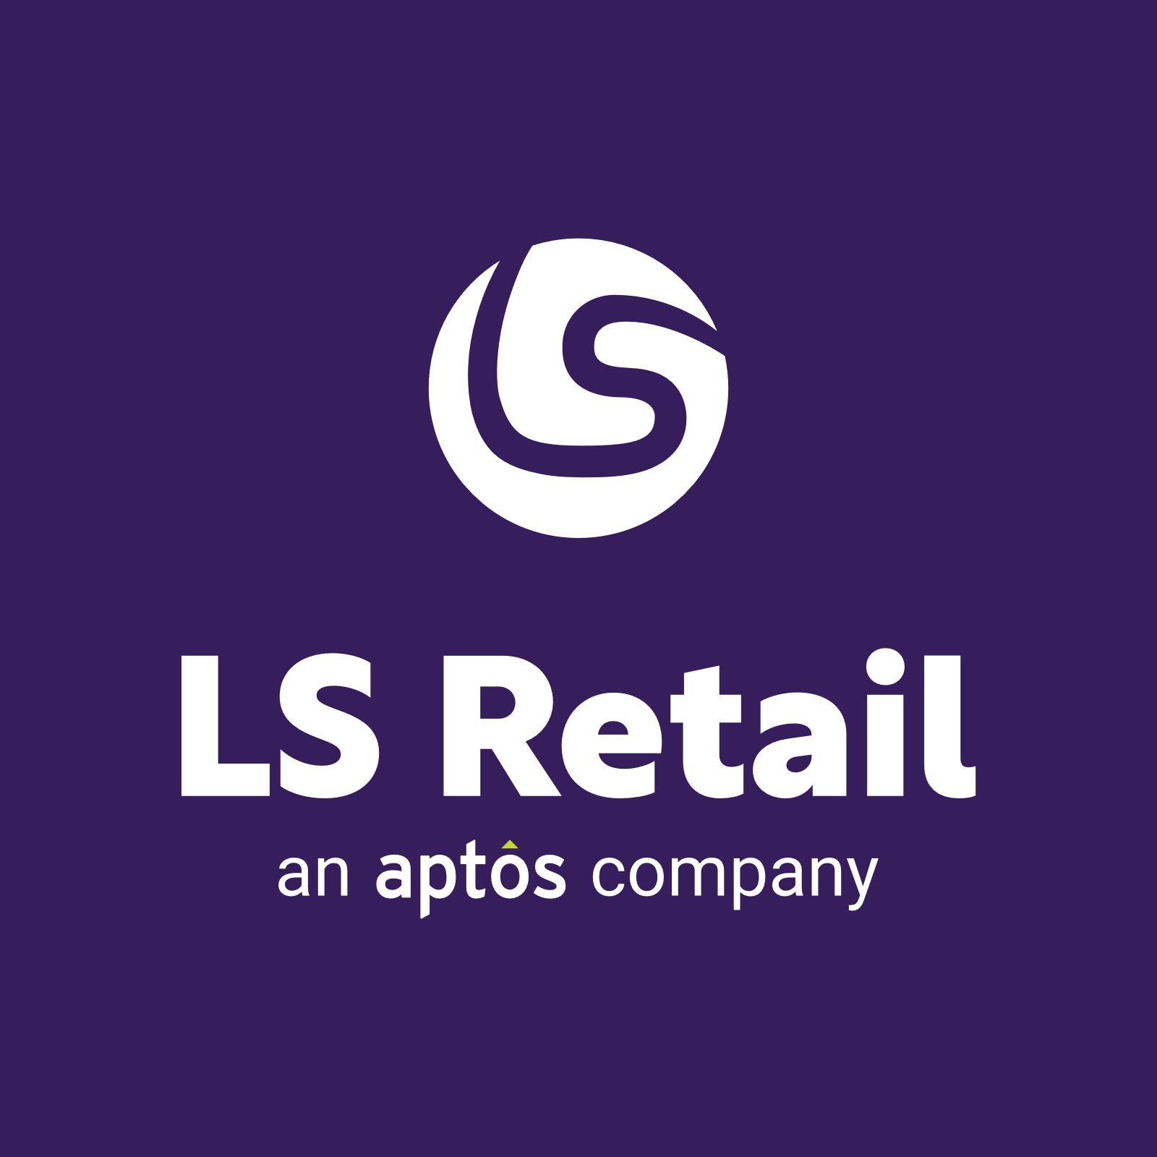



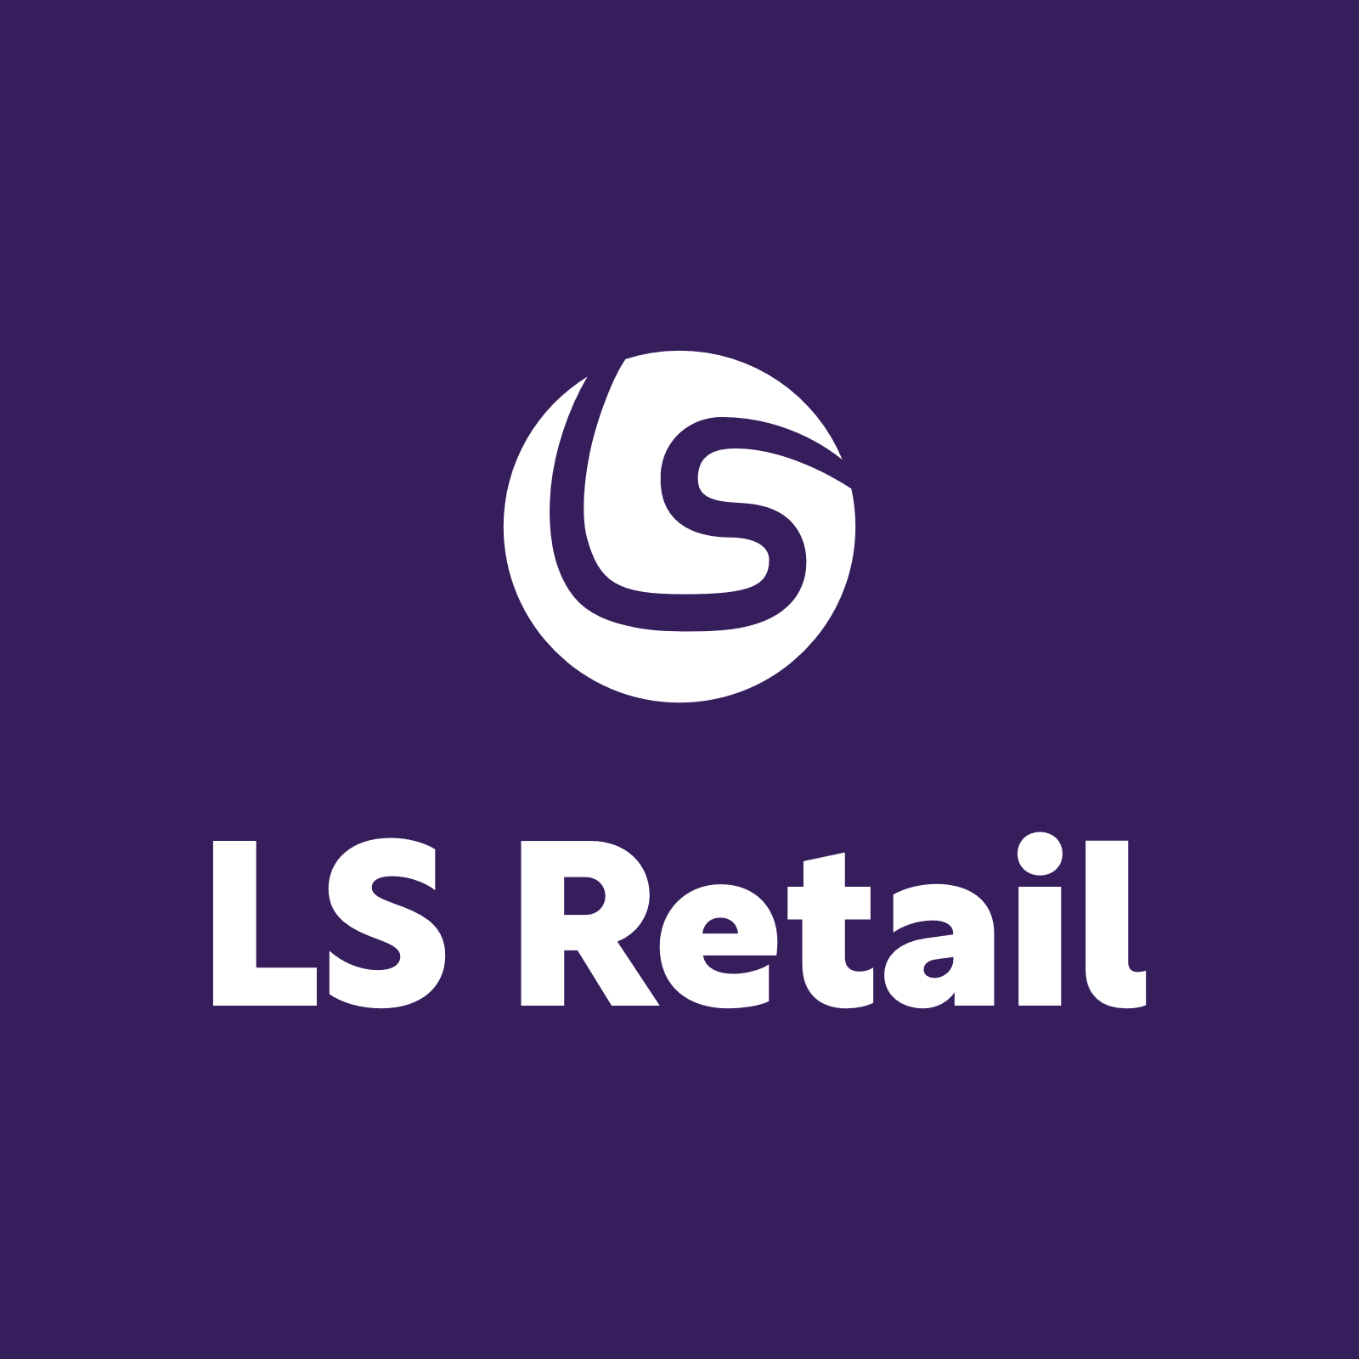
!IMPORTANT!
The “an Aptos company” version is the main version to use. Only use the logo without it if the logo is very small.
Primary
Secondary
Primary
Secondary

Slide 10















Slide 11

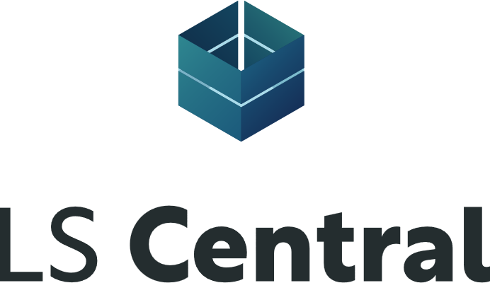




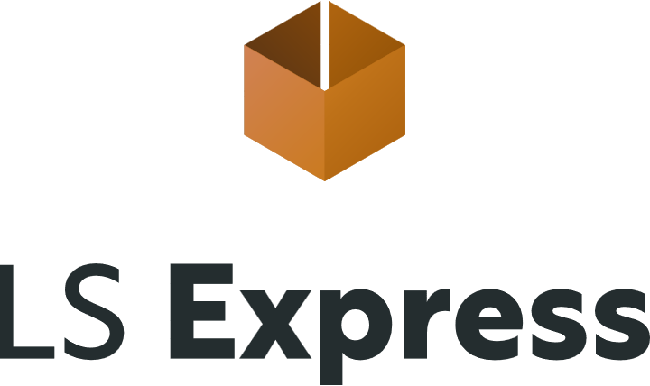
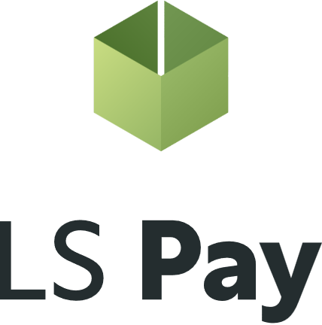




Slide 12













Slide 13





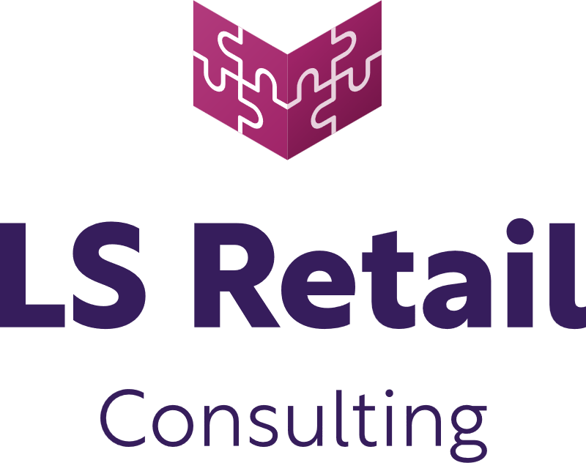
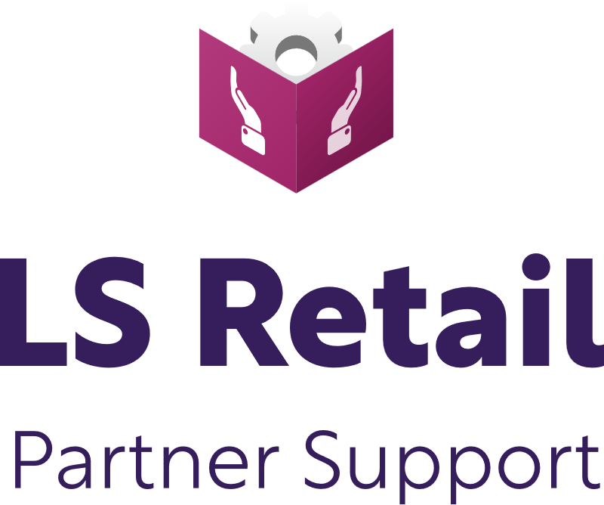
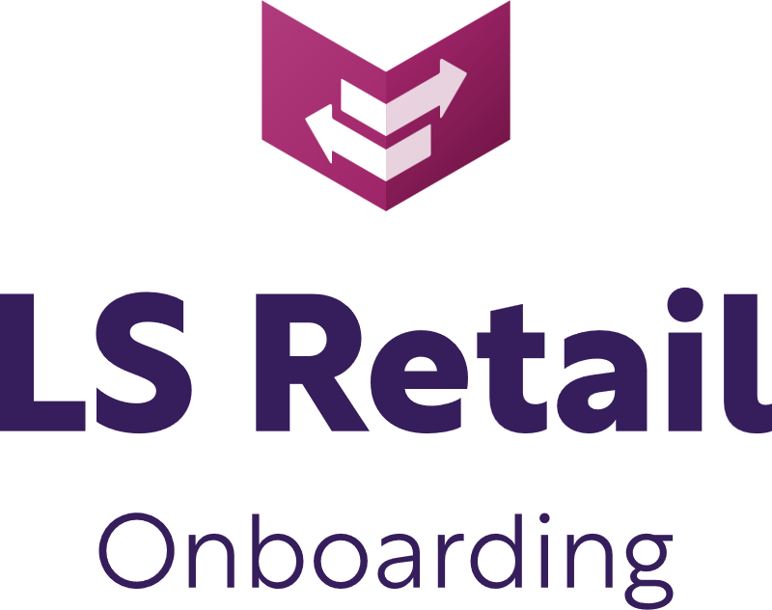

Slide 14

Desktop/POS

Slide 15

POS/Tablet

Slide 16

Tablet/surfacePro

Slide 17

Tablet/iPad

Slide 18

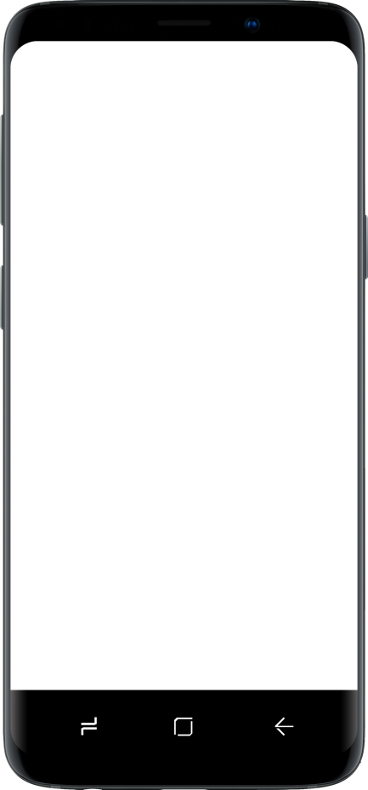
Mobile

Slide 19














