Slide 1
What is LS Central for pharmacies?
Henrik Oskar Thordarson
Stefan Georgsson

Slide 2




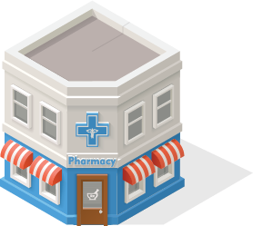
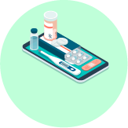
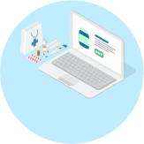
Our vision for innovation in pharmacy
Unified Pharmacy
All-in-one pharmacy suite
ERP
Finance
Warehousing
Advanced Shipping Notification
Dispensing
E-prescriptions
Rx master data
Dose dispensing
Integration
Localization for prescription & insurance gateways
Retail
Health and beauty
Loyalty
360-degree view of the customer
Clienteling
Personalized service on the pharmacy floor
Appointments and reservations
eCommerce
Retail and prescriptions
Prescription
Retail items
Click & collect
Traditional
Social media
Customer
App
Done
We know dispensing
Web

Slide 3

Modular design of LS Central
  Each component in the system is like a Lego brick with seamless data integration
  For customers, this means that it is now possible to update the system without a major upgrade project
  Works both as a standalone pharmacy solution and a complete ERP, retail, and pharmacy solution
  Unifies all channels & runs them from the same back-end solution
  Member management/loyalty program is an integrated part of the solution
Customer Integrations
Country
Integration
Pharmacy module
LS Central
MS Dynamics 365 Business Central

Slide 4
LS Central for pharmacies
Contains general processes commonly used by all localizations
Prescription handling with or without connection to centralized ePrescription entity
BC24/SaaS available
Fully integrated to the LS Retail product portfolio
Can be used as a standalone solution
Ready for localizations or integrations
Now available all over the world by LS Retail and the LS Retail Partner Network
Customer Integrations
Country
Integration
Pharmacy module
LS Central
MS Dynamics 365 Business Central

Slide 5
Localizations and integrations
Localizations developed by LS Retail and supported by LS Retail to include any changes needed as local regulations evolve
Available for
  Iceland
  Norway
  Sweden
  UK – England, Scotland and Wales
Next countries?
Customer Integrations
Country
Integration
Pharmacy module
LS Central
MS Dynamics 365 Business Central

Slide 6


Key functionality areas
All standard prescription processes
  Prescription handling
    paper, electronic, emergency, animal, etc.
  Generic substitution
  Pharmaceutical control
  Pick control
    FMD Control
  Order requests when item is not in stock and subscriptions
  Pharmacy specific user permissions
Customer identification
  Pharmacy customer database or link to national registry
  Handling of Power of Attorney and care units
Master data import and management
  Master data for prescription handling
    Pharmaceutical Items
    Item Groups including ATC and Substance Groups
    Health Personnel

Slide 7
DEMO

Slide 8
Why LS Central for pharmacies?
Built on Microsoft Business Central and LS Central
  Browser based, low footprint
  Available as SaaS in Microsoft Azure
  Easy integration with Power BI and other Microsoft apps
  Continuous updates from Microsoft and LS Retail
  Security
  Built on server and client from Microsoft
  MS SQL database
  User traceability
    Possibility to use RFID and MFA
  Pharmacy access restricted by roles
  Barcode control for safety
Efficient flow for prescription
handling
Has been sold to nearly 3,000 pharmacies
A-Z single solution
  ERP, POS, retail, and prescriptions

Slide 9
Questions?

