Slide 2



Analytics for
LS Central
Create your epic BI journey
Omair Zuberi
Martin Kleindl
Jonheidur Isleifsdottir

Slide 3


Slide 4


Slide 5


Slide 6
Agenda
Reporting in BC and Analytics
Analytics under the hood
What’s new
Architecture options
The BC23 challenge
How to get started
How to implement with success

Slide 7

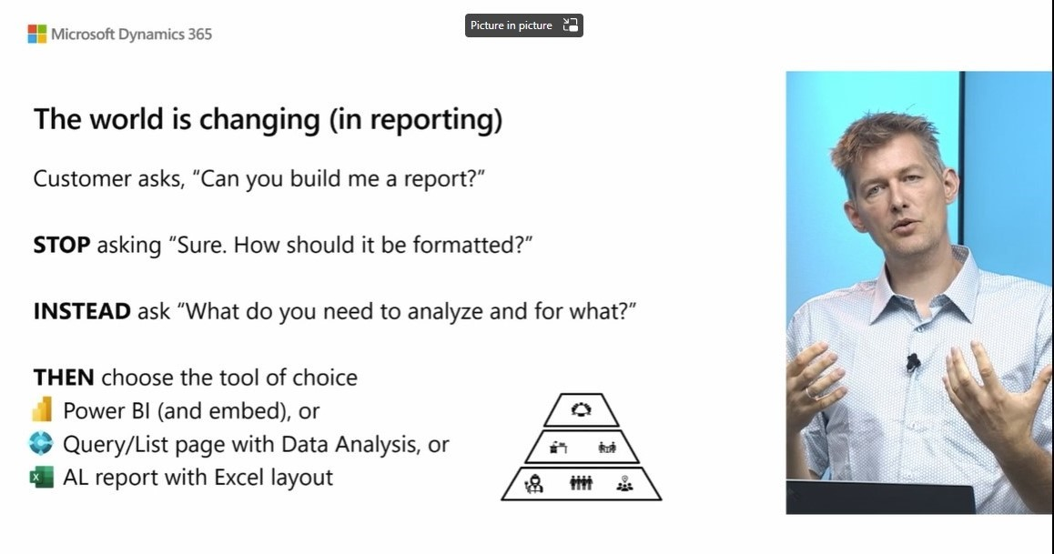
Kennie Pontoppidan
Principal Program Mgr.
Microsoft

Slide 8
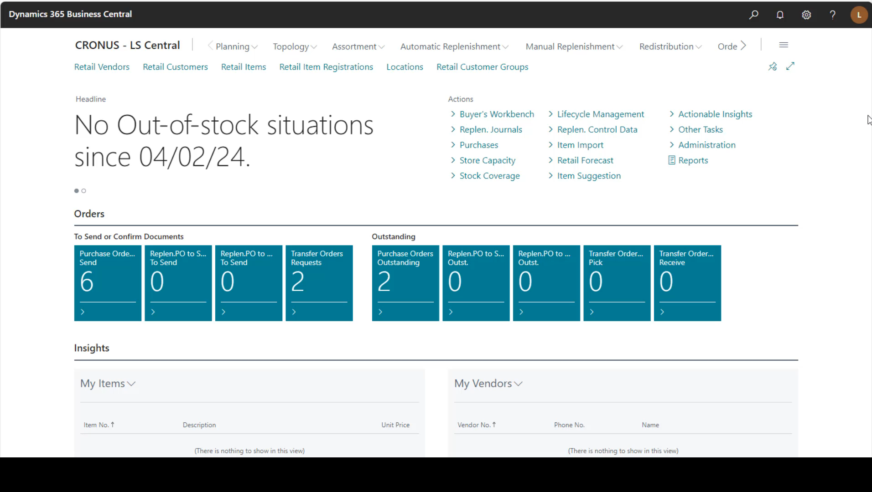
Data analysis in Business Central

Slide 9
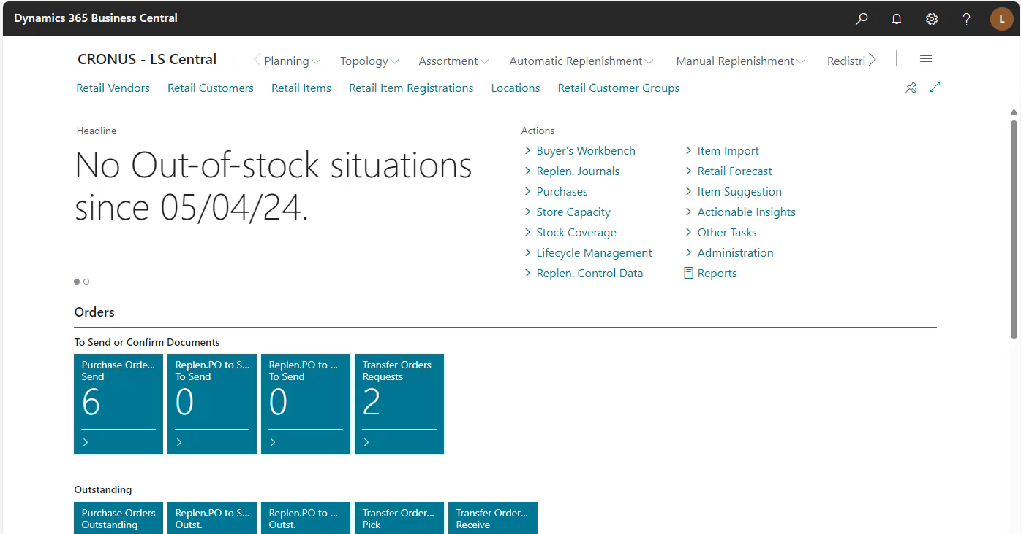
LS Central –Analysis views

Slide 10
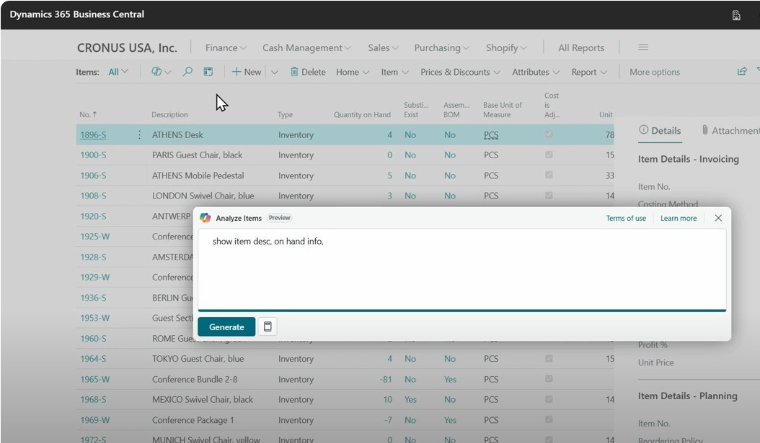
Kennie Pontoppidan
Principal Program Mgr., MS

Slide 11
Analytics
for LS Central

Slide 12


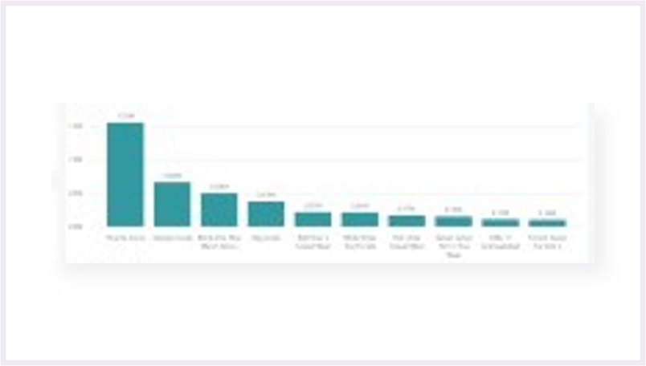
Analytics for LS Central
Business Central
Power BI
Service
Power BI
Reports
API
Microsoft
Power BI
Connector
Tables
(on-prem)
API
Data
Tables
(SaaS)
API
Query
business logic
API

Slide 13
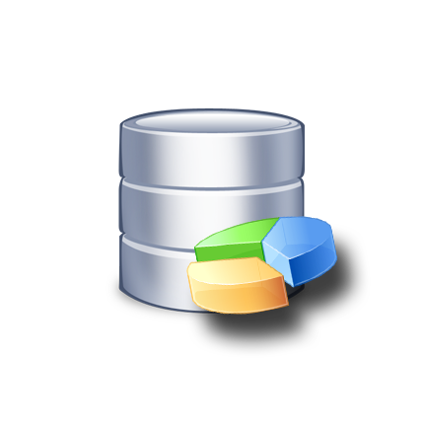
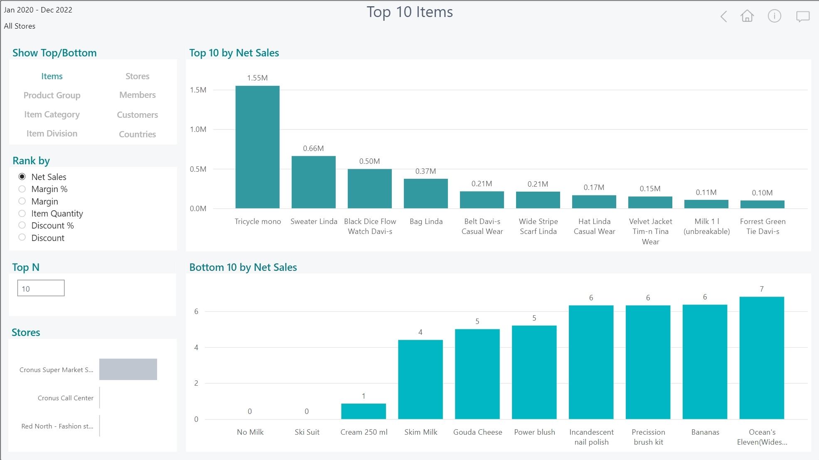
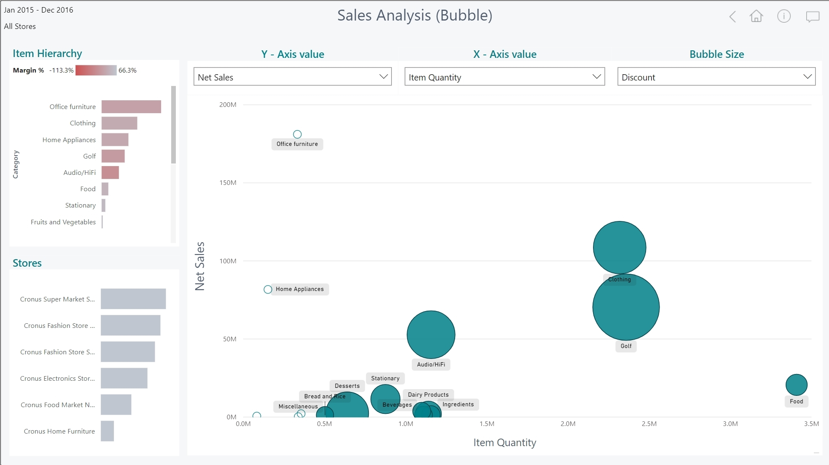


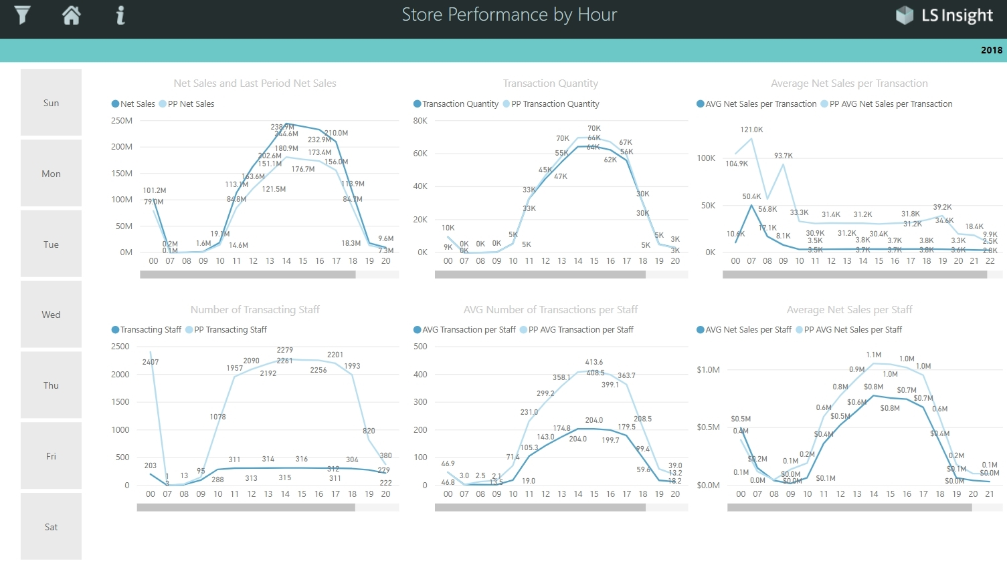
Analytics for LS Central
150+
Business Central
Azure SQL Server
Datawarehouse
Power BI
Service
Power BI Reports
Power BI Report
templates
Azure Data
Factory
Data
warehouse
Tables
(on-prem)
Data
warehouse
Data
Staging
Tables
(SaaS)
Staging
Query
business logic
Prestaging
Prestaging
Data Director
Webservices
Azure Data
Factory

Slide 14
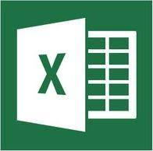

Analytics for LS Central
Analytics - Data Warehouse
  Standard Microsoft technology
    Azure SQL Server or SQL Server
    Azure Data Factory (ETL processes and pipelines)
  Easy to extend (new fields, tables, and other data sources)
LS Retail…
Provides ready-to-use data model, pipelines and logic
You…
Setup SQL Server (Azure /on-prem)
Download and setup the deployment package from LS Retail
Connect to BC, load data → GO!
…
Analytics – Data WH
Business Central
(LS Central)

Slide 15
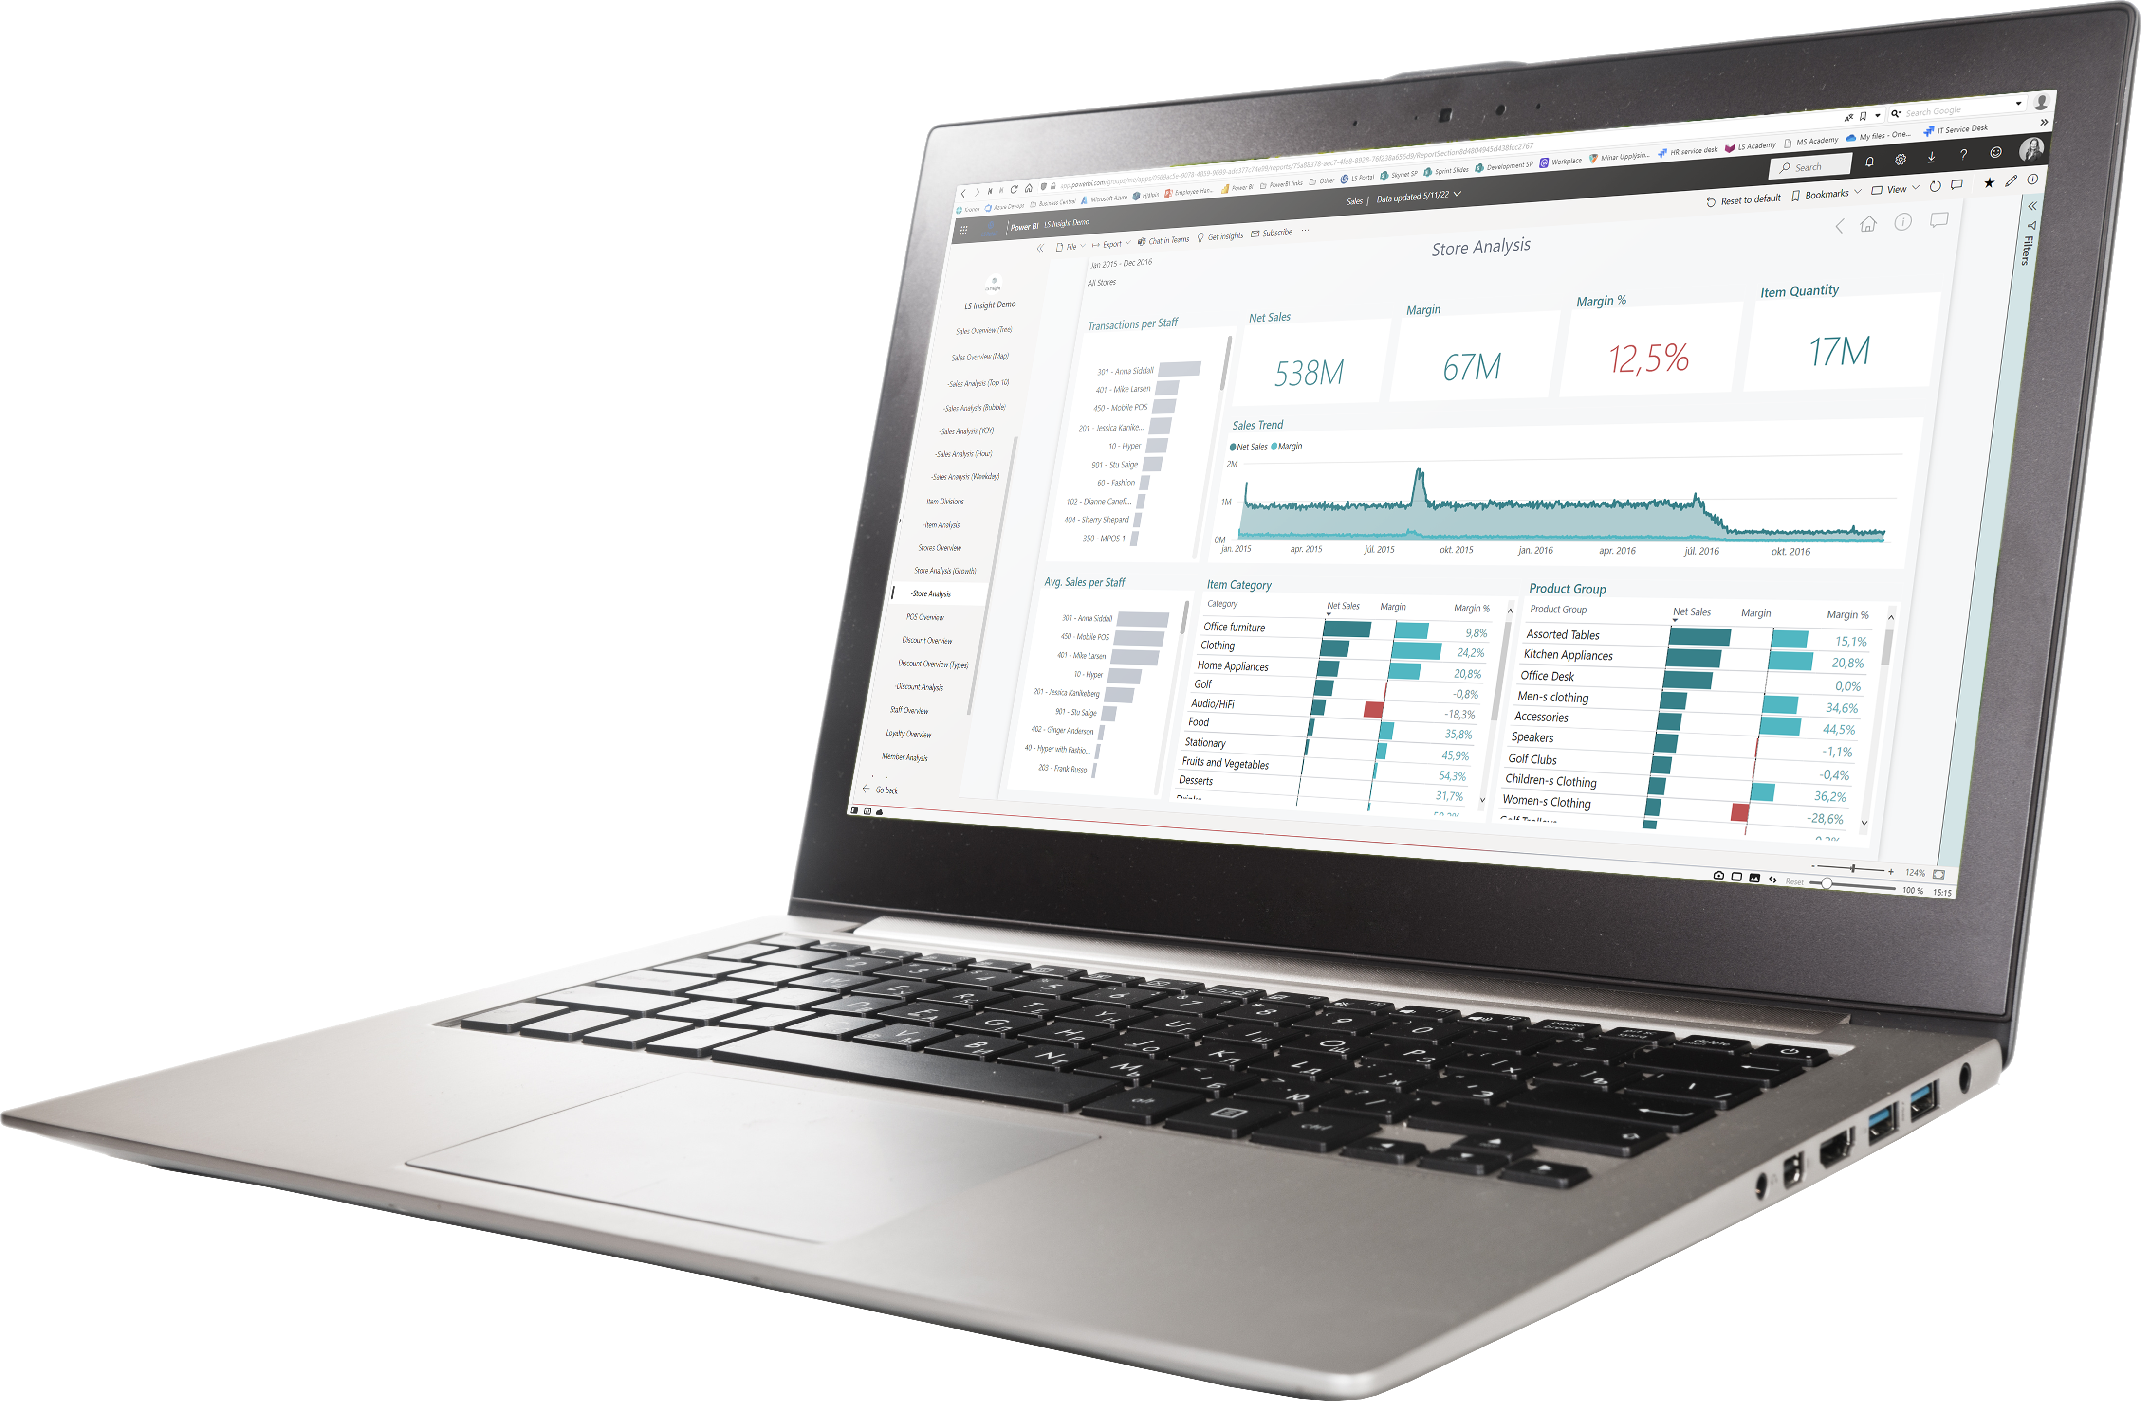
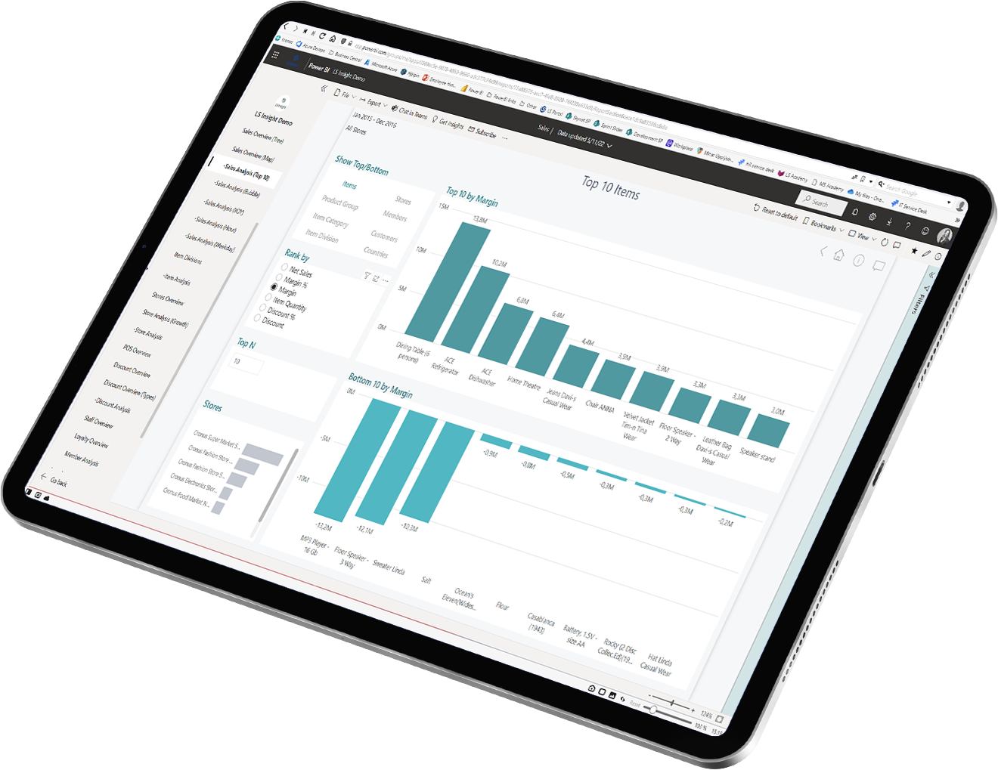
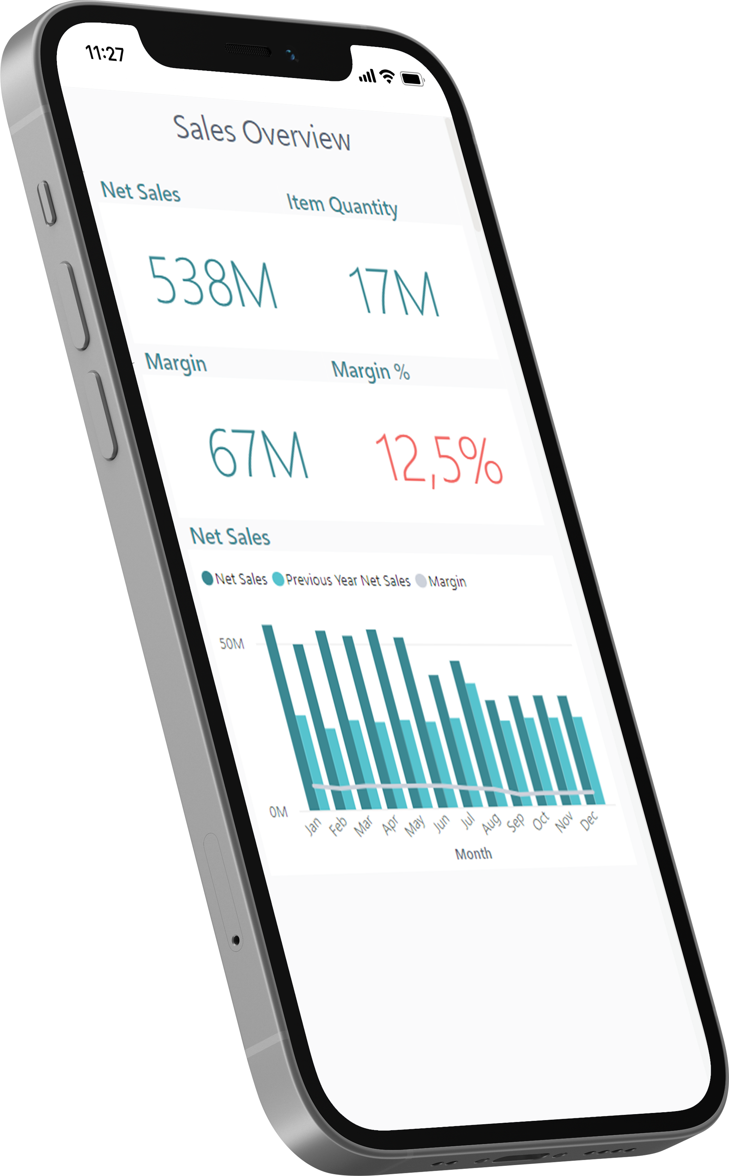
Analytics for LS Central
Analytics - Reports
  Power BI based Report and Dashboard templates
    Built on data from Analytics Data Warehouse
    150+ report page templates
  Easy to adapt, extend or build your own
  Strong integration with MS Teams, Excel, and Powerpoint
LS Retail…
Provides ready-to-use report templates
You…
Subscribe to Power BI (@ Microsoft)
Setup the report packages from the deployment package
Connect to DW, load data → GO!

Slide 16
Analytics for LS Central
Report packs
  Sales (added Budget and Section/Shelve reports)

Slide 17
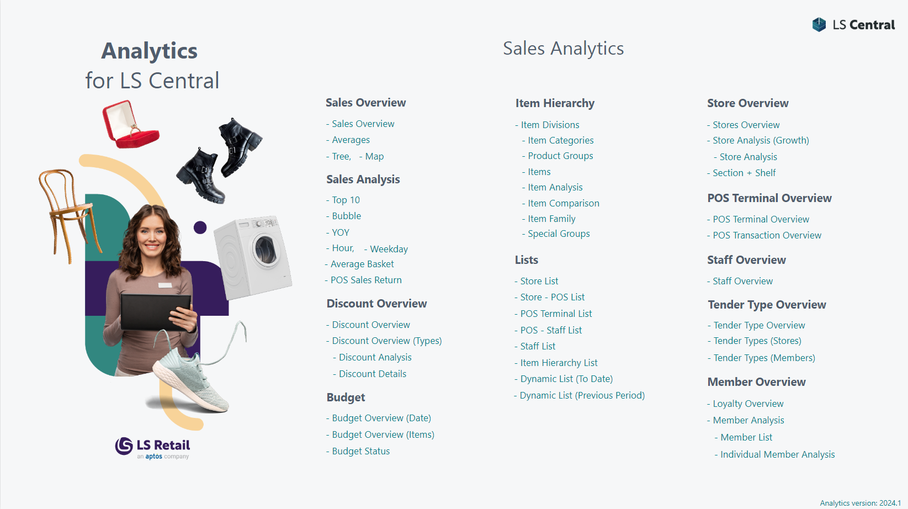
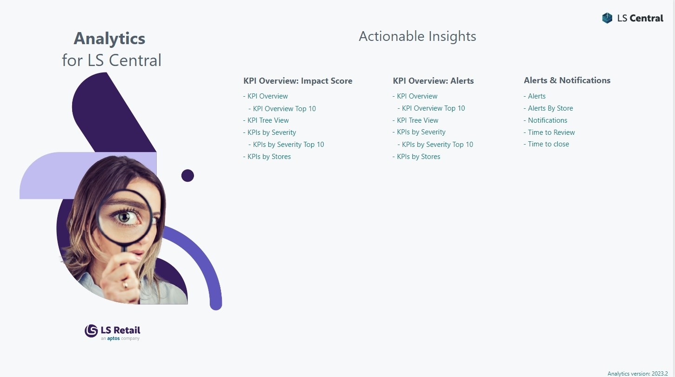
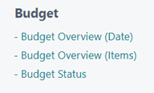
Should be sales

Slide 18
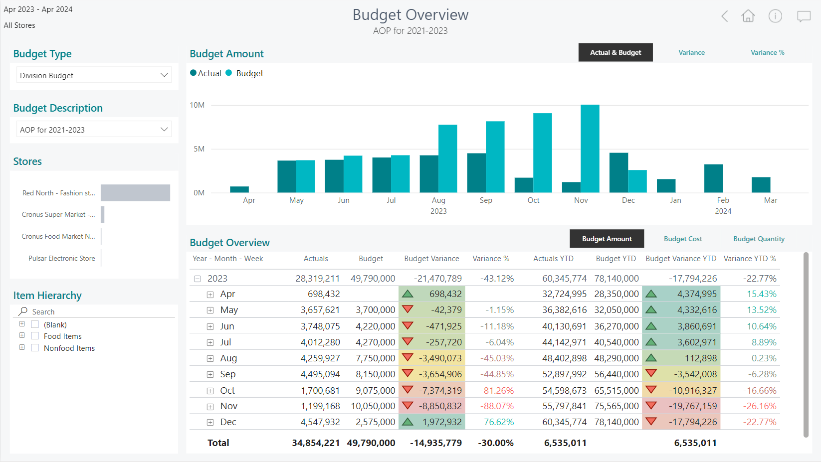
Enhancements in sales
reports

Slide 19
Should be sales

Slide 20
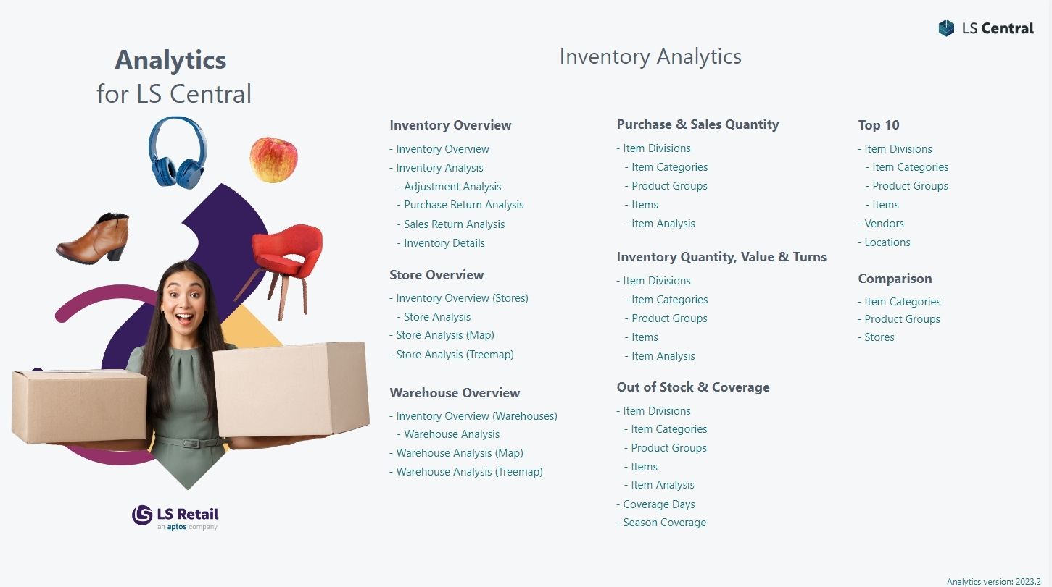
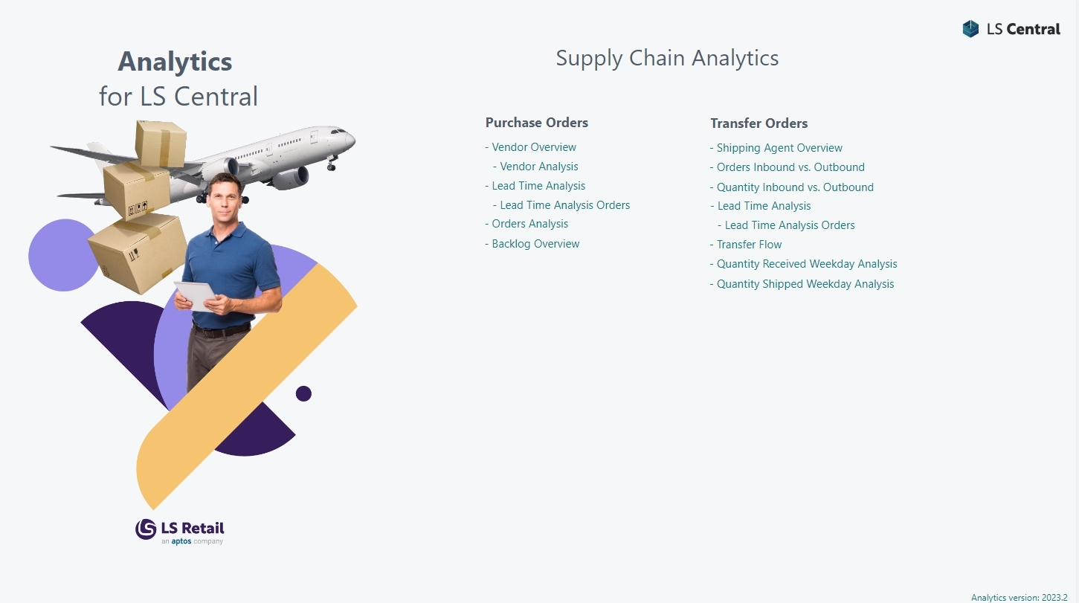
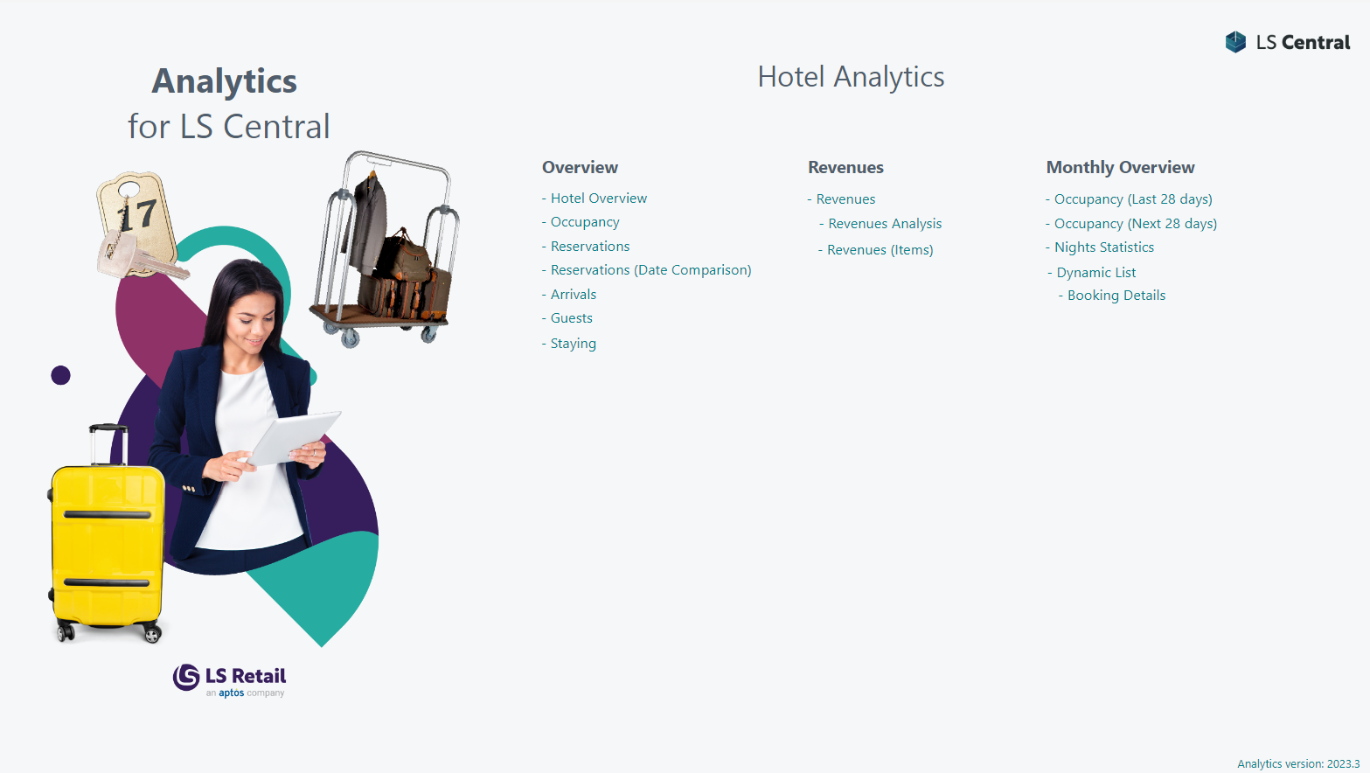

Slide 21
Analytics for LS Central
Report packs
  Sales (added Budget and Section/Shelve reports)
  Inventory
  Supply Chain
  Actionable Insights
  Hotels
  Hospitality (!!! New !!!)

Slide 22
Analytics for LS Central
Report packs
  Sales (added Budget and Section/Shelve reports)
  Inventory
  Supply Chain
  Actionable Insights
  Hotels
  Hospitality (!!! New !!!)
  Aggregated Inventory (work in progress)

Slide 23
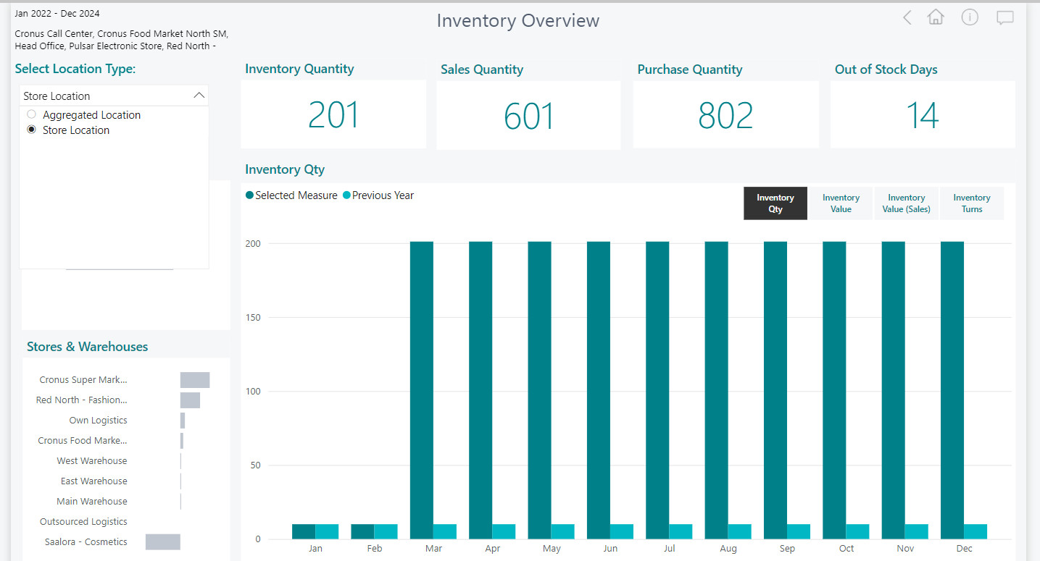

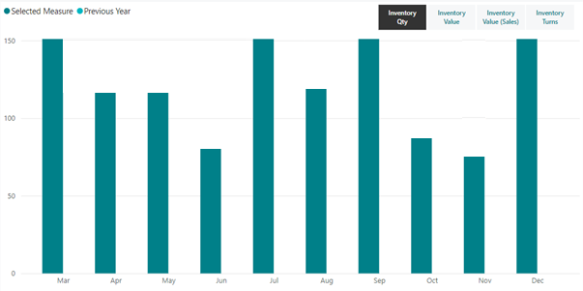
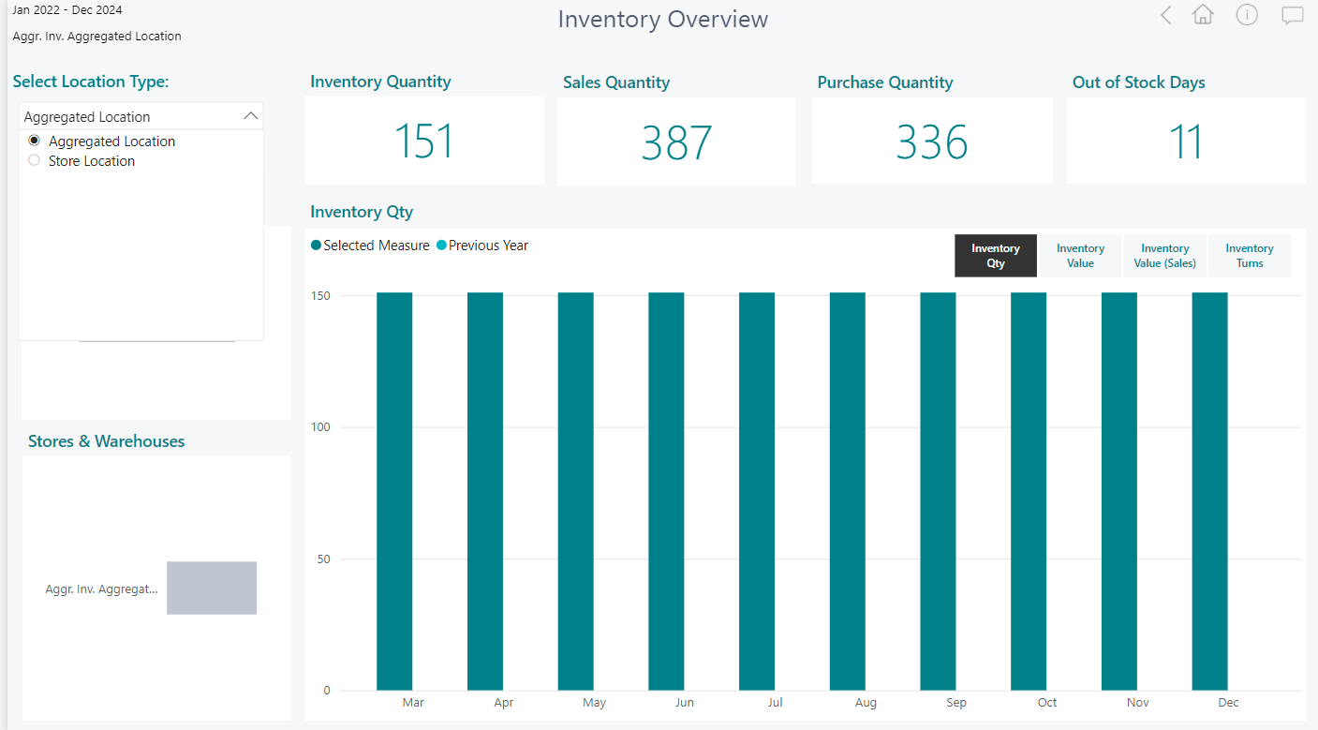
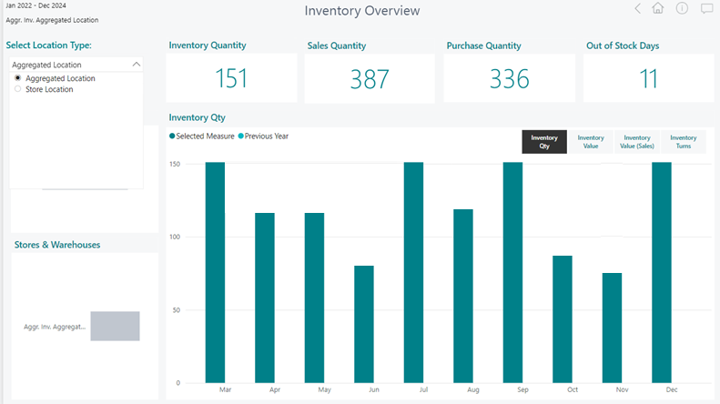
Aggregated Inventory

Slide 24
Analytics for LS Central
Report packs
  Sales (added Budget and Section/Shelve reports)
  Inventory
  Supply Chain
  Actionable Insights
  Hotels
  Hospitality (!!! New !!!)
  Aggregated Inventory (work in progress)
  Continuous improvements and additions based on
  customer feedback
  Industry specific report packs currently in development

Slide 25
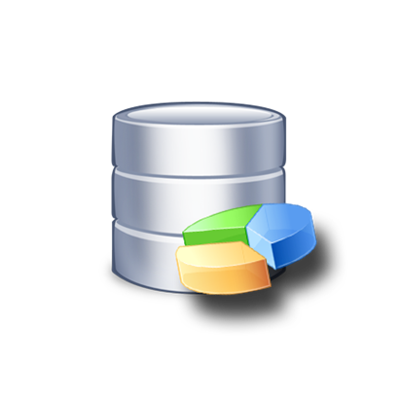
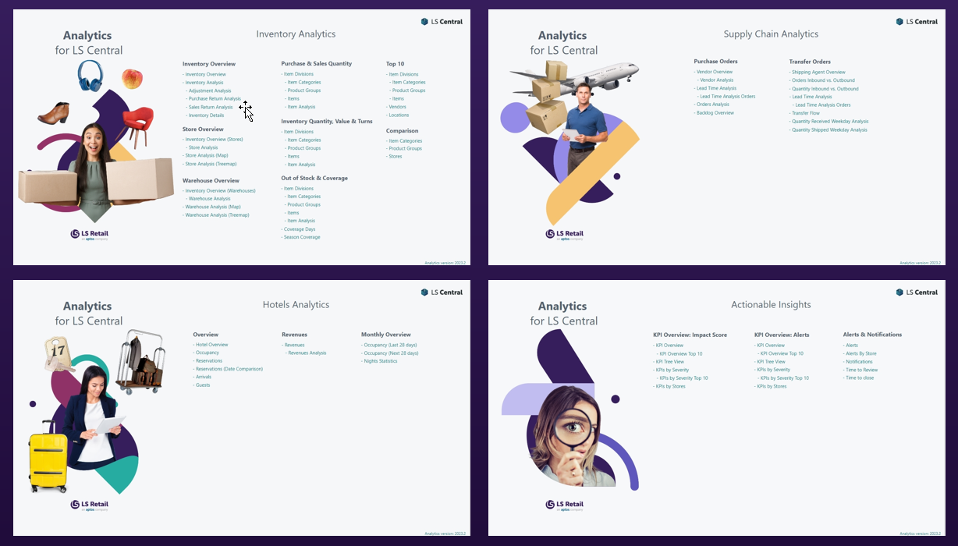
Customizations
Business
Central
Analytics for LS Central DW
Power BI
Service
SaaS or
On-premise

Slide 26
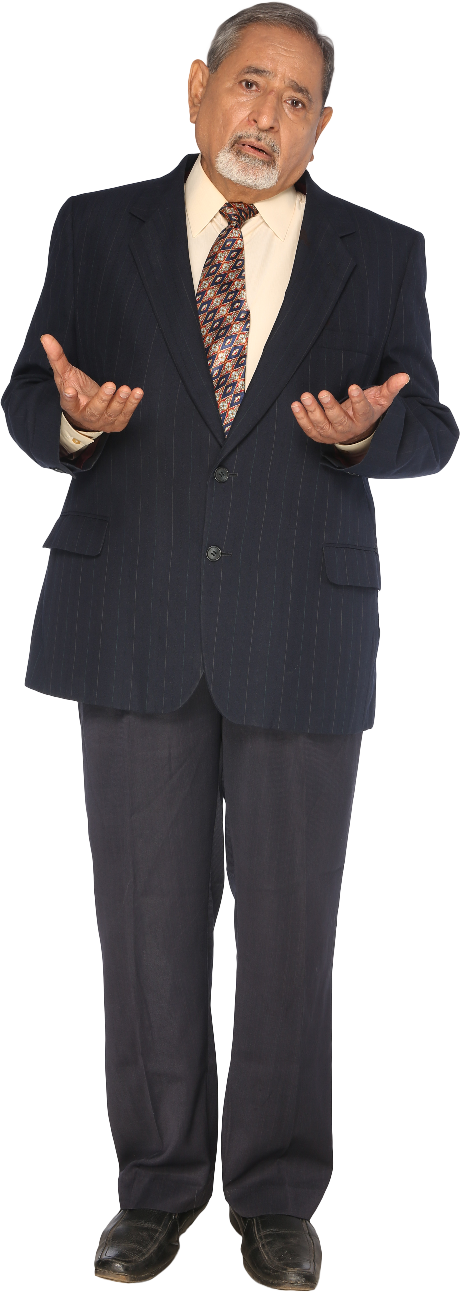
Can we add data from an external system that we have?
Can we add this field from LS Central?
What about the data from the extension you created?
We really need this information to be able to make the big decisions.

Slide 27


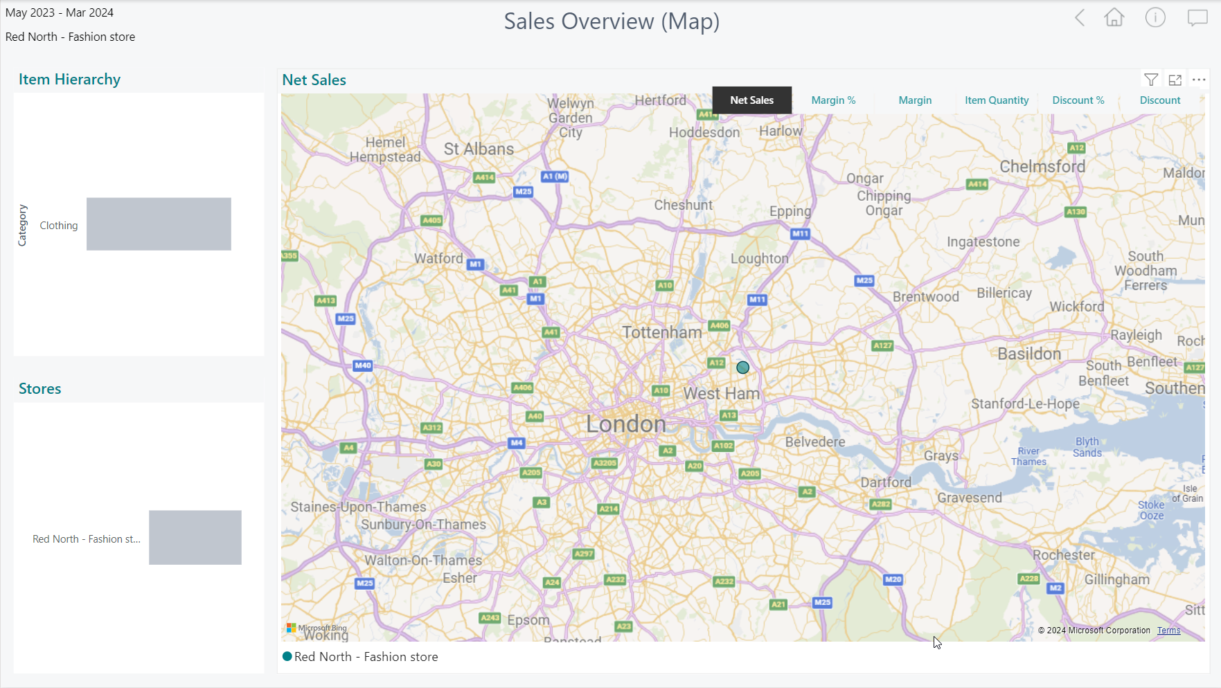
Customizations
Third party data
Business
Central
Analytics DW
for LS Central
Power BI
Service
SaaS or
On-premise

Slide 28


Slide 29
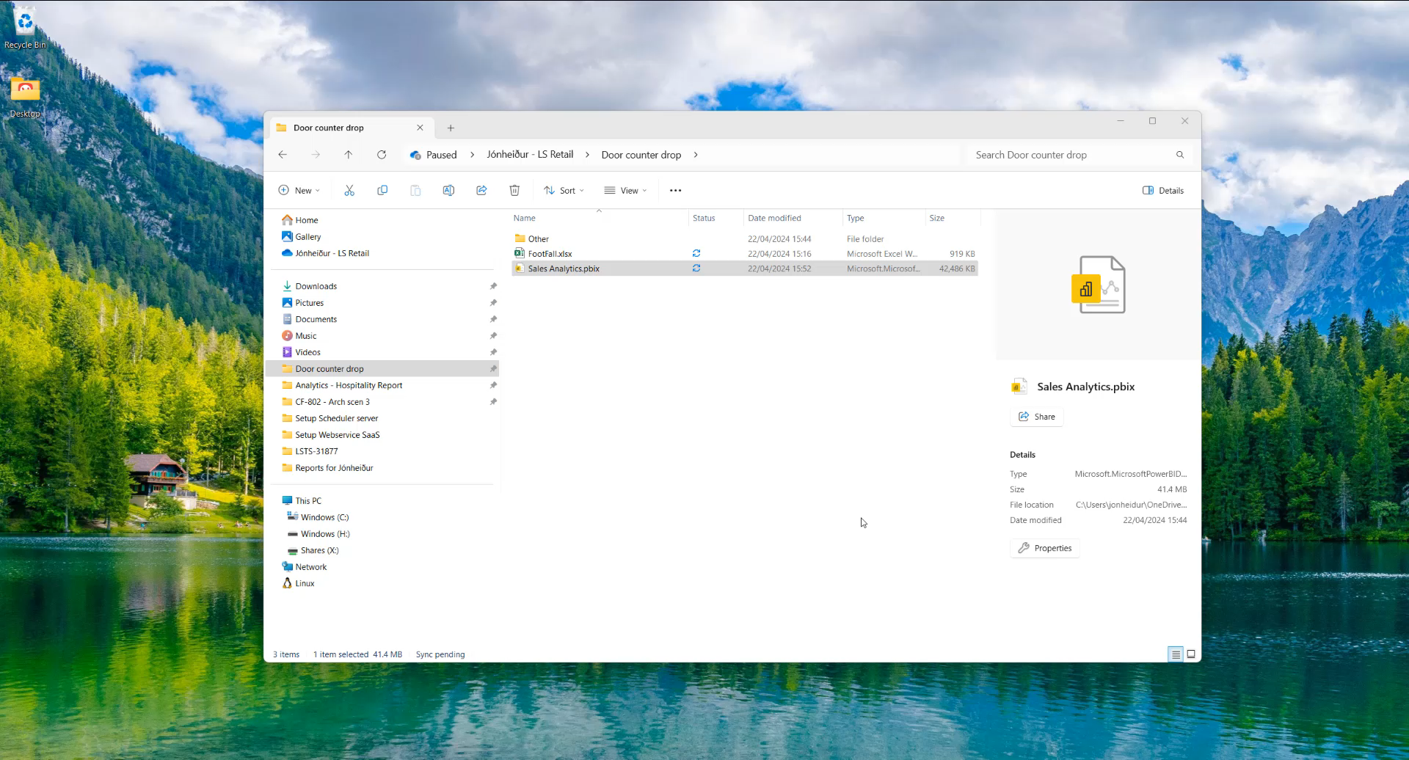

Slide 30
Customizations
Third party data
Business
Central
Analytics DW
for LS Central
Power BI
Service
SaaS or
Documentation for customization scenarios
is available in Extension guidelines in Online Help
On-premise

Slide 31

Analytics for LS Central
Architecture options

Slide 32
Architecture options
Business
Central
Analytics DW
for LS Central
Power BI
Service
Business
Central
SaaS
DW on
Azure SQL
DW on
on-prem SQL
Azure Data
Factory
Data Director
Webservices
On-premises
Power BI
Connector

Slide 33


Architecture options – on prem
Business
Central
on-prem
Azure SQL
Server
(Analytics DWH)
Power BI
Service
Azure Data Factory
Integration Gateway
(Interface to read from
SQL server)
Power BI service
pulls data from the
data warehouse
(based on a schedule)
Azure Data Factory
(Pipelines to load and transform data)

Slide 34
Architecture options – SaaS
Business
Central
SaaS
Azure SQL
Server
(Analytics DWH)
Power BI
Service
HCS Server / VM
LS Central Scheduler,
Data Director
Power BI service
pulls data from the
data warehouse
(based on a schedule)
Scheduled data
replication
- from Business
Central
- to Analytics
database
Azure Data Factory
(Pipelines to transform data)

Slide 35
Needed licenses/subscriptions
Analytics - BC on premises
Request Analytics license
Subscribe (Microsoft)
  Power BI License
  Azure SQL Server
  Azure Data Factory
Analytics - BC SaaS
Request Analytics License
Subscribe (Microsoft)
  Power BI License
  Azure SQL Server
  Azure Data Factory
Purchase 1 Offline Store license for the VM/Server to replicate data
(not needed if you are using hybrid approach)

Slide 36

Business Central v23
SQL schema change
for extension companion tables

Slide 37

Upgrade to BC 23 – LSC on-prem
New SQL schema for extension companion tables
LS Central
on-premises 22.3 and earlier
LS Central
on-premises
23.0 and later
Actions:
Upgrade Analytics
to 2023.4 or later
Run the Factory Reset
pipeline
Pro-Tip:
Boost your environment for 1 day ☺
Steps:
Upgrade Analytics
to 2023.4 or later
Run the Factory Reset
pipeline
Pro-Tip:
Boost your environment for 1 day ☺
Analytics for LS Central
2023.3 or earlier
Analytics for LS Central
2023.3 or earlier
Analytics for LS Central
2023.4 or later

Slide 38
Upgrade to BC 23 – LSC SaaS
LS Central SaaS 22.3 and earlier
LS Central SaaS 23.0 and later
No immediate action needed.
We recommend upgrading
to get the latest version.
Analytics for LS Central
2023.3 or earlier
Data Director
Webservices
Analytics for LS Central
2023.3 or earlier
Analytics for LS Central
2023.4 or 2024.1

Slide 39
Agenda
Reporting in BC and Analytics
Analytics under the hood
What’s new
Architecture options
The BC23 challenge
How to get started
How to implement with success

Slide 40


Slide 41

Project plan
“Analytics for LS Central is so easy to install…
why aren’t all my customers using it.”
Project plan in a nutshell
  Key decisions
  Prerequisites
  Installation/Configuration
  Go live

Slide 42
Project phases
½ Hour
Key Decisions
Pre
requisites
Installation
GO LIVE
Configura-tion
Key Decisions:
LS Central on-prem
  → Analytics in Azure
  → Analytics database on-prem
LS Central SaaS → Analytics in Azure
Communication Server
(for LS Central SaaS only)
Physical Server
VM in Azure

Slide 43
Project phases
4 hours
Pre
requisites
Installation
GO LIVE
Key Decisions
Configura-tion
Prerequisites (LS Retail):
Register for the license
Download the product package
Procure/Spin Up – Communication Server
Prerequisites (Microsoft):
Power BI Pro account (10 USD per person/month)
Azure subscription (~100 USD per month)
  Data Factory
  Azure SQL Database

Slide 44
Project phases
8 Hours
Installation
GO LIVE
Key Decisions
Pre requisites
Configura-tion
Installation:
(only LS Central SaaS)
Setup Communication Server
(Physical or VM)
  SQL Server
  LS Central
  Data Director

Slide 45
Project phases
8 Hours
Installation
GO LIVE
Key Decisions
Pre requisites
Configura-tion
Configuration:
Get Azure login credentials
Configure database connection
Run scripts in Data Factory
Assign users for Power BI

Slide 46
Project phases
0 Hours
GO LIVE
Key Decisions
Pre requisites
Installation
Configura-tion
GO LIVE:
Relax, have coffee
Enjoy the praise
Look at the reports with your data
Start building your own or modify existing

Slide 47

Analytics - after Go Live
GO LIVE
Key
Decisions
Pre-requisites
Installa-tion
After
GO LIVE
Configuration
Is the project really over after going live?
Things to consider
  Updates
  Customization
  Monitoring
  Maintenance
Analytics, like any other software, needs updates,
monitoring, and maintenance. Managed by partners
or customers.

Slide 48


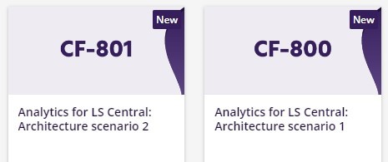
The future
Report packs
  General improvements
  Bookings reporting pack
Aggregated Inventory
LS Retail Academy courses
We listen to you!
CF-803
Soon

Slide 49
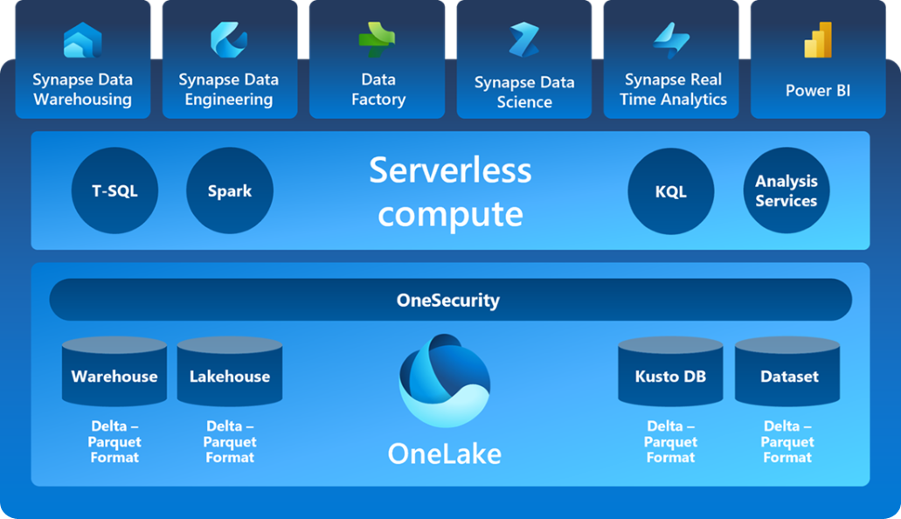
The future
Data load with Microsoft Fabric
Microsoft
Fabric
Database
mirroring
Business Central

Slide 50
Your Questions please!
(or feedback ☺)

Slide 51


Slide 52
Thank you

