Slide 1
Technical session:
Telemetry
Bjarni | Ricardo | Damir
working smart on improving performance

Slide 2
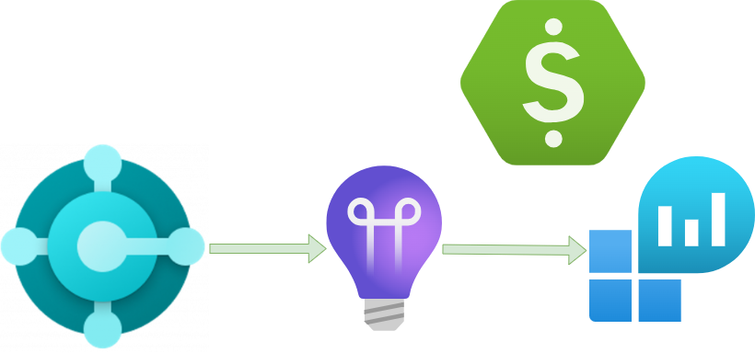
General info – Azure
Azure subscription
Application Insights (App Insights)
Log Analytics (ALA)

Slide 3
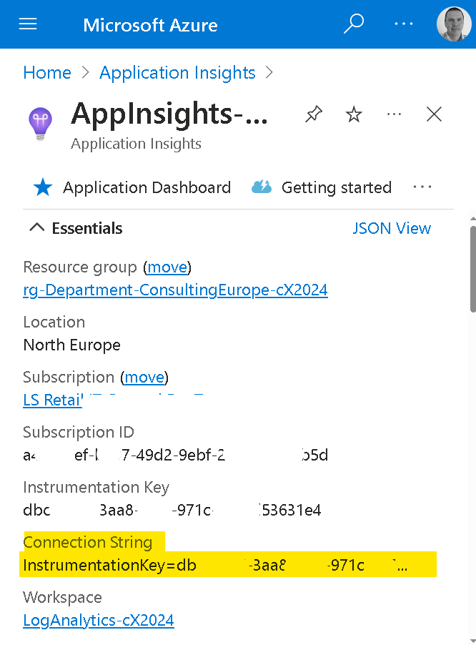
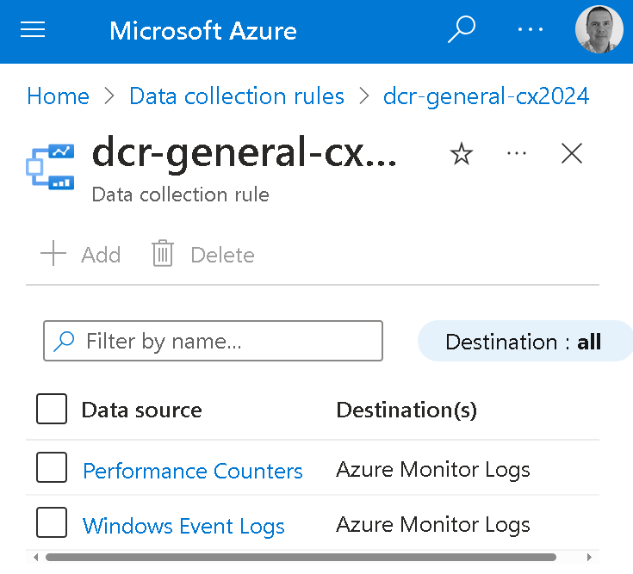
General info – Setup
Create App Insights
Get Connection String
Update BC
On-premises – Performance Counters via Data Collection Rules (DCR)
Older Versions – Events & Performance Counters via DCR

Slide 4
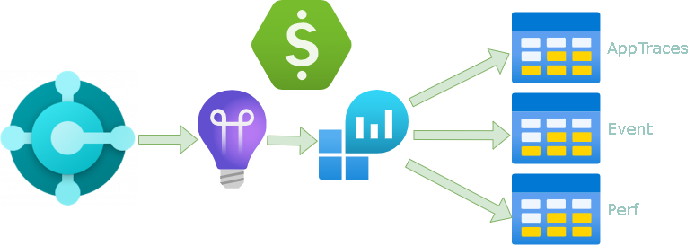
General info – Dude, where is my data?
Flow of data
  BC Service –> App Insights –> ALA –>AppTraces Table
  Performance Counters –> ALA –>Perf Table
  Events –> ALA –>Event Table
Costs and control (cap)
KQL
Alert

Slide 5


Troubleshooting issues on SaaS using telemetry
Real case scenarios
3 different cases
Issues related to:
  #1 - Deadlocks
  #2 - Performance on the POS
  #3 - Long running item cost adjustment
Use telemetry from day 1
Telemetry is not only to troubleshoot issues
Offers comprehensive insights into the condition and behavior of SaaS environment

Slide 6
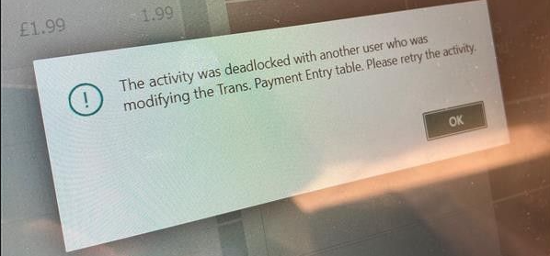
First scenario
Adding some context
“We are getting deadlocks on some transactions on the POS. It has been happening at various points during the week”
“On Saturday we had a lot of deadlocks on receipt posting on our customer running on SaaS”
# POS: 120 Fully Online
Retail Low Volume
No Data Replication

Slide 7
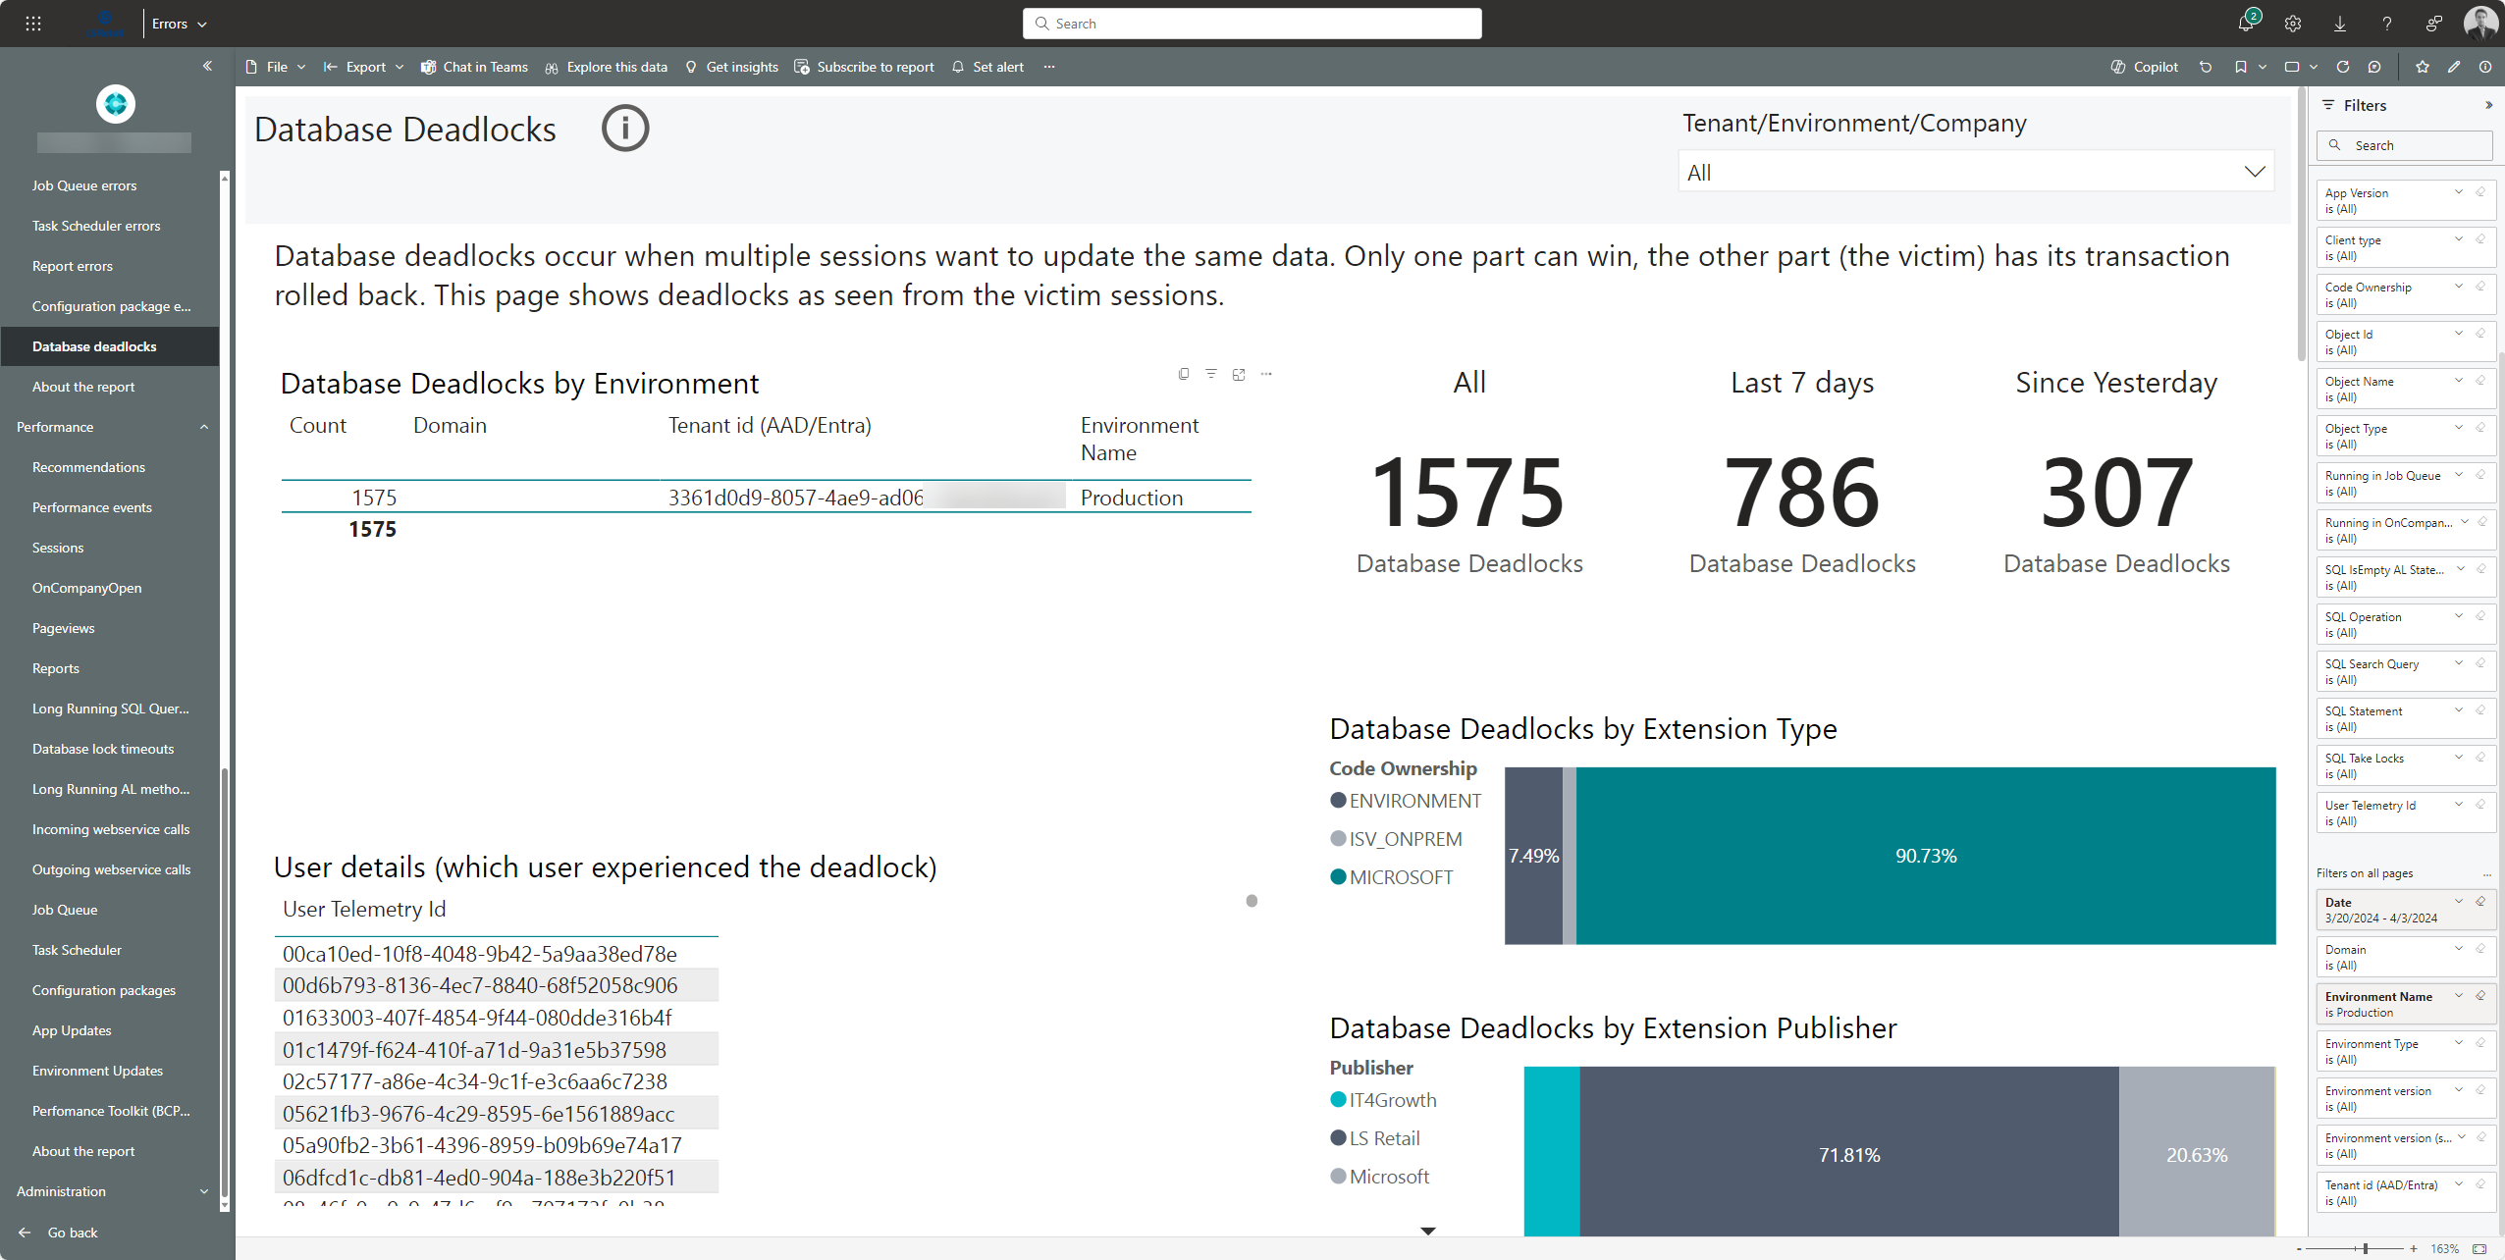
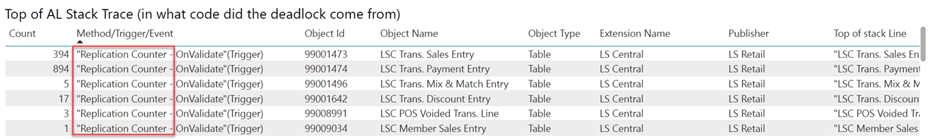
Step #1
Dynamics 365 Business Central Usage Analytics (PowerBI app)
Errors -> Database Deadlock

Slide 8
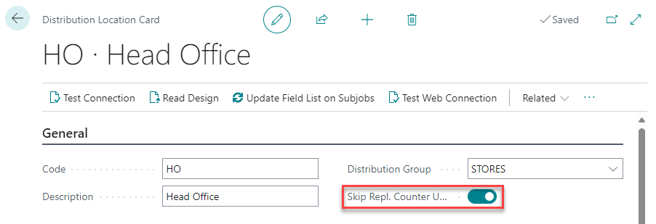
Step #2
Head Office Distribution Location card
Enable the Skip Repl. Counter Update flag
https://help.lscentral.lsretail.com/Content/Implementation-Guide/Performance-Online.htm

Slide 9
Second scenario
Adding some context
Proof-of-concept
HO on-premises in NAV 2016
Online POS in SaaS
Data replication from NAV 2016 to SaaS
“Our customer is having an issue where their very small environment which consists of a SaaS environment and few online POS is very slow in the morning”
Retail Low Volume
Data Replication
HO on-premises in NAV 2016
# POS: 2 Online

Slide 10
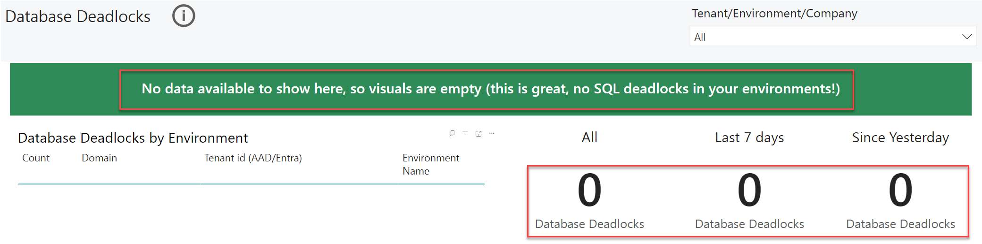
Step #1
Dynamics 365 Business Central Usage Analytics (PowerBI app)
Errors -> Database Deadlocks
No deadlocks!

Slide 11
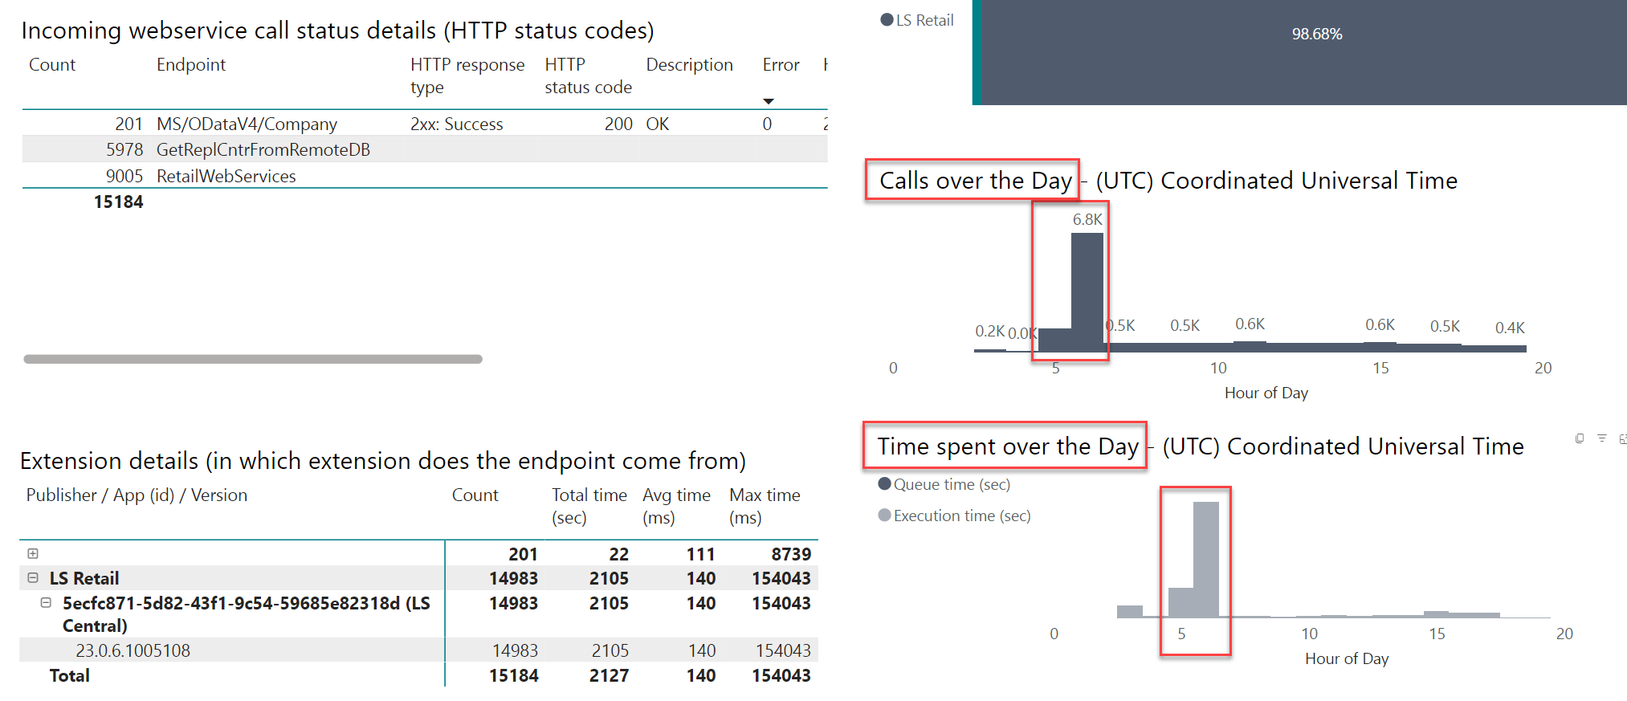
Step #2
Dynamics 365 Business Central Usage Analytics (PowerBI app)
Performance -> Incoming webservice calls

Slide 12
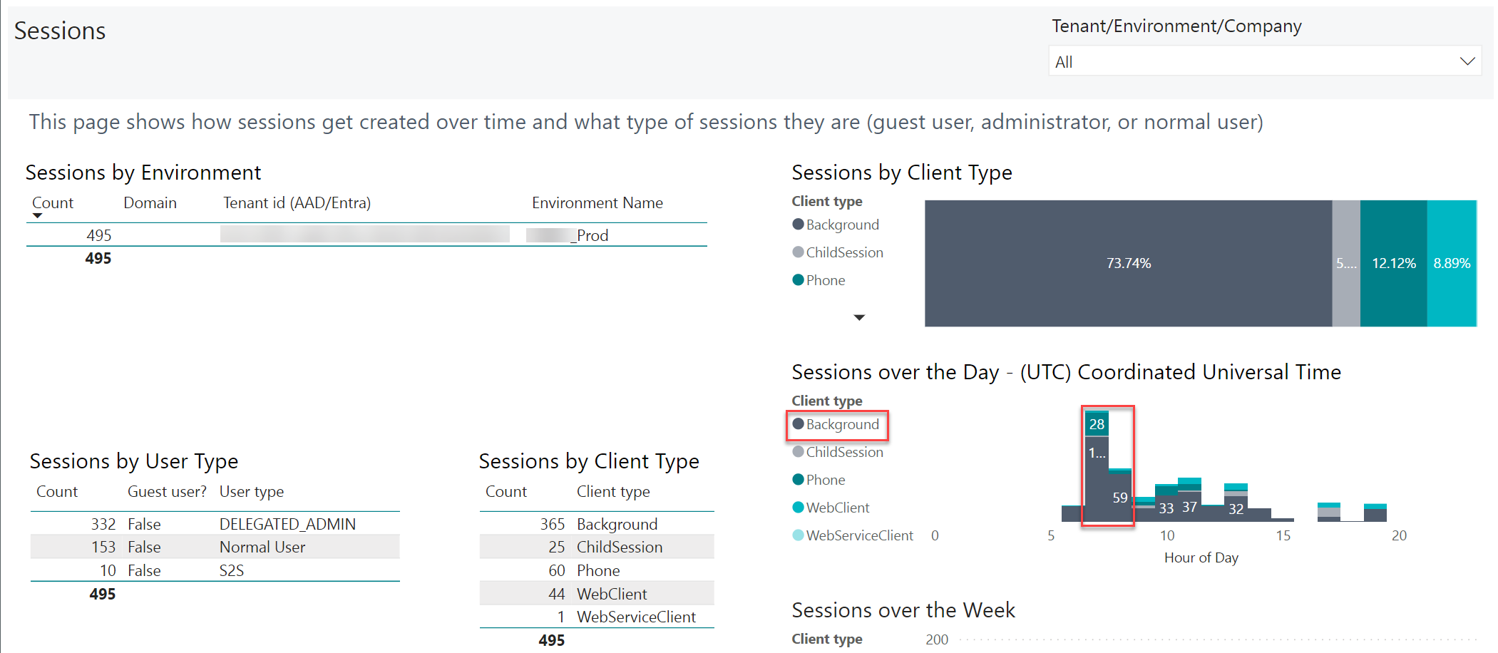
Step #3
Dynamics 365 Business Central Usage Analytics (PowerBI app)
Usage -> Sessions

Slide 13
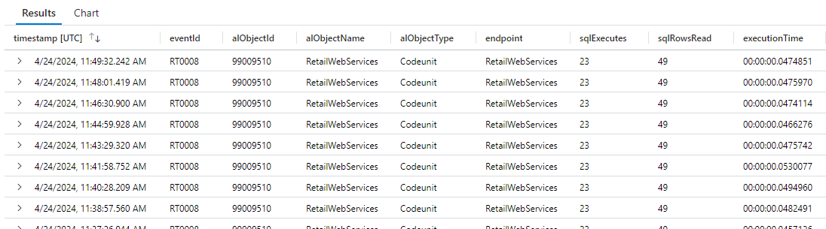
Step #4
Azure Application Insights
Run this KQL query
traces
| where timestamp > ago(1d)
| where customDimensions.eventId == "RT0008"
| project timestamp
, eventId = customDimensions.eventId
, alObjectId = customDimensions.alObjectId
, alObjectName = customDimensions.alObjectName
, alObjectType = customDimensions.alObjectType
, endpoint = customDimensions.endpoint
, sqlExecutes = toint(customDimensions.sqlExecutes)
, sqlRowsRead = toint(customDimensions.sqlRowsRead)
, executionTime = customDimensions.serverExecutionTime
Incoming Web Services Calls telemetry
Event Id RT0008
From Microsoft BCTech repository in Github:
https://github.com/microsoft/BCTech/blob/master/samples/AppInsights/KQL/Queries/ExampleQueriesForEachArea/WebServiceCalls.kql

Slide 14


Business
Central
Single
Endpoint
Request Type
(Request ID)
Web Services
GET_TABLE_DATA
WEB_REPL_START_PACKET
WEB_REPL_ADD_TABLE
WEB_REPL_EXE_PACKET
WEB_REPL_END_PACKET
…
RetailWebServices

Slide 15
Step #5
VS Code
New extension subscribing events from LSC Web Services codeunit
[EventSubscriber(ObjectType::Codeunit, Codeunit::"LSC Web Services", OnAfterRequestType, '', false, false)]
local procedure OnAfterRequestType(Request: Record "LSC WS Request"; RequestID: Text[30]; var pxmlRequest: Text; Authorized: Boolean; LocalProcess: Boolean;
Response_Code: Code[30]; Response_Text: Text[1024]; var pxmlResponse: Text; StartDateTime: DateTime);
var
Dimensions: Dictionary of [Text, Text];
begin
Dimensions.Add('RequestID', RequestID);
Dimensions.Add('StartDateTime', Format(StartDateTime));
Dimensions.Add('RequestXml', pxmlRequest);
Dimensions.Add('ResponseCode', Response_Code);
Dimensions.Add('ResponseText', Response_Text);
Dimensions.Add('ResponseXml', pxmlResponse);
// Event Id will be ALLSC-0001
Session.LogMessage('LSC-0001', 'RetailWebService called', Verbosity::Normal, DATACLASSIFICATION::SystemMetadata, TelemetryScope::All, Dimension);
end;

Slide 16
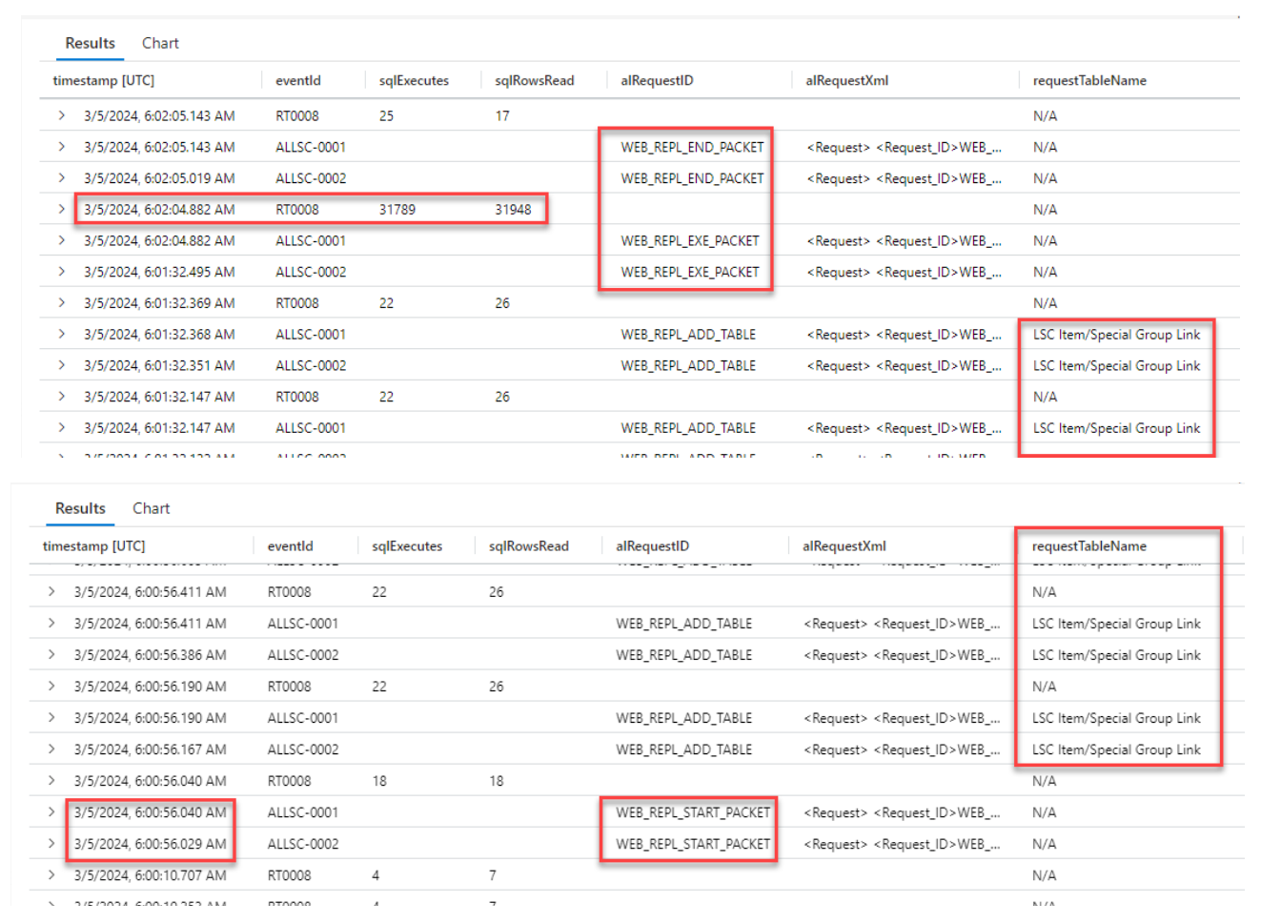
Step #6
Azure Application Insights
Run this KQL query
traces
| where timestamp >= datetime(2024-02-20 05:50:00.000)
| where timestamp <= datetime(2024-02-20 07:10:00.000)
| where customDimensions.eventId == "RT0008"
or customDimensions.eventId startswith "ALLSC"
| extend requestTableName =
case (
customDimensions.alRequestID == 'WEB_REPL_ADD_TABLE’,
extract('<Table_Name>(.*?)</Table_Name>', 1,
tostring (customDimensions.alRequestXml))
, "N/A")
| project timestamp
, eventId = customDimensions.eventId...

Slide 17
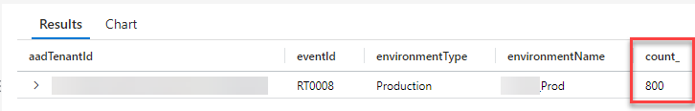
Step #7
Azure Application Insights
Run this KQL query
traces
| where timestamp >= datetime(2024-03-05 06:00:56.000)
| where timestamp <= datetime(2024-03-05 06:02:06.000)
| where customDimensions.eventId == "RT0008"
| project timestamp
, eventId = customDimensions.eventId
, aadTenantId = tostring (customDimensions.aadTenantId)
, environmentName = tostring (customDimensions.environmentName)
, environmentType = tostring (customDimensions.environmentType)
| summarize count() by aadTenantId, eventId, environmentType, environmentName
800 WS calls in 1 minute!

Slide 18
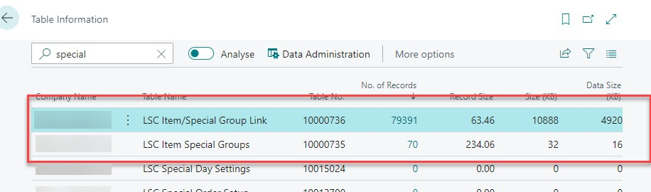
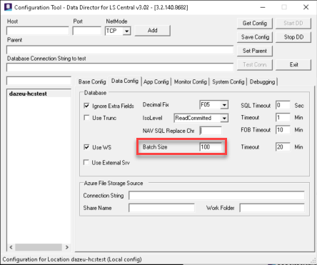
Step #7
LSC Item/Special Group Link
Batch Size in Data Director set to
Results in a huge amount of Web Service calls
(in 1 min)
Environment flooded with WS calls
(running in background sessions)
80k records
100
800

Slide 19
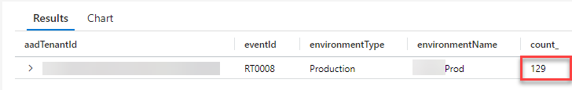
Step #8
Data Director Config Tool or Scheduler Job Card
Batch Size updated to 500 (most likely could even go higher)
Run this KQL query
traces
| where timestamp >= datetime(2024-03-04 06:01:00.000)
| where timestamp <= datetime(2024-03-04 06:06:00.000)
| where customDimensions.eventId == "RT0008"
| project timestamp
, eventId = customDimensions.eventId
, aadTenantId = tostring (customDimensions.aadTenantId)
, environmentName = tostring (customDimensions.environmentName)
, environmentType = tostring (customDimensions.environmentType)
| summarize count() by aadTenantId, eventId, environmentType, environmentName
800 WS calls per minute
129 WS calls per minute

Slide 20
Third scenario
Adding some context
“Customer has run item cost adjustment routine (Adjust Cost – Item Entries report) for 3 days but didn’t finish yet”
“Customer has about 6000 SKUs and costing method is average by item & location & variant”
#POS: 100
Fully Online
Coffee Shop
No Data Replication

Slide 21

Recommendations/Best practices
Adjust Cost – Item Entries report
  Run it more often
  Run it in batches of items (instead of running for all the items)
How many batches should I run?
How many and what items should I include in each batch?
What items are taking longer, and do I need to analyze deeper?
We need… metrics!

Slide 22
Step #1
VS Code
New extension subscribing events from Inventory Adjustment codeunit
[EventSubscriber(ObjectType::Codeunit, Codeunit::"Inventory Adjustment", OnMakeSingleLevelAdjmtOnBeforeCollectAvgCostAdjmtEntryPointToUpdate, '', false, false)]
local procedure OnMakeSingleLevelAdjmtOnBeforeCollectAvgCostAdjmtEntryPointToUpdate(var TheItem: Record Item);
var
Dimensions: Dictionary of [Text, Text];
begin
Dimensions.Add('ItemNo', TheItem."No.");
Dimensions.Add('EventTriggered', 'OnMakeSingleLevelAdjmtOnBeforeCollectAvgCostAdjmtEntryPointToUpdate');
Session.LogMessage('LSC-0002', 'OnMakeSingleLevelAdjmtOnBeforeCollectAvgCostAdjmtEntryPointToUpdate called',Verbosity::Normal,
DATACLASSIFICATION::SystemMetadata, TelemetryScope::All, Dimensions);
end;
[EventSubscriber(ObjectType::Codeunit, Codeunit::"Inventory Adjustment", OnMakeSingleLevelAdjmtOnAfterUpdateItemUnitCost, '', false, false)]
local procedure OnMakeSingleLevelAdjmtOnAfterUpdateItemUnitCost(var TheItem: Record Item; var TempAvgCostAdjmtEntryPoint: Record "Avg. Cost Adjmt. Entry Point" temporary; var LevelExceeded: Boolean; IsOnlineAdjmt: Boolean; var ItemJnlPostLine: Codeunit "Item Jnl.-Post Line");
var
Dimensions : Dictionary of [Text, Text];
begin
Dimensions.Add('ItemNo', TheItem."No.");
Dimensions.Add('EventTriggered', 'OnMakeSingleLevelAdjmtOnAfterUpdateItemUnitCost');
Session.LogMessage('LSC-0003', 'OnMakeSingleLevelAdjmtOnAfterUpdateItemUnitCost called', Verbosity::Normal,
DATACLASSIFICATION::SystemMetadata, TelemetryScope::All, Dimensions);
end;

Slide 23
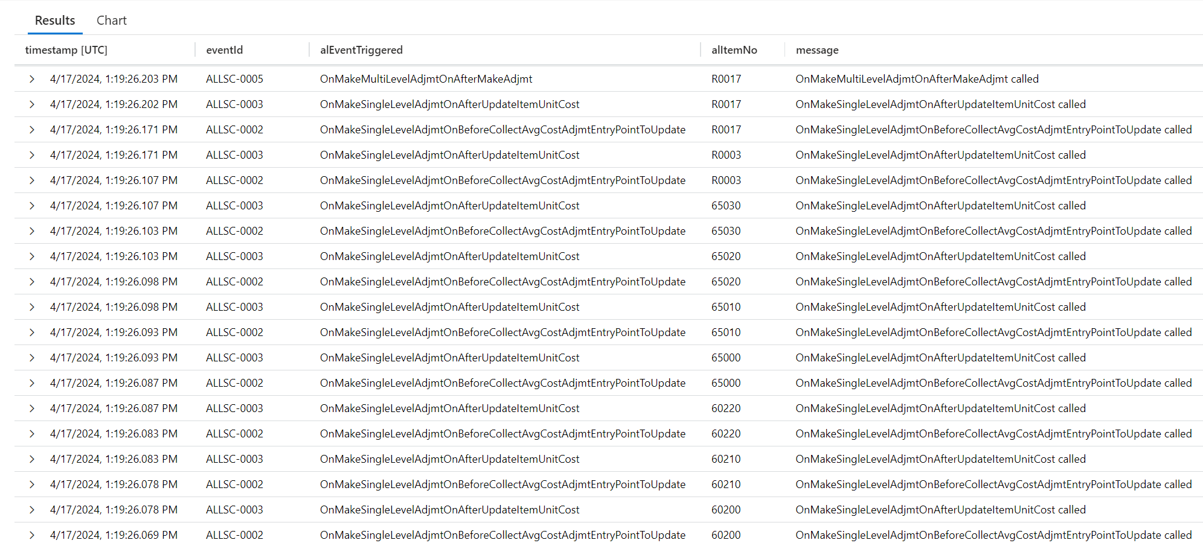
Step #2
Azure Application Insights
Run this KQL query
ALLSC-0002
Item entries (for an item) started being adjusted
traces
| where customDimensions.eventId startswith "ALLSC"
| extend eventId = customDimensions.eventId
| extend alEventTriggered = customDimensions.alEventTriggered
| extend alItemNo = customDimensions.alItemNo
| order by timestamp desc
ALLSC-0003
Item entries (for an item) have been adjusted

Slide 24
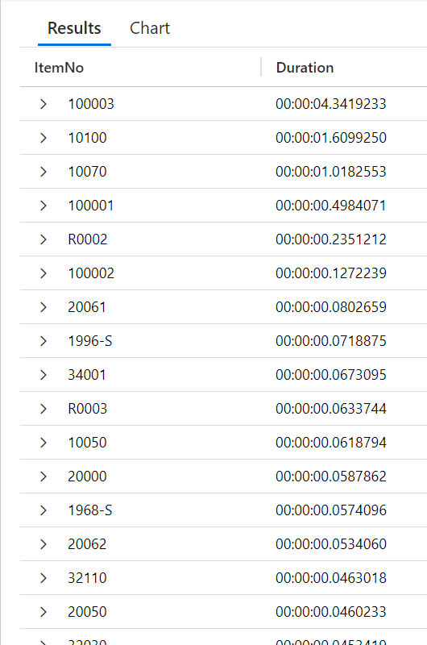

Step #3
Azure Application Insights
Run this KQL query
traces
//| where timestamp > ago(1d)
| where customDimensions.eventId startswith "ALLSC"
| summarize diff =
anyif(timestamp,customDimensions.eventId == "ALLSC-0003") -
anyif(timestamp,customDimensions.eventId == "ALLSC-0002")
by tostring(customDimensions.alItemNo)
| where isnotnull(diff)
| order by diff desc
| project ItemNo = customDimensions_alItemNo, Duration = diff
Now we know
how much time it took
to run the
Item Cost Adjustment
for each item

Slide 25

Result
    Don’t start a SaaS implementation without setting up telemetry
Partner setup the item cost adjustment routine to run in batches, a few times a week during non-business hours.
Time to run the routine went down from 3 days to 3 hours ^{(*)}
(*) To run the routine one last time, at the end of the month, to adjust the remaining entries

Slide 26
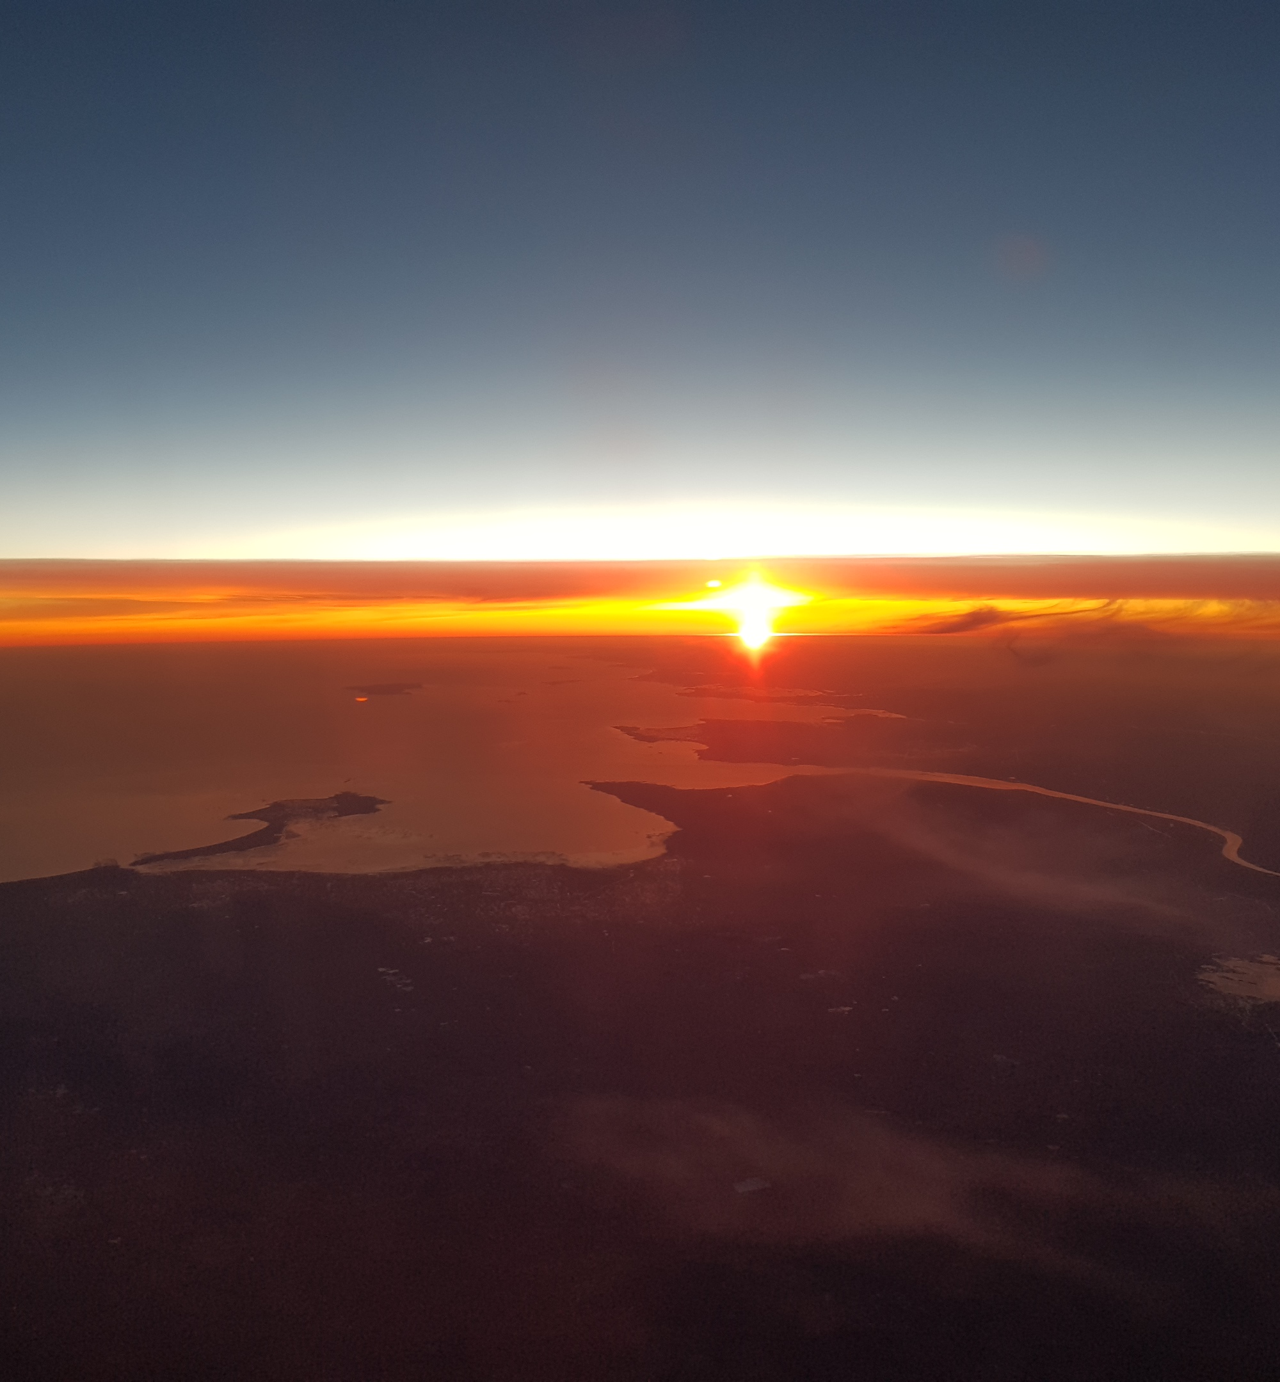
On-premises
Everything that is not SaaS
More moving parts require more control
Performance Counters
Demo: KQL basics, capturing latency, Dashboard and Alert

Slide 27

You wanted this…

Slide 28

…and to avoid this...

Slide 29
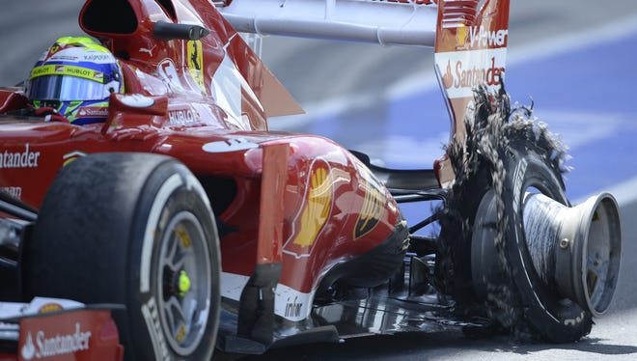
...and that should not happen...

Slide 30
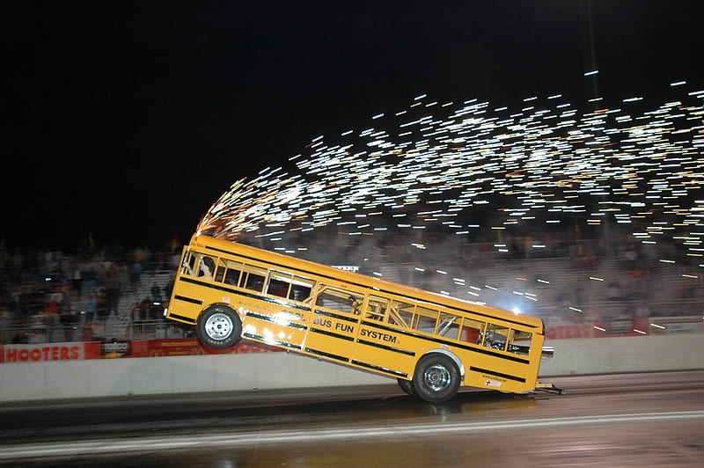
…or maybe get more room for passengers

Slide 31

Performance review
Very often we are back to the basics
  It is important to get the fundamentals right
  Is the “hardware” correct?
  Is the timeline - hours per day - utilized well?
  Are we using the tools we have?
But as well
  Is the architecture supporting us?
  Details around parameters and tuning.
We have been doing this
  for all types of clients from different verticals
  in all continents
  with a very high success rate identifying issues

Slide 32

On-prem challenges solved
Extreme slow performance
  Slow disk system under SQL
  Or “incorrect” disk system
  Under spec’d Service tier Server(s)
Index maintenance and tuning
Analyzing best options for parallelism
Extensive growth of TempDB
Tables with excessive no. of records
Table and deadlocks we might be able to work around

Slide 33
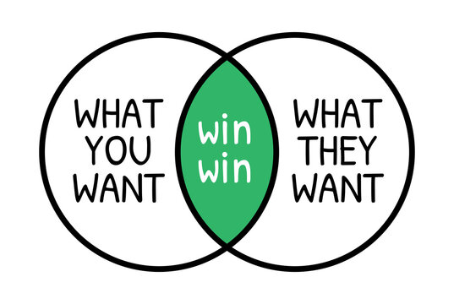
Goal
The client wins
The partner wins
…and LS Retail wins
Challenge identified and solved
Faster stable solution
Focus on other tasks or projects
Time for more projects
Happier channel

Slide 34
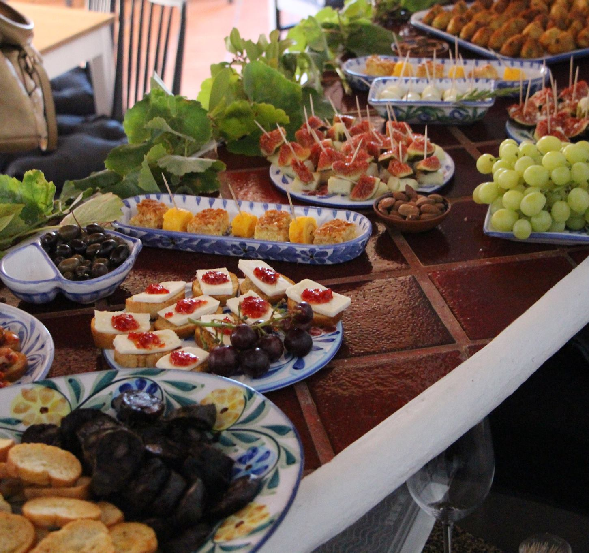
Final takeaway
Telemetry is your best friend
It’s not only for troubleshooting, not only for production
Dashboards & alerts are a great way to monitor our customers’ environment state
Telemetry can help you
  increase customers’ satisfaction & retention
  as well as create additional products & services
Get trained in telemetry – new on demand course is available from LS Retail Academy
Still stuck? We can help you with SaaS and on-premises, reach out to LS Retail

Slide 35
Questions?

