Slide 2

AppShell for LS Central - all you ever wanted to know
Thorir Bjornsson
Customer Technical Lead

Slide 3

appshell noun
app-shell | \‘app-, shell \
plural appshells
Definition of appshell
: an App to start LS Central in a controlled way
and in some scenarios provide direct access to hardware

Slide 4
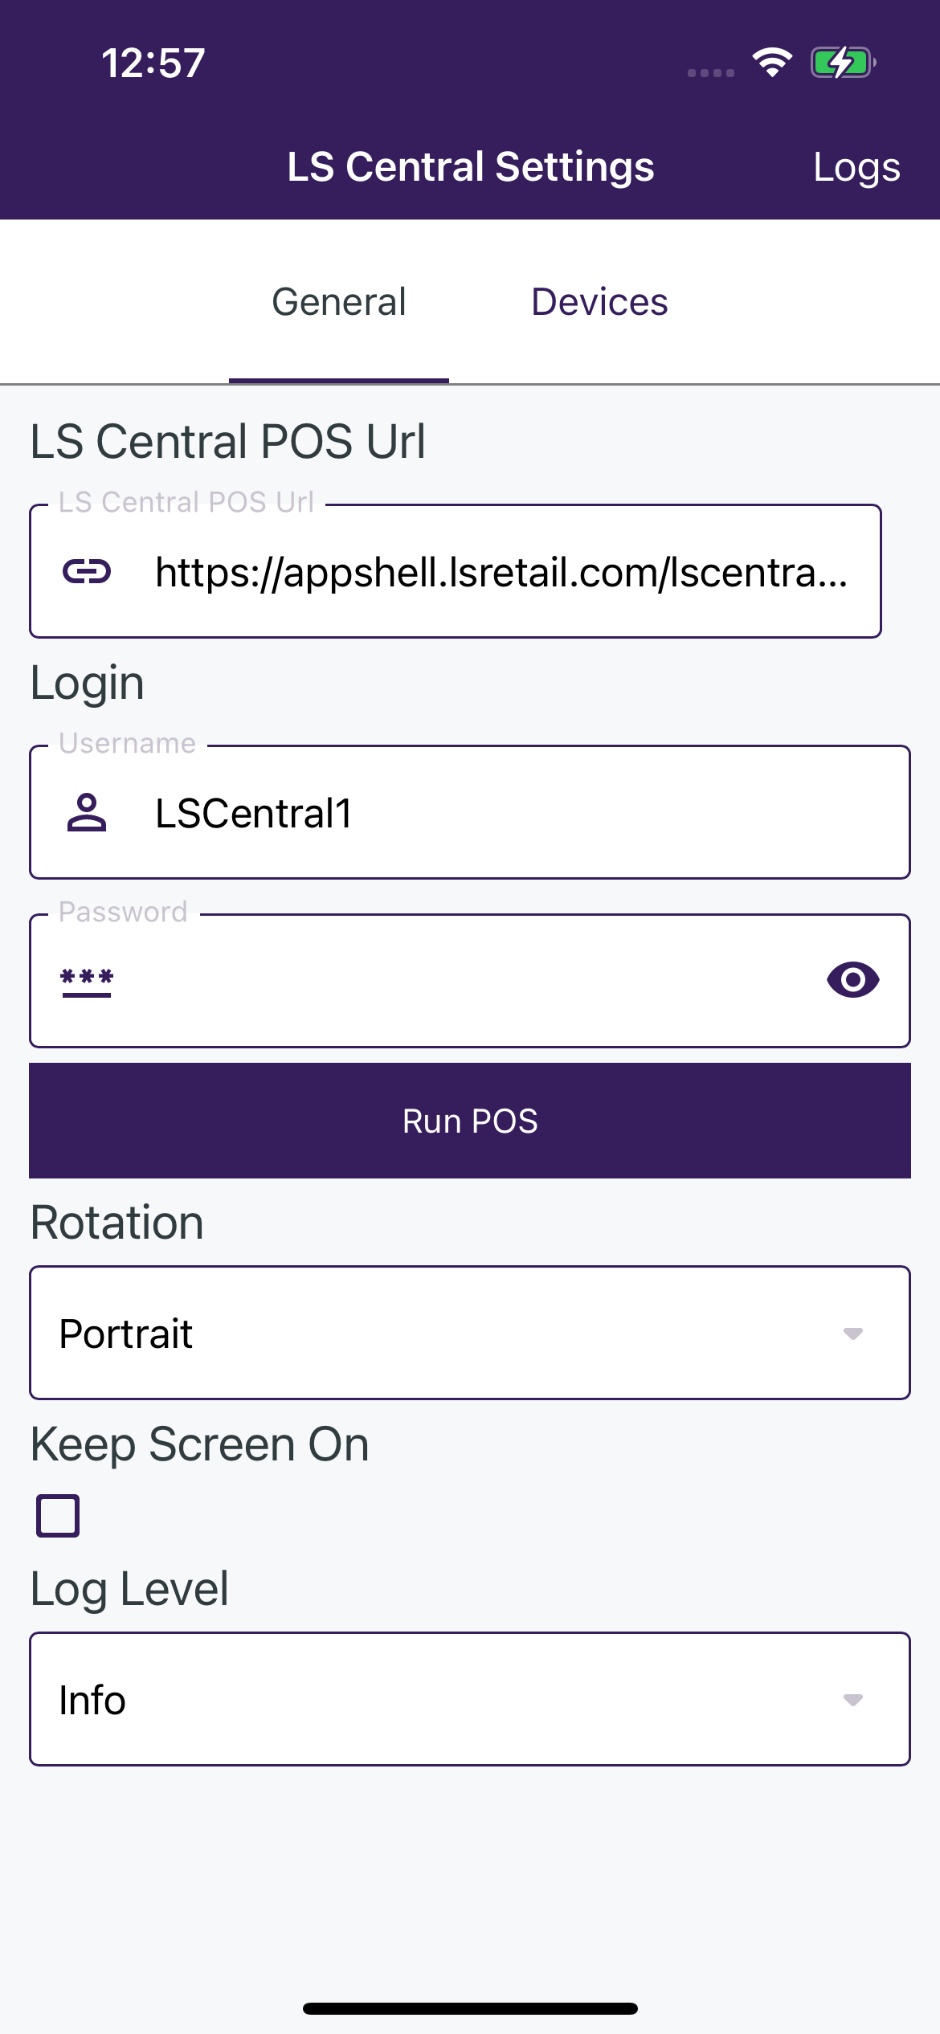
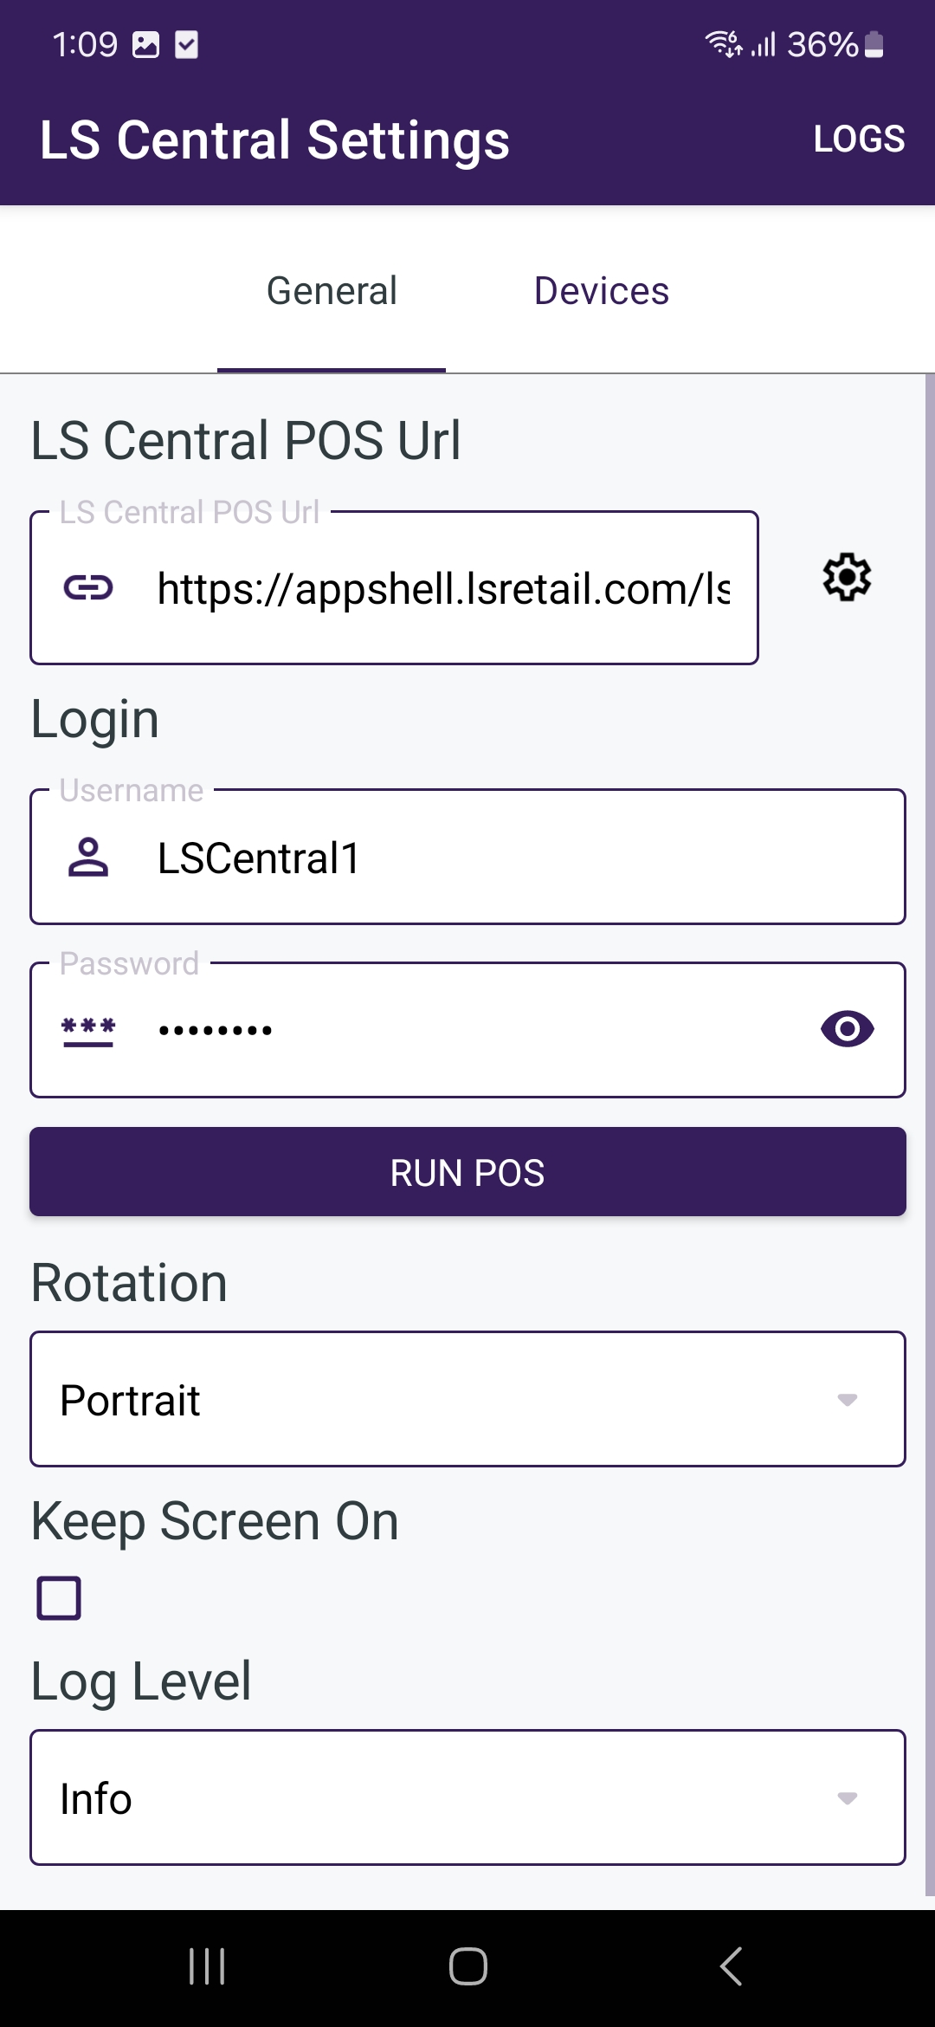
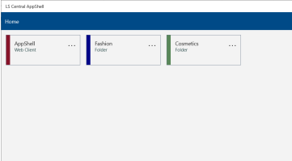



App(s) for different operating systems
Windows 10 build 17763 or later
Android 7.0 or later
iOS 13.4 or later

Slide 5



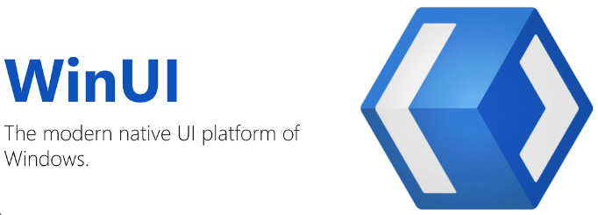


The development environment
Android/iOS AppShell
  Made as a single app using Microsoft .Net Maui 8
  Shares a single UI, uses native controls under the hood
  Released in Google Play, Apple App Store,
  and LS Retail Partner Portal
Windows AppShell
  Created using the Windows App SDK and WinUI 3 Controls
  Released in the Microsoft Store
  and LS Retail Partner Portal

Slide 6





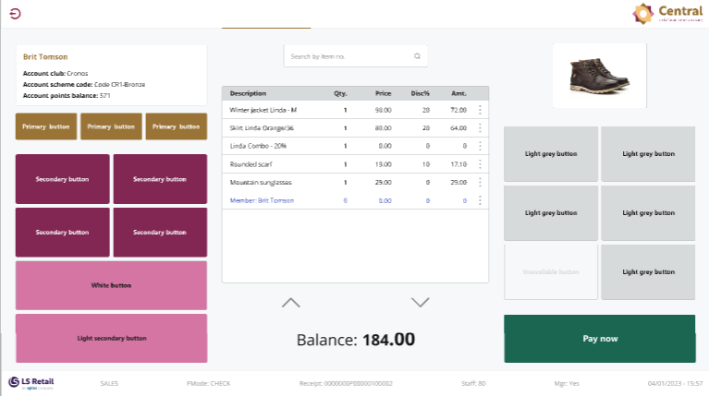
What browser does the AppShell use?
?

Slide 7



What browser does the AppShell use?
Windows AppShell
  Chromium engine through the WebView2 runtime from Microsoft
Android AppShell
  Chromium engine through Android Webview provided by Google
iOS AppShell
  Uses the WKWebView control from Apple, uses the WebKit engine, same as Safari

Slide 8
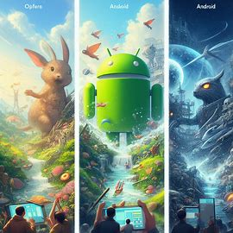
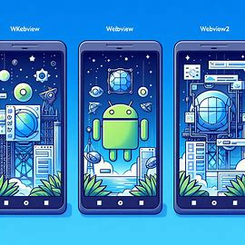
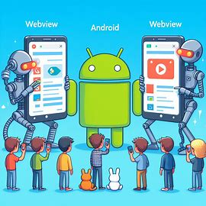
AI : explain the browser libraries with a simple image

Slide 9
appshell noun
app-shell | \‘app-, shell \
plural appshells
Definition of appshell
: an App to start LS Central in a controlled way
and in some scenarios provide direct access to hardware

Slide 10
-DEMO-

Slide 11
appshell noun
app-shell | \‘app-, shell \
plural appshells
Definition of appshell
: an App to start LS Central in a controlled way
and in some scenarios provide direct access to hardware

Slide 12
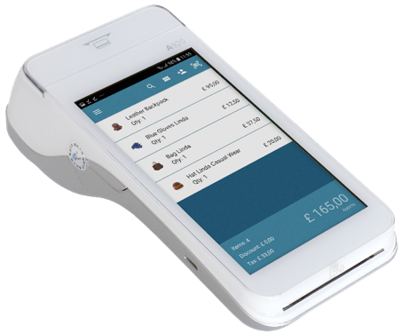
LS Central access to hardware
Windows
Access to hardware is through Hardware Station for LS Central
iOS
Access to hardware can be through Hardware Station for LS Central
Access to hardware can be through Hardware Station for LS Central
and additional direct hardware access:
Printers supported
Zebra
Epson
Bixolon
PED Printers
Payments
LS Pay Service
Android payment
devices supported by LS Pay
and additional direct hardware access:
Printers supported
Bixolon
Payments
LS Pay Service

Slide 13
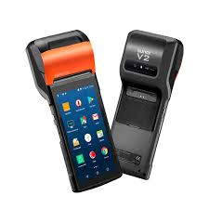
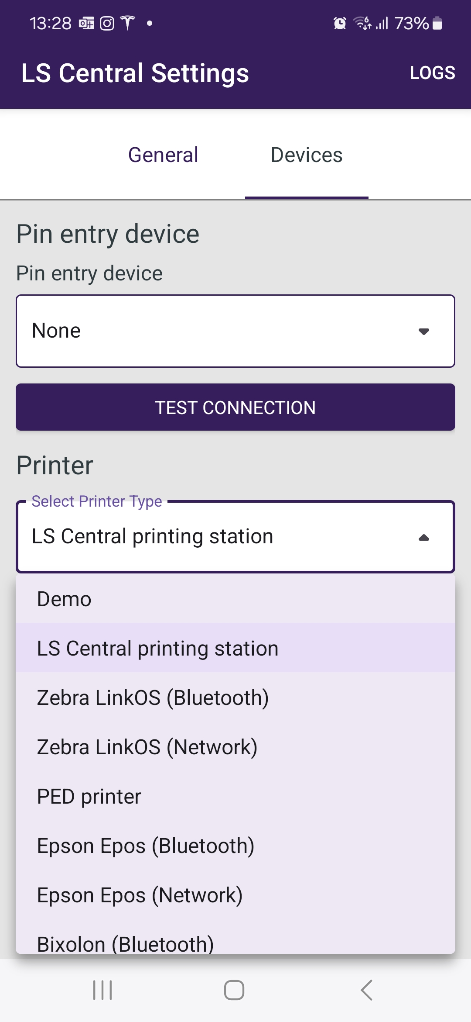
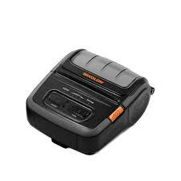
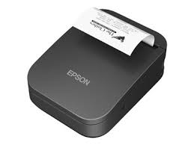
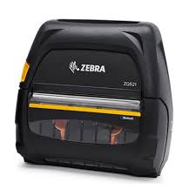
Android AppShell access to hardware
Android AppShell
Access to hardware can be through Hardware Station for LS Central.
AppShell has additional direct hardware access to a built-in
hardware or hardware connected via Bluetooth or WiFi.
Printers supported:
Zebra LinkOS (Bluetooth or Network)
Epson Epos (Bluetooth or Network)
Bixolon (Bluetooth)
PED Printers (Sunmi)
Payments:
LS Pay Service
Android payment devices supported by LS Pay
Scanners:
Directly through build in scanner or camera
NFC:
Directly through build in NFC reader

Slide 14
iOS AppShell access to hardware
iOS AppShell
Access to hardware can be through Hardware Station for LS Central
iOS AppShell can provide direct access:
Printers supported
Bixolon Bluetooth connected
Payments
LS Pay Service

Slide 15
-DEMO-

Slide 16
appshell noun
app-shell | \‘app-, shell \
plural appshells
Definition of appshell
: an App to start LS Central in a controlled way
and in some scenarios provide direct access to hardware

Slide 17

Roadmap ..
Development is driven by feedback from development/consulting, customers and partners
Multi-environment support
More printer support for Android and iOS versions
Support for NFC reader in Android Done
Thank you for your comments and feedback ☺

Slide 18
Your questions please!
(or feedback ☺)

Slide 19
Frequently asked questions
How is the browser engine used by AppShell updated?
  - Browsers automatically update themselves
Is POS started in AppShell slower than when it's started directly in a browser?
  - Overhead of AppShell is minimum. Using a browser directly should have similar performance although browser specific implementations could have an effect.
What options are there for older operating systems?
  - The old windows based “LS Start” program can be used with older operating systems
Are AppShell versions backwards compatible?
  - Yes, you can always update to the latest version and get the newest features and fixes
Is the iOS version of AppShell now recommended?
  - LS Retail's preferred mobile operating system is Android, but the iOS version is in development although it is not as rich in supported devices.

Slide 20
Thank you

