Slide 1
Update Service in real life
Thorir Bjornsson
Customer Technical Lead

Slide 2

Update Service in real life
Compass 2024 Europe
Thorir Bjornsson
Customer Technical Lead

Slide 3

Packages
Components split into multiple packages
Package is a zip archive:
  Installation files
  Install scripts
  Manifest
    Name
    ID
    Version

Slide 4
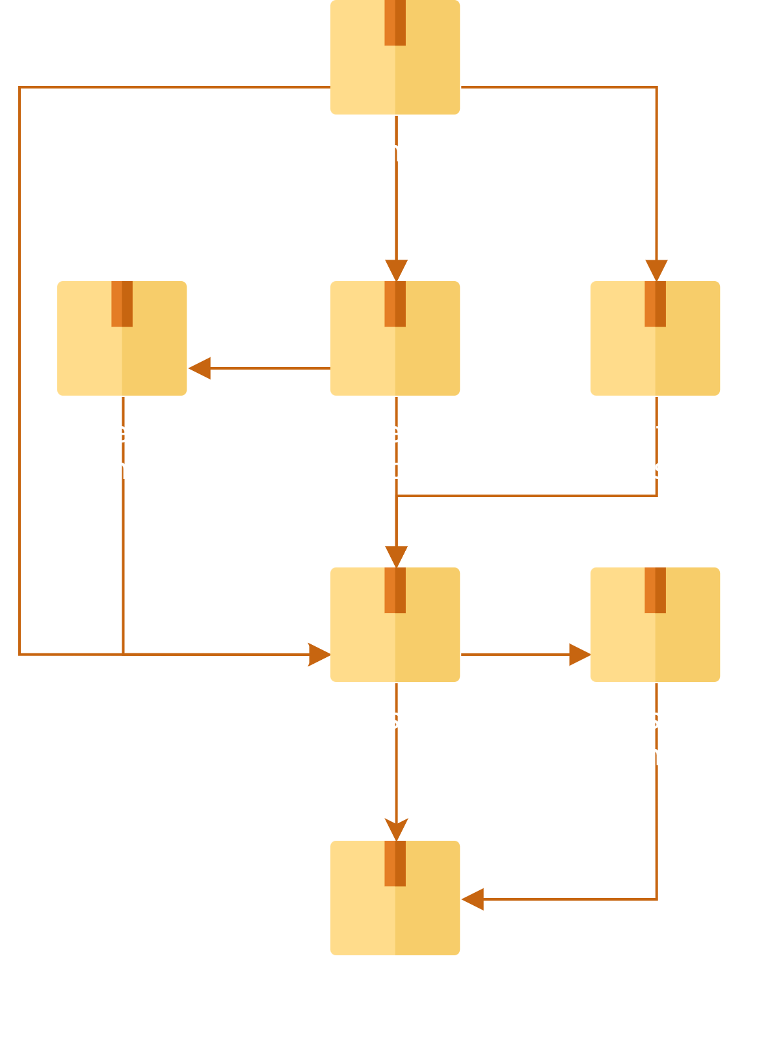
Dependencies
Package can depend on other packages
Installing a package will install its dependencies
Ensures correct order

Slide 5
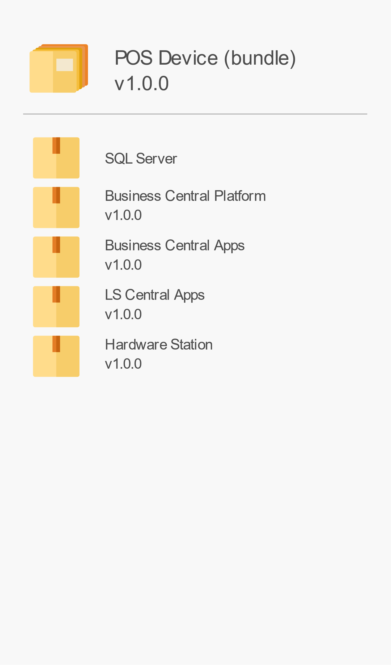
Bundle
Create a bundle to
  Pick components
  Select versions
  Set configuration
Installs all components
In correct order
Bundle a package with dependencies

Slide 6
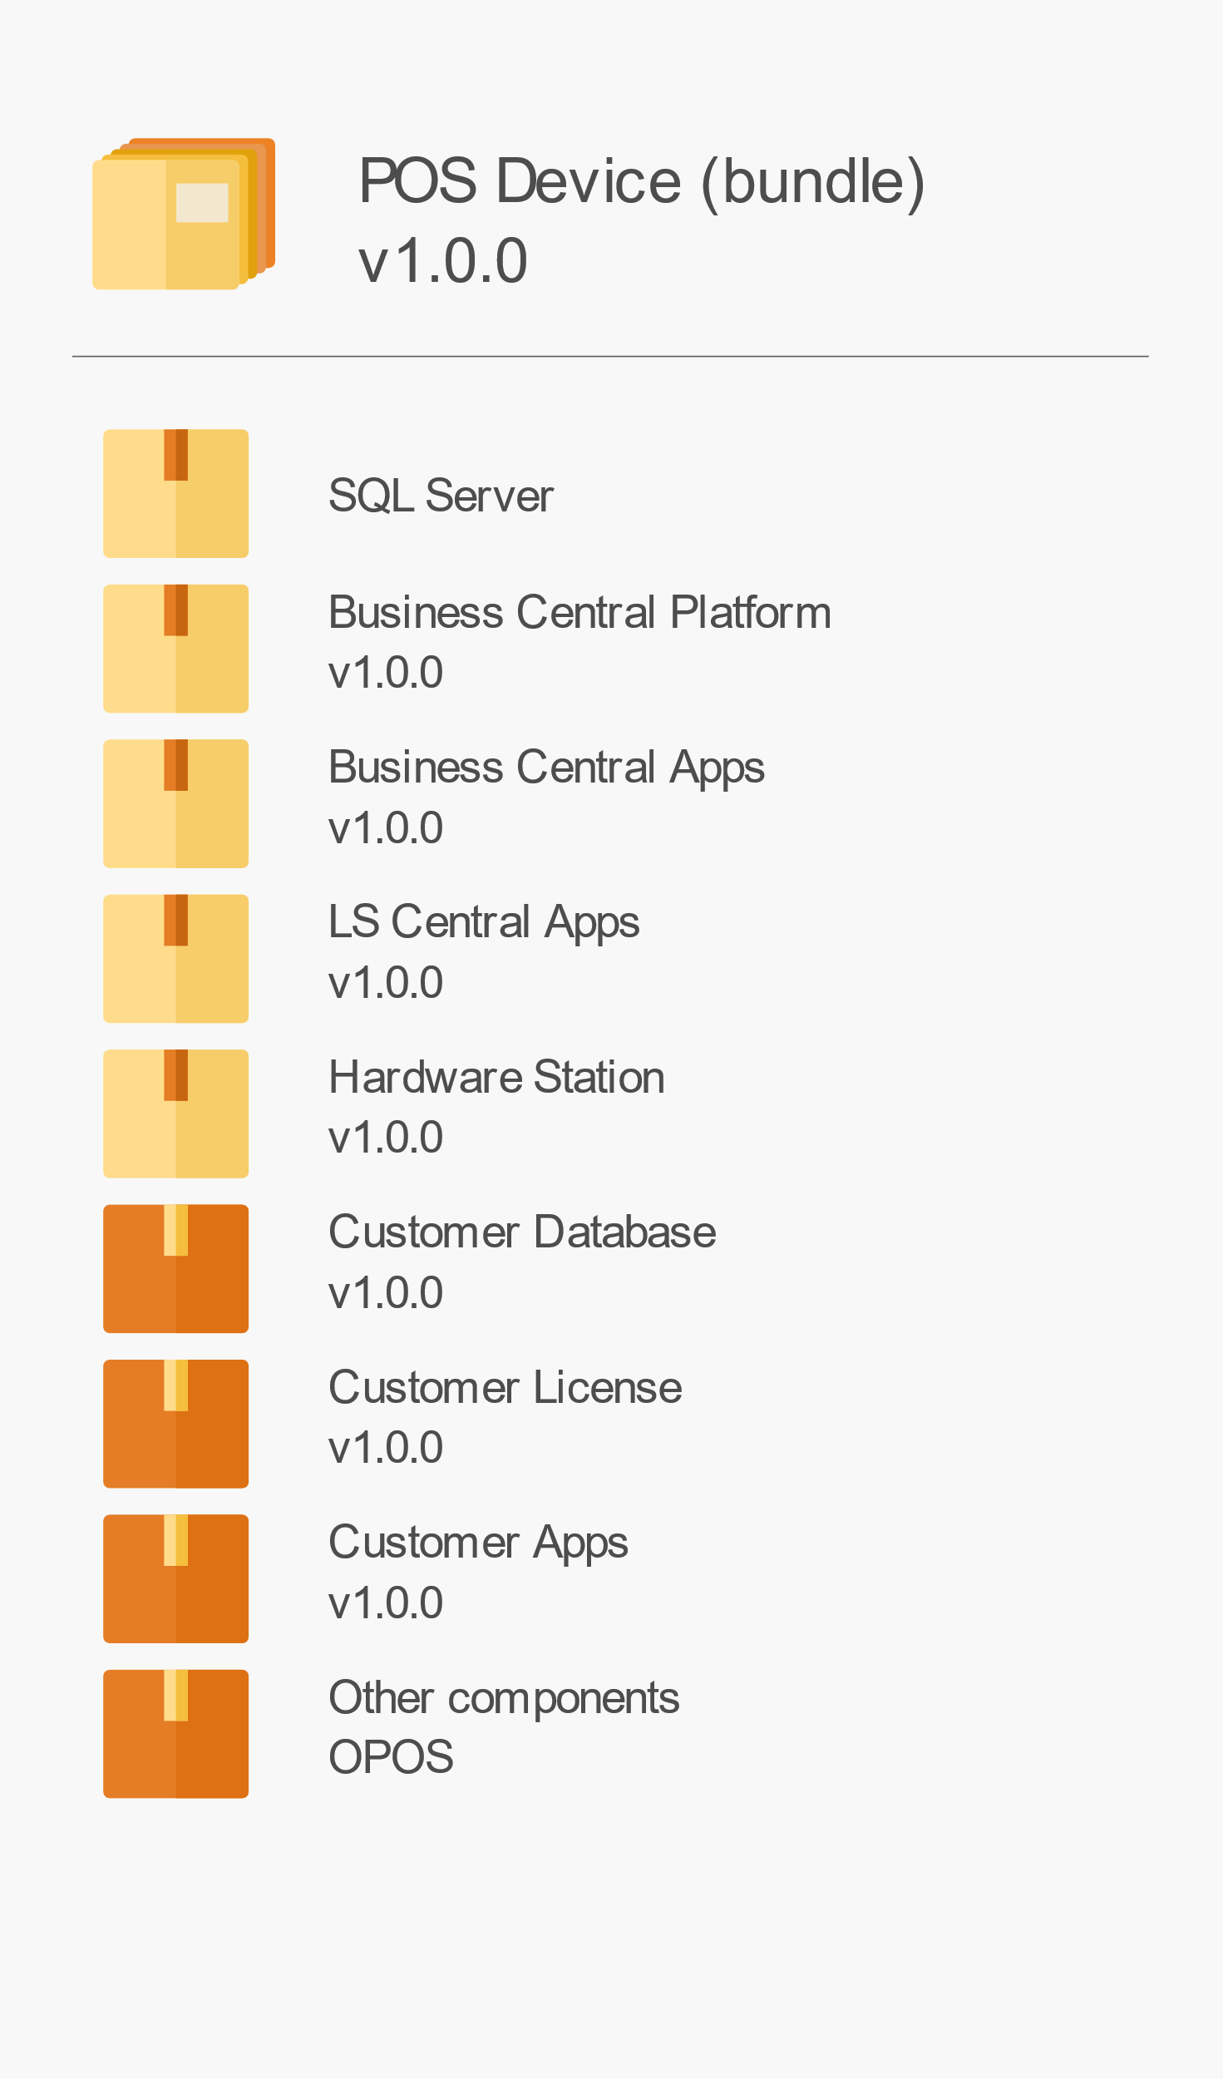
Bundle
Create a bundle to
  Pick components
  Select versions
  Set configuration
Installs all components
In correct order
Bundle a package with dependencies

Slide 7
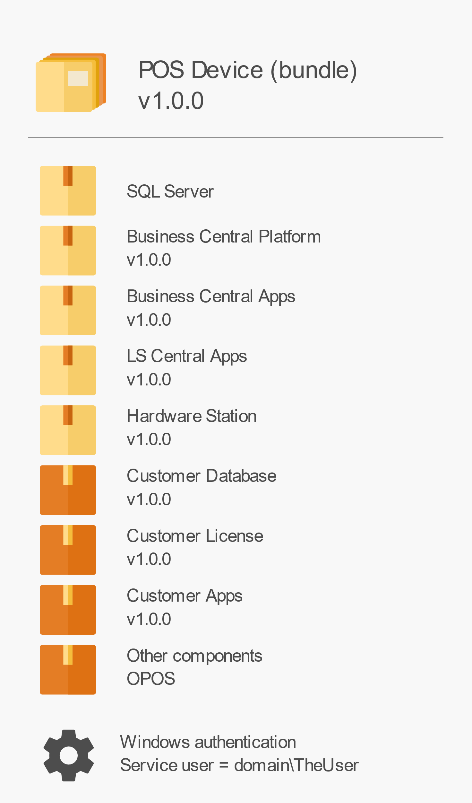
Bundle
Create a bundle to
  Pick components
  Select versions
  Set configuration
Installs all components
In correct order
Bundle a package with dependencies

Slide 8
Packages
/ Bundle
  Exsample SaaS POS / Online
  Version = '22.3.4'
  Name = "$($Config.Name) POSFB"
  Instance = $true
  # POS LS Hardware station /Devices and registry files for devices
  @{ Id = 'ls-hardware-station'; 'Version' = "24.1.0+03d05fb3" }
  @{ Id = 'cl-hwst-device-config'; 'Version' = "1.0.1" }
  @{ Id = 'cl-windows-registry'; 'Version' = "1.0.0" }
  # POS OPOS
  @{ Id = 'ls-central-opos'; 'Version' = ">=14.02.00.1035" }
  # POS DISPLAY (we install the LS AppShell
  # AppShell is running under user context after installation y
  @{ Id = "ls-central-appshell"; 'Version' = "2024.6.169.0"}
  @{ Id = "cl-appshell-config-file-ct"; 'Version' = "1.0.1"}
  #POS AppShell
  @{ Id = 'bc-web-client'; Version = $Config.BcPlatformVersion }
  @{ Id = 'ls-central-start'; 'Version' = ">=14.04.00.1129" }

Slide 9
Bundle package for Offline POS
bundle offline.txt

Slide 10
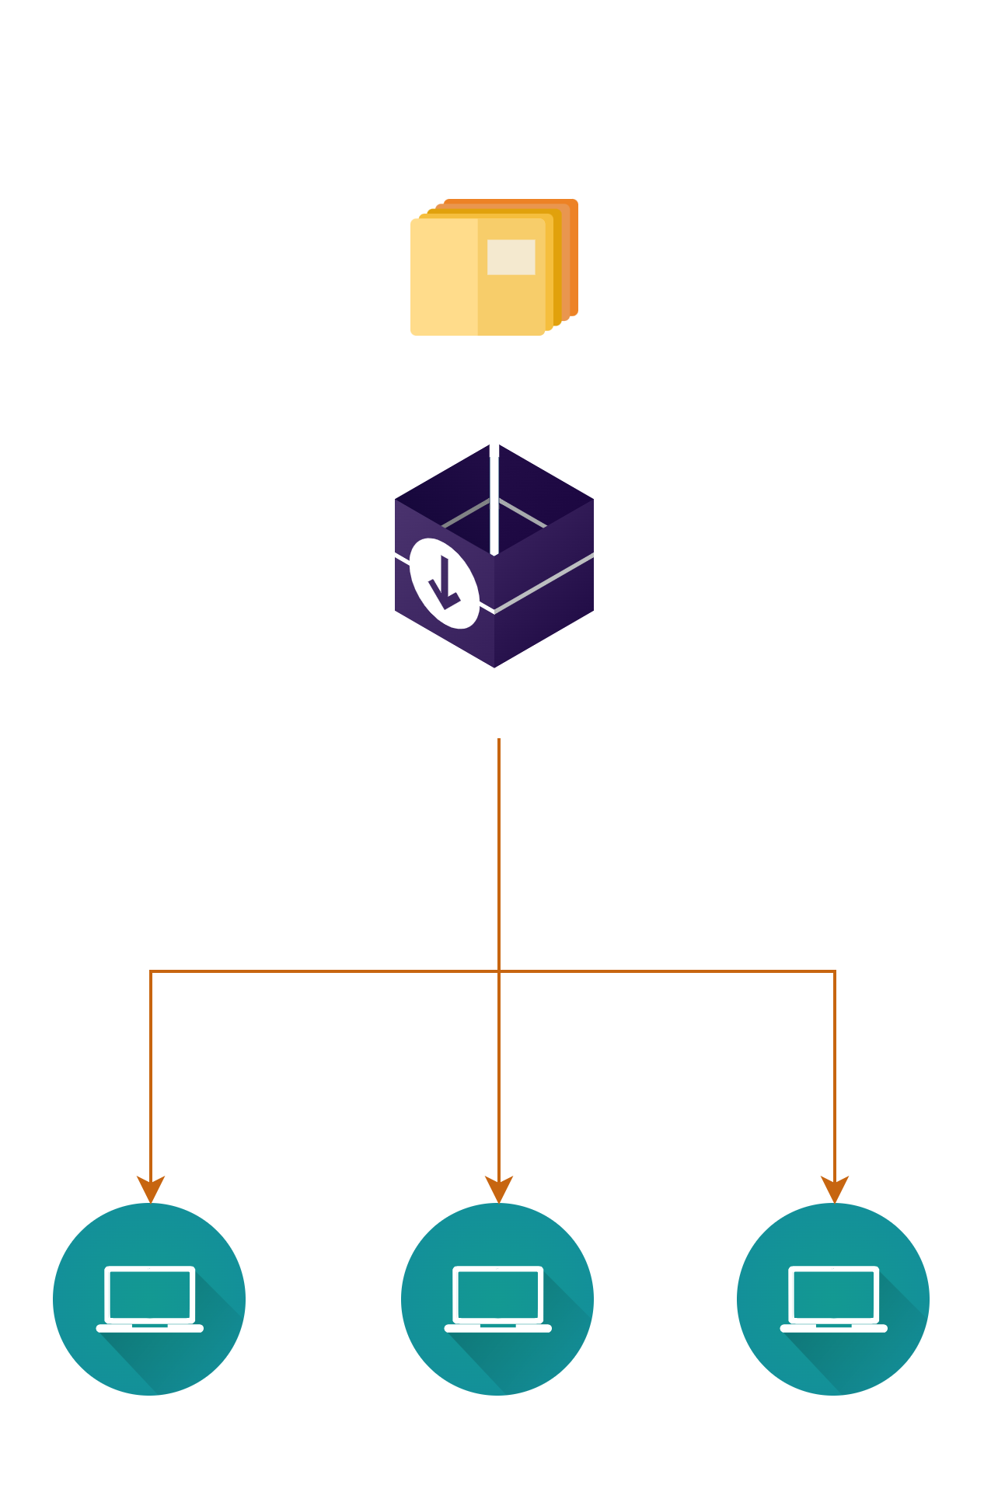
Install: Installer

Slide 11
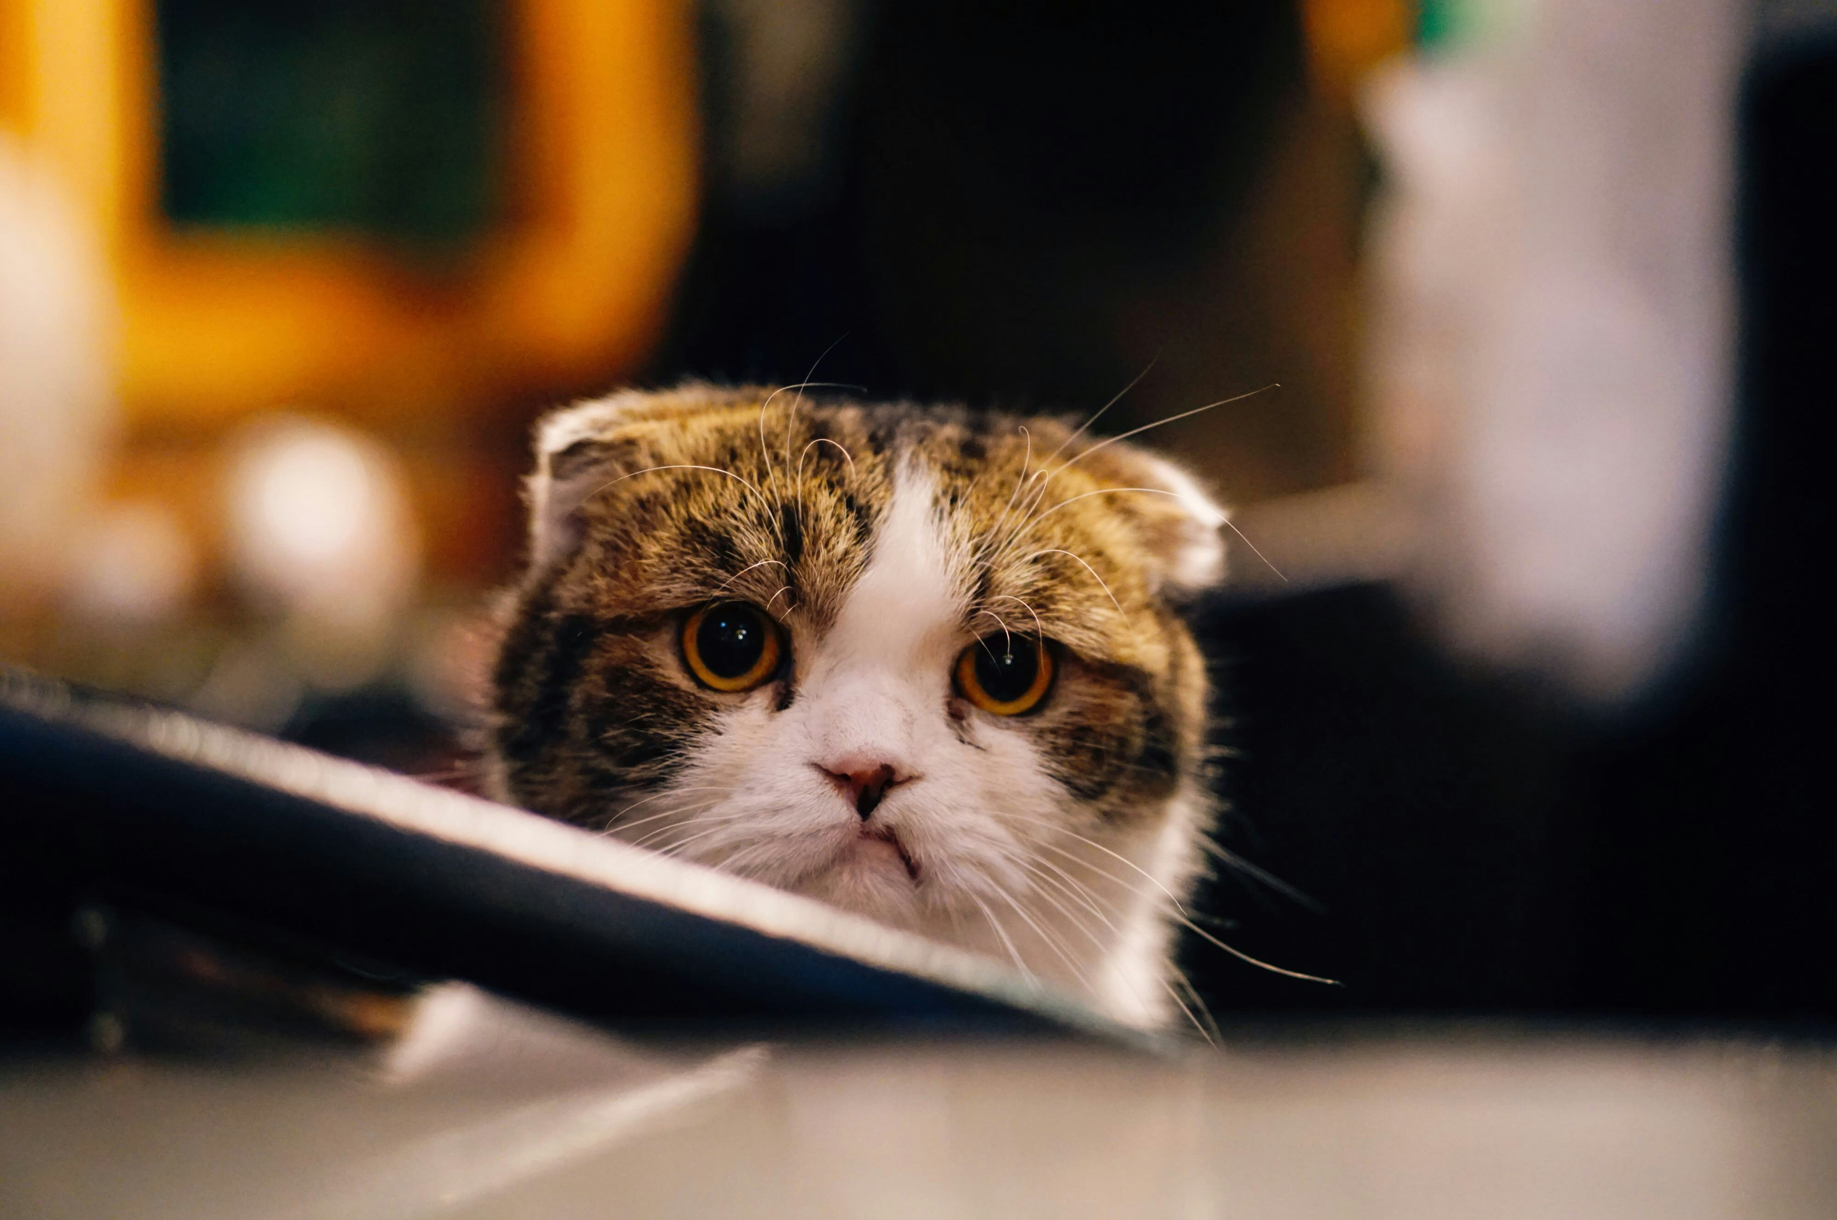
Installation errors!

Slide 12
Installation errors
Common errors
  First install fails – restart required
  Sensitive to Windows updates
  Configuration errors
    I.e. incorrect SQL server
  Apps incompatible
  Destructive schema changes
  Machine out of memory
Online troubleshooting page
help.gocurrent.lsretail.com/docs/ls-central/ troubleshooting.html

Slide 13
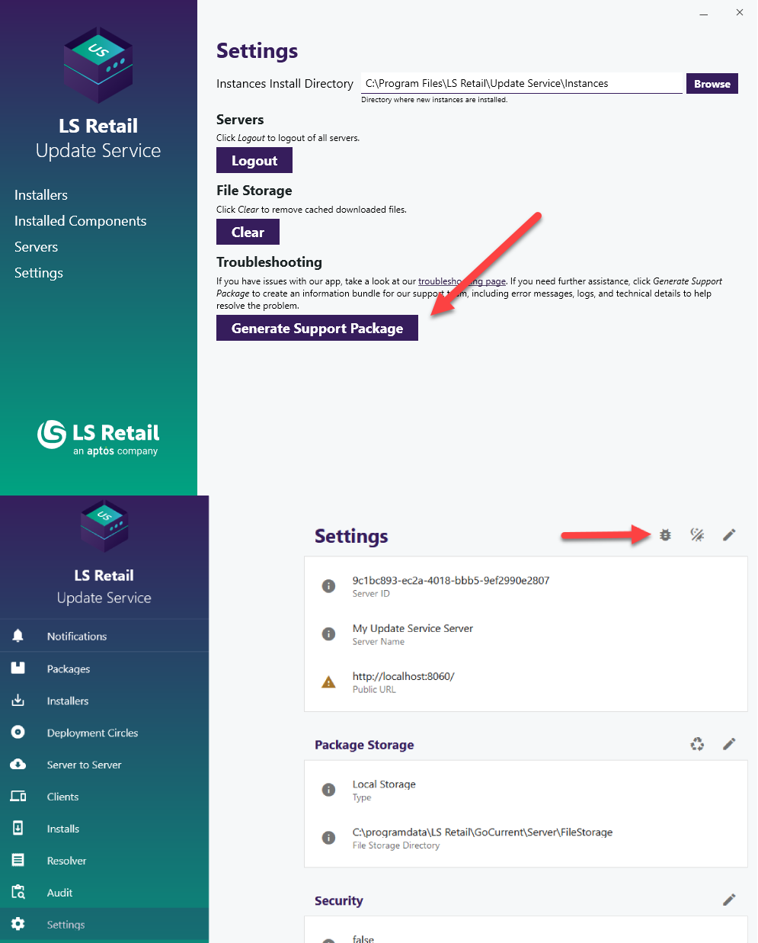
Support package
Client and server
Include necessary information for troubleshooting
  Application logs
  Event viewer
  Installed components
Reduces the time to resolve the issue

Slide 14
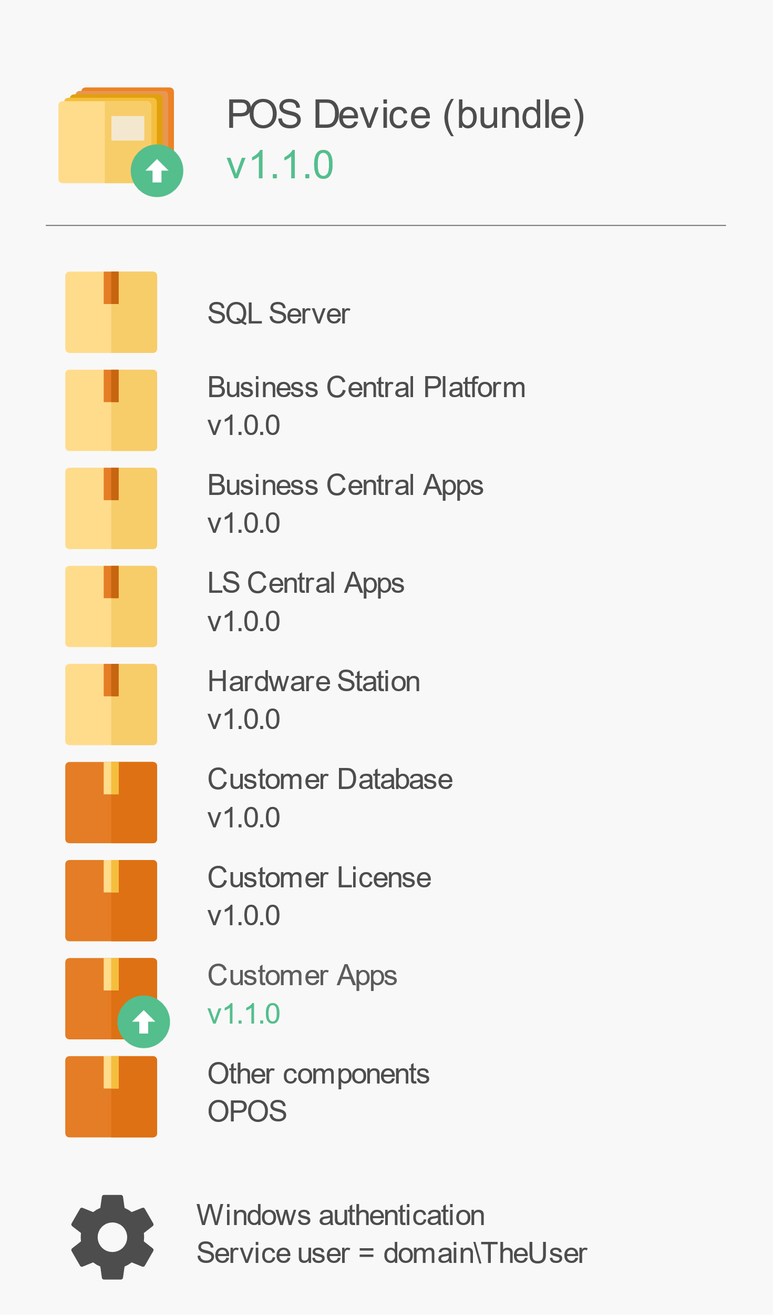
Update bundle
Update customer apps 1.1.0
Update bundle to 1.1.0

Slide 15
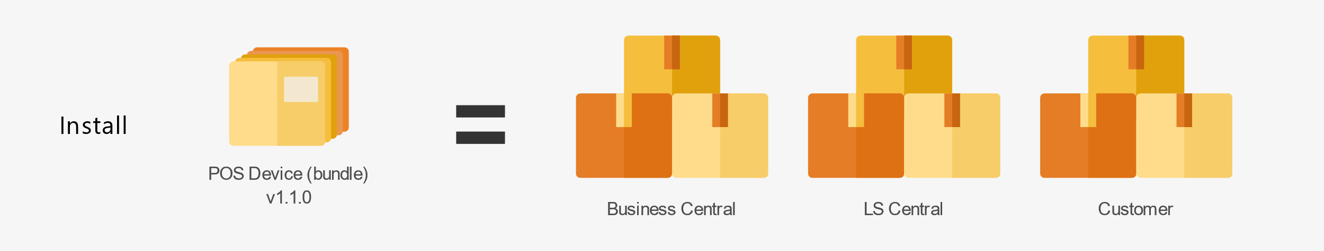
Update bundle
Update customer apps 1.1.0
Update bundle to 1.1.0

Slide 16
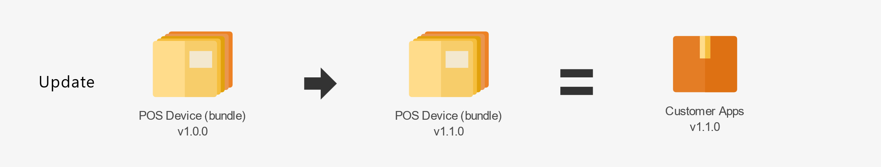
Update bundle
Update customer apps 1.1.0
Update bundle to 1.1.0

Slide 17
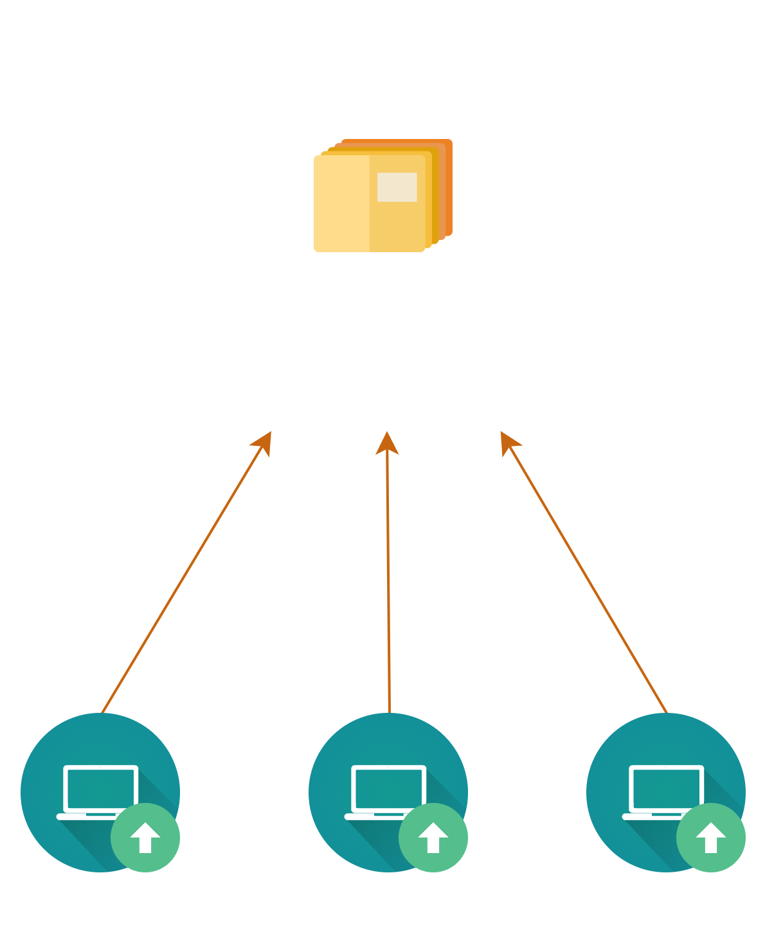
Update

Slide 18
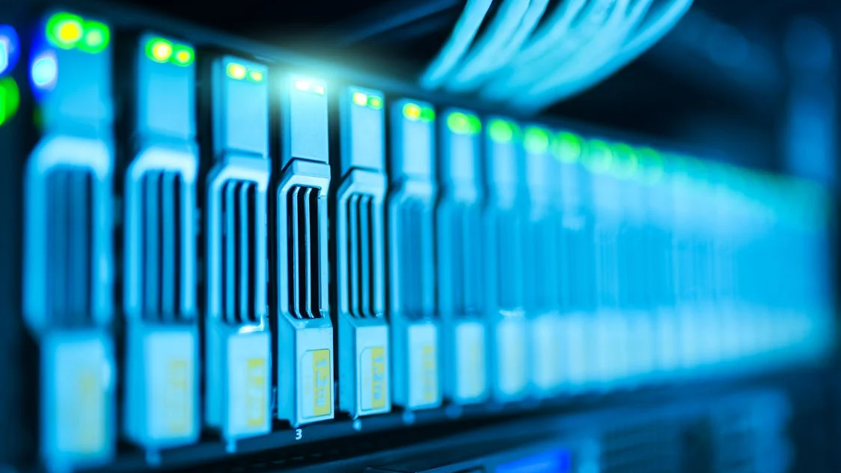
Servers_

Slide 19
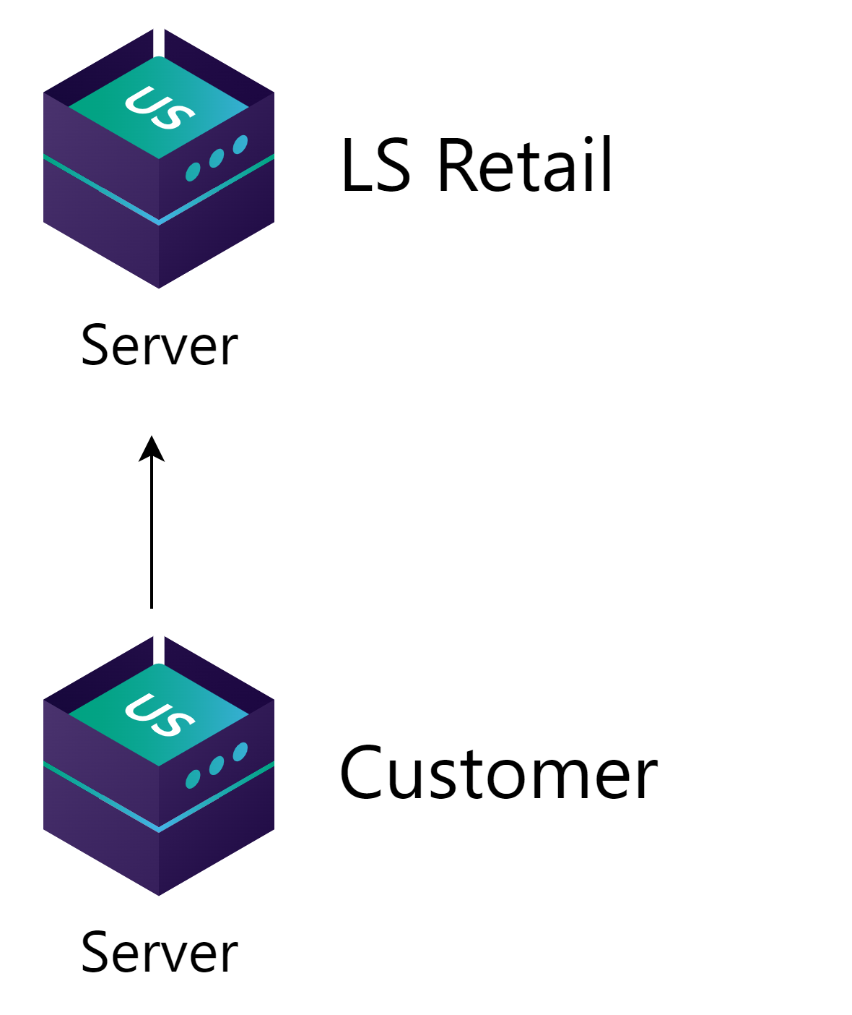
Customer setup
LS Retail provides standard packages
  LS Central
  Business Central
  SQL server
  And more
Adds any customer specific packages

Slide 20
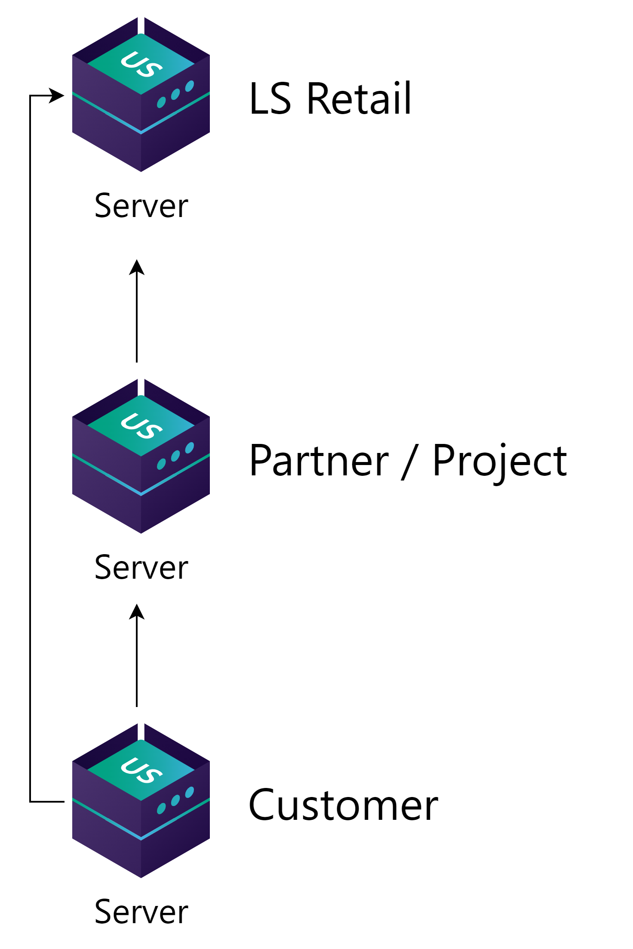
Partner to customer setup
Get standard packages from LS Retail
  LS Central
  Business Central
Develop and test apps and other packages on partner’s server
Deliver packages to customer server

Slide 21
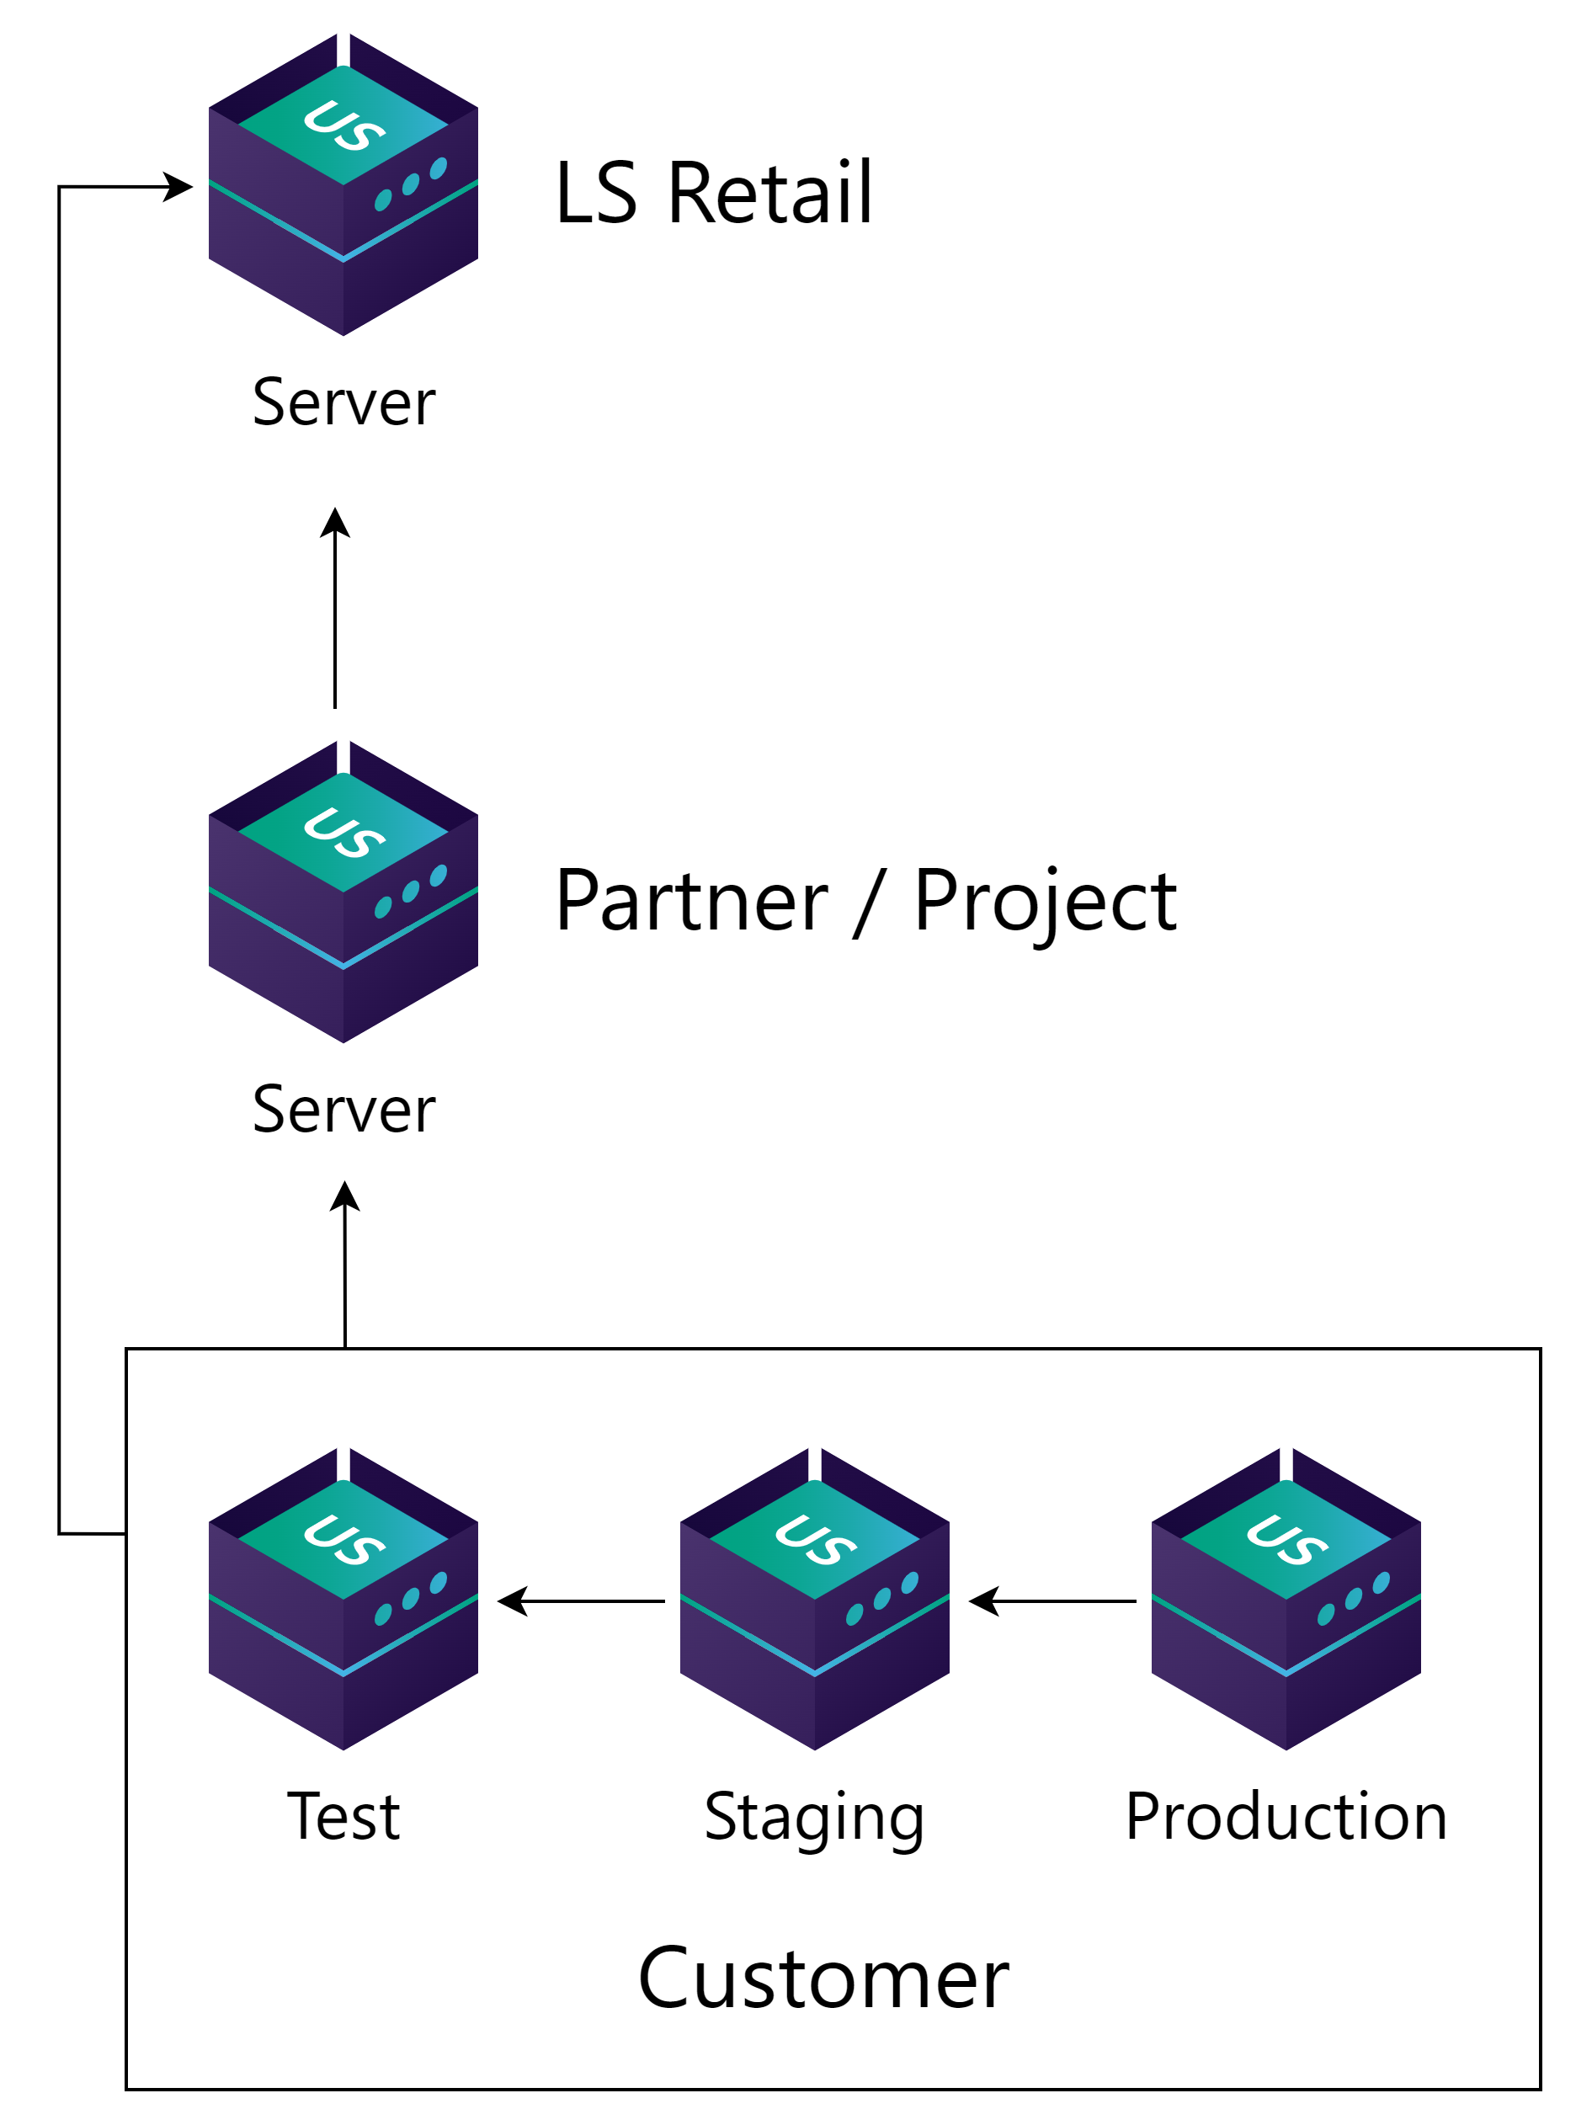
Partner to customer setup
Get standard packages from LS Retail
  LS Central
  Business Central
Develop and test apps and other packages on partner’s server
Deliver packages to customer server

Slide 22
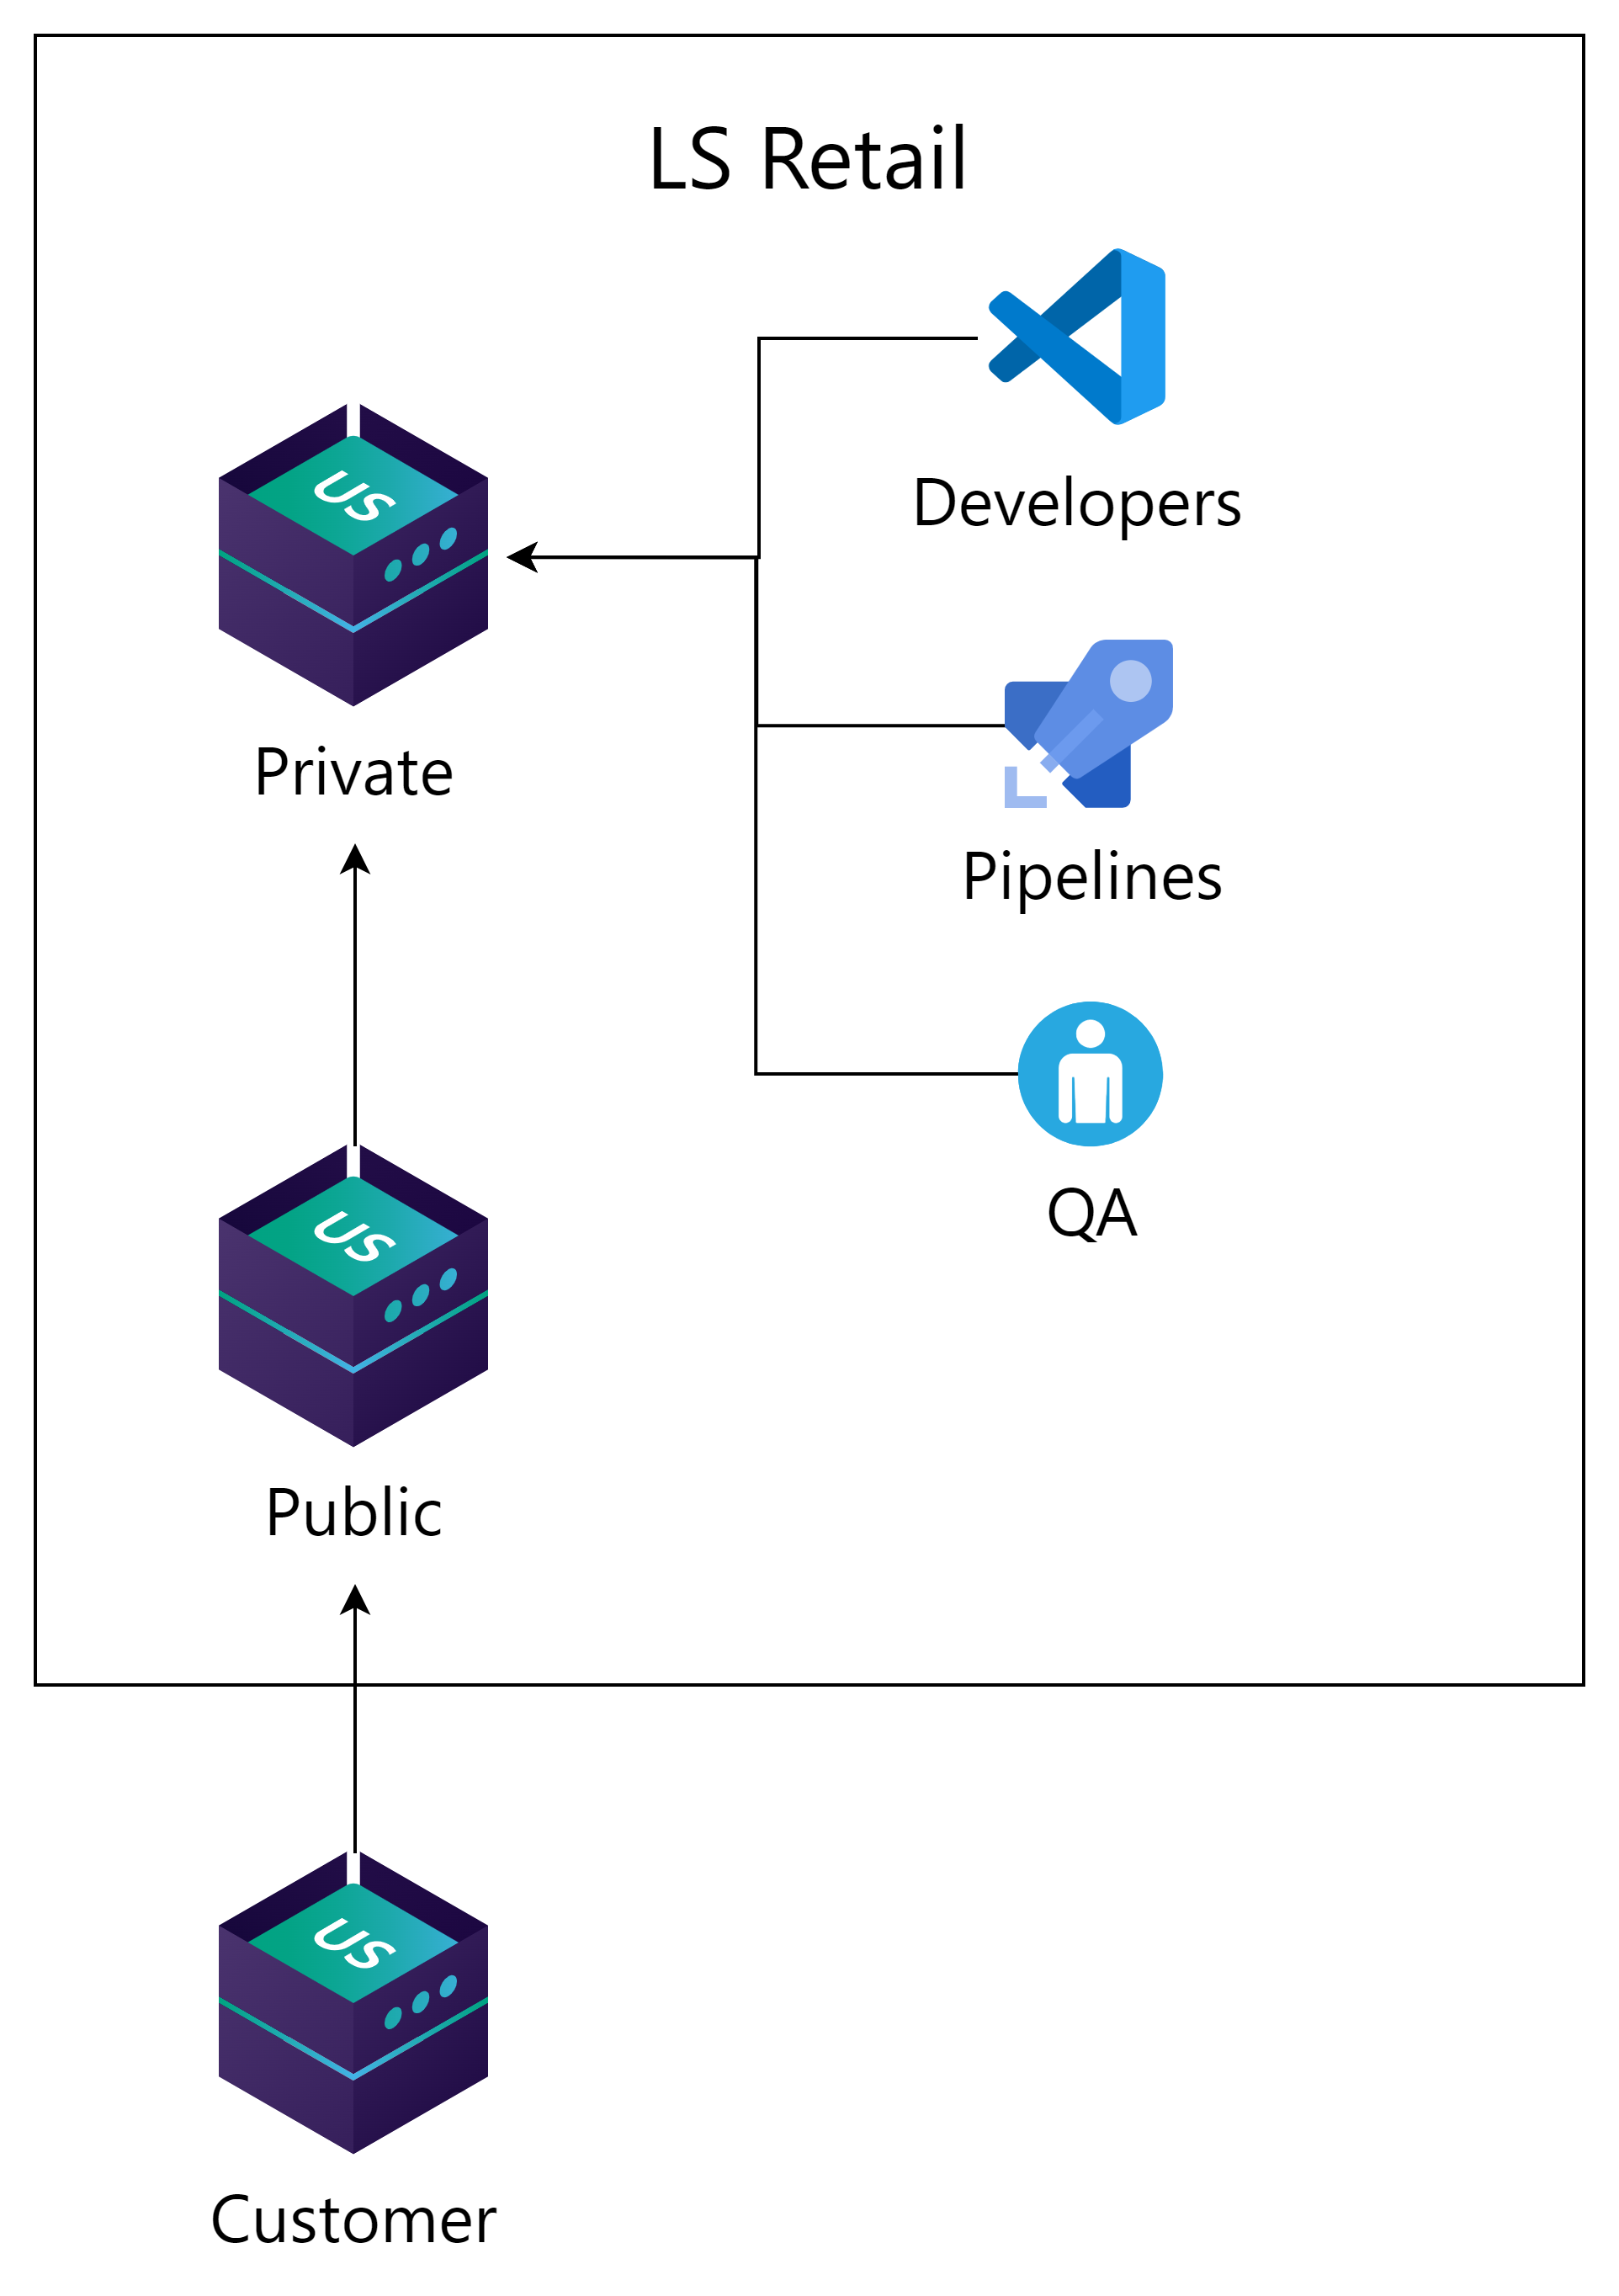
LS Retail setup
Get standard packages from LS Retail
  LS Central
  Business Central
Develop and test apps and other packages on partner’s server
Deliver packages to customer server

Slide 23

Release 1.2.0_

Slide 24
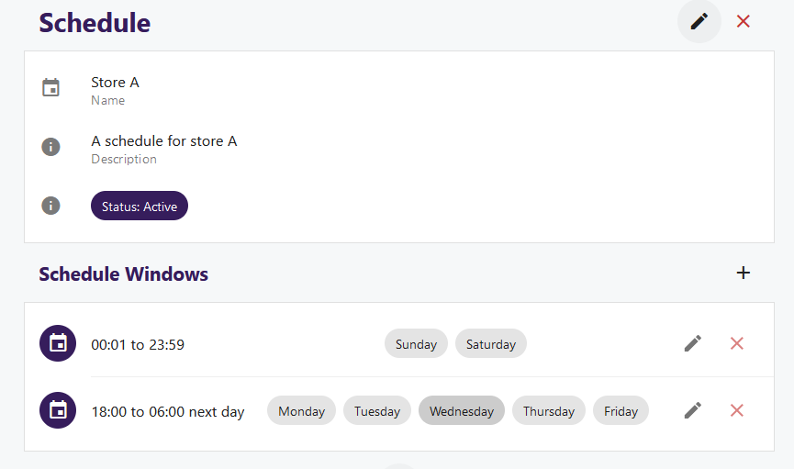
NEW: Scheduling window
A way to limit when a client can deploy updates during the day or week.

Slide 25
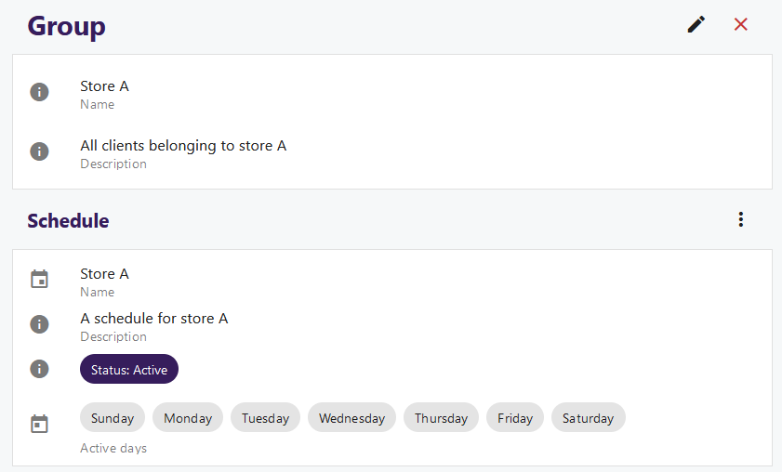
NEW: Groups
Organize clients into logical groups
Assign schedule windows to groups
Assign to circles

Slide 26

Update Service, as a service
In progress
Hosted by LS Retail
Update Service application support
Platform and infrastructure
  Manage multiple customers
  Commerce, KDS and other non-bc based services.
Rapid prototyping inhouse

Slide 27

Road ahead
Simplify Update Service
  Reduce the need for PowerShell
  Managing bundles, packages from UI
Improved deployments
  Deploy new installation from server
  Manage client software on server

Slide 28
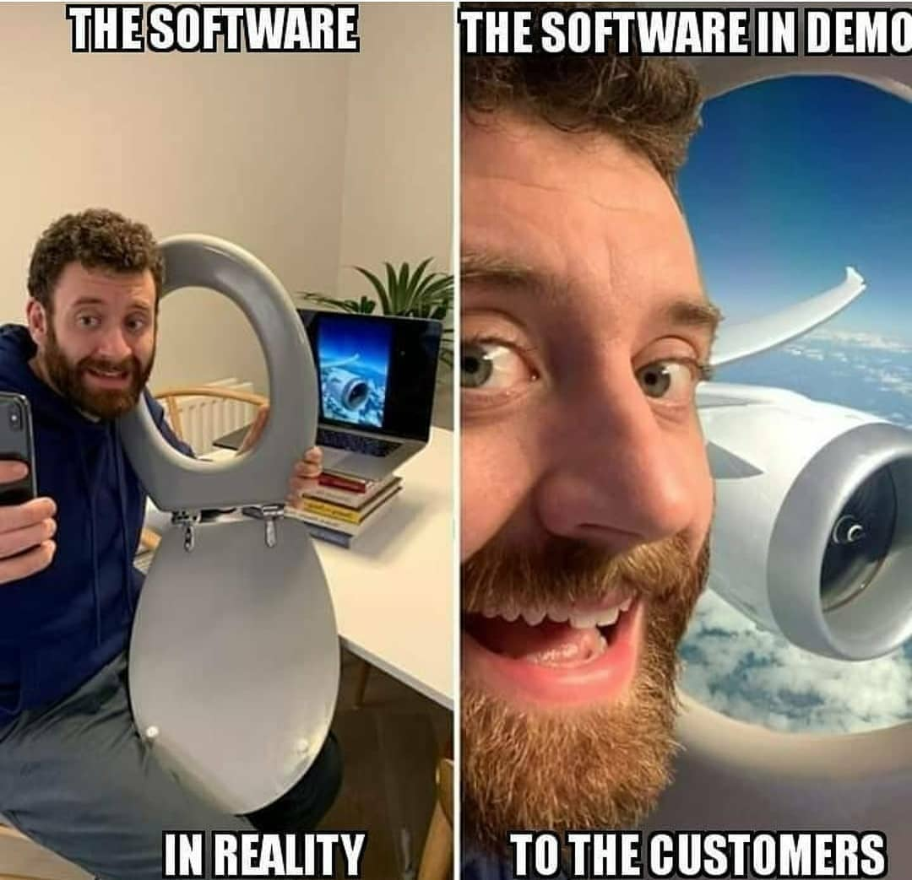
Demo

Slide 29

Getting started
Online help:
https://help.updateservice.lsretail.com/
PowerShell basics
Install LS Central with PowerShell
Project lifecycle
  Step by step guide
  Video series
  Do a test project

Slide 30

Need help?
Yammer group
  https://yammer.com/gocurrent
  Troubleshooting
  Consulting
  Feedback
  Community - anyone can help
LS Retail Partner Support
  Troubleshooting
  Urgent matters
  Customer specific

Slide 31

Questions?

