Slide 2
Jasvinder Singh
Technical Consultant
The New Hybrid Setup For LS Central SaaS
SaaS Architecture & Replication

Slide 3
The New Hybrid Setup
For LS Central SaaS
SaaS Architecture
Replication

Slide 4

Jasvinder Singh
Technical Consultant

Slide 5
Agenda
Hybrid Architecture
Replication
The Big Picture
Performance & Scalability
Disaster Recovery
Q&A

Slide 6
Hybrid Architecture

Slide 7




History In Session
Pre SaaS
  Data Director
HEAD OFFICE IN
on-premise
Direct SQL Access​
DATA DIRECTOR
STORE 1
STORE 2
Offline POS
Offline POS
Offline POS
Offline POS

Slide 8
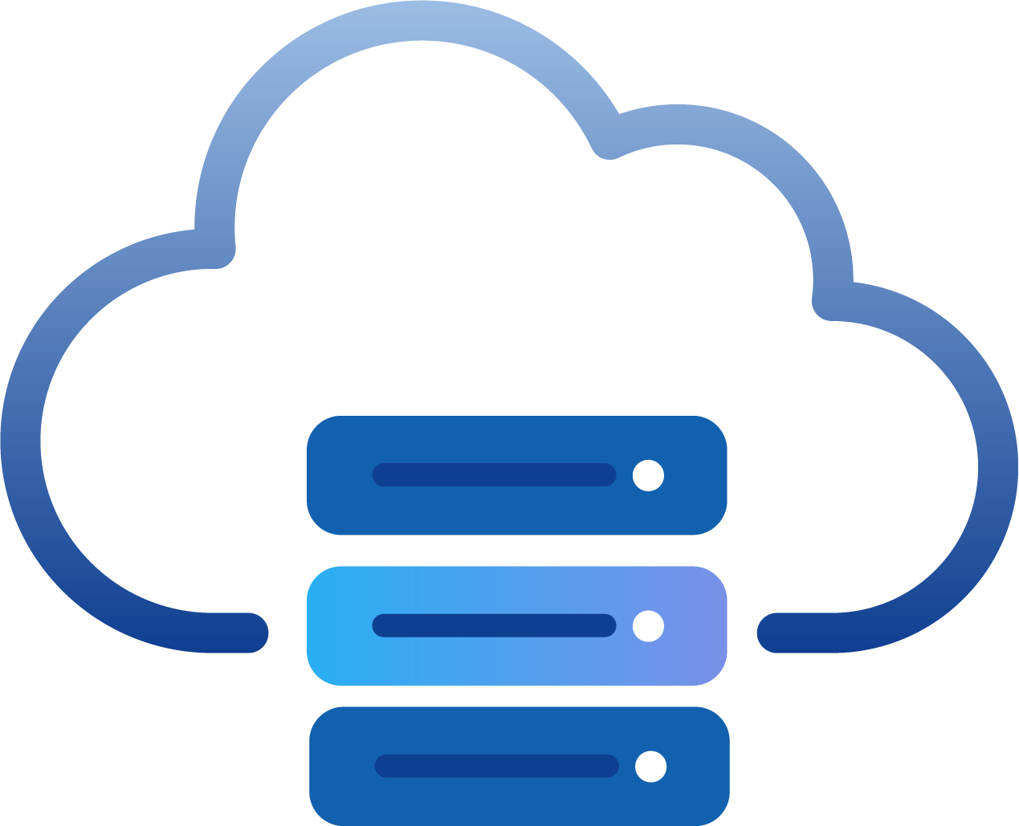
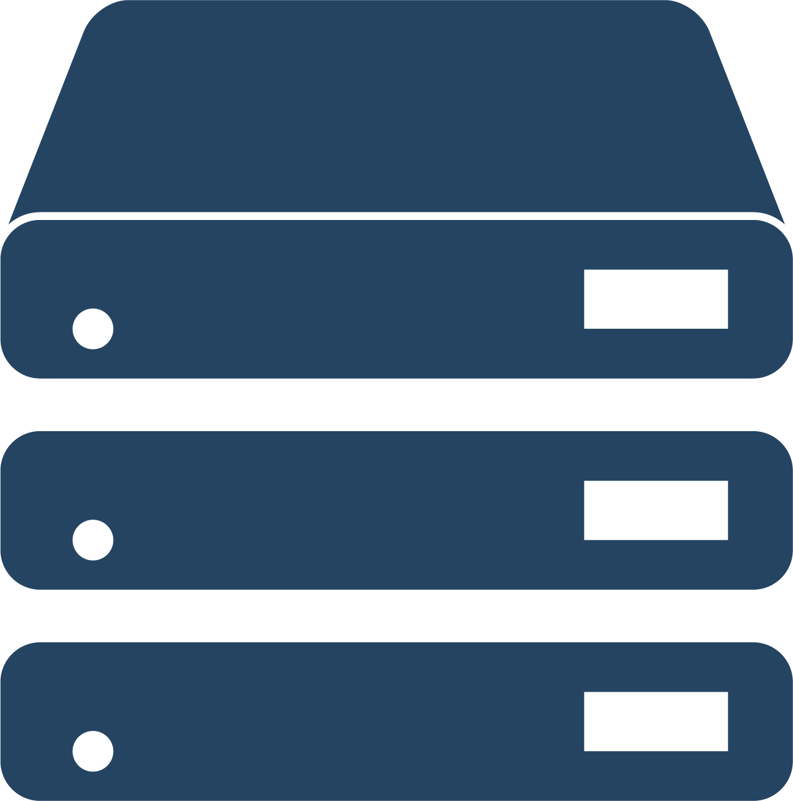

History In Session
HEAD OFFICE IN
BC SaaS
Pre SaaS
  Data Director
SaaS
  Hybrid Component Server
DD Webservice mode​
HYBRID COMPONENT SERVER
POS MASTER
DATA DIRECTOR
UPDATE SERVICE
STORE 1
STORE 2
Offline POS
Offline POS
Offline POS
Offline POS

Slide 9

History In Session
HEAD OFFICE IN
BC SaaS
Pre SaaS
  Data Director
SaaS
  Hybrid Component Server
DD Webservice mode​
HYBRID COMPONENT SERVER
POS MASTER
DATA DIRECTOR
UPDATE SERVICE
STORE 1
STORE 2
Offline POS
Offline POS
Offline POS
Offline POS

Slide 10
The New Hybrid Setup
Pre SaaS
  Data Director
SaaS
  Hybrid Component Server
The NEW Hybrid Setup
HEAD OFFICE IN
BC SaaS
UPDATE SERVICE
STORE 1
STORE 2
Offline POS
Offline POS
Offline POS
Offline POS

Slide 11
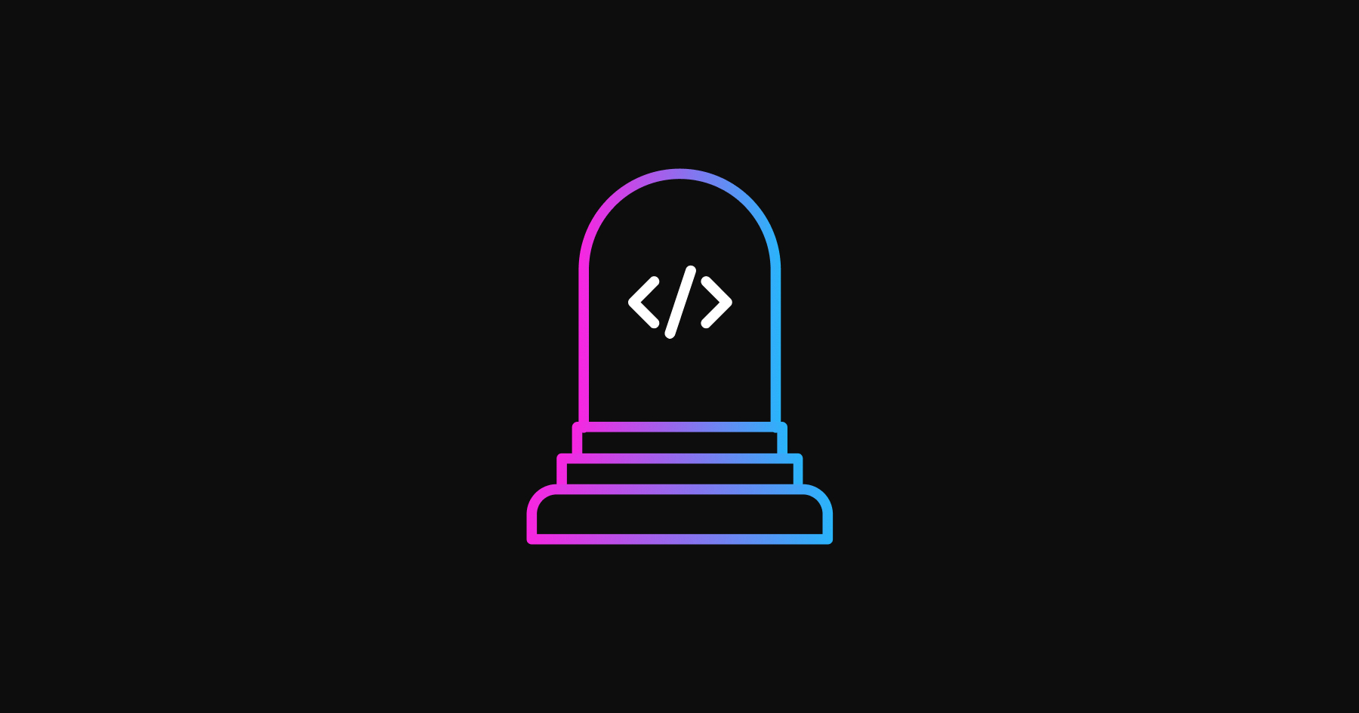

Slide 12
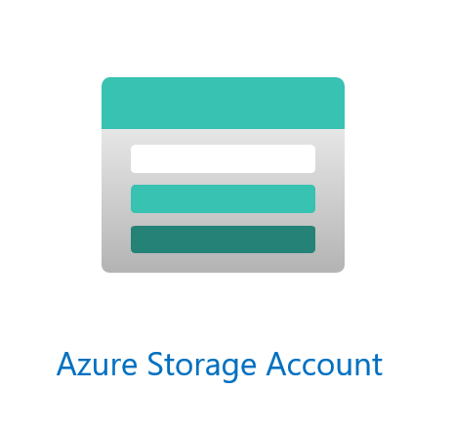
The New Hybrid Setup
Pre SaaS
  Data Director
SaaS
  Hybrid Component Server
The NEW Hybrid Setup
  Azure Storage Replication
    No more Hybrid Component Server
HEAD OFFICE IN
BC SaaS
UPDATE SERVICE
STORE 1
STORE 2
Offline POS
Offline POS
Offline POS
Offline POS

Slide 13
Replication

Slide 14
New Hybrid Replication – how does it work?
Azure Storage Account
  Owned by customer
HEAD OFFICE IN
BC SaaS
STORE 1
STORE 2
Offline POS
Offline POS
Offline POS
Offline POS

Slide 15



New Hybrid Replication – how does it work?
Azure Storage Account
  Owned by customer
Scheduler Replication Job
  Creates a package
  Registers destinations
HEAD OFFICE IN
BC SaaS
STORE 1
STORE 2
10
15
POS | Created | Inform. | Import.
10 | X
15 | X
Offline POS
Offline POS
Offline POS
Offline POS

Slide 16
New Hybrid Replication – how does it work?
Azure Storage Account
  Owned by customer
Scheduler Replication Job
  Creates a package
  Registers destinations
POS inquires about data for that POS
  POS fetches package information from HO
HEAD OFFICE IN
BC SaaS
STORE 1
STORE 2
10
15
POS | Created | Inform. | Import.
10 | X
15 | X | X
Offline POS
Offline POS
Offline POS
Offline POS

Slide 17
New Hybrid Replication – how does it work?
Azure Storage Account
  Owned by customer
Scheduler Replication Job
  Creates a package
  Registers destinations
POS inquires about data for that POS
  POS fetches package information from HO
POS fetches the package from Azure Storage Account
HEAD OFFICE IN
BC SaaS
STORE 1
STORE 2
10
15
POS | Created | Inform. | Import.
10 | X
15 | X | X
Offline POS
Offline POS
Offline POS
Offline POS

Slide 18

New Hybrid Replication – how does it work?
Azure Storage Account
  Owned by customer
Scheduler Replication Job
  Creates a package
  Registers destinations
POS inquires about data for that POS
  POS fetches package information from HO
POS fetches the package from Azure Storage Account
Package imported to POS and marked as completed at HO
HEAD OFFICE IN
BC SaaS
STORE 1
STORE 2
10
15
POS | Created | Inform. | Import.
10 | X
15 | X | X | X
Offline POS
Offline POS
Offline POS
Offline POS

Slide 19
New Hybrid Replication
HEAD OFFICE IN
BC SaaS
UPDATE SERVICE
STORE 1
STORE 2
10
15
Offline POS
Offline POS
Offline POS
Offline POS

Slide 20
Update service
Is the corner stone for continues updates
  Online
    Appshell / Hardwarestation / OPOS drivers / Registry files
  Offline POS
    Same as in online pos
    BC service tier
    DB
    SQL server
    Data Director

Slide 21
New Hybrid Replication
What if the offline POS loses connection with Azure Storage?
  POS continues to request at an interval
    Scheduler Job
    Background Session
  Packages queues at Azure Storage
How can we track for failed packages?
  Centrally at the HO on the Web Replication Monitor
Can we migrate from an existing HCS to the new Azure Storage replication?
  Yes, with the new Offline POS installer in Update Service

Slide 22
The Big Picture

Slide 23
Offline POS - Standard
Azure
BC SaaS
Azure SQL
BC Environment
BC Company
Update Service
Transactions POS Webservice
App updates

Slide 24
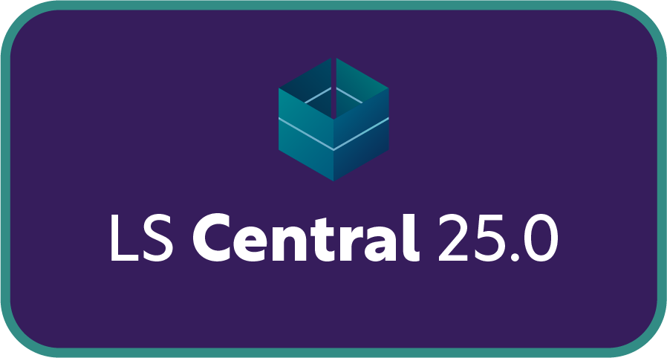
LS Central replication
Scheduler Replication Job
  Replication request
    Sent to Data Director through web service
    Request stored for the web replication process
    Scheduler Web Replication Process
  Request queue table
    Creates data package
    Runs defined method
      Odata Replication
      Azure Storage Replication
      Company Replication
Job
Repl.
Data
Data Director
Request Queue
Web Replication
- OData4
- Azure Storage
- Company

Slide 25
Online POS – Distributed companies
Azure
BC SaaS
Azure SQL
BC Environment
Primary BC Company
BC Company B
Transactions
Master Data
BC Company C
Update Service
App updates
1
2
3
4
Online POS
Online POS
Online POS
Online POS

Slide 26
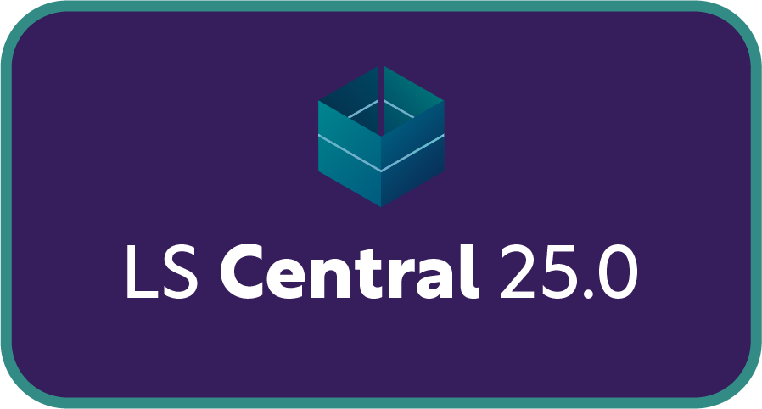
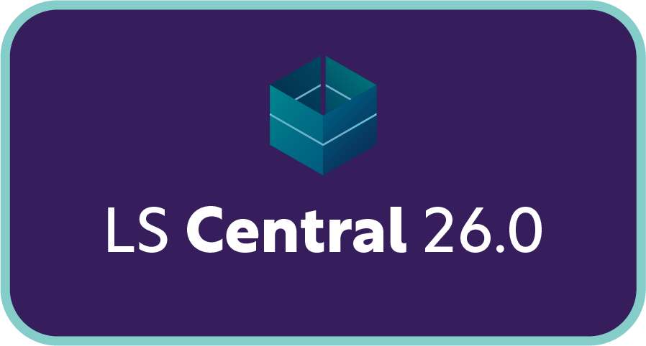
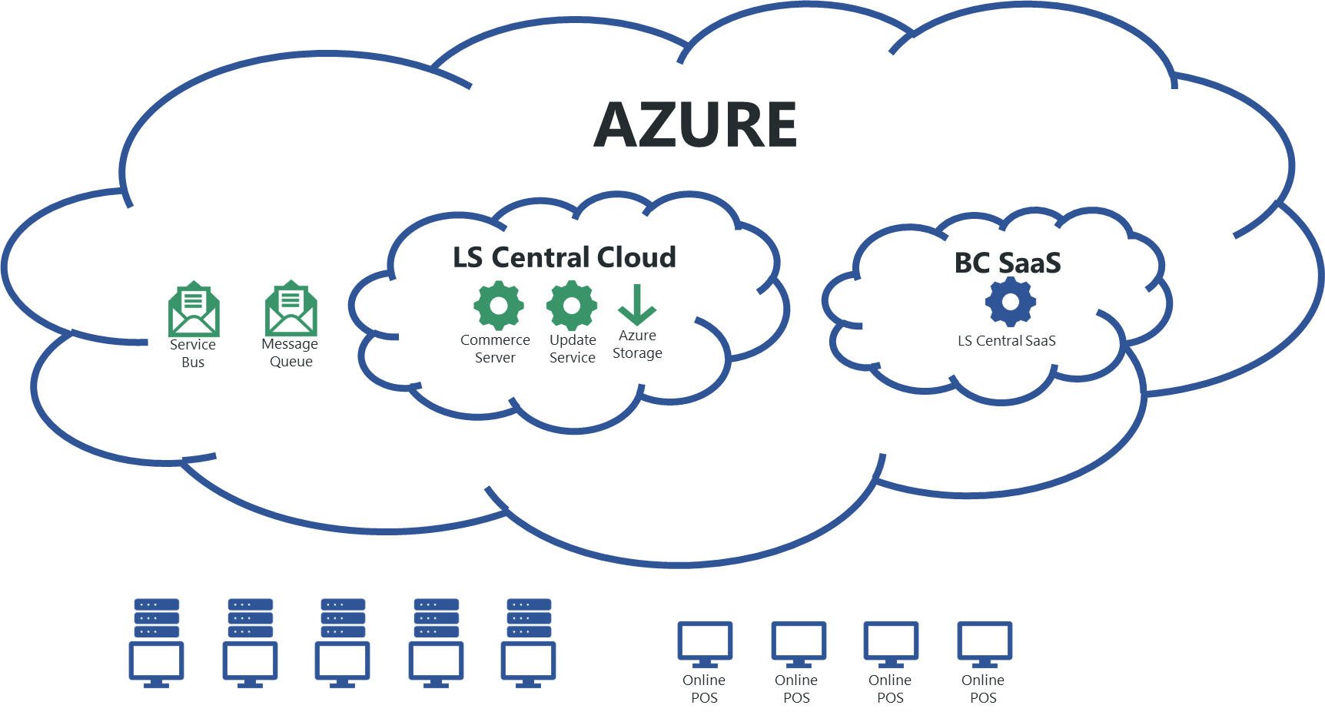
LS Central Cloud

Slide 27




Simpler integrations
Replicate data from Head Office
Using
  Scheduler Jobs
    Known functionality
  Azure Storage
    Same as offline POS replication
  Service Bus
    External services/entities can subscribe to data
Service Bus
Master Data Message
Master Data
BC Environment
Azure Storage
External Service/
entity

Slide 28
Performance & Scalability
What’s under the hood in SaaS

Slide 29
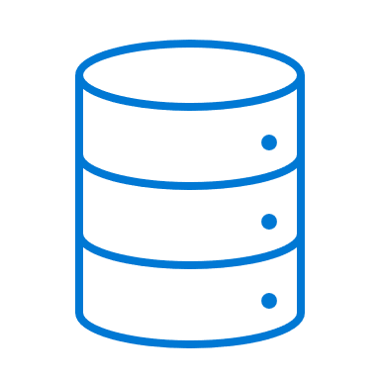



















Business Central: reliability, performance, and scale
Performance and Scale
40+
microservices
Security
21
Azure regions
Business Continuity and Disaster Recovery
Compliance

Slide 30
What does it mean that customers get “larger”?
3. More data
1. More users
Business Central Online
(compute tier)
Database
UI sessions
1 user
500 users
API calls
Other system
Size could also mean other things, e.g.
Number of sales orders posted per day
Number of lines on each sales order
Number of job queues/tasks
...
2. More API calls

Slide 31
Handling heavy load in the compute tier
Business Central Online
(compute tier)
VM 1
Web Server
NST
CPU = 10%
No new sessions on this VM!
VM 2
Web Server
NST
CPU = 61%
CPU = 40%
UI sessions
VM 3
Web Server
NST
CPU = 20%
Load
Balancer
500 users
VM 4
Web Server
NST
CPU = 15%
API calls
VM 5
Web Server
NST
CPU = 50%
Other system

Slide 32
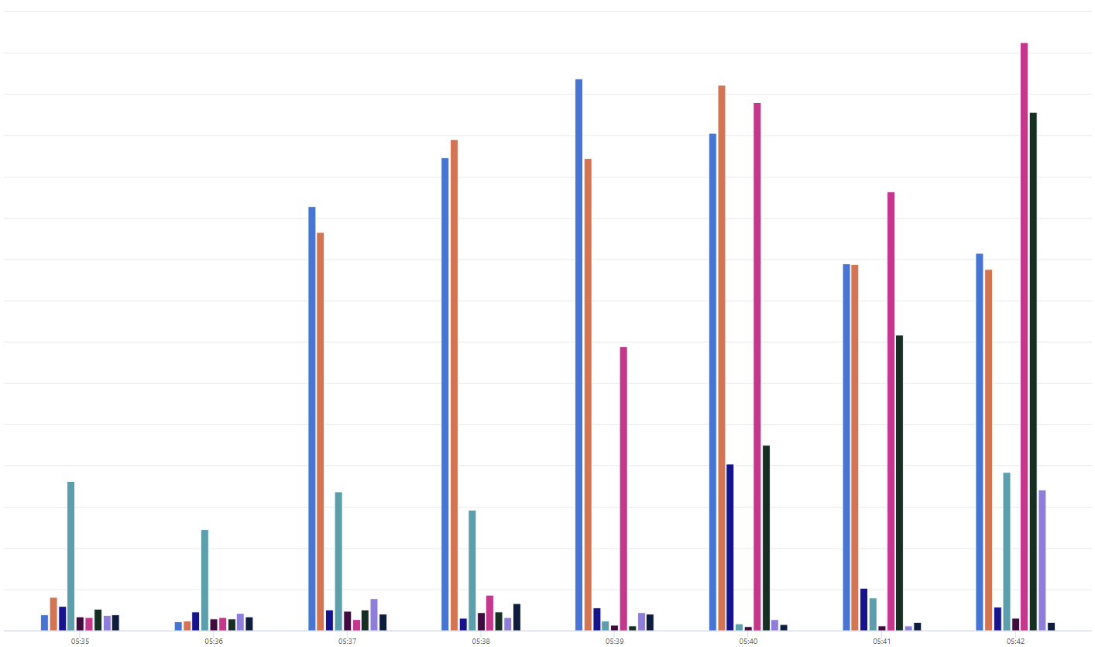
Load balancing in practice (a cluster in the US)
70
Looking at one specific cluster of VMs,
which started to receive a lot of load.
65
60
55
50
45
40
35
30
25
20
15
10
5
0
05:35
05:36
05:37
05:38
05:39
05:40
05:41
05:42

Slide 33
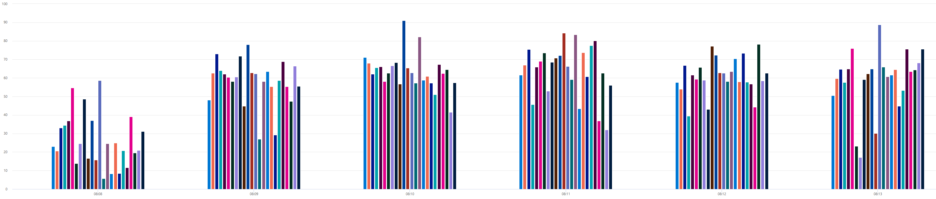
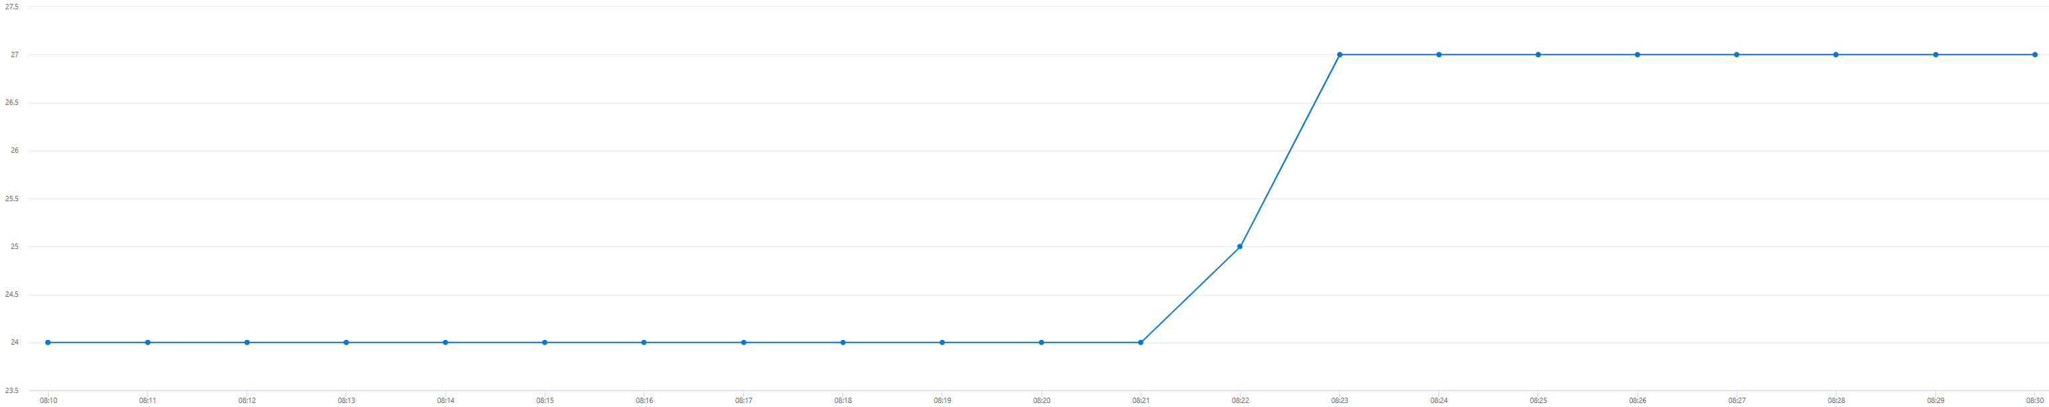
Auto-scaling a compute cluster (in Sweden)
100%
08:12
Enough sustained high load
60%
0%
08:08
08:09
08:10
08:11
08:12
08:13
More VMs requested
3 VMs added and ready
27
24
08:12
08:23

Slide 34
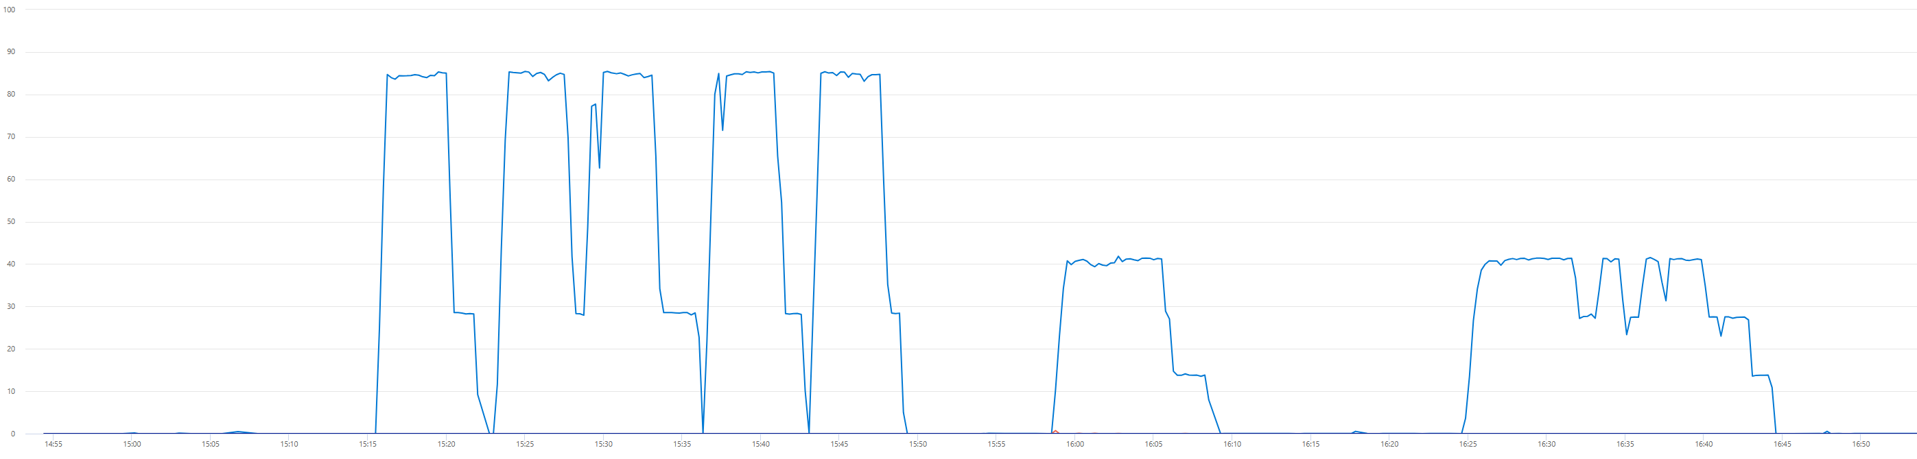
Database scaling in action
100
Enough sustained load
70
0
Scale Up

Slide 35
Disaster Recovery
Azure Storage

Slide 36
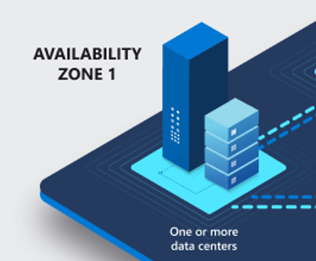
Disaster recovery
Locally Redundant Storage (LRS):
Your data is replicated three times within a single data center in the primary region. While LRS is the least expensive option, it’s not recommended for applications requiring high availability or durability.

Slide 37
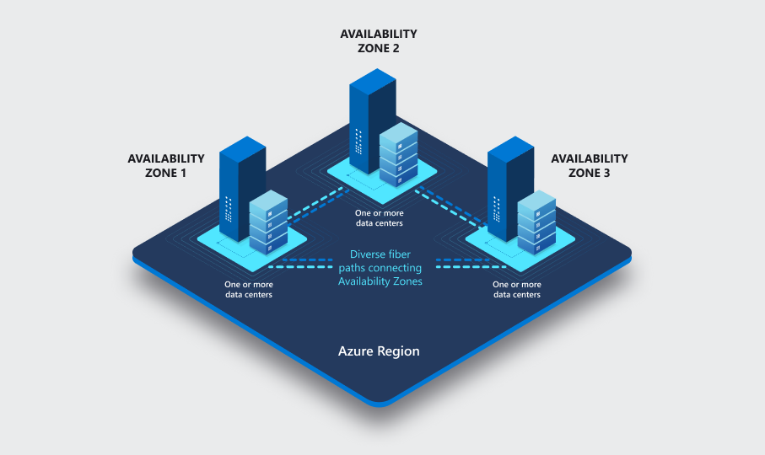
Disaster recovery
Locally Redundant Storage (LRS):
Zone-Redundant Storage (ZRS):
ZRS copies your data synchronously across three Azure availability zones in the primary region. Microsoft recommends using ZRS for high availability within the primary region.

Slide 38
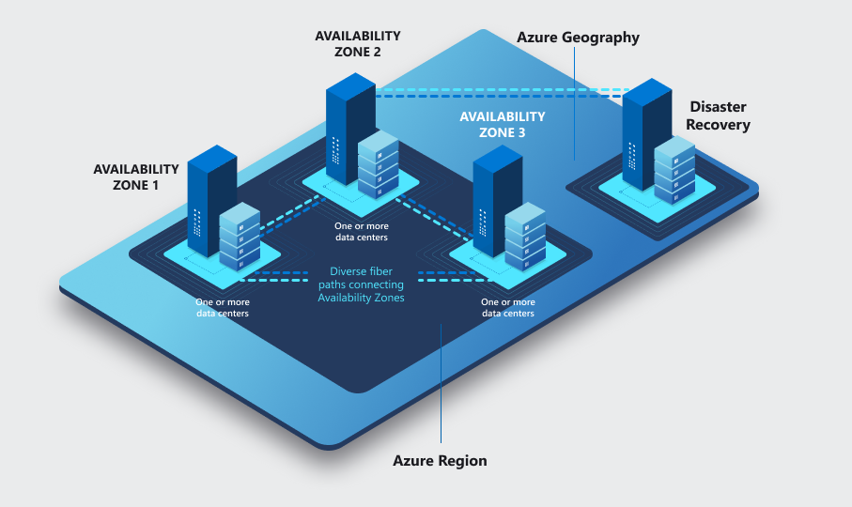
Disaster recovery
Locally Redundant Storage (LRS):
Zone-Redundant Storage (ZRS):
Geo-Redundant Storage (GRS): GRS takes it a step further. It synchronously replicates your data three times within the primary region using

Slide 39
How do I set up the new offline POS?
Web Replication using Azure storage was released in LS24.0
Link to the online help
Offline POS project for Update Service
Book a session with the CAP team: https://calendly.com/lsconboarding/30minsession

