Slide 2

Have you attended
cX24 in Iceland?
Have you heard
about Aggregated
Inventory?
…or Distributed Architecture?

Slide 3

Breaking down barriers: Aggregated inventory
and Distributed Architecture
Bjarni Asmundsson
Regional Director

Slide 4




A short recap
of
what happened so far

Slide 6
Business Central SaaS

Slide 7


Slide 8


Slide 9

Challenges for large(r) retailers
Data volume in entry tables
Item Ledger Entries
Value Entries
Storage cost of data in BC SaaS

Slide 10

Challenges for large(r) retailers
Long running processes
Statement Calculation & Posting
Replenishment calculation
Cost Adjustment & Posting
Data volume in entry tables
Item Ledger Entries
Value Entries
Storage cost of data in BC SaaS

Slide 11



Statement posting - Current approach
G/L Entries
Item Ledger Entries
Example:
A retailer operates 300 stores and
sells 2000 different items per day.
This creates:
  600.000 Item Ledger Entries per day
  18 Mio. Item Ledger Entries per month
Store 1
- Cash
- CC
Store 2
- Cash
- CC
Store 300
- Cash
- CC
Store 1
- Item A, 10 pcs
- Item B, 20 pcs
Store 2
- Item A, 20 pcs
- Item B, 20 pcs
Store 300
- Item A, 15 pcs
- Item C, 10 pcs
Sales
Statement
Calc.
Statement Post
Store 1
Sales
Statement
Calc.
Statement Post
Store 2
…………………………………………………………………………………………….......…
Sales
Statement
Calc.
Statement Post
Store 300
Many stores
→ data volume
→ long running
processes

Slide 12



Slide 14
Aggregated Inventory
  The “Loki” idea:
  Instead of posting every stock movement
  into individual store locations
  let’s post into aggregated locations
  (and keep the details in a separate table)

Slide 15
Statement posting - New approach
Aggregated posting for store locations
Current approach
Item Ledger Entries for individual stores
One entry per item, per location, per day
New approach
  Item Ledger Entries
  for aggregated store location(s)
  Details are stored in a new table
  LSC Aggr. Inventory Entry (10059488)
Item Ledger Entries
current
Aggr. Inventory
Entries
new
Store 1
---------------
---------------
Store 2
---------------
---------------
Store 3
---------------
---------------
Store 4
--------------- ---------------
Store 300
--------------- ---------------
Store 1
---------------
---------------
Store 2
---------------
---------------
Store 3
---------------
---------------
Store 4
---------------
---------------
Store 300
---------------
---------------
Store “RETAIL-1”
---------------
---------------
one day’s entries
Store “RETAIL-2”
---------------
---------------

Slide 16

Statement posting - New approach
G/L Entries
Item Journal
Store 1
- Cash
- CC
Store 2
- Cash
- CC
Store 300
- Cash
- CC
Store 1
- Item A, 10 pcs
- Item B, 20 pcs
Store 2
- Item A, 20 pcs
- Item B, 20 pcs
Store 300
- Item A, 15 pcs
- Item C, 10 pcs
Sales
Statement
Calc.
Statement Post
Store 1
Sales
Statement
Calc.
Statement Post
Store 2
…………………………………………………………………………………………….......…
Sales
Statement
Calc.
Statement Post
Store 300
1. Aggregate Stores
Store “RETAIL”
- Item A, 45 pcs
- Item B, 40 pcs
- Item C, 10 pcs
2. Post

Slide 17
Statement posting - New approach
Item Ledger Entries
Aggr. Inventory Entries
G/L Entries
Store 1
- Cash
- CC
- Revenue
Store 2
- Cash
- CC
- Revenue
Store 300
- Cash
- CC
- Revenue
Store 1
- Item A, 10 pcs
- Item B, 20 pcs
Store 2
- Item A, 20 pcs
- Item B, 20 pcs
Store 300
- Item A, 15 pcs
- Item C, 10 pcs
Sales
Statement
Calc.
Statement Post
Store 1
Store “RETAIL”
- Item A, 45 pcs
- Item B, 40 pcs
- Item C, 10 pcs
Sales
Statement
Calc.
Statement Post
Store 2
…………………………………………………………………………………………….......…
Sales
Statement
Calc.
Statement Post
Store 300
Store “RETAIL”
- Inventory
- Cost

Slide 18
Let’s take a look….

Slide 19


Slide 20
Other documents, processes, and integrations
Purchase
Purchase Orders
Purchase Quotes
Sales Orders
Sales Quotes
Transfer Orders
Drop Shipments
Integrations
Sales
Blanket Orders
Purchase Return Orders
Blanket Orders
Sales Return Orders
Other
Special Orders
Analytics for
LS Central
Store Worksheet
(Count, Pick, Recv)
POS Lookups (Availability check)
eCom Integration (Availability check)
Web Services
Mobile Inventory
Item Revaluation
Item Reclassification

Slide 21
Aggregated Inventory
an Extension for LS Central
Status
  Released with LS Central version 24 (April ‘24)
  Provided on request to partners
  Will be downloadable from Partner Portal in the future
  First requests for POCs
Package includes
  Aggr. Inventory Extension
  Wizard (in BC) to upgrade from “classic” approach
  SQL Scripts to calculate improvements before implementation
This is not just Plug & Play → This requires a project.

Slide 22
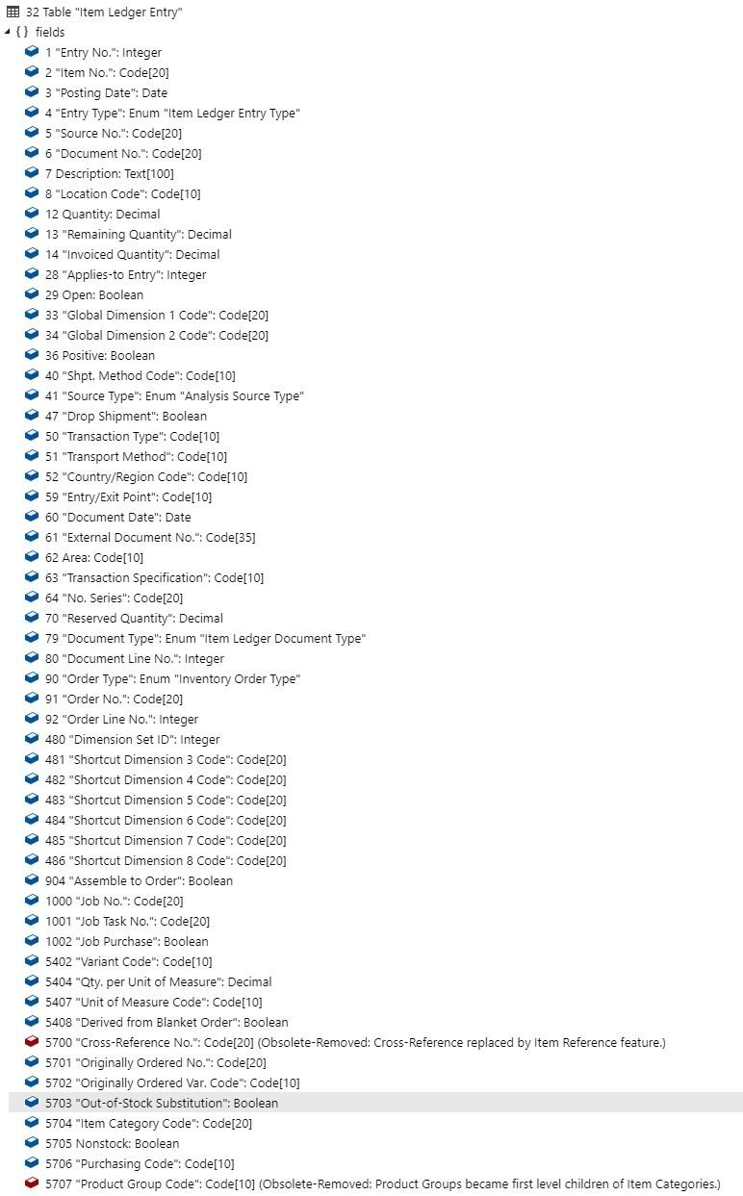
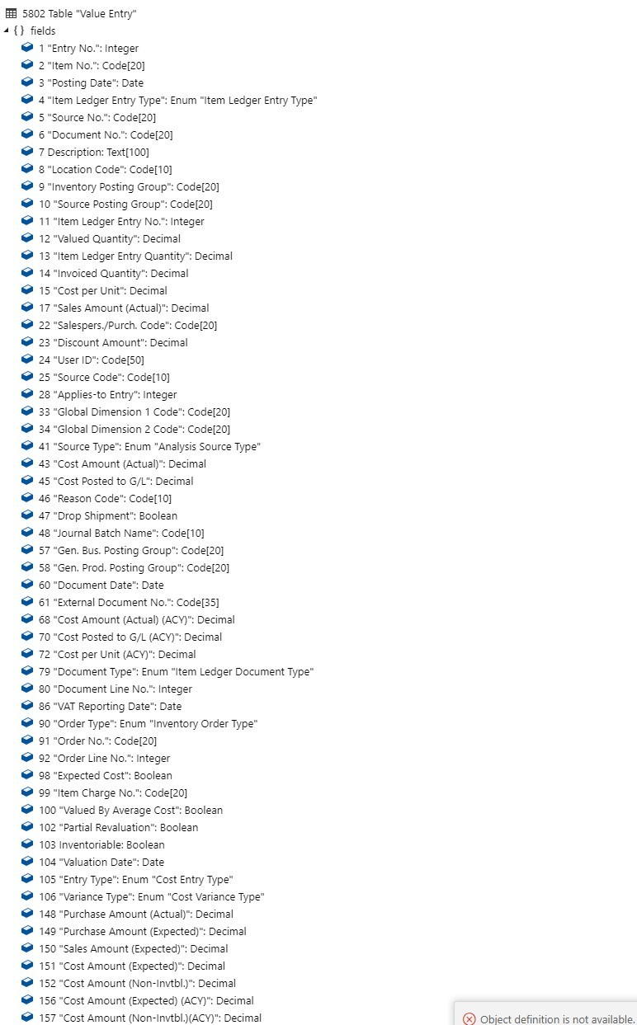
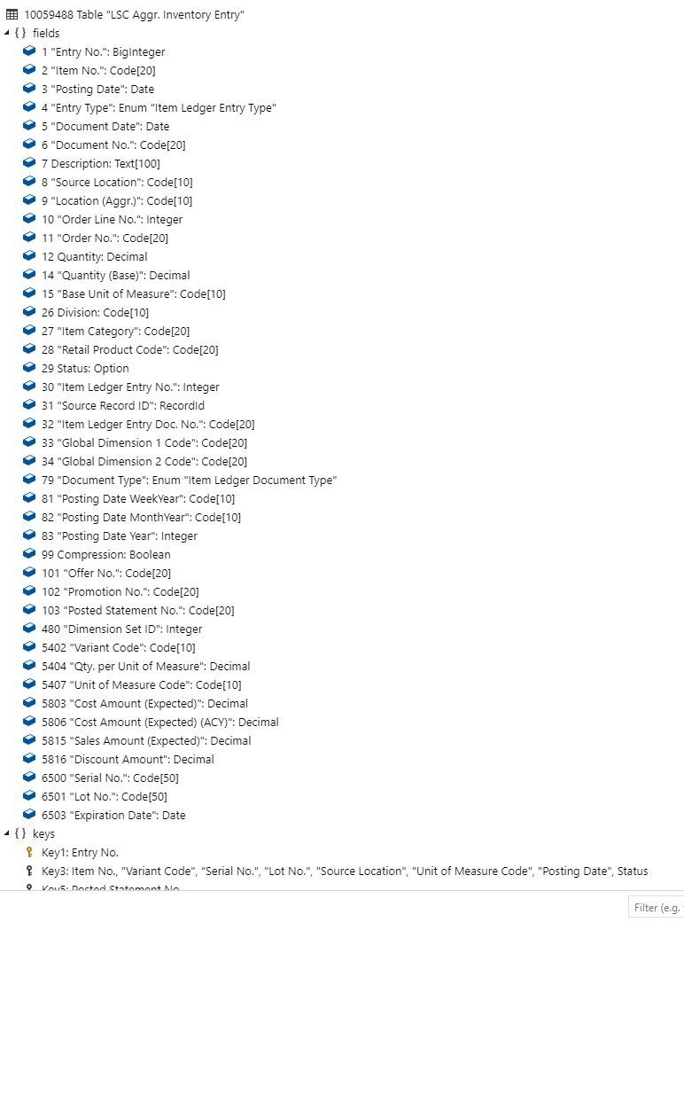
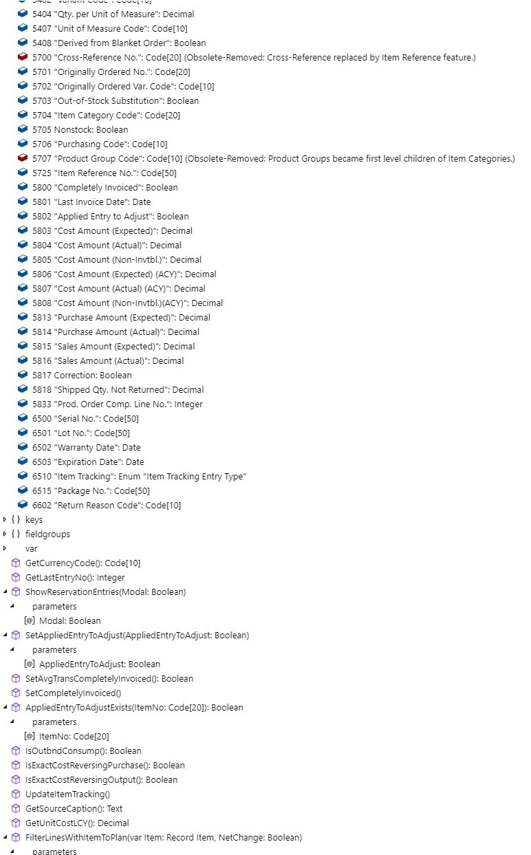
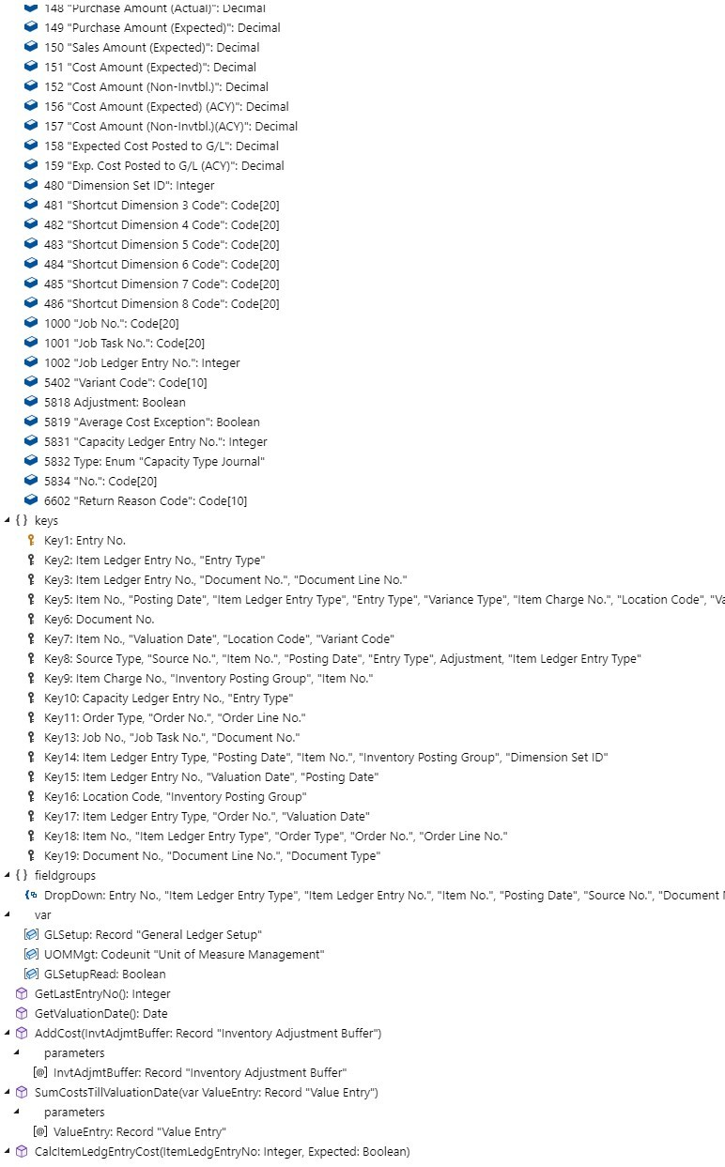
Your benefits
Reduced database size growth
Optimized data structure
Compression and archiving of data
Item Ledger Entry Value Entry Aggr. Inventory Entry
Fields: 85, Keys: 11 Fields: 76, Keys: 17 Fields: 42, Keys: 10

Slide 23
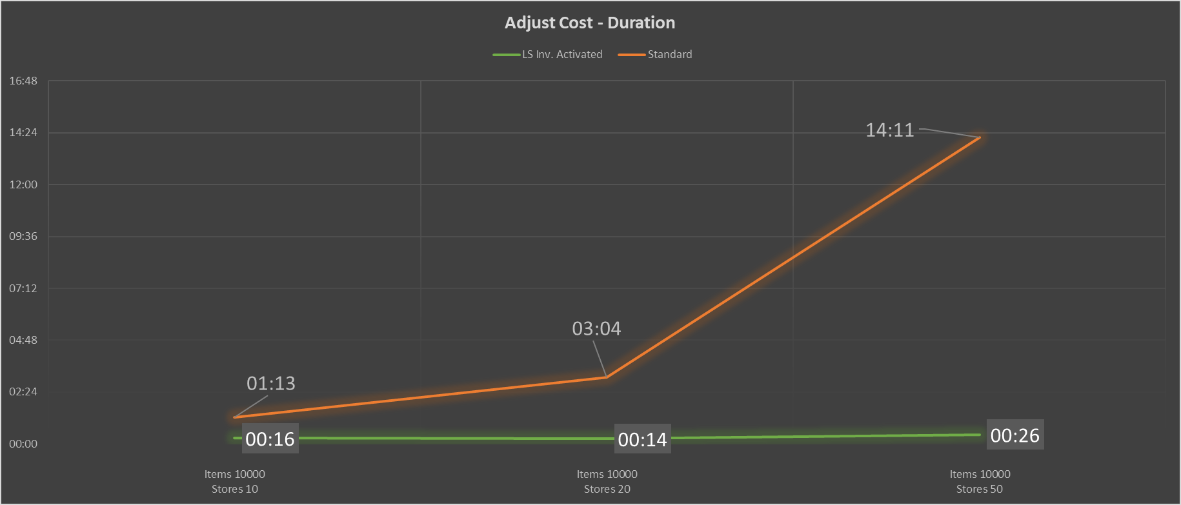
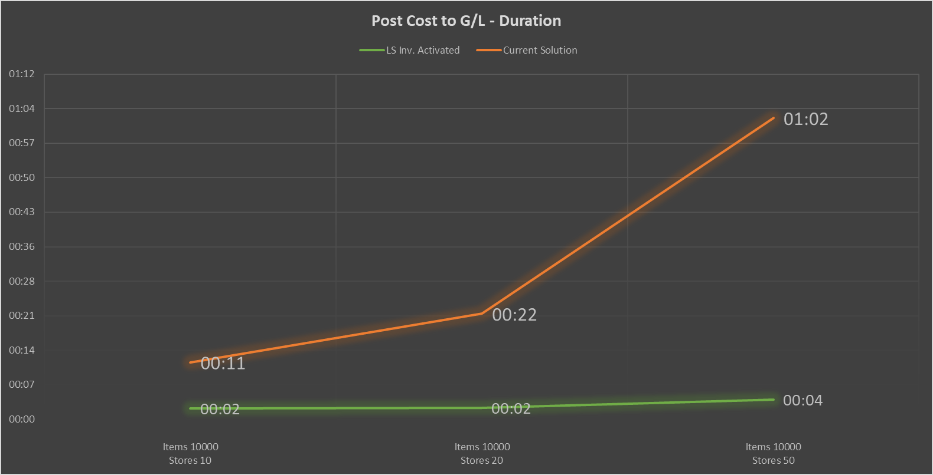
Your benefits
Faster processes
(Example: 10.000 items, 200 stores)
  ILE & VE (record count): -99%
  Adjust Cost (duration): -97% (14hours to 26min)
  Post Cost (duration) : -94% ( 1hour to 4min)
Adjust Cost
Post Cost to G/L

Slide 24

Known limitations
Aggregated inventory is not the best fit if:
  Very diverse assortments across stores
  Many sales for on-account customers (invoices)
  Many items with lot / serial no. tracking
  Integrations to 3rd party solutions with
  dependency on Item Ledger Entries
Groceries
Convenience stores
Hospitality
Fashion
“mass retail”
Electronics
Furniture

Slide 26
The happy end?

Slide 27


Slide 28

More challenges
Reported shortfalls:
  Replenishment for LS Central
  (not supported currently)
  Cost rollup after cost adjustments
  (not supported currently)
  G/L reporting on store/location level
  (We can have multiple aggregation locations for
  store groups to mitigate this.)

Slide 29
Replenishment with Aggr. Inventory
Key areas (sorted by your priority):
  Automatic Replenishment
    Out of Stock Calculation & Item Quantity
    Replen. Journal calculation
  Manual Replenishment
    Buyer’s Push, Allocation Plan
    Stock Recall, Cross Docking
  Store Stock Redistribution
  Budgets and Planning
  Other features

Slide 30
Replenishment with Aggr. Inventory
What is the challenge?
  Warehouses
    Item Ledger Entries exist for individual warehouse locations
  Store Locations
    Item Ledger Entries are at the Aggr. Store Location level
  Purchase to WHS: ☺
  Purchase to Stores: ☹
  Transfers to Stores: ☹
Replen.
to store
Replen.
to warehouse
Vendor
Vendor
Warehouse
Aggregated
Store
Location
1
Agg.
Store Location 2
Store 1
Store 2
Store 3
Store 4
Store 5
Store n

Slide 31
Replenishment with Aggr. Inventory
Solution
Replenishment considers
Item Ledger Entries and
Aggregated Inventory Entries
  Purchase to WHS: ☺
  Purchase to Stores: ☺
  Transfers to Stores: ☺
We support Queries and parallel processing.
Replen.
to store
Replen.
to warehouse
Vendor
Vendor
Warehouse
Store 1
Store 2
Store 3
Store 4
Store 5
Store n

Slide 32
Let’s take a look….

Slide 33

Replenishment with Aggr. Inventory
Key areas (sorted by your priority):
  Automatic Replenishment
    Out of Stock Calculation & Item Quantity
    Replen. Journal calculation
  Manual Replenishment
    Buyer’s Push, Allocation Plan
    Stock Recall, Cross Docking
  Store Stock Redistribution
  Budgets and Planning
  Other features

Slide 34
Replenishment with Aggr. Inventory
Key areas (sorted by your priority):
  Automatic Replenishment
    Out of Stock Calculation & Item Quantity
    Replen. Journal calculation
  Manual Replenishment
    Buyer’s Push, Allocation Plan
    Stock Recall, Cross Docking
  Store Stock Redistribution
  Budgets and Planning
  Other features

Slide 35
Replenishment with Aggr. Inventory
Key areas (sorted by your priority):
  Automatic Replenishment
    Out of Stock Calculation & Item Quantity
    Replen. Journal calculation
  Manual Replenishment
    Buyer’s Push, Allocation Plan
    Stock Recall, Cross Docking
  Store Stock Redistribution
  Budgets and Planning
  Other features

Slide 36


Replenishment

Slide 37

Cost rollup
Item Ledger Entries
Aggr. Inventory Entries
Purchase
Order
Purchase
Receipt
Sales
- Purchase (Exp. Cost)
- Sales (Exp. Cost)
- Purchase (Exp. Cost)
- Sales (Exp. Cost)
Store 1
Purchase
Invoice
with new
Unit Cost
- Purchase (Act. Cost)
-- no update --
Cost Adjustmt.
- Sales (Act. Cost)
-- no update --
In the first version (LS Central 24)
we do not recalculate/update the Aggr. Inventory Entries
for Value Entry adjustments

Slide 38
Cost rollup
Item Ledger Entries
Aggr. Inventory Entries
Purchase
Order
Purchase
Receipt
Sales
- Purchase (Exp. Cost)
- Sales (Exp. Cost)
- Purchase (Exp. Cost)
- Sales (Exp. Cost)
Store 1
Purchase
Invoice
with new
Unit Cost
- Purchase (Act. Cost)
- Purchase (Act. Cost)
Cost Adjustmt.
- Sales (Act. Cost)
- Sales (Act. Cost)
Cost rollup is solved with a Scheduler job
which should be run periodically.
(available in version 25)

Slide 39
Replenishment
Cost
Rollup

Slide 40
Dimensions in G/L
What is the challenge?
  Statement aggregation
  To aggregate the Store Statements we need to use the Aggr. Location’s Dimension values.
  Dimension-based reporting in
  G/L on Store level not possible. ☹
  Workaround:
  Multiple Agg. Locations for
  Store Groups (ex. North, South)
  But what if this is needed per
  individual store?
Statements
G/L Entries
Store 1
Dimensions from Store 1
Store 2
Dimensions from Store 2
……………………………………………………………………..…………
Aggr. Location 1
Dimensions from Aggr. Location
Aggr. Location 2
Dimensions from Aggr. Location

Slide 41
Dimensions Distribution
Date Period and Dim filtered
The solution
3 step approach
  Locate G/L Accounts needing distribution
  (Calculate balance for Aggr. Location’s Dim values and Date period)
  Calculate Distribution ratio from
  Aggr. Inventory Entries
  (Calculate % share based on undistributed Cost Amount and Date period)
  Post Distribution to G/L
  (Post Dimension correction for Balance from step 1, using % share from step 2 on chosen Posting Date)
Aggr. Loc.
Dim Values
G/L
Account Balance
HQ,
AGG1
2110 (100.000)
7190 100.000
Aggr. Inventory Entries (Cost Amount)
Aggr. Location
Dim Values
60%
Store 1 Dim Values
40%
Store 2 Dim Values
G/L Acct Dim Values Amount
2110 Store 1 Dim values (60.000)
2110 Store 2 Dim values (40.000)
7190 Store 1 Dim values 60.000
7190 Store 2 Dim values 40.000

Slide 42
Cost Rollup & Dimensions Distribution
Cost Rollup
  Codeunit to update the Aggregated Inventory Entries cost values from Item Ledger Entries and Value Entries
  Can be run with Scheduler
  Run AFTER Business Central: Adjust Cost - Item Entries
Dimension Distribution
  Report to adjust G/L Entries created from Statement posting to reflect Store Dimensions
  Run AFTER Business Central: Post Inventory Cost to G/L
  Expected use case: run it once at the end of an accounting period
Typical flow at the end of month (period)
  Business Central: Adjust Cost & Post to G/L
  AGRI: Cost Rollup & Dimension Distribution

Slide 43
Replenishment
Cost
Rollup
G/L Dim
Distribution

Slide 44

How to get started ?
Request access to Aggregated Inventory
  Reach out to LS Retail’s Support team or
  directly to the Product team (Martin.Kleindl@LSRetail.com)
First orientation meeting
  Solution discussion
  Discuss your case, POC, customer, etc.
  Advice
Product access
  After the meeting we share a download link
  for you to access the Extension
  Partner Portal download being planned

Slide 46



Slide 48
Distributed Architecture
  The “Thor” idea:
  Instead of running a monolithic
  company / database
  shatter it into smaller pieces
  to distribute data & workload

Slide 50
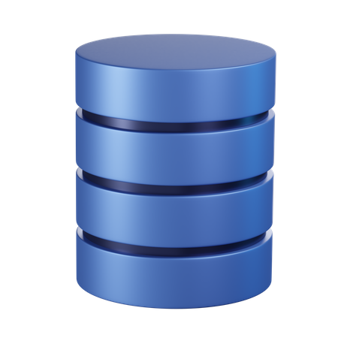
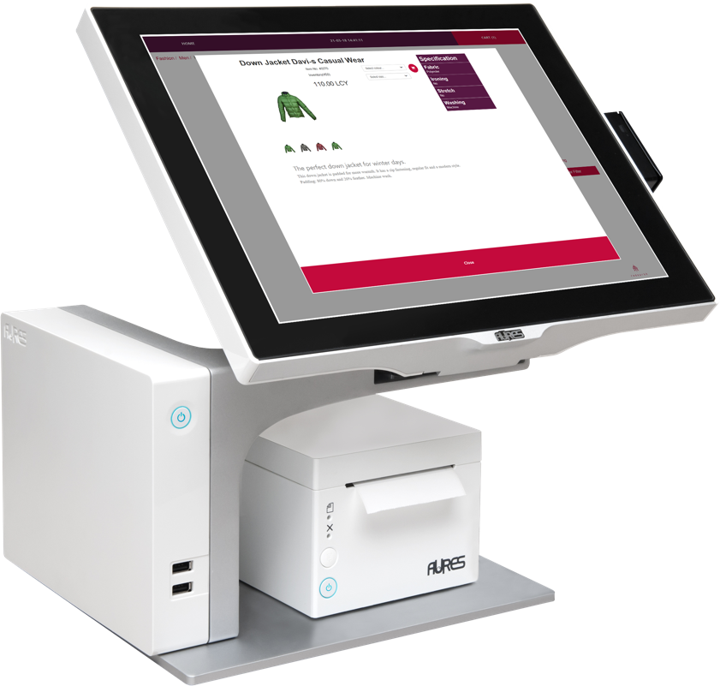
Monolithic Approach
BC Company
100
POS
100
POS
100
POS
100
POS

Slide 51
Distributed Approach
BC Company
Each BC company has its own SQL tables
100
POS
100
POS
BC Company
Each BC company has its own SQL tables
100
POS
BC Company
Each BC company has its own SQL tables
100
POS
BC Company
Each BC company has its own SQL tables

Slide 52
There are some more things we need to take care of…
Finance
Master data management
POS data entries validation (gift cards and vouchers)
Member management and loyalty points validation
Inventory lookup
Replenishment management

Slide 53

Distributed Approach
GL only
AP / AR / Bank etc.
Finance
100
POS
100
POS
100
POS
100
POS

Slide 54
Distributed Approach
Master Data : Store, Location,
POS Terminal etc.
100
POS
Finance
Master Data : Items, Prices,
Discounts, Vendors, etc.
Centralized Replenishment
Retail Master
100
POS
POS Data Entries validation
Loyalty Points Earn & Burn etc.
100
POS
100
POS

Slide 55
Distributed Approach
Finance
100
POS
Retail Master
100
POS
100
POS
POS Transactions
Purchase Orders
Transfer Orders
Sales Orders
etc.
Item Ledger Entries
Value Entries
Retail 1
Retail 2
Retail 10
Retail 11
100
POS
Retail X
Retail Y

Slide 56




Distributed Approach v.2
Finance
Retail Master
100
POS
100
POS
Retail 1
Retail 2
100
POS
Retail 10
Retail 11
100
POS
Retail X
Retail Y

Slide 57
Your benefits
Supported by all standard functionality
Low additional cost
Grows with you
Upgrades made easier
Note! Currently this is project configuration and needs careful planning

Slide 58


Slide 60
Your Questions please!
(or feedback ☺)

