Slide 2

Ólafur Jónsson
webPOS and Hardware Station
Product owner
Olafur@lsretail.com

Slide 3













From WindowsPOS to webPOS
Microsoft Dynamics 365
Business Central
HQ
HQ
Store
Store
LS Hardware Station
Windows application, stationary/tablet
C/AL, can use .DLLs
Directly connects peripherals
Browser, OS independent, stationary/tablet/mobile
AL, no DLLs
Connect peripherals thru HW station or LS Central AppShell

Slide 4
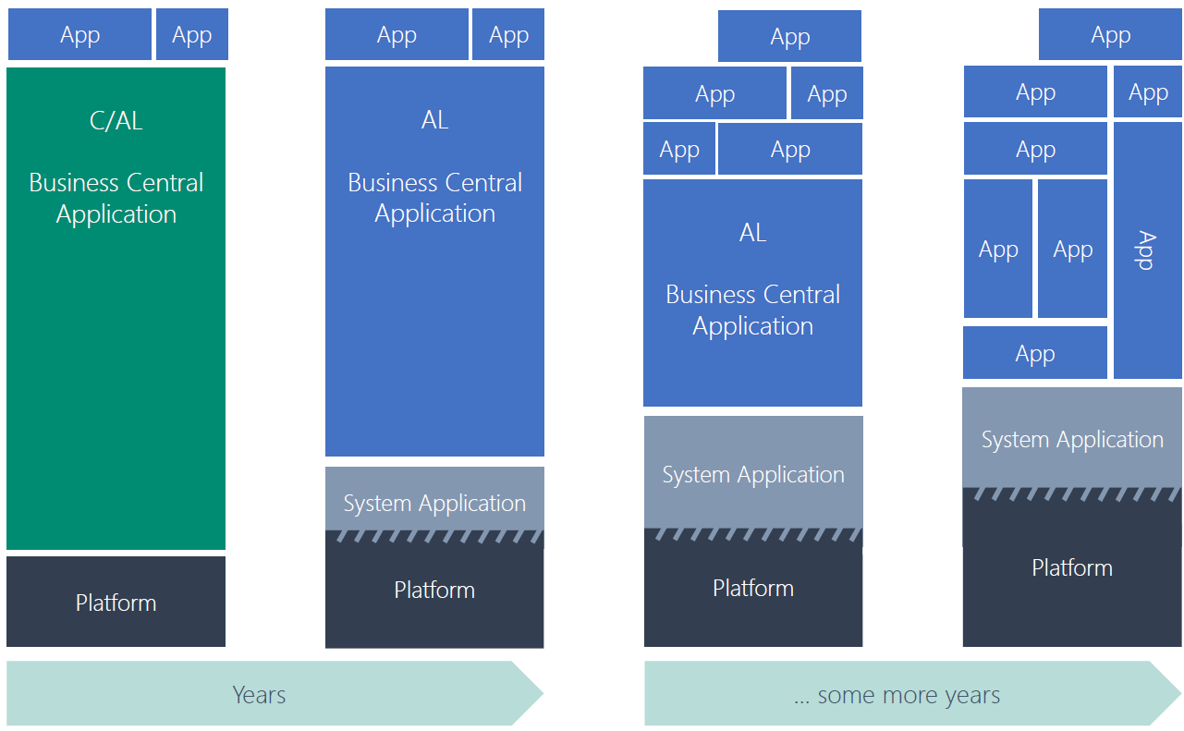
The architecture
Customer
Extensions
Extensions from AppSource
w/ BC (all) + LS Central dependency
LS Central localization App
Extension
LS Central App
Extension
LS POS
Extension
Microsoft
Business Central
App
BC system App

Slide 5

Extending the POS
The OLD method of coding
Events
Events & Extensions
Customization Code
Add-On
LS Central code
Customization Code
Add-On
LS Central code
Add-On
LS Central code
BC code
BC code
BC code
Customization Code

Slide 6



On-premise to In-cloud
On-premise
Hybrid Cloud
In-cloud
Dynamics 365
cloud
Dynamics 365
cloud
HQ
HQ
HQ
Store
Store
Store
Online POS
Online POS
Standalone POS
Standalone POS Server
Standalone POS
Standalone POS Server

Slide 7
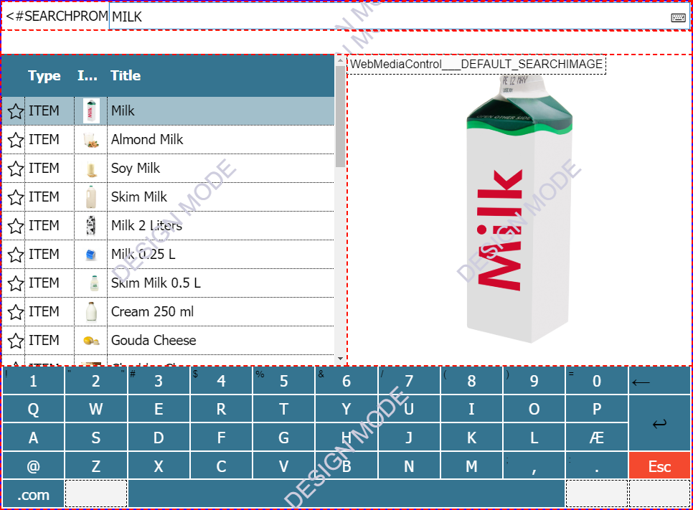
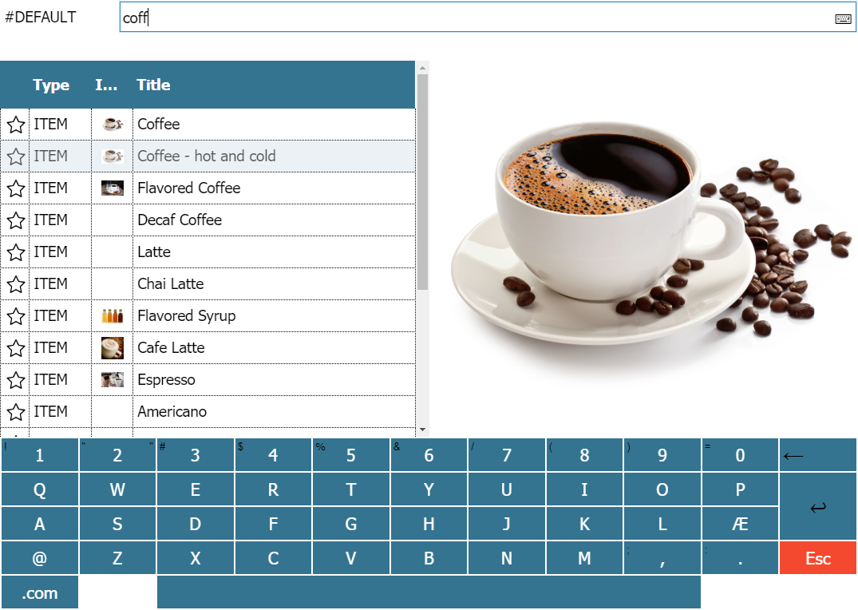
POS setup – easy, simple, fast
The layout of the POS is defined in LS Central by creating panels and placing controls on them, specify their properties and add skins fonts and color etc
The configuration is stored in the LS Central Database
LS Central creates the POS pages at run time
Same process as with the WindowsPOS but …
In developing note the difference in behaviour between POS and ServiceTier
  WindowsPOS = Synchronus
  webPOS = Asynchronus
Specific webPOS API functions (AddHtml, AddJavascript, AddStyle)

Slide 8
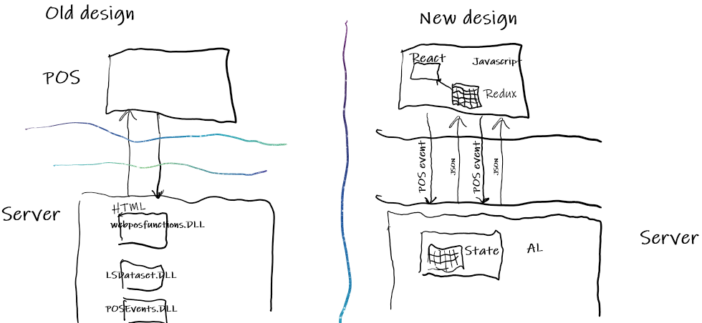
Going forward: NoDLL’s + standard web components

Slide 9
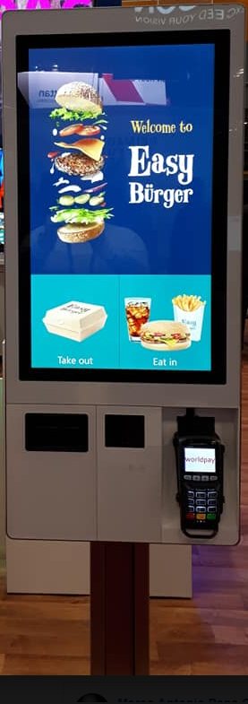
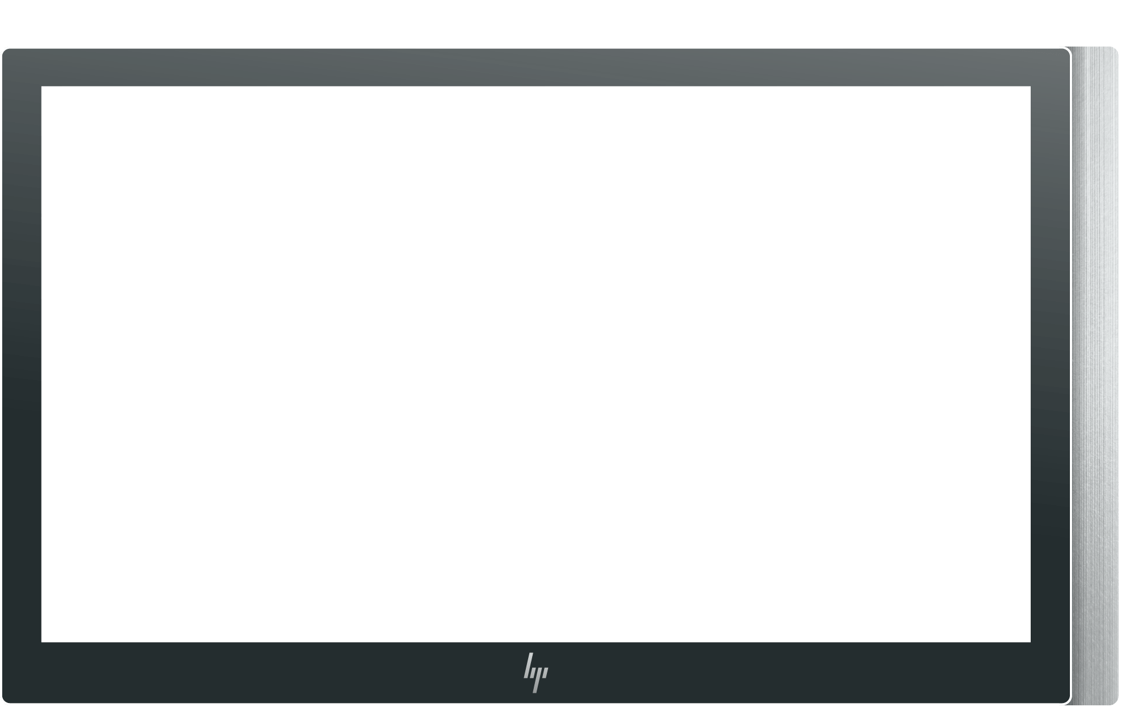
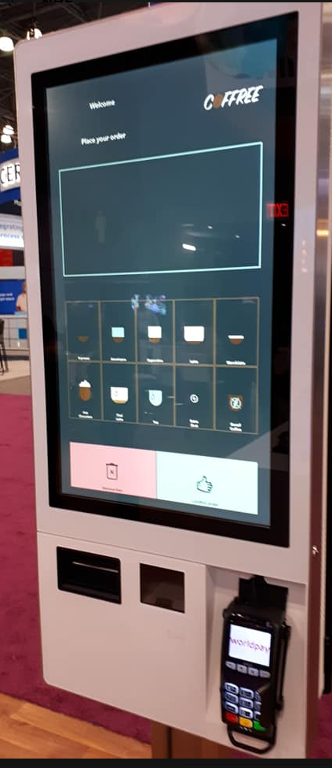
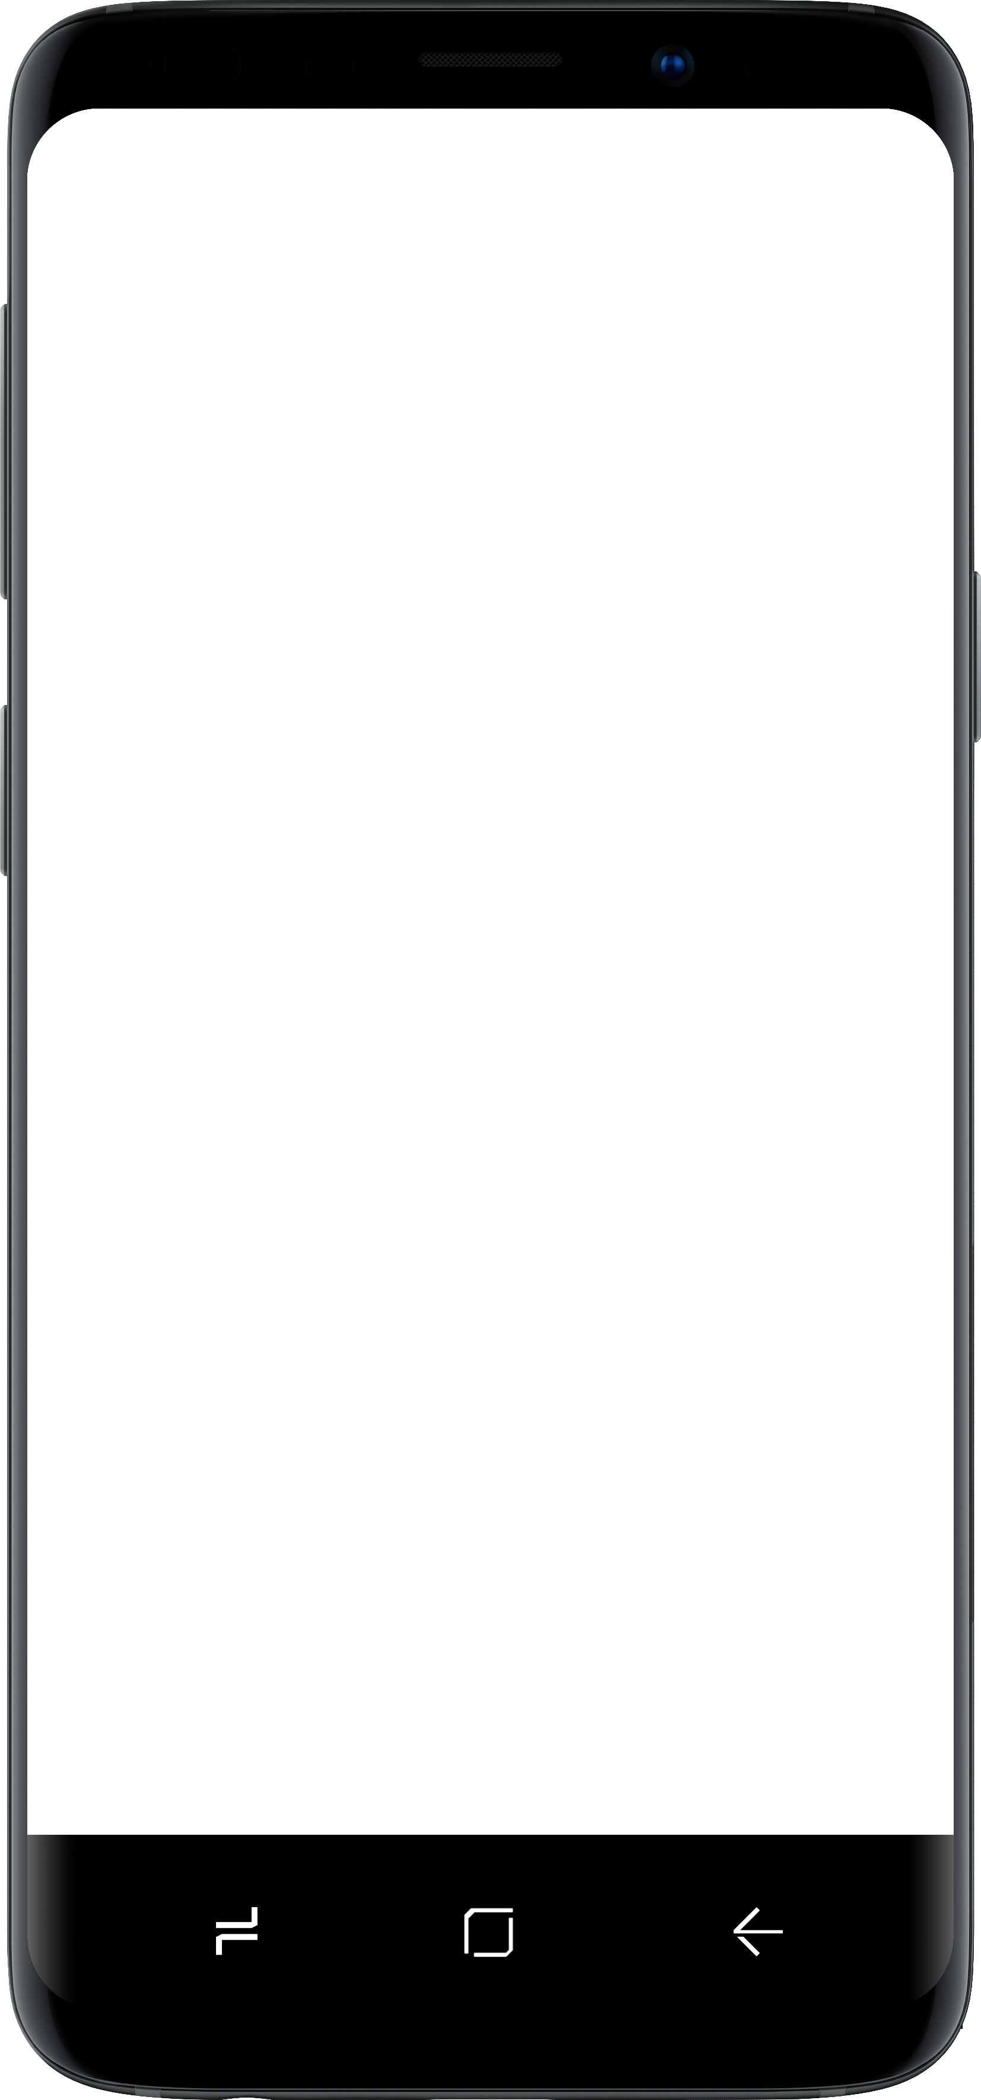
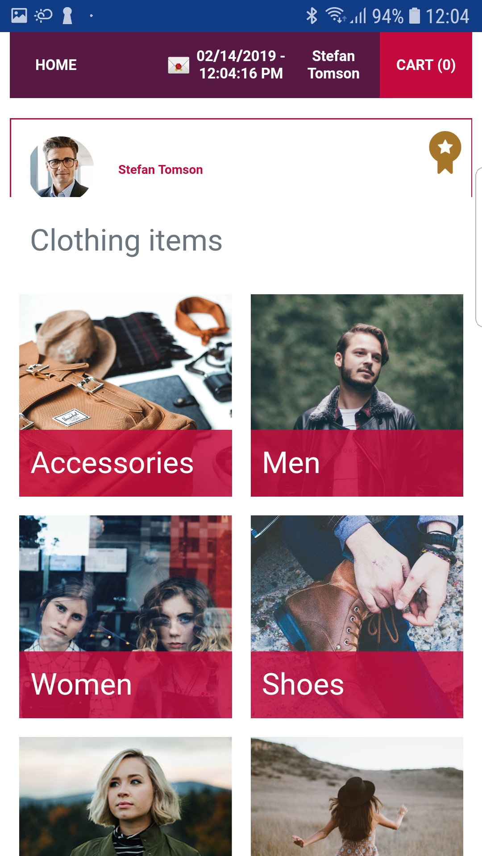
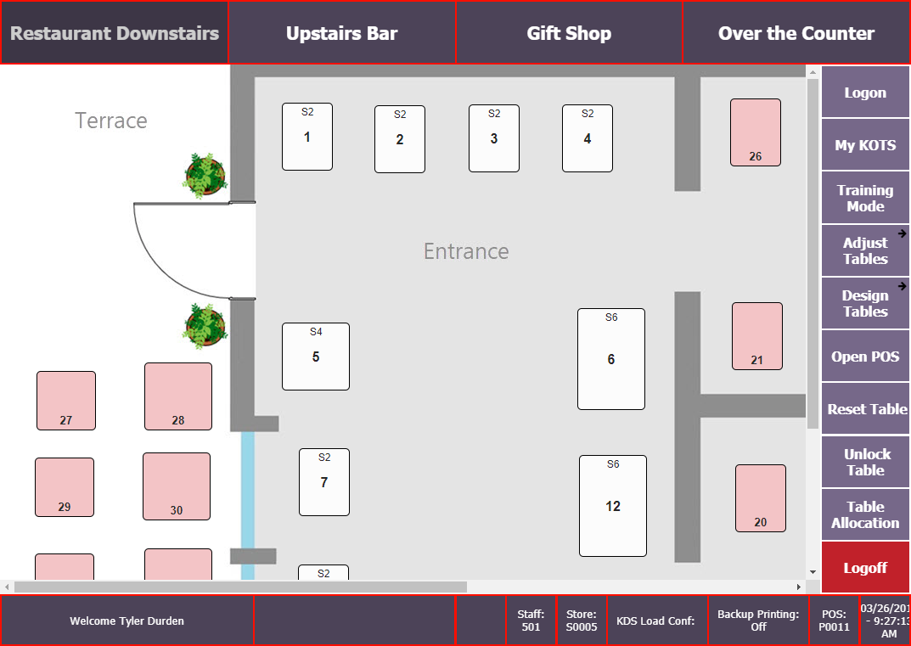
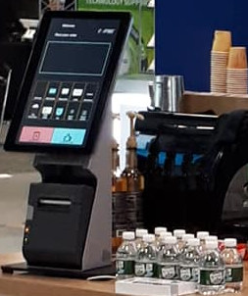
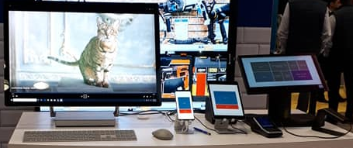
The many faces of the webPOS ..

Slide 10

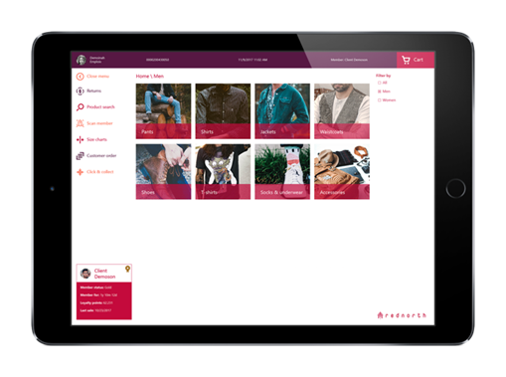
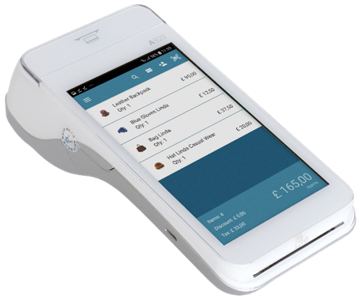
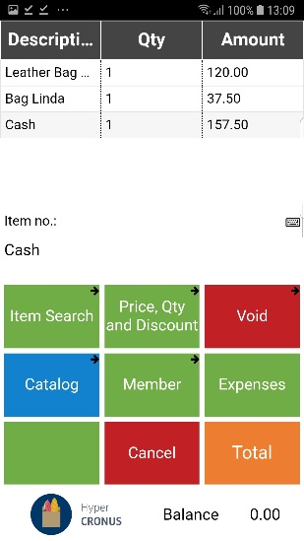
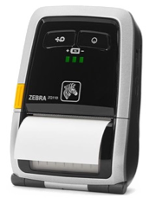
The LS Central AppShell
App to run POS on a device ( )
in a controlled way
Gives POS direct access to peripherals *
  Printers (Epson EPos, Zebra link OS)
  LS Pay connected EFT device
  Camera built into a mobile device to scan
Pheripheral can be
  Built-into the device
  Connected via Bluetooth / WiFi / network connected
        * EFT&Printer access only available in Android version
LS Central
AppShell

Slide 11



LS Central AppShell on different platforms
on Android
  Full device support
    Mobile printers / LS Pay connection
    Barcode scanners / Camera to scan
on iOS
  Camera to scan
  Device support thru HW station on network
  on Windows*
  Camera to scan
  Device support thru HW station locally or on network
  * released with 16.0

Slide 12

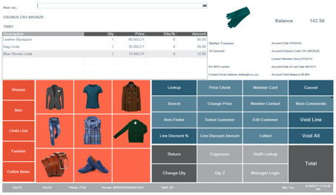
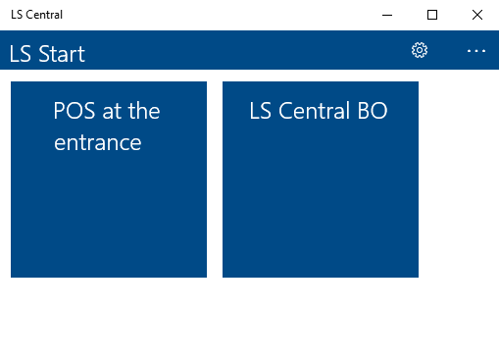
LS Central AppShell for windows
Run the POS by a click of a button or select
  Pre-configure URL/user/.. in the Settings option
  Or import Pre-configure settings from a file *
Additional run options
  Select between different POS / BO configs (LS Start!)
  Option to exit (shutdown) the App on logoff in POS
  Option to force app with POS to stay open
Resource access
  Access to resources on a tablet device
    Camera
  HW station used to access other resources
    Printers / LS Pay connected EFT device / etc
    * coming version

Slide 13
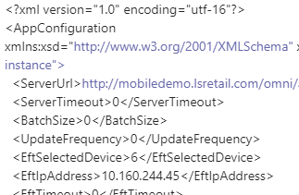


LS Central AppShell distributed config support *
Create centrally an XML file with the config info for the Appshell
Send the XML file to all devices that will use LS Central Appshell with a distribution software
On the device, the LS Central Appshell detects the XML config file and the user accepts to load and use settings from the XML file
. . . . .
User can test the settings and the LS Central Appshell is ready to use
POS device
POS device
The LS Central Appshell now also has the feature of exporting a config from the App to an XML file that can also be used to distribute
. . . . .
LS Central App
* available on Android

Slide 14
LS Hardware Station
Microsoft Dynamics 365
Business Central
HQ
A Windows service
Is configured using the Hardware Station Management Portal
Gives access to OPOS devices + LS Pay
Many POS can use same Hardware Station
Simple selection of Hardware Station to use from POS
Store
POS 1
POS N
LS Hardware Station

Slide 15

Simple selection of Hardware Station
Hardware
Station 1
Hardware
Station 2
  Pre-configured
  By scanning a QR-code
  Push of a button

Slide 16
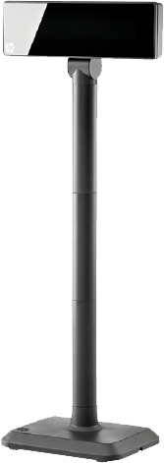
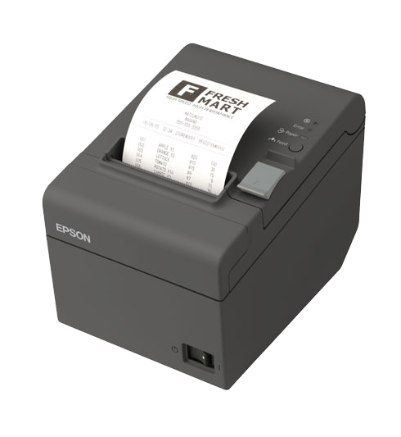
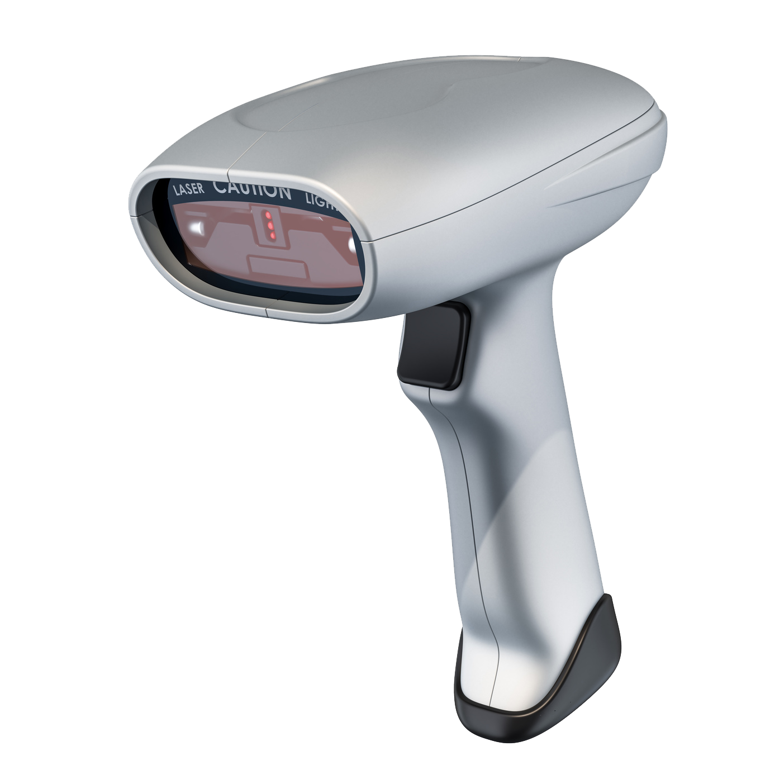
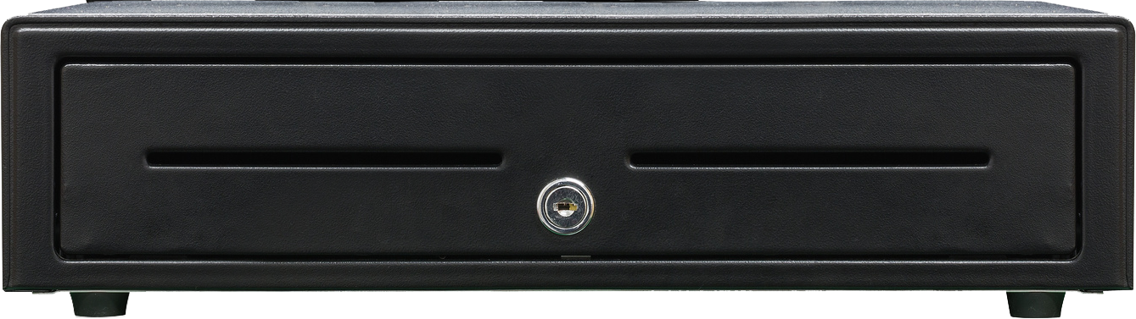
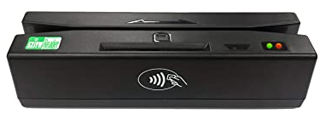


Hardware Station peripherals supported
Devices supported
  Printer (OPOS and Windows)
  Cash drawer
  Scanner
  Line Display
  Serial device
  MSR
  Payment terminals (EFT) thru LS Pay
In development
  Scale
  Dual Display

Slide 17


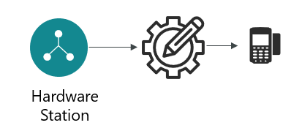
EFT: LS Pay support or custom created
LS Pay support
Custom EFT
LS Pay
Engine
LS Pay
Engine
Adyen
Adyen
Adyen
Adyen
Verifone Point
Verifone Point
Worldpay
Worldpay
PayEx
Valitor
Hardware Station
Hardware Station
PayEx
…
Valitor
PayEx
Nets
…
PayEx
“LS Pay Information Pack” on LS Partner portal shows plugin availability at any time

Slide 18

Payment tokens in POS and Hardware Station
POS EFT flow today
POS EFT flow with Payment tokens
LS Central
LS Central
Token store
POS
Purchase (token)
Void (EFTtransactionID | token)
Refund (EFTtransactionID | token)
Get pre-auth (token)
Update pre-auth token (token)
Finalize pre-auth token (token)
Purchase
Void (EFTtransactionID)
Refund (EFTtransactionID)
EFTtransactionID
HW station
EFTtransactionID
token
LSPay
PSP

Slide 19

Tokenization and system components
eCommerce
(order,token)
(transaction,token)
LS Central
Token store
LS Hotels
Customer orders
.
.
POS
Purchase (token)
Void (EFTtransactionID | token)
Refund (EFTtransactionID | token)
Get pre-auth (token)
Update pre-auth token (token)
Finalize pre-auth token (token)
HW station
LSPay
PSP

Slide 20


Fiscalisation using Hardware Station
Different Fiscal requirements and devices between countries
Common thing is that POS needs to “talk to” the Fiscal unit and get “ok” before proceeding
Fiscal unit can be a web service / USB stick / printer …
LS Hardware Station devices have DLL implementation that can be overridden/replaced by partners
LS has a package to demo how one the devices, the Serial device, can be replaced with a custom implementation that communicates with external service
POS
HW station
PSP
Fiscal
unit
…

Slide 21



A custom serial starter pack is available
A general description document on customizing HW station Dll’s
demo .Net project that implements a serial device with injection points for different Fiscal requirements (web service / Printer / Fiscal blackbox device / ..)
AL code unit that demos communication in POS with a Custom Serial device thru HW station, sending data and receiving an answer
+ error handling

Slide 22
Selecting POS options connecting to devices
LS Hardware Station connection to all devices
LS Central AppShell : PED directly
& Printer direct or network connected
POS 1
LS webPOS in
LS Central AppShell
POS N
LS webPOS in
LS Central AppShell

Slide 23

LS POS can mix and match ..
LS Central
Every POS can use one or more
LS Hardware Stations
One Hardware Station can have many POS connected
LS Central AppShell PED and printer possibilities
POS can mix options, feks a POS can use EFT device thru LS Central AppShell and a printer thru LS Hardware Station, or any other combination.
LS Hardware Station 1
POS
LS Hardware Station N
POS
POS
LS POS in
LS Central App
Android device
POS
LS POS in
LS Central AppShell
LS POS in
LS Central App

Slide 24
Customer example: adding a coffee shop
HQ
Store
LS Hardware Station
Adyen
LS Central
LS webPOS
Epson
Adyen (WiFi)
Adyen (WiFi)
LS webPOS in
LS Central AppShell
LS webPOS in
LS Central AppShell

Slide 25
Customer example: A ferry company
LS Central
HQ
A ferry
LS Central
Store server
POS retail –
handout goods on car deck
POS retail / hospitality
KDS printers
LS Central
PayEx
LS POS
LS Hardware Station
LS webPOS in
LS Central AppShell
Toshiba

Slide 26

Support material
Customer journey documents and videos
Increased documentation and how-to videos on LS YouTube channel
  How to set up the LS Hardware Station for EFT devices
  Hardware station setup for Adyen Local Connection
  Hardware station setup for Adyen Cloud Connection
  LS Pay - Hardware Station setup for Verifone Point
  LS Pay - Hardware station setup for Valitor USB Connection
  Hardware station setup for UnionPay
  ….

Slide 27
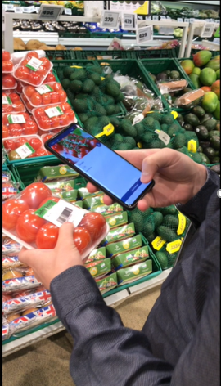
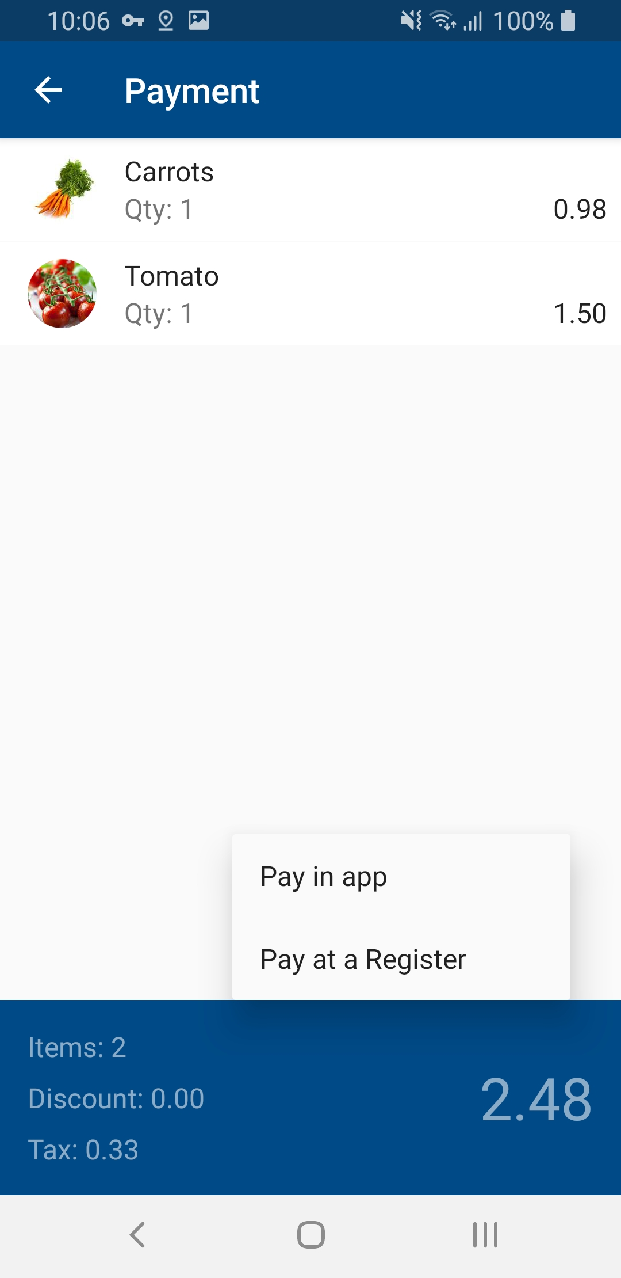
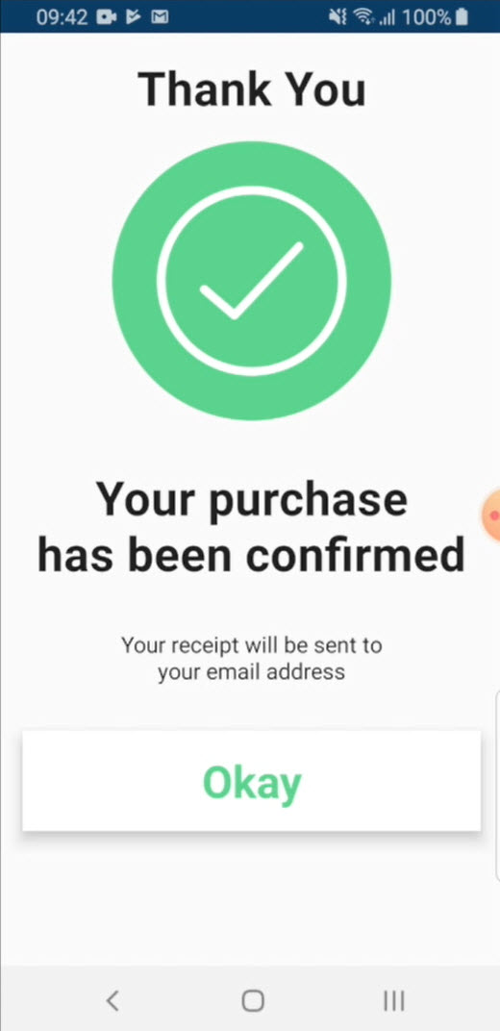
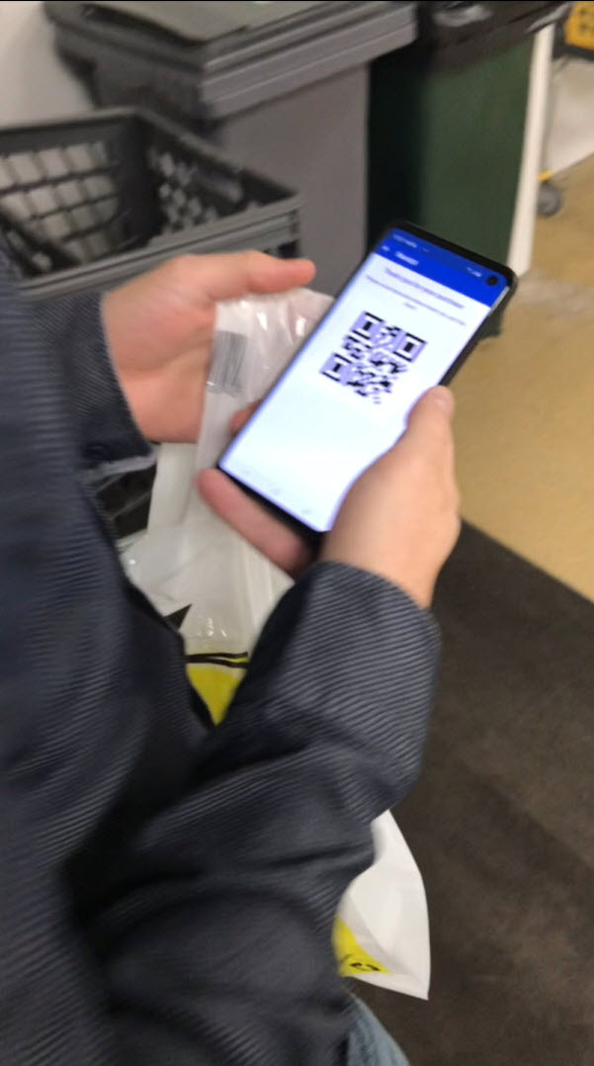
LS Scan-Pay-Go – mobile Self-Checkout
-> Webinar in June – LS mobile solutions

Slide 28

Questions?

