Slide 1


Run successful events with Bookings for LS Central
Anna Dis Thorvaldsdottir
Consulting Manager
Alejandro Vazquez
Principal Consultant

Slide 2


Slide 3




Managing an event
Quote
Reservation
Operating event
Payment

Slide 4
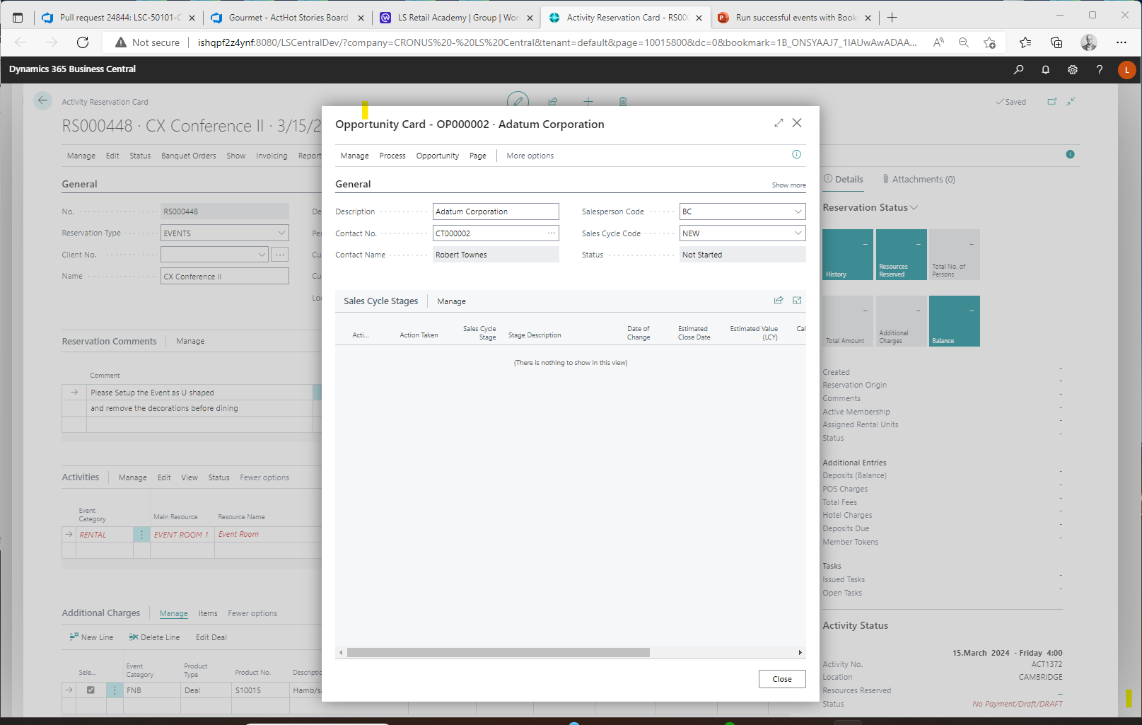
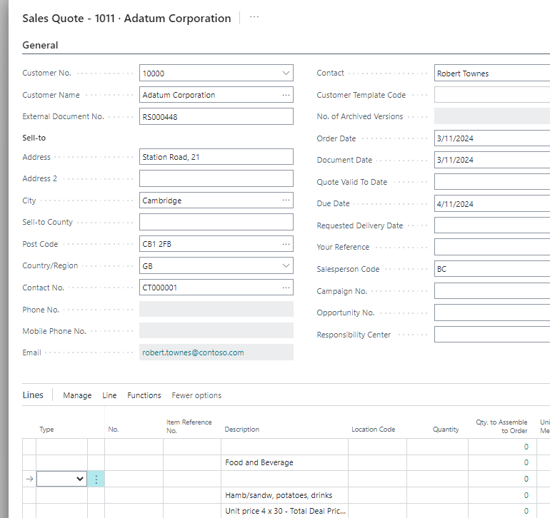
Banquet Events – The presale process
Standard BC functionality:
CRM (Opportunity)
  Create Opportunity
    Linked to a reservation
  Manage sales cycle
  To Do's/Emails
  Communication Mgmt
Quote
  Create BC quote

Slide 5
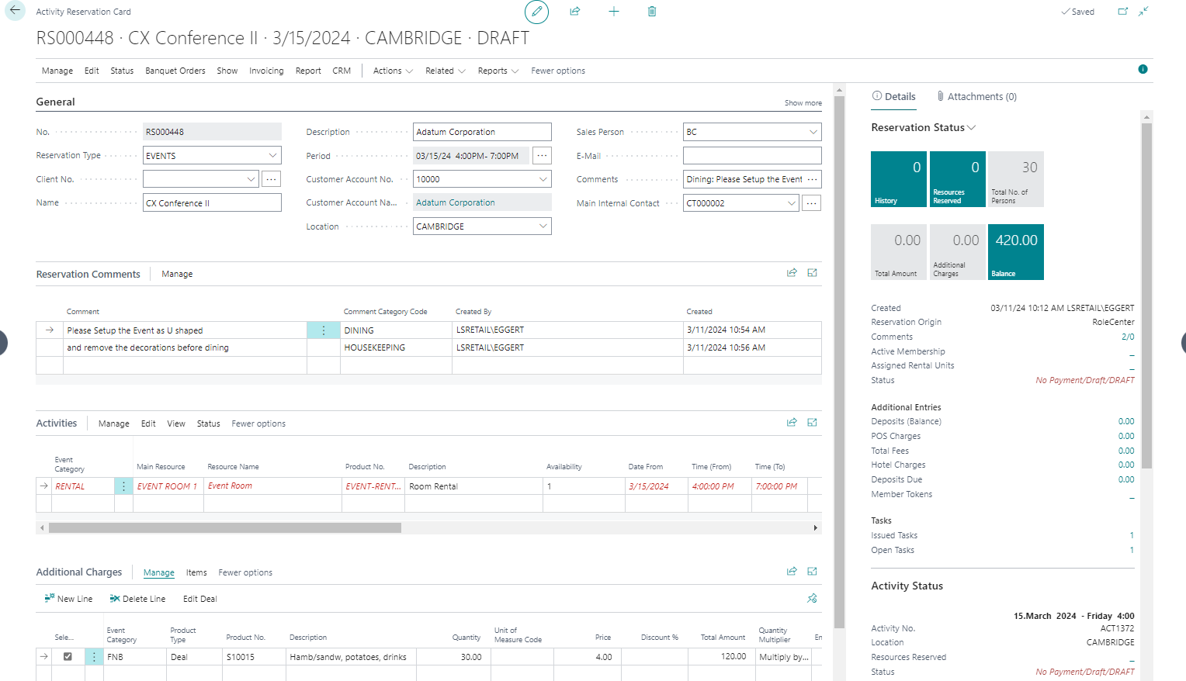
Banquet Events – The Reservation
Reserve and charge for
  Event Rooms
  Equipment
  Human Resources
  Items
  Food & Beverage
    Menus & deals
Track comments and requests
Assign responsibilities
Issue and monitor tasks

Slide 6
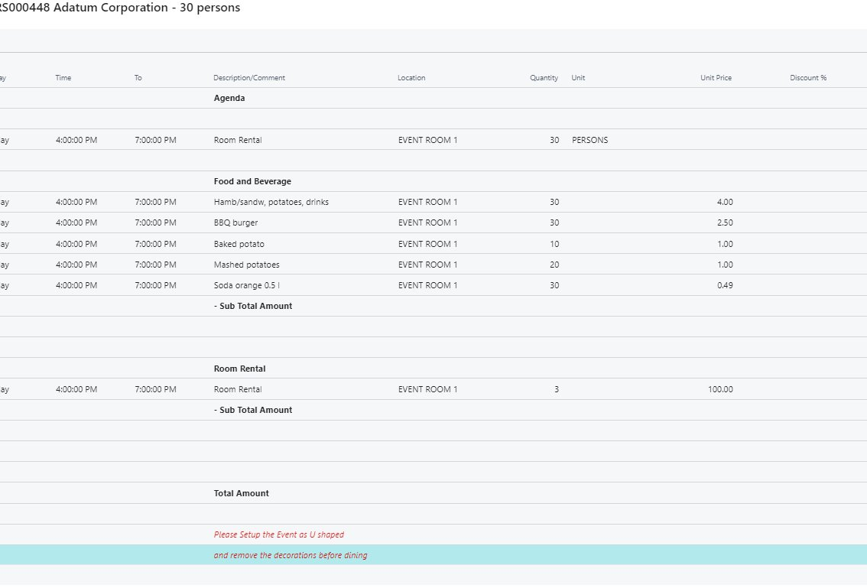
Banquet Event: Versioning and change tracking
Track all changes during the lifetime of the event reservation and notify the responsible parties if needed.
Group the reservation entries into Banquet Categories, i.e. AV, F&B, RENTAL, and define the layout of the BEO (banquet event order).
Version Control of the reservation and changelog of all reservation changes, including rooms, prices, quantities and comments.

Slide 7
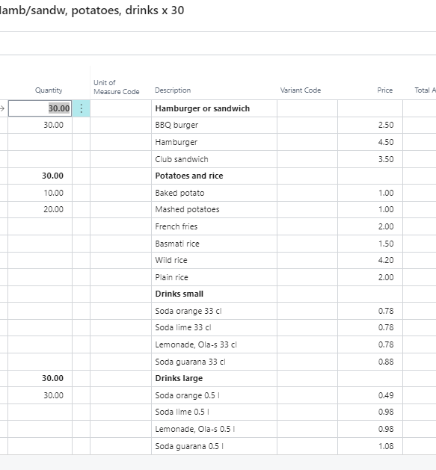
Menu & deal handling
Use F&B deals to setup menus and offers
Preselect menu options for catering
Client selects menu options for a la carte
  Using allowances
Cost calculations
Compress menu content details at POS

Slide 8
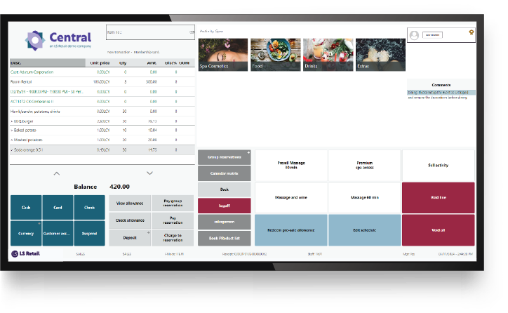
Finalizing and Payments
Finalizing of event reservations using
  Point of Sale
  BC Sales Invoice
Token (Pre-authorization) handling
Deposit management
  Deposit policies
Cancellation & refunds
  Cancellation policies

Slide 9
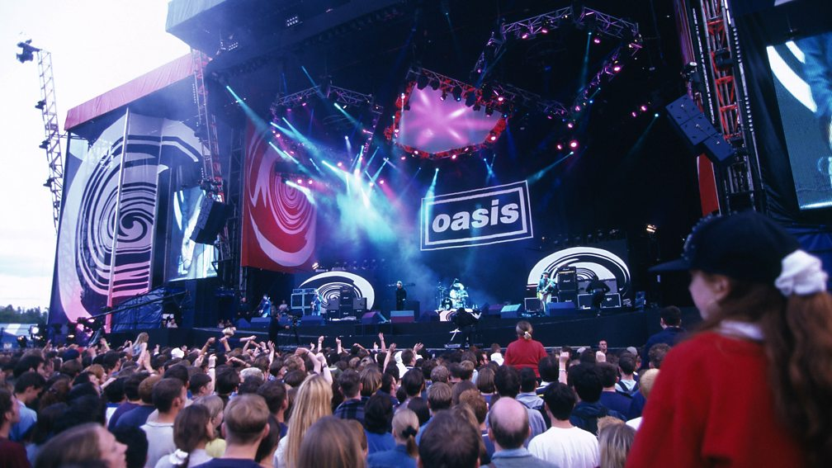

Slide 10
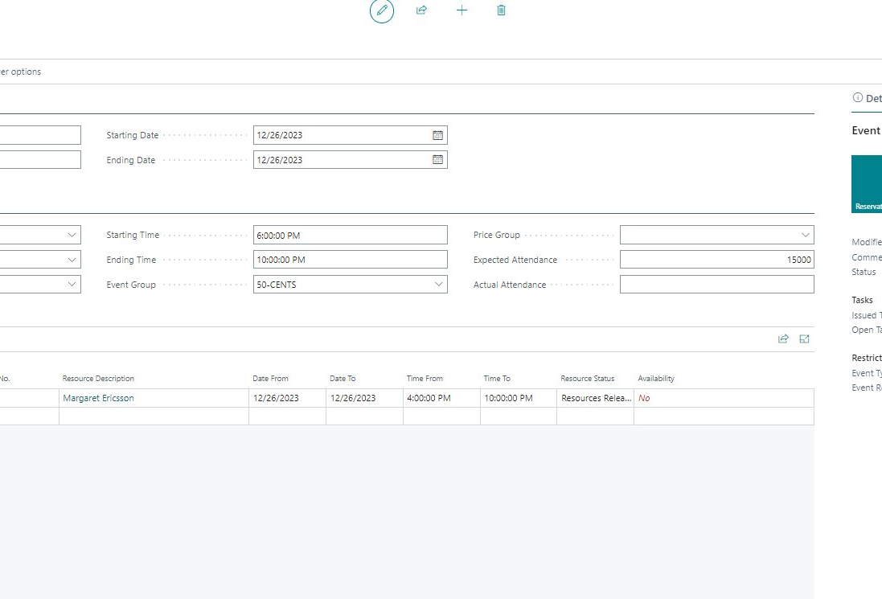
Event Management: Stadiums & shows
Reserve resources and charge for
  Suites
  Equipment rental
  Items
  Food & beverages
    Menus & deals
Keep track of multiple event related reservations under one "umbrella"
Pre-allocate resources
  Can then only be reserved by event related reservations
Issue and monitor tasks
Set charge restrictions based on event

Slide 11
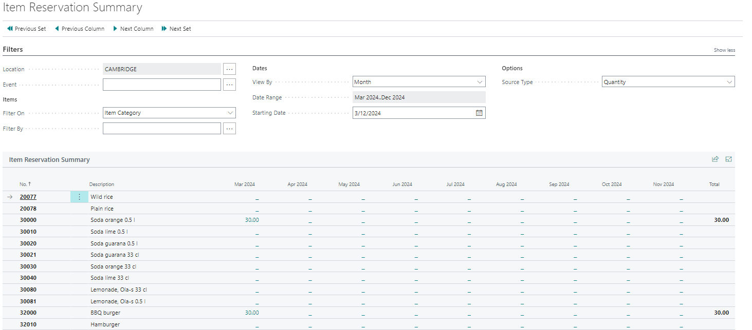
Analysis and summaries
Summary of item/deal reservations
  Cost Amount
  Quantity
  Sales Amounts
  Periods – years, months, weeks, or dates
  Per Event
  Per Item Category
  Per Product Group
  Per Special Group
  Per Deal / Menu
  Cost Reports
    Per Reservation
    Per Event
All general reports in BC/LS Central
  Sales
  Inventory

Slide 12
Banquet Events and Event Management demo

Slide 13

Event Management v25
Cost management
  Quotes
  Invoiced
Task defaults for event types
Banquet event category
Cost Management

Slide 14
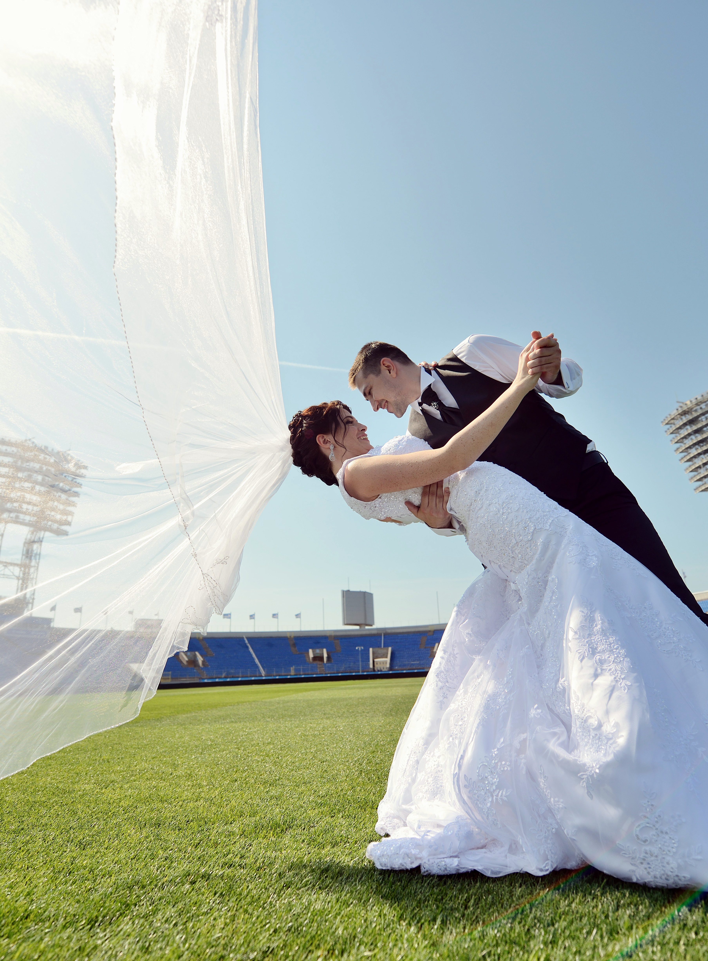
What are events?
Banquet Event Orders (BEO management)
  Conferences/Weddings
  Meetings/Celebrations
Event management (Stadiums/Venues)
  Concerts
  Sporting events
  Theater and shows

Slide 15
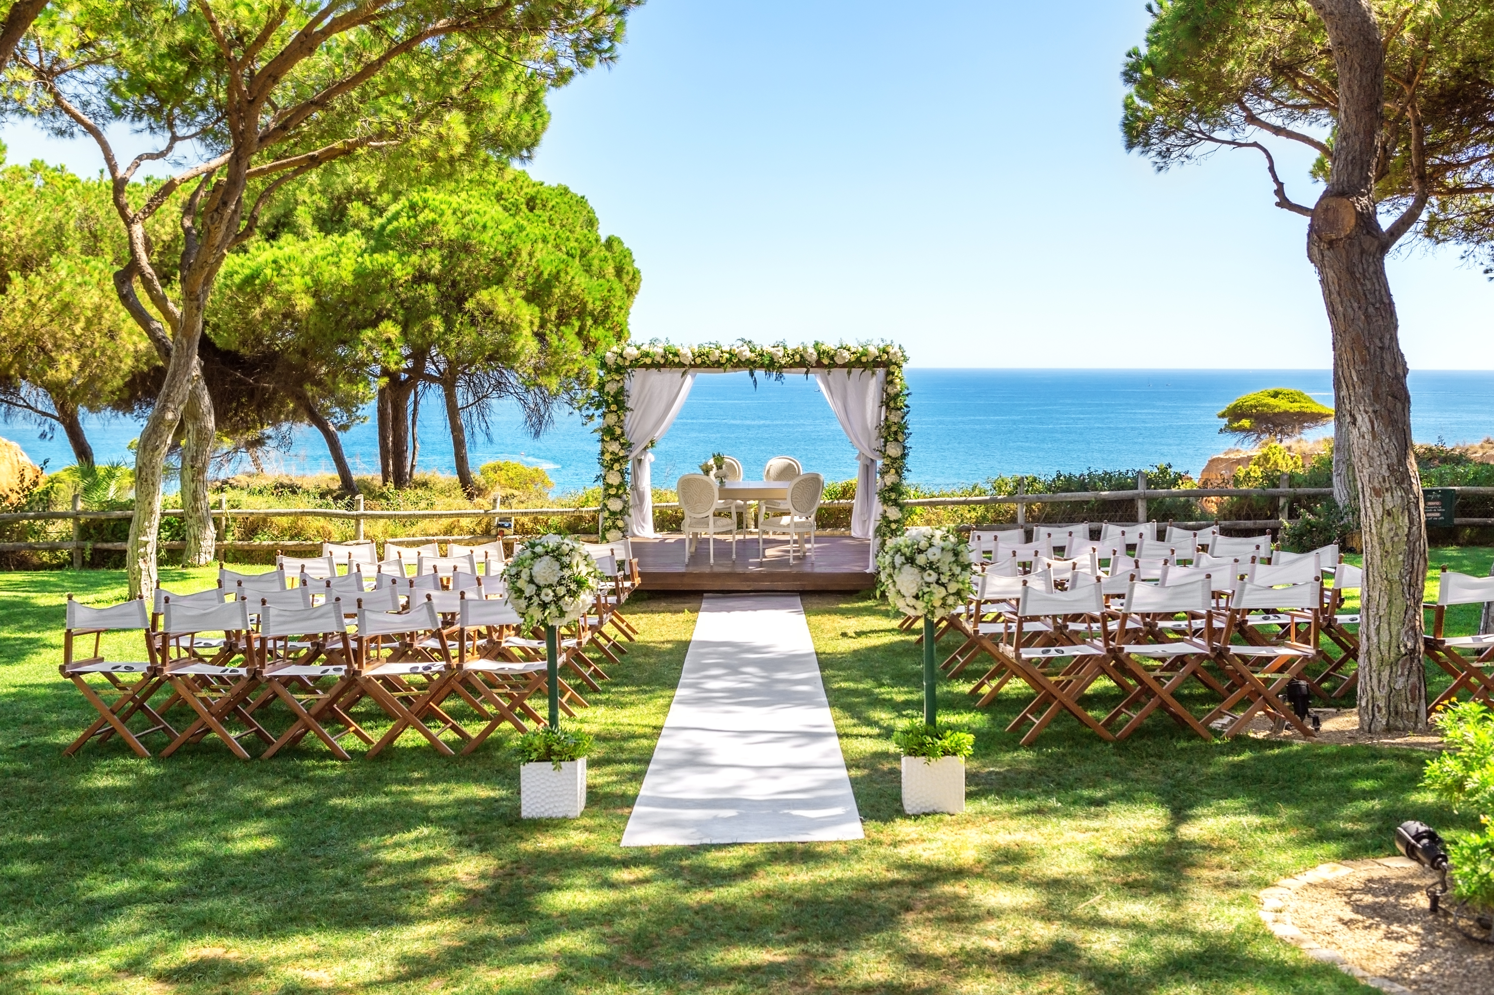
Questions?

