Slide 2

Steven Lim
“Technical” Consultant
Auto-Tests for LS Central
Deploy Auto-Tests for LS Central and add to your extensions

Slide 3

Agenda
Prerequisite for LSC Auto Test.
Testing the LSC Auto-test
Create a custom Auto-test AL extension?
When Auto-test failed?
Q & A

Slide 4
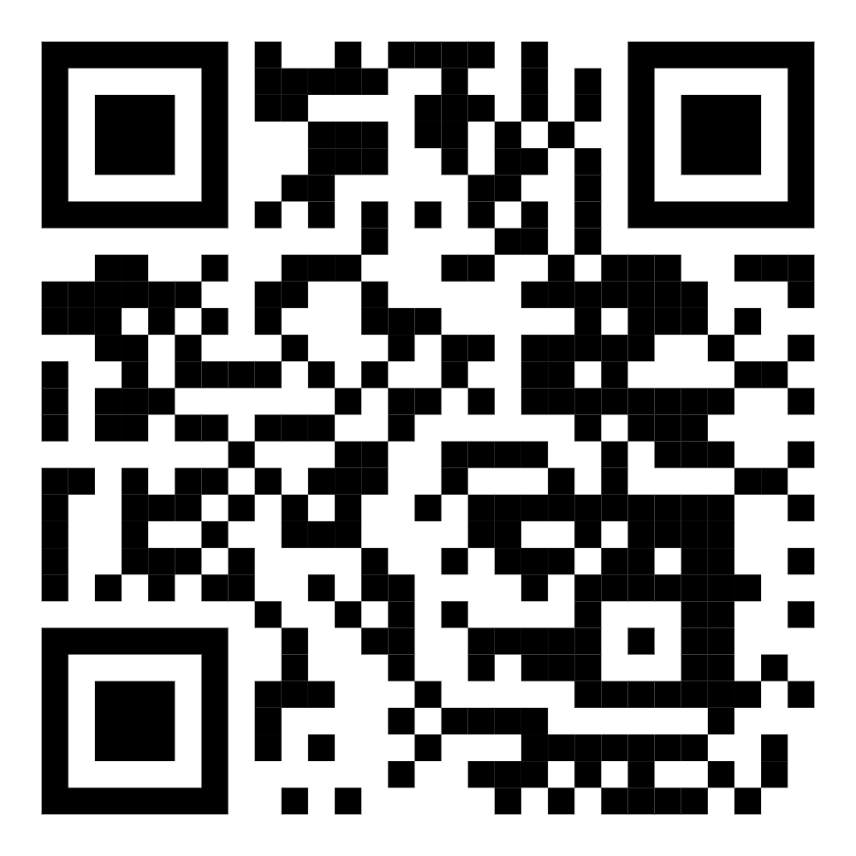
steven.lim@lsretail.com

Slide 5
Prerequisite for LSC Auto Test.
Notes:
This slide is just to divide the talk into the main chapters of the agenda.

Slide 6

What do we need before start?
Dynamic 365 BC & LS Central !
BC Version 24.1.18927
LSC Version 24.1.0.306
List of Dynamic 365 BC App (Extension)
List of LS Central Apps (Extension)
LSC Demo Database
How much Hard Disk Space available?
Notes:
LSC Auto-test Prerequisite

Slide 7
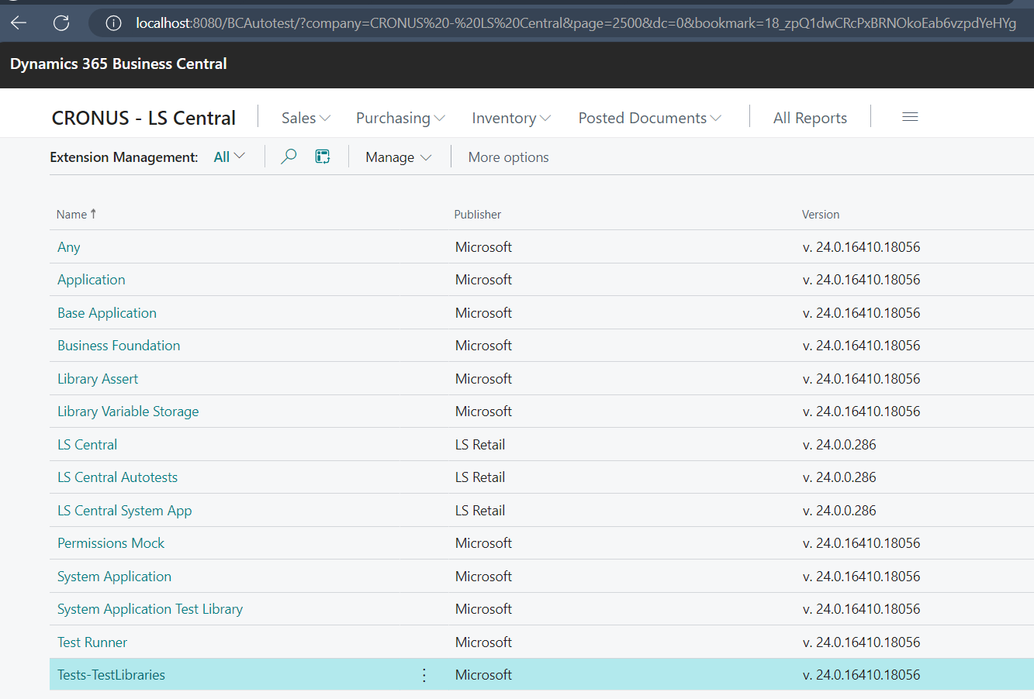
Extension need for LSC Auto-test
The required apps found in the Dynamics 365BC installer,
Dynamics.365.BC.xxxxx.xx.DVD\Applications subfolder
…\testframework\TestLibraries
  Microsoft_Library Assert.app
  Microsoft_Any.app
  Microsoft_Library Variable Storage.app
  Microsoft_Permissions Mock.app
…\system application\test
  Microsoft_System Application Test Library.app
…\Applications\system application\source
  Microsoft_System Application.app
\BaseApp\Test
  Microsoft_Tests-TestLibraries.app
\testframework\TestRunner
  Microsoft_Test Runner.app

Slide 8
Extension need for Auto-test
  Remember!!!
  Deploying LS Central Apps
LS Retail LS Central System App_24.1.0.306_runtime.app
(LS Central System App)
LS Retail LS Central_24.1.0.306.app
(LS Central)
LS Retail LS Central Autotests_24.1.0.306.app
(LS Central Autotests)

Slide 9
LSC Auto-test Prerequisite Link
  Prepare the Link in QR Code paste it here on 24th Sept 24
  Set Expire on 26th Sept 24

Slide 10
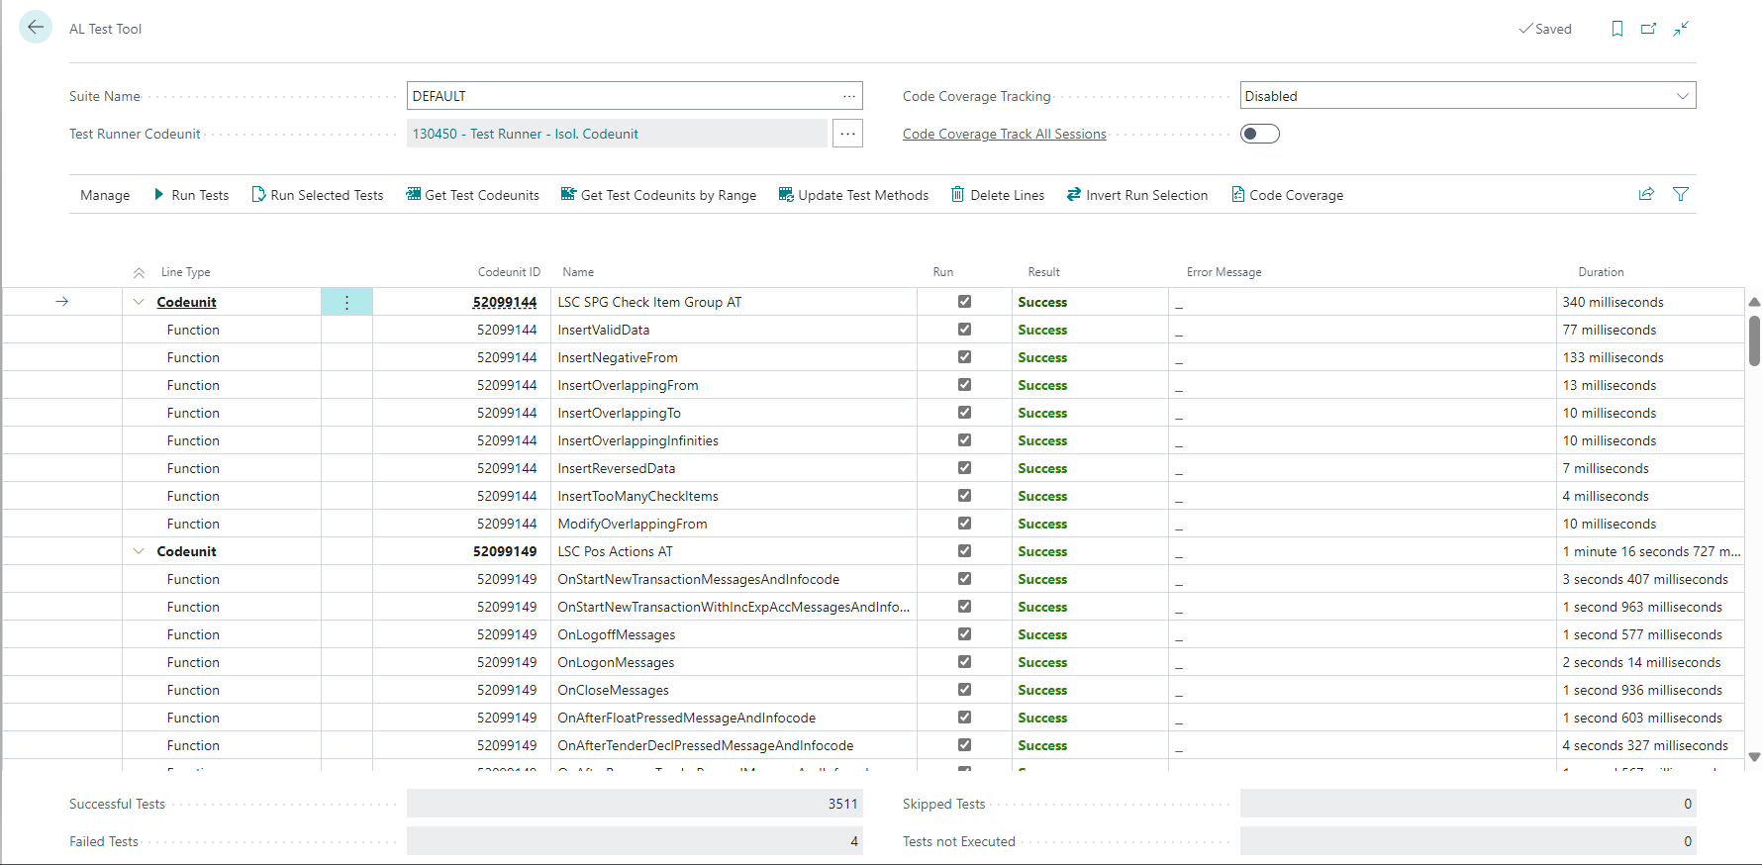
Exercise Time – Publish & Install Extension
Microsoft Apps
LSC Apps
Test Run Auto-test

Slide 11
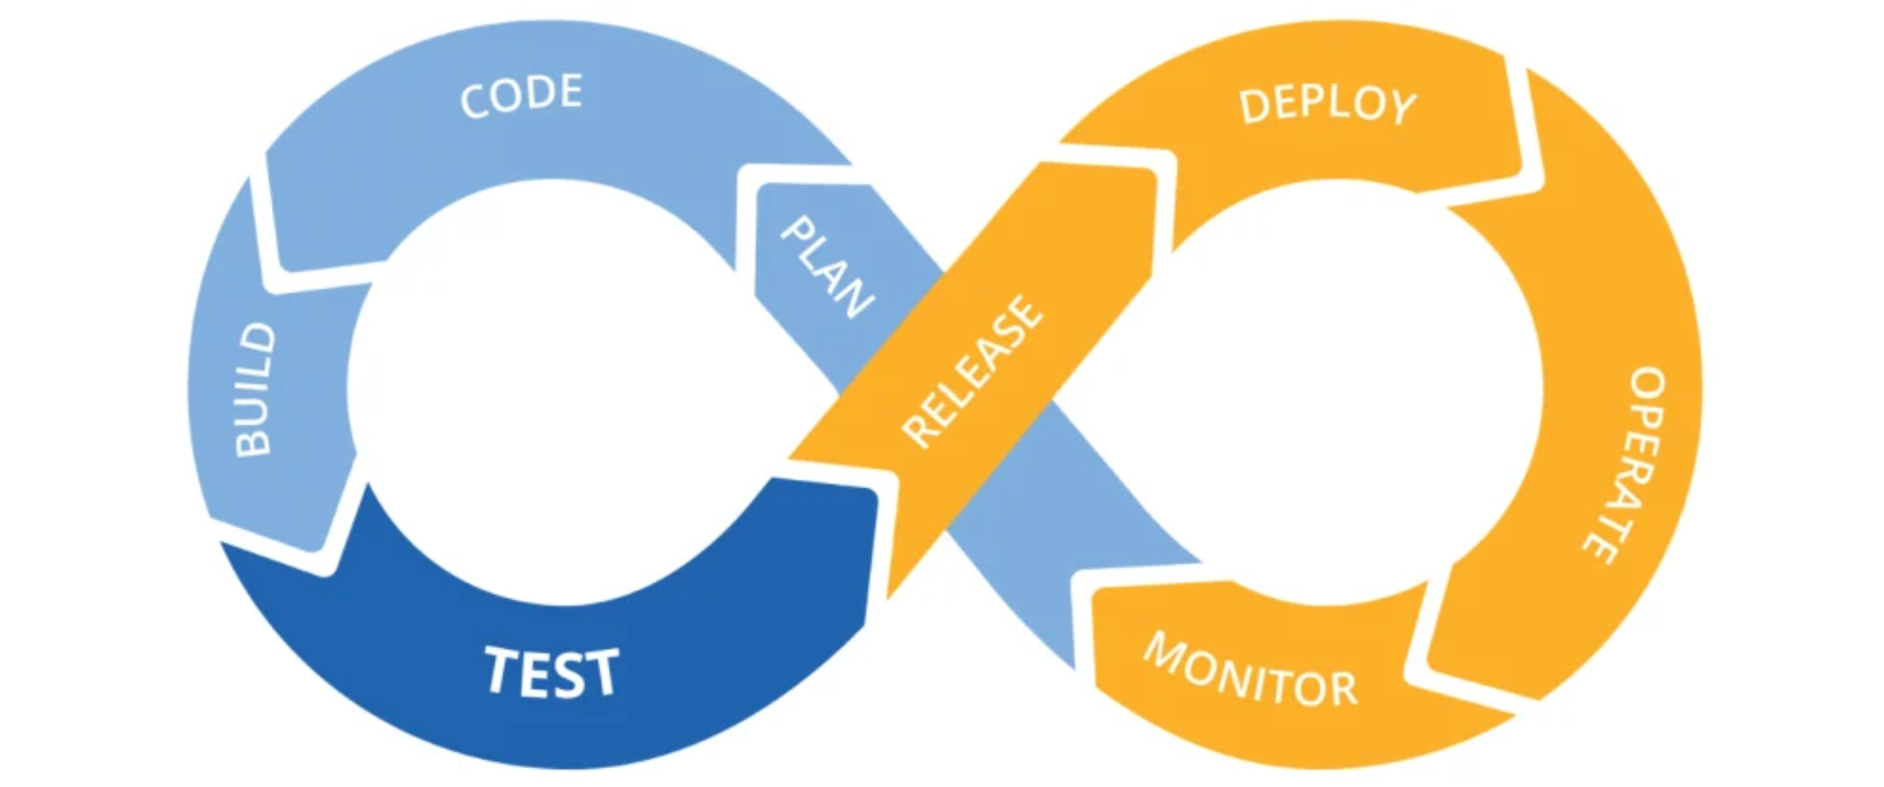
CI/CD
Notes:
CI/CD, which stands for continuous integration and continuous delivery/deployment, aims to streamline and accelerate the software development lifecycle.
Big and deep Blue [TESTING]
Challenge of manually testing.
Ensuring that these customizations and integrations function correctly before each release can be a major challenge.
Significantly increasing the workload for quality assurance teams (a.k.a Consultant).
Manual testing, isn’t a sustainable strategy.
the complexity of testing customized and integrated systems demands a more sophisticated solution than manual methods can provide.

Slide 12
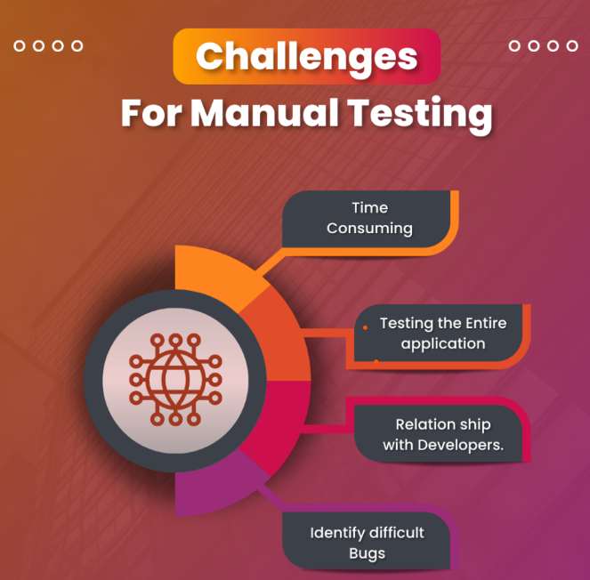
Challenge of manually testing BC
Unstable Environment
Tight Deadlines
Less Test Coverage
Friday Releases
Testing docs created incomplete/not updated
Fixing issue while testing in progress
Different Time Zone
Team Coordination issues
Last minute requirement changes
Wrong Est. on time & resources for Testing
Manual Testing Challenges
Notes:
Is the testing environment closed to the Real Life/Production environment
The given timeline insufficient for complete/comprehensive testing.
Estimation have been depleted, forfeited the full testing
Test coverage is basic or surface. No in-depth testing.
Worst, released/deployment done on Friday Evening.
How’s your weekend?
What happen to outdated documentation?
Testing in Progress, there is fixes enter. What should you do? Retest or move on?
Client/Partner on different time zone with you.

Slide 13
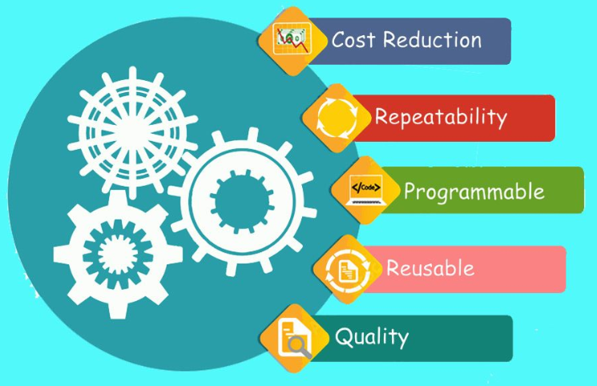
Challenge of manually testing BC
Decreased Business Expenses
Faster Feedback Cycle
Higher Test Coverage
Reusability Test Suite
Better Insights
Less time to Market
Less Stress on QA Team
Enhance Accuracy
Team Saves Time
Auto-test give more Features
Notes:
1. Decreased Business Expenses
When using an automated test atmosphere, your firm will save money as limited resources are spent on testing your product. The notion is that you should not be performing any manual testing. Over the whole project, this can create a huge difference.
As we know that installing and setting up an automated testing environment saves time and resources. Furthermore, chances are that you’ll pay for an adequate test automation tool that can help you in building a stable test automation environment.
2. Faster Feedback Cycle
Without test automation, feedback for recently formulated features can take a while. Test automation enables you to decrease the feedback cycle and generate faster validation for phases in the improvement of your product. Test automation is extremely beneficial because it assists you to detect problems or bugs first during the advancement phase, which enhances the team’s efficiency.
3. Team Saves Time
By automating your testing method, your team has to spend limited time assessing recently developed features. It also enhances communication with other departments like design, marketing, or product owners who depend on the outcomes of these tests. These departments can effortlessly check the logs of the automated tests and see what’s going on.
4. Higher Test Coverage
Manual testing sets limits on how many tests you can assess or verify. Automation enables you to spend time writing modern tests and augmenting them to your automated test suite. This boosts the test coverage for your output or product, so more features are suitably tested arising in a higher quality application.
Moreover, automated testing enables developers to write more in-depth tests that test complicated use cases. Prolonged tests that are frequently avoided during manual testing can be run unattended.
5. Reusability of The Test Suite
At first, creating your automated test suite is a challenge. But, once you have distinguished your suite, it’s very precise to reuse tests for other aim cases or even other projects. The benefit is that you can handily hook up another project to your automated test suite.
You’ve already attained a thorough understanding of preparing an automated test suite and all relevant tools such as the continuous integration (CI) pipeline. Hence, you can easily imitate this knowledge to put up your test automation for a fresh project.
6. Better Insights
Automated testing gives better insights as compared to manual testing when some tests fail. Automated software testing not only provides insights into the application but also demonstrates the data tables, memory contents, file contents, and other interior program states. This assists creators determine what’s gone wrong.
7. Less Time to Market
As we discussed earlier, recently developed characteristics can be continuously tested and examined with test automation. This curtails the feedback and testing cycle and enables organizations to give rise to their products to market faster.
8. Automated Testing Gives More Characteristics
An automated test suite can assist you with more features—for instance, emulating thousands of virtual users interacting with your web application to watch how the application functions. It’s not possible to simulate this aspect of behavior by performing manual testing. Elements like this save creators a lot of time!
9. Less Stress on The QA Team
By executing an automated testing strategy, you enable your QA team to spend time on assignments other than manual testing. Furthermore, the job description of a QA engineer becomes more delightful once you eliminate the repetitive component of manual testing.
10. Enhanced Accuracy
Even a brilliant testing engineer can make mistakes during manual testing. Primarily when testing a difficult use case, drawbacks can occur. On the other hand, automated tests can enforce tests with 100-percent accuracy as they deliver the same conclusion every time you run them.

Slide 14

Test Automation Responsibilities
Always test in BC online Environment.
Note: Test in an on-premises deployment, you might miss errors that would be seen online.
The extension should be able published without signing errors.
The extension should be able uninstall and unpublish without any errors.
The extension should be able reinstall and republish without any errors.
Not use skipverification flag when publish.
Notes:
Always test in a Dynamics 365 Business Central online environment.
If you test in an on-premises deployment, you might miss errors that would be seen online.
Ensure that your extension can be published without code signing errors. You must not use the skipverification flag.
The extension should be able to be installed without errors.
If you are using Assisted Setup, ensure that you can use your wizard to completion without errors.
Walk through the setup and usage of your extension to verify it works as expected (remember to test as a user that doesn't have SUPER permissions).
Check that you can uninstall and unpublish your extension without any errors.
Make sure you can republish and reinstall your extension without any errors.

Slide 15
Test Automation Responsibilities
If you are using Assisted Setup, ensure that you can use your wizard to completion without errors.
Walk through the setup and usage of your extension to verify it works as expected
  remember to test as a user that doesn't have SUPER permissions.
Use correct version of Dynamics 365 Business Central.
Use the correct data when you test your app. CRONUS demo data.
Testing your app
Maintaining your app
Notes:
For countries or regions that don't include this demo data, you must import the CRONUS evaluation demo data. Not the International CRONUS company data, the evaluation demo data. We don't use custom data, and we don't use any other data. We always use the base evaluation demo data.

Slide 16
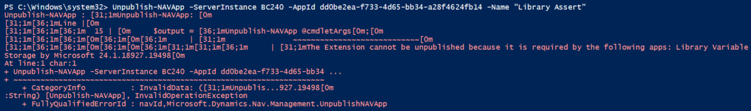

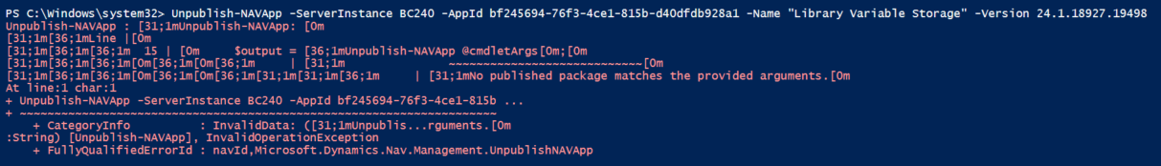
Extension published without signing errors.
Wrong App ID

Slide 17

Testing your App
Test your app in its entirely.
Just test on few areas of your app. Test everything.
You should test 100% of the Functionality of your app. Not Microsoft & Not LS Retails Responsibility.
Ensure that no permission errors are thrown for any of your app's functionality.
With the ESSENTIAL, make sure that the user can still use core Business Central without facing permission errors.
Notes:
Test your app in its entirely. Do test 100% of the functionality of your app.
Testing just a few areas of your app won't suffice. You should test everything.
Microsoft won't test 100% of the functionality of your app. They expect you to be doing that.
If the testing works for you, most likely work for Microsoft.
Ensure that no permission errors are thrown for any of your app's functionality.
With the ESSENTIAL user (before you assign your permission sets to it), make sure that the user can still use core Business Central without facing permission errors. You must allow that user to do things such as accessing the customer card, posting a sales order, and so on.

Slide 18


Maintaining your App
You know your app the best
Any changes may impact or break your app from future Dynamics 365 BC release.
Doing regular testing against Microsoft & LSC new release.
Notes:
{after the slide message} … …
Who should maintain the App?
Test automation is often seen as a technical exercise: it is the developers who should be doing this
In my experience, this is a major misconception. Just my opinion
After all, same like any implementation, it is a team effort.
Need both functional and technical which are inextricably linked

Slide 19

How should I start an Application Testing?
Prerequisites
  Developer License
  Demo data Company
  Import the Test Toolkit
  Dependencies (app.json)
Task 1: Create the Test codeunit and method
  [FEATURE]
  [SCENARIO]
  [GIVEN-WHEN –THEN]
Task 2: Create a helper method
Notes:
Task 1: Create the Test codeunit and method
The name of the test method consists of the tested functionality. There are relevant parameters that affect the test result.
FEATURE Tag
Represent the name of the fature, application area, functional area or another aspect of the application. It point to an are of your solution that is touched by the test.
If a test is supposed to have the same list of tag a the codeunit has, you don’t have to add the [FEATURE] tag for this test. At least there is something specific to say
SCENARIO Tag
Links the test to a work item for the functionality. Test Description represents a short description of the purpose of the test.
AAA = Unit Testing (Arrange-Act-Assert) where each part is a step leading to the next
GIVEN
Describes one step in setting up the test. If you feel a need to add an AND, you should probably add a separate GIVEN.
In most of cases, in order to run an action under test, you must prepare the database.
Tests can be complex, so you can add more than one GIVEN. They can come in one block or comment particular lines of code.
Don't try to repeat code and comment each line. Instead, add information of a higher level that would be valuable when reading without the test code.
WHEN
Describes the action under test. A test is to test one thing.
There should be only one WHEN in a test.
It's the line of code that changes the state of something that we're going to verify.
If you feel a need to add more than one WHEN followed by different verification, you should split this test in two or more tests.
THEN
Describes what is verified by the test. All tests must have a verification part.
If there's no verification, the test doesn't test anything.
You can add more than one THEN tag.
Task 2: Create a helper method
Helper method prepares data for the test. Like create a master record, creating Sales or Purchase document.
Helper method is not specific to the test, always can reuse it for similar tests.

Slide 20
Positive Testing:
Also known as “Happy Flow Testing”. It is an approach that executes test cases in normal conditions. It focuses on the application performing as intended according to its specifications when valid inputs are entered.
Negative Testing:
Also known as “Error Flow Testing” or “Failure Testing”. It is an approach that executes test cases in unexpected and extreme conditions. It focuses on how gracefully the application performs when invalid inputs are entered.

Slide 21

GIVEN
In this step we are putting the system into known state by defining start data.
WHEN
This step defines a key action. It means that in this part of the test system does think what we expect from him
THEN
This is a verification step. In this part we observe system output, we check if system behave in the expected way or not and we draw conclusions.
Notes:
GIVEN
In this step we are putting the system into known state by defining start data. For example we can put some data into database, set up environment data and so on.
WHEN
This step defines a key action. It means that in this part of the test system does think what we expect from him
THEN
This is a verification step. In this part we observe system output, we check if system behave in the expected way or not and we draw conclusions.
The given part describes the state of the world before you begin the behavior you're specifying in this scenario. You can think of it as the pre-conditions to the test.
The when section is that behavior that you're specifying.
Finally the then section describes the changes you expect due to the specified behavior.

Slide 22
Create Test Codeunit and Test Method
Create test codeunits and then test methods in the test codeunits.
Set Property SubType to Test.
The results of a test codeunit and of the individual test methods are displayed in a message window.
You can use the OnAfterTestRun Trigger on a test runner codeunit to capture the results.
The outcome of a test method is either SUCCESS or FAILURE. If any error is raised by either the code that is being tested or the test code, then the global outcome of the test codeunit is FAILURE and the error is included in the results log file.

Slide 23
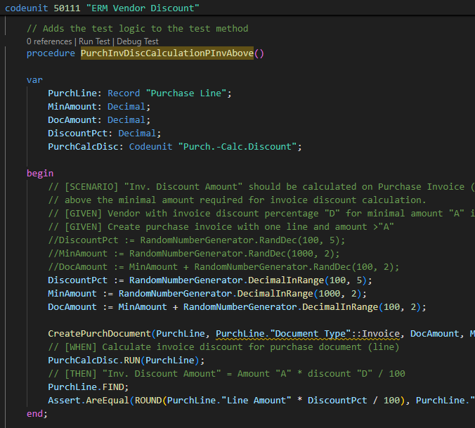
Sample 1: Testing Purchase Invoice Discounts
Modified codeunit 70, Purch-Calc.Discount,
Test the customized functionality of codeunit before you offer the customized application.
Create a new test codeunit with new test methods to test the Purch-Calc.Discount codeunit.
During development, use application test libraries to help write a test with fewer lines of code.

Slide 24
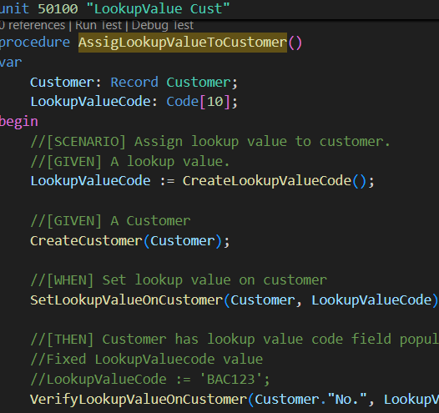
Sample 2: Assign Lookup Value
Create new Table Lookup Value Customer
Extend Table Customer with new field “Lookup Value Code”.
Experience use Libraries create random code
Create a helper method that generates data for the test

Slide 25
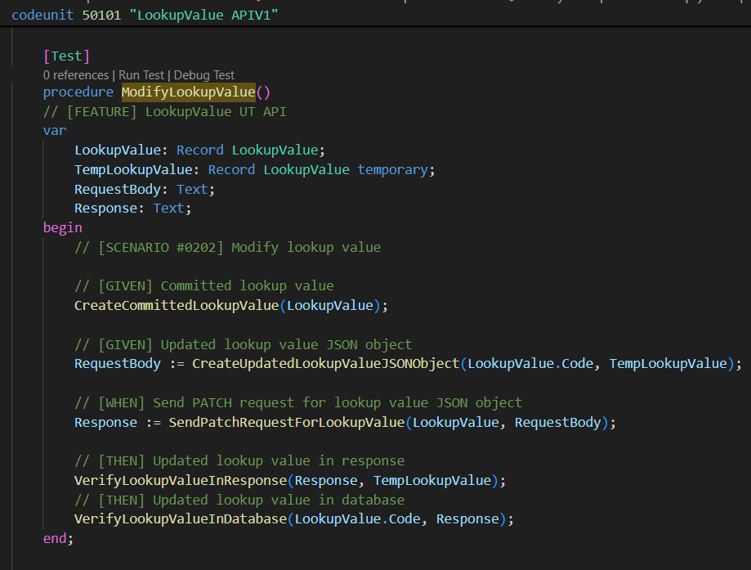
Sample 3: API Integration
Positive Test
Get Lookup Value
Modify Lookup Value
Delete Lookup Value
Create Lookup Value
Negative Test
Modify Lookup Value with empty Description
Create Lookup Value with empty Description
Notes:
Test Runner Codeunit, select 130451 Test Runner - Isol. Disabled

Slide 26
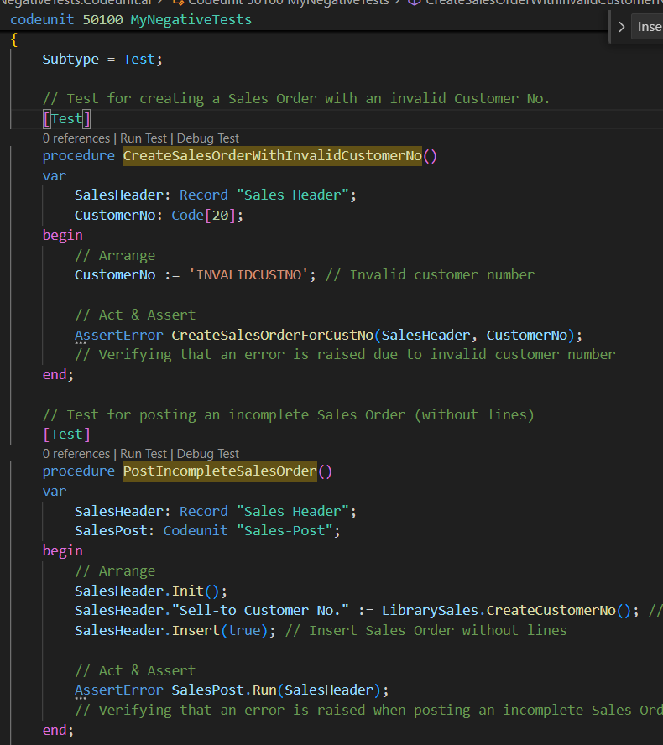
Sample 4: Negative Test
CreateSalesOrderWithInvalidCustomerNo:
Tries to create a sales order using an invalid customer number.
Verifies that an error is raised when the customer number is invalid.
PostIncompleteSalesOrder:
Tries to post a sales order without any sales lines.
Verifies that posting an incomplete order raises an error.

Slide 27

Auto Testing Best Practice
Separate Production Code and Test code
One Codeunit at a time
Independent Unit tests and Repeatable
Use of GIVEN-WHEN –THEN for Test Case Readability
Identify and solve Bugs First
Name Variables Properly
Write Readable and Maintainable Tests
Embrace Test-Driven Development
Integrate with CI/CD
Notes:
Best Practices in Unit Testing
1. Write Readable and Maintainable Tests
Use Descriptive Test Names: Clearly state what each test does. For example, testShouldThrowNullPointerExceptionWhenInputIsNull() is more informative than testInput().
Keep Tests Focused: Each test should verify one aspect of the function under test.
2. Embrace Test-Driven Development
Write Tests Before Code: This ensures that your code only does what it's supposed to do and helps in designing cleaner APIs.
Refactor with Confidence: TDD (Test-Driven Development) allows for safer refactoring since tests can immediately catch any introduced errors.
3. Ensure Tests are Independent and Repeatable
Avoid Shared State: Each test should set up its own input data and not rely on the outcome of other tests.
Use Mocks and Stubs: These are crucial for isolating the unit of code being tested, especially when dealing with external dependencies.
4. Integrate with CI/CD
Automate Testing: Ensure that unit tests are automatically run as part of the build process.
Monitor Test Coverage: Use tools to track how much of your codebase is covered by tests.

Slide 28


