Slide 1
LS Central performance
under the hood
Bjarki Hall
Vlad Jacota
Hilmar Vilhjalmsson

Slide 2

Agenda

Slide 3

Agenda
Performance in LS Central
  Introduction
  Tests, diagnostics, debugging
  POS Client improvements
Back office
  Replenishment
  Parallel statement posting
  Replacing PreAction to Timestamp
Consulting – user stories

Slide 4
Performance in LS Central

Slide 5
Why performance matters
Performance directly impacts user experience, productivity, and overall project success
Collaboration between Development and Consulting is crucial to address performance challenges effectively
Together we ensure smooth operations and satisfied clients

Slide 6

Ambiguity
Performance can be ambiguous
  What is slow?
  How?
  In what context?
  For everyone?
  Every time?
  Compared to what?
How do we measure it?
How can we improve it?
How can we make sure it stays that way?

Slide 7

Outside factors
Web Browser version
Windows version
BC version
  Web Client performance
  AL Runtime performance
  Database performance
  AL coding performance
Hardware specs
  Slow printer/scanner?
  Old drivers?
  Old computer (Bad CPU? Low memory?)
  Slow network/router?
  How far away is the server?
  Cold starts?

Slide 8
Trade-offs
Performance is a balance:
  Bad performance means too much is happening
  Improvement is usually at the cost of removing something else
  Removing involves risk
Over time, other things get favored over performance:
  Maintenance cost
  Quick-fixes
  Code readability
If decisions like these are made, they should be intentional
  Know the performance cost
  Benefits should be more rewarding than their cost

Slide 9
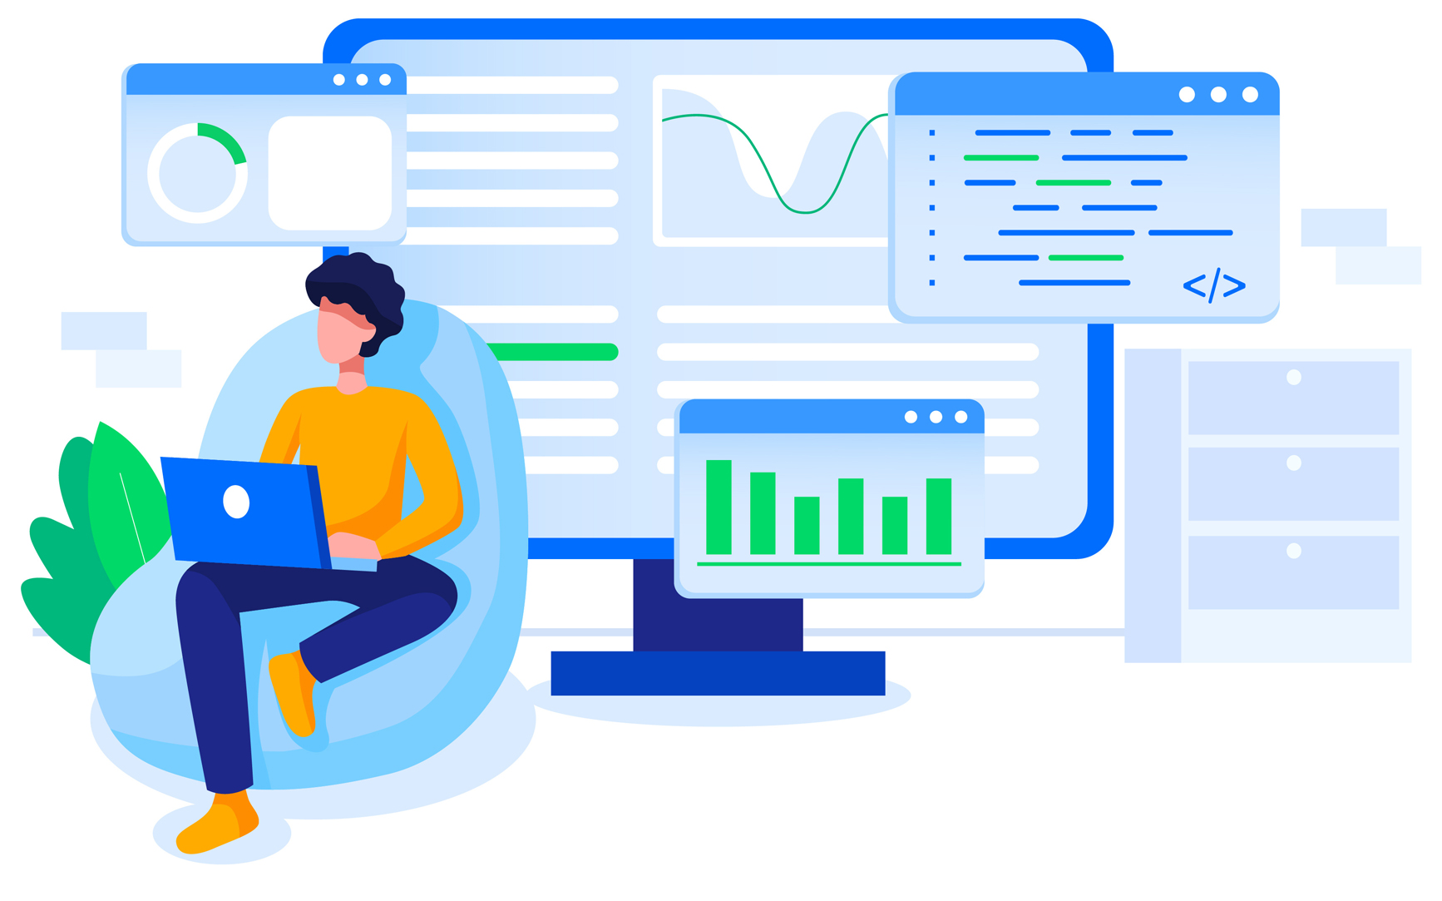
What are we doing about it?
Everything we can!
Workflows:
  Following AL guidelines
  More focus on training/workshops
  Seeking advice from MVPs and Microsoft
  Github contributions
Tooling:
  Grouping code and placing under code-ownership
  Using Code Analyzers, Build Validations, Autotests
  Advice from Github Copilot
  Telemetry, logging, feedback from partners

Slide 10
Tooling
for monitoring and debugging

Slide 11
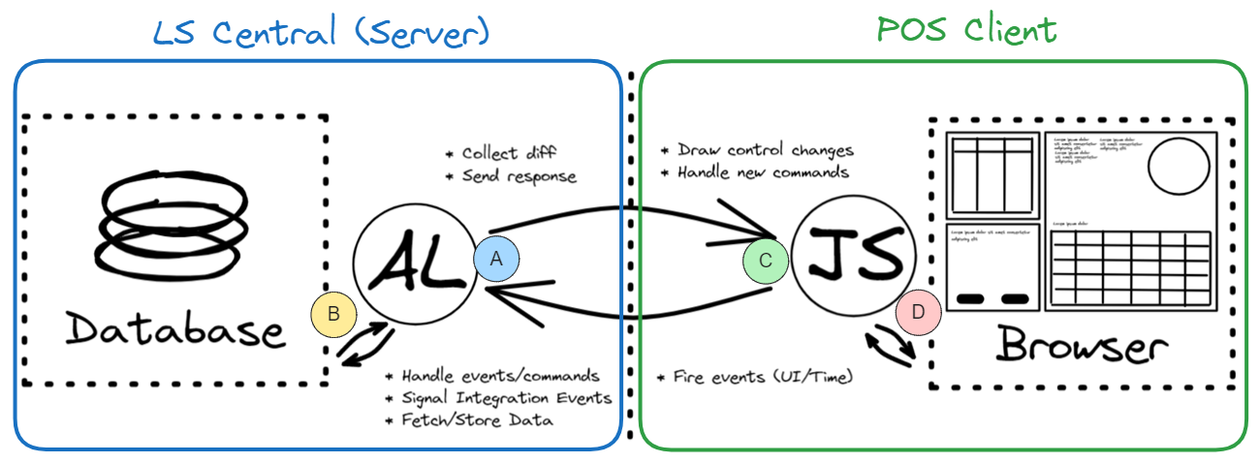
Pipelines
We run compilation, code-analysis, and auto-tests (unit/integration) for:
  LS Central (A, B), POS Client (C) and the automation tool itself
We run full (end-to-end) tests against:
  LS Central (on-prem w. Demo Data) and Standalone POS Client (D)

Slide 12

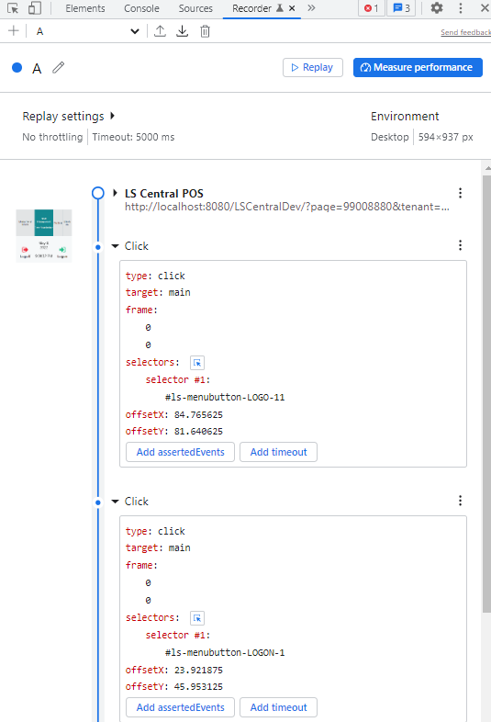
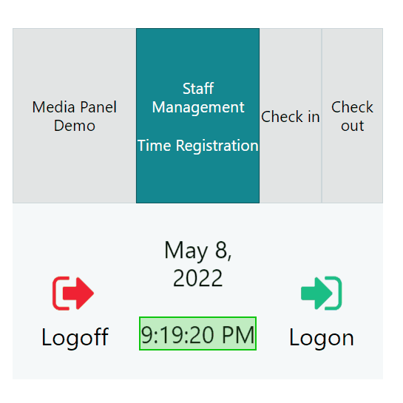
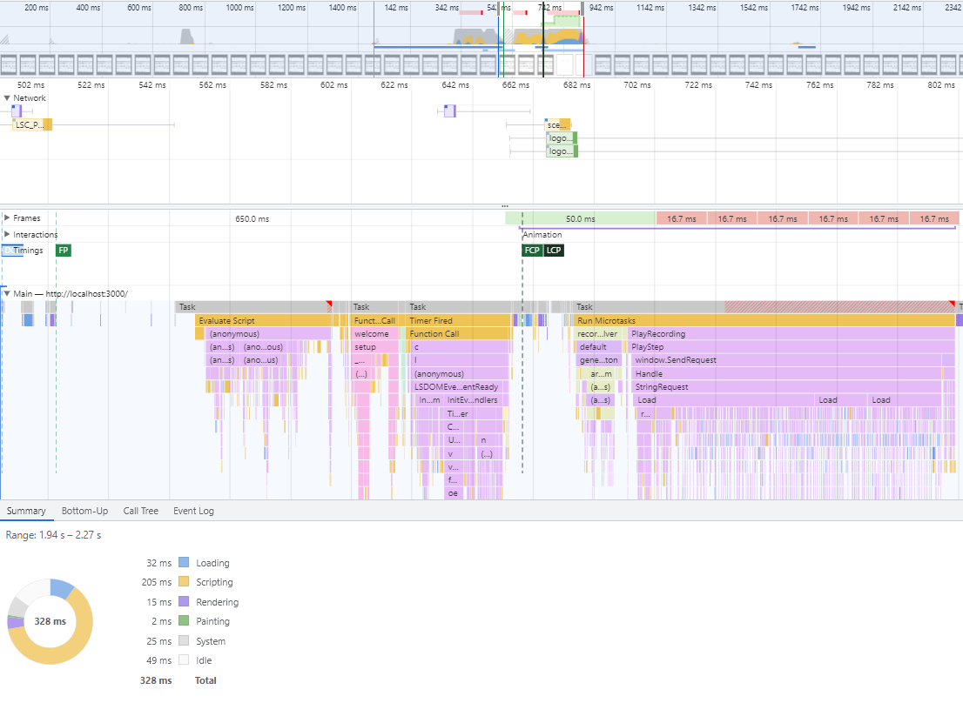
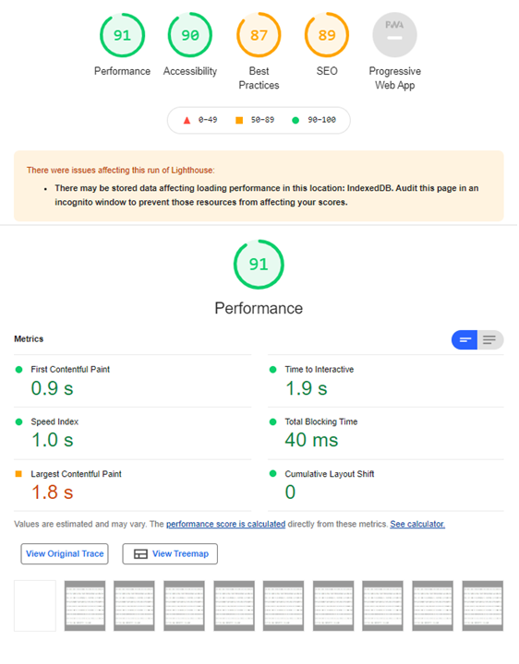
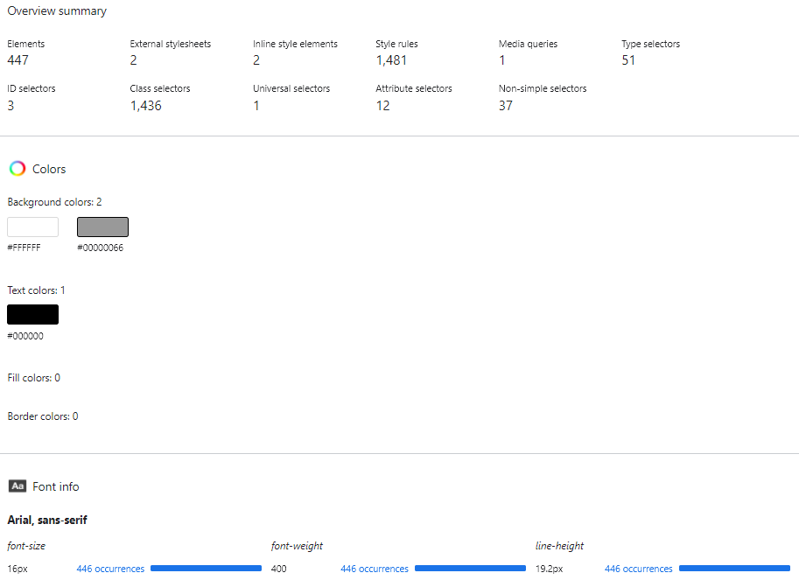
Browser tools

Slide 13
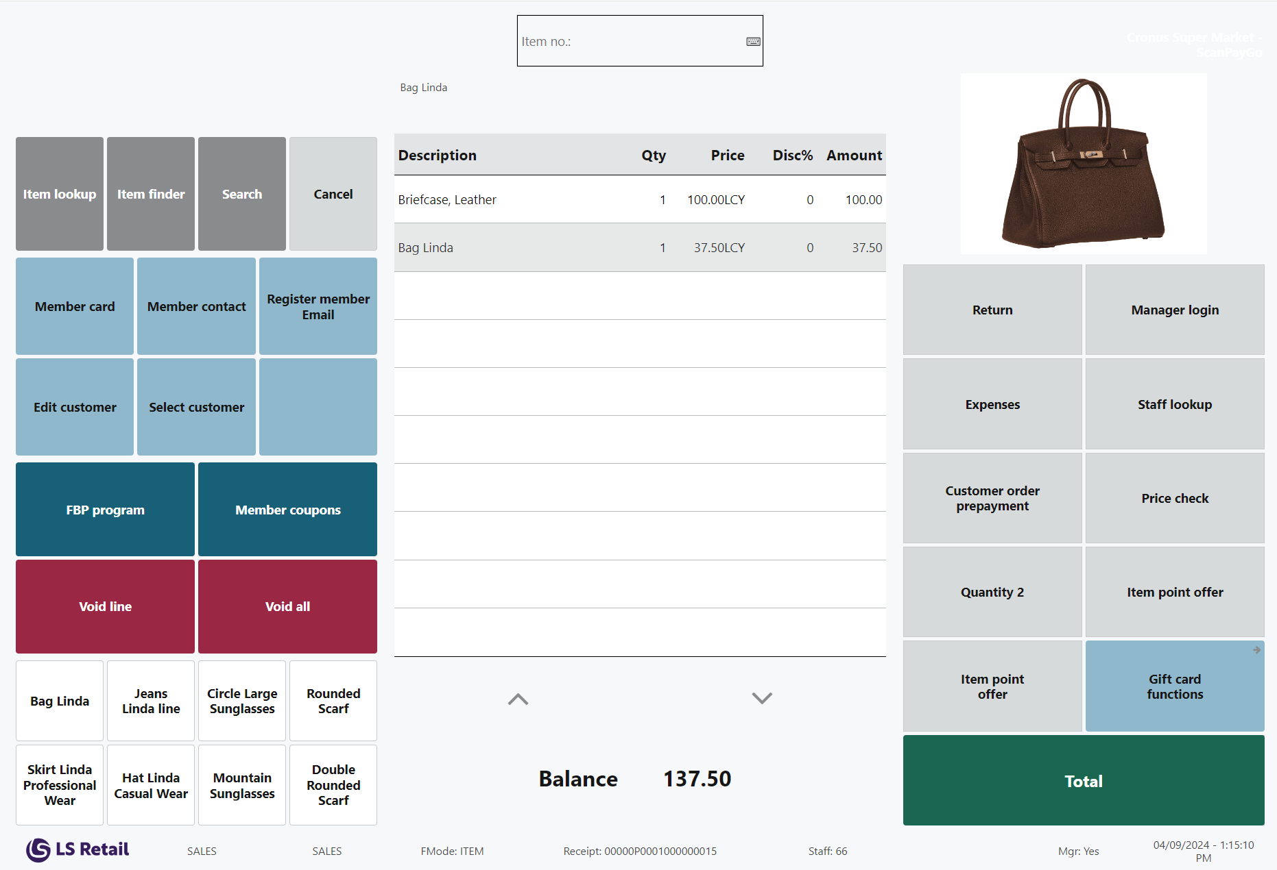
Diagnostics: Data recording
Collect data sent to/from Server
Replay the recording to debug/fix
Contains metadata and timings
Steps to download:
  Add &ls-record to URL
  Execute steps
  Press Alt+R

Slide 14
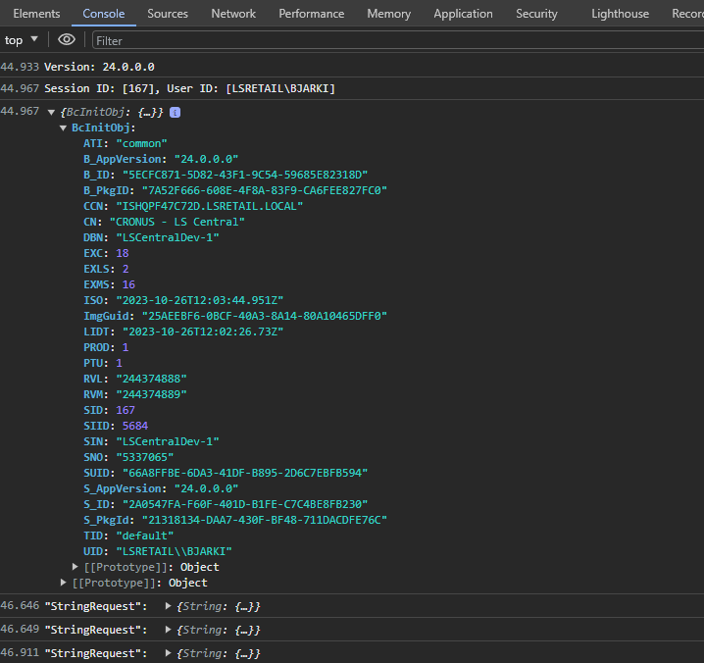
Diagnostics: Client log
Sometimes the web browser has:
  Metadata/warnings/errors
  These are not logged in AL
Optionally enable more extensive client logging:
  Server communication
    Add &ls-logstr=1 to URL
  And more (Dual Display, Web Templates, …)
Steps to download:
  F12
  Console
  Right-click
  Save as (.log file)

Slide 15
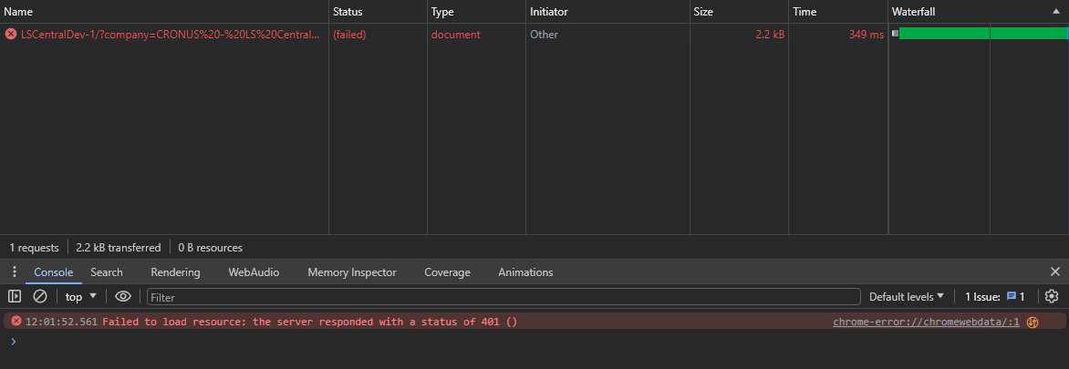
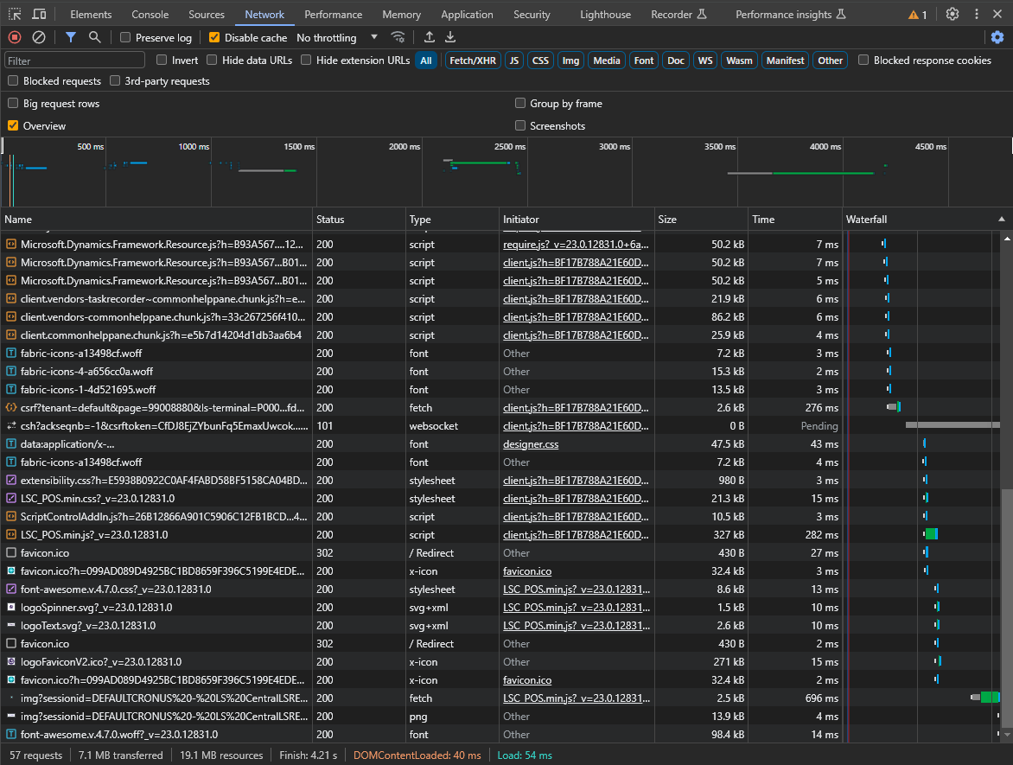
Diagnostics: Network error
Performance regressions/errors?
  Big files
  Slow network connection
  Waterfall requests
  File not found (404)
Steps to download:
  F12
  Network
  Record
  Export Har (.har)

Slide 16
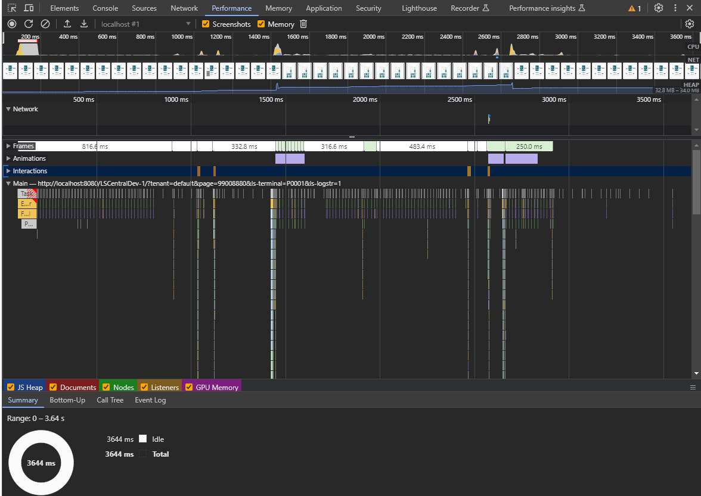
Diagnostics: Client performance
Client vs. Server?
Flamechart
Rendering
Screenshots/Video
Memory/CPU load
Steps to download:
  F12
  Performance
  Record
  Save profile (.json)

Slide 17
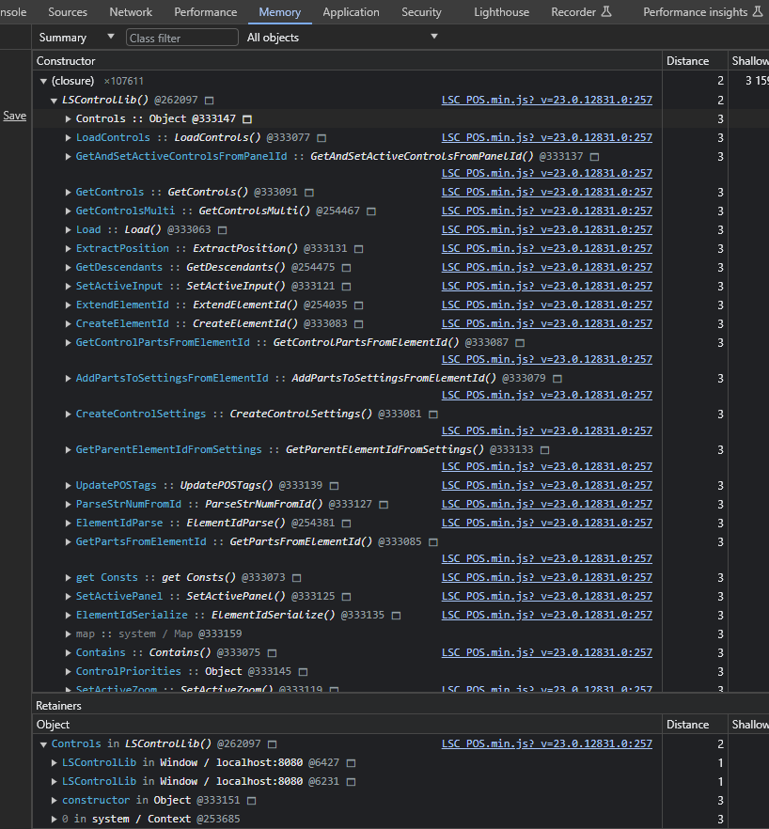
Diagnostics: Client memory
Analyze memory leaks
Compare 2 recordings
Where is memory reserved?
Steps to download:
  F12
  Memory
  Take Heap snapshot
  Save (.heapsnapshot)

Slide 18
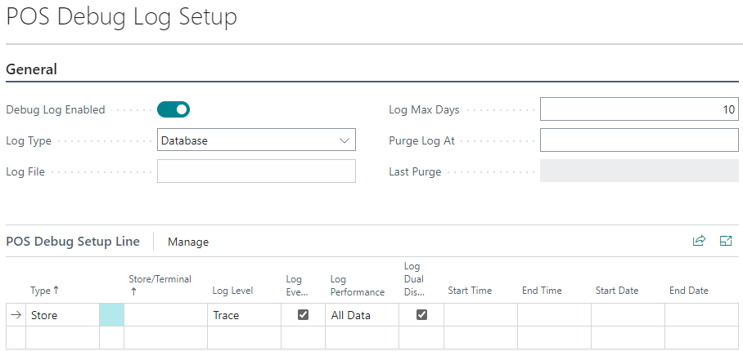
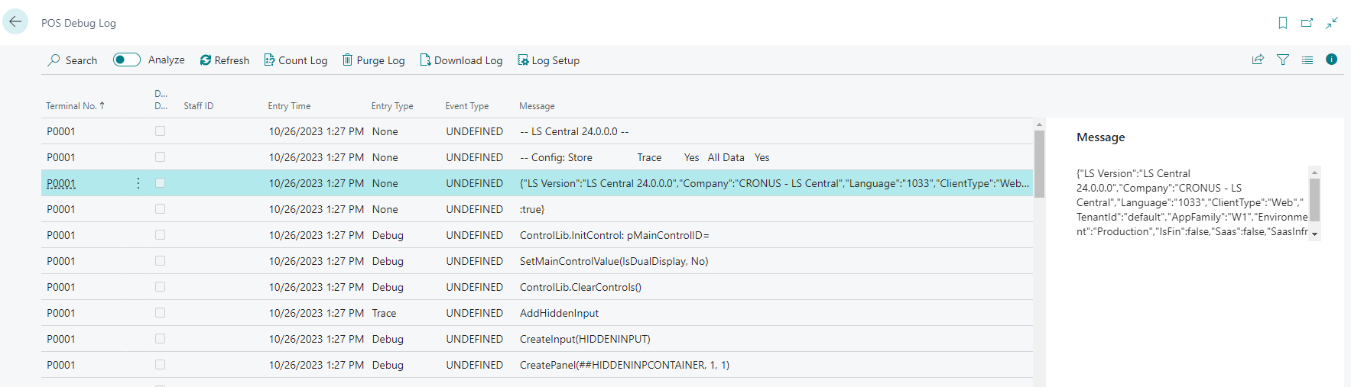
Diagnostics: Server log
Verbosity (warning/error/tracing)
Performance information
  SQL statements, durations, timestamps
Scoped/Timed/Purged
  Store/Terminal, Start/End Time
Logging impacts performance
Steps to download:
  Open “POS Debug Log Setup” page and make sure logging is enabled
  Execute steps in POS
  Open “POS Debug Log” page and hit Download (.txt)
Quicker approach:
  Add &ls-debuglog to URL, or use POS Command=DEBUGLOG

Slide 19
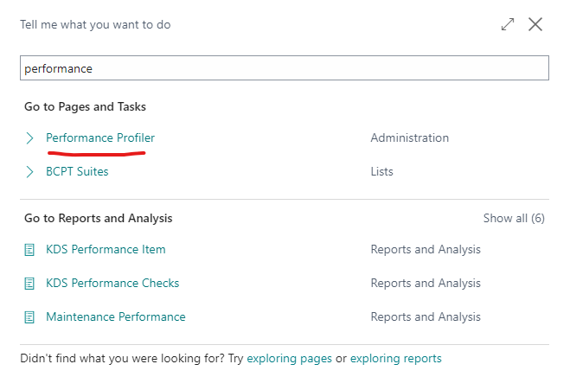
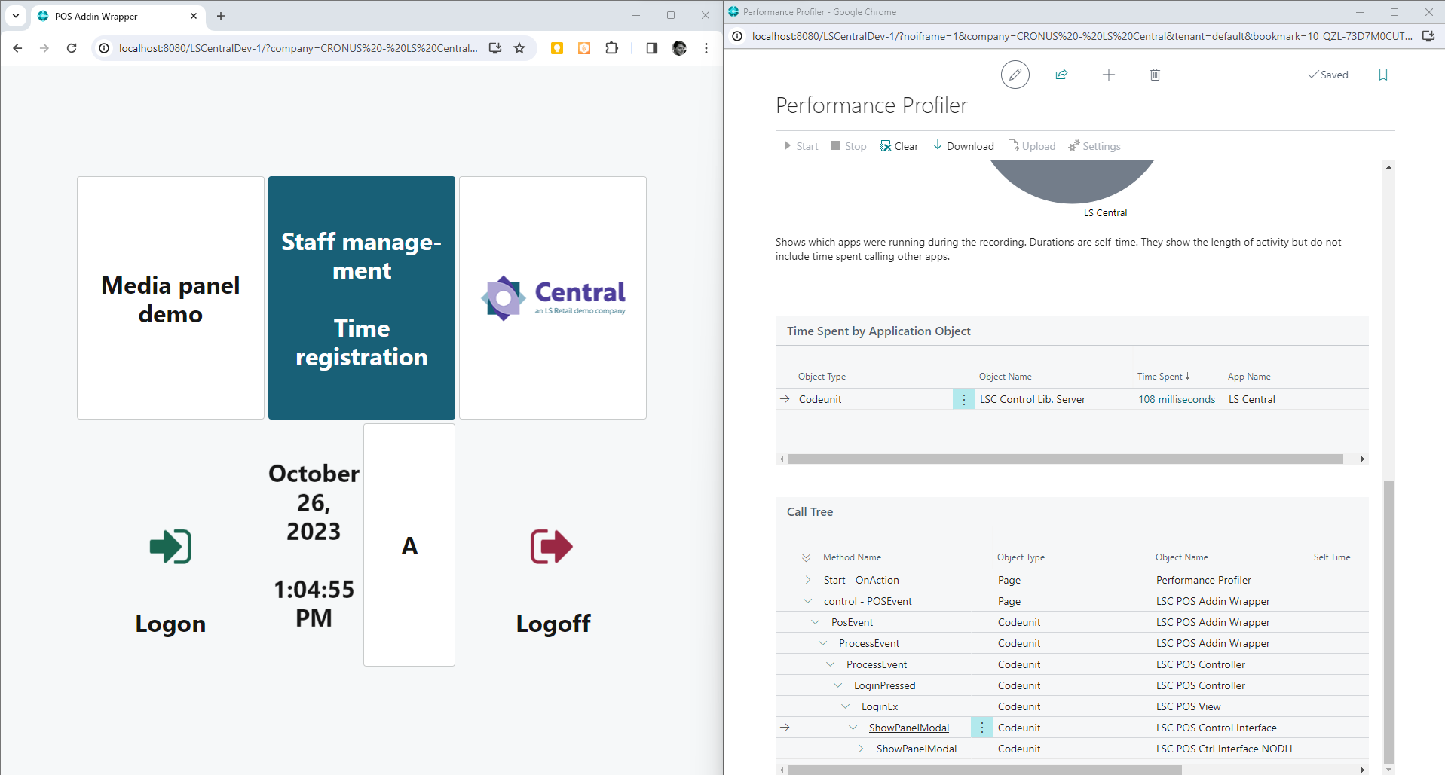

Diagnostics: Server performance
Find long-running AL methods
  Using In-Client Profiling (Sampling)
Old Steps (while in POS):
  Press Alt+Q+Q
  Search for and open “Performance Profiler”
  Pop the window out
  Place the windows side by side
  Click Start, execute steps, Stop, and Download
Quicker approach:
  Add &ls-alprofiler to URL
    or use POS command ALPROFILER
  Execute steps
  Trigger command again to Stop and Download (.alcpuprofile file)

Slide 20
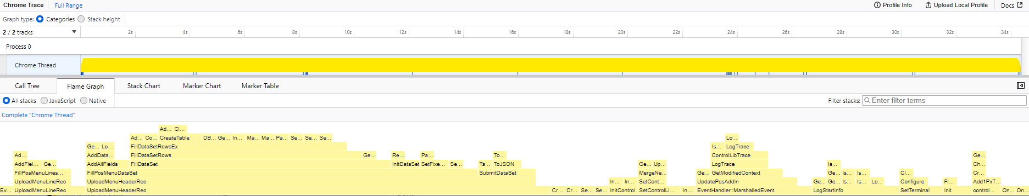
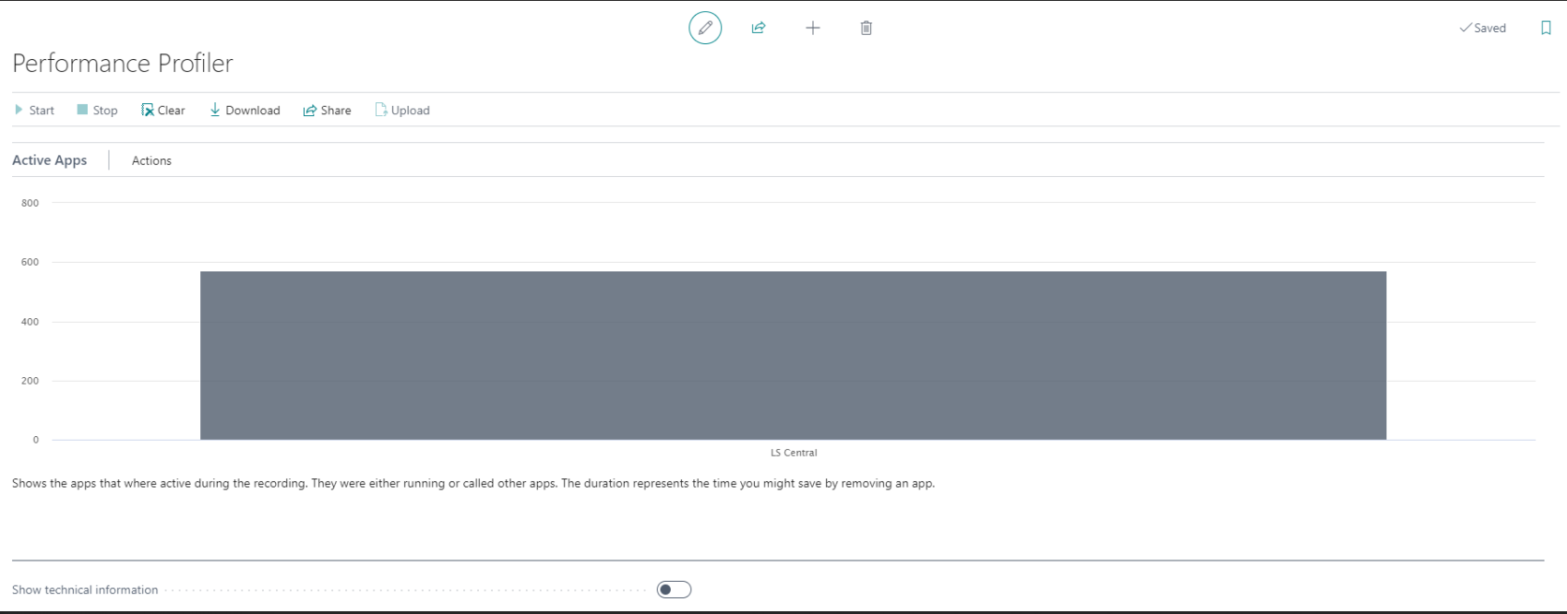
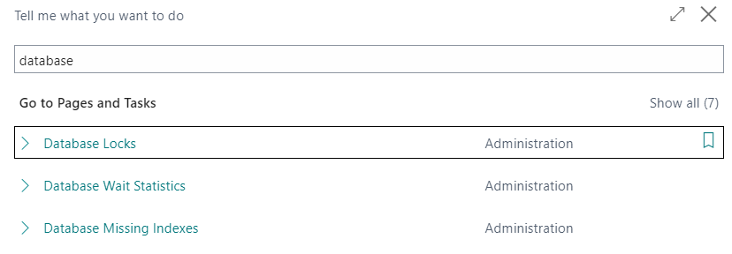
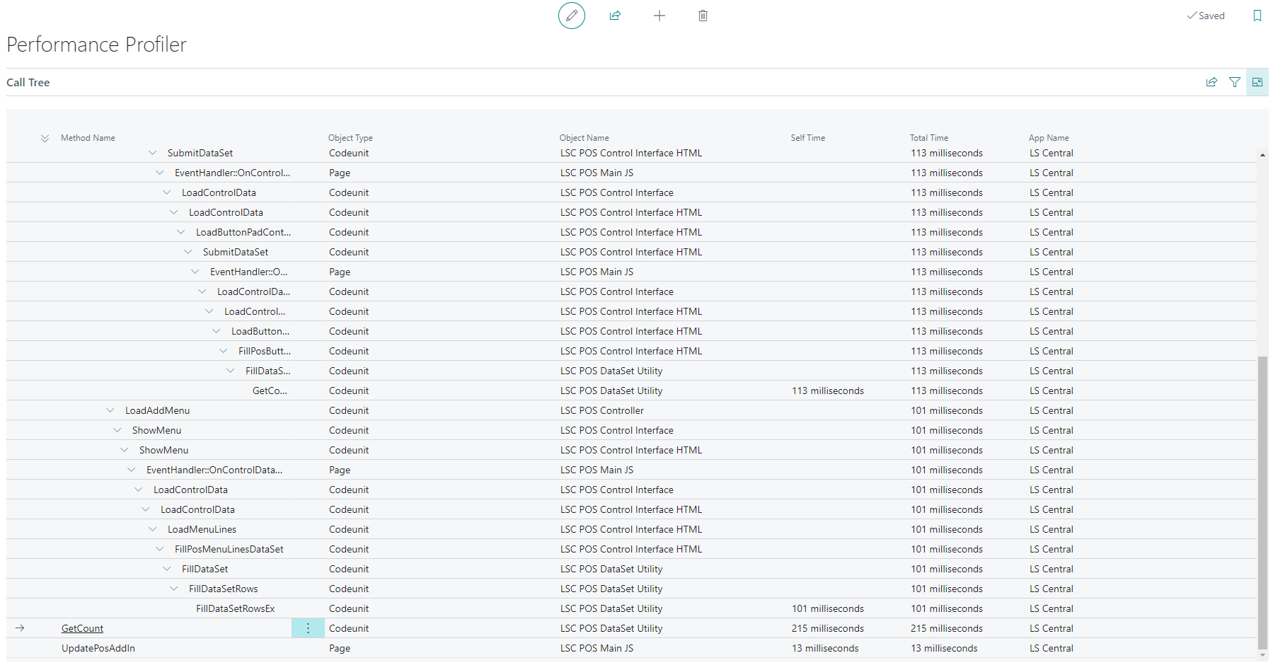
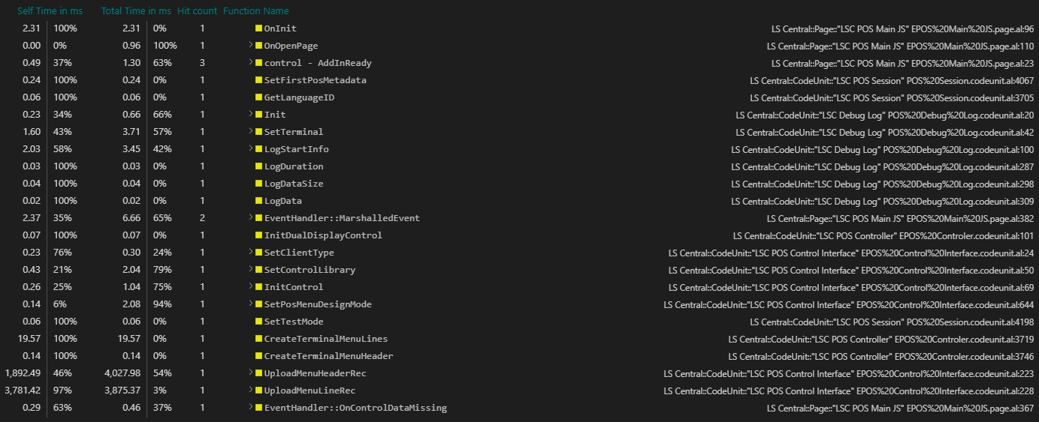
Instrumentation Profiling (vscode)

Slide 21
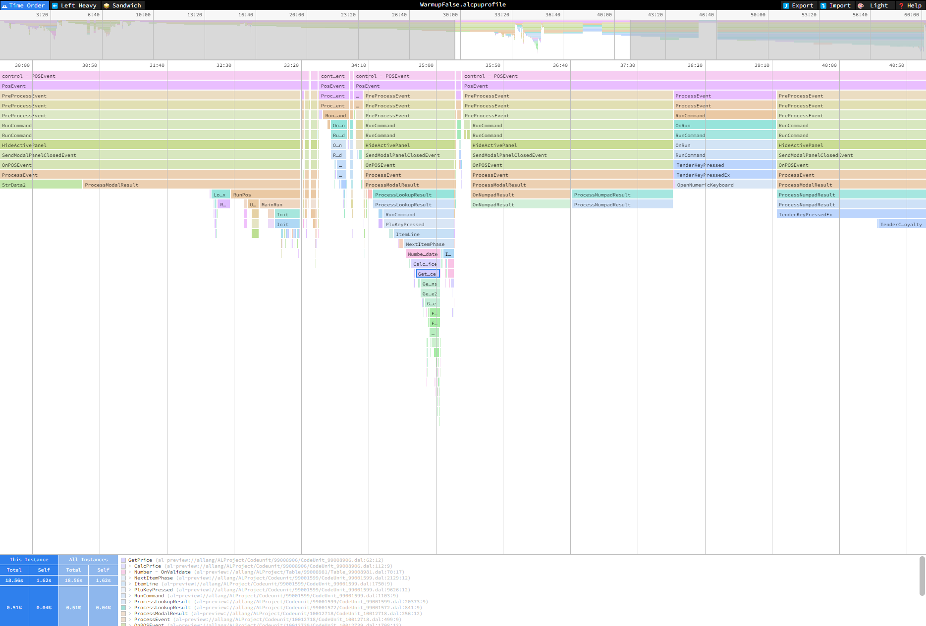

Tip: speedscope.app

Slide 22
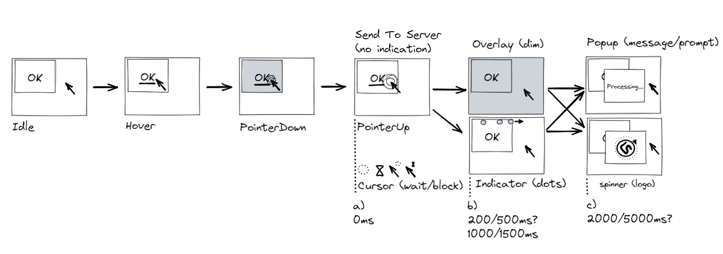
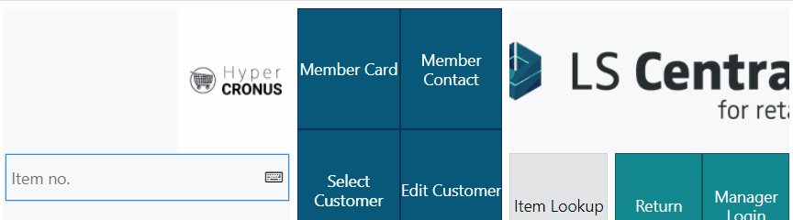
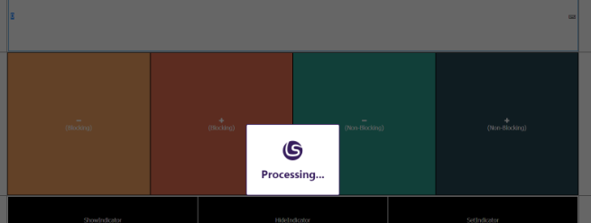
POS perceived performance
Sometimes things just “take time”
  Not possible to do things in the background (or small steps)
  Maybe users should not do much while process is still running?
Gradual visual indication/guidance:
  “Loading indicator”
    Three dots fly over the top of the screen
    Happens, X seconds after BC started a task and hasn’t finished
    User can still interact, but commands are queued
    Can be enabled/disabled globally
  “Blocked UI”
    Buttons/Commands can be marked as “Blocked”
    No user interaction (click/keyboard/etc.) allowed until
    execution has finished
    Can be enabled/disabled globally

Slide 23
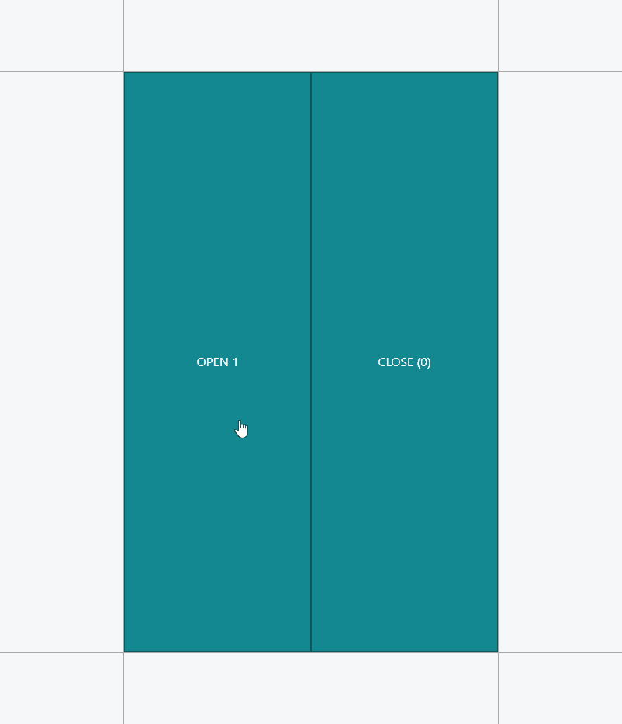
POS client startup
POS client is tested in isolation from BC
  And vice versa
Minimal baseline and startup
  Compress client-code, lazy-load data, diff-check, debounce…
Stress-test what might happen
  How does the POS client handle 500 buttons on a menu? Or a million data grid lines?
Playback recordings where things were slow and measure
  Browsers can profile performance, network requests, memory footprint…

Slide 24
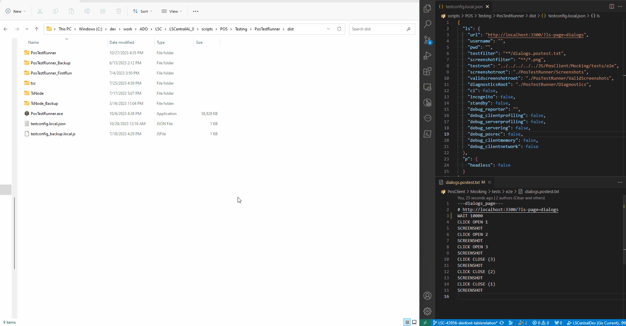

Slide 25
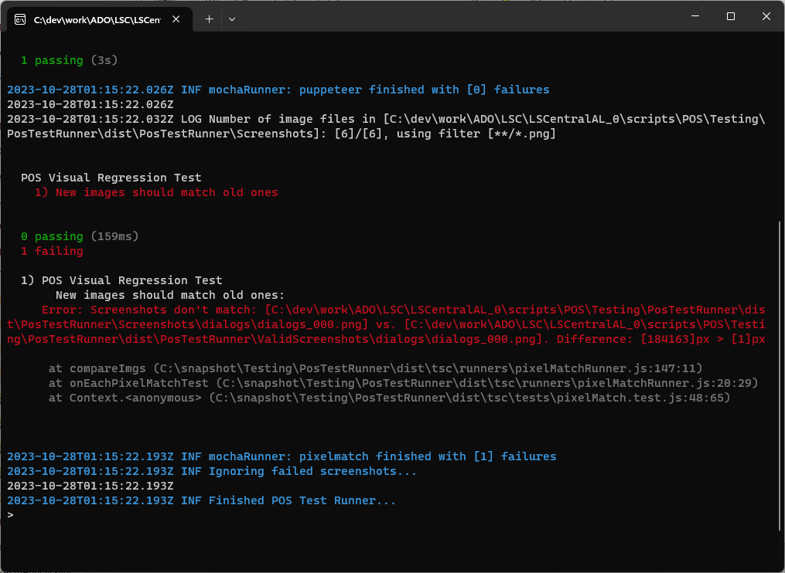
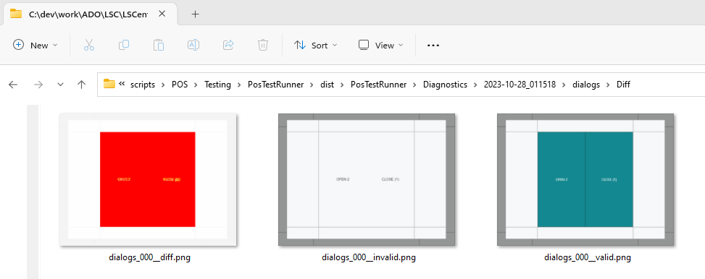
Screenshot comparison
Visual Regression Testing
  Keep “valid” screenshots
  Catch if text/style changes
Diff folder will contain 3 images:
  Valid
  Invalid
  Diff
Steps to resolve:
  Review the changes
  Replace old screenshots with new

Slide 26
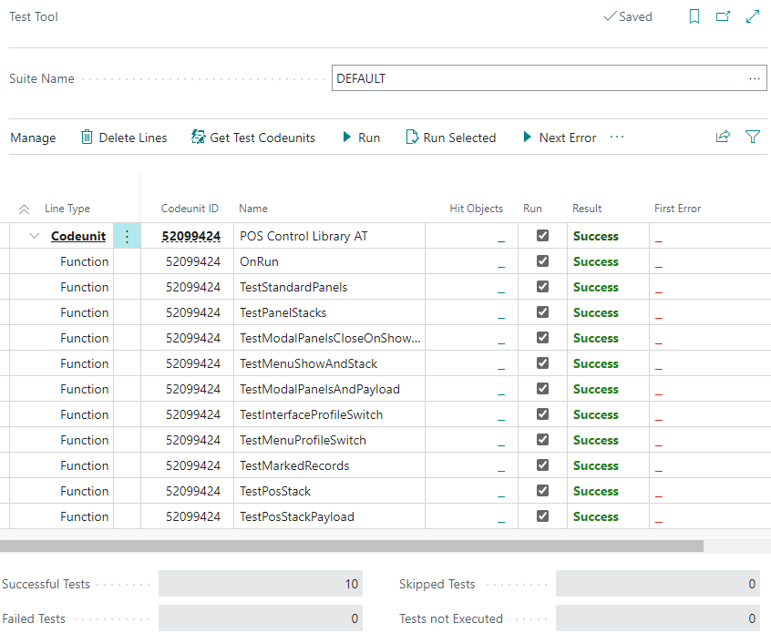
Autotests
Unit/Integration/E2E tests report durations
Track durations to see when a test started reliably taking 5x longer to execute
The whole chain can be automated
MS introduced “Page Scripting” for BO in BC 24.0
LS Central has similar internal tool for the POS
AL can be tested in isolation from POS Client
Benchmarks compare single-user execution
BC Performance Toolkit simulates multi-user scenarios

Slide 27

LS Central performance toolkit
Run multiple POS sessions
Easy configuration
  Number of POS terminals
  Transactions per minute
  Items per transactions
Run in pipeline

Slide 28
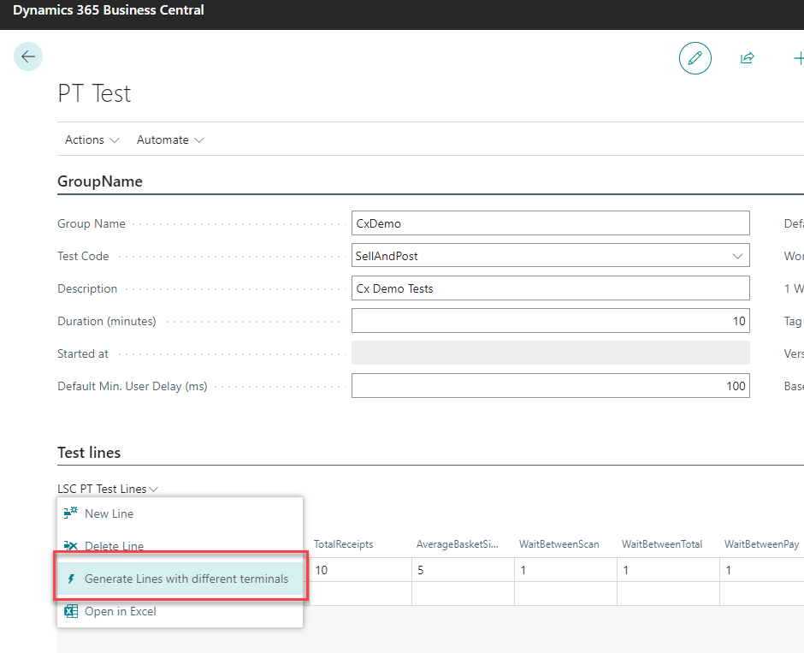
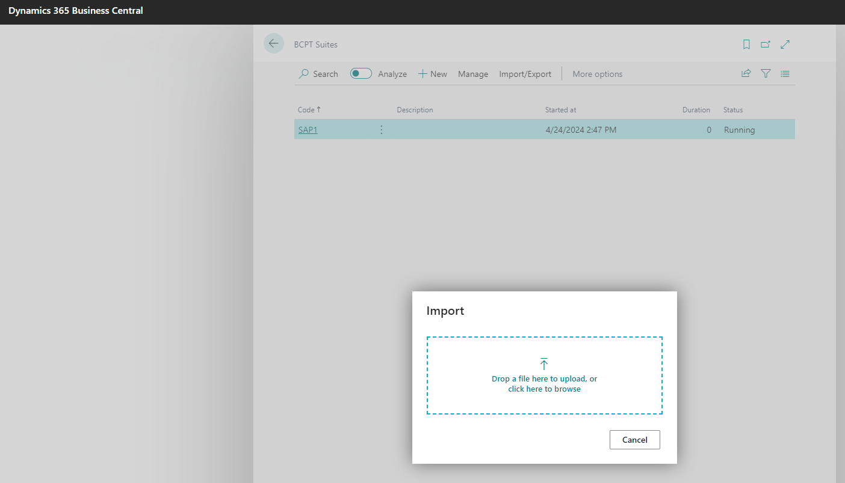
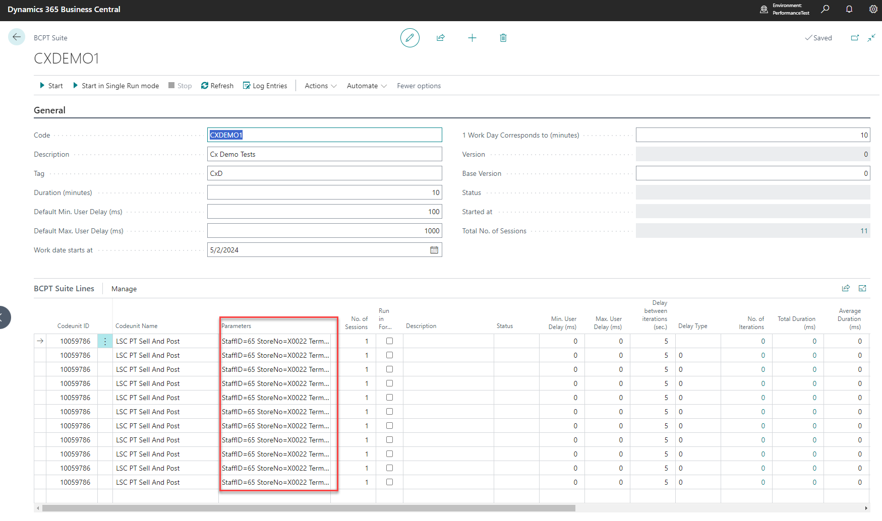
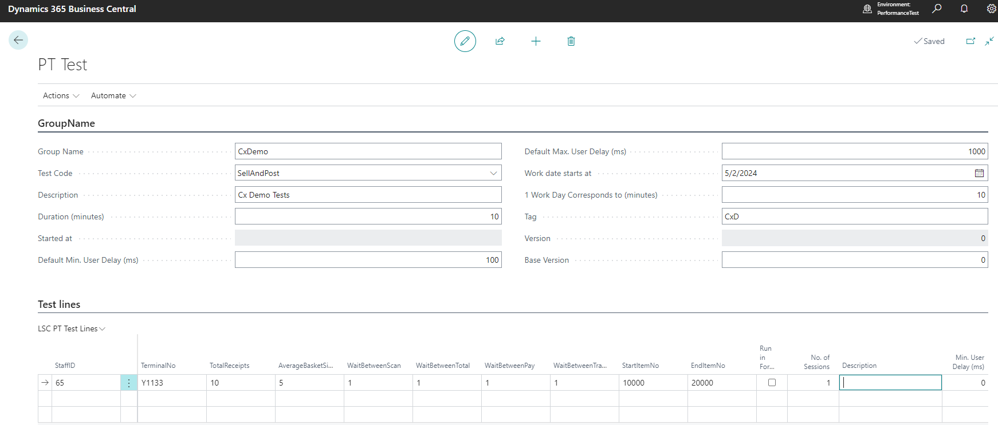
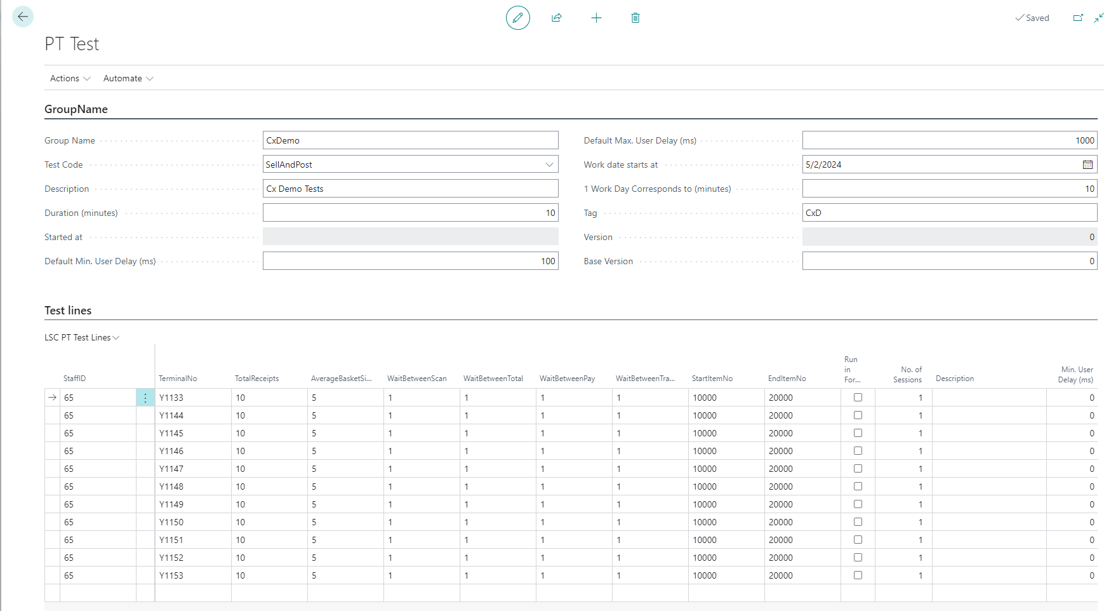
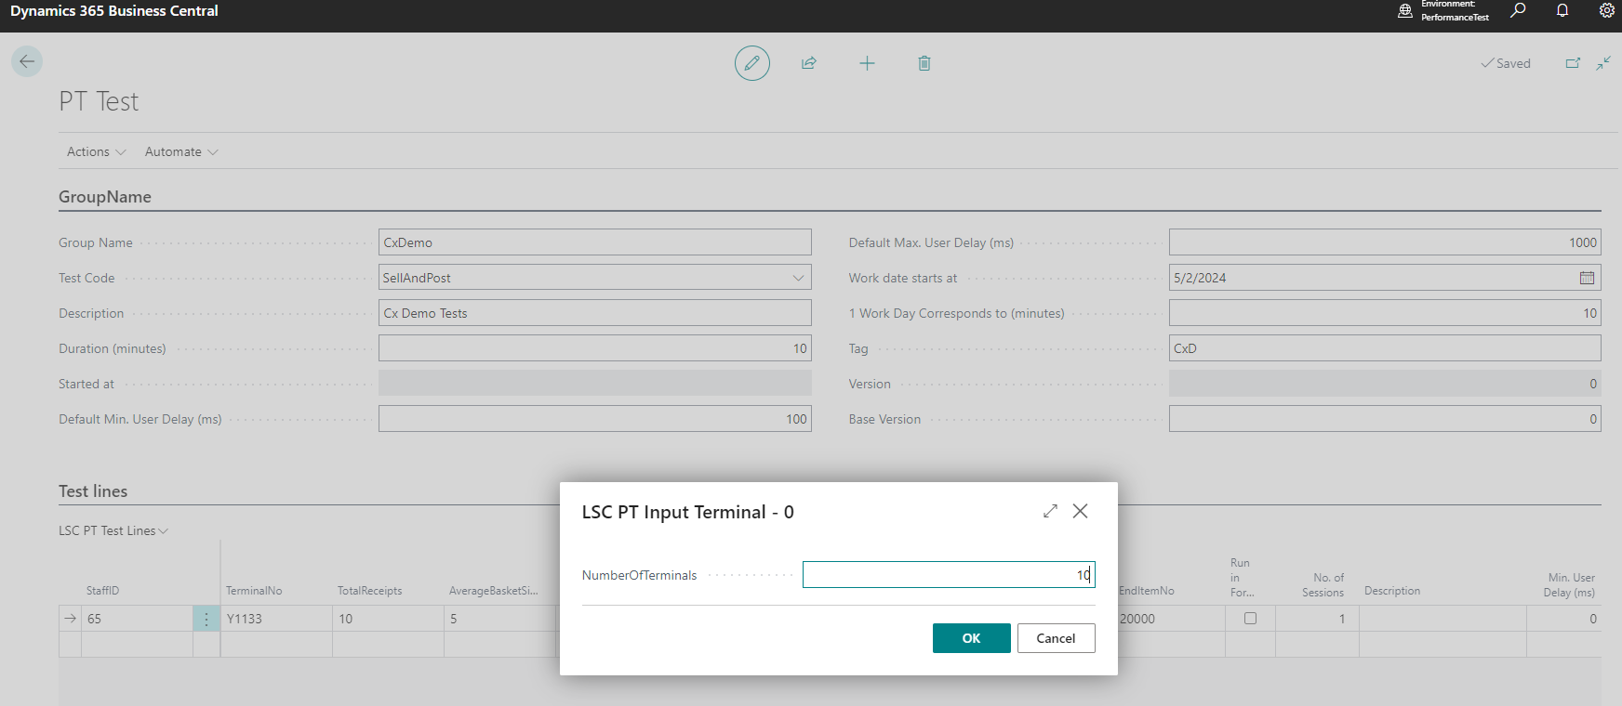
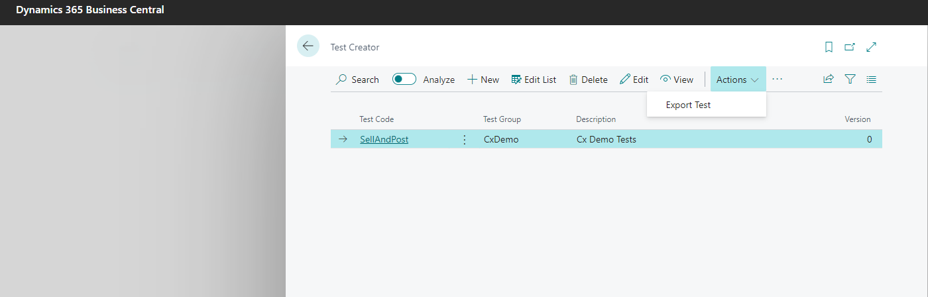
LS Central performance toolkit
Run multiple POS sessions
Easy configuration
  Number of POS terminals
  Transactions per minute
  Items per transactions
Run in pipeline
Create your own tests

Slide 29
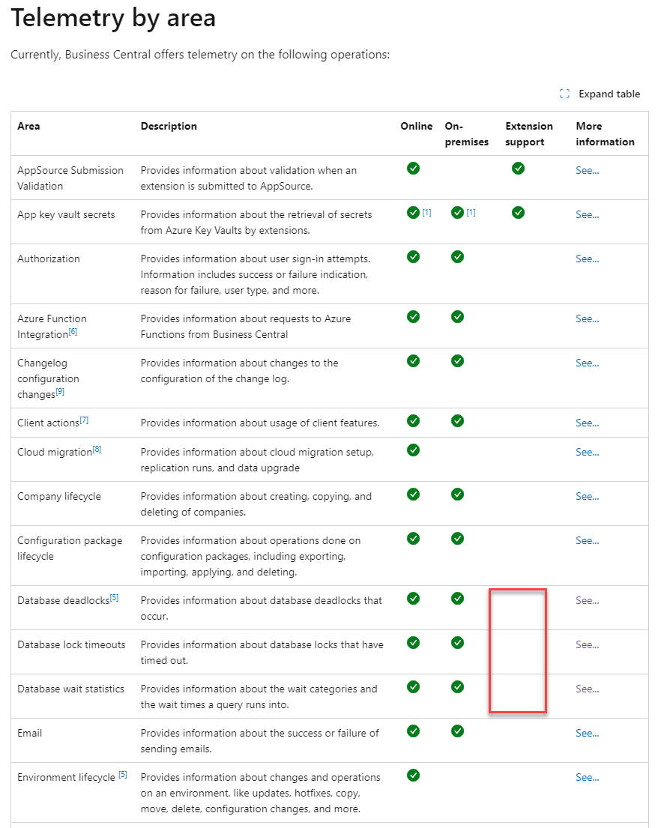
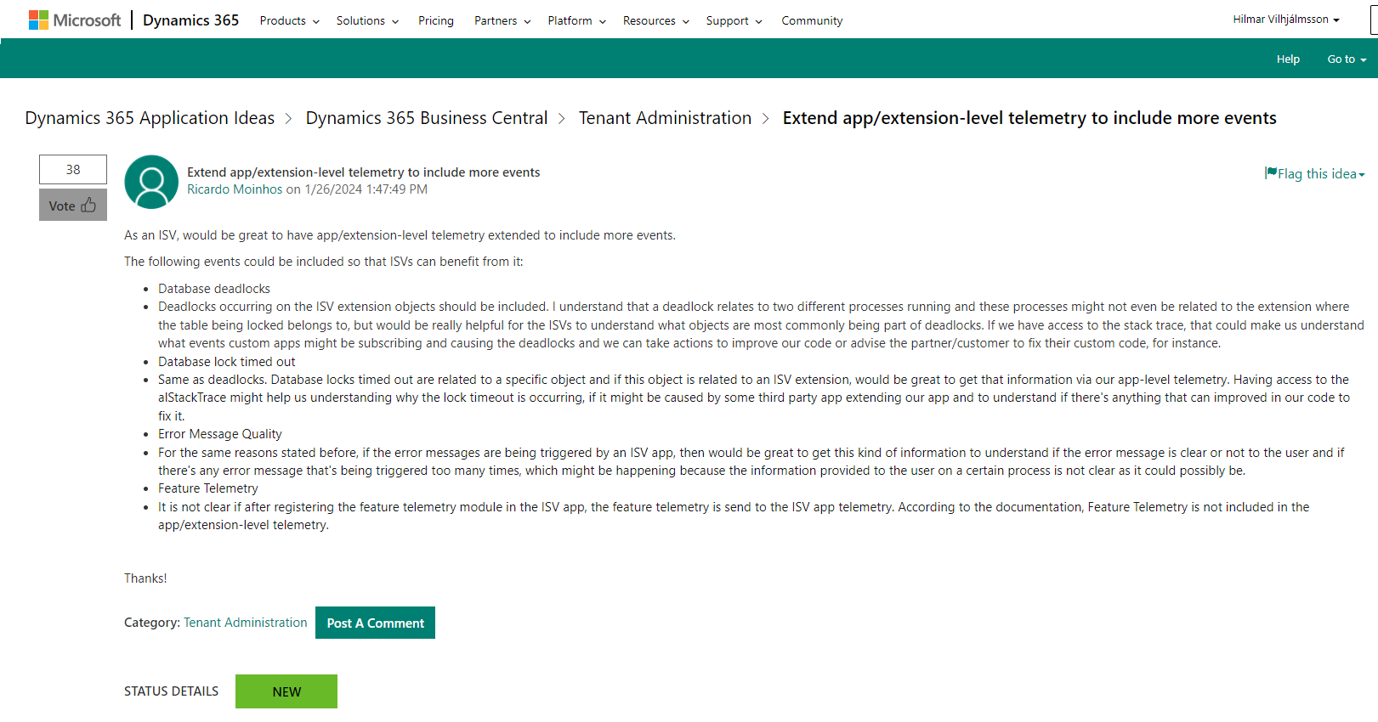
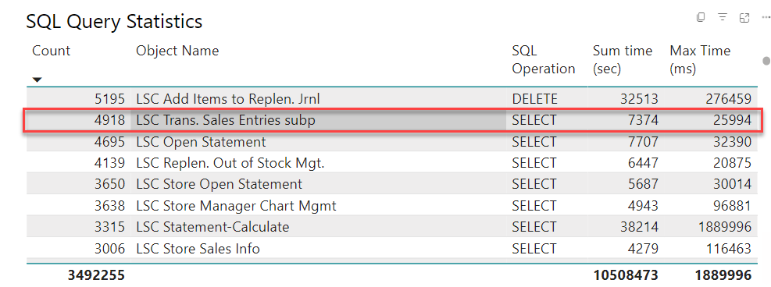
Telemetry
Analyze customer specific issues
Limitations in ISV Telemetry
Please give the BC idea your vote
Detect performance issues proactively

Slide 30
Back office
Performance improvements

Slide 31
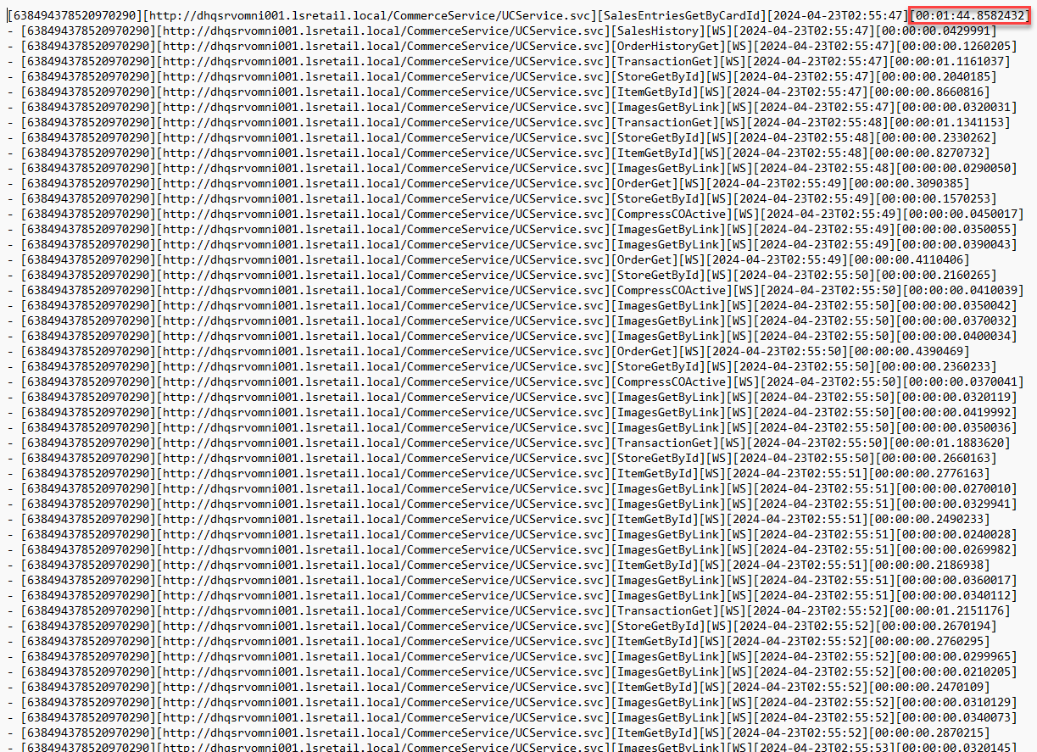
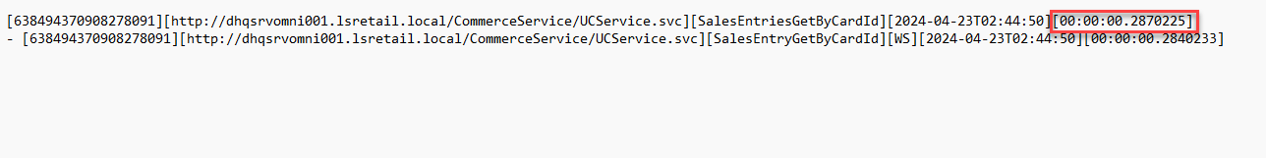
Commerce Server
Commerce request mgt
Optimized web services for ecommerce

Slide 32

Statement calculation and posting improvements
Statement calculation
  70% faster due to code improvements
  New process: Incremental Statement Calc.
Statement posting
  55% faster due to code improvement
  Improved process: Parallel Batch Posting
    72% time reduction with parallel posting

Slide 33
Replenishment Calculation
Performance Test Results:
Replenishment Calculation | Baseline Calc. Time | 10 Parallel Calc. Time | Improvement
RIQ | 4 hours 3 mins | 38 mins | 84.50 %
OOS | 6 hours 25 mins | 1 hour 18 mins | 79.08 %
Replenishment Quantity Items calculation
Out-of-stock calculation
Replenishment Journal Calculation
No. of Parallel Sessions | Original Calc. Time (mins) | New Calc. Time (mins) | Improvement %
1 | 56 | 50 | 11%
2 | 56 | 26 | 54%
5 | 56 | 12 | 79%
10 | 56 | 10 | 82%

Slide 34

Replenishment challenge
SaaS customer
Before
7 (seven!!) hours

Slide 35

Replenishment challenge
SaaS customer
After
2 (TWO) hours

Slide 36
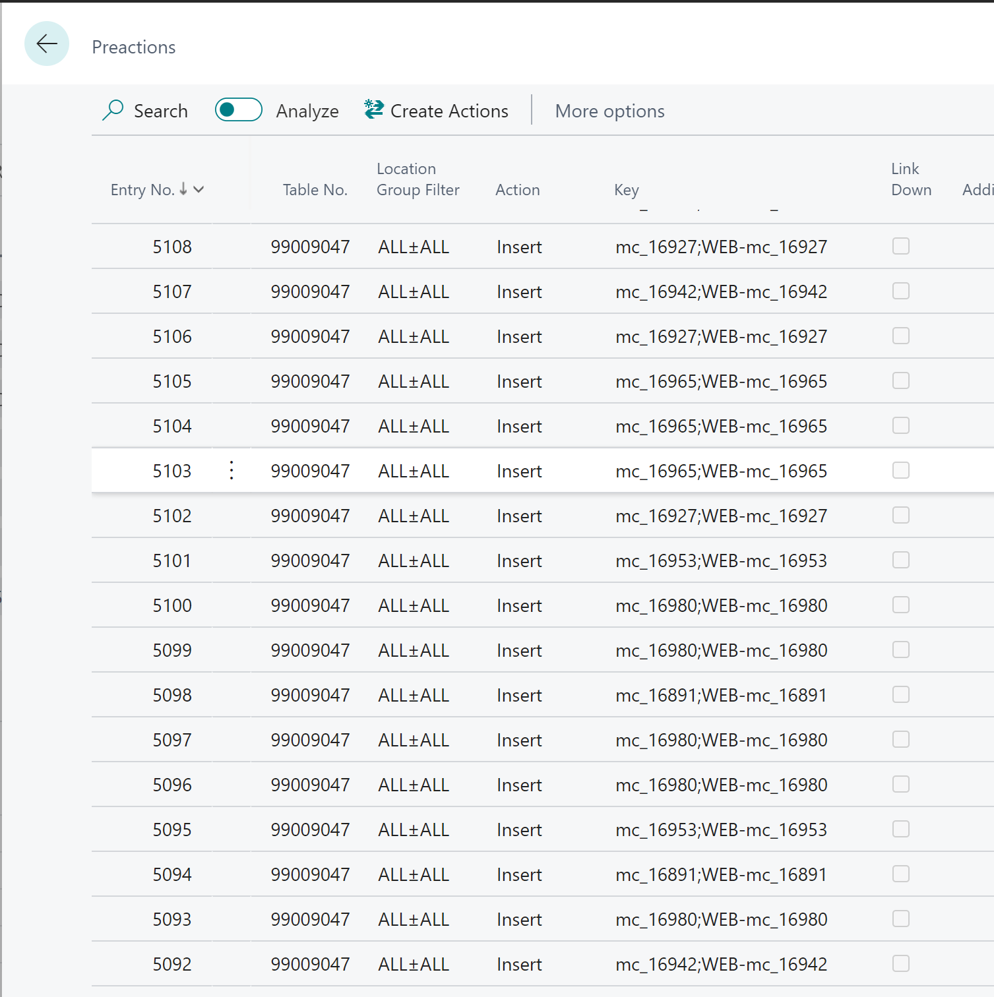
Replacing PreAction with Timestamp
Business Central feature
  Auto-save as you work
PreAction created for every field modified in a page instead of one PreAction when closing the page
Base delta on Timestamp instead of PreAction
PreActions are created on demand in temp table

Slide 37
Collaborative performance optimization
Maximizing project success

Slide 38

Collaboration in performance optimization
Development department:
Implements performance-enhancing features
Consulting department:
Provides performance analysis and recommendations
Close collaboration:
Continuous feedback loop ensures alignment and effectiveness

Slide 39

Success Story #1: Pharmacy industry
Challenging project in the Pharmacy industry
  Customer: 90,000 items assortment, 350 stores rollout
  Only 3.5hrs available per night for replenishment calculation
LS Retail Consulting's innovative solution: Optimized Replenishment Journal calculation process
Technical details: Optimistic approach for record marking and batch deletion
Result: 30% reduction in Replenishment Journal calculation time
Impact: Improvement part of LS Central standard as of LSC 24.0

Slide 40

Success Story #2: Ferry company
Customer:
Ferry Company with a high number of daily reservations
Challenge:
Performance issues during upgrade to centralized comments for activities and restaurants
LS Retail Consulting's solution:
Utilized Database Missing Indexes and Query Store to identify missing index
Collaboration with Development:
Index included in hotfix
Result:
Improved performance and seamless upgrade

Slide 41
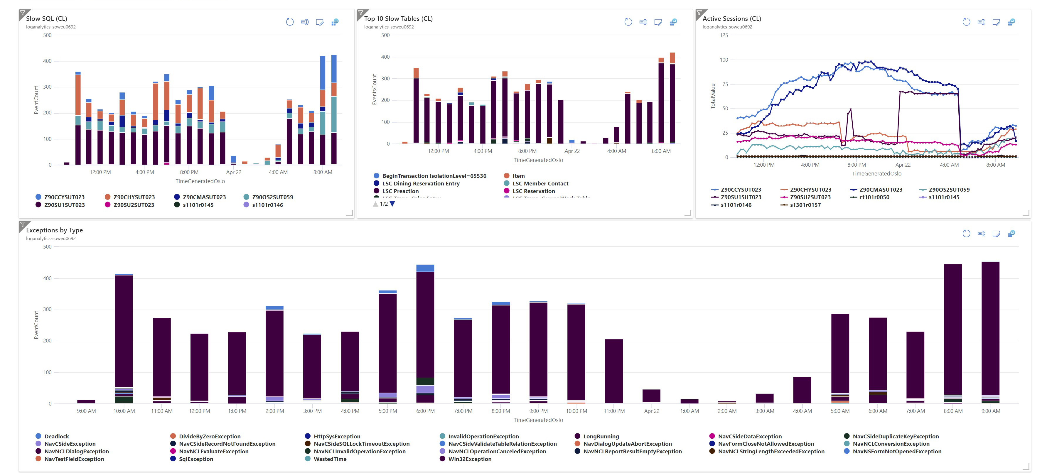
Tools for monitoring

Slide 42
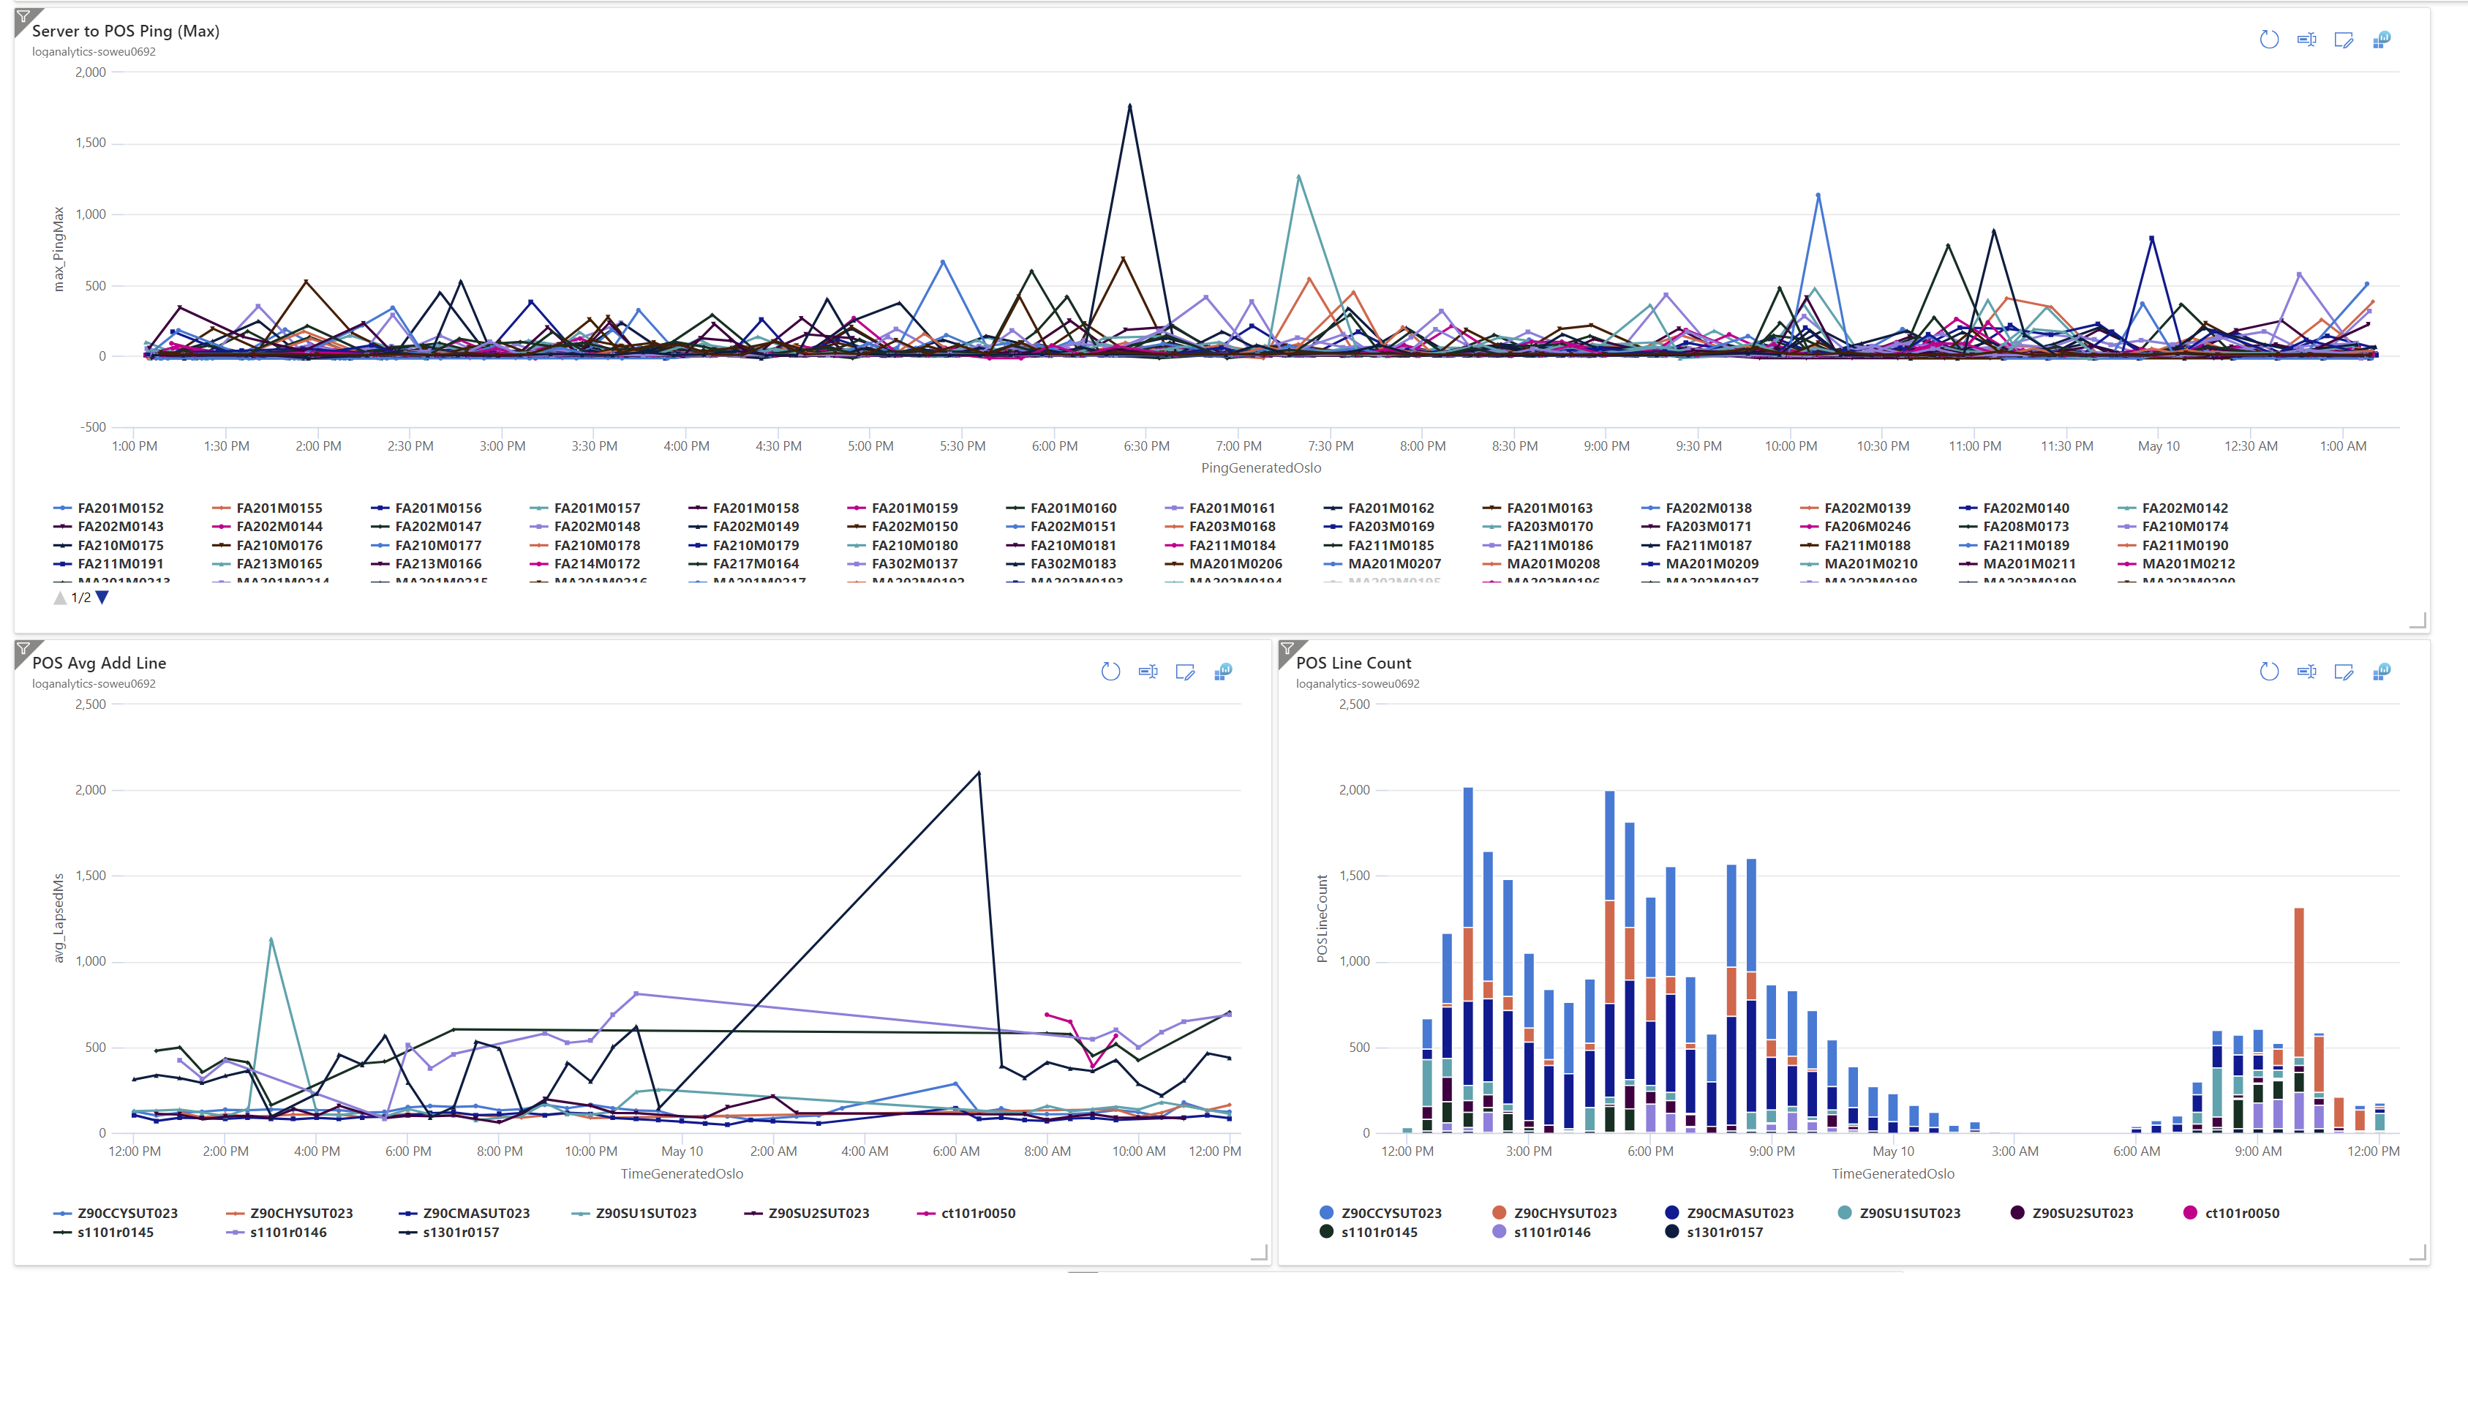
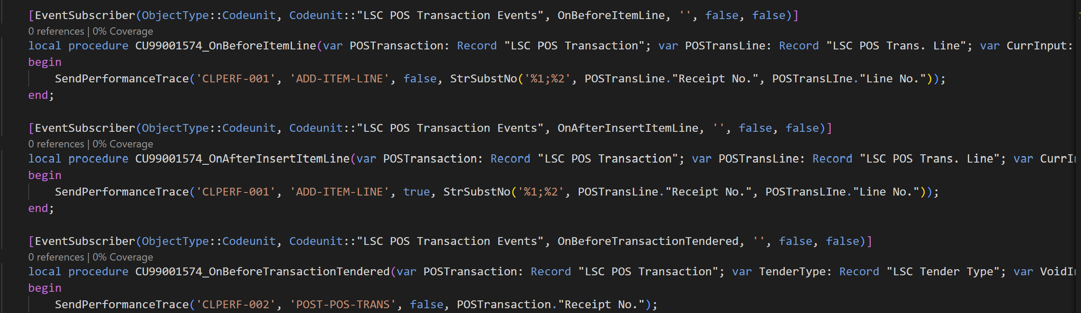

Slide 43

Summary
Eliminate ambiguity/external factors
Set a clear goal for improvement
Use the appropriate tool
It’s a continuous effort
It’s a collaboration

Slide 44
Thank you
Who has the first question?

Slide 45










!IMPORTANT!
The “an Aptos company” version is the main version to use. Only use the logo without it if the logo is very small.
Primary
Secondary
Primary
Secondary

Slide 46















Slide 47











Slide 48











Slide 49












Slide 50













Slide 51









Slide 52

Desktop/POS

Slide 53

POS/Tablet

Slide 54

Tablet/surfacePro

Slide 55

Tablet/iPad

Slide 56


Mobile

Slide 57



































































































