Slide 2


Andrej Zajec
Technical Sales Executive
Analytics for LS Central
Create your epic BI journey
Martin Kleindl
Director of Customer Experience,
Product Director

Slide 3


Slide 4
Agenda
Reporting in BC and Analytics
Analytics under the hood
What’s new
Architecture options
Customer story
The future

Slide 5

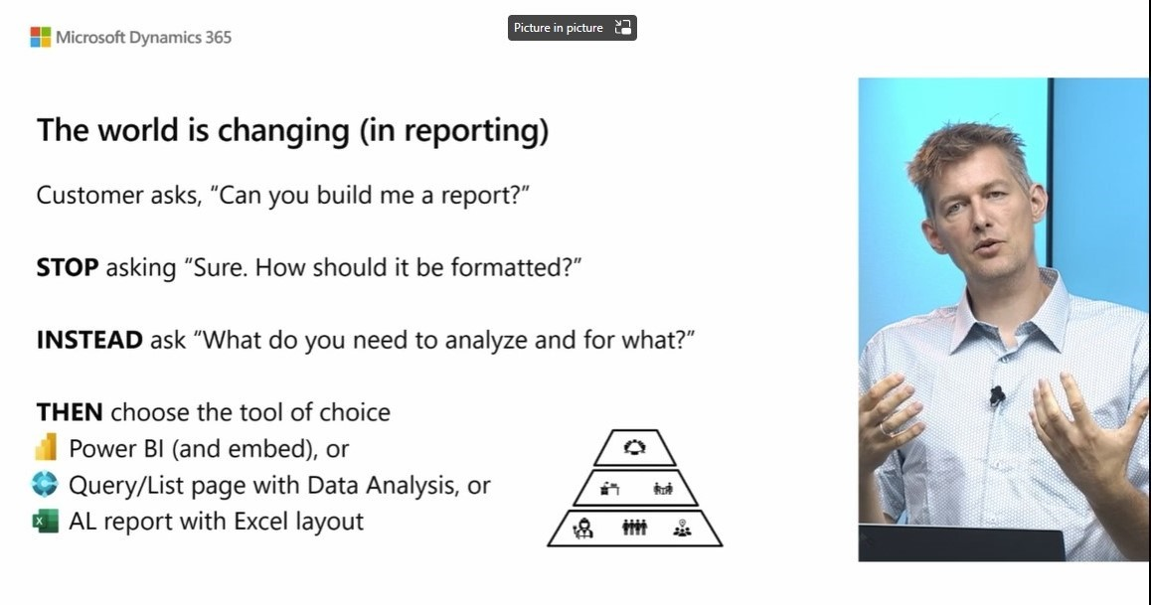
Kennie Pontoppidan
Principal Program Mgr.
Microsoft

Slide 6
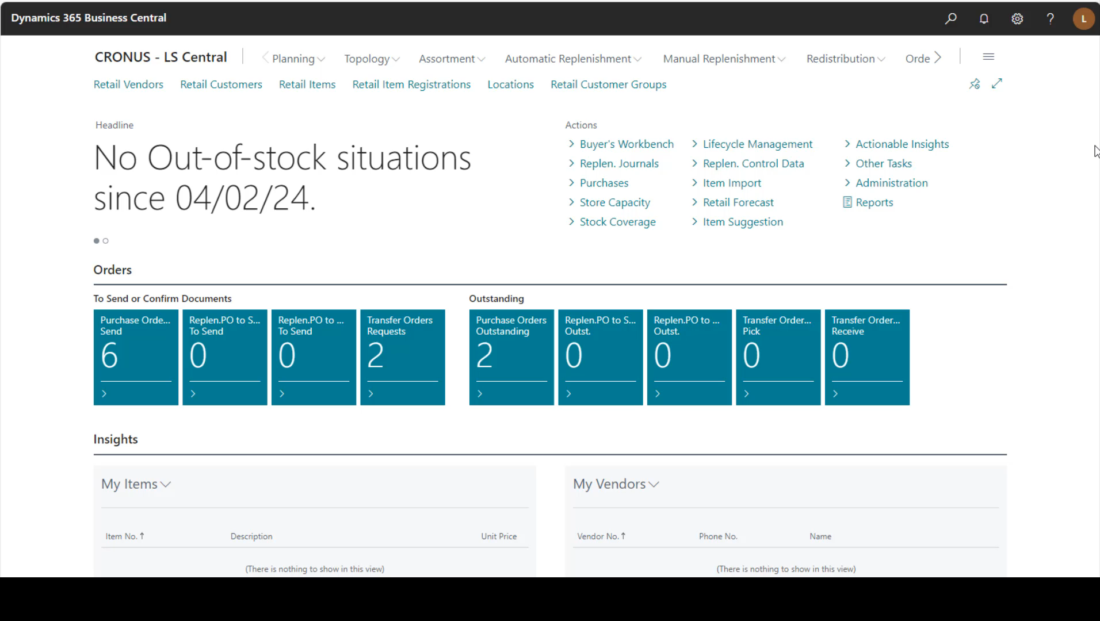
Data analysis in Business Central

Slide 7
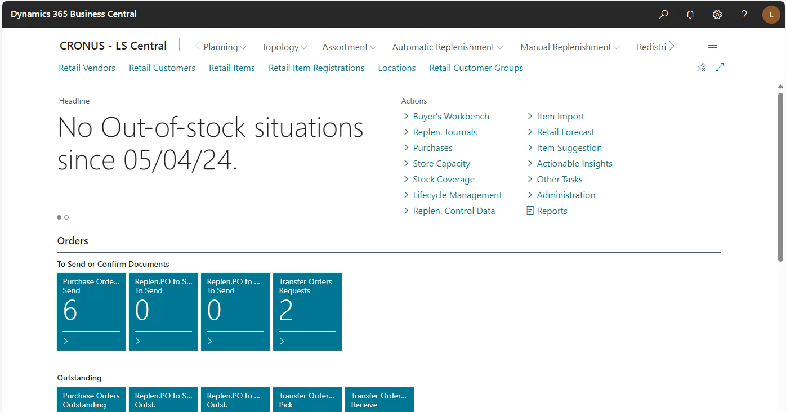
LS Central –Analysis views

Slide 8
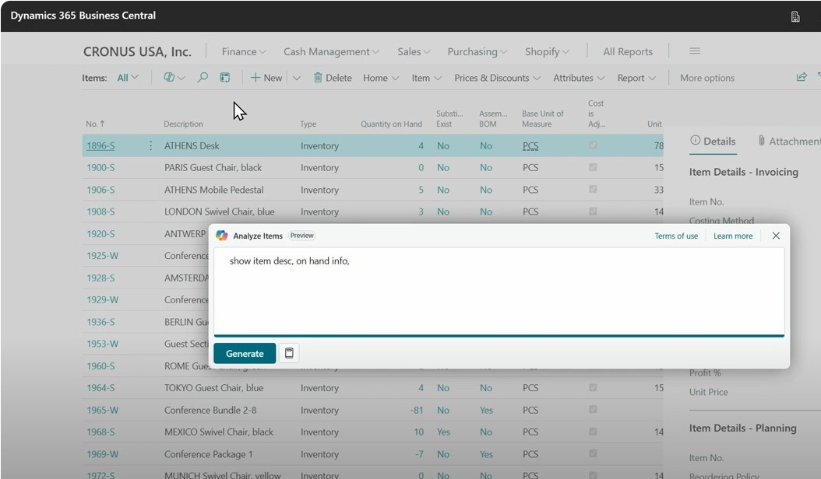
Kennie Pontoppidan
Principal Program Mgr., MS

Slide 9
Analytics
for LS Central

Slide 10


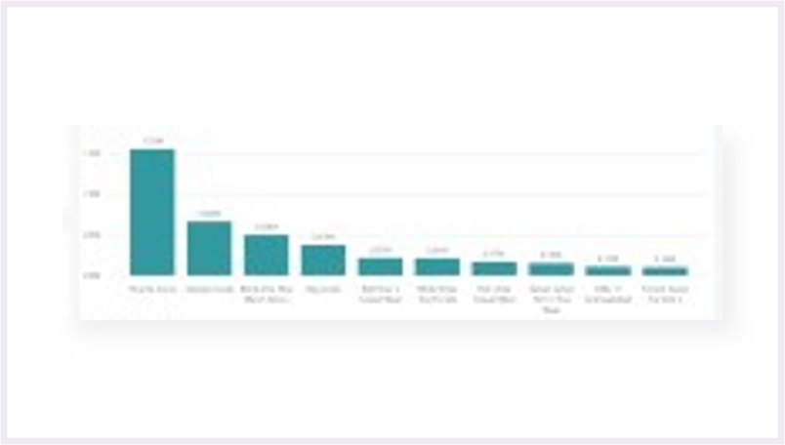
BI for Business Central
Business Central
Power BI
Service
Power BI
Reports
API
Microsoft
Power BI
Connector
Tables
(on-prem)
API
Data
Tables
(SaaS)
API
Query
business logic
API

Slide 11
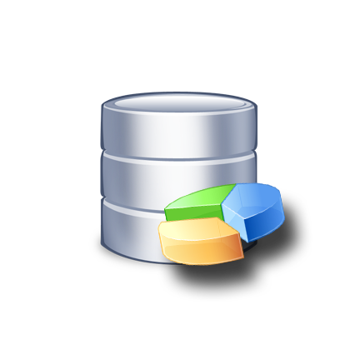
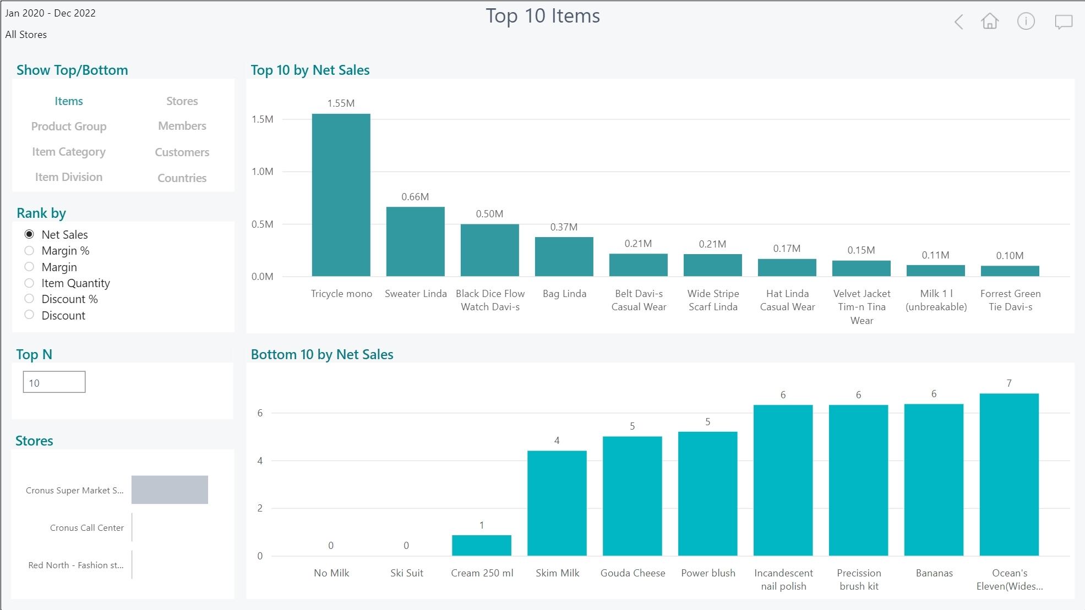
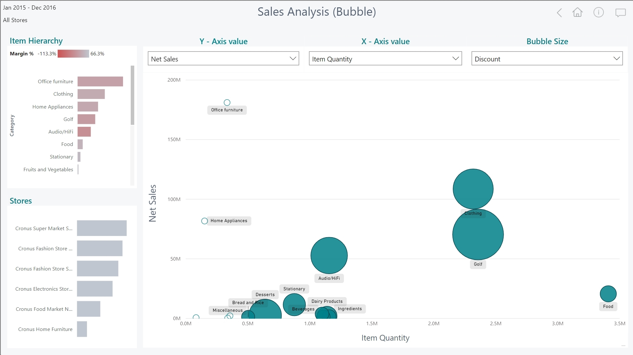


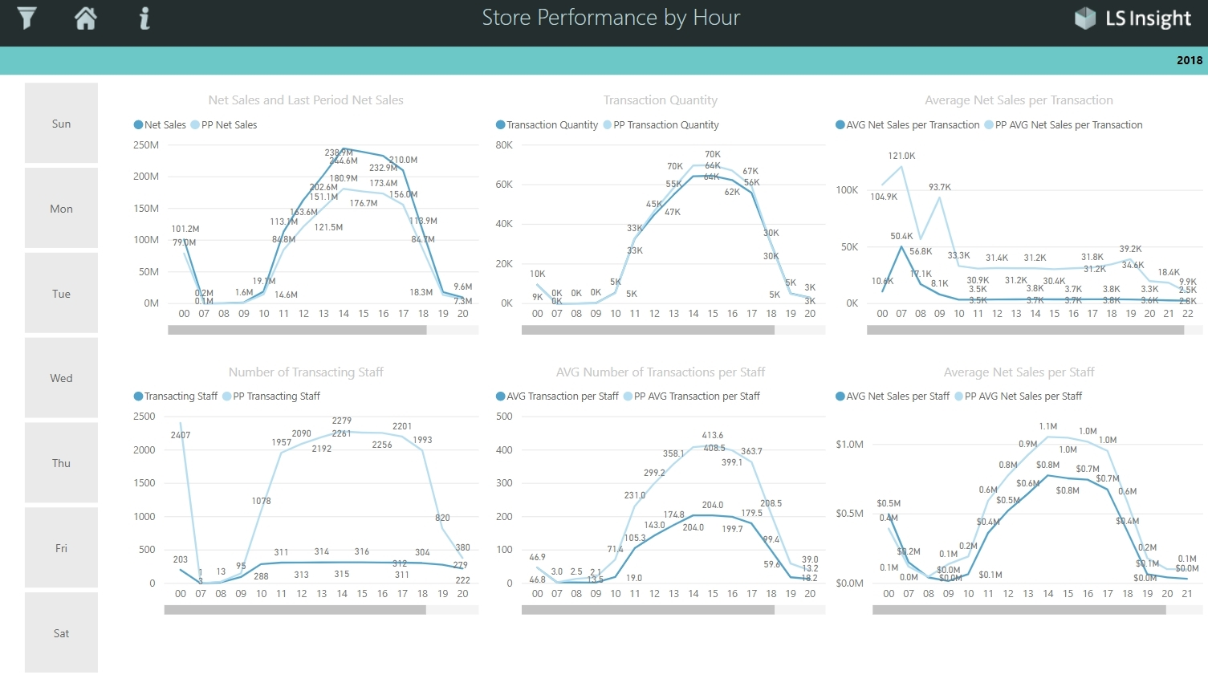
Analytics for LS Central
150+
Business Central
Azure SQL Server
Datawarehouse
Power BI
Service
Power BI Reports
Power BI Report
templates
Azure Data
Factory
Data
warehouse
Tables
(on-prem)
Data
warehouse
Data
Staging
Tables
(SaaS)
Staging
Query
business logic
Prestaging
Prestaging
Data Director
Webservices
Azure Data
Factory

Slide 12


Analytics for LS Central
Analytics - Data Warehouse
  Standard Microsoft technology
    Azure SQL Server or SQL Server
    Azure Data Factory (ETL processes and pipelines)
  Easy to extend (new fields, tables, and other data sources)
LS Retail…
Provides ready-to-use data model, pipelines and logic
You…
Setup SQL Server (Azure /on-prem)
Download and setup the deployment package from LS Retail
Connect to BC, load data → GO!
…
Analytics – Data WH
Business Central
(LS Central)

Slide 13
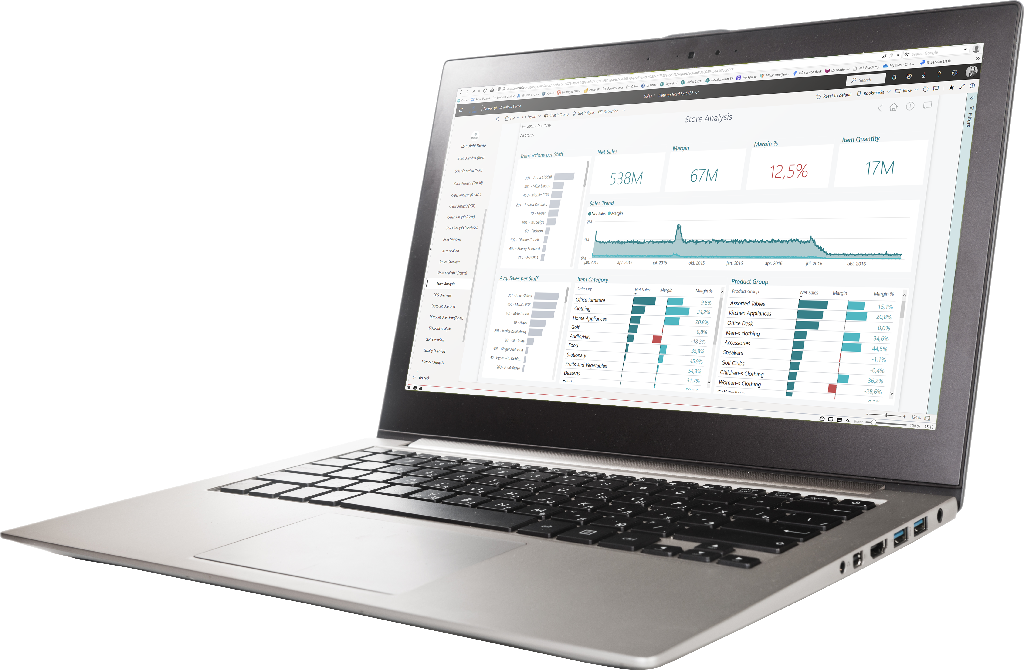
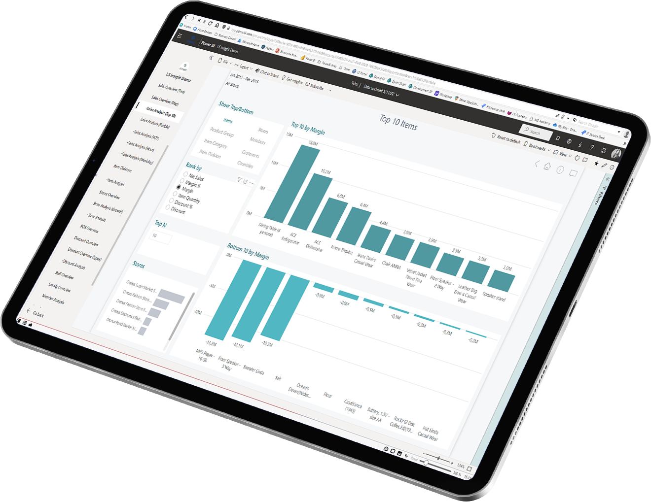
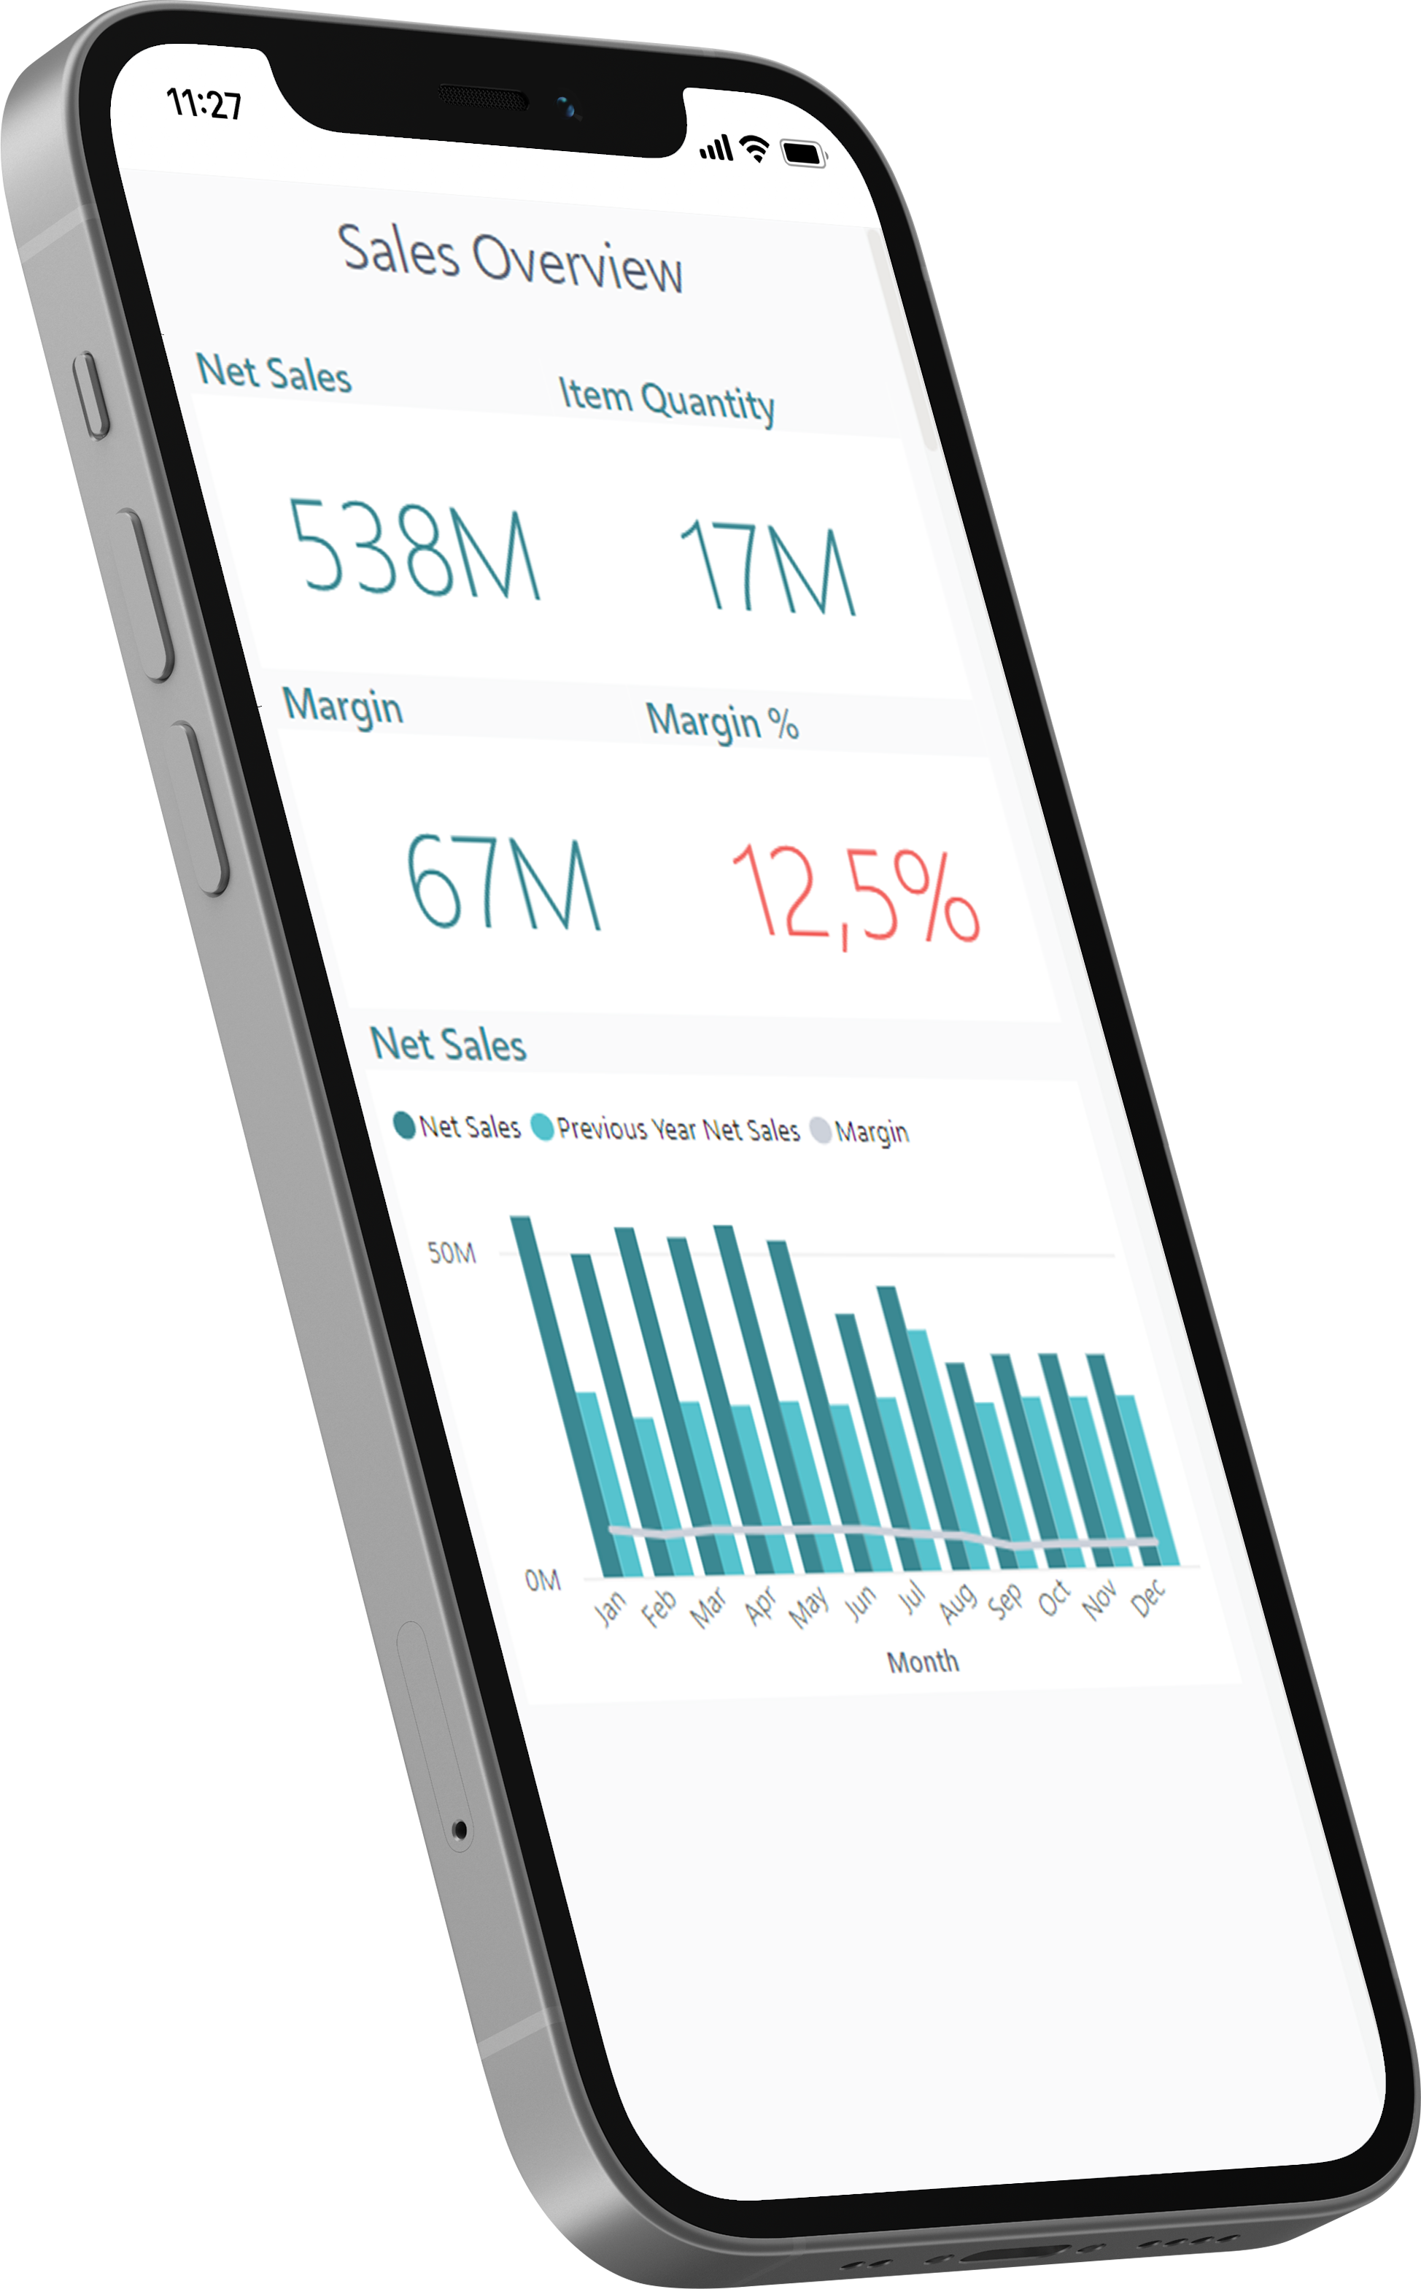
Analytics for LS Central
Analytics - Reports
  Power BI based Report and Dashboard templates
    Built on data from Analytics Data Warehouse
    150+ report page templates
  Easy to adapt, extend or build your own
  Strong integration with MS Teams, Excel, and Powerpoint
LS Retail…
Provides ready-to-use report templates
You…
Subscribe to Power BI (@ Microsoft)
Setup the report packages from the deployment package
Connect to DW, load data → GO!

Slide 14
Analytics for LS Central
Report packs
  Sales (added Budget and Section/Shelve reports)

Slide 15
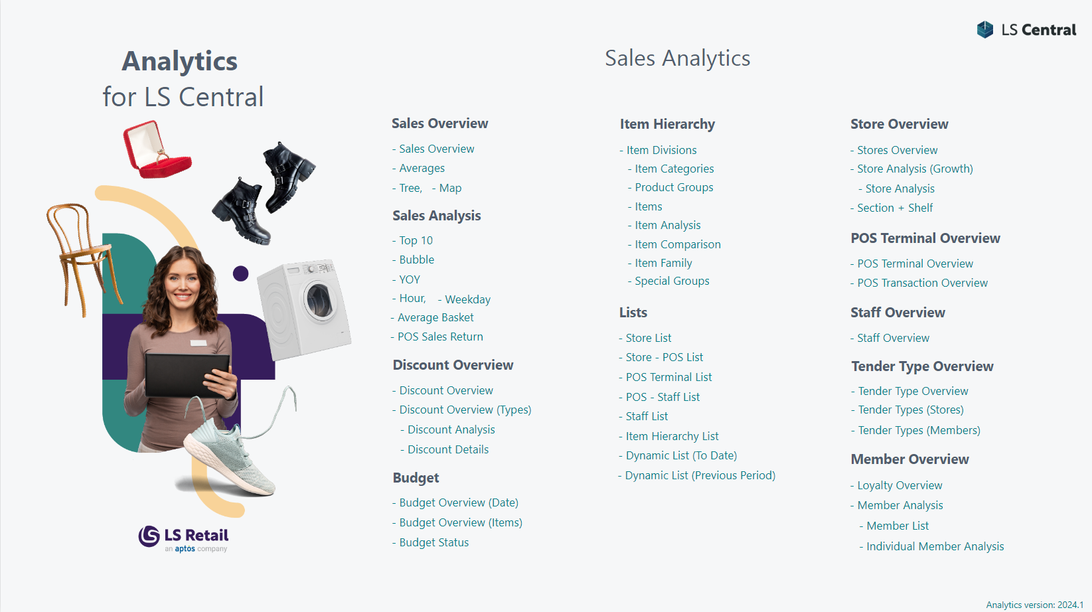
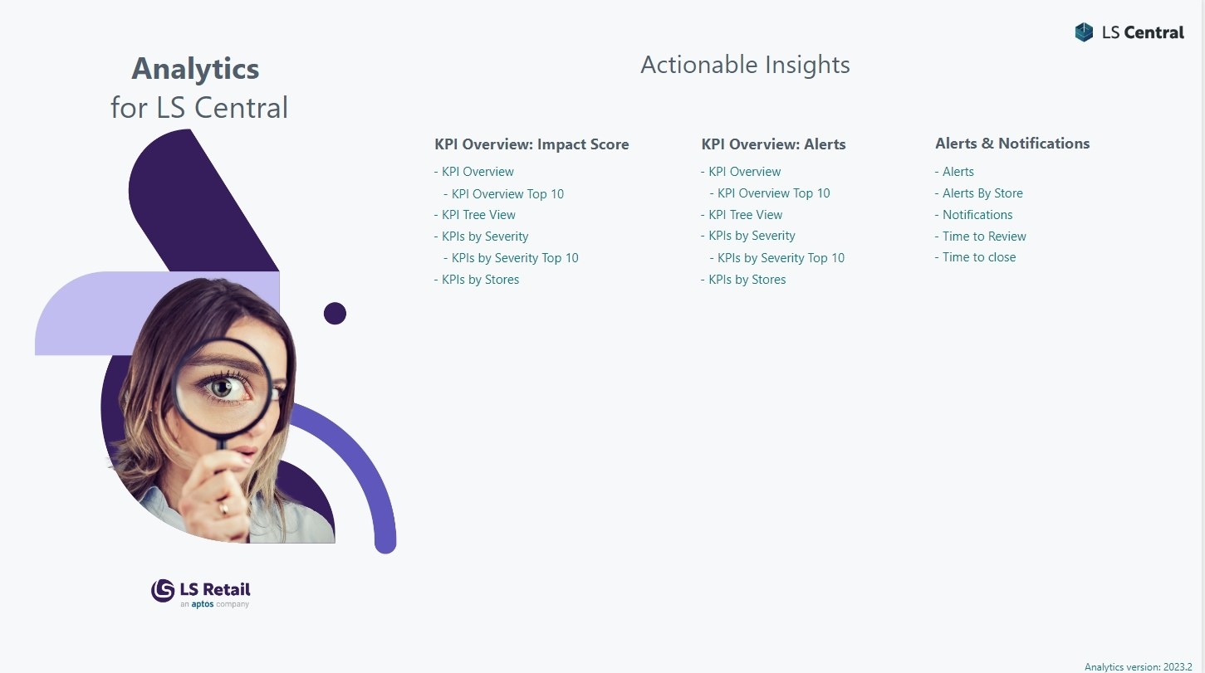
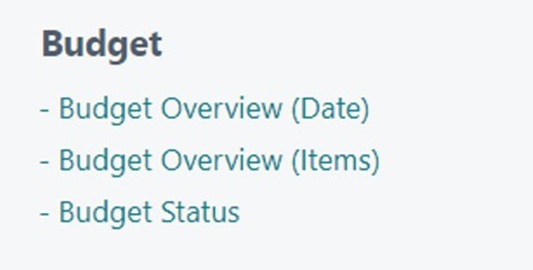
Should be sales

Slide 16
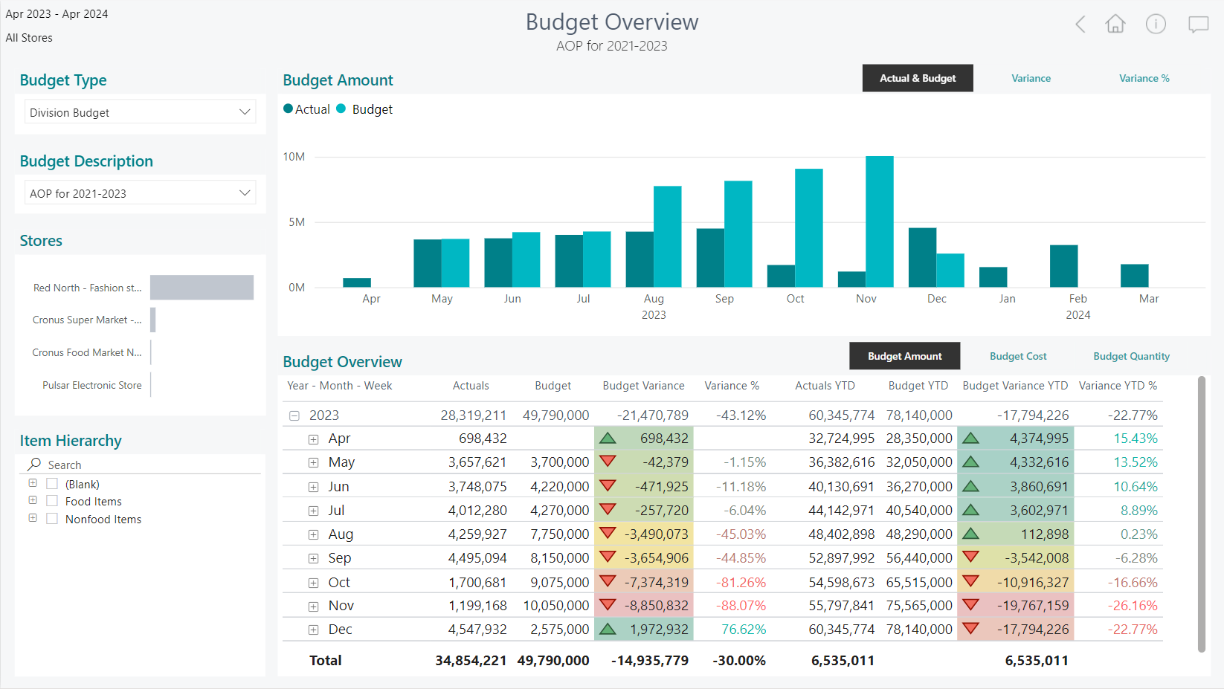
Enhancements in sales
reports

Slide 17

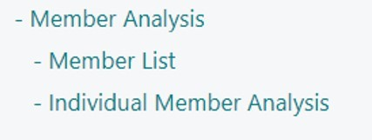
Should be sales

Slide 18
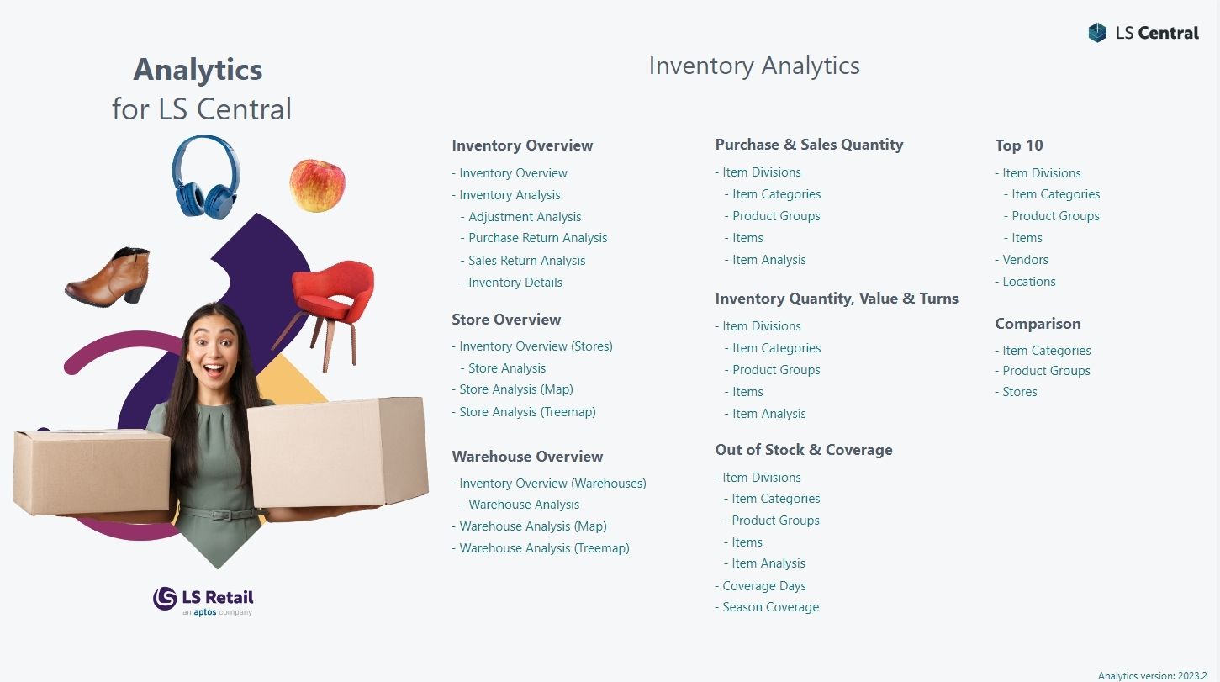
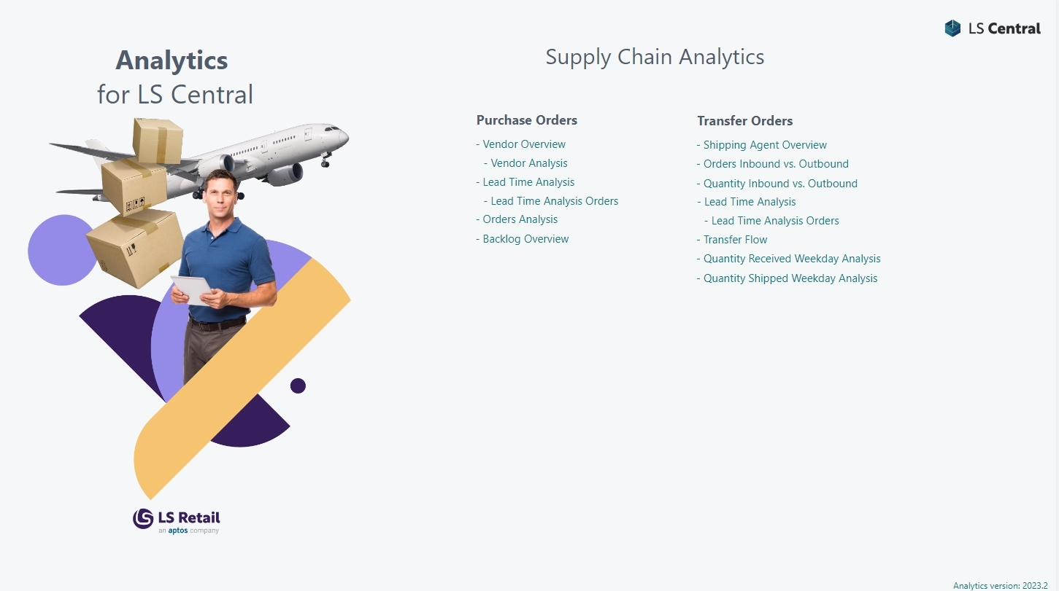
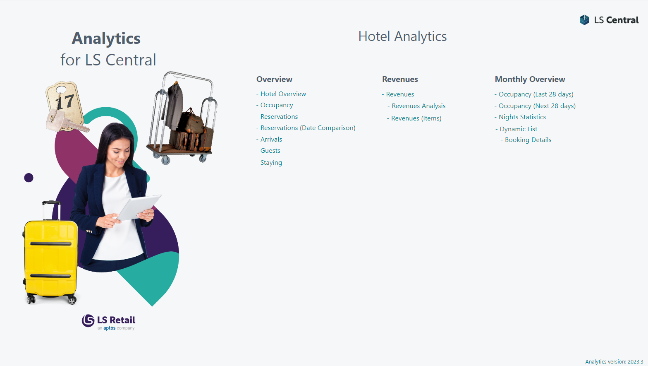

Slide 19
Analytics for LS Central
Report packs
  Sales (added Budget and Section/Shelve reports)
  Inventory
  Supply Chain
  Actionable Insights
  Hotels
  Hospitality (!!! New !!!)

Slide 20
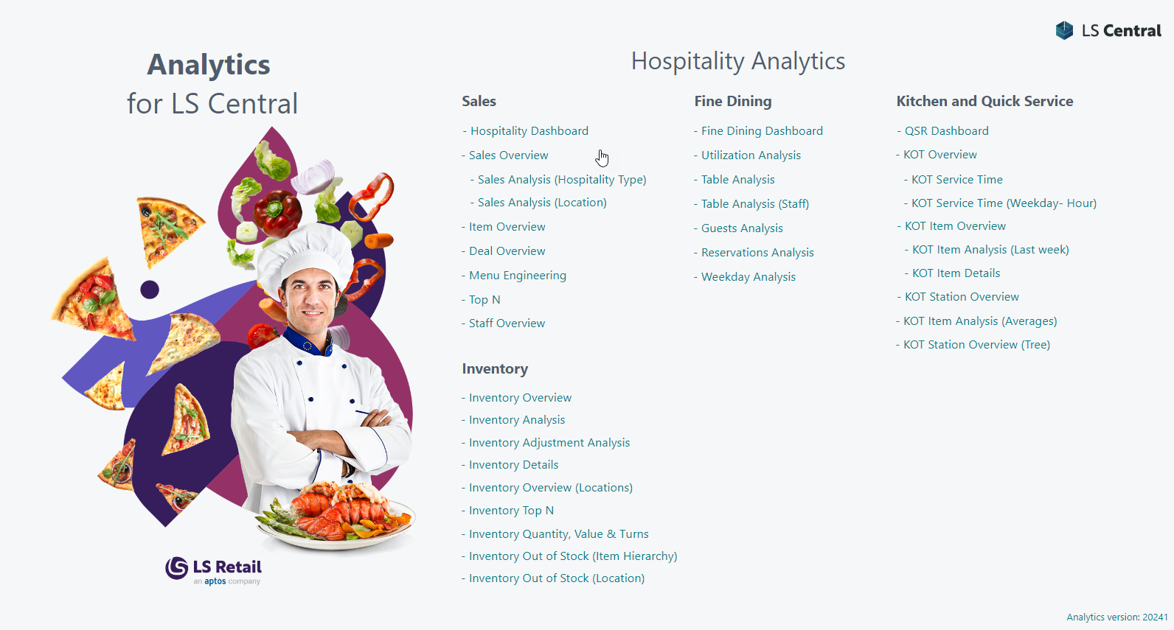

Slide 21
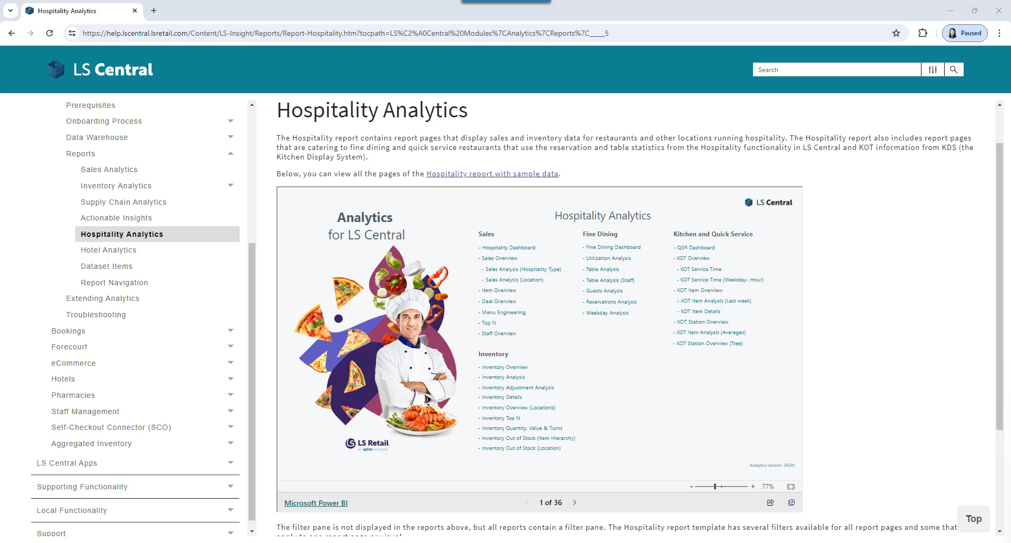

Slide 22
Analytics for LS Central
Report packs
  Sales (added Budget and Section/Shelve reports)
  Inventory
  Supply Chain
  Actionable Insights
  Hotels
  Hospitality (!!! New !!!)
  Bookings (!!! New !!!)

Slide 23
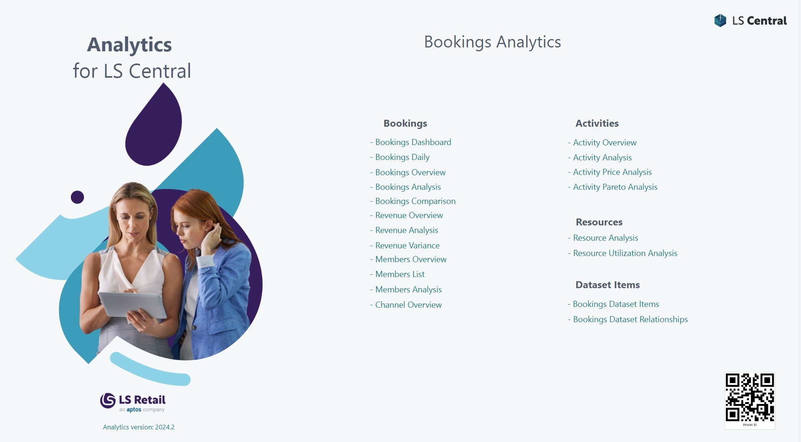

Slide 24
Analytics for LS Central
Report packs
  Sales (added Budget and Section/Shelve reports)
  Inventory
  Supply Chain
  Actionable Insights
  Hotels
  Hospitality (!!! New !!!)
  Bookings (!!! New !!!)
  Aggregated Inventory (work in progress)

Slide 25
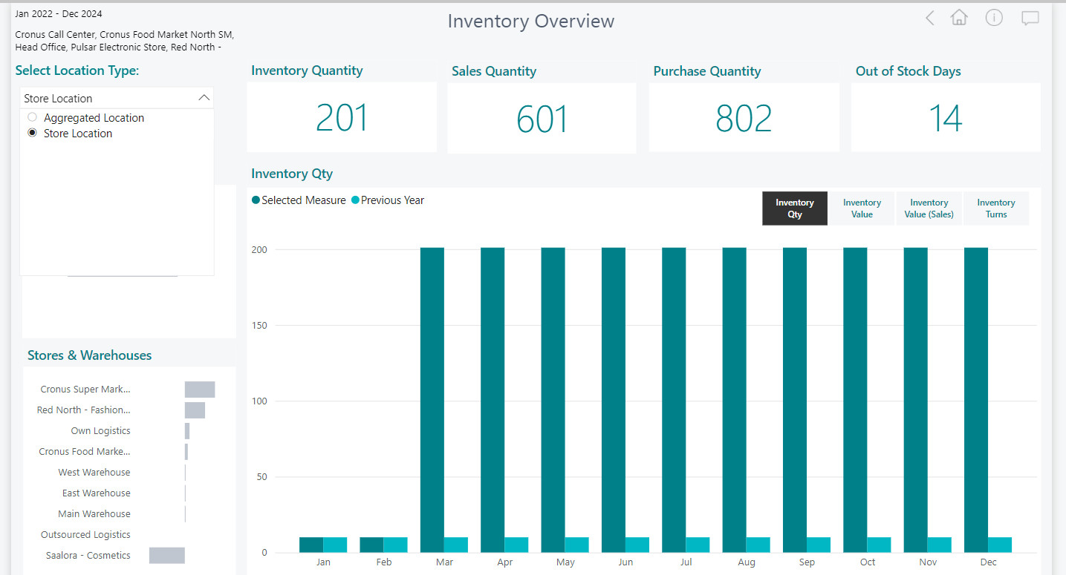

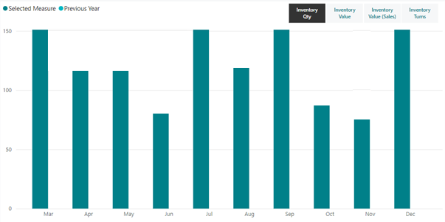
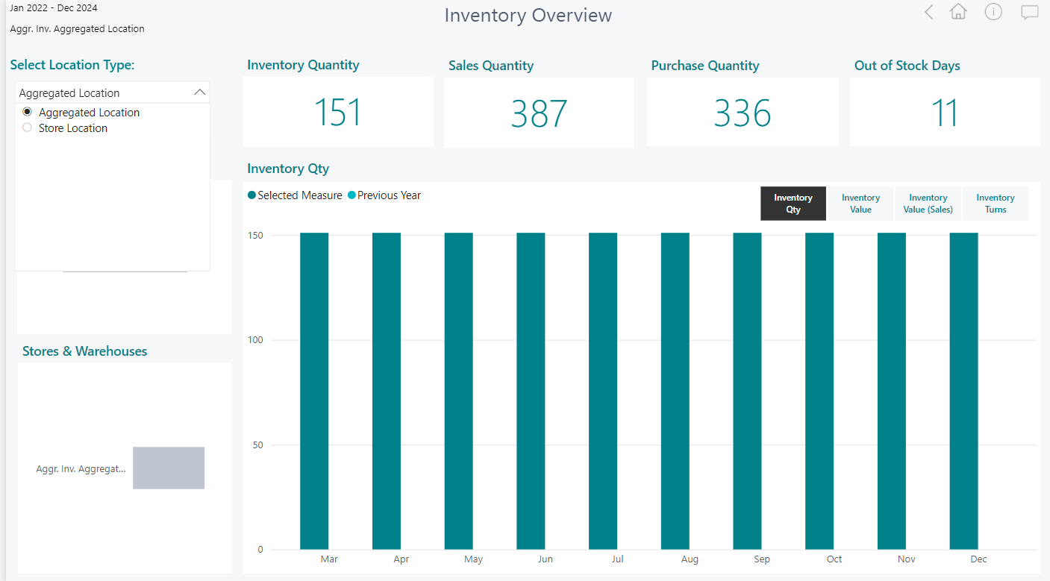
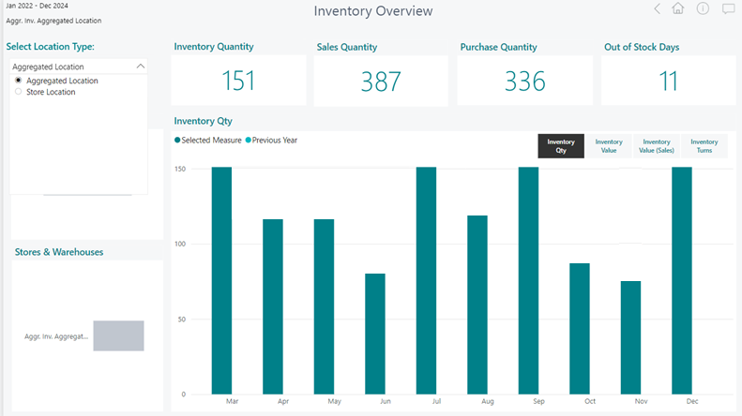

Aggregated Inventory

Slide 26
Analytics for LS Central
Report packs
  Sales (added Budget and Section/Shelve reports)
  Inventory
  Supply Chain
  Actionable Insights
  Hotels
  Hospitality (!!! New !!!)
  Bookings (!!! New !!!)
  Aggregated Inventory (work in progress)
  Continuous improvements and additions based on customer feedback.
  Industry specific report packs currently in development

Slide 27

Can we add data from an external system that we have?
Can we add this field from LS Central?
What about the data from the extension you created?
We really need this information to be able to make the big decisions.

Slide 28


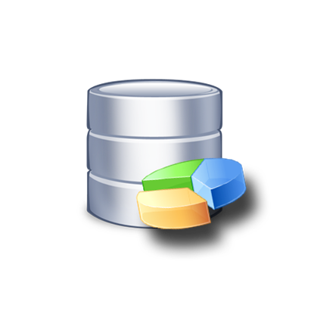

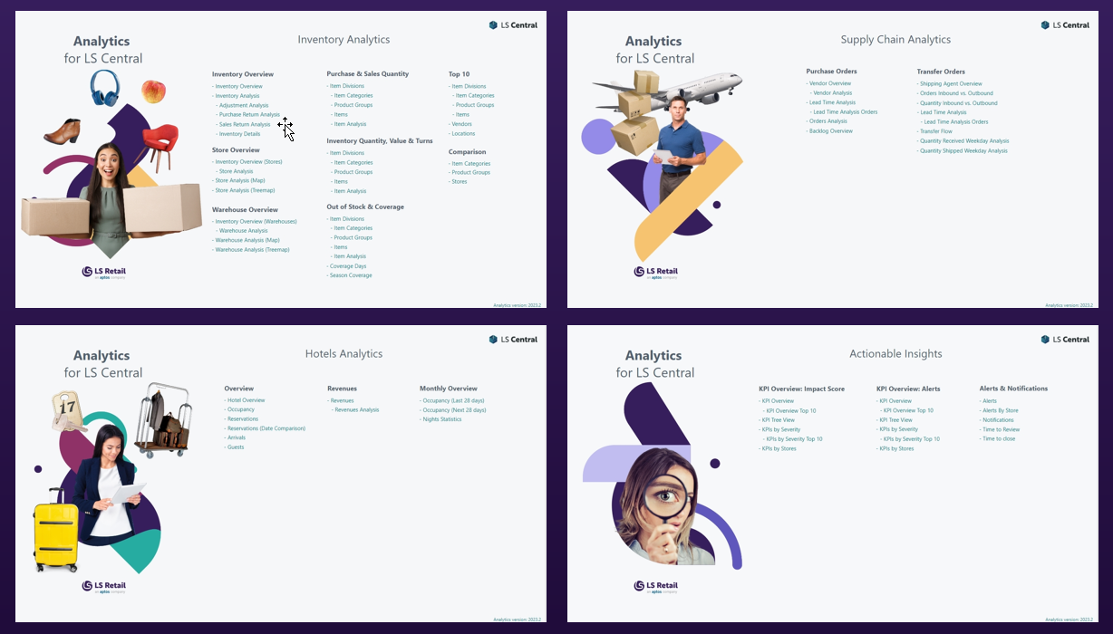
Customizations
Third party data
Business
Central
Analytics DW
for LS Central
Power BI
Service
Additional fields
Additional tables
Additional extensions
SaaS or
On-premise

Slide 29


Slide 30
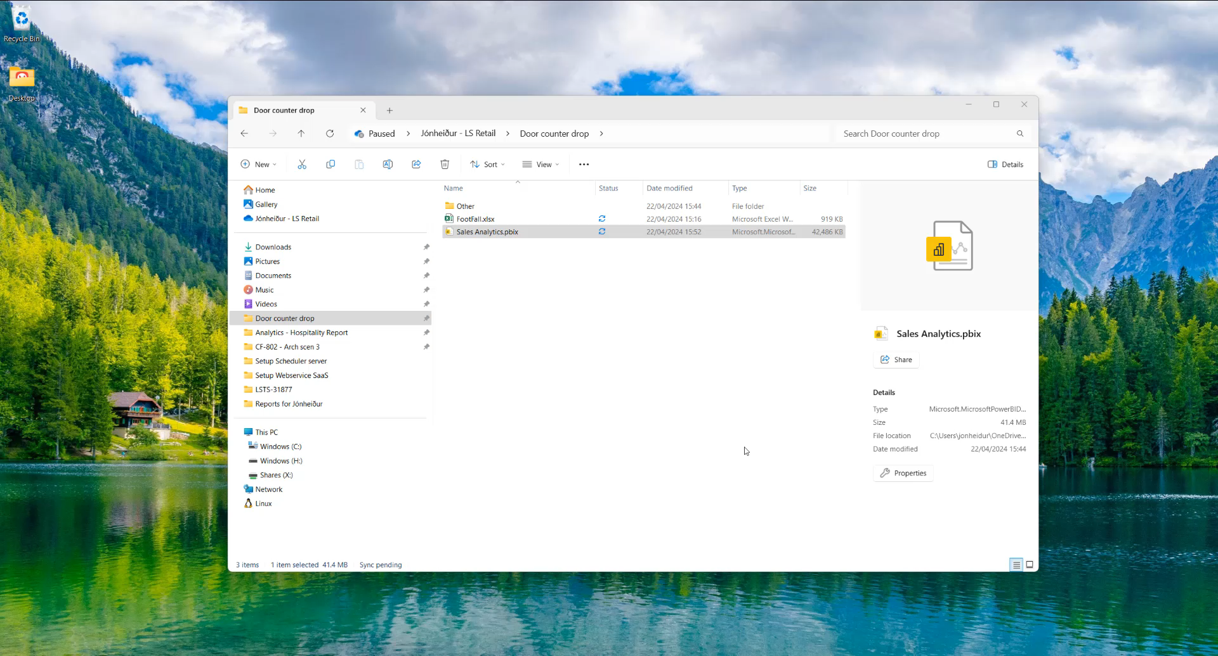

Slide 31
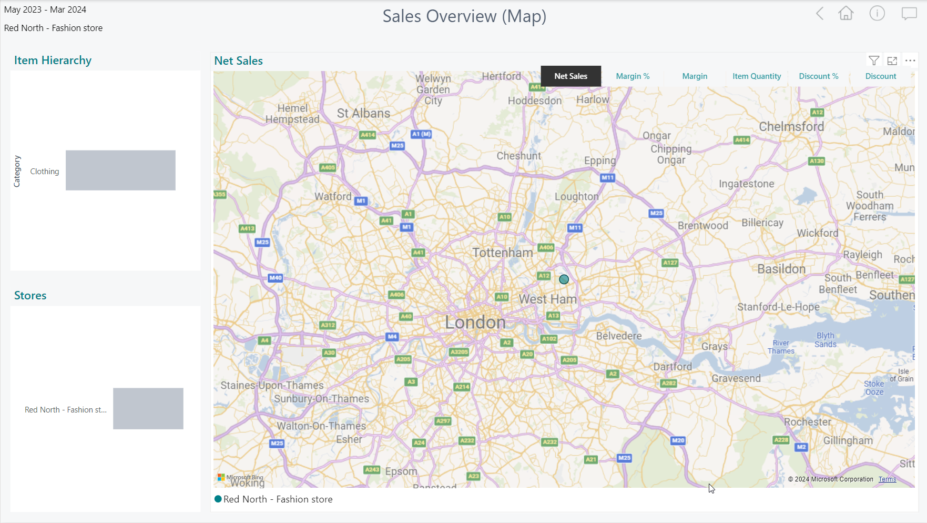
Customizations
Third party data
Documentation for customization scenarios
is available in
Extension guidelines
in Online Help
Business
Central
Analytics DW
for LS Central
Power BI
Service
SaaS or
On-premise

Slide 32

Analytics for LS Central
Architecture options

Slide 33
Architecture options
Business
Central
Analytics DW
for LS Central
Power BI
Service
Business
Central
SaaS
DW on
Azure SQL
DW on
on-prem SQL
Azure Data
Factory
Data Director
Webservices
On-premises
Power BI
Connector

Slide 34



Architecture options – on prem
Business
Central
on-prem
Azure SQL
Server
(Analytics DWH)
Power BI
Service
Azure Data Factory
Integration Gateway
(Interface to read from
SQL server)
Power BI service
pulls data from the
data warehouse
(based on a schedule)
Azure Data Factory
(Pipelines to load and transform data)

Slide 35
Architecture options – SaaS
Business
Central
SaaS
Azure SQL
Server
(Analytics DWH)
Power BI
Service
HCS Server / VM
LS Central Scheduler,
Data Director
Power BI service
pulls data from the
data warehouse
(based on a schedule)
Scheduled data
replication
- from Business
Central
- to Analytics
database
Azure Data Factory
(Pipelines to transform data)

Slide 36
How to get started
Analytics - BC on premises
Request Analytics license
Subscribe (Microsoft)
  Power BI License
  Azure SQL Server
  Azure Data Factory
Analytics - BC SaaS
Request Analytics License
Subscribe (Microsoft)
  Power BI License
  Azure SQL Server
  Azure Data Factory
Purchase 1 Offline Store license for the VM/Server to replicate data
(not needed if you are using hybrid approach)

Slide 37
Agenda
Reporting in BC and Analytics
Analytics under the hood
What’s new
Architecture options
Customer story
The future

Slide 38

IT'Sugar
IT'SUGAR has become one of the largest
specialty candy "retailtainers" in the world.
100 locations throughout the United States and Canada.
IT'SUGAR is more than just a candy store - it's an experience.
“All the information is available in Analytics.
Whenever anyone asks for data all I have to do
is bring it together”
Steve – Consultant Power BI

Slide 39
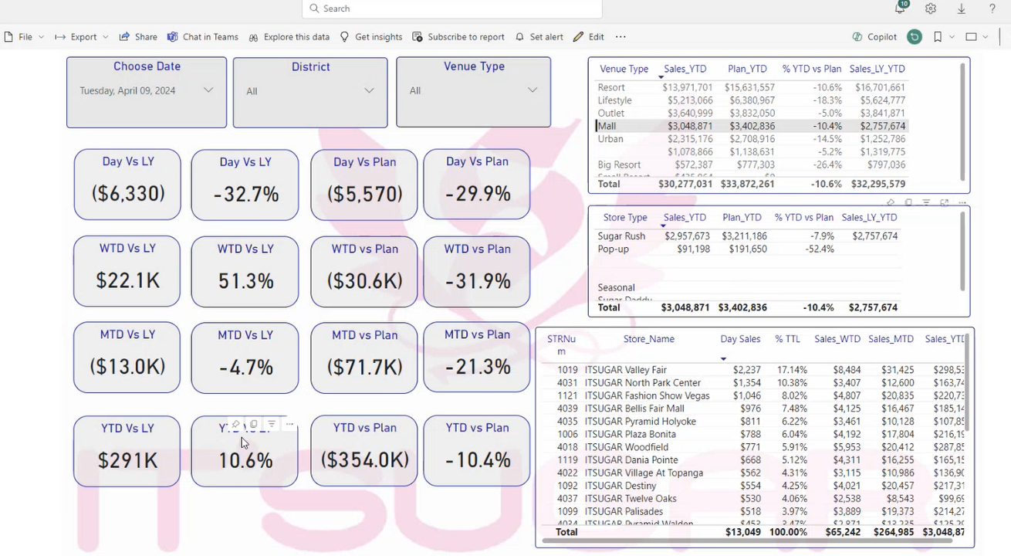
IT’Sugar – report highlights (custom report)

Slide 40


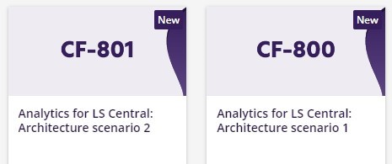
The future
Report packs
  General improvements
  Financials report pack
Aggregated Inventory
LS Retail Academy courses
We listen to you!
CF-803
Soon

Slide 41
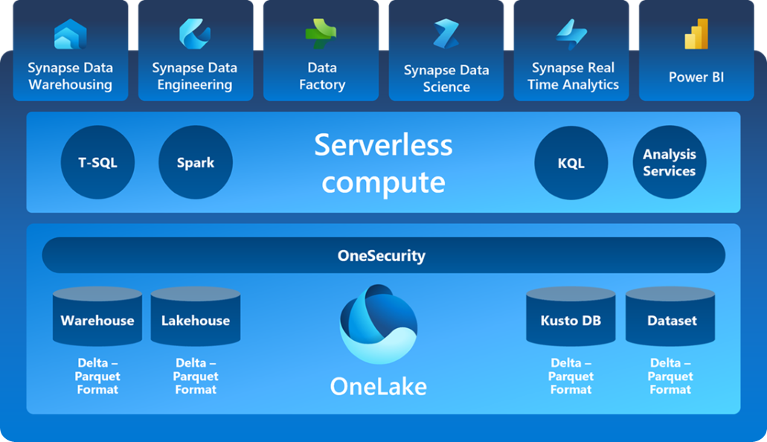
The future
Data load with Microsoft Fabric
Microsoft
Fabric
Database
mirroring
Business Central

Slide 42
Your Questions please!
(or feedback ☺)

Slide 43


Slide 44
Thank you

