Slide 1
What Retailers Should Expect from Consumers in 2024 and Beyond
Nikki Baird
VP Strategy & Product
LS Retail Connexions 2024

Slide 2




A Process
1
2
3
4
Current State
Expectations for 2024
Capability Gaps
Tech Priorities
The state of Consumers, Tech, and Retailers at the end of 2023
What do consumers want and how are retailers responding?
What retailers will need to do but can’t
Which gaps are retailers prioritizing for tech investment?

Slide 3
Expectations 2023 vs 2024
Expectations of a recession |  | Hopeful for a soft landing
Rate hikes / inflation |  | Rate cuts? / “disinflation”
WFH |  | RTO?*
China |  | India
Revenue up, profits up, units down |  | Difficult comps, units down
Supply chain disruptions |  | More stable supply chain (caveat for Red Sea), questions about sources*
Crypto |  | GenAI
FROM
TO

Slide 4

Generative AI:
Lots of hype, less reality
Even though it’s moving fast, it’s still very early days for understanding how GenAI will impact retailers and consumers
Something like 4% of all companies, across industries say they have “implemented” GenAI
Productivity studies show that GenAI’s biggest impact is in bringing poor performers up to “average”
A real, open question:
  “When everyone is super, no one will be” – Syndrome, The Incredibles
  Generation loss?
  No such thing as “unlearning”

Slide 5





Five Dominant Consumer Behaviors in 2023
Wellness
Less is More
Actionist
Manifesting Optimism
Decentral
Moving beyond more specific terms like “fitness” or “health” to mean something broader – mental, physical, emotional, proactive & preventive.
Tied to wellness, a belief that scaling down and using less (owning less) is an important contribution to the overall health of Earth and us, by extension.
An expectation that the only way to get change is to agitate for it. The next step in cancel culture, an extension of the demand for greater transparency.
Weariness of “permacrisis” is leading consumers to focus more on optimism and how to create positive outcomes.
Starting to see the results of decentralized technology, and an accrual of benefits to consumer “creators”.

Slide 6
How these are trending in 2024
Wellness
Less is More
Actionist
Manifesting Optimism
Decentral
Moving beyond more specific terms like “fitness” or “health” to mean something broader – mental, physical, emotional, proactive & preventive.
Tied to wellness, a belief that scaling down and using less (owning less) is an important contribution to the overall health of Earth and us, by extension.
An expectation that the only way to get change is to agitate for it. The next step in cancel culture, an extension of the demand for greater transparency.
Weariness of “permacrisis” is leading consumers to focus more on optimism and how to create positive outcomes.
Starting to see the results of decentralized technology, and an accrual of benefits to consumer “creators”.

Slide 7
Wellness
Consumer Drivers:
Over-consumption is unhealthy
Technology is being used to make us unhealthy – “dark patterns” “protection from The Algorithm”
Even entertainment & leisure should have “functional” benefits
Loneliness is unhealthy, and there is too much loneliness
“Disposable” is unhealthy
Social media is unhealthy
Resilience is something to invest in
Local is “more healthy” than global
Retail Implications:
Consumers increasingly expect retailers to help them interrupt ”bad behavior”, like over-consumption – slow consumption
Retailtainment is not enough – it needs to contribute to wellness and well-being
Retailers and brands are expected
to contribute to fostering connections and combatting loneliness – and this needs to be executed at an authentic, local level
Brands need to put an end to “disposable” products and practices (this applies to how they treat employees too)
Wellness
Moving beyond more specific terms like “fitness” or “health” to mean something broader – mental, physical, emotional, proactive & preventive.

Slide 8

Less is More
Consumer Drivers:
A rejection of unbridled consumerism
Multi-function products over
single-purpose or single-use
Tied to multi-function – genderless, accessible to all, inclusive, esp. fashion
Tech only if it serves/curates for
“me” – simplifies
The rise of young luddites, rejecting
the algorithm
Paying attention to how products are made – embracing products that use less, recycle more
Retail Implications:
Assortments need to narrow and focus on multiple uses, non-binary, inclusive
Retailers are at risk in their use of personalization if it is perceived as promoting “unconscious consumption”
Putting tech less front and center
in stores
The 3 R’s: Rental, Resale, Recycle, and bonus R emphasizing consumer reuse/upcycle
Manufacturing, packaging, shipping
Less is More
Tied to wellness, a belief that scaling down and using less (owning less) is an important contribution to the overall health of Earth and us, by extension.

Slide 9
Actionist
Consumer Drivers:
Being “authentic” or passively contributing is no longer enough – companies must be actively making things better
Transparency expectations are rising – tech should be used to provide “radical” transparency
It’s not enough to “cancel” a company for something a consumer doesn’t like – they have to actively engage with
the company to change. Boycotts are not enough.
Retail Implications:
Greenwashing is a death knell
– and it’s not enough to reduce impact. Investment has to offset past impact
Expectations of seeing all the way into the supply chain – meeting the people
Expect much more intense
blowbacks for missteps. Expect that simple apologies are not enough and that symbolic gestures will only fan
the flames
Actionist
An expectation that the only way to get change is to agitate for it. The next step in cancel culture, an extension of the demand for greater transparency.

Slide 10
Actionist
Consumer Drivers:
Being “authentic” or passively contributing is no longer enough – companies must be actively making things better
Transparency expectations are rising – tech should be used to provide “radical” transparency
It’s not enough to “cancel” a company for something a consumer doesn’t like – they have to actively engage with
the company to change. Boycotts are not enough.
Retail Implications:
Greenwashing is a death knell
– and it’s not enough to reduce impact. Investment has to offset past impact
Expectations of seeing all the way into the supply chain – meeting the people
Expect much more intense
blowbacks for missteps. Expect that simple apologies are not enough and that symbolic gestures will only fan
the flames
Actionist
An expectation that the only way to get change is to agitate for it. The next step in cancel culture, an extension of the demand for greater transparency

Slide 11
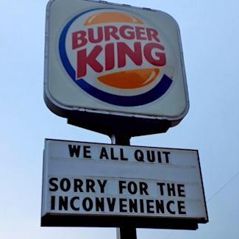
Respectavist
Consumer Drivers:
Transparency has meant that what happens on Wall Street does not stay there – consumers see high prices = high profits and executive bonuses
Trust in brands is eroding as companies try to reduce the direct impact of inflation through “shrinkflation” and “skimpflation”
Viral videos of employees in bad situations / on the receiving end of cuts in labor hours to offset rising wages
Rising theft: ”you steal from me, I steal from you” and “you’re too cheap to staff so why shouldn’t I?” justifications
Retail Implications:
Greenwashing is a death knell
– and it’s not enough to reduce impact. Investment has to offset past impact
Expectations of seeing all the way into the supply chain – meeting the people
Expect much more intense
blowbacks for missteps. Expect that simple apologies are not enough and that symbolic gestures will only fan
the flames
More angry, impatient customers, more brand shifts & abandonment
Respectavist
Demand that companies treat consumers and employees with greater respect – “I’m not stupid”

Slide 12
Manifesting Optimism
Consumer Drivers:
Demand for solutions rather than just an emphasis on problems and how bad they are – focus on a hopeful future
An emphasis on “future proof” and proof of having thought through long-term impacts
Not about “living forever” – emphasis on living WELL (but also forever)
Tied to wellness, an emphasis on fun, “kidulting”
Retail Implications:
Fun can be considered “functional” entertainment
Distraction from bad news has to be balanced with being realistic about
bad news – but demonstrating resilience, support, enablement in
the face of bad news
Beware falling into nostalgia-only – that can be a basis for fun, but not the only one. And who are you appealing to with this nostalgia? Gen Z’s fascination with the 80’s
Manifesting Optimism
Weariness of “permacrisis” is leading consumers to focus more on optimism and how to create positive outcomes

Slide 13
Manifesting Optimism
Consumer Drivers:
Demand for solutions rather than just an emphasis on problems and how bad they are – focus on a hopeful future
An emphasis on “future proof” and proof of having thought through long-term impacts
Not about “living forever” – emphasis on living WELL (but also forever)
Tied to wellness, an emphasis on fun, “kidulting”
Retail Implications:
Fun can be considered “functional” entertainment
Distraction from bad news has to be balanced with being realistic about
bad news – but demonstrating resilience, support, enablement in
the face of bad news
Beware falling into nostalgia-only – that can be a basis for fun, but not the only one. And who are you appealing to with this nostalgia? Gen Z’s fascination with the 80’s
Manifesting Optimism
Weariness of “permacrisis” is leading consumers to focus more on optimism and how to create positive outcomes

Slide 14
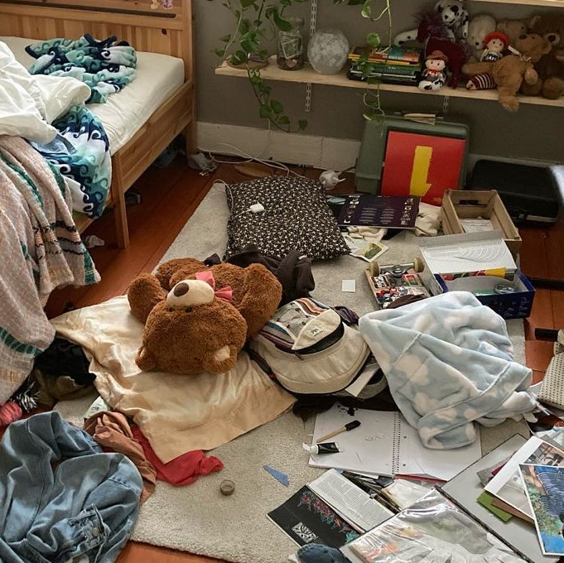
Embracing the Mess
Consumer Drivers:
The Algorithm rewards formulas, “average’, predictable, boring
Over-engineered, over-curated, “too perfect” scenarios are what get rewarded on social media
An extension of wellness – “finding wellness” means acknowledging when things aren’t perfect
A craving for things that are quirky, strange, breakout from the pack – individualism, unique, novel
Retail Implications:
An extension of the changing power balance between consumers and brands – not only do you have to
be authentic as a brand, you have
to prove it by showing that you’re
all human
”Authentic” means more than being true to your brand values – it means being real about the pros and cons of those values, acknowledging unintended consequences, showing behind-the-scenes messiness
Beware falling into nostalgia-only – that can be a basis for fun, but not the only one. And who are you appealing to with this nostalgia? Gen Z’s fascination with the 80’s
Embracing the Mess
Manifesting optimism didn’t work. The first step to recovery is acknowledging where you are today and all of its mess

Slide 15

Decentral
Consumer Drivers:
Continued expansion of virtual goods & impact on brand loyalty
Greater frictionless interoperability – super apps, passwordless security, composability/no-code
Expansion of creator economy – new capabilities, new business models
Retail Implications:
For luxury and status goods, virtual fashion will continue to be a thing. Unclear how much it will be impacted by crypto crash, though
Watch out for erosion of physical brand loyalty – Future Commerce stat is troubling: 75% of US consumers surveyed said you can love a brand without ever owning anything it makes
Making room for consumers as creators – enabling or at least blessing a creator ecosystem
Pay attention to super apps – not in 2023, but coming down the road
Decentral
Starting to see the results of decentralized technology, and an accrual of benefits to consumer “creators”

Slide 16
Decentral
Consumer Drivers:
Continued expansion of virtual goods & impact on brand loyalty
Greater frictionless interoperability – super apps, passwordless security, composability/no-code
Expansion of creator economy – new capabilities, new business models
Retail Implications:
For luxury and status goods, virtual fashion will continue to be a thing. Unclear how much it will be impacted by crypto crash, though
Watch out for erosion of physical brand loyalty – Future Commerce stat is troubling: 75% of US consumers surveyed said you can love a brand without ever owning anything it makes
Making room for consumers as creators – enabling or at least blessing a creator ecosystem
Pay attention to super apps – not in 2023, but coming down the road
Decentral
Starting to see the results of decentralized technology, and an accrual of benefits to consumer “creators”

Slide 17

Uncategorizable
Consumer Drivers:
Cost of living has pushed “normal” or “average” life stages off the table for many younger consumers
Additional rejection of “expected” life stages – marriage, mortgage, kids, etc.
Aided by the desire for unique experiences – leading to wanting to be treated uniquely
Retail Implications:
You better have really good, first-party customer data
Dangerous to use life stage, age,
or education cohorts as a basis
for segmentation – more dangerous than ever
Personal vs. relevant – still better
to be relevant vs. personalized, but harder to do
Segmentation based on behavior only – makes consumers harder to find too
Uncategorizable
1:1 means more than unique offers – it means using anything other than demographics or life stages to group customers

Slide 18
Four Key Consumer Behavior Questions in 2024
Will consumers embrace GenAI or will they reject it in favor of “genuine” human expression?
Will consumers let companies step back from cause-related marketing or demand more?
Will consumers renew their trust
in companies and brands or will anti-corporatism and anti-consumerism take hold?
Will consumers continue to spend or pull back?
Will GenAI unlock human creativity or unleash a torrent of low-grade content that drowns out the rest?
“Unapologetic self-expression” as a way to demonstrate authenticity
“Thanks, Bud Light.”
Bud-Light-The-Sequel in 2024?
Shrinkflation and Skimpflation destroy
brand trust
Wallet detox?
“Doom-spending”?
“Microdosing gratification”
Travel’s return won’t
save retail

Slide 19
Retailer Priorities
Inventory
Performance
Business Model
Leverage
Store Format
Evolution
1st Party Data &
The Return of Brand
Maintaining price perception during “disinflation”
A focus on unit growth in the face of falling prices (including promotions)
Omnichannel with stores as nodes – not a supply chain thing, an inventory performance thing
RFID (fashion)
Alternative retail
Supply chain sustainability as ROI driver
Returns
Is the traditional, stand-alone retail business model dead?
RMN’s
Tech services
Data services
Referrals on third party marketplaces
Paid loyalty programs
Adjacent services
Logistics services
Store’s role in customer acquisition in the face of flattening eCom growth
Mobile employee & productivity
Renewed store & district manager focus
Pop-ups, events, taking it to the consumer
Blurring the lines on formats
LP & computer vision
India > China for growth
Company-level data strategies – renewed interest in “data as the new oil (gold)”
Pragmatic customer insights and how to deliver them – segment-less customer segments
GenAI for customer experience, engagement, and offers

Slide 20
Thank You! and Questions?

