Slide 1
Overlooking performance and resilience with telemetry
Johann Sveinsson
Senior Developer
Sergio Castelluccio
Consulting Manager

Slide 2
Why Telemetry?
To get insight into performance, usage and health of the system
IT administration
  Proactive monitoring of the health, security and performance of the application in real time
Consulting
  User activity tracking to understand and optimize how users interact with the system
Development
  Track performance for objects and system parts
Vendors and partners
  Monitor the general health of the application to find where table locking’s and bottle necks are for improving the system

Slide 3
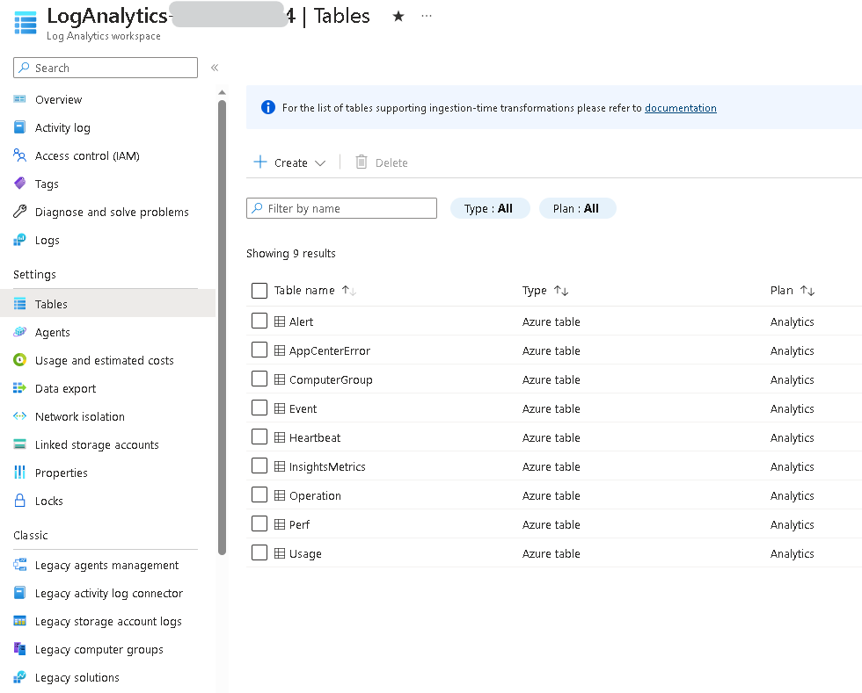

Overview of BC Telemetry History
Windows Events (ETW)
Performance Counters
SaaS – now creators themselves need it
Log Analytics
Application Insights

Slide 4
Anatomy of Event
Part of BC service core, both on-prem & SaaS
Can be on App level
Use Windows OS subsystem, negligible performance impact
Do not look pretty (even in friendly view)
Various info sent under different event ID
Do not exist long on very busy server
Not transaction dependent
Can be pushed to any cloud analytics or Azure Application Insights
Can be turned on/off

Slide 5
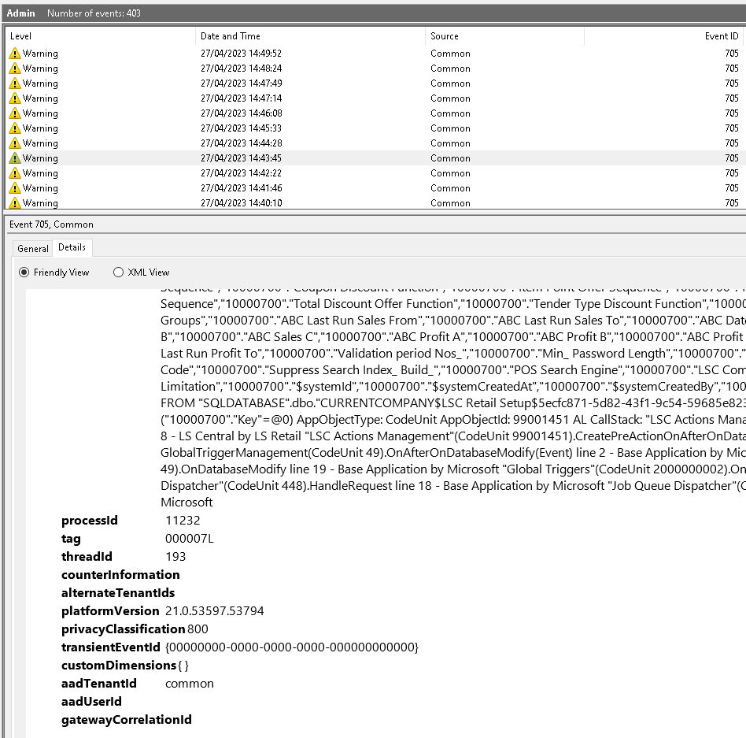
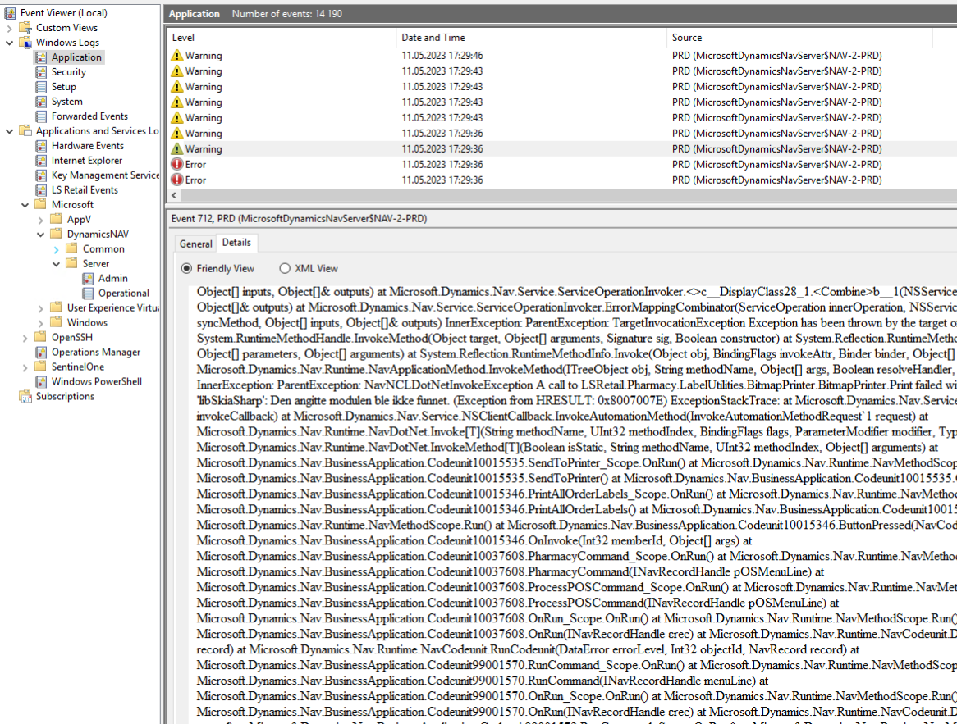
Not So Friendly View

Slide 6
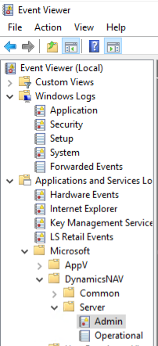
Standard Events
Admin & operational
  Windows Logs / Application
NAV server trace Events
  Application and Services Logs / Microsoft / DynamicsNAV / Common
  Application and Services Logs / Microsoft / DynamicsNAV / Server

Slide 7
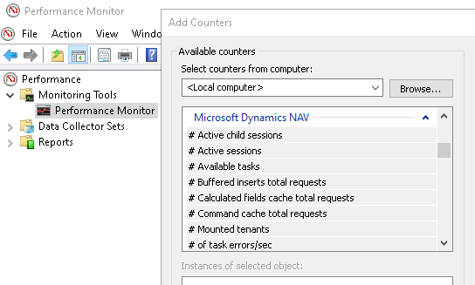
Performance Counters
Windows has plenty, just few here
  Memory(*)\% Committed Bytes In Use
  Processor(_Total)\% Processor Time
  System(*)\Processor Queue Length
  LogicalDisk(*)\Avg. Disk sec/Write
  LogicalDisk(*)\Current Disk Queue Length
More available for Dynamics NAV server instances
  # Active sessions
  # Open application connections
  # Primary key cache total requests
  More here: https://learn.microsoft.com/en-us/dynamics-nav/microsoft-dynamics-nav-performance-counters

Slide 8
Custom Events / Traces
Session.SendTraceTag(Tag: Text, Category: Text, Verbosity: Verbosity, Message: Text [, DataClassification: DataClassification])
NOTE: Above method is supported only in Business Central on-premises.
Session.LogMessage(EventId: Text, Message: Text, Verbosity: Verbosity, DataClassification: DataClassification, TelemetryScope: TelemetryScope, CustomDimensions: Dictionary of [Text, Text])
SENDTRACETAG(Tag, Category, Verbosity, Message)
NOTE: In older versions, CAL

Slide 9
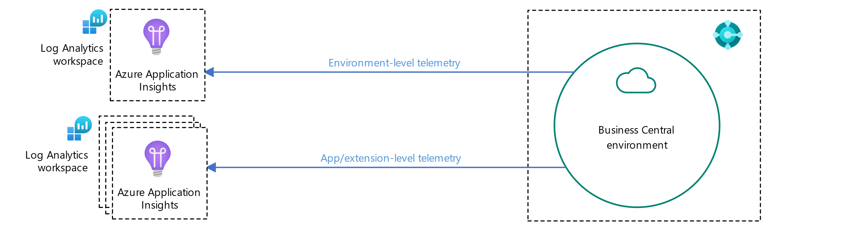
Telemetry: Azure Application Insights
You can integrate Business Central with Azure Application Insights by enabling the telemetry feature. With telemetry, system owners can look at usage and lifecycle operations of environments/apps, diagnose problems, and analyze operations that affect performance.
Telemetry in Business Central can be enabled on two different levels:
Environment-level telemetry
App/extension-level telemetry (for each app/extension installed)
Source: https://learn.microsoft.com/en-us/dynamics365/business-central/dev-itpro/administration/telemetry-overview

Slide 10
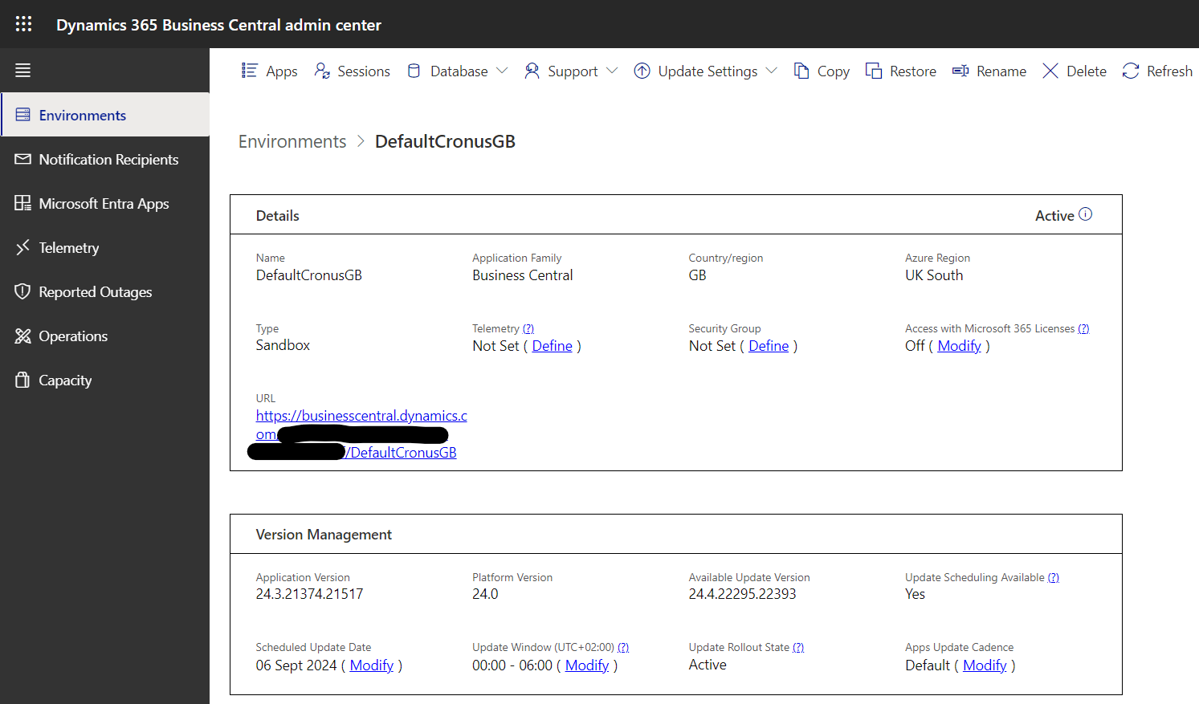
Setup: Enable Telemetry

Slide 11
Setup: Enable Telemetry
Set up Azure Application Insights
If you don't already have one, get a subscription to Microsoft Azure
Sign in to the Azure portal
Create an Azure Application Insights resource by following the guidelines at Workspace-based Application Insights resources
  Create a workspace-based resource (Application Insights)
  Create a workspace (Log Analytics workspace)
Copy the Connection String
Click Define to paste the Connection String
Restart the Environment
(in a safe maintenance window)
Create Application Insights and Log Analytics in the same region of your Tenant
Source: https://learn.microsoft.com/en-us/dynamics365/business-central/dev-itpro/administration/telemetry-enable-application-insights

Slide 12
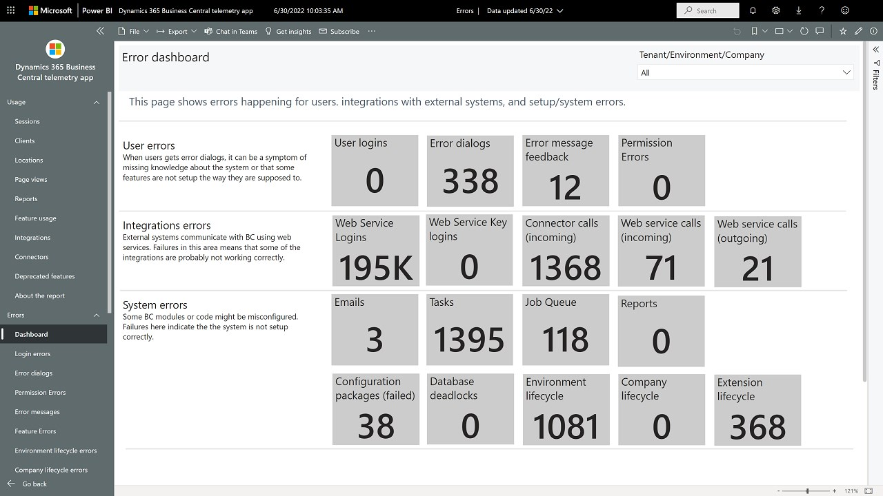
Power BI - Dashboard
Source: https://appsource.microsoft.com/en-us/product/power-bi/microsoftdynsmb.bc_telemetry_pbi_app

Slide 13
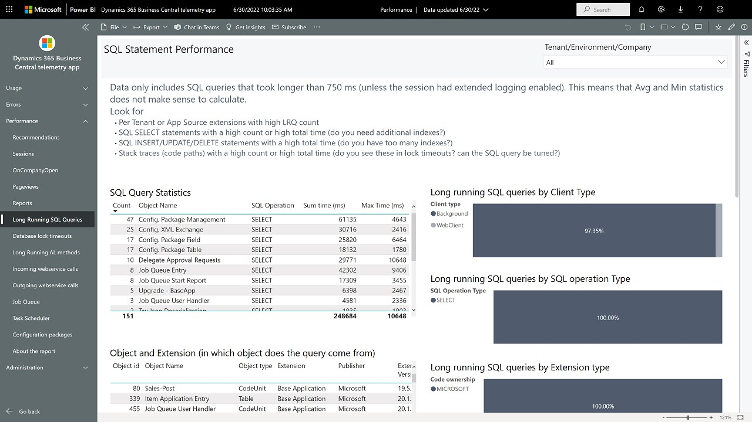
Power BI - Performance
Source: https://appsource.microsoft.com/en-us/product/power-bi/microsoftdynsmb.bc_telemetry_pbi_app

Slide 14
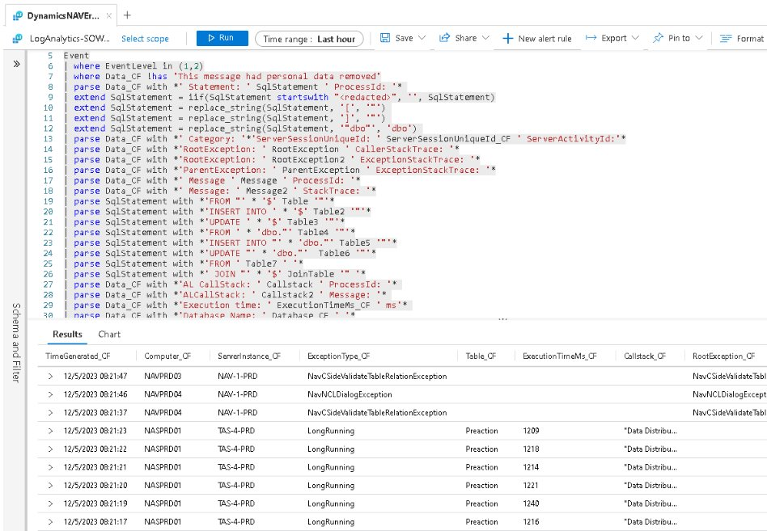
Kusto Query in Azure Portal

Slide 15
Resources
Telemetry in BC https://aka.ms/bctelemetry
Telemetry FAQ
https://github.com/microsoft/BCTech/blob/master/samples/AppInsights/FAQ.md
Videos https://github.com/microsoft/BCTech/blob/master/samples/AppInsights/VIDEOS.md
Samples, including KQL https://aka.ms/bctelemetrysamples
Power BI prerequisites
https://github.com/microsoft/BCTech/tree/master/samples/AppInsights/PowerBI/Reports/AppSource
Dynamics 365 Business Central Usage Analytics
https://appsource.microsoft.com/en-us/product/power-bi/microsoftdynsmb.bc_telemetry_pbi_app
Dynamics 365 Business Central App Usage Analytics
https://appsource.microsoft.com/en-us/product/power-bi/microsoftdynsmb.bc_telemetry_pbi_app_isv_version
Azure Monitor References https://learn.microsoft.com/en-us/azure/azure-monitor/overview
Controlling Telemetry Cost
https://learn.microsoft.com/en-us/dynamics365/business-central/dev-itpro/administration/telemetry-control-cost

