Slide 2
Alejandro Vázquez
Principal Senior Consultant
Johann Sveinsson
Senior Developer
Technical SaaS
Best practices & Challenges

Slide 3
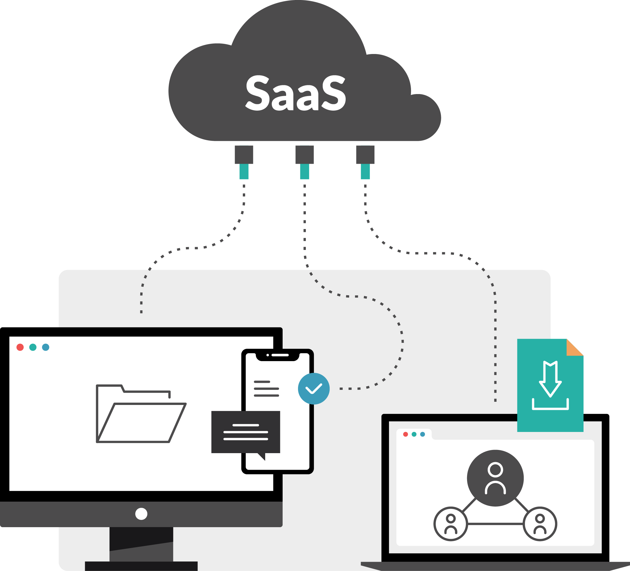


Agenda
Best Practices
Challenges

Slide 4
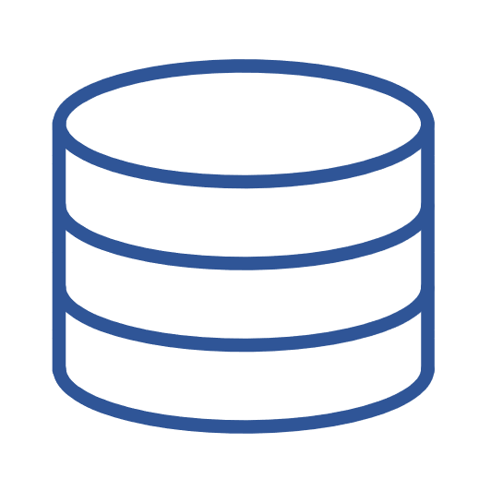


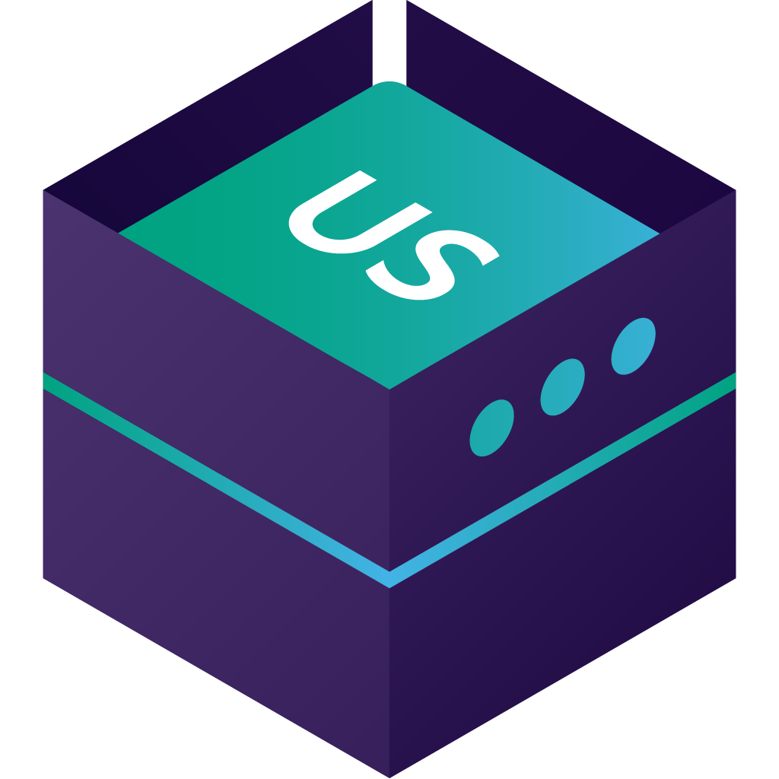
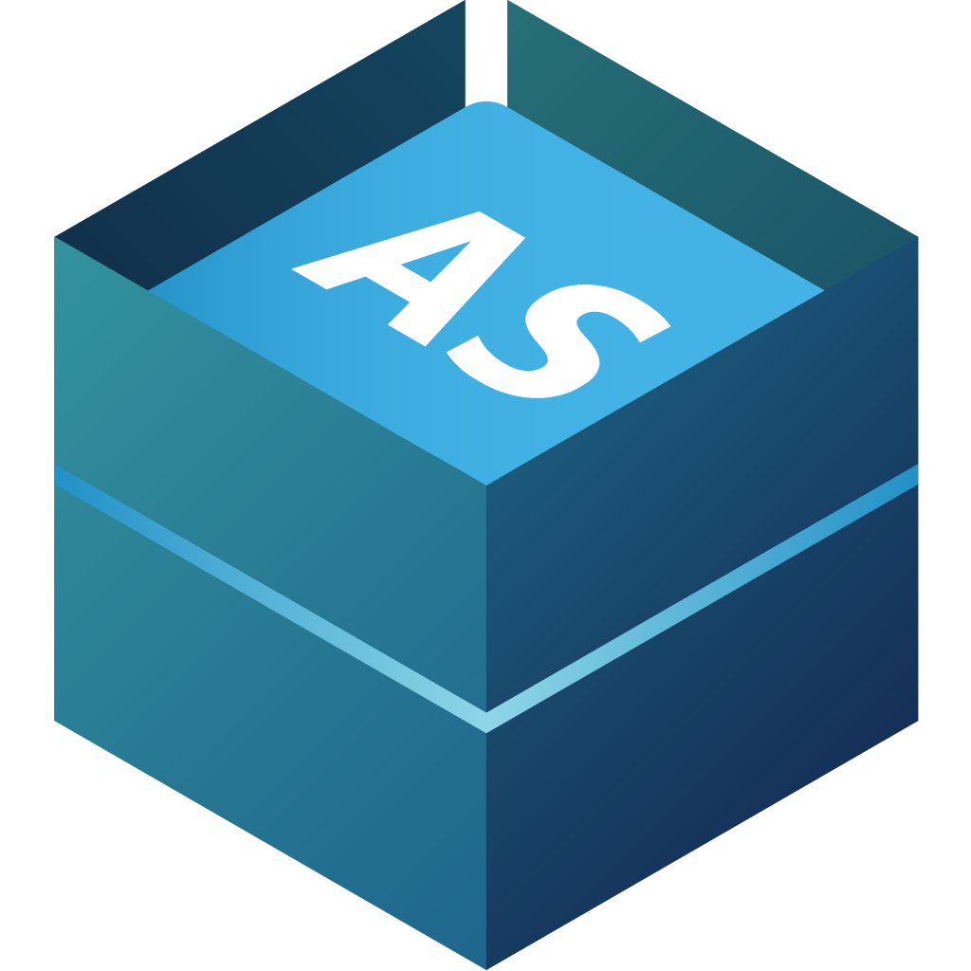



Architecture – Pure SaaS
Clients are web browsers
POS is using AppShell for LS Central
Hardware Station for LS Central
Update Service for LS Central and client
  Hardware Station
  Hardware drivers
  AppShell
Web Service Replication
SaaS
Update Server for LS Central
Web Service Replication
Master Date
Company 1
On-Prem
Company n
Update Service for LS Central
Update Service Client for LS Central
Hardware Station
Client
Client
App Shell for LS Central
POS

Slide 5
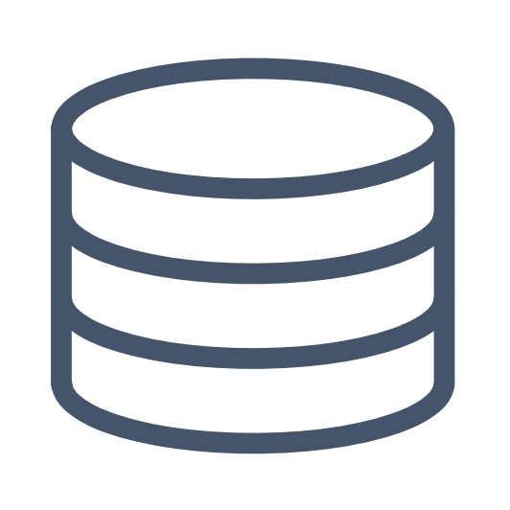

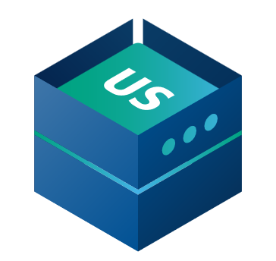


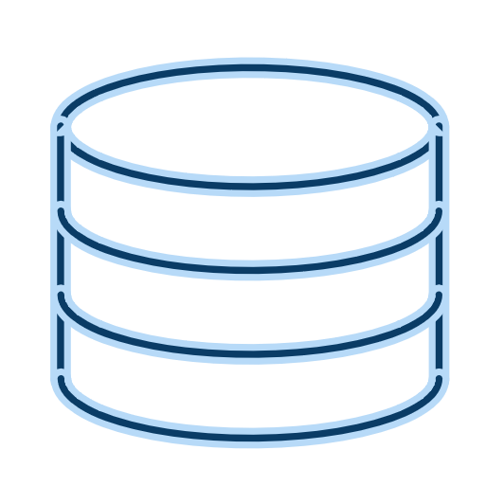
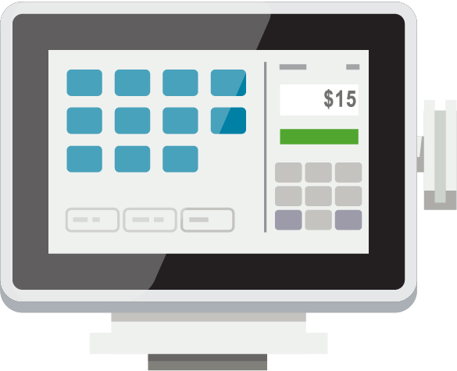

Hybrid Component Server
SaaS
HCS is an on-prem SQL database
Data Director for LS Central used to move data to and from the SaaS database
Web replication using Azure Storage
Online functionality with web services
Update Service for LS Central and client
  Hardware Station
  Hardware drivers
  AppShell
  LS Central BC versions
POS is a standalone SQL database
Web Requests
Hybrid Component Server
UPDATE SERVICE
DATA DIRECTOR
POS MASTER
STORE
Offline POS’s
BackOffice user
Offline POS’s

Slide 6


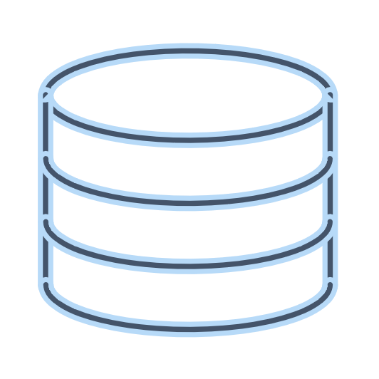
Web Replication using Azure Storage
Web Replication job in the Scheduler creates package in Azure Storage and updates the table Azure Storage Packet Queue
The POS is monitoring the Packet Queue with web request. Running in a Background Session
If there is a packet waiting, then the package is download from Azure Storage and the data inserted
The POS updates the status in Packet Queue
BC - SaaS
Azure Storage
Azure Storage Packet Queue
STORE
BackOffice user
Offline POS’s
Offline POS’s

Slide 7
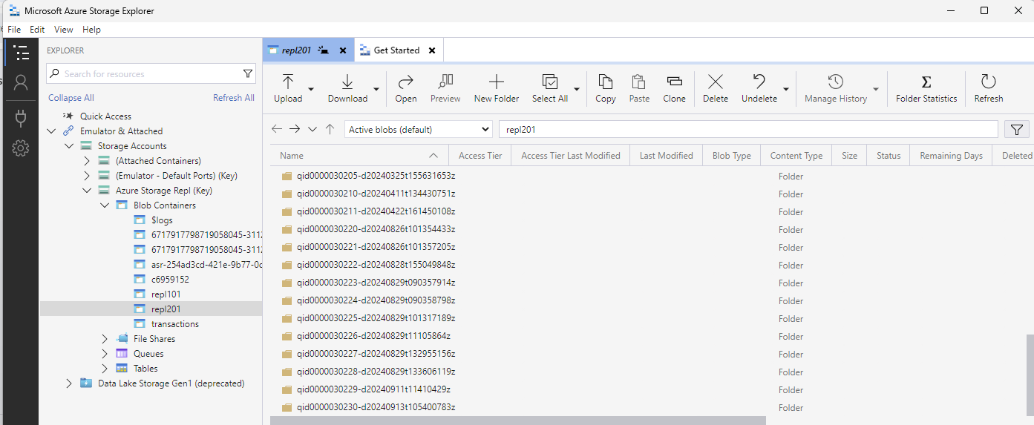
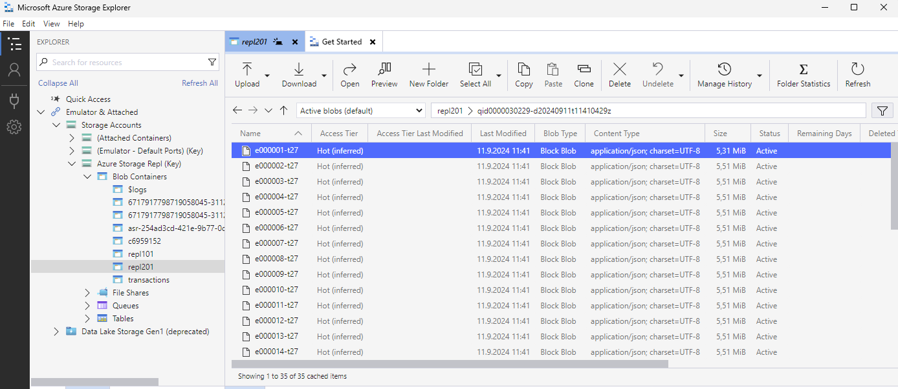
Microsoft Azure Storage Explorer

Slide 8
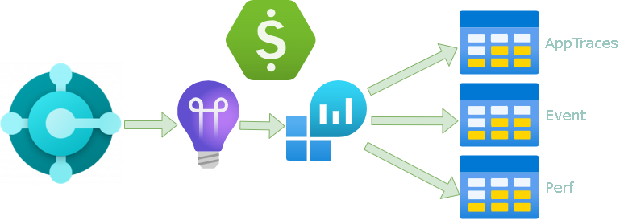
Telemetry
Architecture
Telemetry
  Environment and app/extension-level telemetry (BC2020+)
  Available telemetry (errors, database, long running, job queue, and more)
  Enabling
  Controlling cost
  Microsoft Power BI apps
  KQL – github.com/microsoft/BCTech/tree/master/samples/AppInsights
  Alerts
AppTraces
Event
Perf

Slide 9
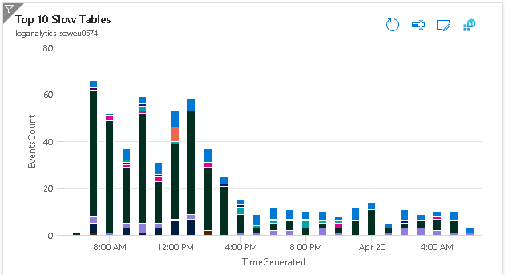
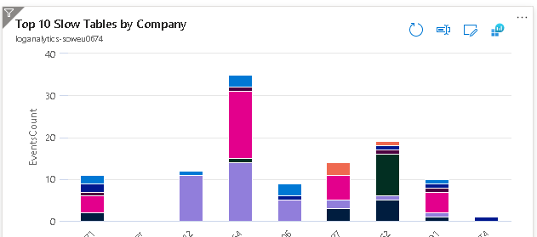
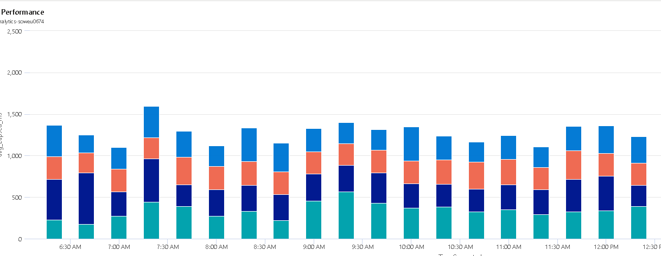
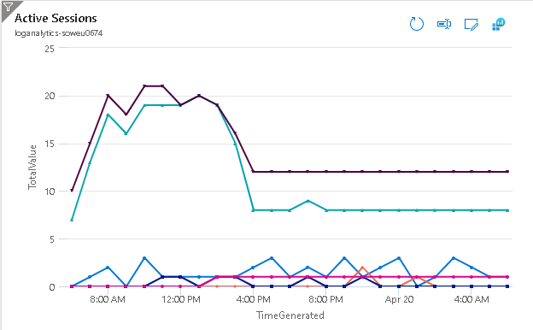
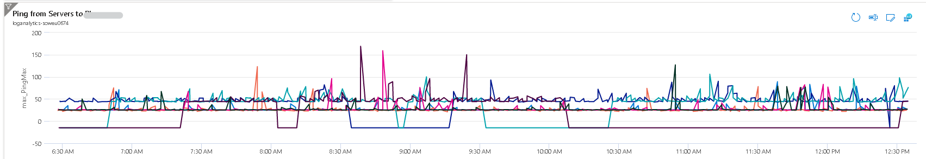

Slide 10
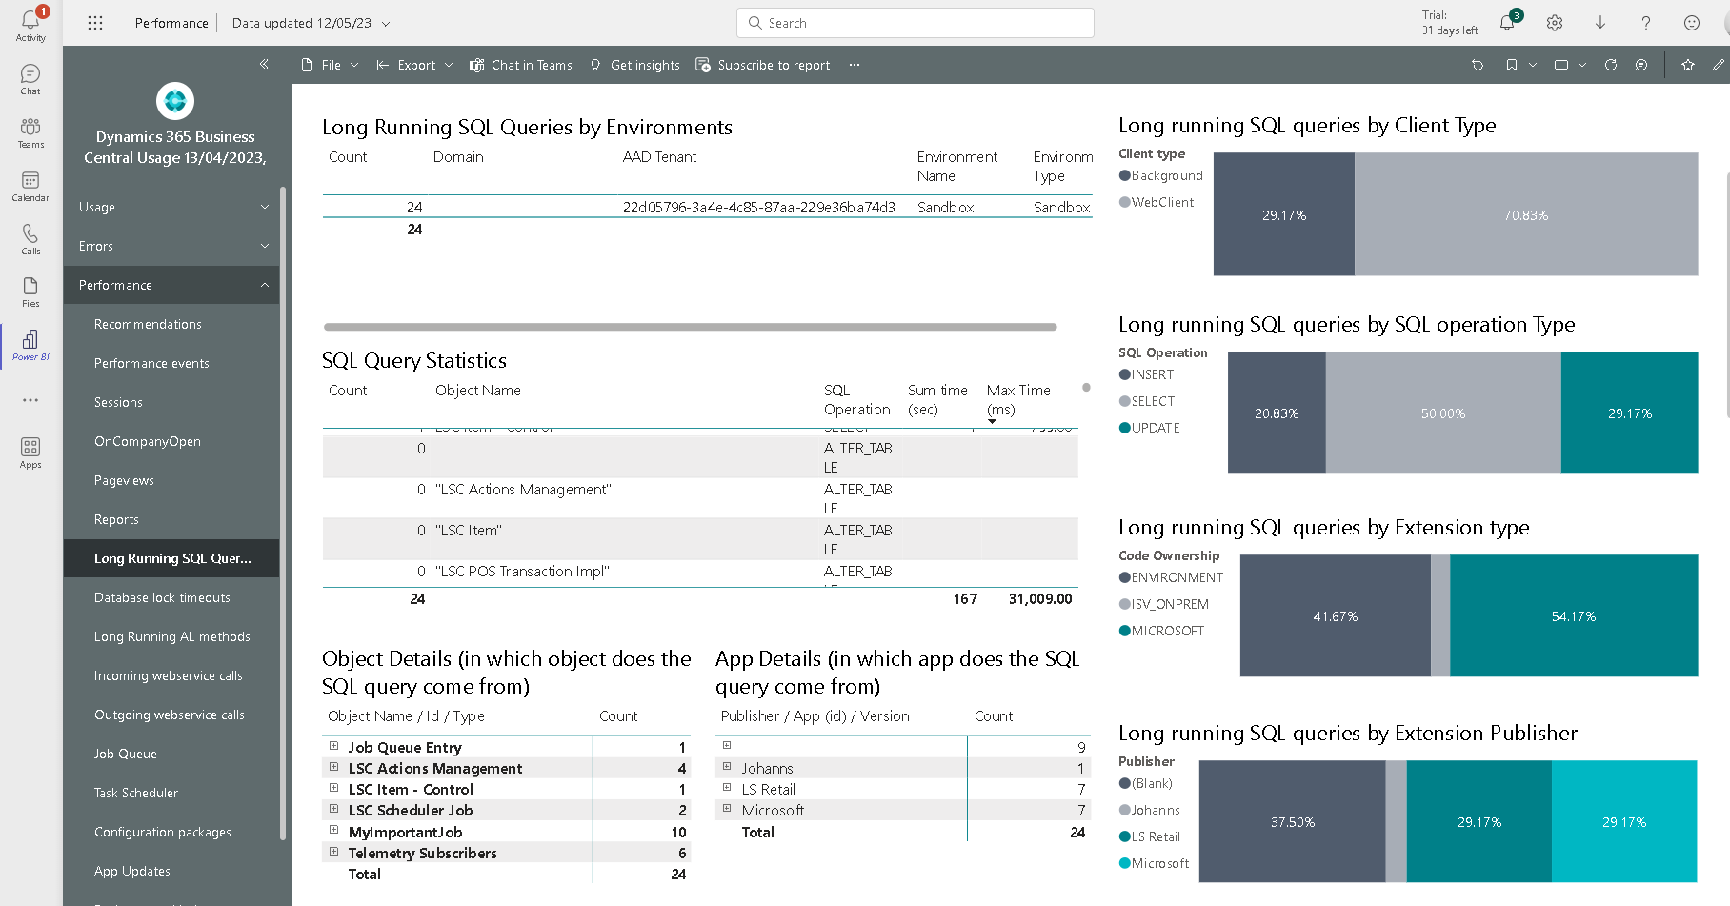

Slide 11
Want to learn more about telemetry?
Documentation: https://aka.ms/bctelemetry
Telemetry FAQ: FAQ.md at microsoft/BCTech (github.com)
Videos: VIDEOS.md at microsoft/BCTech (github.com)
Powerpoint decks: Presentations at microsoft/BCTech (github.com)
Sample code and tips&tricks: https://aka.ms/bctelemetrysamples

Slide 12
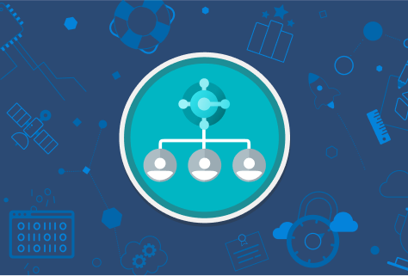
Authentication & connectivity
Architecture
Telemetry
Admin Center
  Users
  Device users
Azure Cloud
  S2S Authentication
  Webservices
  BC API’s / KDS (s2s OAuth)
  Logic-Apps / Az. Functions
  Replication
POS
  WebClient
  AppShell

Slide 13
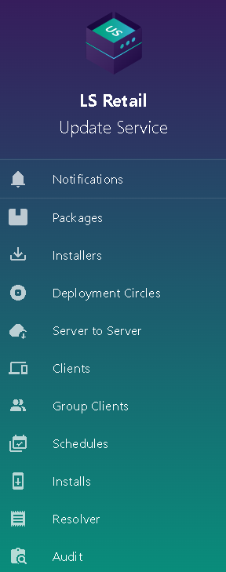
Update Services
Architecture
Telemetry
Authentication & connectivity
Update Service for LS Central
  Package manager and deployment tool
  Server – Client
  Packages
  PowerShell Cmdlets
  VS Code extension
  LS Retail Update Service Workspace

Slide 14


SaaS Implementation
https://help.lscentral.lsretail.com/Content/Implementation-Guide/LS-Core/LS-Central-SaaS.htm
CAP & Onboarding process
Upgrade from older version
Testing in sandbox
Hybrid model
Support
pops@lsretail.com

Slide 15
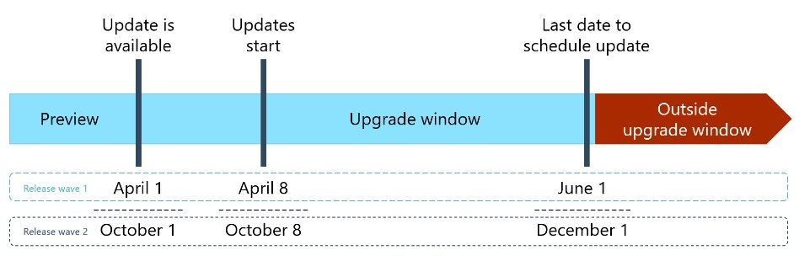
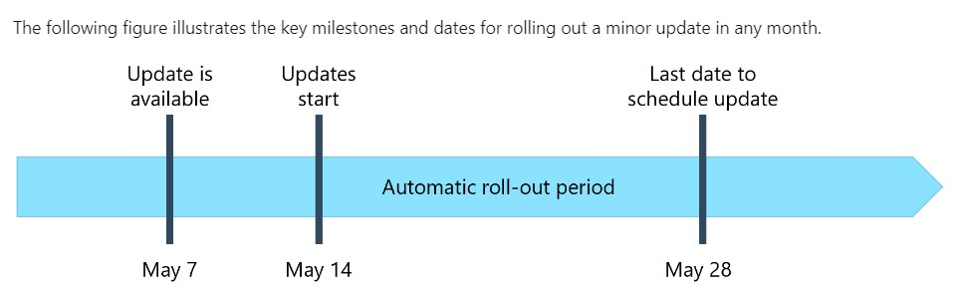
Challenge: Automatic updates
Major updates and minor updates for Business Central online - Business Central | Microsoft Learn
Major updates
Minor updates
Notifications
Schedule update
Environments
Country availability
Hotfixes are released when needed
New events are released weekly

Slide 16
What do I need to do when a new update is released?​
Update is available
Last date to schedule update
Outside upgrade window
LS Central preview
Upgrade window
Day 1
Day 60
Get familiar with the new release
Test your add-ons on the new release
Set scheduled update date and define update time window in the Business Central Admin Center
Notify customers

Slide 17
Challenge: 24/7 operations
Implementation
Automatic updates
Achieving 24/7 operations, minimizing update impact

Slide 18
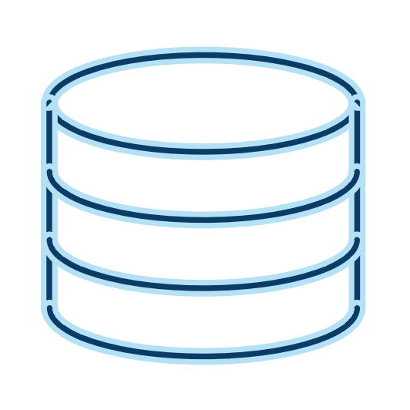
Challenge: Large scale implementation
Operational limits of BC have been expanding constantly in the past years
Today there are no operational limits for:
  Number of users (sessions)
  Database size
  Transactions
Throughput is improved
  BC can handle 6,000 web service requests per 5 minutes per user
  Over 25,000 web requests per minute
There are continuous performance enhancements
More effective SQL compression
Microsoft Concierge Program
SaaS
Hybrid Component Server
POS’s Online
POS´s Offline

Slide 19

Challenge: Cloud Ready
Implementation
Automatic updates
Achieving 24/7 operations in SaaS, minimizing maintenance window impact
Large scale implementations: 1000+ POS
LS Central is cloud ready (no DLL) - is your app ready?

Slide 20
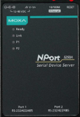


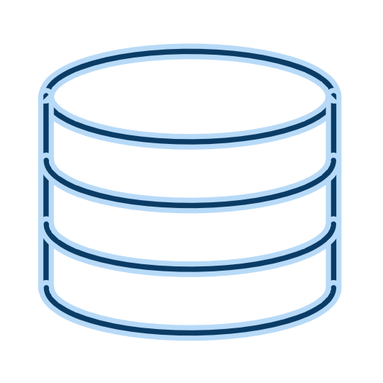
Cloud ready with no DLL - Example
Challenge
Read data from a device with socket communication through a DLL
Solution
Create a service that is executing the DLL task
Communicate with web service requests between the service and LS Central
Device
Telnet - IP address and port
Service
Web Service – Get Setup
Web Service – Send coordinates
LS Central

Slide 21

Challenge: Universal Code Initiative
Full extension. No customization in the base application.
Program for cloud (“target”:”Cloud”).
All .nets must be replaced with the Azure functions or some 3rd party application with the use of WebService.
For any file storage in the FTP must be switched to OneDrive or SharePoint.
No direct database access. Access through web service requests.

Slide 22
Q&A

