Slide 2
LS Central Operation Monitoring & Telemetry
"Driving Insight, Powering Precision"
Lee Boon Leng & Bryan Koh
Technical Consultant

Slide 3

Our 45-minute journey…
Azure Monitor Agent with Azure Log Workspace
Standard & Custom Telemetry with Azure Application Insights
Query and analyze logs with KQL
Monitor and visualize metrics with Azure Workbooks
Alerts and Actions
Q&A

Slide 4




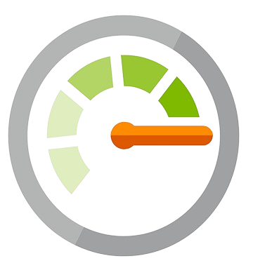

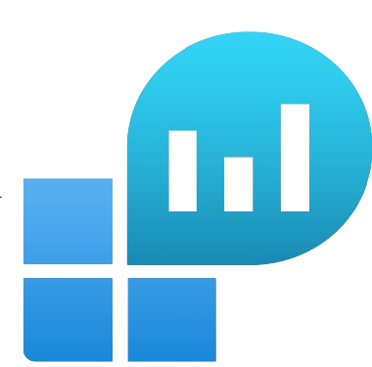

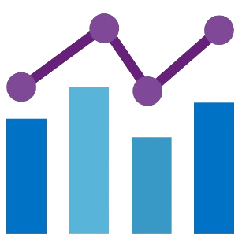

Overview
D365 Business Central
Application Insights Workspaces
Azure Monitor
Azure Virtual Machine
Log Analytics Workspaces
Data Collection Rule
Metrics
Workbooks
Azure Arc-enabled Server

Slide 5
Installation of Azure Monitor Agent
By Boon Leng
Technical Consultant

Slide 6
Azure Arc-enabled servers
Supported Installation of the Connected Machine agent to onboard Physical Server, Virtual Machines hosted outside of Azure to the Azure Arc.
Specifically designed to onboard non-Azure resources to Azure.
Supported environments
  Physical Server (on-premise)
  Virtual Machines hosted outside of Azure
    VMware (including Azure VMware Solution), Azure Stack HCI
    Other cloud environments such as Amazon EC2, GCP
Supported operating systems
  Windows 10, 11
  Windows IoT Enterprise
  Windows Server 2012, 2012 R2, 2016, 2019, and 2022
  Linux
  Windows Server 2008 R2 SP1 (last supported agent version 1.39)

Slide 7
Azure Virtual Machines
Azure Monitor Agent (AMA) deployed as an extension
  Create the Data Collection Rule (DCR)
  Associate it with the resource
  It only applicable to Azure VM and Azure Arc enabled servers
Azure Monitor Agent (AMA) will be installed automatically in the form of extension on Azure VMs, scale sets, and Azure Arc-enabled servers.

Slide 8
Azure Monitor Agent (AMA)
To collect logs and performance data from the guest OS of the VM Azure and hybrid VM and ingested them to log analytics workspace.
It can use other services like MS Sentinel and MS defender for cloud.
The OS can be Windows / Linux, the machines can be client or servers and exist anywhere either in Azure or an On-Prem environment
Azure Monitor Agent (AMA) replace all of Azure monitor's legacy agents MMA / Log Analytics Agent which deprecated by 31 August 2024.
For non-Azure resources, we need to install the Azure Connected Machine Agent first to get onboard as Azure Arc enabled servers.
For Windows 10 & 11, manually down and install Azure Monitor Agent Client from https://go.microsoft.com/fwlink/?linkid=2192409

Slide 9
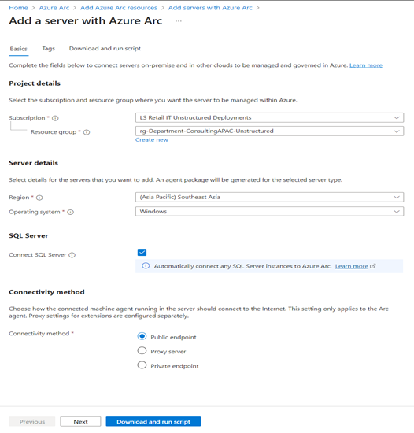
Azure Arc-enabled Server - Installation
Add a Single Server, Click Generate script
Select the Subscription, Resource Group, Region, Operating System as Windows and Connectivity method as Public endpoint. Put in the tag
Next is to download the onboarding script and run it in the server.
Run PS1 as Administrator to execute the downloaded script in the target server. Sign-in to Azure when it prompted you for login.
Once the onboarding script is completed, target server will be onboard to Azure Arc in Azure Portal

Slide 10
Data Collection Rule (DCR)
To define what type of logs data must be collected
Any transformation must be applied before data getting ingested into Log Analytics workspace
To define destination of where to send the collected data (Log Analytics Workspace)
Data Collection Rule (DCR) only applicable to Azure VM and Azure Arc enabled server resource.
Azure Monitor Agent (AMA) going to use the configuration defined in Data Collection Rule (DCR) to perform data ingested
Once the Data Collection Rule (DCR) deployment is completed, the target server will be added to Azure Arc in the form of extension.
To verify Azure Monitor Agent (AMA) is operational and communicating properly by running query in Log Analytics Workspace to check record in the Heartbeat or Event or Perf table.

Slide 11
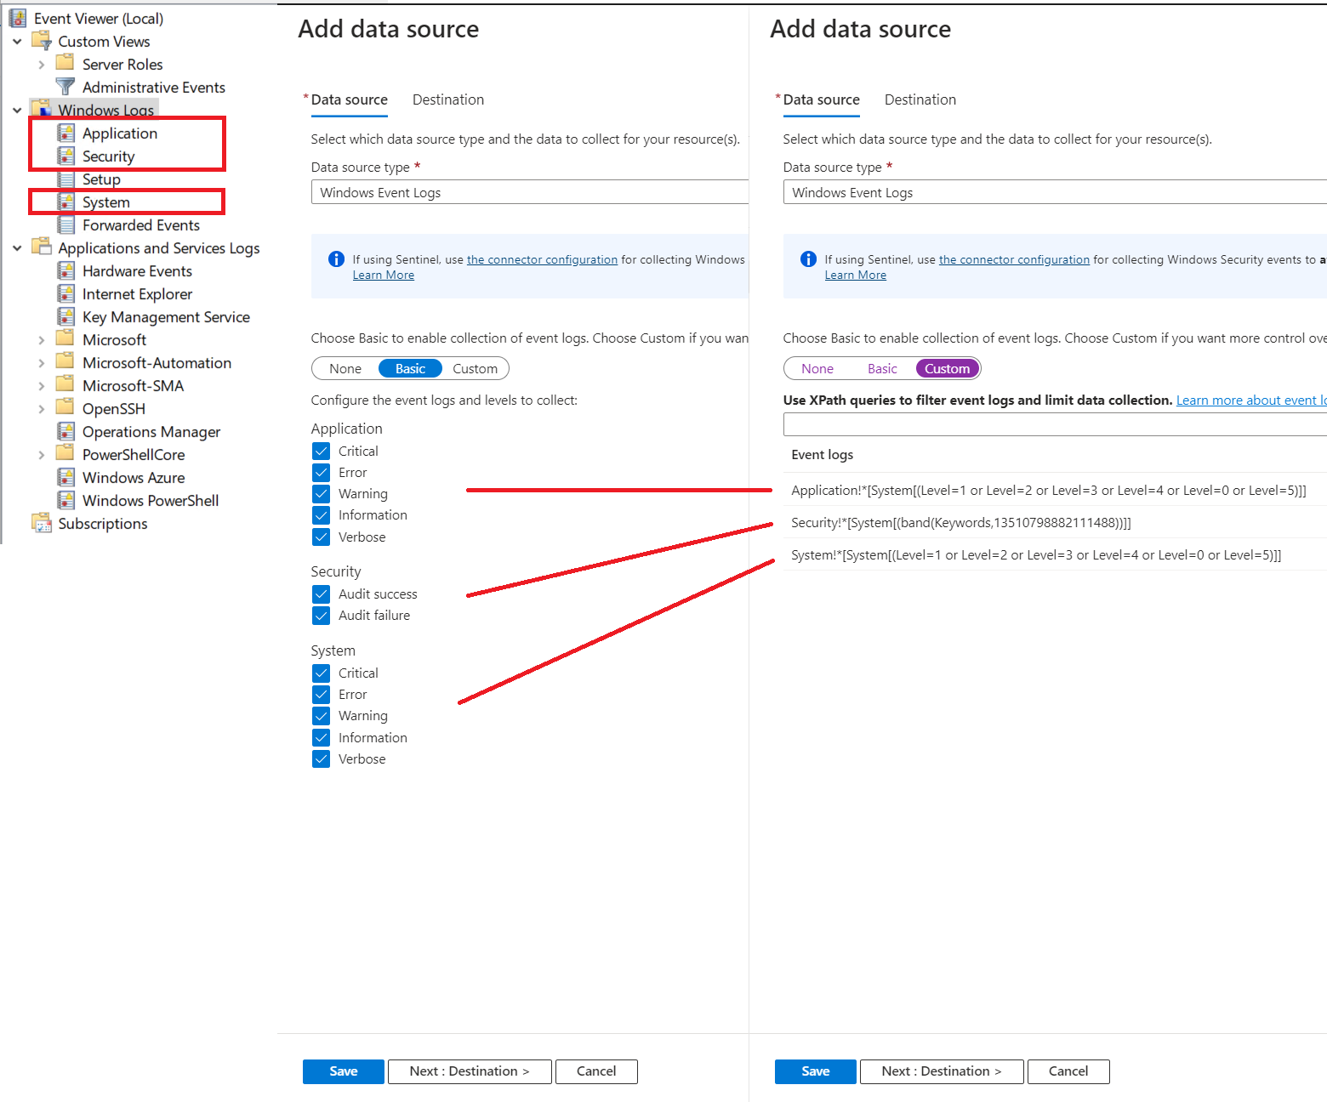
Data Collection Rule (DCR) - Data Source Type
Platform Type Windows
Windows Event Log
  Configure default log collection (Application, Security, System)
  Configure custom log collection by defining XPath queries
  XPATH:
  Microsoft-DynamicsNAV-Common/Admin!*[System[(Level=1 or Level=2 or Level=3)]]
Performance Counters
  Configure default log collection (CPU, Memory, Disk, Network)

Slide 12
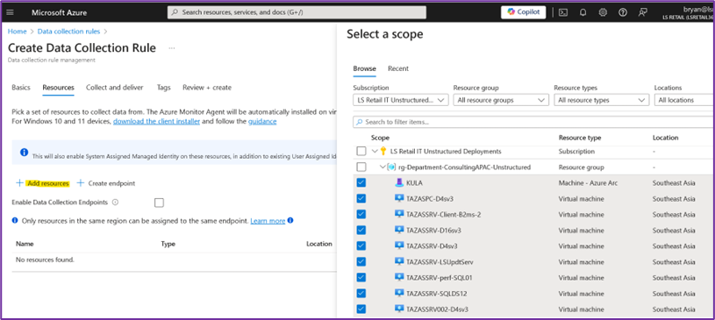
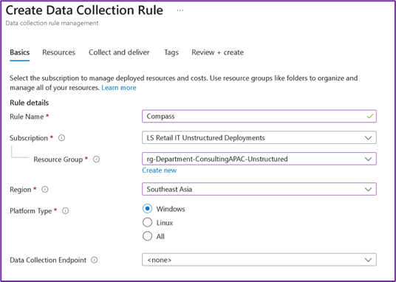
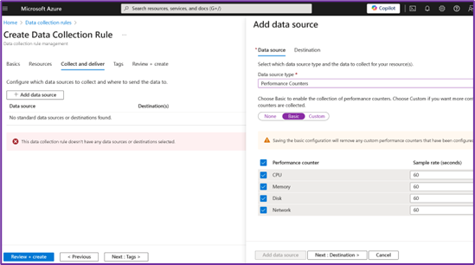
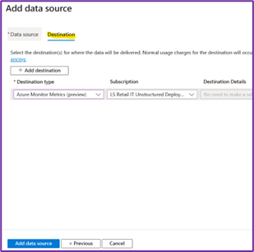
Data Collection Rule (DCR)
2
1
3
4

Slide 13
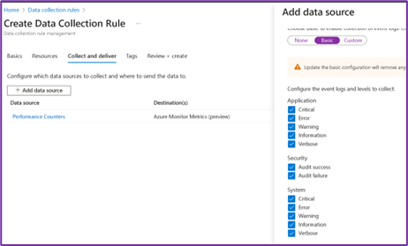
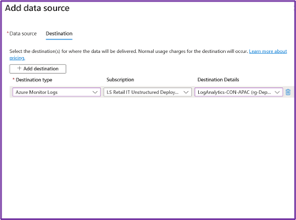
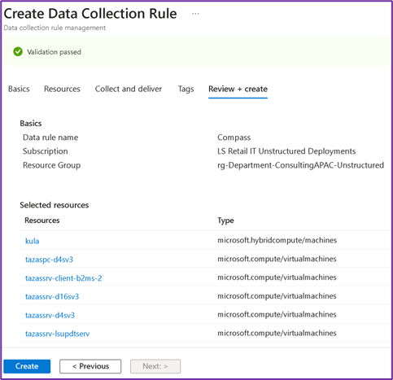
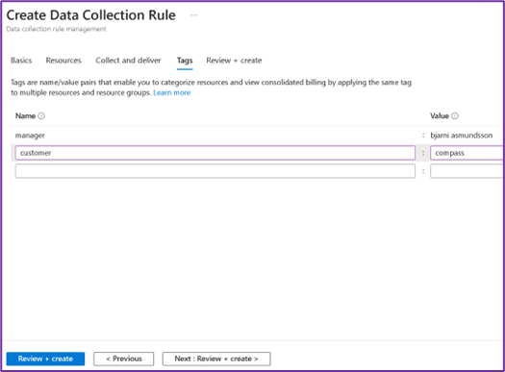
Data Collection Rule (DCR)
5
6
8
7

Slide 14
Setup of Application Insights
By Boon Leng
Technical Consultant

Slide 15
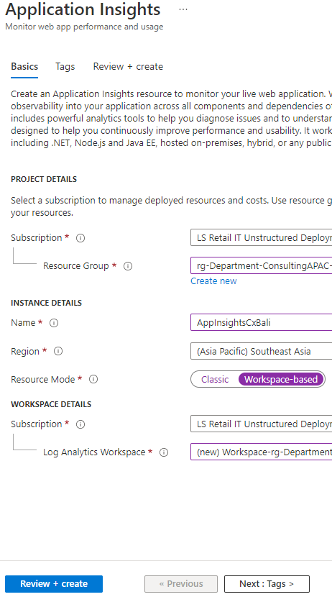
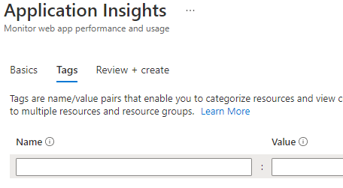
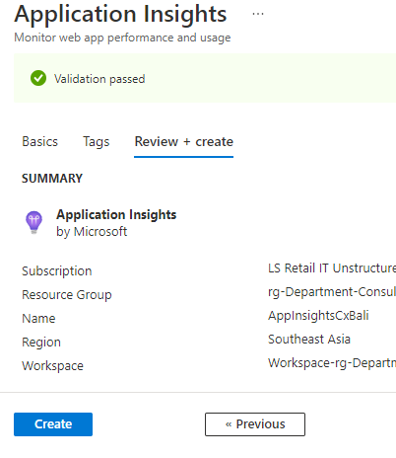
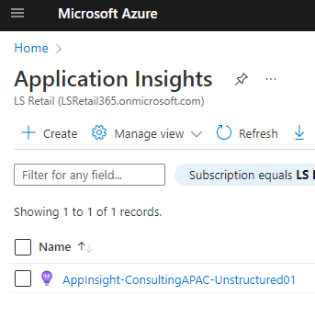
Azure Application Insights Setup
2
3
1
4

Slide 16
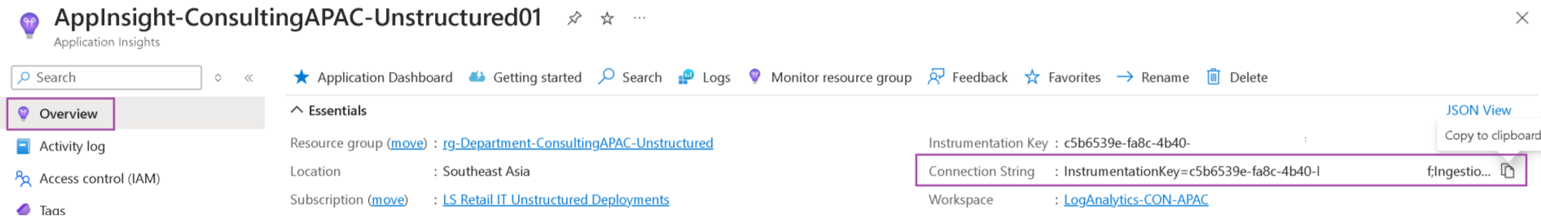
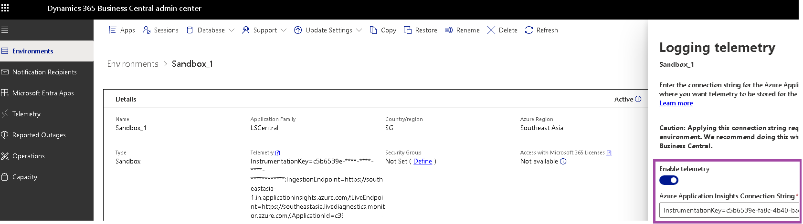
LS Central Online
Create the Azure Application Insights workspace
Copy the Connection String from Azure Application Insights workspace
Paste the connection string into the environment and enable the telemetry

Slide 17
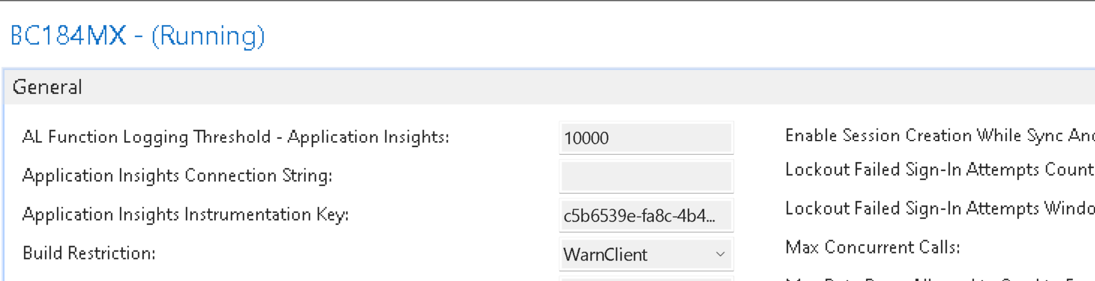
LS Central On-Prem
Copy the Connection String/Instrumentation key from Azure Application Insights workspace
  Instrumentation Key: BC 2019 release wave 2 to BC 2020 release wave 2
  Connection String: BC 2021 release wave 1 and onwards
Business Central Server Administration tool is removed with BC 2022 release wave 2 (BC21)
Update the service tier and restart it

Slide 18
Querying Data with Kusto Query Language
By Bryan
Technical Consultant

Slide 19
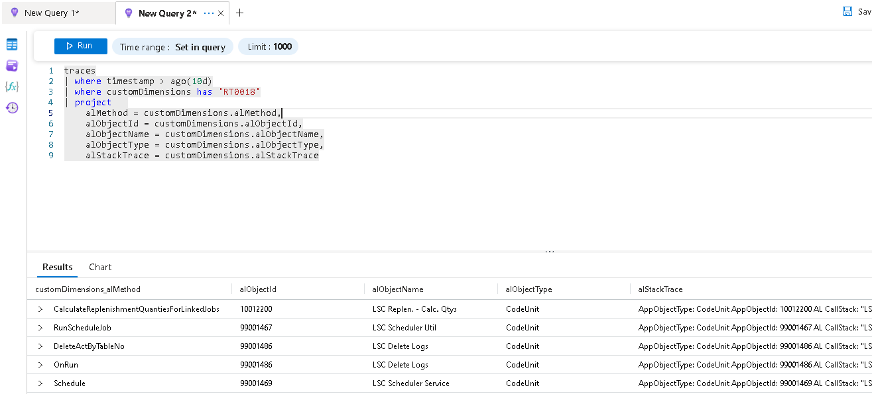
Querying Data with Kusto Query Language (KQL)
Read-only request
Case-sensitive
Tables and columns have specific names
  App. Insights: traces & pageViews
  Log Analytics: Event & Perf
Operators and functions have specific syntax
Can combine multiple operators to create complex queries.
Basic Query Structure
  <table name>
  where <condition>
  project <columns>
  | piping operator
More: https://learn.microsoft.com/en-us/azure/data-explorer/kql-learning-resources

Slide 20
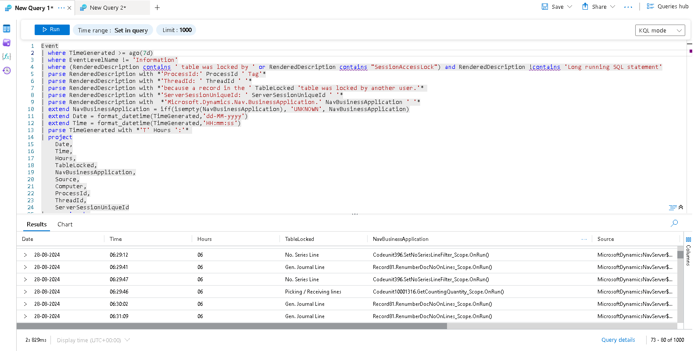
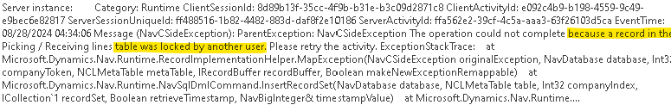
Querying Log Analytics with KQL

Slide 21
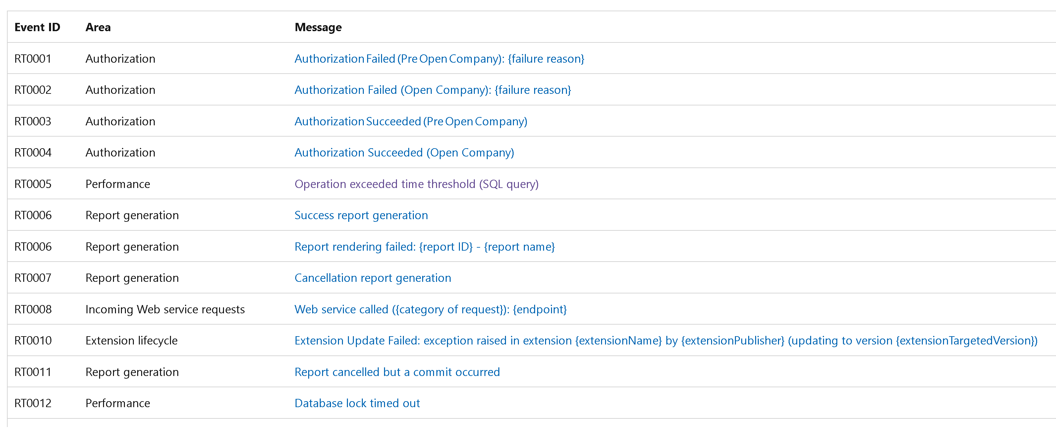
Querying Application Insights with KQL
Telemetry is logged into the traces or pageview tables.
More structured, by application area and specified event id.
More: https://learn.microsoft.com/en-us/dynamics365/business-central/dev-itpro/administration/telemetry-event-ids

Slide 22
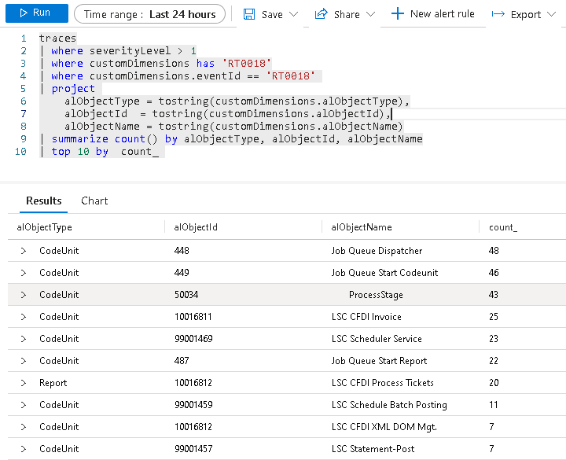
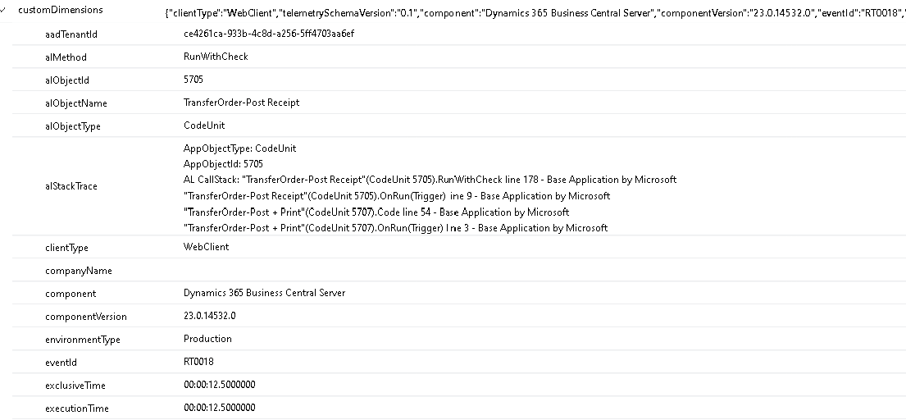
Querying Application Insights with KQL
RT0018 Operation exceeded time threshold (AL method)
More: https://github.com/microsoft/BCTech/tree/master/samples/AppInsights

Slide 23
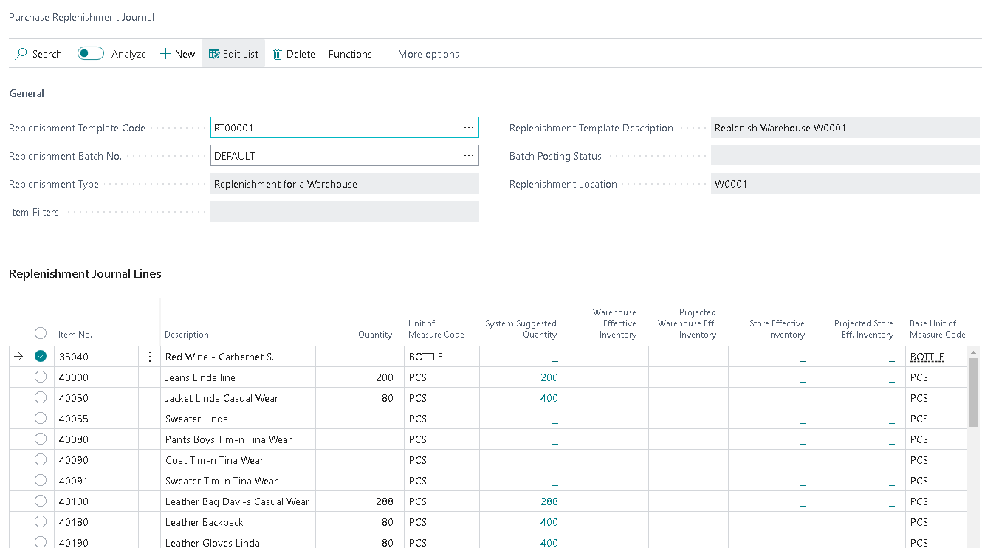
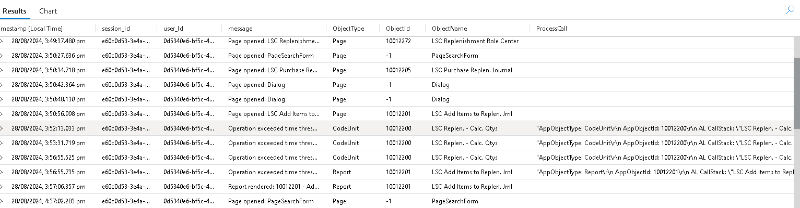
Querying Application Insights with KQL
Can also use for troubleshooting by session and user id

Slide 24
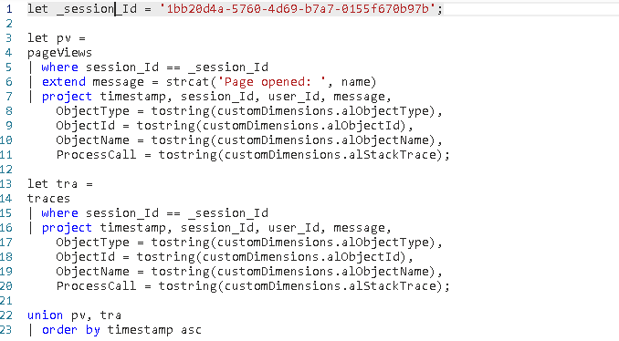
Querying Application Insights with KQL
Combine both pageViews and traces

Slide 25
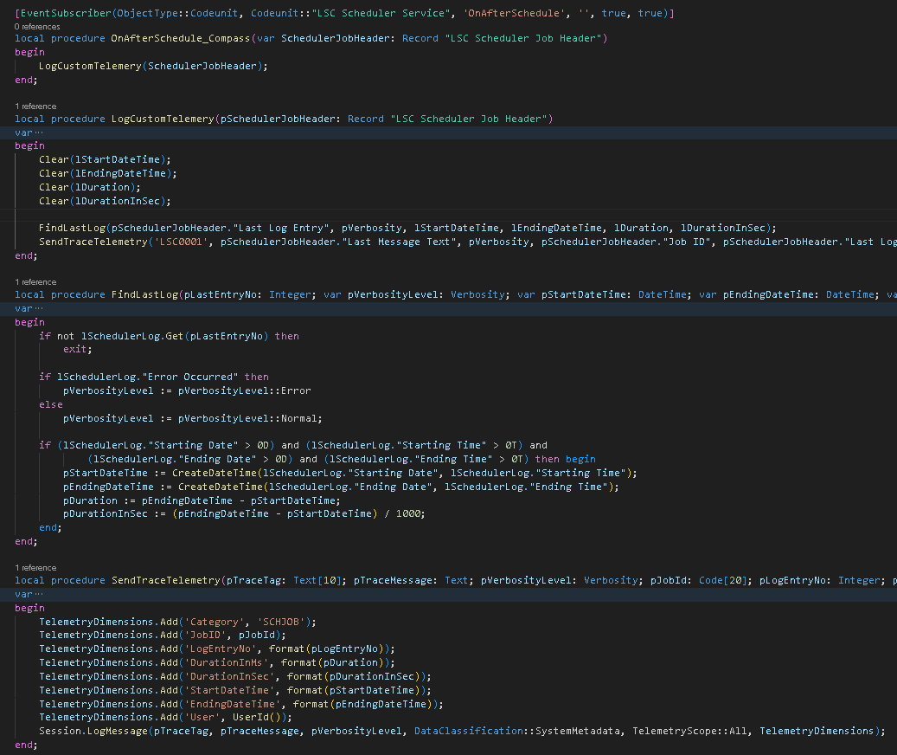
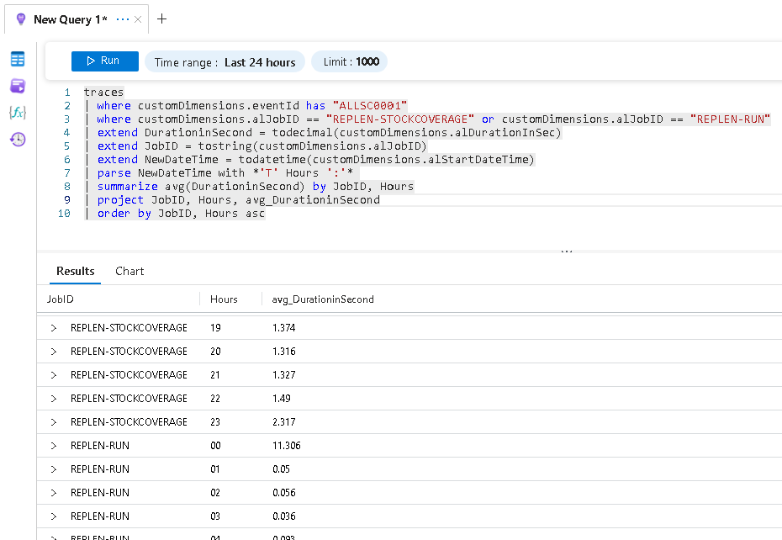
Querying Application Insights with KQL
Custom Telemetry

Slide 26
Monitor and visualize trends with
Azure Workbooks and PowerBI
By Bryan
Technical Consultant

Slide 27
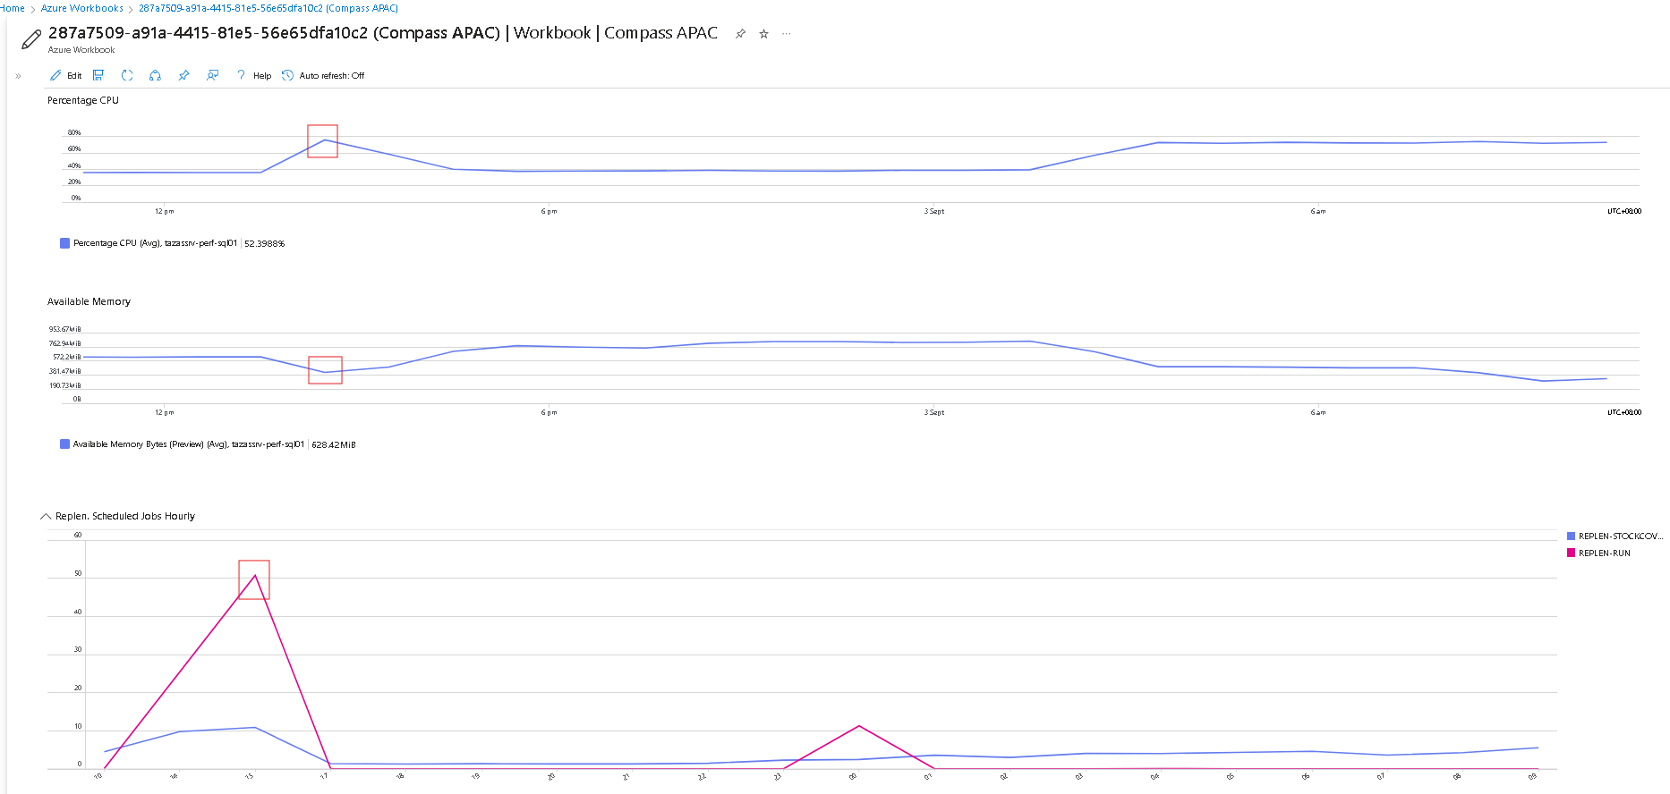
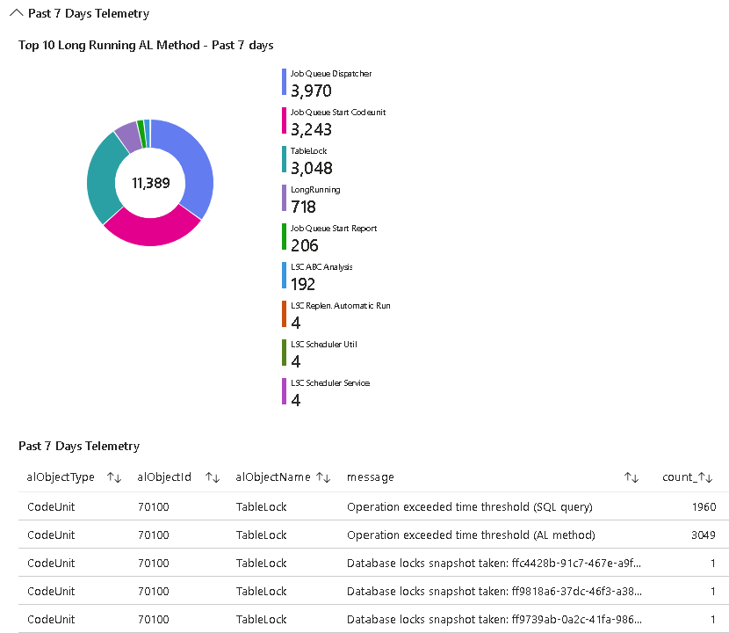
Use Azure Workbooks
Can combine both telemetry and metrics

Slide 28
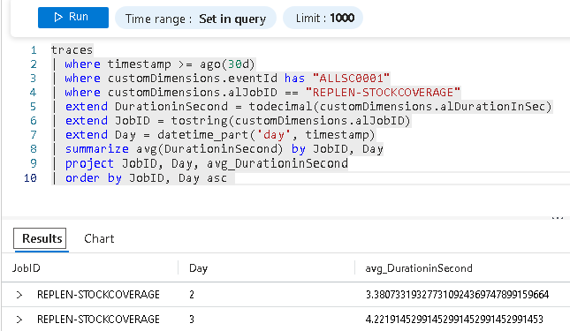
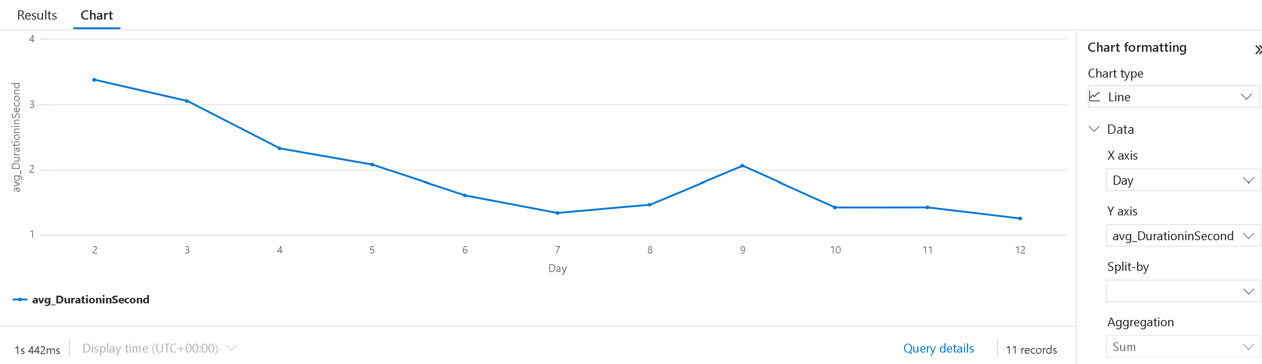
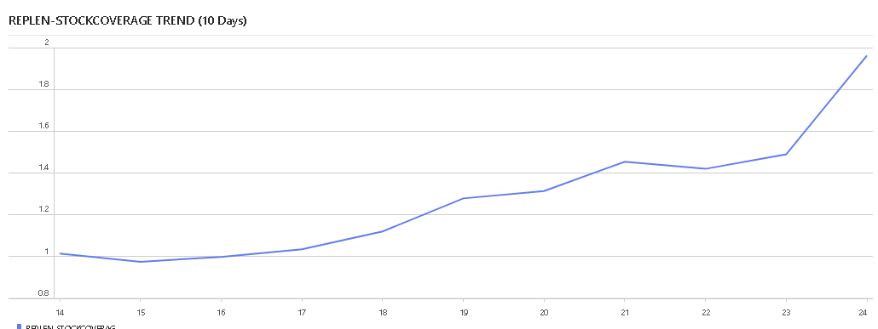
Use Azure Workbooks
Monitor for trend

Slide 29
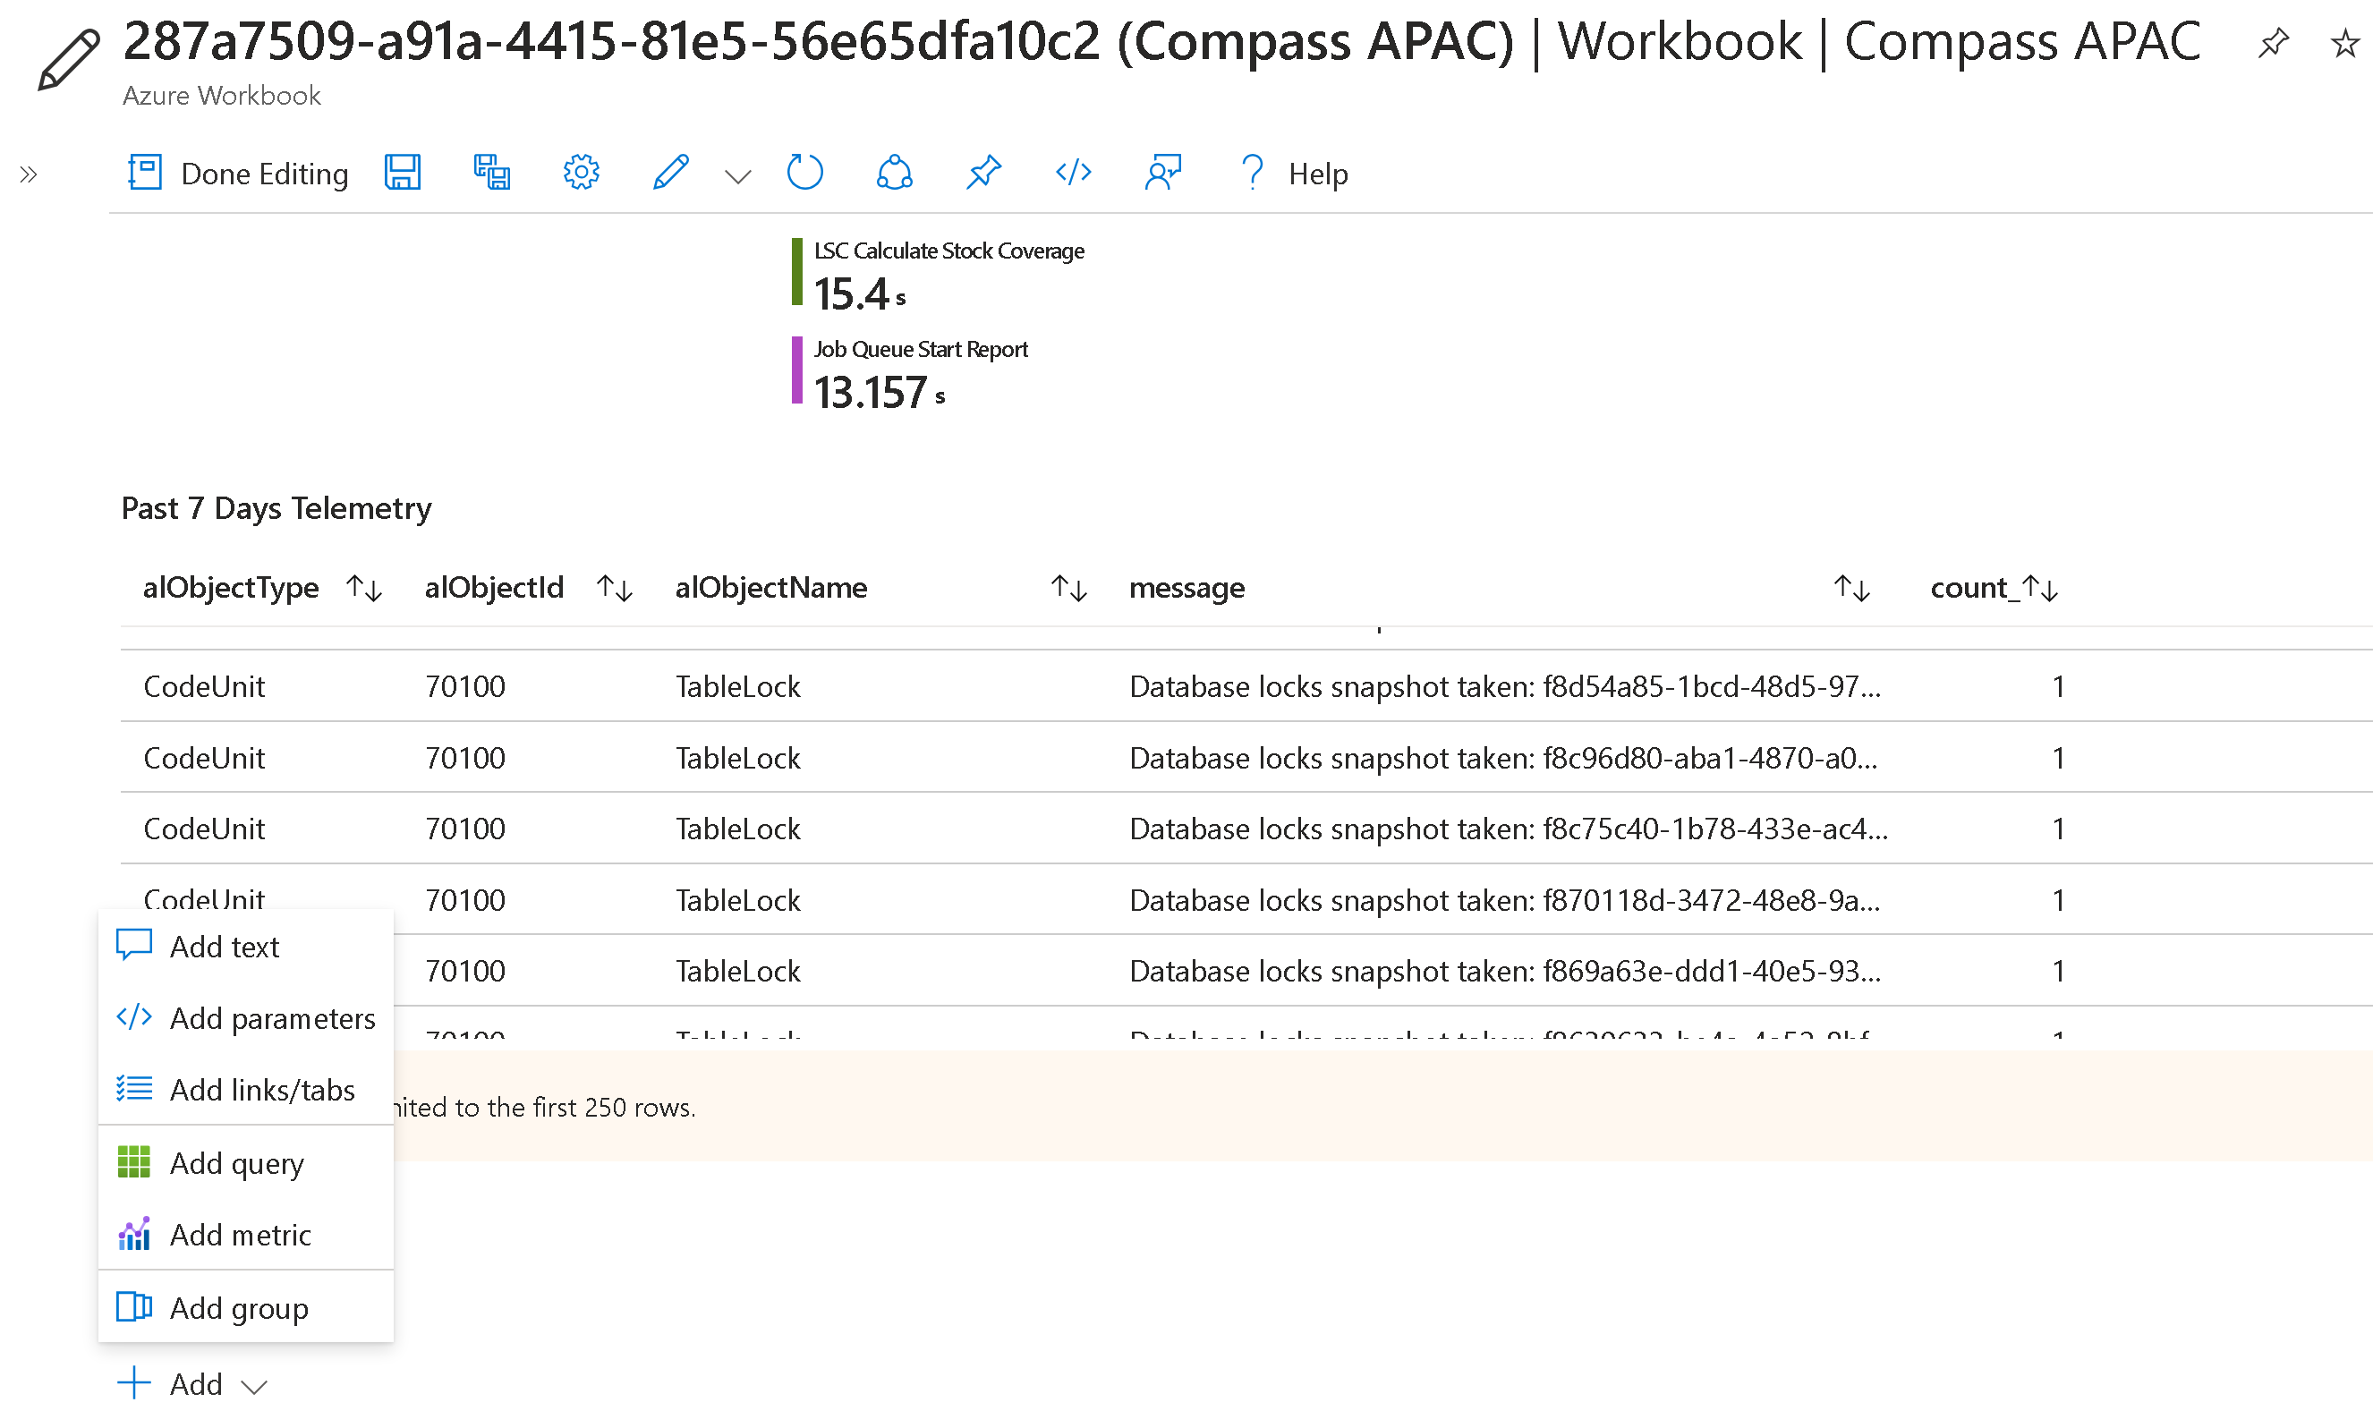
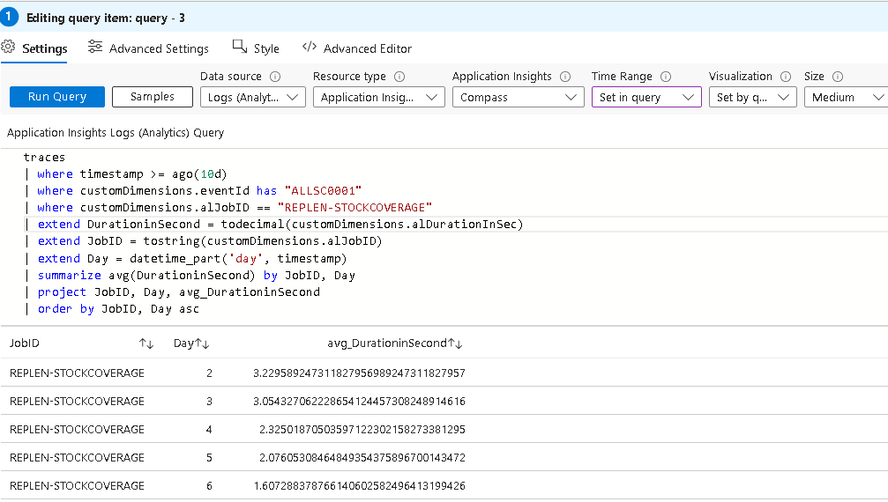
Use Azure Workbooks
Create a new Line Chart to show past 10 days Replen-StockCoverage

Slide 30
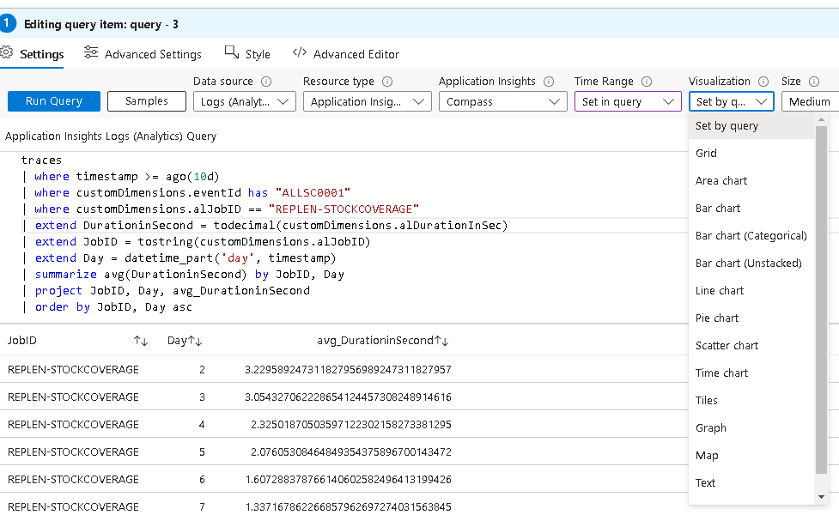
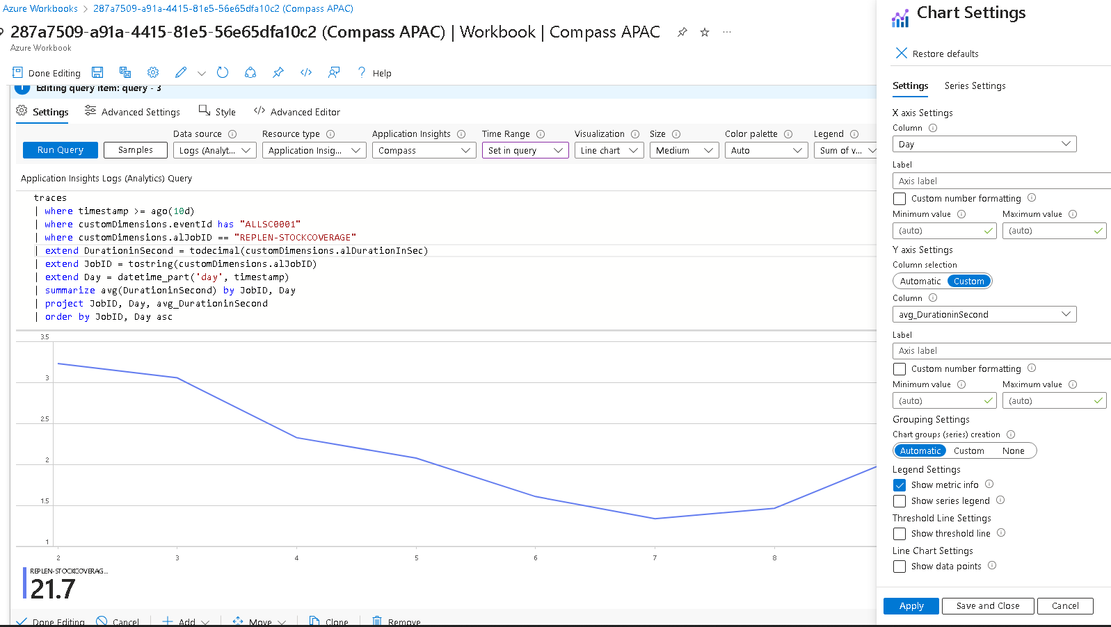
Use Azure Workbooks

Slide 31
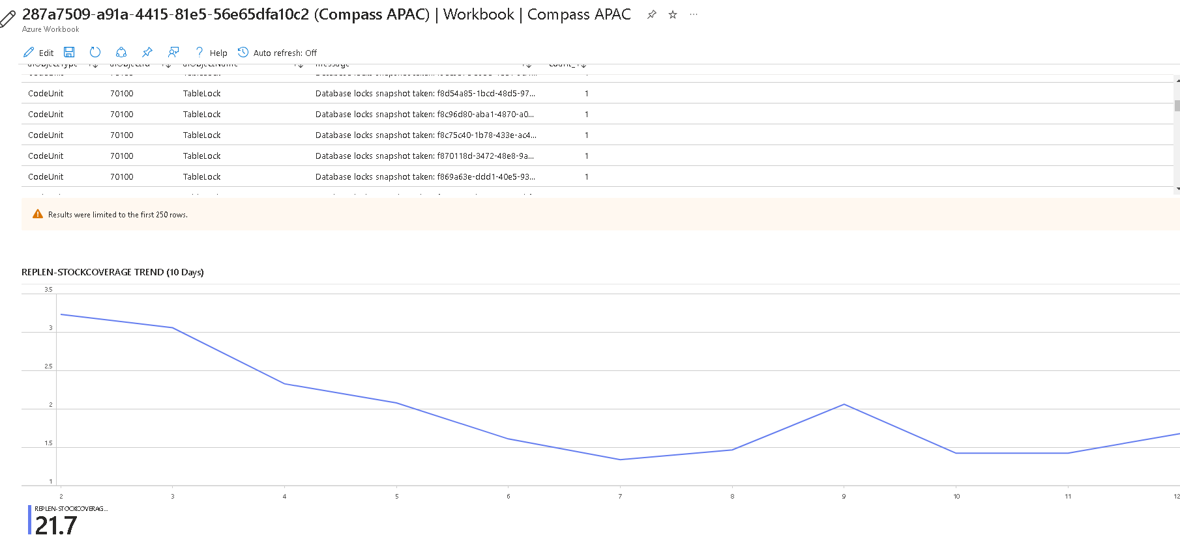
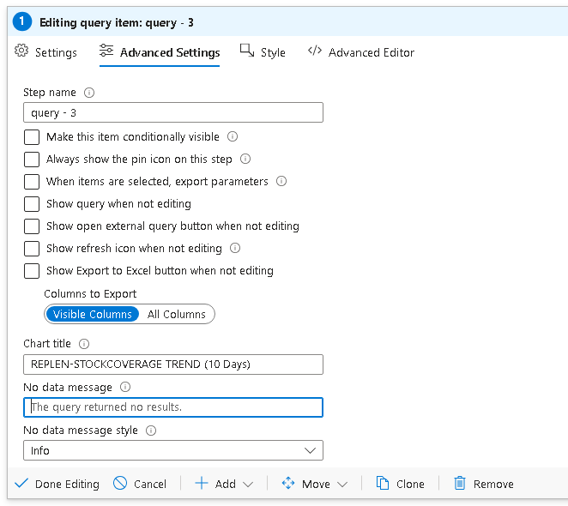
Use Azure Workbooks

Slide 32
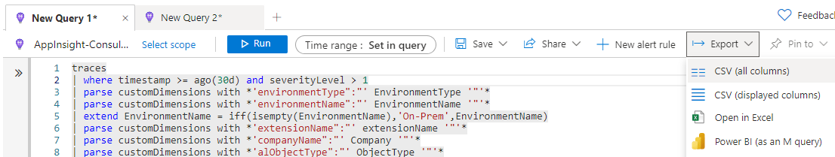
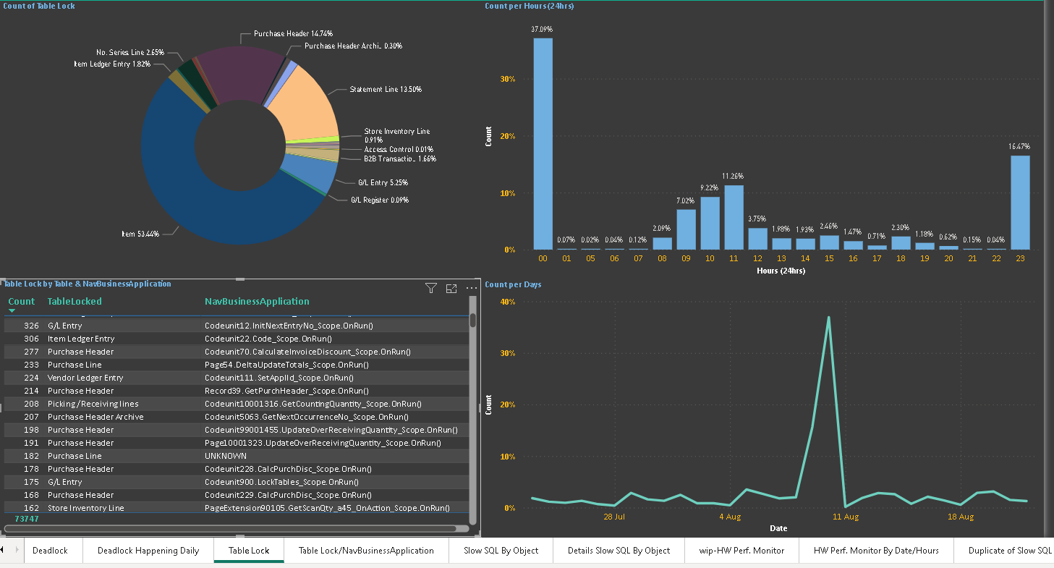
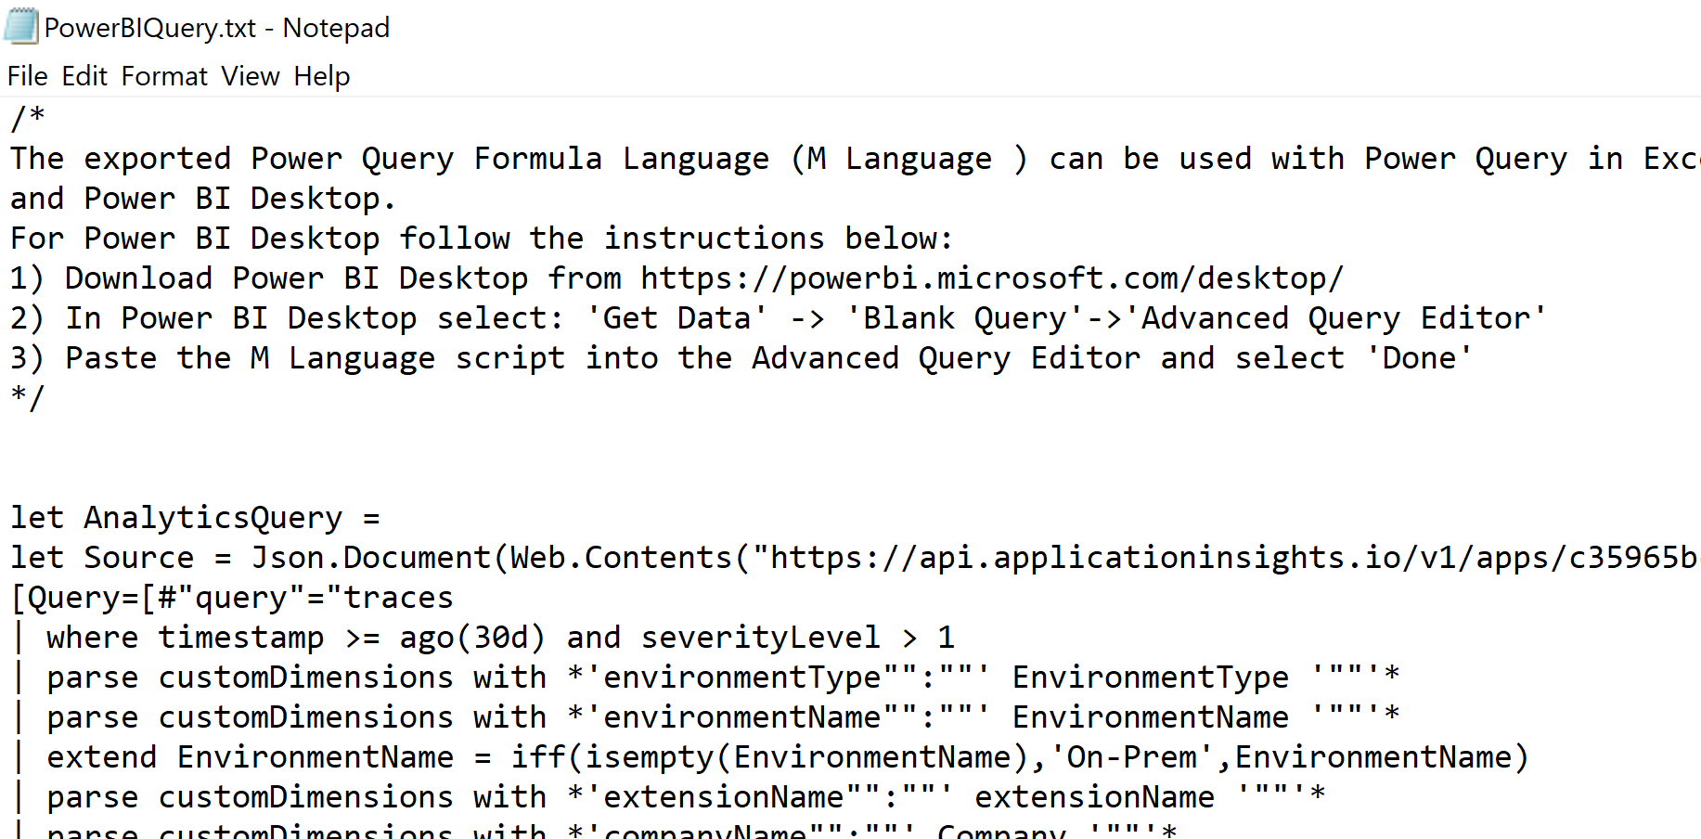
Create Your Own PowerBI

Slide 33
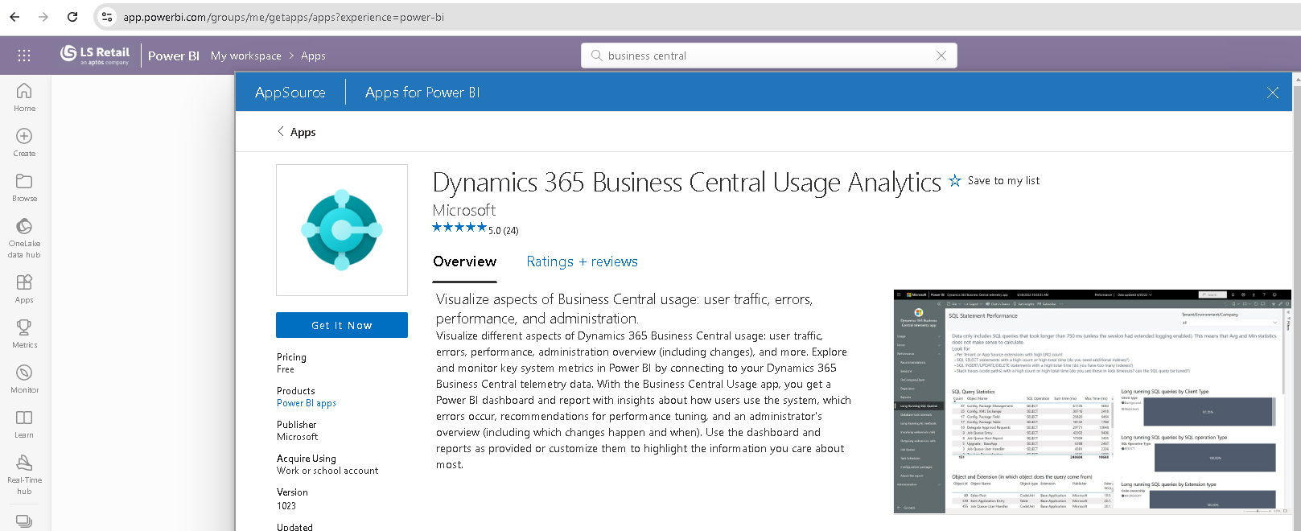
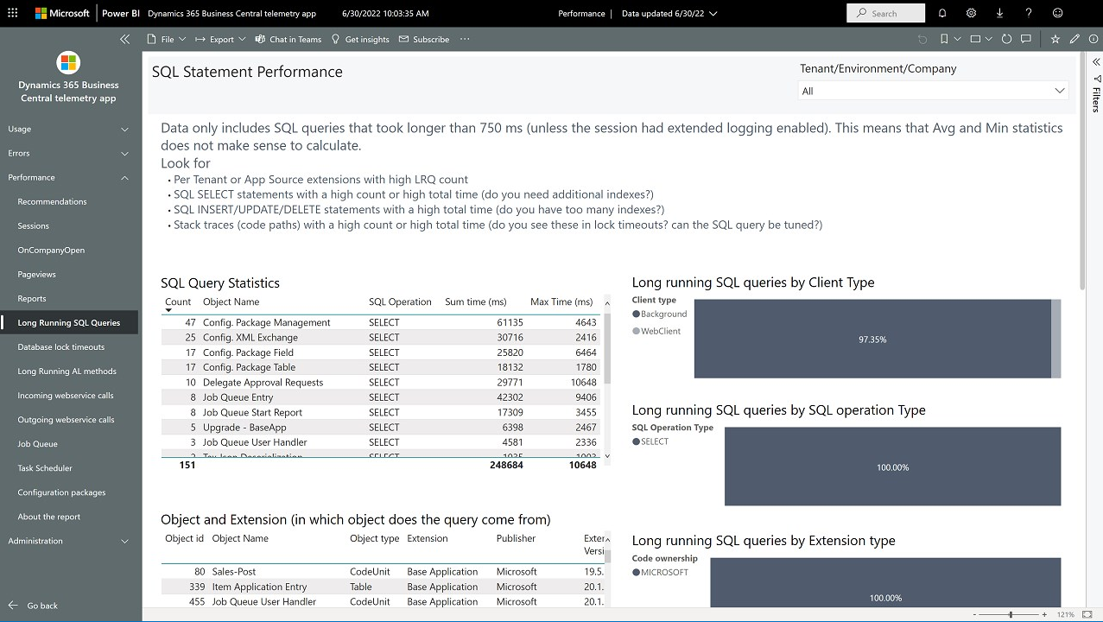
Use Dynamics 365 Business Central Usage
PowerBI template is free but require Power BI license
Connect to Azure Application Insights
More: https://learn.microsoft.com/en-us/dynamics365/business-central/dev-itpro/administration/telemetry-power-bi-app

Slide 34
Monitor for Alerts
By Bryan
Technical Consultant

Slide 35

Setting up alerts on telemetry
Alert System: Azure Application Insights allows you to create alerts for specific events in your environment.
Customizable Alerts: You can define alerts based on various telemetry.
Proactive Response: Alerts help you proactively address issues and take necessary actions.

Slide 36
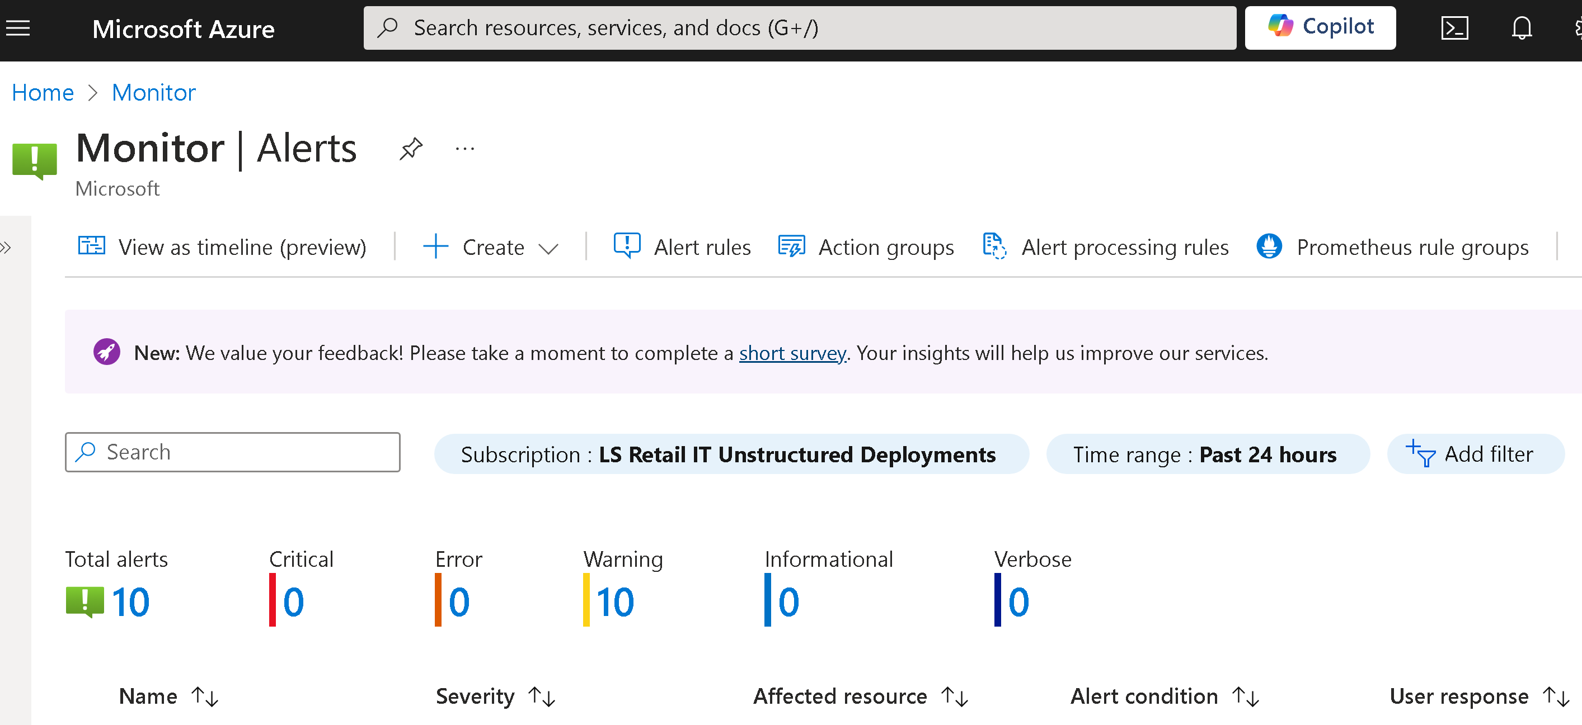
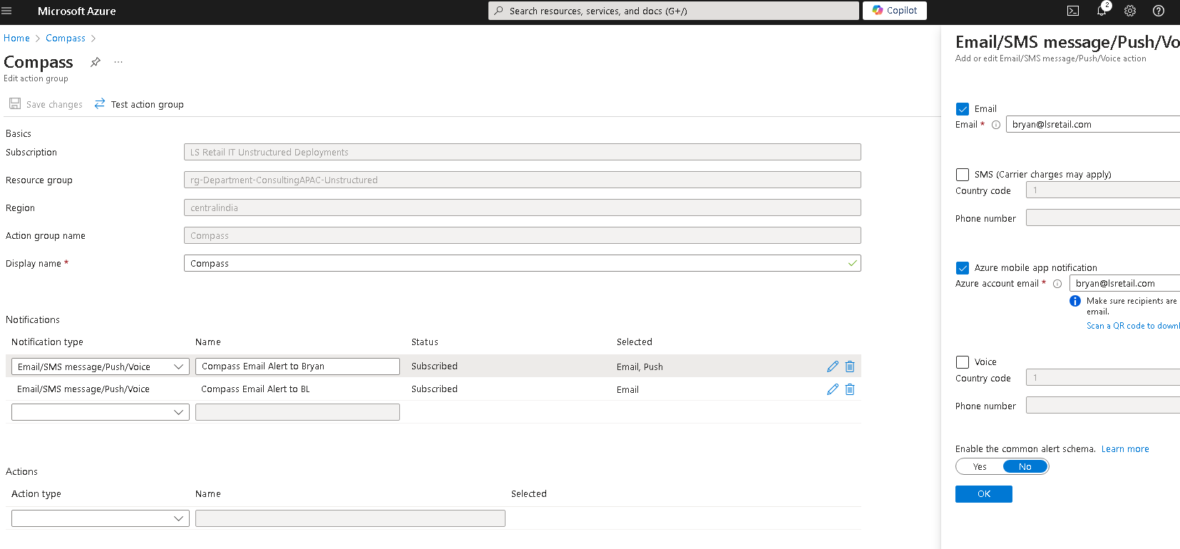
Azure Monitor Alerts - Action Groups
2
1

Slide 37
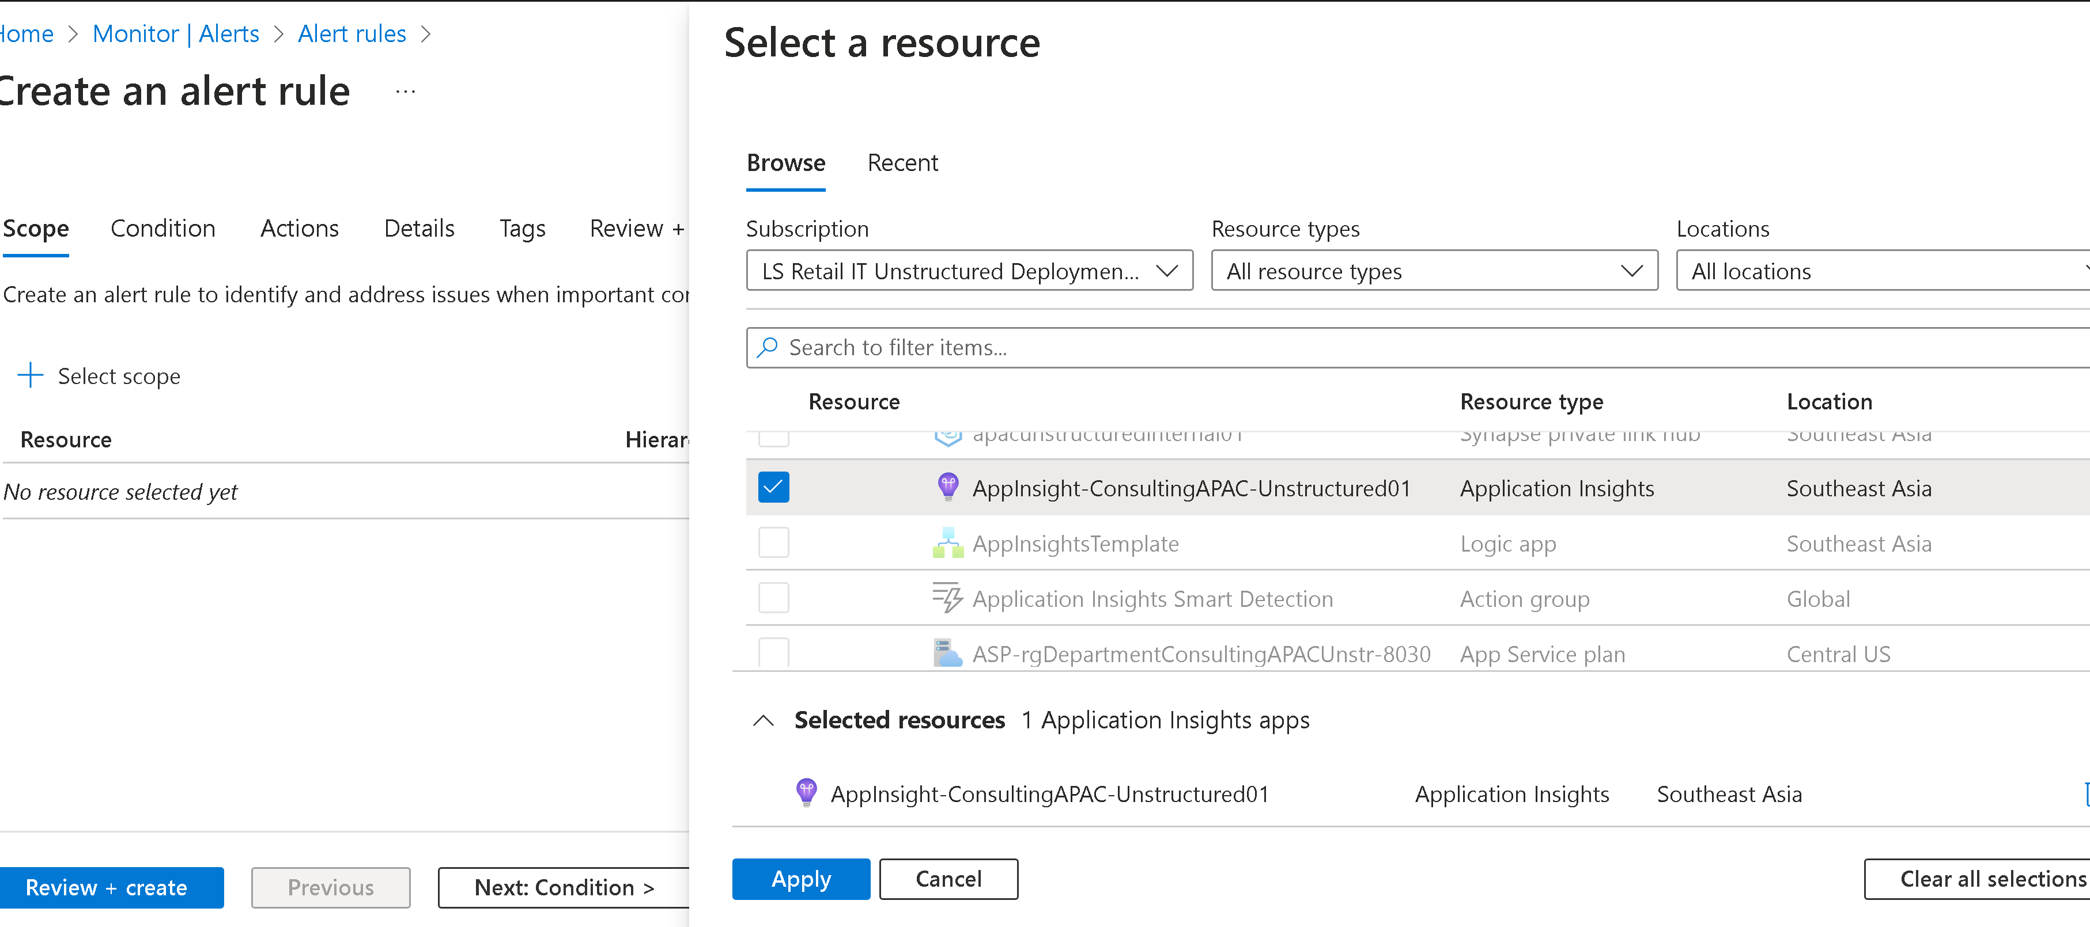

Azure Monitor Alerts - Alert Rules

Slide 38


Azure Monitor Alerts - Alert Rules

Slide 39
Monitor for Alerts
Service Tier Cannot Be Started
By Bryan
Technical Consultant

Slide 40



Azure Monitor Alerts - Alert Rules

Slide 41
Monitor for Alerts
Data Director – Jobs Error
By Bryan
Technical Consultant

Slide 42



Azure Monitor Alerts
More: https://help.lscentral.lsretail.com/Content/LS-Retail/LS-Data-Director/WebMonitor/Data%20Director%20Job%20Monitor.htm#Application

Slide 43


Azure Monitor Alerts

Slide 44

Final takeaway
Telemetry is your best friend
LS Central Online – enable Application Insights
LS Central On-Prem - enable Application Insights or AMA with Application Log
Workbooks & alerts are a great way to monitor our customers’ environment state
Telemetry can help you
  increase customers’ satisfaction & retention
  as well as create additional products & services
Still stuck? We can help you, reach out to LS Retail Consulting

Slide 45
Q&A
Any questions?
Boon Leng & Bryan
Technical Consultant

Slide 47
Why Telemetry?
Performance Monitoring and Optimization
Telemetry enables real-time tracking of your LS Central environment's performance. It helps identify slow processes, long page load times, and performance bottlenecks, allowing you to optimize the system and enhance the user experience.
Proactive Issue Detection
Telemetry data provides insights into system errors, crashes, and warnings before they impact users. By monitoring this data, you can proactively address potential issues and prevent downtime, improving overall system reliability.
Security and Compliance
Telemetry data helps track user activities and unauthorized access attempts, which can be crucial for security audits and compliance requirements. It provides visibility into any suspicious or abnormal activity, helping you secure your LS Central environment.
Troubleshooting and Root Cause Analysis
Telemetry provides detailed logs and traces of events leading to issues, enabling developers and admins to quickly diagnose and resolve problems. This reduces troubleshooting time and minimizes business disruption, allowing for continuous monitoring and improvement of the LS Central environment.

