Slide 1

LS Pay
For LS Central and BC
Andrej Zajec
Technical Sales Executive

Slide 2

B2C payment behaviour
Preference for
digital payments
Contactless payments
eCommerce growth

Slide 3
Payment researches
McKinsey’s 2023 Global Payments Report highlights that global payments revenue grew by double digits for the second consecutive year, reaching over $2.2 trillion. The report also discusses the rise of instant payments and digital wallets, and the decline in cash usage globally.
Juniper Research predicts that the number of smart POS terminals in service globally will grow by 156% by 2026. This growth is driven by the increasing adoption of contactless payments and the integration of features like inventory management and loyalty schemes directly into POS terminals.
The European Central Bank’s 2022 SPACE study found that contactless card payments at POS increased significantly, from 41% of all card payments in 2019 to 62% in 2022. Cash remains the most frequently used method for small-value payments, while cards are preferred for payments over €50.

Slide 4

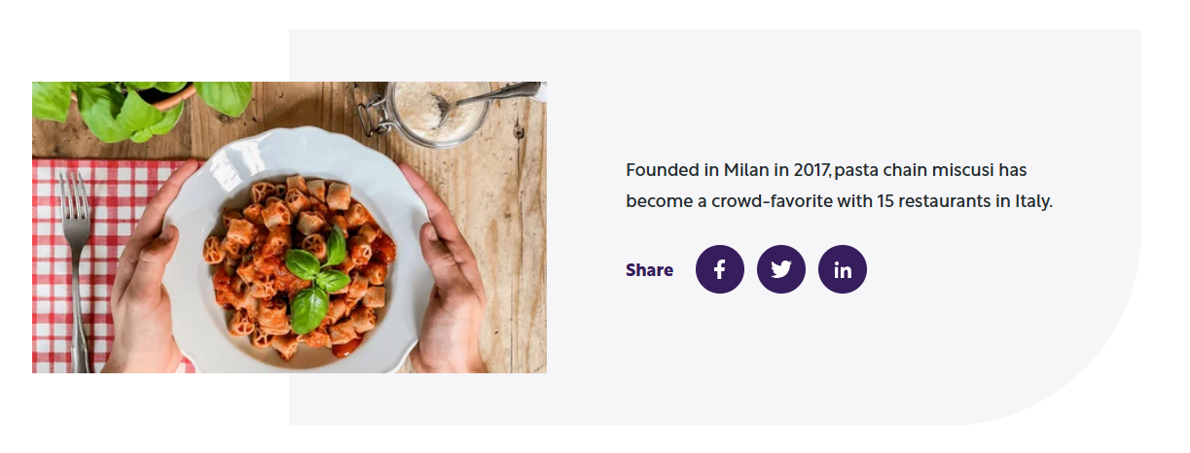
LS Central is one of the core technologies for miscusi due to its stability and the possibility to develop all the features we
need to improve the
productivity of our teams.
Michele Mihu, Software engineer
Ability for customers to pay at the table,
using LS Retail’s payment solution, LS Pay
miscusi chose LS Retail software solutions

Slide 5
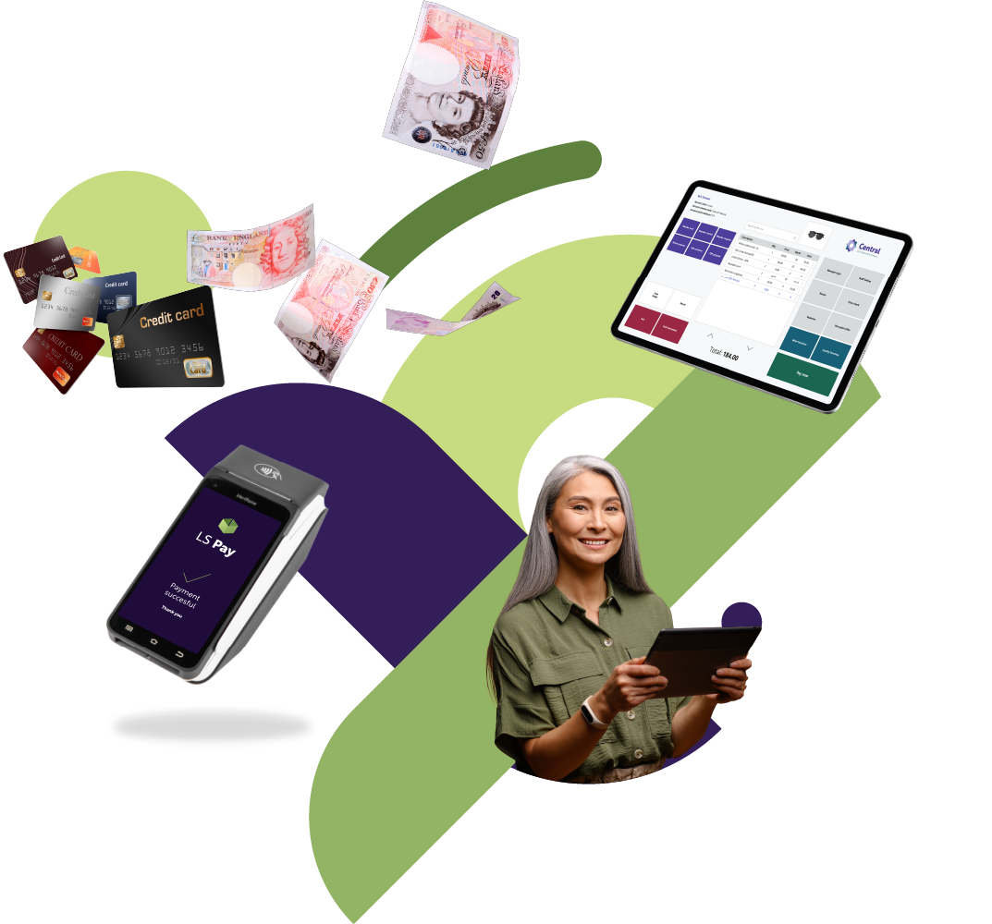

Offers EFT integrations
to the leading
PSPs in all our
main market regions

Slide 6
65+
50+
Payment integrations
Supported countries
285
32
Customers
Countries

Slide 7





















Slide 8
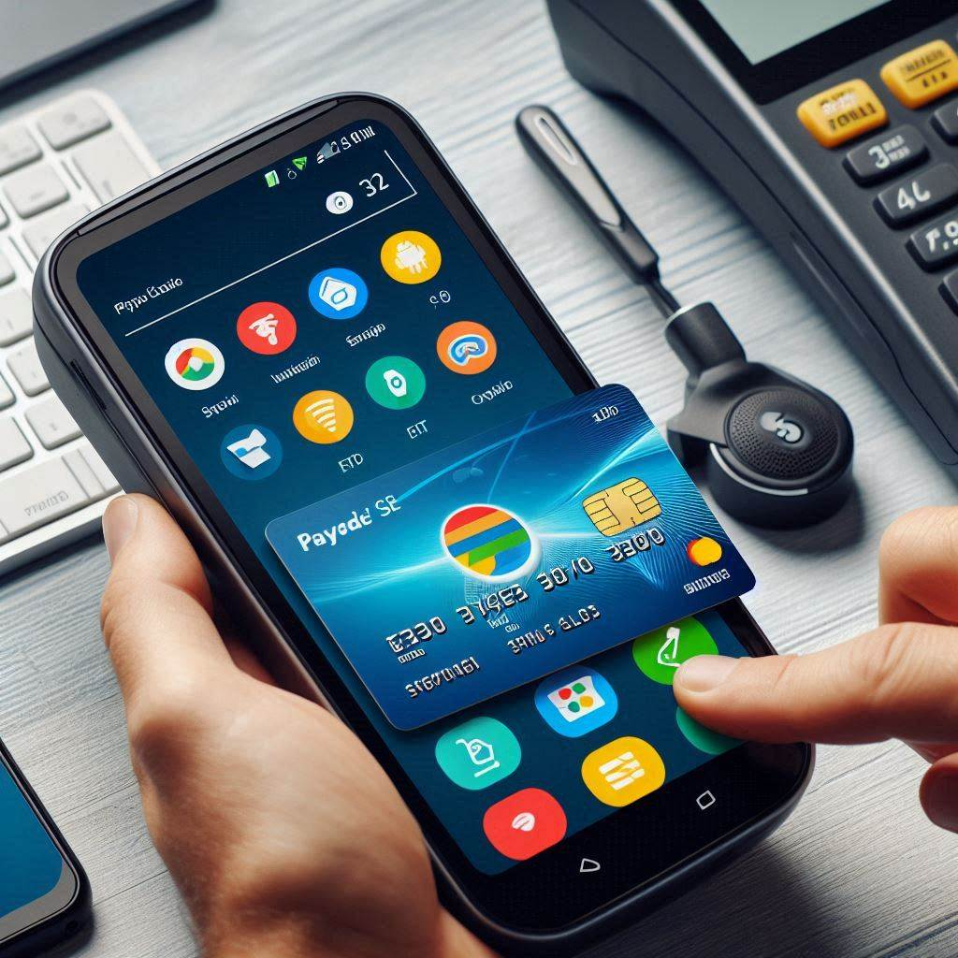














Some of our customers

Slide 9


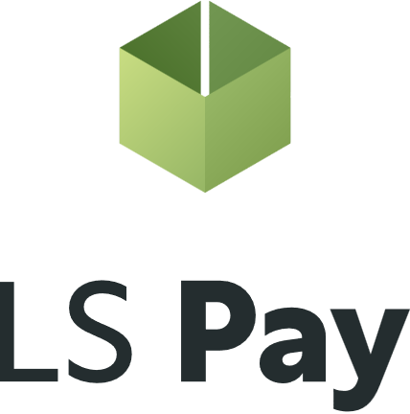

Using LS Pay
Adyen
Elavon
Planet
Freedom Pay

Slide 10
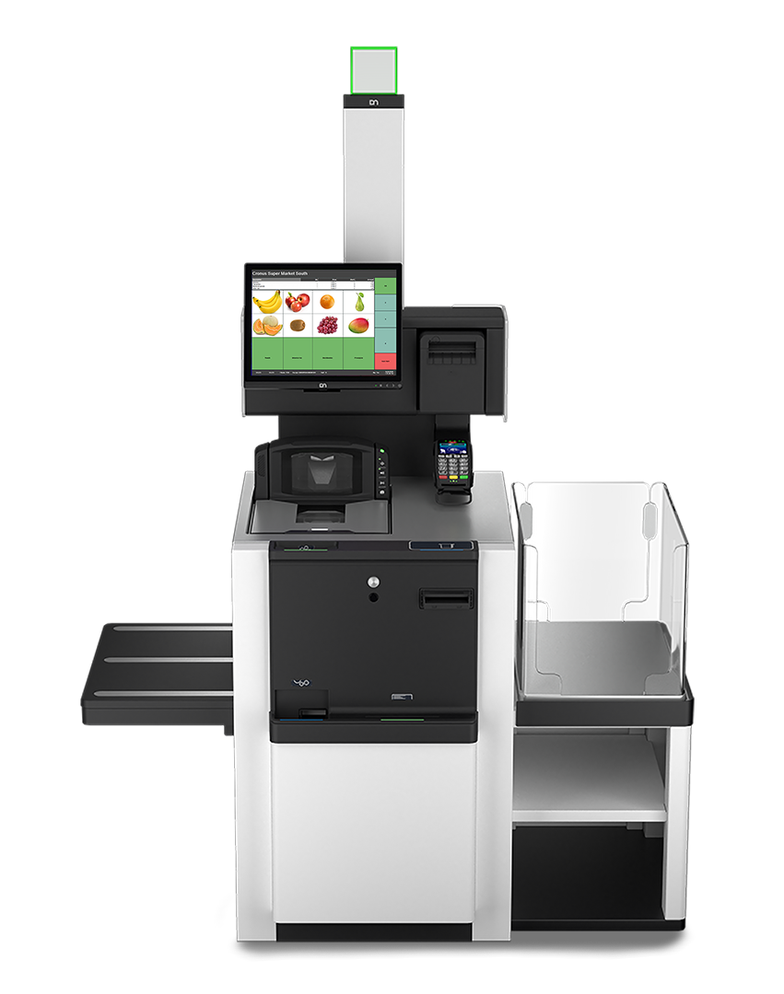
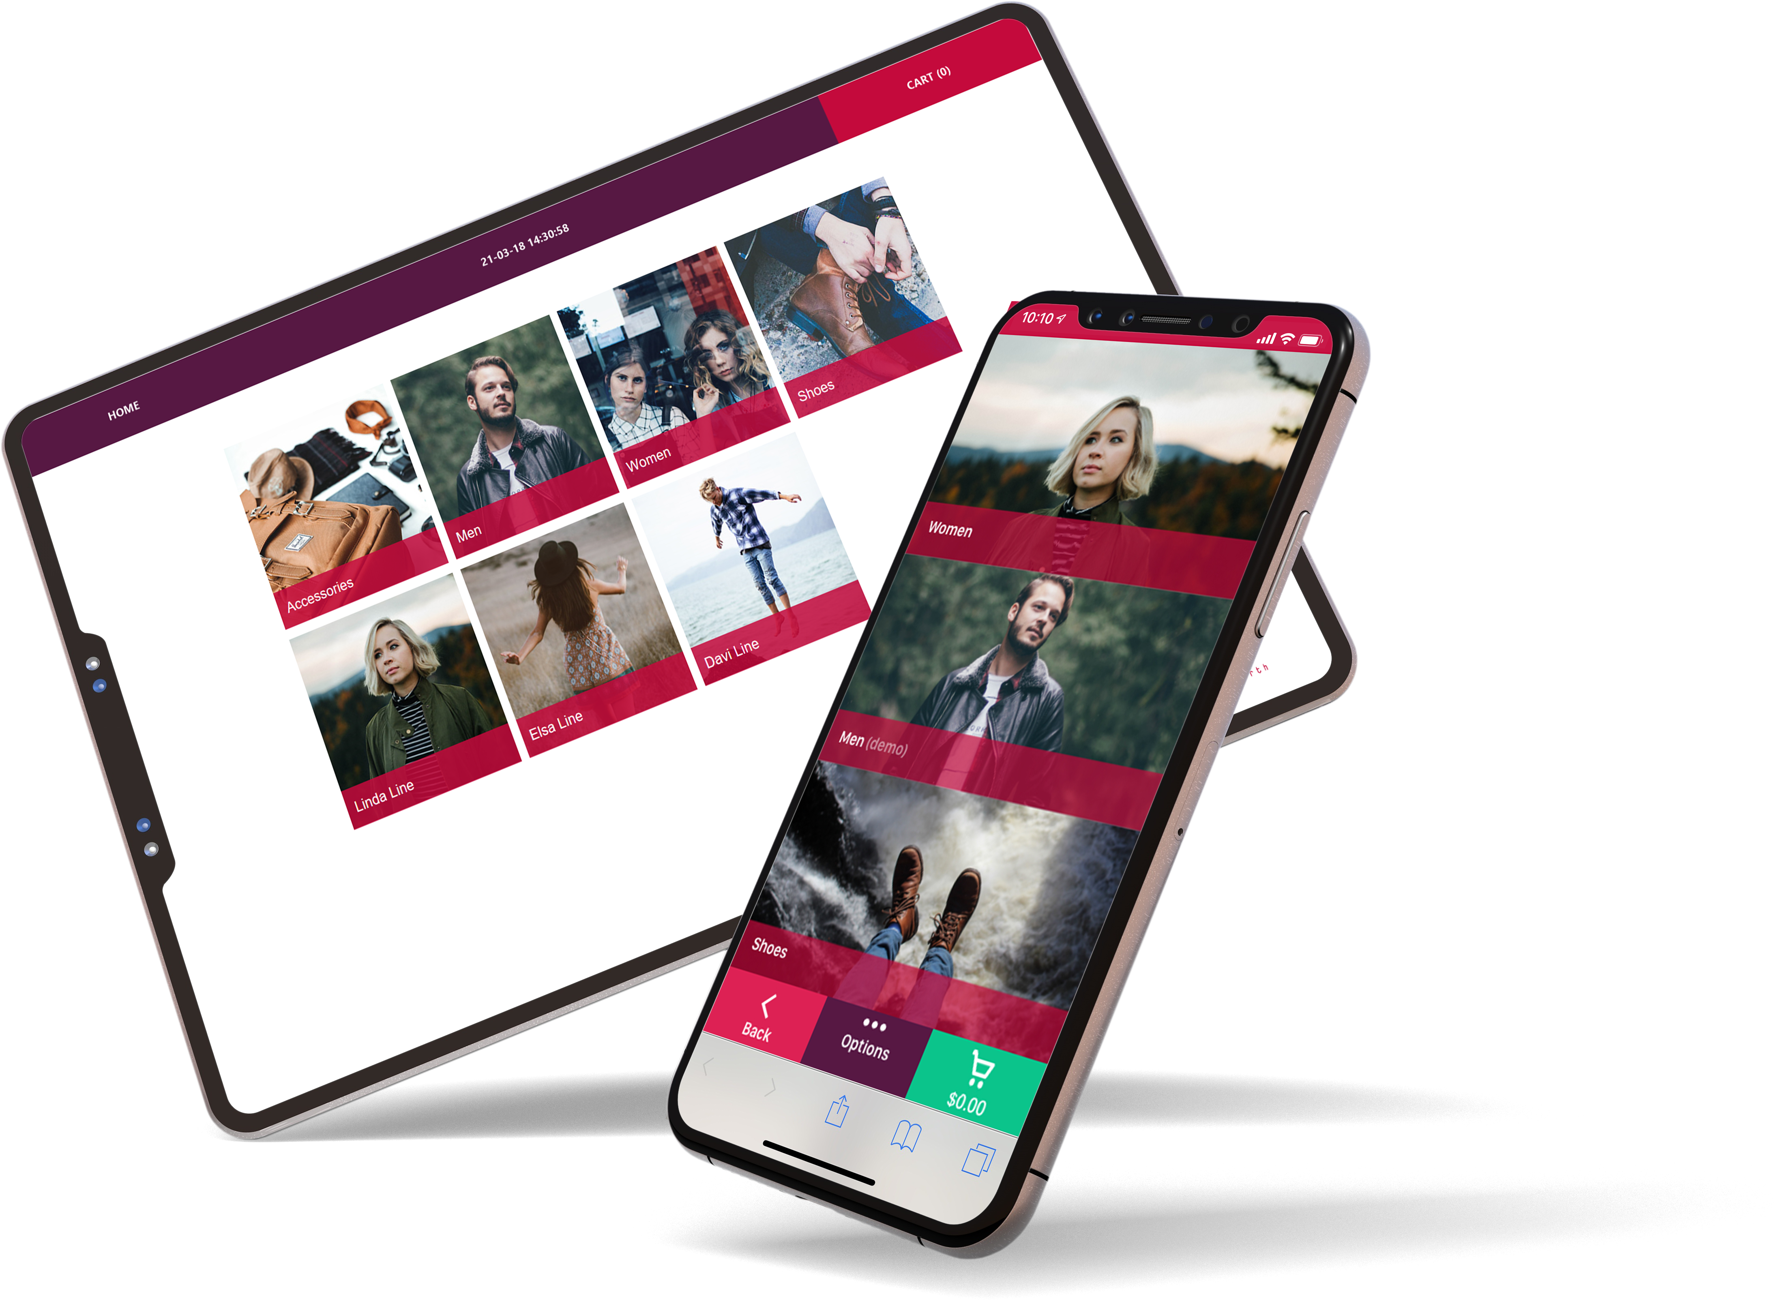
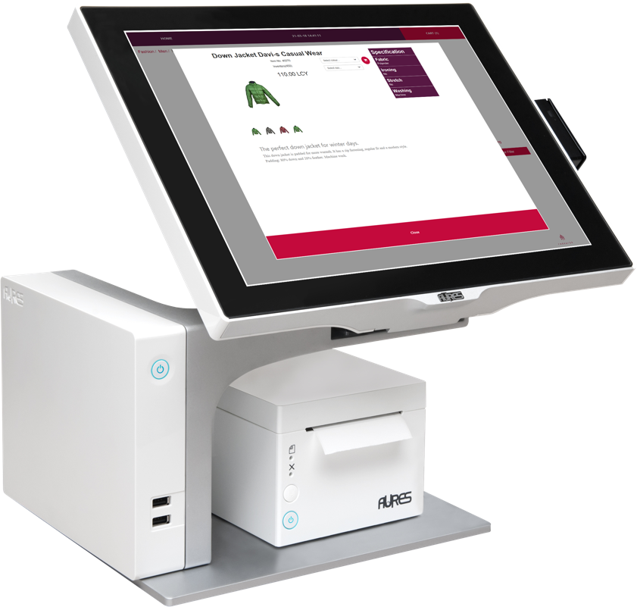
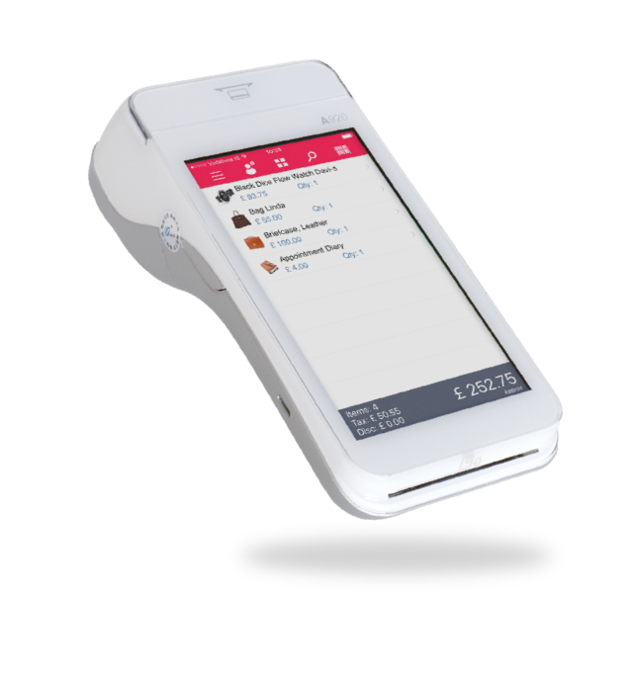
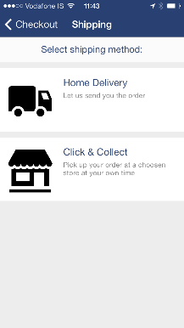
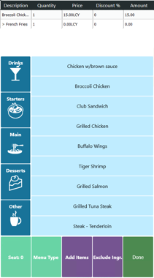
Supporting all platforms & form factors

Slide 11
Supported functions
Purchase
Refund
Void
Get transaction
Get last transaction
Get last raw transaction
Cancel
X and Z reports
Start session
End session
EBT
Pre-auth tokenization
Full capture tokenization
Purchase tokenization
Return tokenization
Signature verification
Voice authentication
Return receipt
Reprint card receipt
Display QR code on PED
Subscription tokenization
FSA Debit Card
Customer cards

Slide 12

LS Pay and
Business Central

Slide 13
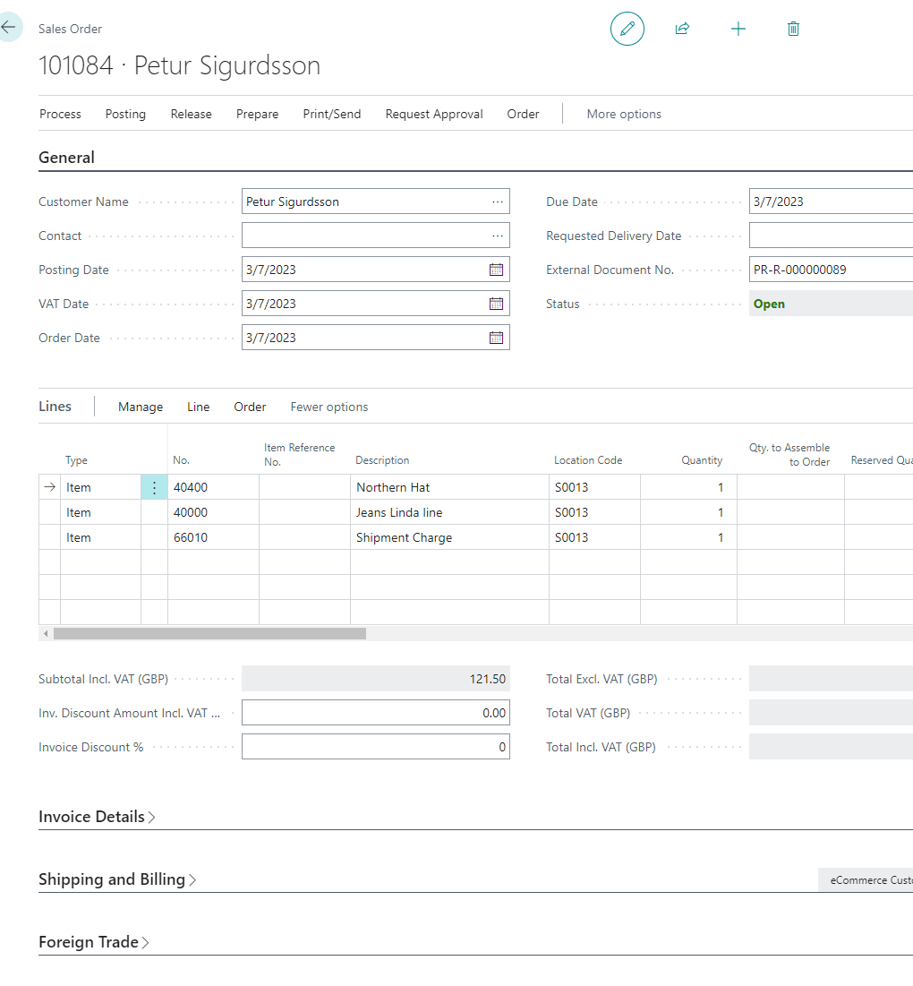
Generic payment support
Full payment/capture when
placing an order
Pre-auth on placing an order and
full capture on shipping
Extending time periods of pre-auths
Adjusting pre-auth amounts for shipping charges
Support for Card-on-File
Card not present
  Manual card number entry on PED
  Payment links via email and text messages

Slide 14
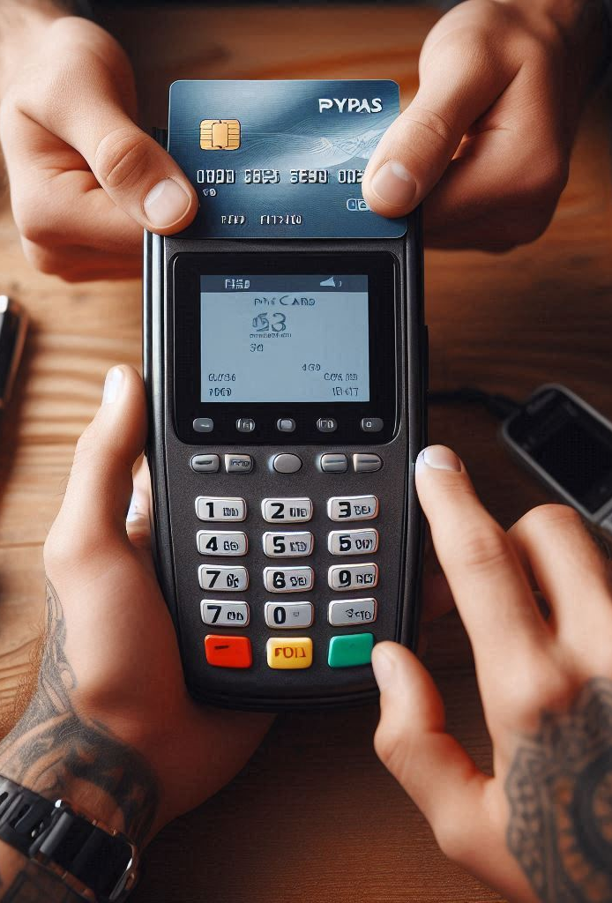
Sales Credit Memos
Voiding payments
Refunding payments
Cancelling pre-authorizations
Modifying pre-authorization amounts
Customer Accounts
Paying multiple invoices at once
Card-on-file
Online payment links

Slide 15

eCommerce orders
Many merchants use generic 3rd party eCommerce integrations for Business Central
Ability to do full captures, modifications and cancels of
pre-authorizations that accompany eCommerce orders into Business Central
Triggering web hooks for
execution by the respective eCommerce platform

Slide 16

In summary…
LS Pay app on the
MS AppSource
Target customers:
  LS Central customers requiring back office and/or 3rd party eCommerce payments
  Any Business Central users selling into sales order and not requiring a POS system
Initially via LS Retail partners
Subsequently via generic
MS BC partners

Slide 17

LS Pay and Consulting Services

Slide 18

Custom integrations
Short lead time
  Next available consultant
Statement of Work (SOW)
  Time and materials or fixed price
Development
  We allow up to 3 months
    Development and certification
  Full support from the LS Pay team
  Using LS Pay’s development processes

Slide 19

Custom integrations
The plugin becomes a default part of LS Pay
The LS Pay development team maintains the plugins going forward

Slide 20

LS Pay
before and after

Slide 21

Backwards compatibility
All versions of LS Central are supported
LS NAV EFT downgrade package available on our portal (FOBs)
  Default support for various LS NAV versions
    14.02, 13.05, 11.05, 10.10, 9.10
Partners can use given FOBs (LS NAV) as blueprint to add support for versions not supported by default

Slide 22






Roadmap
LS Pay for Business Central
Enriched PSP documentation
LS Retail Academy: LS Pay course
Adyen Tap2Pay
PSP plugins and gift card support

