Slide 1
Daniel Ong
Sales Executive APAC
Unlocking potential:
Showcasing value and benefits of LS Central in presentations

Slide 2
Presales Initiative
@ LS Retail…

Slide 3
Presales Initiative
Background
In 2023 we started an initiative to review and improve our Presales activities.
Main Goals:
  Improve LS Retail’s processes
  Improve our tools (Virtual Machine, etc.)
  Improve our Powerpoint presentations
  Introduce an improved Presales methodology
This initiative is led by Martin Kleindl, Director of Customer Experience and
his global Presales team.
Notes:
Why are we doing this?
We know that the competition out there is tough and selling ERP and Retail solutions can be challenging.
We at LS Retail want to provide you with great tools and support when it comes to selling our products to new customers or existing customers.
We want to share from our experiences and knowhow that we gain from trainings and other sources.

Slide 4
No slide, just talking
Why? Why are we doing this?
We at LS Retail want to provide you with great tools and support
when it comes to selling our products to new customers or existing customers.
We know that the competition out there is tough and selling ERP and Retail solutions can be challenging.
We want to share from our experiences and knowhow that we gain from trainings and other sources.
We started the sharing this year, at conneXion in Iceland

Slide 5
Progress
so far …

Slide 6
Presales Initiative
Progress so far
Action points:
  Created a global Presales team @ LS Retail
  to better support partners
  Internal trainings
  Work on improved Presales methodology
And most important:
We started to share this information with you, our partners.
First step was a presentation at conneXion ‘24 in Iceland.
(Martin Kleindl, Kathryn White, Tom Bevans from TNP)

Slide 7

Presales Process
Qualification
Resource allocation
Preparation
Rehearsal
Demo
De-briefing
Briefing
Qualification
Before we invest time and effort,
we make sure that the sales case is worthwhile.
Key questions:
  Is there an opportunity?
  Can we compete?
  Can we win?
  Is it worth winning?

Slide 8
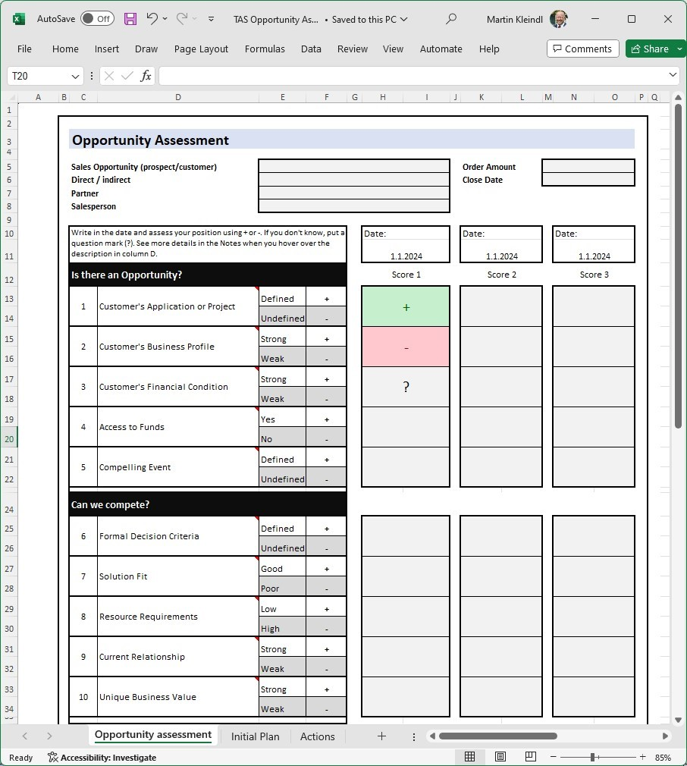
Presales Process
Qualification
Resource allocation
Preparation
Rehearsal
Demo
De-briefing
Briefing
Qualification
Before we invest time and effort,
we make sure that the sales case is worthwhile.
Key questions:
  Is there an opportunity?
  Can we compete?
  Can we win?
  Is it worth winning?
Notes:
we also shared and presented a tool that helps you to ask these questions, breaks it down to some sub questions and also to track the score.
If you are interested feel free to reach out and we are happy to provide it to you.

Slide 9
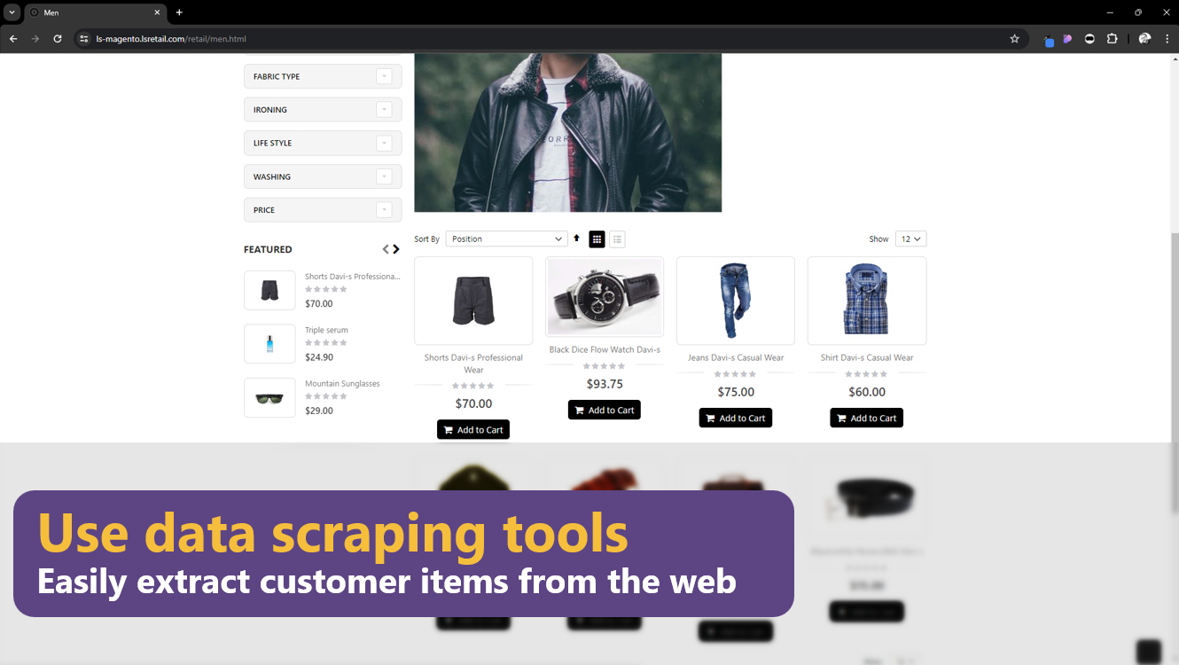
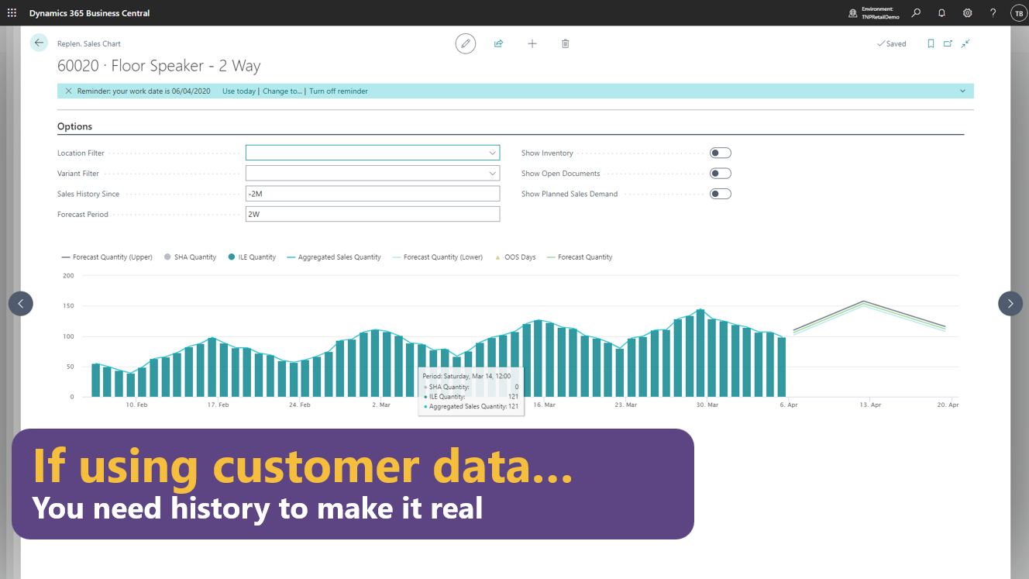
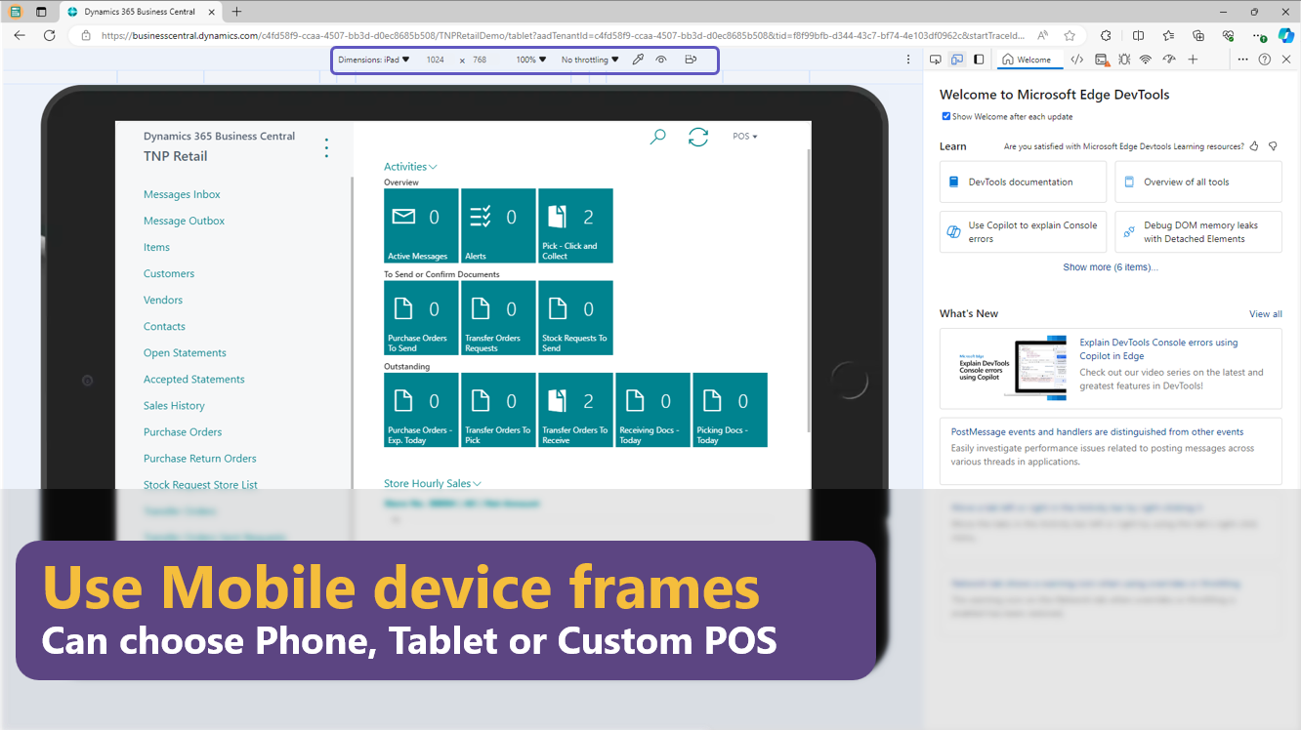
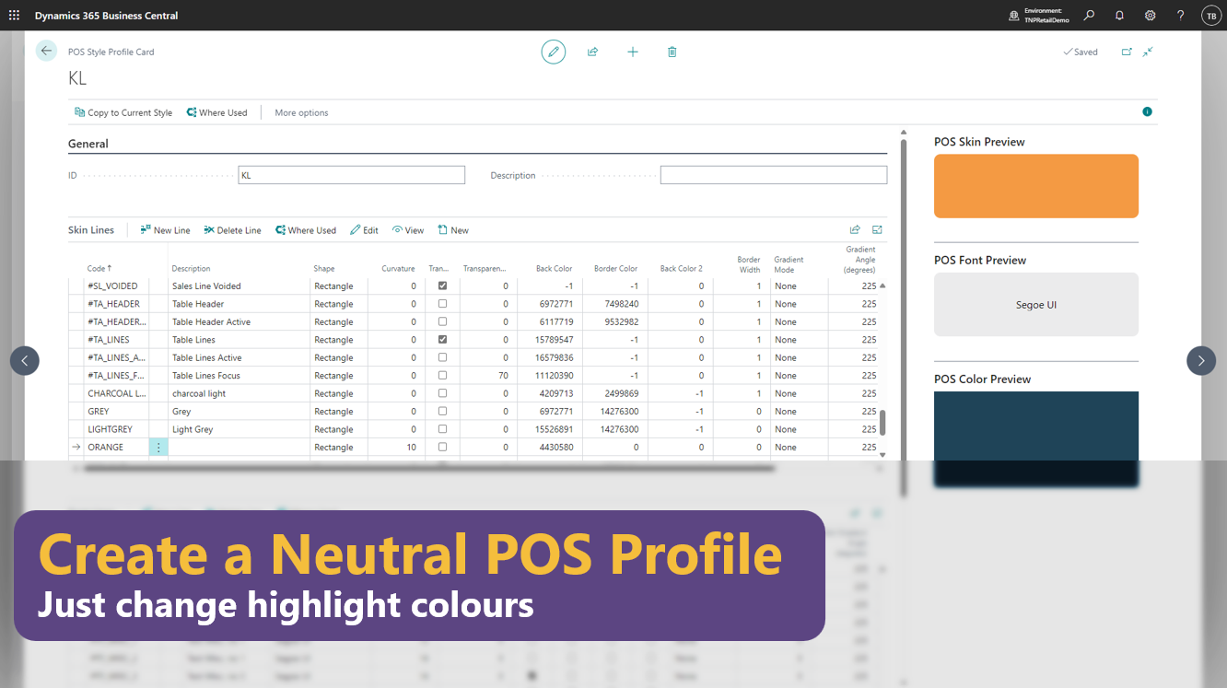
Presales Process
Qualification
Resource allocation
Preparation
Rehearsal
Demo
De-briefing
Briefing
Tips & tricks for personalizing
your demo environments
  Data scraping tools
  Generating demo data
  Demoing different devices
  Neutral color schemes
Notes:
We also talked about tips and tricks:
- how you can personalise your demo environments with some data scraping tools where you pull customer items, pictures, text from the web and use it in your demo environment.
- how to generate demo data to have a good visualisation when you demo for example here the history of an item.
- how to use different devices to demo and some good hints how to prepare to use neutral colour schemes and use the customers UI. So, a lot of things have been shared there.

Slide 10

Presales Process
Qualification
Resource allocation
Preparation
Rehearsal
Demo
De-briefing
Briefing
Objection handling
Techniques to respond to and overcome any
  reasons
  excuses
  or other hesitation
given by the prospect to delay or reject
adoption of our software solution or service offering
Notes:
We also talked about objection handling which are techniques to respond and to overcome any reasons, excuses given by the prospect to delay or reject the adopt of the software solution or the serving offering.

Slide 11
Next step:
How to build
Presentations
that showcase value
and benefits
Notes:
the next step is focusing on presentation, especially how to build presentations that showcase value and benefits.

Slide 12
Presales Process
Qualification
Resource allocation
Preparation
Rehearsal
Demo
De-briefing
Briefing
Preparing demos with benefits and values in mind
Presenting the solution to the prospect.
Ingredients Key questions:
  2% rule, software decisions (how close it can be)
  Context & Benefits (from features to values & benefits)
  Who is in the audience, different messages (pyramid?)
  Managing time & attention (→ don’t show everything, don’t educate, just highlights)
Don’t call this 2% rule. That’s plagiarism
Notes:
Old message: What do we have?
New message: What do you get?

Slide 13
Presales planning & demo structure
Qualification
Resource allocation
Preparation
Rehearsal
Demo
De-briefing
Briefing
Preparing demos with a values first approach
How are software decisions made…
  Feature differentiation?
  Relationships?
  Instinct?
  What else?
Notes:
Old message: What do we have?
New message: What do you get?
And when we think about that, then we should start by thinking how software decisions are made usually and what influences them. So, is this based on feature differentiation between different products only?
Or is it about relationships that we built?
Our prospect of having an instinct.
What do you think and what else could be in there?

Slide 14
Presales planning & demo structure
Qualification
Resource allocation
Preparation
Rehearsal
Demo
De-briefing
Briefing
Preparing demos with a values first approach
How are software decisions made… subjectively.
How can we leave the best impression on decision makers?
Is the purpose of the demo to explain
Notes:
Old message: What do we have?
New message: What do you get?
we all agree a lot of these things are subjectively based, it's not about a scorecard as it covered everything.
So, it's really about the impression that we make so and how can we leave the best impression on decision makers when we have these demos and this brings me to the point of the purpose of a demo.

Slide 15

Presales planning & demo structure
Qualification
Resource allocation
Preparation
Rehearsal
Demo
De-briefing
Briefing
Preparing demos with a values first approach
How are software decisions made… subjectively.
How can we leave the best impression on decision makers?
Is the purpose of the demo to explain “this is what we have” ?
The Encyclopedia of the features of Microsoft Dynamics 365 Business Central
&
LS Central
Is the purpose of the demo to explain “this is what we have” ?
Notes:
Old message: What do we have?
New message: What do you get?
Is the purpose of the demo to explain this is what we have in our solution and go through the encyclopaedia of features in Microsoft Business Central and LS Central and show everything that we have.
Or is it?
To talk about what you get, what our prospects will get.

Slide 16
Presales planning & demo structure
Qualification
Resource allocation
Preparation
Rehearsal
Demo
De-briefing
Briefing
Preparing demos with a values first approach
How are software decisions made… subjectively.
How can we leave the best impression on decision makers?
Is the purpose of the demo to explain “this is what you get” ?
Notes:
Old message: What do we have?
New message: What do you get?

Slide 17
Presales planning & demo structure
Qualification
Resource allocation
Preparation
Rehearsal
Demo
De-briefing
Briefing
Preparing demos with a values first approach
Is the purpose of the demo to explain “this is what you get” ?
Prospect Value,
Pain Points
LS Central Solution
Our demo message
Notes:
Old message: What do we have?
New message: What do you get?
To achieve so, we need to understand that the prospect they are searching for a value in the solution benefits and also to solve their pain points. And then we have our LS Central solution, and our demo message of course should cover as much as possible of the values and pain points of this process.

Slide 18
Presales planning & demo structure
Qualification
Resource allocation
Preparation
Rehearsal
Demo
De-briefing
Briefing
Preparing demos with a values first approach
Is the purpose of the demo to explain “this is what you get” ?
Prospect Value,
Pain Points
LS Central Solution
Our demo message
Notes:
Old message: What do we have?
New message: What do you get?

Slide 19
Presales planning & demo structure
Qualification
Resource allocation
Preparation
Rehearsal
Demo
De-briefing
Briefing
Preparing demos with a values first approach
Is the purpose of the demo to explain “this is what you get” ?
Prospect
Value, Pain Points
LS Central Solution
Our demo message
Our demo message
Notes:
We hope it looks like this

Slide 20
Presales planning & demo structure
Qualification
Resource allocation
Preparation
Rehearsal
Demo
De-briefing
Briefing
How to get there?
Understanding the audience
  What are their roles (operational users, management, executives)
  What do they “hope” to get from the solution
  Shape our messages accordingly
Focus on value/benefits instead of features
Build compelling presentations with
  Strong opening / closing to carry the message
  Engage with the audience, using Tell-Show-Tell techniques
  Make sure that we talk about our advantages
  Avoid common “demo mistakes”
Notes:
Old message: What do we have?
New message: What do you get?

Slide 21
How
to do that ?

Slide 22
Presales workshop
is coming to you:
regional conneXion 2025

Slide 23
Presales workshop
A hands-on workshop (with exercises) to learn about best practices and
techniques for your Presales presentations
When ?
  Venue: conneXion 2025, partner day
  Duration: 1 day
For whom ?
  Presellers, Functional Consultants, Sales
Price
  The workshop is free for partners who attend conneXion
  Limited seats (20pax), upfront registration needed
  We might limit seats per partner if there is a high demand
The trainers
  Martin Kleindl and members of his Presales team

Slide 24
Presales workshop
Workshop content
What will you learn?
Needed ingredients for a good demo
How to create a good story line
Presentation techniques
How to avoid common demo mistakes
Improve your time management (problems staying in time?)
Tips & tricks to build a personalized demo, with little effort.
(Content & agenda is work in progress and might be adapted)

Slide 25
Will we see
YOU
there?
Notes:
So, the question is, will we see you there?
Of course, we will ask you and hope to have a conversation with you. How you like this idea?
And if it's something you would be interesting in and we are also open to hear about your input, what could or should be covered in this workshop and so on.

Slide 27










!IMPORTANT!
The “an Aptos company” version is the main version to use. Only use the logo without it if the logo is very small.
Primary
Secondary
Primary
Secondary

Slide 28















Slide 29












Slide 30













Slide 31









Slide 32

Desktop/POS

Slide 33

POS/Tablet

Slide 34

Tablet/surfacePro

Slide 35

Tablet/iPad

Slide 36

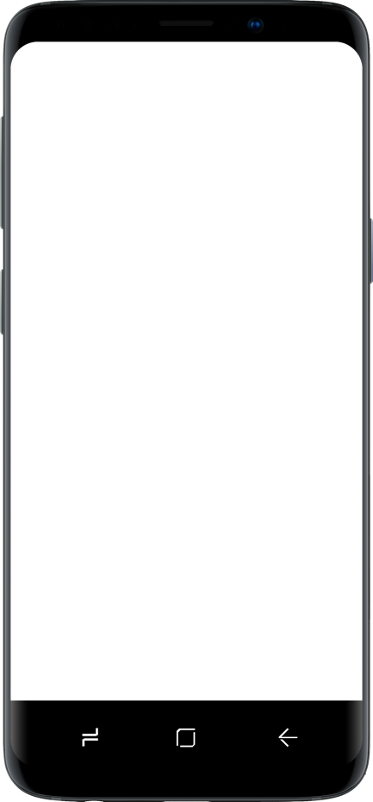
Mobile

Slide 37






















































